Slide 1
Muon g-2: An Overview
David Kessler – University of Massachusetts, Amherst
On behalf of the Muon g-2 Collaboration
New Perspectives
6/17/2022
Work supported by DoE grant DE-FG02-88ER40415 and SCGSR program.

Slide 2
Background
All of physics
Muon g-2 is dedicated to measuring the muon magnetic moment anomaly.
Muon magnetic moment: $\vec{μ}=g\frac{q}{2m_{μ}}\vec{s}$
Magnetic moment anomaly: $a_{μ}=\frac{g−2}{2}$
$$a_{μ}$$
With a muon beam in a magnet ring, we find the anomaly from anomalous precession frequency $\vec{w_{a}}$ and magnetic field $\vec{B}$.
$$\vec{w_{a}}=\vec{w_{s}}−\vec{w_{c}}=a_{μ}∗\frac{−q}{m_{μ}}∗\vec{B}$$

Slide 3
Motivation
In the early 2000s, a similar experiment at Brookhaven National Laboratory discovered a possible discrepancy with the Standard Model prediction for $a_{μ}$.
New physics could lead to such a discrepancy!
BNL experimental result ~3.5σ different than SM prediction.
Threshold for discovery is typically 5σ or greater difference.
The goal of g-2 is to achieve an uncertainty of 140 ppb, four times smaller than BNL.
Run-1 results from g-2 show agreement with BNL, with uncertainty on track to reach the goal!

Slide 4
Overview
Figure 1, “Measurement of the anomalous precession frequency of the muon in the Fermilab Muon g−2 Experiment”.
Phys. Rev. D 103, 072002 – Published 7 April 2021.
The magnet ring contains the muon beam with a 1.45 T magnetic field.
Detector stations collect data while additional fields aim the muons and keep them on track.

Slide 5
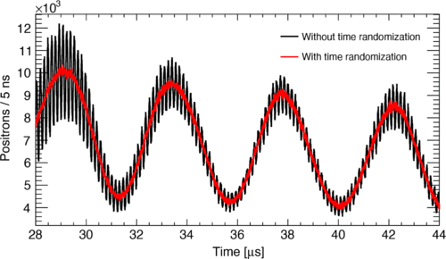
Precession Frequency
Figure 5, “Measurement of the anomalous precession frequency of the muon in the Fermilab Muon g−2 Experiment”.
Phys. Rev. D 103, 072002 – Published 7 April 2021.
Anomalous precession frequency $w_{a}$ is connected to observables from muon decay.
$$μ^{+}→e^{+}+ν_{μ}$$
Energy distribution of decay $e^{+}$ depends on muon spin and momentum directions, and oscillates at $w_{a}$.
Positron equation:
Run-1 positron data from a single calorimeter shows modulation at $w_{a}$ (red), as well as faster cyclotron oscillation (black) which vanishes when all calorimeters are combined.
$$N\left(t,E\right)=N_{0}\left(E\right)∗e^{\frac{−t}{γτ}}∗\{1+A\left(E\right)\cos\left[w_{a}t+φ_{0}\left(E\right)\right]\}$$

Slide 6
Beam Dynamics
Because we are not in the ideal world of physics textbooks, many correction factors must be applied to the measured value of $w_{a} (w_{a}^{m})$.
$$w_{a}^{m}∗\left(1+C_{e}+C_{p}+C_{ml}+C_{pa}\right)→w_{a}$$
$C_{e}$: Correction from electric influence from ESQs.
$C_{p}$: Correction from small tilt of muon orbital plane.
$C_{ml}$: Correction for bias from lost muons.
$C_{pa}$: Correction for drift in beam profile.
These steps provide $w_{a}$. Next, we need magnetic field $B$.

Slide 7
Magnetic Field
Fixed NMR probes track the magnetic field while the muon beam is stored.
Our “calibration chain” lets us use the field seen by the fixed probes to find the field seen by the muons.
Transient fields from kickers and quads are too small for the fixed probes, so they are measured separately.
Fixed Probes
Trolley Probes
Plunging Probe
Absolute Sample

Slide 8
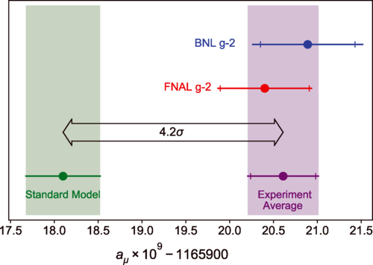
Results (So Far)
Run-1 result, unveiled in 2021:
$a_{μ}=116592040\left(54\right)∗{10}^{−11}$.
This agrees with the BNL result, supporting the discrepancy with the Standard Model prediction.
The g-2 Run-1 result has comparable uncertainty to the BNL result.
Combining both into an average with a reduced final uncertainty expands the SM discrepancy to 4.2σ.
Figure 4, “Measurement of the Positive Muon Anomalous Magnetic Moment to 0.46 ppm”.
Phys. Rev. Lett. 126, 141801 – Published 7 April 2021.

Slide 9
Next Steps
Data from Runs 2 through 5 are being processed and analyzed. Aiming to publish next results in 2023.
Run-1 uncertainty was dominated by statistics. Incorporating all of the data from later Runs will significantly reduce uncertainty.
The g-2 Theory Initiative is making progress on the theory side, refining the SM prediction.
Later Runs feature many improvements! Statistical and systematic uncertainties will be reduced.
More muons, better beam control, better field stability, better field calibration, and more!

Slide 10
Thank you!
Thanks for listening! Any questions?

Slide 11
Appendix: Results and Uncertainty Breakdown
g-2 Run-1 Result: $a_{μ}=116592040∗{10}^{−11}$. Uncertainty: 460 ppb.
Uncertainty from $w_{a}^{m}$: 434 ppb statistical, 56 ppb systematic.
Uncertainty from beam dynamics: 90 ppb.
Uncertainty from $B$: 114 ppb.
BNL Result (2006): $a_{μ}=116592080∗{10}^{−11}$. Uncertainty: 540 ppb.
Standard Model (2020): $a_{μ}=116591810∗{10}^{−11}$. Uncertainty: 370 ppb.
New SM predictions from lattice QCD might reduce the discrepancy. Currently being investigated.

