Slide 1
Evolution of US strategy for future Lepton Colliders
David MacFarlane & Jim Brau

Slide 2
American Linear Collider Physics Group
ALCPG was formed in 2002 to advance preparation for an experimental program at an electron-positron linear collider
ALCPG leadership has spurred:
Studies of critical physics processes with full simulation
Understanding of detector requirements, including the machine-detector interface
Development of integrated detector concepts with international collaboration, essential to assessment of physics performance
Promotion of prioritized detector R&D program funded by government agencies
Organization of periodic workshops with international participation, coordinated with accelerator community
The ALCPG is the North American part of a global effort working closely with Europe and Asia colleagues

Slide 3
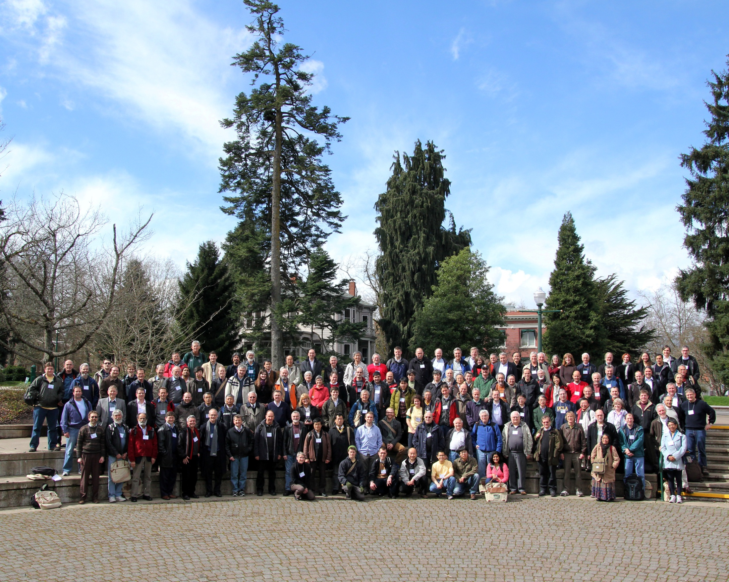
Recent ALCPG meeting in Oregon
March 19-23, 2011
US hosting LCWS 2012 meeting in Arlington, TX

Slide 4
Emerging direction from last summer
Need an ALCPG-like organization to advance a broader agenda for energy frontier Lepton-Collider physics
Will likely reconstitute ALCPG to assume the same functions for a broader set of energy frontier options
Would like to see it recognized in this broader role by LCSGA, DPF, and DOE
Coordinate development of physics studies aimed at Snowmass 2013 community meeting
Need a common simulation tool to underpin physics studies
Fermilab and SLAC will submit a joint proposal to DOE to enhance LCSim capabilities and provide community support
Detector R&D needs will emerge from these studies
Group could coordinate detector R&D proposals as part of national generic R&D program

Slide 5
US Lepton Collider Physics Framework (LCPF)
Goal:
Coordinate a research program to prepare the US HEP community for a forefront experimental program at a high-energy Lepton Collider
LCPF would coordinate studies needed to reach this goal
Define and compare the physics potential for Lepton Colliders with a common benchmarks and simulation tools
Evaluate machine backgrounds & impacts on physics capabilities
Support developing detector concepts for Lepton Colliders
Establish a list of critical R&D required and coordinate LC related detector R&D as part of a national generic R&D program

Slide 6
LCPF roles
Develop the essential elements of the LC physics program for each collider
LCPF should select a representative set of critical physics measurements for detailed study and full simulation
This set of benchmarks, studied quantitatively, will enable a systematic comparison of the LC options.
Facilitate close collaboration between the groups focusing on physics issues, detector design and development, and the machine/detector interface
Coordinate evaluation of detector concepts for each LC using a set of well documented, common simulation tools.
Formulate a process by which the R&D needs are identified and prioritized, and seek funding

Slide 7
LCPF roles
Organize workshops, including participation in the established global linear collider workshops
Coordinate a program that is open and responsive to changing needs and opportunities, resulting from developments such as physics discoveries, accelerator technology advances, or developing global project plans
Document information derived from LC studies and provide this documentation to funding agencies and panels upon request
Support regional and global bodies, including the LCSGA, Linear Collider Board, and the research directorate being planned for the Linear Collider Organization
Serve the LCSGA as it principal physics and detector subgroup.

Slide 8
Ideas about structure
The LCPF will be administered by a Steering Committee, consisting of:
Director and members from key institutions with lepton collider interests
Membership will represent all constituents of the lepton collider physics and detector community within the Americas.
Options for establishing LCPF and agreeing on charter
Director and steering committee could appointed by DPF, or by the Director of Fermilab and the HEP research directors of SLAC, ANL, LBNL, and BNL
Relevant parties for consultation include Linear Collider Steering Group of the Americas (LCSGA), DPF, DOE, & NSF
Framework is envisioned to function for the next 3-5 years.

Slide 9
DPF considerations
Lepton Collider represents a future program direction
Not yet reached the point where there are established collaborations, timescales or even a defined technical direction
Different from other established research areas with existing collaborations
Community needs an organization to coordinate:
Pursuit of conceptual designs & physics studies, to promote future collider options, & to interface to the international community
DPF role would be re-establishing a structure to promote exploration of future lepton collider directions for the field
Would also need endorsement from LCSGA, funding agencies, and support from the HEP labs

Slide 10
LCPF and Snowmass 2013
LCPF in the context of Snowmass 2013
Leadership for Energy Frontier & Facilities Frontier working groups being established
Some number of subgroups will be established, presumably several involving future lepton collider opportunities
Some may map directly onto future Lepton Collider options, some will likely be cross cutting (interplay of LHC and LC)
LCPF could provide:
Advice on subgroup leadership & organization
Be a point of contact with the national & international Lepton Collider efforts and the Snowmass organizers
Support simulations and community engagement in preparation for Snowmass

