Slide 1
Report to the DPF Exec Comm
Gene D. Sprouse
Editor in Chief, APS
March 31, 2012

Slide 2
Physical Review has grown and split into a total of 10 journals, that are now the premier set of physics journals in the world.
1958
PRL
PRL
PRD
1893
PRC
Physical Review
PRB
PRA
1913
APS takes over Phys. Rev.
PRE
Reviews of Modern Physics
1970
PR split into A,B,C,D
1929
Rev. Mod. Phys.
1993 A split into A,E
1998 PRST-AB
2005 PRST-PER
2008
2011 PRX
(all are electronic only)

Slide 3
PR features
Open access, online only.
High editorial standards for selecting the best original research.
Broad scope covering all areas of pure, applied, and interdisciplinary physics, notably cross-field and cross-disciplinary research of wide impact.
Efficient and responsive review processes.
Scientific oversight by a distinguished, international Editorial Board.
Global free access to all content supported by a $1500 article-processing charge to authors or their institutions.
Acceptance rate so far is 20%!
120 citations to 49 papers in first 6 months

Slide 4
Introducing
PR
High Profile
Open Access
Commercial
Society
PRL
NJP
Nature Physics
Nature Materials
Nature Photonics
Nature
Nanotechnology
PR
AIP Advances
PlosOne

Slide 5
Country Distribution of Articles Submitted to APS
Articles/year

Slide 6
Geographical distribution of 2011 APS Journal receipts, published articles and referees used
Published
Received manuscripts
Referees

Slide 8
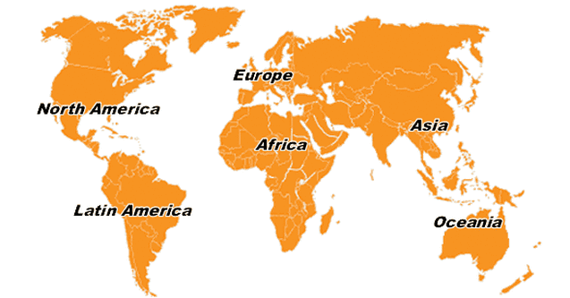
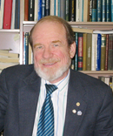
Four Senior Editors are outside of the US
Gordon Drake PRA
Laurens Molenkamp PRB
Frank Zimmerman PRSTAB
Achim Richter, RMP

Slide 9
Most of our subscriptions now are for electronic access only.

Slide 10
APS Position on Open Access
The APS supports the principles of Open Access to the maximum extent possible that allows the Society to maintain peer-reviewed high-quality journals, secure archiving, and the Society's long-term financial stability, to the benefit of the scientific enterprise.

Slide 12
Operationally, what do we do for Open Access?
We have 3 purely open access journals:
PR Special Topics-Accelerators and Beams
PR Special Topics-Physics Education Research
PRX
Our publication is free, and the target articles of Viewpoints are free from the site.
We offer publication with a Creative Commons license to any article for a fee.
We work with other organizations such as arXiv, INSPIRE, ADS to make our content easily usable by working scientists.
We are working with NSF and the Max Planck Society to explore sustainable alternatives to the subscription model.

Slide 14
SCOAP3, the CERN initiative to convert High Energy Physics Journals to Open Access, announced getting pledges from Japan, so they now have 80% of their budget “pledged”.
We responded to CERN’s questionnaire about providing “peer review” services for our journals that would be included in SCOAP3.
We have been placed on the list of “approved publishers” and expect to be invited to respond to a “tender offer” soon.

Slide 15
N

Slide 16
If libraries pledged in 2008, and pay their current costs, then there is a 30% decrease from the pledged amount

Slide 17
APS Response to SCOAP3 questionnaire
Although SCOAP3 would benefit from our peer review of high energy physics articles, we wish to make clear that we are publishing our journals, and that we have complete control of the editorial policies and content of our journals. We are not just providing “peer review for SCOAP3” and “other publication services”. …
SCOAP3 funding is, in our opinion, not necessarily stable or sustainable. We wish to support the “experiment” because APS is willing to experiment with new modes of open access. However, APS, as the smallest publisher with the largest fraction of the SCOAP3 content, and therefore having the most at stake in the “experiment” wants CERN, that has been the prime mover in this activity, to share the risk, and not place it entirely on us and to a lesser extent, the other publishers. APS will not consider tenders unless the funding is guaranteed by CERN and paid by January 1 of the year, as subscriptions are now paid. …These funds would be guaranteed by CERN, independent of any SCOAP3 fund-raising shortfalls, on a rolling 3-year basis. …

Slide 18
20/01/2012, Major step in the SCOAP3 tendering process
***********************************************************
SCOAP3 is pleased to announce that, through a recent Market Survey,
publishing partners to accompany SCOAP3 in the implementation of its Open
Access initiative have been identified.
These partners, including leading publishers of high-quality peer-reviewed
journals carrying content in the field of High-Energy Physics, have agreed
to the key SCOAP3 principles:
SCOAP3 content will be made available Open Access in perpetuity, with wide
re-use licenses;
Subscription fees to journals carrying SCOAP3 content will be reduced (or
eliminated if the journals become entirely Open Access) to allow libraries
to re-direct these funds to SCOAP3, and package prices will be adjusted
accordingly.
The publishers include: American Physical Society, Elsevier, Europhysics
Letters Association, Hindawi Publishing Corporation, Jagiellonian
University, Nature Publishing Group, The Physical Society of Japan/Oxford
University Press, SIGMA, SISSA, Societa Italiana di Fisica, Springer.
In the next phase of the process, an invitation to tender will be sent to
the publishers, for contracts to be placed in the course of 2012, with
services commencing 1 January 2013.

Slide 19
The End

