Slide 1

Washington Update
DPF Executive Committee Meeting
Atlanta
March 31, 2012
Michael Lubell
Director of Public Affairs

Slide 2
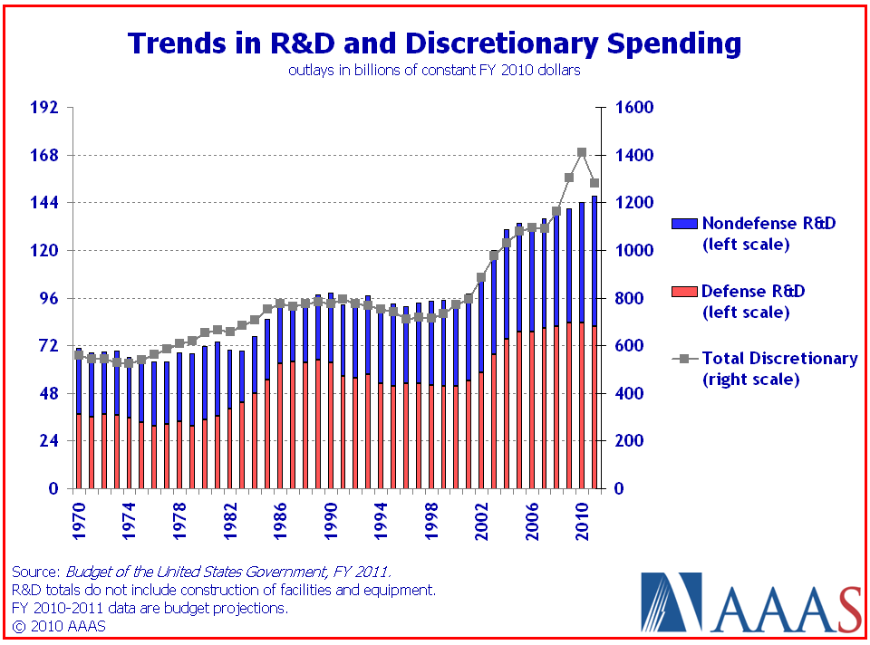
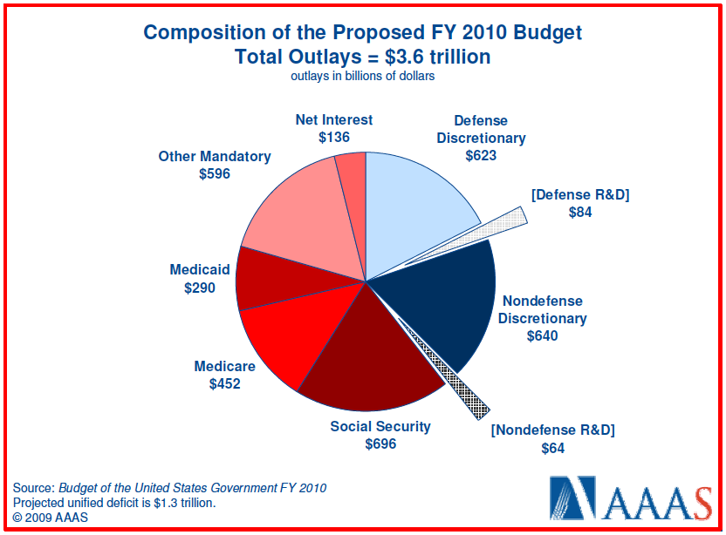
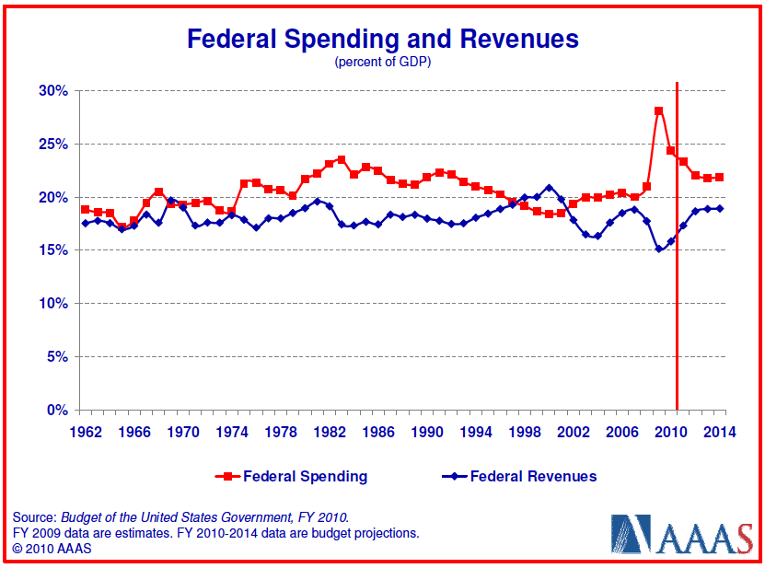
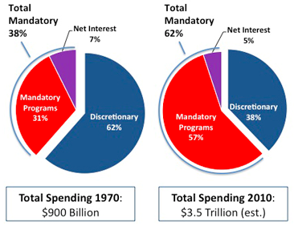
Framing the Science Spending Future

Slide 3
Framing the Science Spending Future
2011 Budget Control Act and House Budget
BCA
  Discretionary 10-year (through FY 2021) spending cut by $917 B but not really starting until FY 14.
  Additional > $1.5 T 10-year deficit reduction to have been determined by select bipartisan 12-member joint committee.
  Committee failure ➔ Across-the-board reductions (sequestrations) to achieve additional $1.2 T 10-year savings begin Jan. 2, 2013 evenly split between defense (including NNSA) and non-defense accounts: defense cuts ~ 11%; non-defense discretionary cuts: ≥ 9%.
  Fire wall in FY 12 & 13 between security (DOD, NNSA, DHS, VA and State) and non-security discretionary accounts.
  FY 12: Total ($1,043 B), Security ($684 B), Non-Security ($359 B)
House Budget
  FY 12: Total ($1,019 B), Security ($695 B), Non-Security ($324 B)
3

Slide 4
Recent Budget History Through December 24, 2011
Science | FY 06 | FY 07 | FY 08 | FY 08S | ARRA | FY 09 | FY 10 | FY 11CR | FY 12H | FY 12S | FY 12F
Account | ($B) | ($B) | ($B) | ($B) | ($B) | ($B) | ($B) | ($B) | ($B) | ($B) | ($B)
DOE SC | 3.47 | 3.81 | 3.85 | 0.0625 | 1.60 | 4.60 | 4.83 | 4.84 | 4.80 | 4.84 | 4.89
DOE EERE | 1.16 | 1.46 | 1.54 | 0.0625 | 16.8 | 1.93 | 1.95 | 1.84 | 1.30 | 1.80 | 1.82
DOE ARPA-E |  |  |  |  | 0.400 |  | 0.015 | 0.180 | 0.180 | 0.250 | 0.275
NSF | 5.59 | 5.84 | 6.07 | 0.0625 | 3.00 | 6.49 | 6.87 | 6.86 | 6.86 | 6.70 | 7.03
R&RA | 4.45 | 4.76 | 4.82 | 0.0225 | 2.50 | 5.18 | 5.56 | 5.56 | 5.61 | 5.44 | 5.72
MREFC | 0.234 | 0.191 | 0.221 |  | 0.400 | 0.152 | 0.117 | 0.117 | 0.100 | 0.117 | 0.167
EHR | 0.700 | 0.698 | 0.726 | 0.0400 | 0.100 | 0.845 | 0.873 | 0.861 | 0.835 | 0.829 | 0.829
NIST Core | 0.431 | 0.493 | 0.519 |  | 0.600 | 0.597 | 0.605 | 0.578 | 0.571 | 0.560 | 0.622
STRS | 0.383 | 0.434 | 0.440 |  | 0.220 | 0.469 | 0.505 | 0.507 | 0.516 | 0.500 | 0.567
CRF | 0.048 | 0.059 | 0.109 |  | 0.360 | 0.128 | 0.100 | 0.070 | 0.055 | 0.060 | 0.055
NIST ATP/TIP | 0.079 | 0.079 | 0.065 |  |  | 0.065 | 0.070 | 0.045 | 0.000 | 0.000 | 0.000
NIH | 28.54 | 29.23 | 29.46 | 0.130 | 8.50 | 30.30 | 31.01 | 30.69 | 31.69 | 30.50 | 30.64
DOD 6.1 | 1.47 | 1.53 | 1.47 |  |  | 1.63 | 1.88 | 1.95 | 2.10 | 2.08 | 2.10
DOD 6.2 | 5.17 | 5.10 | 4.16 |  |  | 5.08 | 5.06 | 4.45 | 4.66 | 4.73 | 4.70
NASA Sci | [5.25] | [5.25] | 4.71 | 0.0625 | 0.400 | 4.50 | 4.49 | 4.94 | 4.50 | 5.10 | 5.09
Notes: 1. Red italics are totals with earmarks removed; 2. NASA accounts were redefined in FY 08, making prior figures in [brackets] difficult to align; 3. NIH FY 11CR includes $0.279 B that was transferred to the Global AIDS Project; 4. JWST funding was $0 in FY 12H and $0.530 B in FY 12S & 12F with a project cap of $8.00 B.

Slide 5
Framing the Science Spending Future
2011 Budget Control Act and House Budget
BCA
  Discretionary 10-year (through FY 2021) spending cut by $917 B but not really starting until FY 14.
  Additional > $1.5 T 10-year deficit reduction to have been determined by select bipartisan 12-member joint committee.
  Committee failure ➔ Across-the-board reductions (sequestrations) to achieve additional $1.2 T 10-year savings begin Jan. 2, 2013 evenly split between defense (including NNSA) and non-defense accounts: defense cuts ~ 11%; non-defense discretionary cuts: ≥ 9%.
  Fire wall in FY 12 & 13 between security (DOD, NNSA, DHS, VA and State) and non-security discretionary accounts.
  FY 12: Total ($1,043 B), Security ($684 B), Non-Security ($359 B)
  FY 13: Total ($1,047 B)
House Budget
  FY 12: Total ($1,019 B), Security ($695 B), Non-Security ($324 B)
  FY 13: RSC Total ($931B) House Defeated 136 -285
  FY 13: Ryan Total ($1,028 B) House Passed 228-191
5

Slide 6
Recent Budget History Through February 26, 2012
Science | FY 07 | FY 08 | FY 08S | ARRA | FY 09 | FY 10 | FY 11CR | FY 12H | FY 12S | FY 12F | FY 13P
Account | ($B) | ($B) | ($B) | ($B) | ($B) | ($B) | ($B) | ($B) | ($B) | ($B) | ($B)
DOE SC | 3.81 | 3.85 | 0.0625 | 1.60 | 4.60 | 4.83 | 4.84 | 4.80 | 4.84 | 4.89 | 4.99
DOE EERE | 1.46 | 1.54 | 0.0625 | 16.8 | 1.93 | 1.95 | 1.84 | 1.30 | 1.80 | 1.82 | 2.34
DOE ARPA-E |  |  |  | 0.400 |  | 0.015 | 0.180 | 0.180 | 0.250 | 0.275 | 0.350
NSF | 5.84 | 6.07 | 0.0625 | 3.00 | 6.49 | 6.87 | 6.86 | 6.86 | 6.70 | 7.03 | 7.37
R&RA | 4.76 | 4.82 | 0.0225 | 2.50 | 5.18 | 5.56 | 5.56 | 5.61 | 5.44 | 5.72 | 5.98
MREFC | 0.191 | 0.221 |  | 0.400 | 0.152 | 0.117 | 0.117 | 0.100 | 0.117 | 0.167 | 0.196
EHR | 0.698 | 0.726 | 0.0400 | 0.100 | 0.845 | 0.873 | 0.861 | 0.835 | 0.829 | 0.829 | 0.876
NIST Core | 0.493 | 0.519 |  | 0.600 | 0.597 | 0.605 | 0.578 | 0.571 | 0.560 | 0.622 | 0.708
STRS | 0.434 | 0.440 |  | 0.220 | 0.469 | 0.505 | 0.507 | 0.516 | 0.500 | 0.567 | 0.648
CRF | 0.059 | 0.109 |  | 0.360 | 0.128 | 0.100 | 0.070 | 0.055 | 0.060 | 0.055 | 0.060
NIST ATP/TIP | 0.079 | 0.065 |  |  | 0.065 | 0.070 | 0.045 | 0.000 | 0.000 | 0.000 | 0.000
NIH | 29.23 | 29.46 | 0.130 | 8.50 | 30.30 | 31.01 | 30.69 | 31.69 | 30.50 | 30.64 | 31.00
DOD 6.1 | 1.53 | 1.47 |  |  | 1.63 | 1.88 | 1.95 | 2.10 | 2.08 | 2.10 | 2.11
DOD 6.2 | 5.10 | 4.16 |  |  | 5.08 | 5.06 | 4.45 | 4.66 | 4.73 | 4.70 | 4.47
NASA Sci | [5.25] | 4.71 | 0.0625 | 0.400 | 4.50 | 4.49 | 4.94 | 4.50 | 5.10 | 5.09 | 4.91
Notes: 1. Red italics are totals with earmarks removed; 2. NASA accounts were redefined in FY 08, making prior figures in [brackets] difficult to align; 3. NIH FY 11CR includes $0.279 B that was transferred to the Global AIDS Project; 4. JWST funding : $0 in FY 12H, $0.530 B in FY 12S & 12F with a project cap of $8.00 B and $0.627 B in FY 13P.

Slide 7
Energy and Water Development Appropriations
Program | FY 2011 CR ($B) | FY 2012 P ($B) | FY 2012 H ($B) | FY 2012 S ($B) | FY 2012 F ($B) | FY 2013 P ($B)
Science | 4.84 | 5.42 | 4.80 | 4.84 | 4.89 | 4.99
BES | 1.68 | 1.99 | 1.69 | 1.69 | 1.69 | 1.80
HEP | 0.796 | 0.797 | 0.797 | 0.780 | 0.792 | 0.776
NP | 0.540 | 0.605 | 0.552 | 0.550 | 0.550 | 0.527
FES | 0.376 | 0.400 | 0.406 | 0.335 | 0.402 | 0.398
BER | 0.612 | 0.718 | 0.547 | 0.622 | 0.612 | 0.625
ASCR | 0.422 | 0.466 | 0.427 | 0.442 | 0.442 | 0.455
EERE | 1.84 | 3.20 | 1.30 | 1.80 | 1.82 | 2.34
ARPA-E | 0.180 | 0.550 | 0.180 | 0.250 | 0.275 | 0.350
NNSA | 10.52 | 11.74 | 10.60 | 11.05 | 11.00 | 11.50
FY 2012 Final: Funds 3 existing Hubs @ $24.3 M each [Fuels from Sunlight (BES), EE Buildings Systems Design (EERE) and Modeling & Simulation (NE)], 2 new Hubs @$20 M each [Batteries & Energy Storage (SC) and Critical Materials (EERE)] and 46 existing Energy Frontier Research Centers @ $100 M total. FY 2013 Request: $140 M for 5 existing Hubs and $20 M for new Electricity Systems Hub (OEDER); $150M for ITER, $40.6M for CEBAF 12 GeV upgrade, $22M for FRIB, $104M for NSLS-II and $63.5M for LCLS-II.
7

Slide 8
Energy and Water Development Appropriations
Making Everything Fit in a Flat Budget Scenario
The Biggest Problems
Fusion
  ITER
High-Energy Physics
  LBNE
  Project X
  DUSEL
Nuclear Physics
  J-Lab CEBAF 12-GeV Upgrade
  FRIB
  RHIC II and e-RHIC
8

Slide 9
9

Slide 10
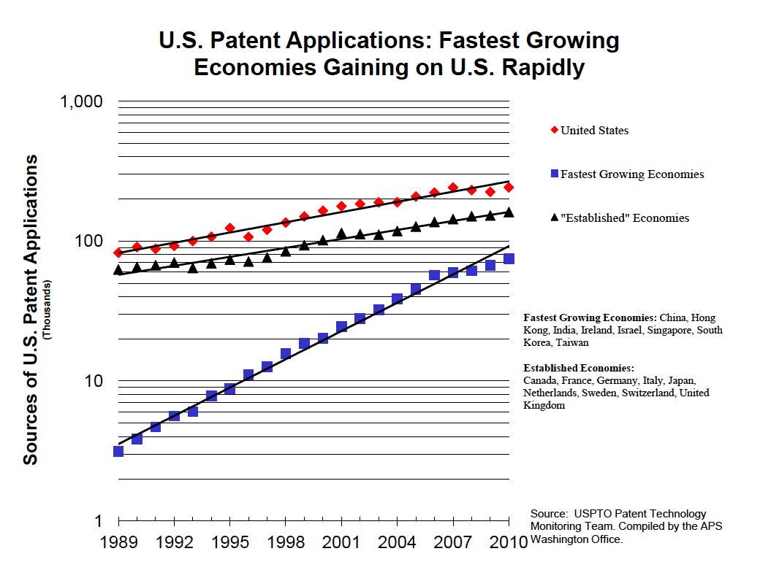
10

Slide 11
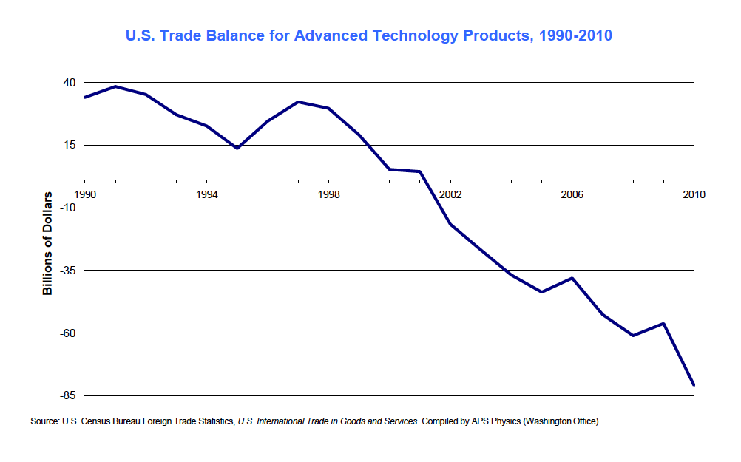
11

Slide 12
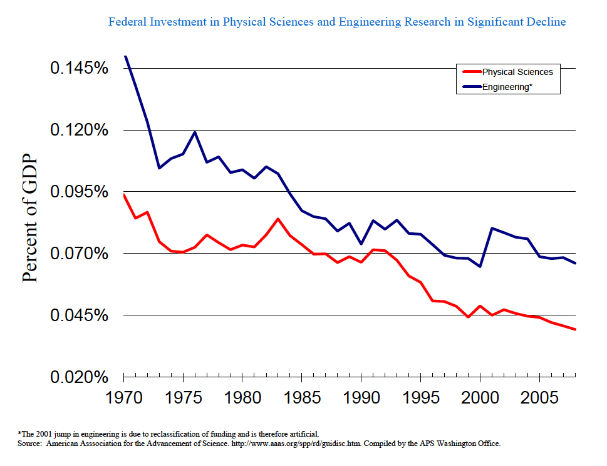
12

Slide 13
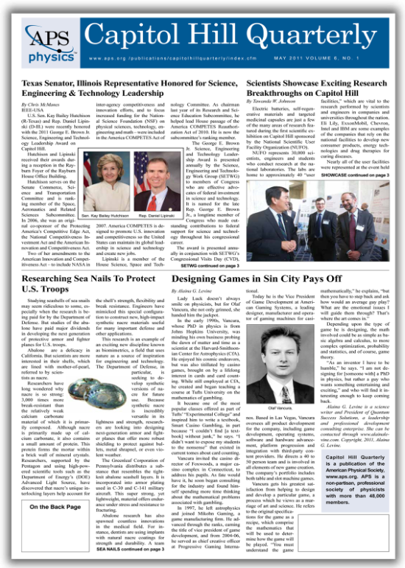
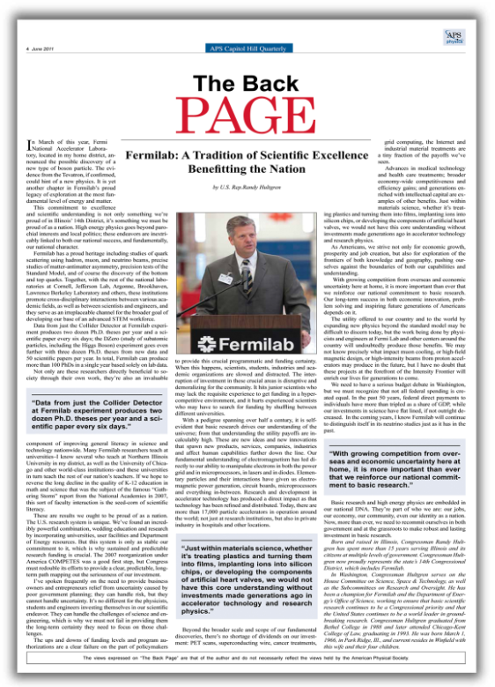
13

Slide 14
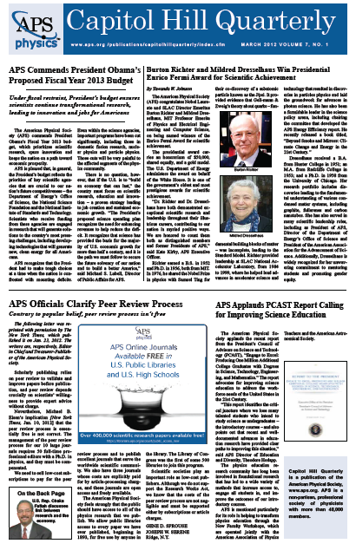
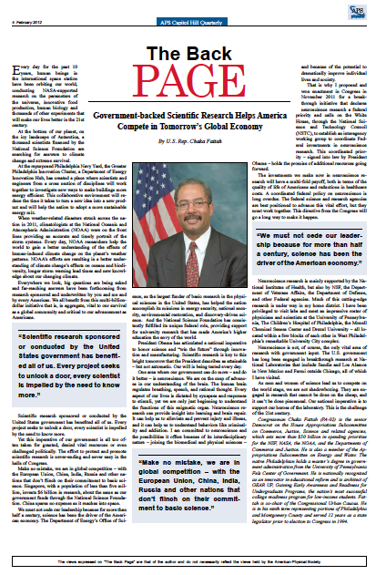
14

Slide 15
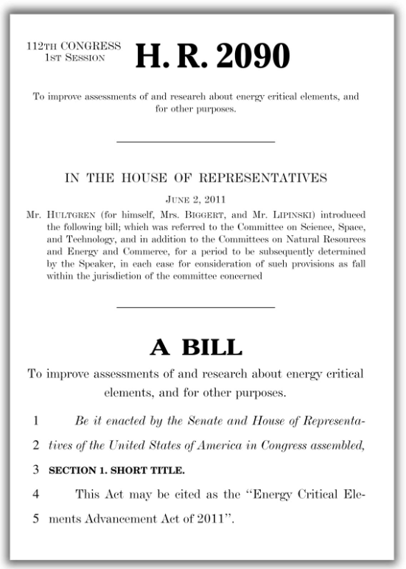
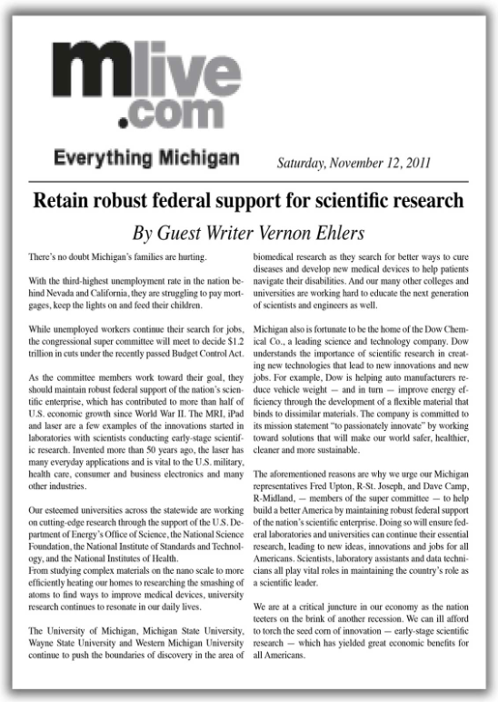
15

Slide 16
APS WASHINGTON OFFICE opa@aps.org
(202) 662-8700
Tyler Glembo
Tawanda Johnson
Jodi Lieberman
Brian Mosley
Jeanette Russo
Francis Slakey
16

