Slide 1
SiPM Low Power Bias Generation for Dune FD2-VD
Sergio Rescia and the BNL Team
BNL Dune FD2-VD Workshop
13 Apr 2022

Slide 2
SiPMBias Generation for Dune FD2-VD
PoF → DC ~12 V_{in} → ~200 Vout
Current PoF unit tested has ~6.7 V at RT and ~10.4 V at cold
Colpitts oscillator + Cockcroft-Walton charge pump → feasibility study
Fairly simple and low power circuit solution capable of cryogenic operation which can generate ~200V bias using ~10-20mW or less power for SiPMbias
Challenge is to control the output voltage and provide regulation
use varactor voltage-controlled attenuator
control supply VDD of Colpitts oscillator

Slide 3
SiPM HV Bias Generator
Inspired by photomultiplier base HV generator
Variable
Attenuator
CW mult.
Colpitts Oscillator
V_{HV_unfiltered}
C_{F}
R_{F}
V_{HV}
200MΩ
+
R_{in}
-
R_{div}
needs cryogenic micropower opamp:
TLC721B (tested by NASA)
(?) TLV9101 newer version of TLC721B
(?) ADA4098-1 high voltage, VDD=50V
V_{REF}
R_{fb}

Slide 4
Colpitts and Attenuator
Colpitts Oscillator
C1
VDD
10n
with:
2 x KV1471
C_{VP}=50pF
C_{cwmult}=20p
control range is +/-12%
V_{control}=0.1V Vpp=20.07V
V_{control}=1V Vpp=18.5V
V_{control}=2V Vpp=17.6V
V_{control}=3V Vpp=16.8V
V_{control}=10V Vpp=15.6V
L1
CVP
12
R1
330n
C2
50p
15Meg
3.3n
CACV1
DV1
CACV2
OUT
0.1µ
DV2
0.1µ
Ccwmult
M1
20p
RJU002N06
KV1471
C3
4.7n
RV1
RV2
R2
CFB
R3
1M
1M
5.6Meg
1µ
5000
Vcontrol
3V

Slide 5
HV Bias: Colpitts oscillator + Cockcroft-Walton charge pump
Inspired by photomultiplier base HV generator
Colpitts Oscillator
VDD
C2
L1
10n
CVP
R1
330n
C3
Cockroft-Walton Multiplier
15Meg
3.3n
DV1
CACV1
CACV2
0.1µ
0.1µ
M1
RV1
RV2
1Meg
1Meg
nHVunfiltered
C4
RFSiPM
R2
CFB1
R3
4.7n
1Meg
5.6Meg
1µ
5000
VDD
CF2
12V
0.47µ
VHV
RF
VREF
Rdivider2
RSiPM
100k
6.3V
500Meg
200Meg
nopamp
+
Rin
CFdiv
ADA4098-1
S
+
Cpos
3p
Rdivider1
needs cryogenic micropower opamp
TLC721B (tested by NASA)
(?) TLV9101 newer version of TLC721B
(?) ADA4098-1 high voltage, VDD=50V
16Meg

Slide 6
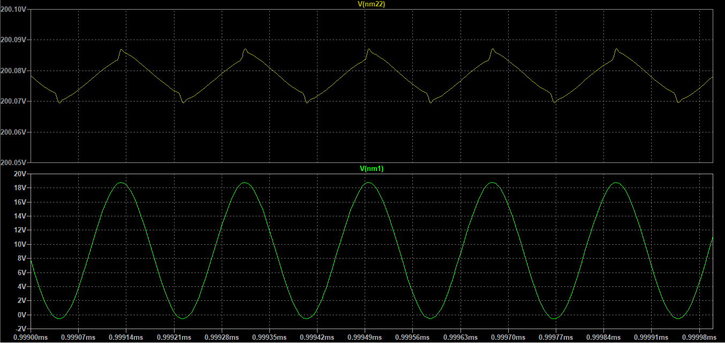
~20mV pp ripple at the output of the Cockroft-Walton
Easily filtered
Colpitts output ~20Vpp

