Slide 1
Step-up/boost DC-DC converters test summary
Eaglekumar Tarpara on behalf of BNL CE team
04/13/2022

Slide 2
Content
X-ARAPUCA and SiPM Readout
Search for Step-up DC-DC modules
Step-up DC-DC modules tested at cryogenic temperatures
  CHVM3-12-0300PW (TDK)
  0.3US12-P0.1, 0.4US5-P0.1 (Advanced Energy)
  C10940-53, C10940-03, C11204-02 (Hamamatsu)
  AH0SP-12, Q025-5C, Q025-12 (EMCO, Xp Power)
  12SAR 250, 5SAR250, 5SM48S (PICO Electronics)
Summary

Slide 3
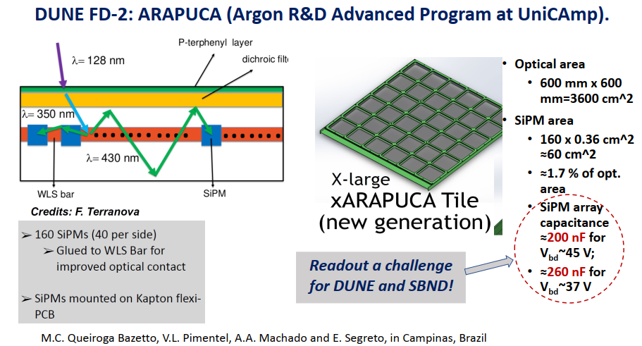
Veljko’s Talk in LIDINE 2021
Light Detection In Noble Elements
Charge and Light Sensing in Noble Liquid TPCs
  https://indico.physics.ucsd.edu/event/1/contributions/103/

Slide 4
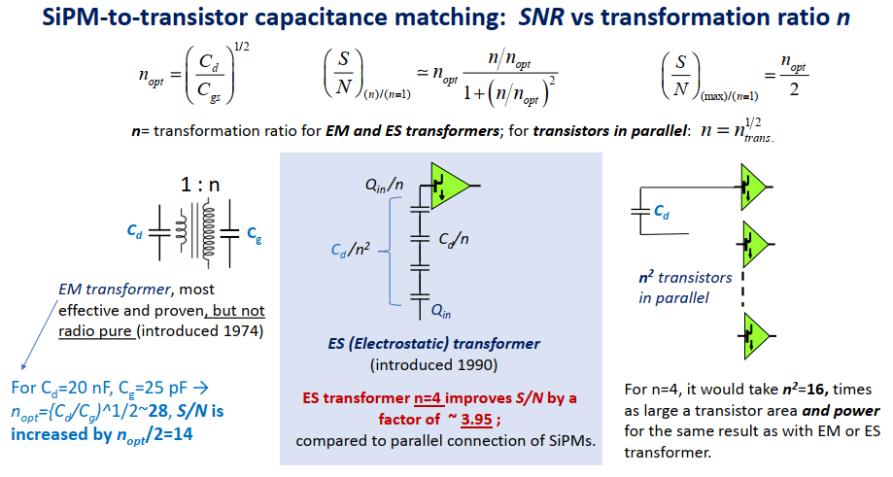
Veljko’s Talk in LIDINE 2021
Light Detection In Noble Elements
Improve SNR with ES (Electrostatic) transformer

Slide 5
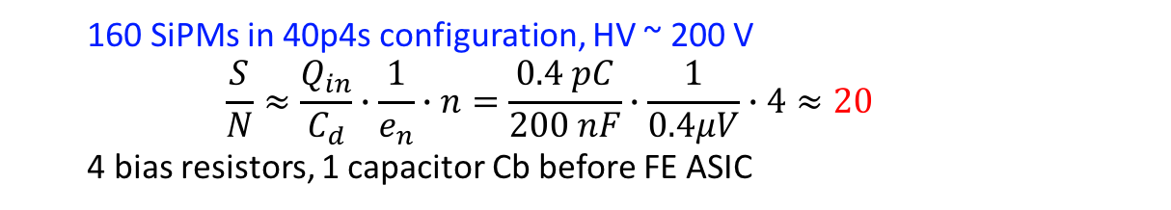
A Possible X-ARAPUCA Readout Scheme
Goal: explore HV DC-DC modules outputting ~200V at cryogenic temperatures (77K-89K)
  160 SiPMs in 40p4s configuration, HV ~ 200 V
  $$\frac{S}{N}≈\frac{Q_{in}}{C_{d}}∙\frac{1}{e_{n}}∙n=\frac{0.4 pC}{200 nF}∙\frac{1}{0.4μV}∙4≈20$$
  4 bias resistors, 1 capacitor Cb before FE ASIC

Slide 6
Search for DC-DC modules
Basic requirements of step-up DC-DC converters
  Output voltage range up to 200V
  Survive at cryogenic temperature as low as 77K (liquid nitrogen)
  High power efficiency when the load current is ~100 µA
  Low noise
Market survey of DC-DC modules

Slide 7
Commercial DC-DC modules
Manufacturer | Model | Type | Input Voltage (V) | Output Voltage (V) | Typical Input Current (mA) | Maximum Output Current | Typical Ripple and Noise
TDK-Lambda | CHVM3-12-0300PW | Integrated Module | 10.8-13.2 | 0-300 | 395 | 10mA@300V | 30 mV
TI | LM3478/LM3488 | Controller | 2.97-40 | 1.26-500 |  | 1A@12V
TI | LM3478Q/LM3488Q | Controller | 2.97-40 | 1.26-500 |  | 3A@10V
TI | LM3481/LTM3481-Q1 | Controller | 2.97-48 | 1.26-500 |  | 2A@12V
 |  | Controller |  |  |  | 1.5A@12V
 |  | Controller |  |  |  | 1.25A@12V
TI | LM51561/LM5156 | Controller | 1.5-60 | 1.5-300 |  | 3A@12V
TI | LM51551/LM5155 | Controller | 1.5-45 | 1.5-300 |  | 2A@24V, 4A@5V, 2A@12V
TI | LM5022/LM5022Q | Controller | 6-60 | 1.25-300 |  | 0.5A@40V
Maxim | MAX17597 | Controller | 4.5-36 | 5-250 |  | 1A@24V
Maxim | MAX17499 | Controller | 9.5-24 | 1.23-400
ADI | LTC3862-1 | Controller | 8.5-36 | <350 |  | 5A@48V
ADI | LTC3862-2 | Controller | 5.5-36 | <350 |  | 10A@50V
ADI |  |  |  |  |  | 2A@120V
ADI |  |  |  |  |  | 6A@12V
ADI | LT8312 | Controller | 10-38 | <400 |  | 0.375A@400V
ADI | LT3757/LT3757A | Controller | 2.9-40 | <350 |  | 1.5A@12V, 3A@5V, 1A@-15V, 3A@5V
ADI | LT3758/LT3758A | Controller | 5.5-100 | <350 |  | 1A@24V, 3A@3.3V
Hamamatsu | C9619-51 | Integrated Module | 12 | <2000 | 460 | 2mA | 60 mV
 | C11152-51 | Integrated Module | 12 | <1500 | 220 | 1mA | 5 mV
 | C12733-04 | Integrated Module | 10-35 | 500-1800 | 90 | 90uA | 100 mV
 | C13890-55 | Integrated Module | 11-16 | <1250 | 125 | 0.6mA | 38 mV
 | C14051-55 | Integrated Module | 11-16 | <10000 | 260 | 0.2mA | 100 mV
 | C11204-02 | Integrated Module | 5 | 20-90 | 40 | 2mA | 0.2 mV
 | C10940-03 | Integrated Module | 5 | -200/-1200 | 230 | 0.6mA | 50 mV
 | C10940-53 | Integrated Module | 5 | 200-1200 | 230 | 0.6mA | 50 mV
Advanced Energy Industries, Inc | ULTRAVOLT US SERIES | Integrated Module | 5 or 12-15V | 0-500 | 50-60 | 0.2-0.5mA | <0.01%*Vout
XP Power | A Series | Integrated Module | 5/12/24V | 0-6000 | 500mA | 5mA | <1%*Vout
 | Q Series | Integrated Module | 5/12/24V | 0-10,000 | 100mA | 1mA | <1%*Vout
 | AG Series | Integrated Module | 5/12/24V | 0-6000 | 500mA | 1mA | <1%*Vout
PICO | Series AV/SMV | Integrated Module | 5/12/15/24/28 | 0-500

Slide 8
DC-DC module testing at cold temperature
# | Module | Manufacture | R load | Vin (V) | Vout (V) at RT | Vout (V) at LN2 | Works at Cold? | Comments
1 | CHVM3-12-0300PW | TDK | 10MΩ | 12 | 200 | 0 | No
2 | 0.3US12-P0.1 | Advanced Energy | 10MΩ | 12 | 200 | 0 | No
3 | 0.4US5-P0.1 | Advanced Energy | 10MΩ | 5 | 200 | 0 | No
4 | C10940-53 | Hamamatsu | 10MΩ | 5 | 205 | 0 | No
5 | C10940-03 (negative HV) | Hamamatsu | 10MΩ | 5 | -200 | 0 | No
6 | C11204-02 | Hamamatsu |  | 5 | 40 | 0 | No
7 | AH0SP-12 | EMCO, XP Power | 10MΩ | 10 | 200 | 0 | No
8 | 12SAR 250 | PICO Electronics | 1MΩ | 12 | 200 | 0 | No
9 | 5SAR 250 | PICO Electronics | 1MΩ | 5.1 | 200 | 0 | No
10 | Q025-5C | EMCO, XP Power | 10MΩ | 5 | 222 | 0 | No
11 | 5SM48S | PICO Electronics | 10MΩ | 5 | 74.5 | 10.63 | Yes | At cold, output voltage reduced to 1.26 V with 20kΩ load Results are not matched with the University of Iowa results
 |  |  | 20kΩ | 5 | 60.5 | 1.26
12 | Q025-12 | EMCO, XP Power | 10MΩ | 12 | 203 | 52 | Yes | Works at cold with reduced voltage ~52 V Ordered a few more modules for retesting

Slide 9
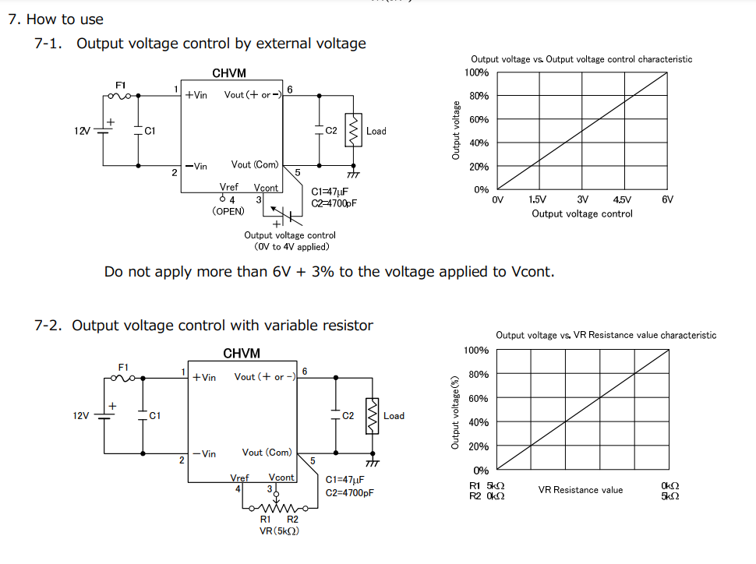
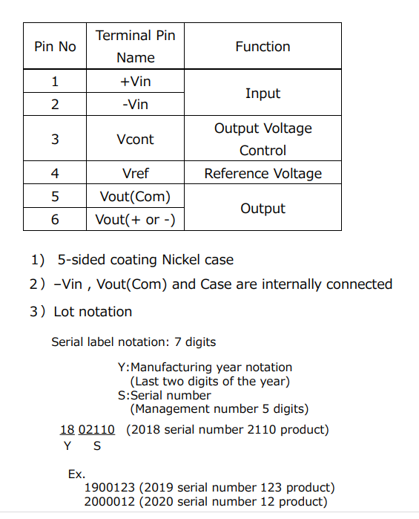
CHVM3-12-0300PW (TDK)
Datasheet
  https://product.tdk.com/system/files/dam/doc/product/power/switching-power/dc-dc-converter/specification/chvm3_spc.pdf

Slide 10
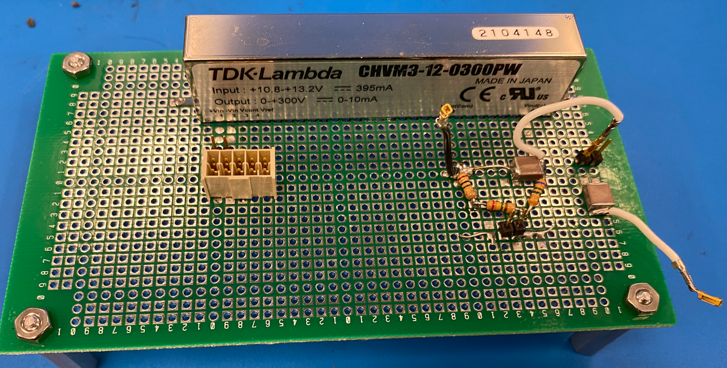
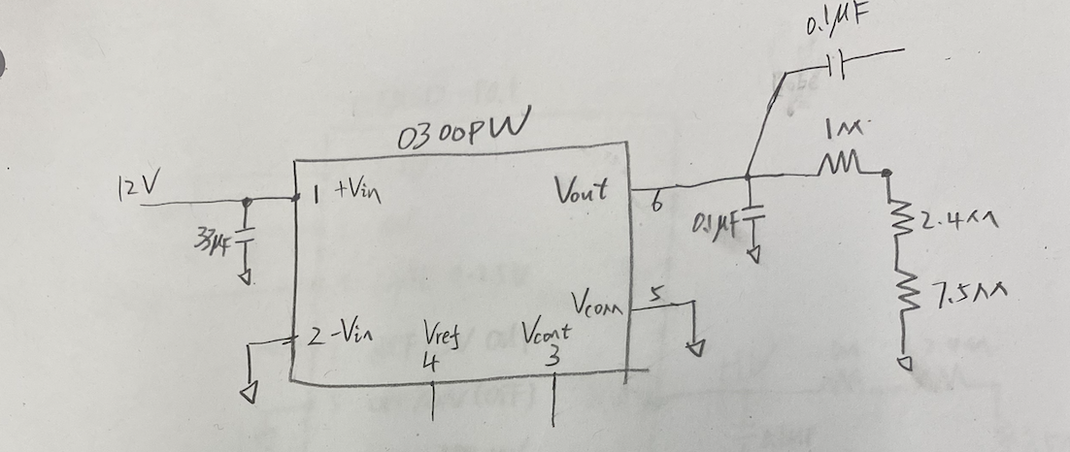
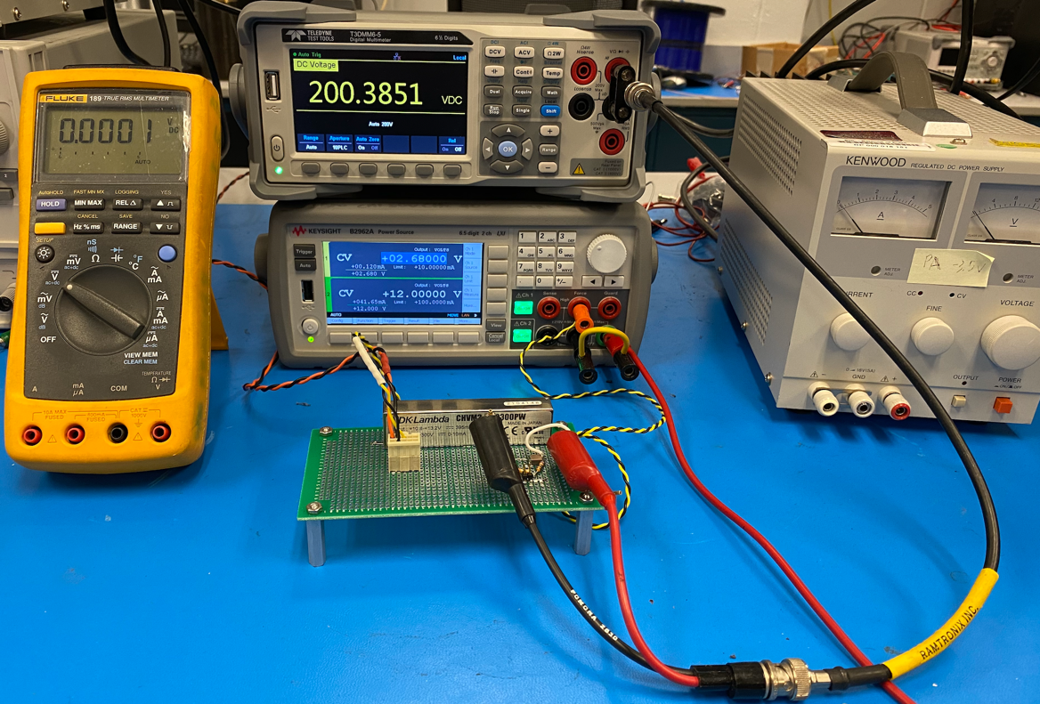
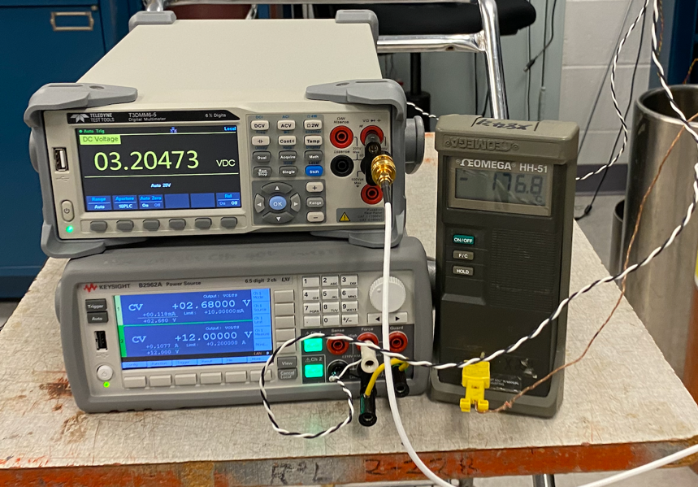
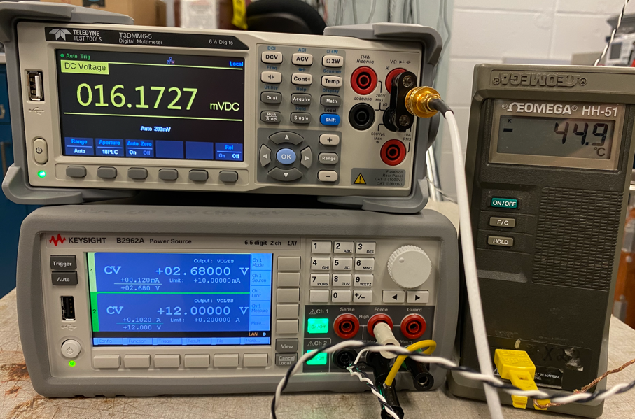
CHVM3-12-0300PW (Failed when T < -50C)
With 10MΩ load
Temp | Vin /V | Iin /mA | Vcntl / V | Icntl /mA | HV /V
RT | 12 | 41.70 | 2.68 | 0.120 | 200.38
Can’t output HV properly when temperature drop to < -50C (note: there is temperature difference between DC-DC kernel and T sensor)
Cool down
warm up

Slide 11
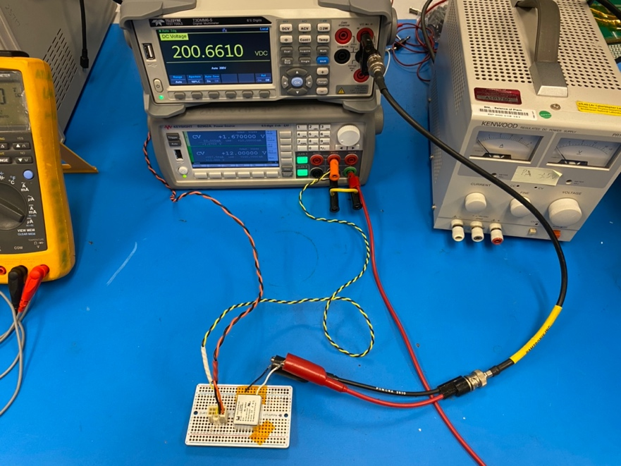
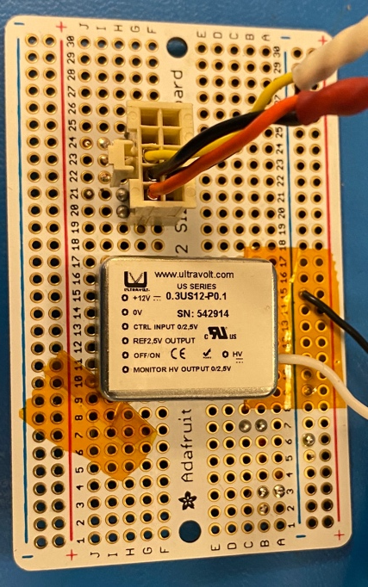
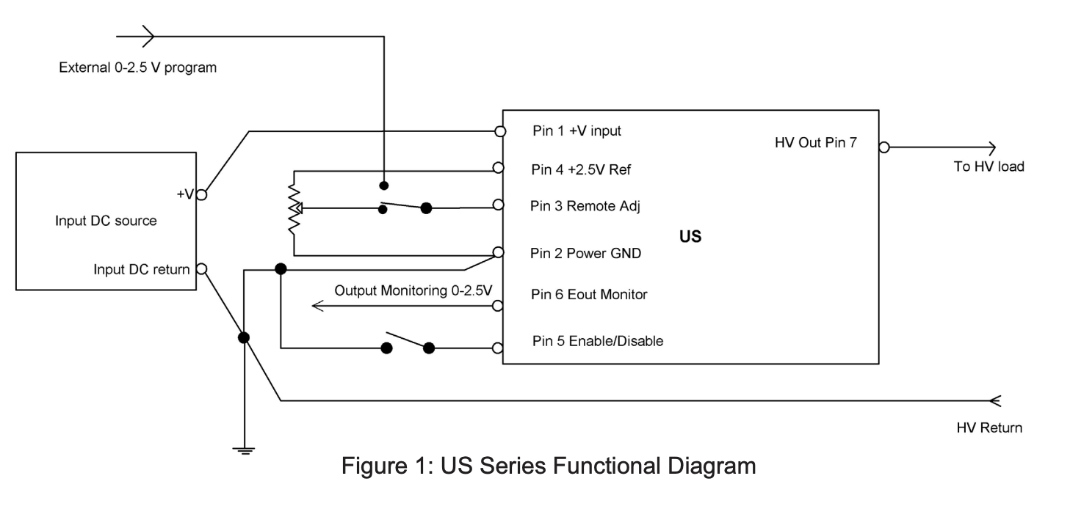
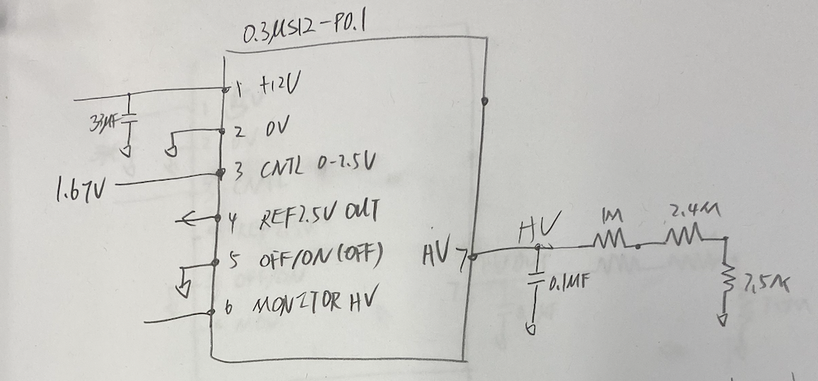
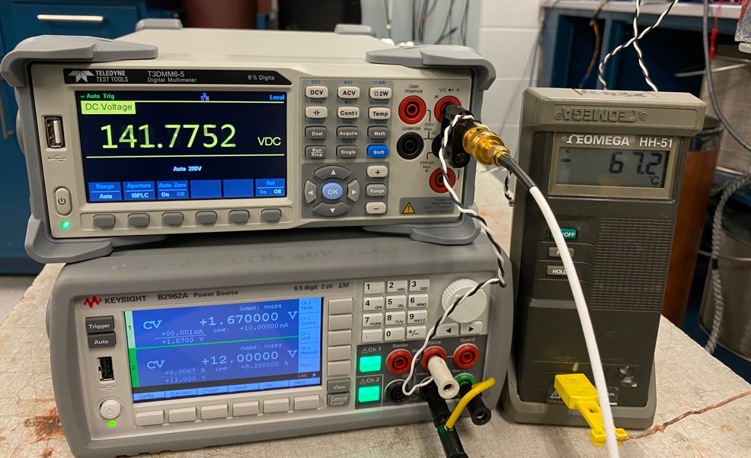
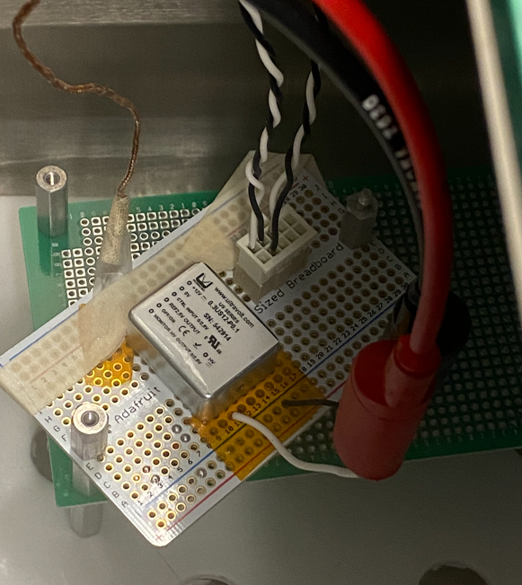
0.3US12-P0.1 (Advanced Energy)
Datasheet
  https://www.advancedenergy.com/products/high-voltage-products/high-voltage-power-supplies/micro-size-high-voltage-dc-to-dc-modules/us-series/
Temp | Vin /V | Iin /mA | Vcntl / V | Icntl /mA | HV /V
RT | 12 | 7.58 | 1.67 | 0 | 200.65
note: REF = 2.494V, MON = 1.67V
Can’t output HV properly when temperature drop to < -50C
With 10MΩ load
Case metal shorts to pin#2 (0V)
0.4US5-P0.1 is also failed at LN2

Slide 12
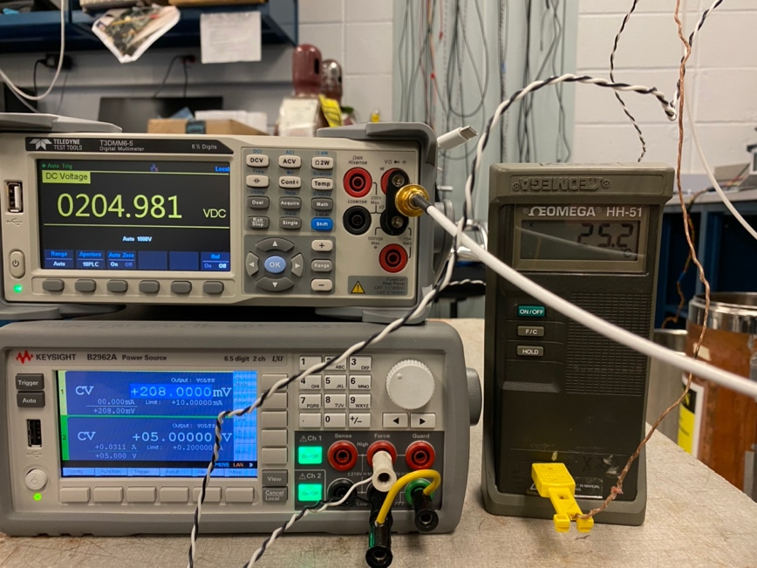
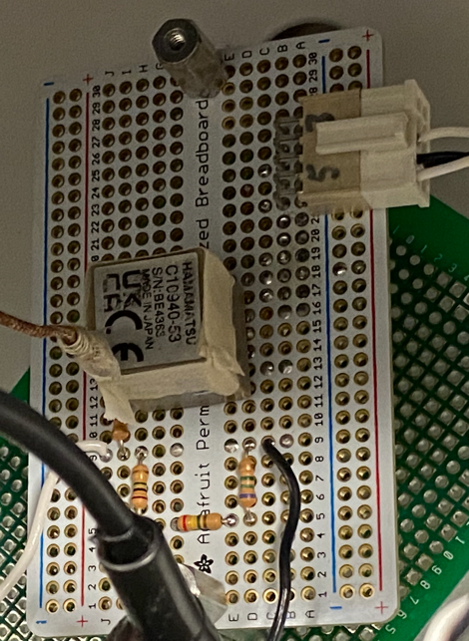
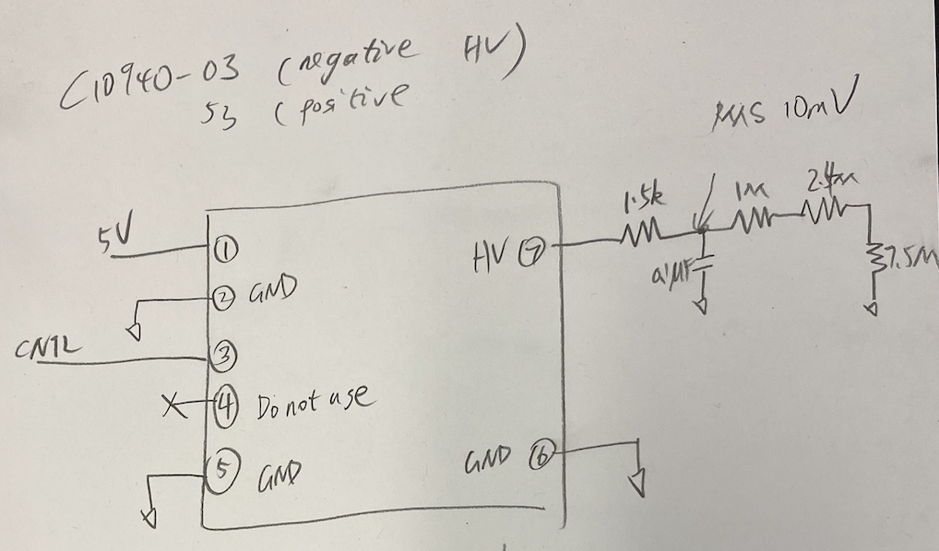
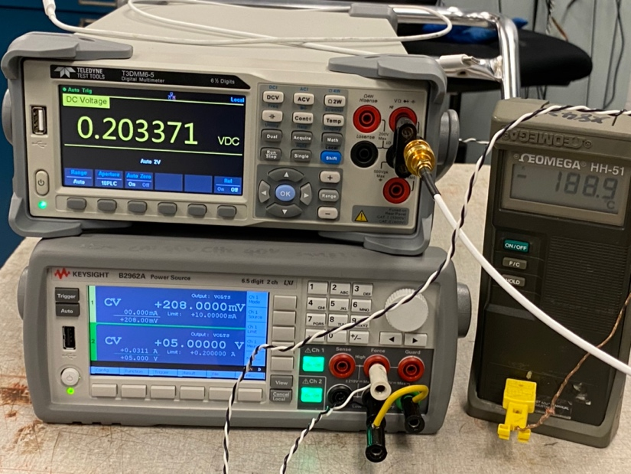
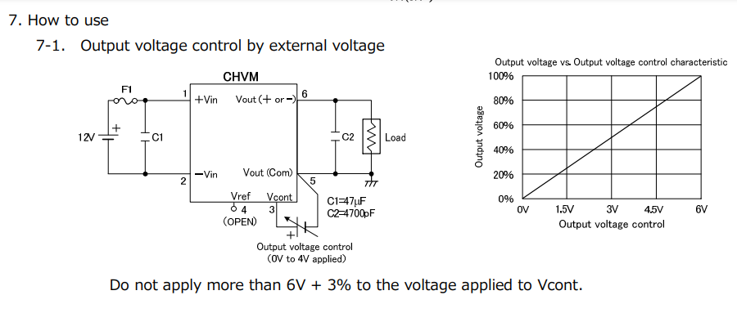
C10940-53 (Hamamatsu)
Datasheet
  https://www.hamamatsu.com/content/dam/hamamatsu-photonics/sites/documents/99_SALES_LIBRARY/etd/C10940_TACC1069E.pdf
Temp | Vin /V | Iin /mA | Vcntl / V | Icntl /mA | HV /V
RT | 5 | 11.49 | 0.208 | 0 | 205.08
Can’t output HV when it submerged in LN2, however it survive when temperature is higher than -170C.
With 10MΩ load
Note: Ripple RMS ~10mV after RC filter

Slide 13
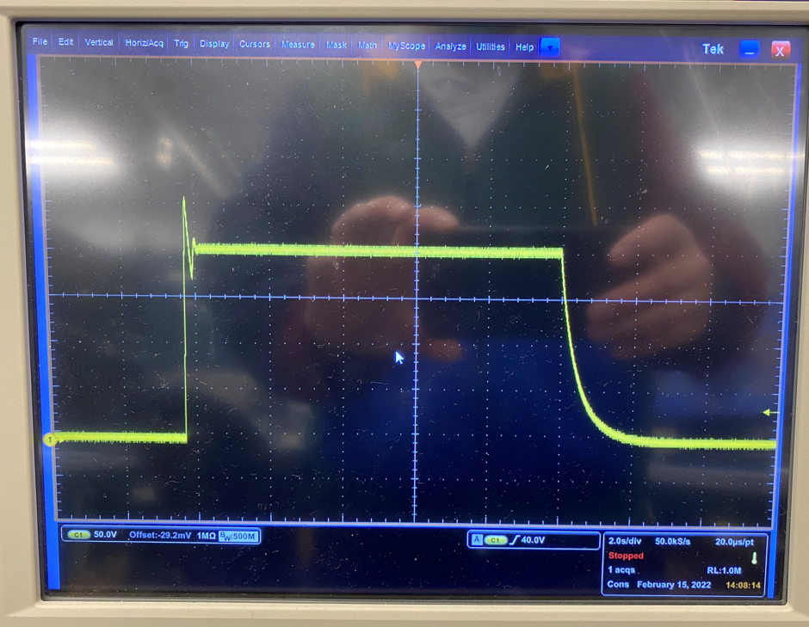
C10940-53 (Hamamatsu)
Place it in the deep Dewar
  Sufficient cooldown time to ensure the inner and surface has the same temperature
  Power is off
    no power until the temperature is stable for ~30 minutes
Temperature °C | Vin / V | Iin /mA | Vout /V
RT | 5V | 11.5mA | 205V
-160 | 5V | ~20mA | 210V
-170 | 5V | 2.6 | 0.09
-170 | 5.2V | 20 | 210
-172 | 5.2V | 3 | 0.1
-172 | 5.5 | 20 | 212
-180 | 6 V | 2.8 | 0.1
-181 | 6.5V | 3.2 | 0.1
in LN2 | 7~10V | 3.6~11mA | 0.1~0.2
In LN2 | 11V | > 1A | 0.2V | damaged
When T < -100C, the output jumps to > 250V and then return to ~200V
C10940-03 (negative HV) and C11204-02 are also failed at LN2 temperature

Slide 14
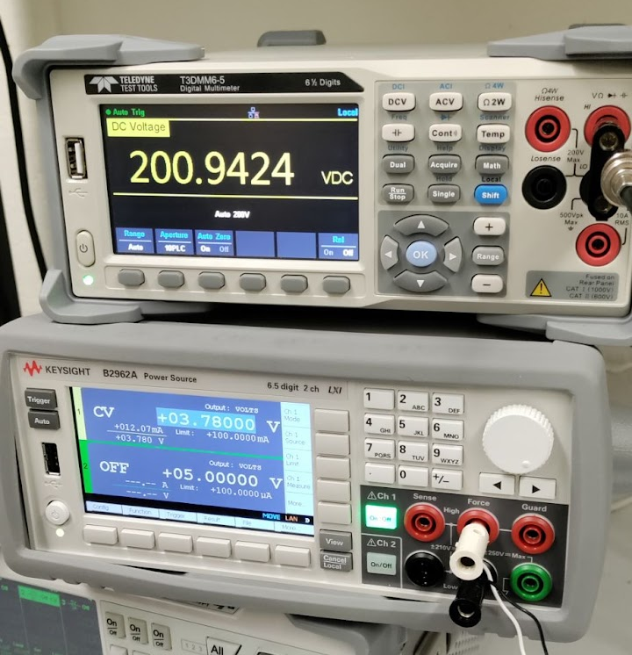
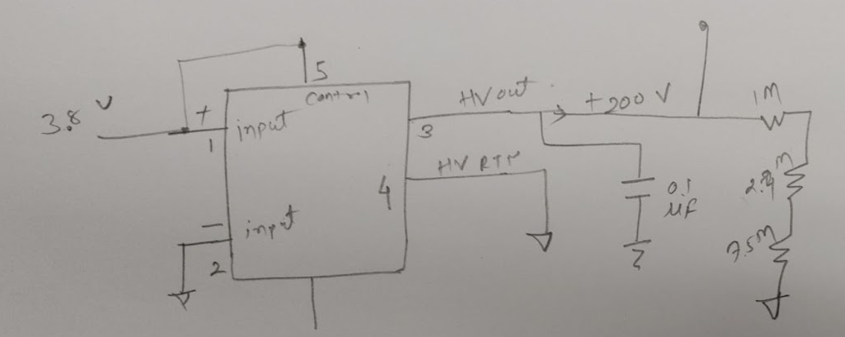
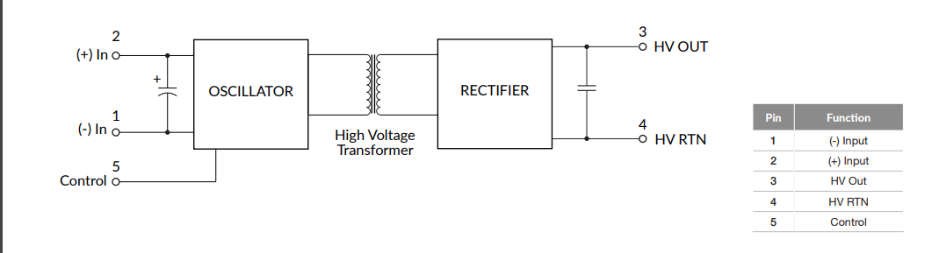
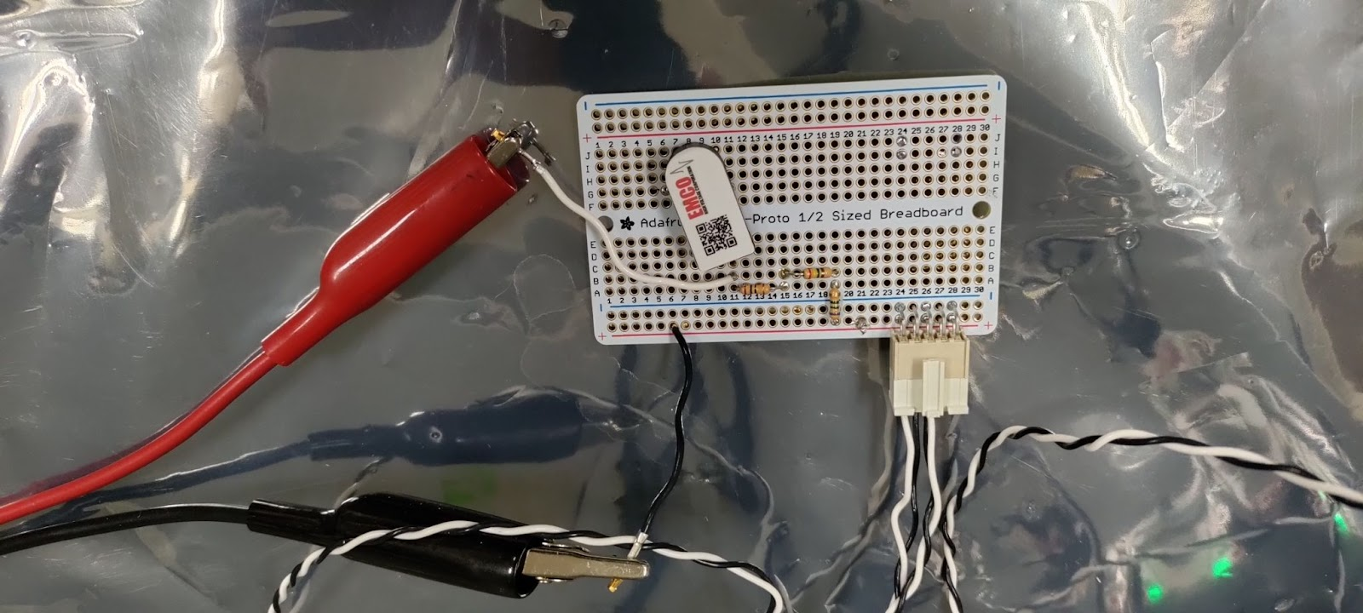
AH0SP-12 (Xp Power)
Datasheet
  https://www.xppower.com/portals/0/pdfs/SF_A_Series.pdf
With 10MΩ load
Temp (C) | i/p Voltage (V) | i/p Current (mA) | o/p Voltage (V) | o/p AC ripple (mV)
+14 | 3.88 | 11.76 | 199.8 | 0.94
-40.2 | 3.88 | 11.76 | 199.9 | 0.8
-45 | 3.88 | 31.75 | 183.72
-77 | 3.88 (4.4) | 31.75 (10.76) | 178.2 (199.9)
-95.5 | 4.4 (4.9) | 12.68 (10.8) | 180 (200)
-120 | 4.9 (5.35) | 13.68 (10.68) | 187.2 (199.9)
-139 | 5.35 (6.7) | 12.62 (13.9) | 156.4 (200)
-176 | 6.7 (10.3) | 12.46 (11.07) | 177 (207.5)
LN2 | 10.3 | 6.62 | 0 V
Output is 0V when submerged in LN2.

Slide 15
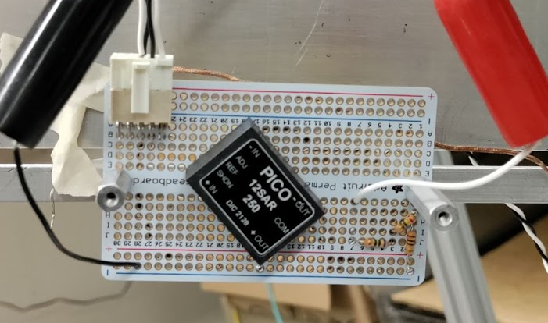
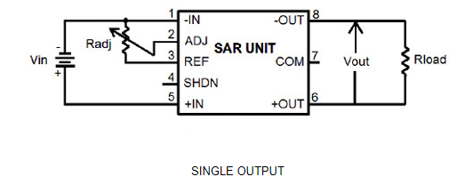
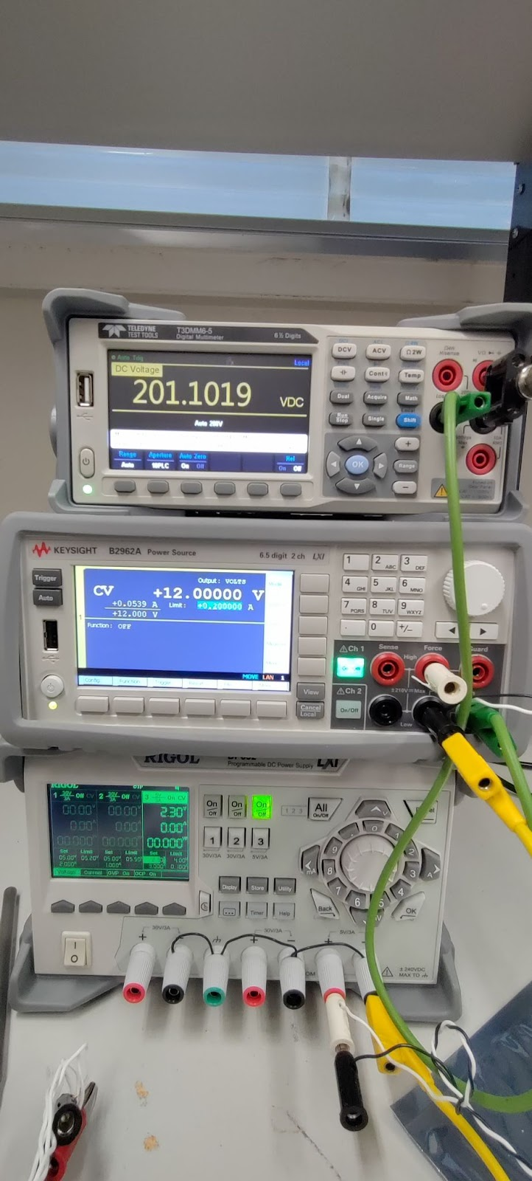
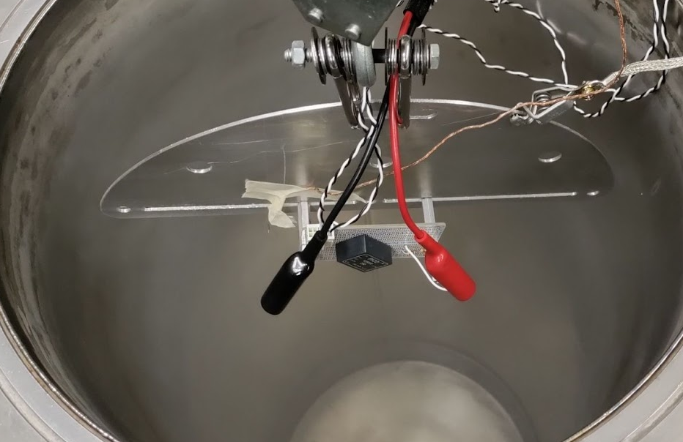
12SAR 250 (PICO Electronics)
With 1MΩ load
Datasheet
  https://www.picoelectronics.com/node/69108

Slide 16
12SAR 250 (PICO Electronics)
Run 1
Run 2
Temp (C) | i/p Voltage (V) | i/p Current (mA) | o/p Voltage (V) | o/p AC ripple (mV)
+24 | 12 | 25.6 | 200.6 | 3.5
-52 | 12 | 25.6 | 199.3 | 4.2
-116 | 12 | 28.8 | 199.2
-150 | 12 | 35.2 | 220
 | 12 | 42.2 | 230
 | 12 | 77.2 | 234
 | 12 | 11.5 | 0 | After few seconds
Temp (C) | i/p Voltage (V) | i/p Current (mA) | o/p Voltage (V) | o/p AC ripple (mV)
+22 | 12 | 22.4 | 200 | 3.8
-80 | 12 | 23 | 199 | 3.5
-151 | 12 | 36.3 | 215 | 3.6
 | 12 | 39.8 | 230
 | 12 | 81.9 | 236
 | 12 | 9.0 | 0 | After few seconds
At -150 C, the output voltage is gradually increased to ~236 V, then suddenly reduces to 0V
5SAR250 is also failed at LN2 temperature

Slide 17
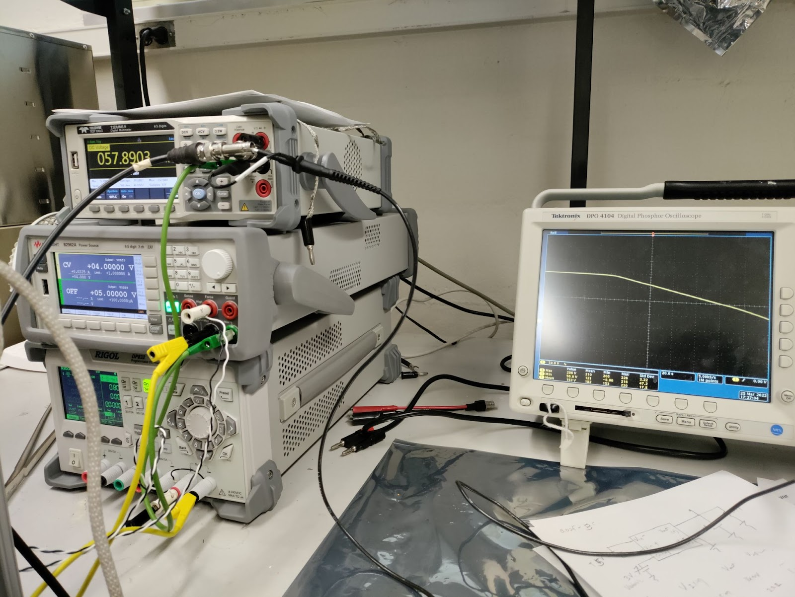
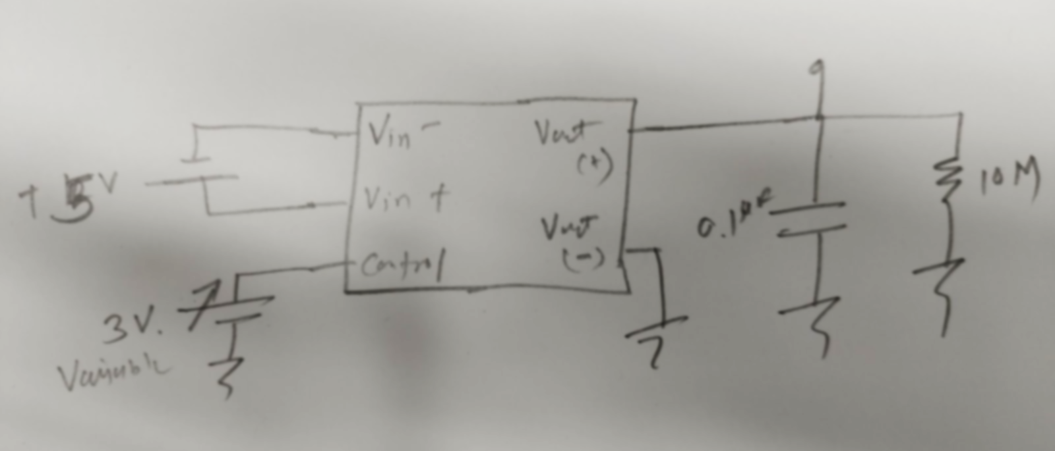
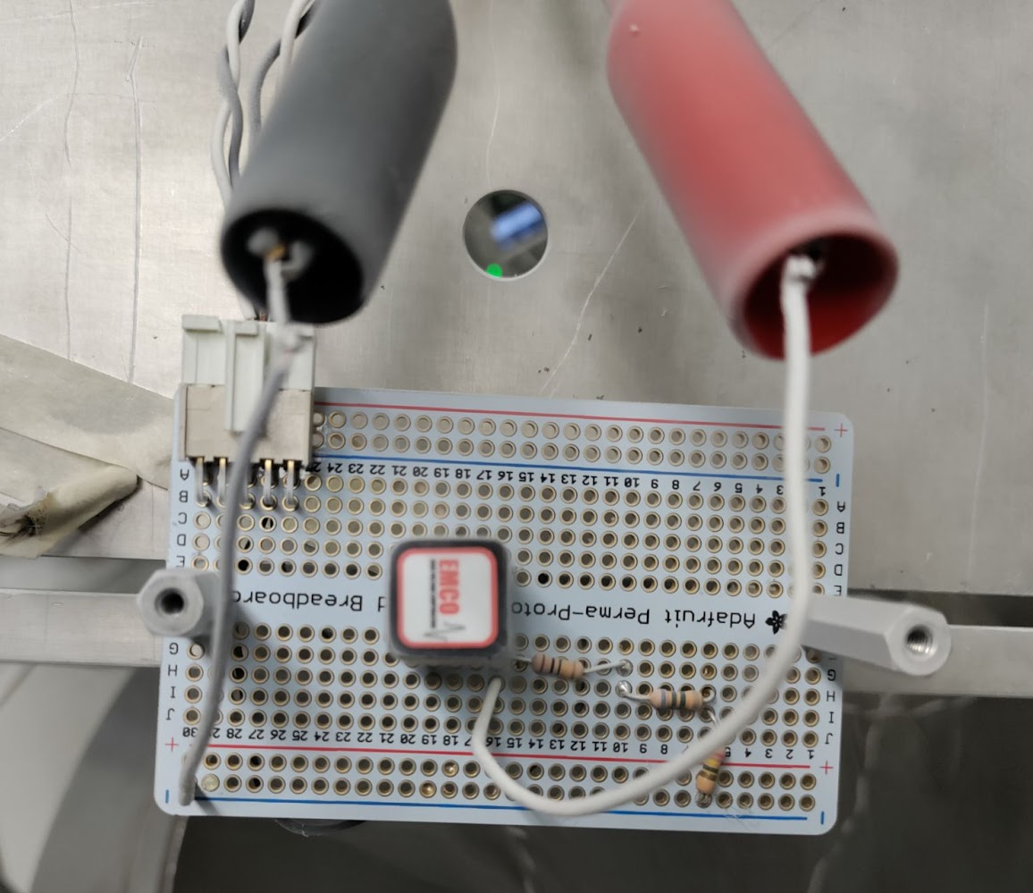
Q025-5C (Xp Power -EMCO)
With 10MΩ load
Datasheet
  https://www.xppower.com/portals/0/pdfs/SF_Q_Series.pdf
Temp (C) | i/p Voltage (V) (Control Voltage (V)) | i/p Current (mA) | o/p Voltage (V) | Comments
+25 | 5 V (2 V) | 22 | 222
-75 | 5 V (2 V) | 30.7 | 207
-135 | 5 V (2 V) | 27.3 | 202
-153 | 5 V (3.5 V) | 44 | 220
 |  |  | 112 | Decreased after few seconds, then constant at 112 V
LN2 | 5 V (3.5 V) | 54 | 112
 |  |  | 0 | Decreased to 0 V after few seconds
At LN2, the output voltage is decreased to 0V

Slide 18
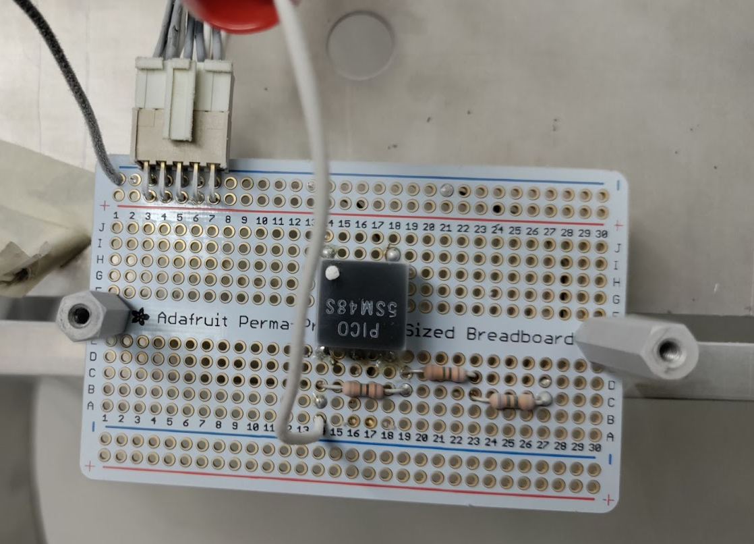
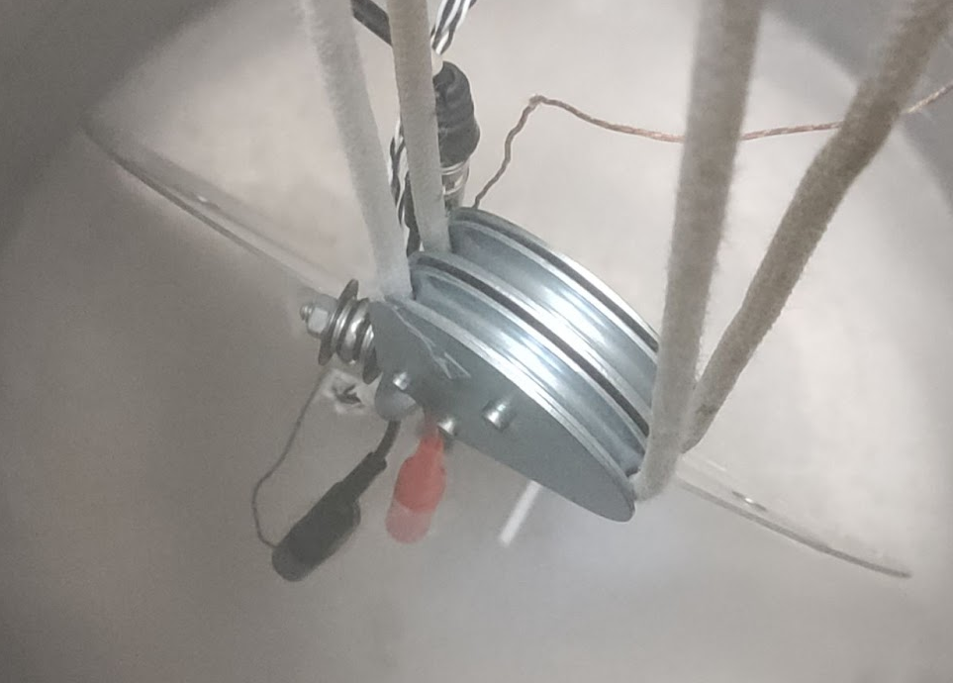
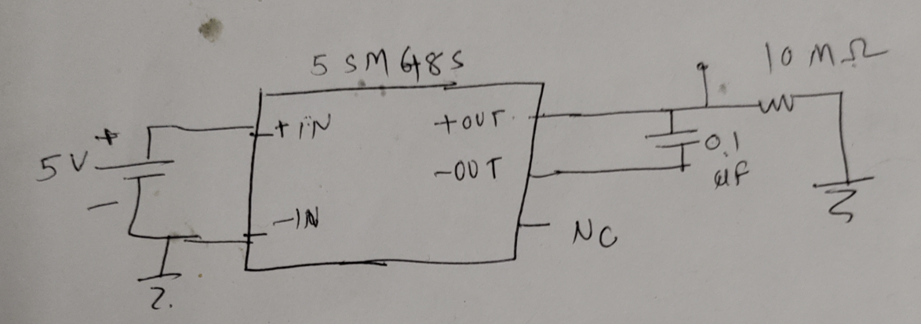
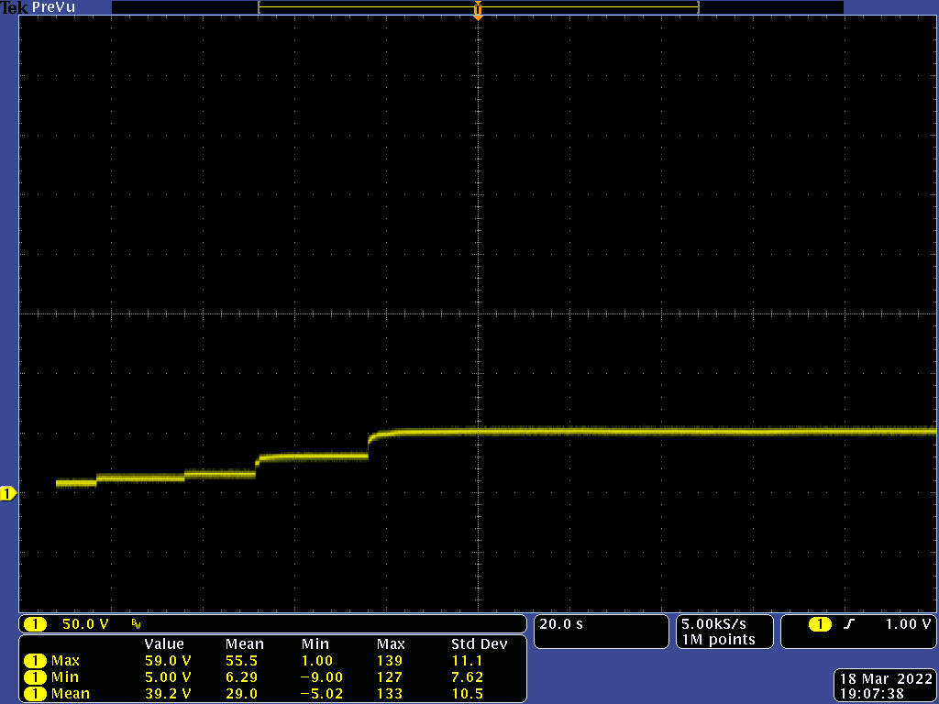
5SM48S (PICO Electronics)
With 10MΩ load
Datasheet
  https://www.picoelectronics.com/node/13270
10 MΩ load
Temp (C) | i/p Voltage (V) (Control Voltage (V)) | i/p Current (mA) | o/p Voltage (V)
+25 | 5 | 74.5 | 133.75
-90 | 5 | 83 | 133
-137 | 5 | 83.2 | 128
 |  |  | 88
-160 | 5 | 63 | 77
 |  |  | 51
LN2 | 5 | 54 | 10.63
 | 6 | 76 | 14.2
 | 7 | 99 | 17.8
 | 10 | 172 | 33.4
 | 12 | 251 | 54.2
@LN2
Vin=1V, Vout= 4V
Vin=5V, Vout=54V
At LN2, the output voltage is constant at 54 V

Slide 19
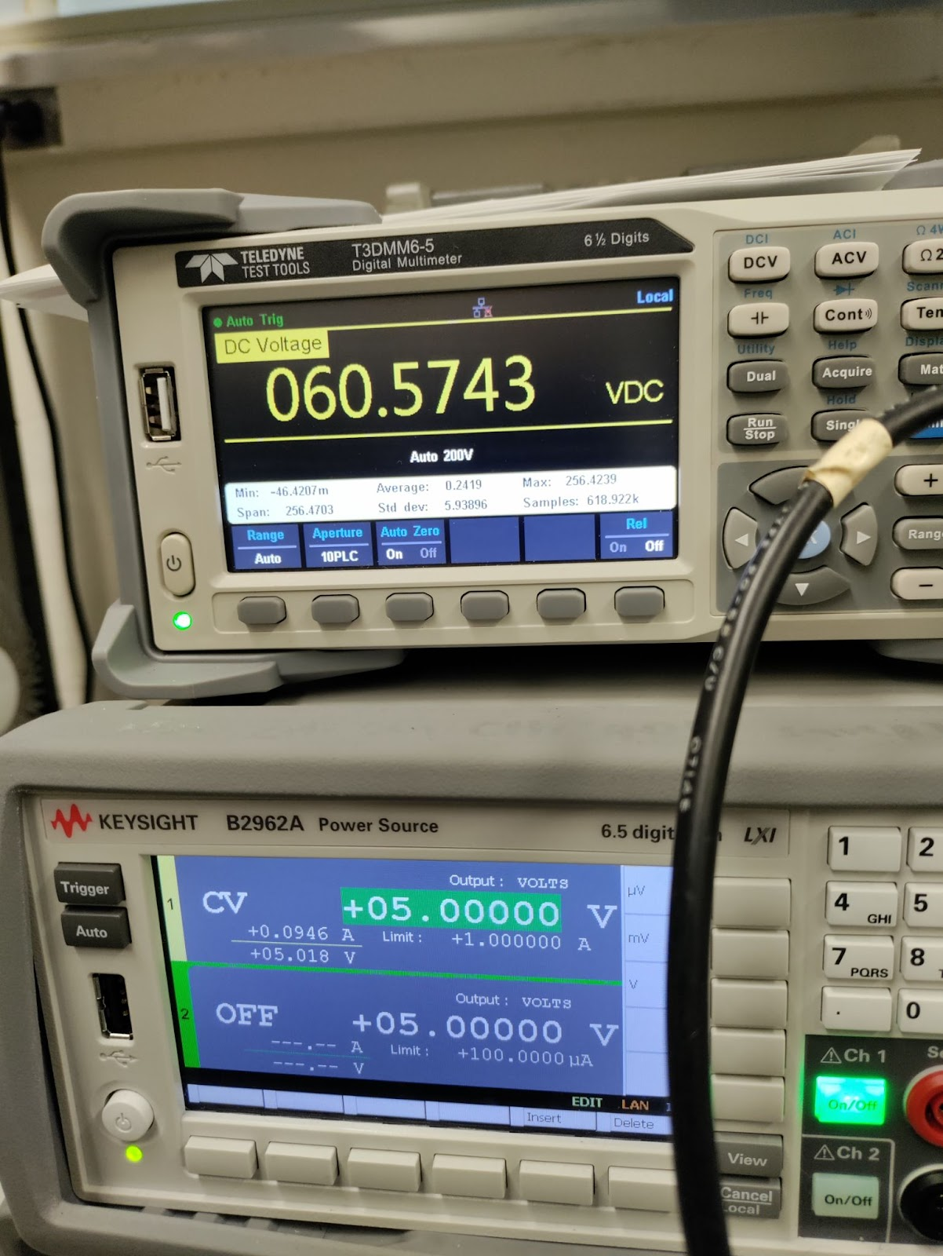
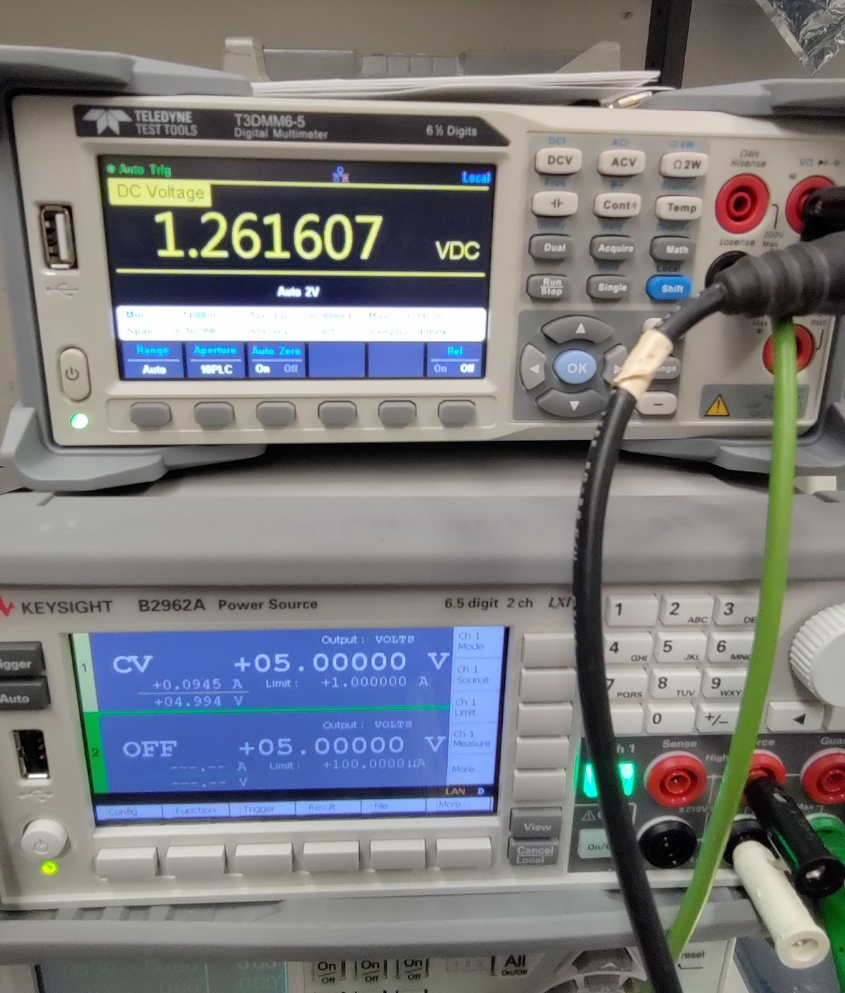
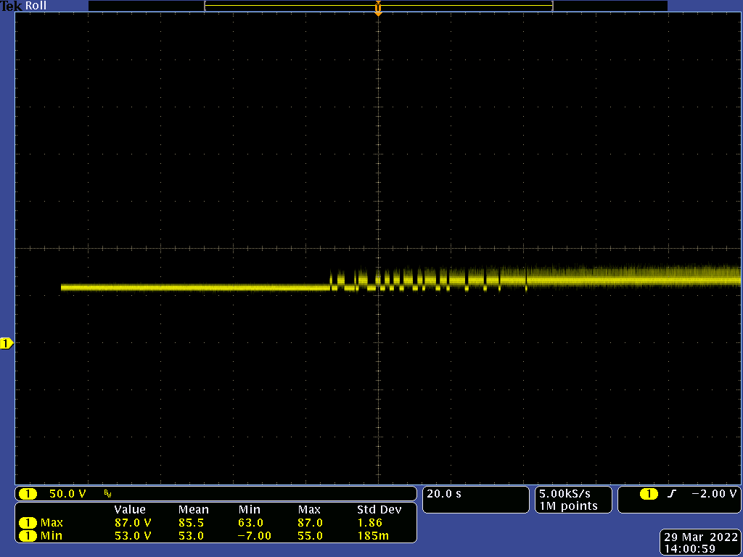
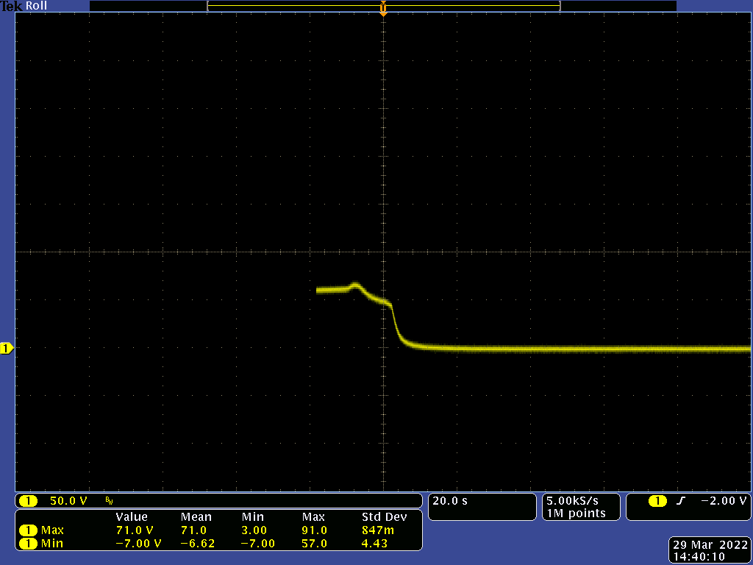
5SM48S (PICO Electronics)
With 20kΩ load
@RT
@LN2
University of Iowa results:
https://indico.fnal.gov/event/53080/
@RT
Vin=5V, Vout=70V and unstable after few seconds
Vin=5V, Vout= 60.3 V
 | Temp (C) | i/p Voltage (V) (Control Voltage (V)) | i/p Current (mA) | o/p Voltage (V) | o/p AC ripple (mV)
BNL | RT | 5 | 94.1 | 60.5 | 141
 |  | 5 | 94 | 70 | 5000 (very noisy after few seconds)
Uni.of Iowa | RT | 5 |  | 54.9
BNL | LN2 | 5 | 94.5 | 1.26 | 0.15
BNL | LN2 | 5.25 | 45 | 1.59
Uni.of Iowa | LN2 | 5.25 |  | 43.4
20s
@LN2
Vin=5V, Vout=1.26 constant
At LN2, results are not consistent with the results presented by the University of Iowa
Possible reasons:
  Test setup difference?
  Since PICO Electronics is a small company, different batch modules may have different performances at cold?

Slide 20
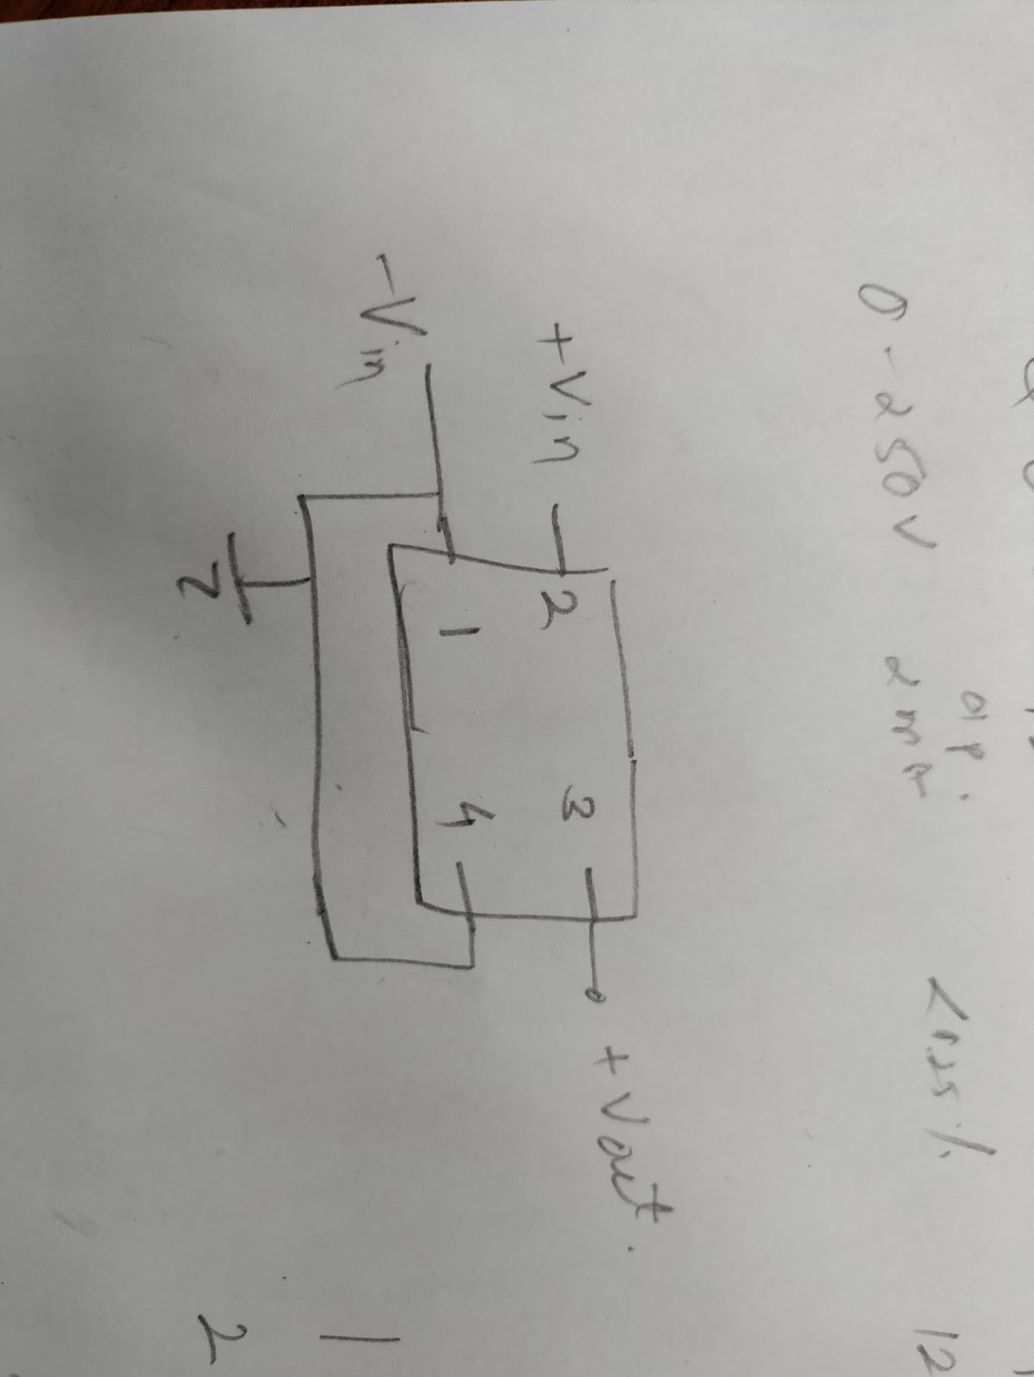
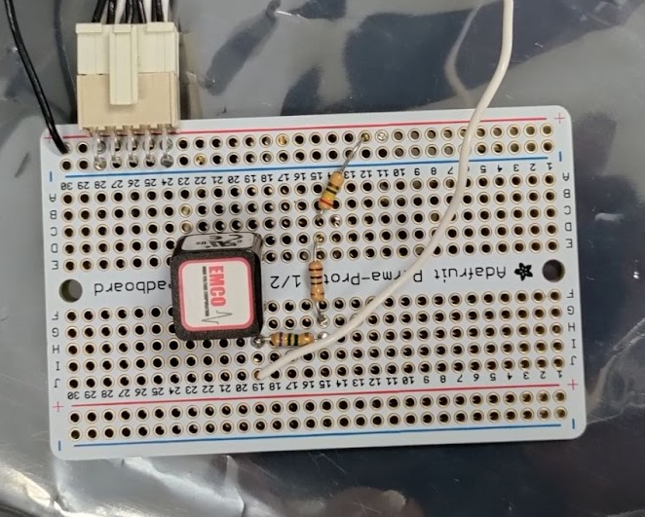
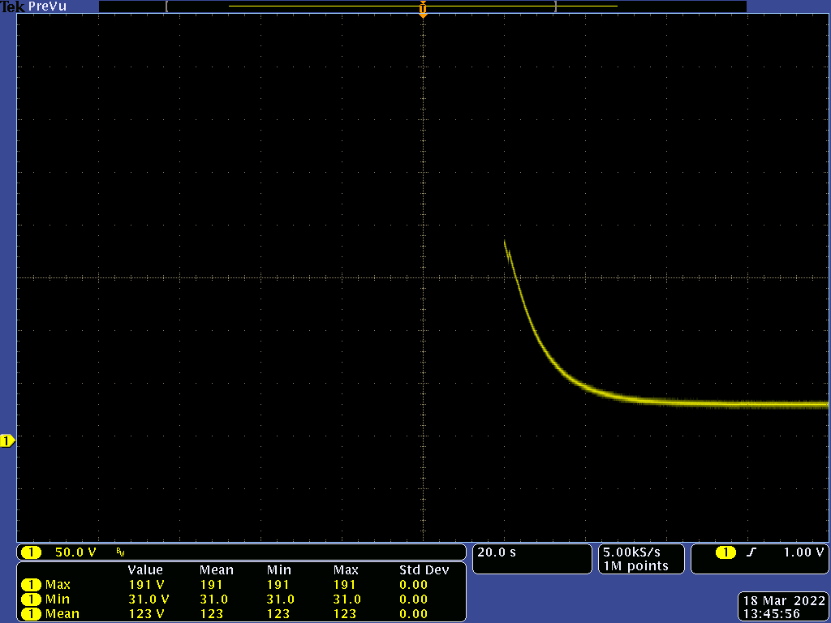
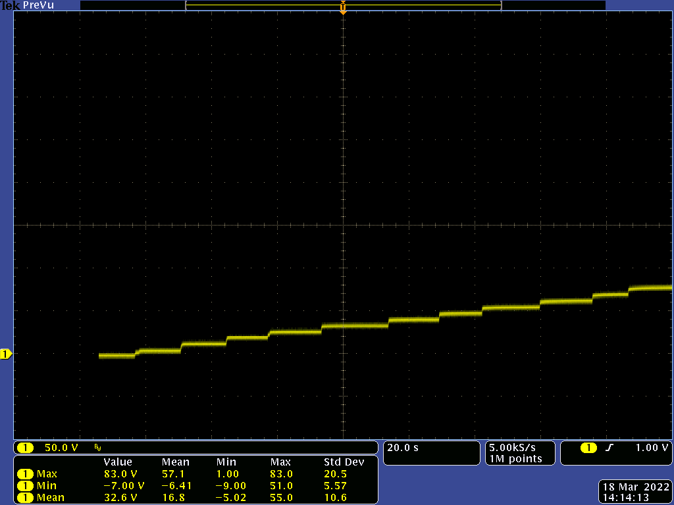
Q025-12 (Xp Power -EMCO)
With 10MΩ load
Datasheet
  https://www.xppower.com/portals/0/pdfs/SF_Q_Series.pdf
@LN2
Vin=9V, Vout= ~37 V
Temp (C) | i/p Voltage (V) (Control Voltage (V)) | i/p Current (mA) | o/p Voltage (V) | o/p AC ripple (mV)
+25 | 9 | 61 | 203.24 | 0.53
-95 | 9 | 91 | 200.64 | 0.5
-115 | 9 | 17.5 | 195.4 | 0.32
-150 | 9 | 13 | 196.88 | 0.4
 | 9.2 | 13.5 | 201.16 | 0.3
-187 | 9.2 | 12 | 198.1 | 0.3
 |  | 2 | 37.11, After few seconds
 | 20 | 9.7 | 125
LN2 | 12 (maximum recommended input voltage) |  | ~52
 | 20 | 9.7 | 129
@LN2
Vin=12V, Vout= ~56 V
Vin=5V, Vout= ~5 V
At LN2, the output voltage is constant at ~52 V

Slide 21
Summary
A step-up DC-DC modules working at cryogenic temperature (77K-89K) is crucial to implement SiPM cold readout scheme
  Especially when PoF is presented for DUNE FD2-VD photon detector
Search and test of step-up DC-DC modules being carried out at BNL
  Tested 12 different (from 5 manufacturers) HV DC-DC modules at RT and cryogenic (as low as LN2) temperatures
  Most of the devices are failed at LN2 temperature
    Commercial DC-DC modules may have used transistors that don’t work at LN2 temperatures, such as bipolar junction transistors (BJTs).
  5SM48S (Pico Electronics) can’t reproduce test results reported with the different test setup
  Q025-12 (EMCO, XP Power) works at a cold with reduced output voltage, still needs to investigate further

Slide 22
Back up slides

Slide 23
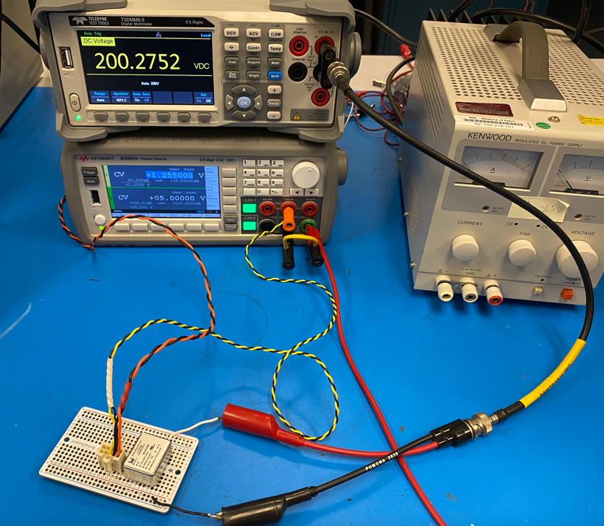
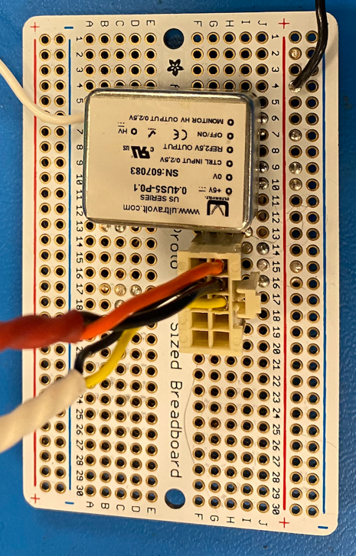
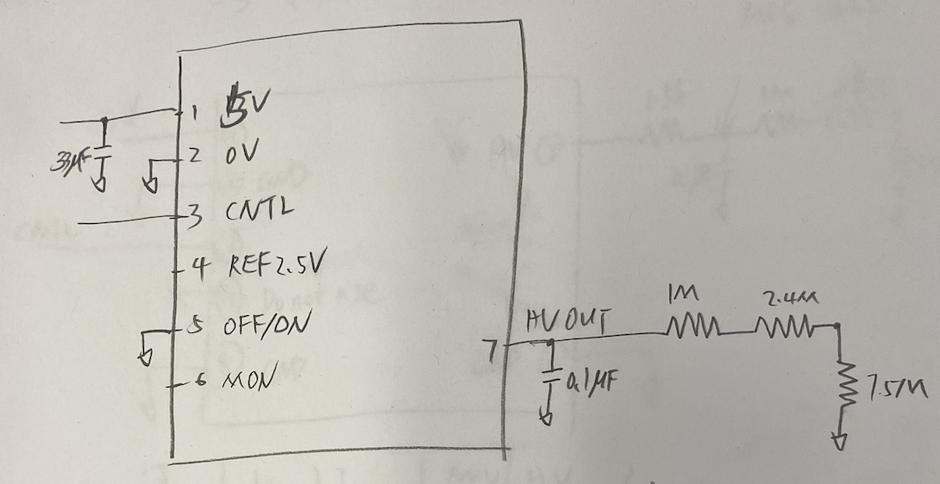
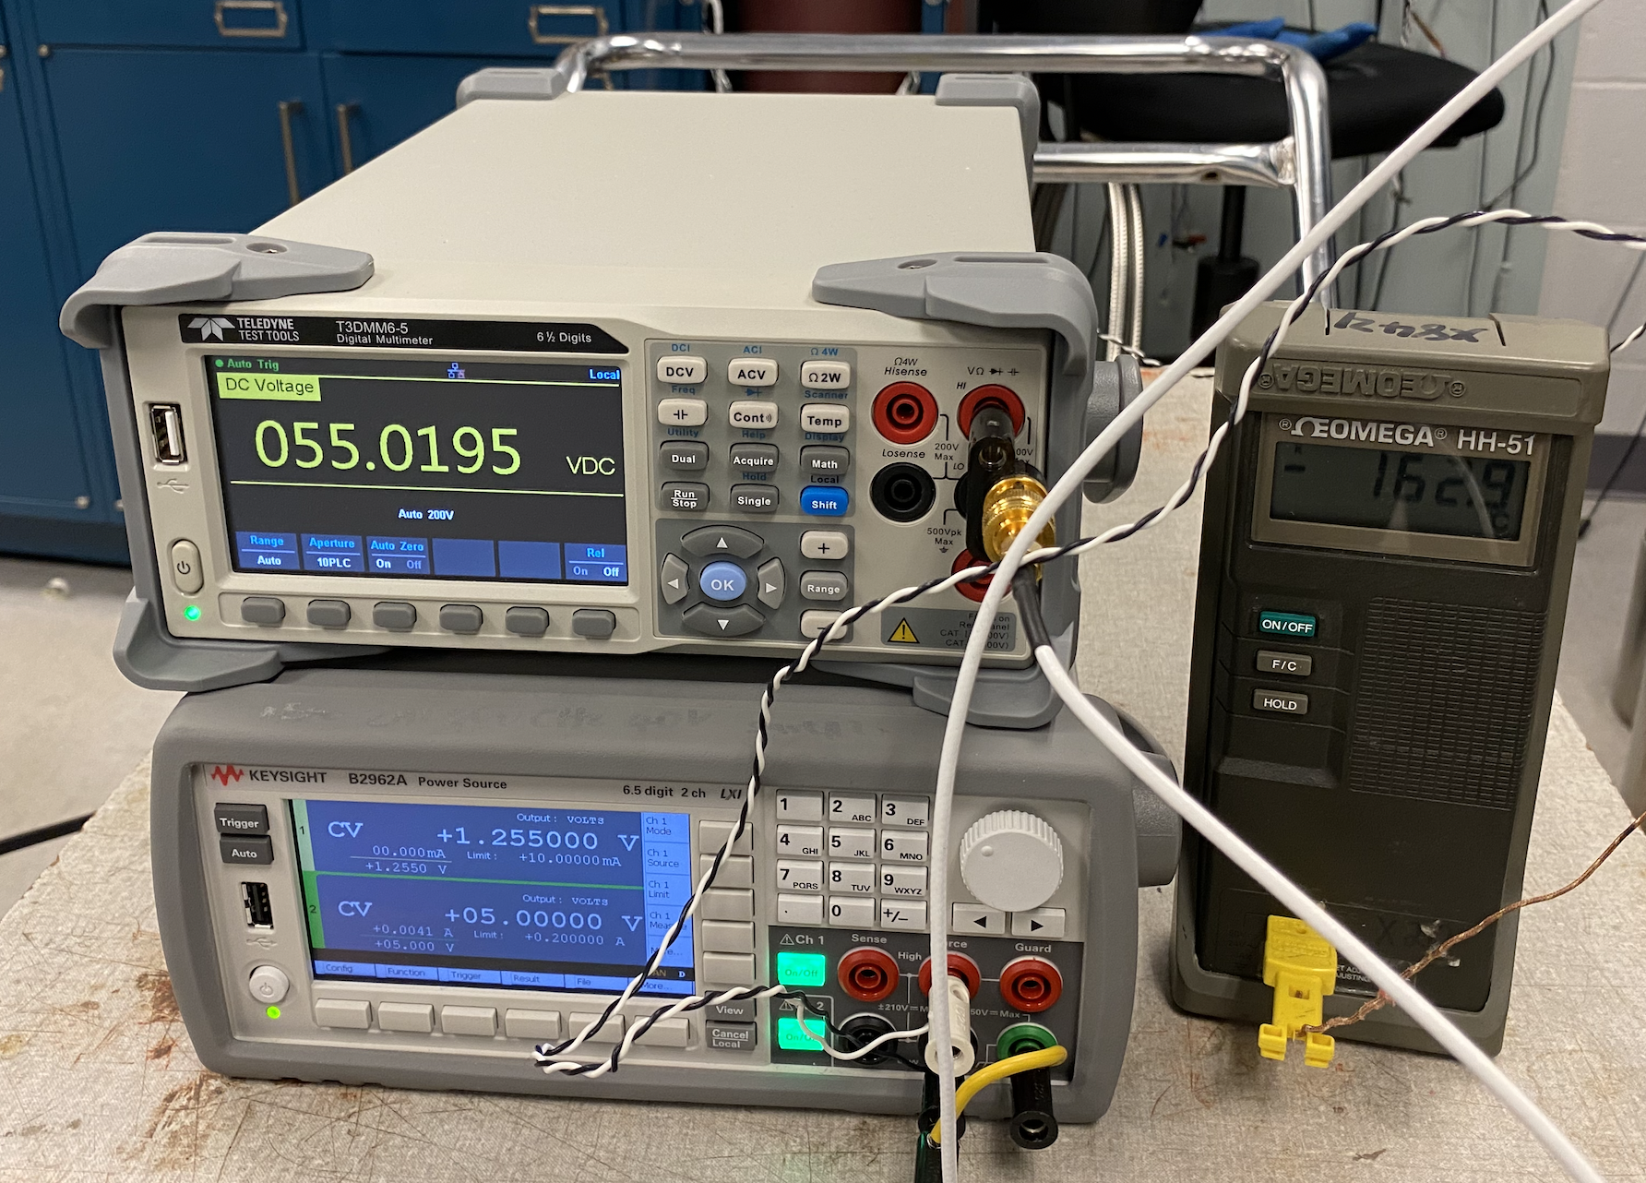
0.4US5-P0.1
Datasheet
  https://www.advancedenergy.com/products/high-voltage-products/high-voltage-power-supplies/micro-size-high-voltage-dc-to-dc-modules/us-series/
Temp | Vin /V | Iin /mA | Vcntl / V | Icntl /mA | HV /V
RT | 5 | 6.81 | 1.255 | 0 | 200.27
note: REF = 2.492V, MON = 1.255V
With 10MΩ load
Can’t output HV properly when temperature drop to < -150C
Case metal is open to pin#2 (0V). It should short to pin#2 according to datasheet

Slide 24
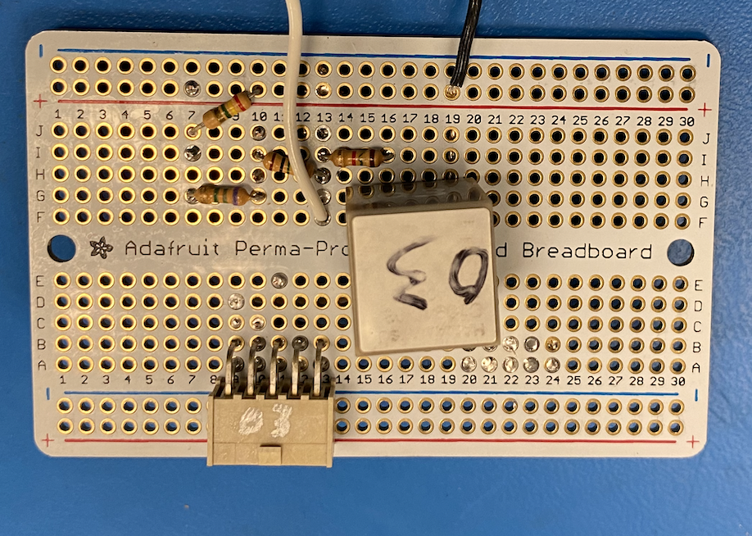

C10940-03 (negative HV)
Datasheet
  https://www.hamamatsu.com/content/dam/hamamatsu-photonics/sites/documents/99_SALES_LIBRARY/etd/C10940_TACC1069E.pdf
Temp | Vin /V | Iin /mA | Vcntl / V | Icntl /mA | HV /V
RT | 5 | 11.39 | 0.208 | 0 | -200.33
Can’t output HV when it submerged in LN2, however it survive when temperature is higher than -170C.
With 10MΩ load
Note: Ripple RMS ~10mV after RC filter

Slide 25



C11204-02
Datasheet
  https://www.hamamatsu.com/content/dam/hamamatsu-photonics/sites/documents/99_SALES_LIBRARY/ssd/c11204-02_kacc1242e.pdf
Can’t output HV properly when temperature is lower than -60C.
HV outputs 40V by default

Slide 26


5SAR 250 (PICO Electronics)
With 1MΩ load
Datasheet
  https://www.picoelectronics.com/node/69108
Temp (C) | i/p Voltage (V) (Control Voltage (V)) | i/p Current (mA) | o/p Voltage (V) | o/p AC ripple (mV)
+25 | 5.1 (2.3) | 43.9 | 202.1 | 4.2
-53 | 5.1 (2.4) | 49.8 | 195.8 | 4.4
-80 | 5.1 (2.4) | 28.8 | 205 | 4.5
-93 | 5.1 (2.4) | 9.4 | 242 | 5.9
 | 5.1 (1.8) | 9.4 | 201.3
-116 | 5.1 (1.8) | 87.1 | 205 | 4.1
-154 | 5.1 (1.8) | 2 | 0
At <-93C, the output voltage is gradually increased
At <-150C, the output voltage is decreased to 0V
Output load is constant 1 MOhm.

