Slide 1
DUNE FD2-VD Discharge Transient Propagation along HV Bus
VR for the BNL team
Jan 13, 2022

Slide 2
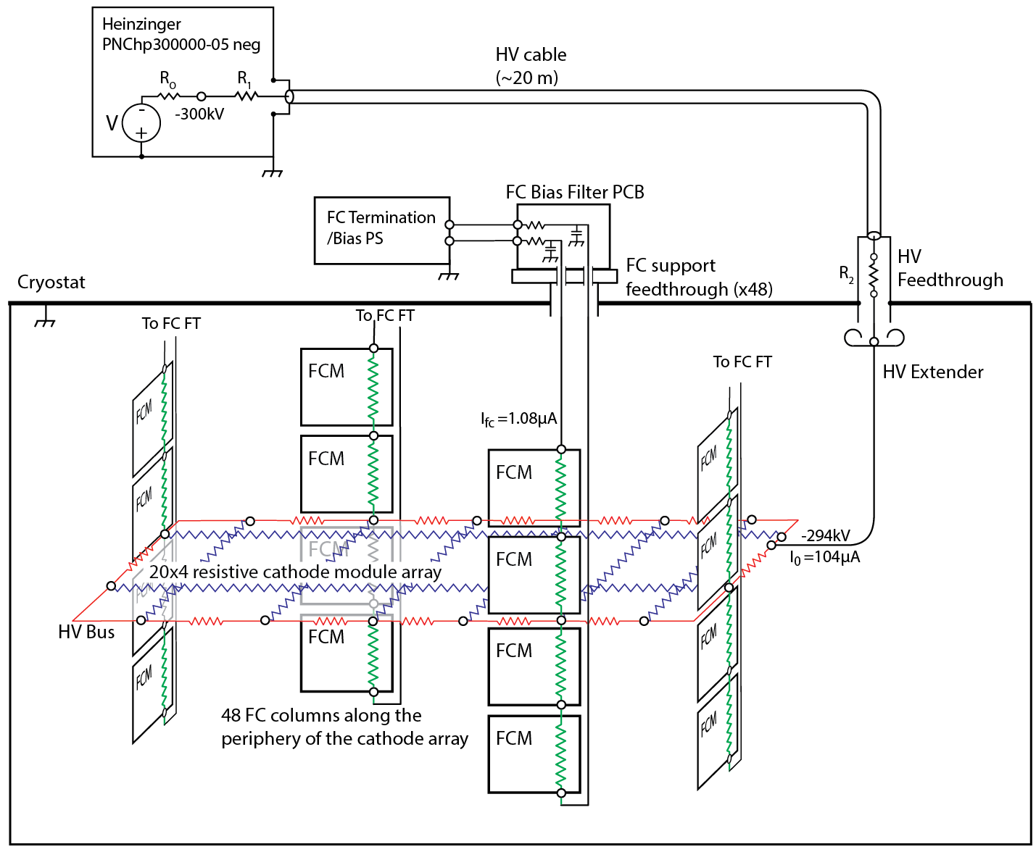
FD2 High Voltage System Schematic Diagram
The total capacitance of a profile near the center the field cage is about
40 pF/m, or 120pF over the 3m width of the field cage column.
There are 48 FC columns along the periphery of the cathode array. 2x20 columns are 3 m wide; 2x4 columns (at the cryostat ends) are 3.4 m wide.
There are about 192 FC modules , each 3m (3.4m) wide and 3m high.
not to scale

Slide 3
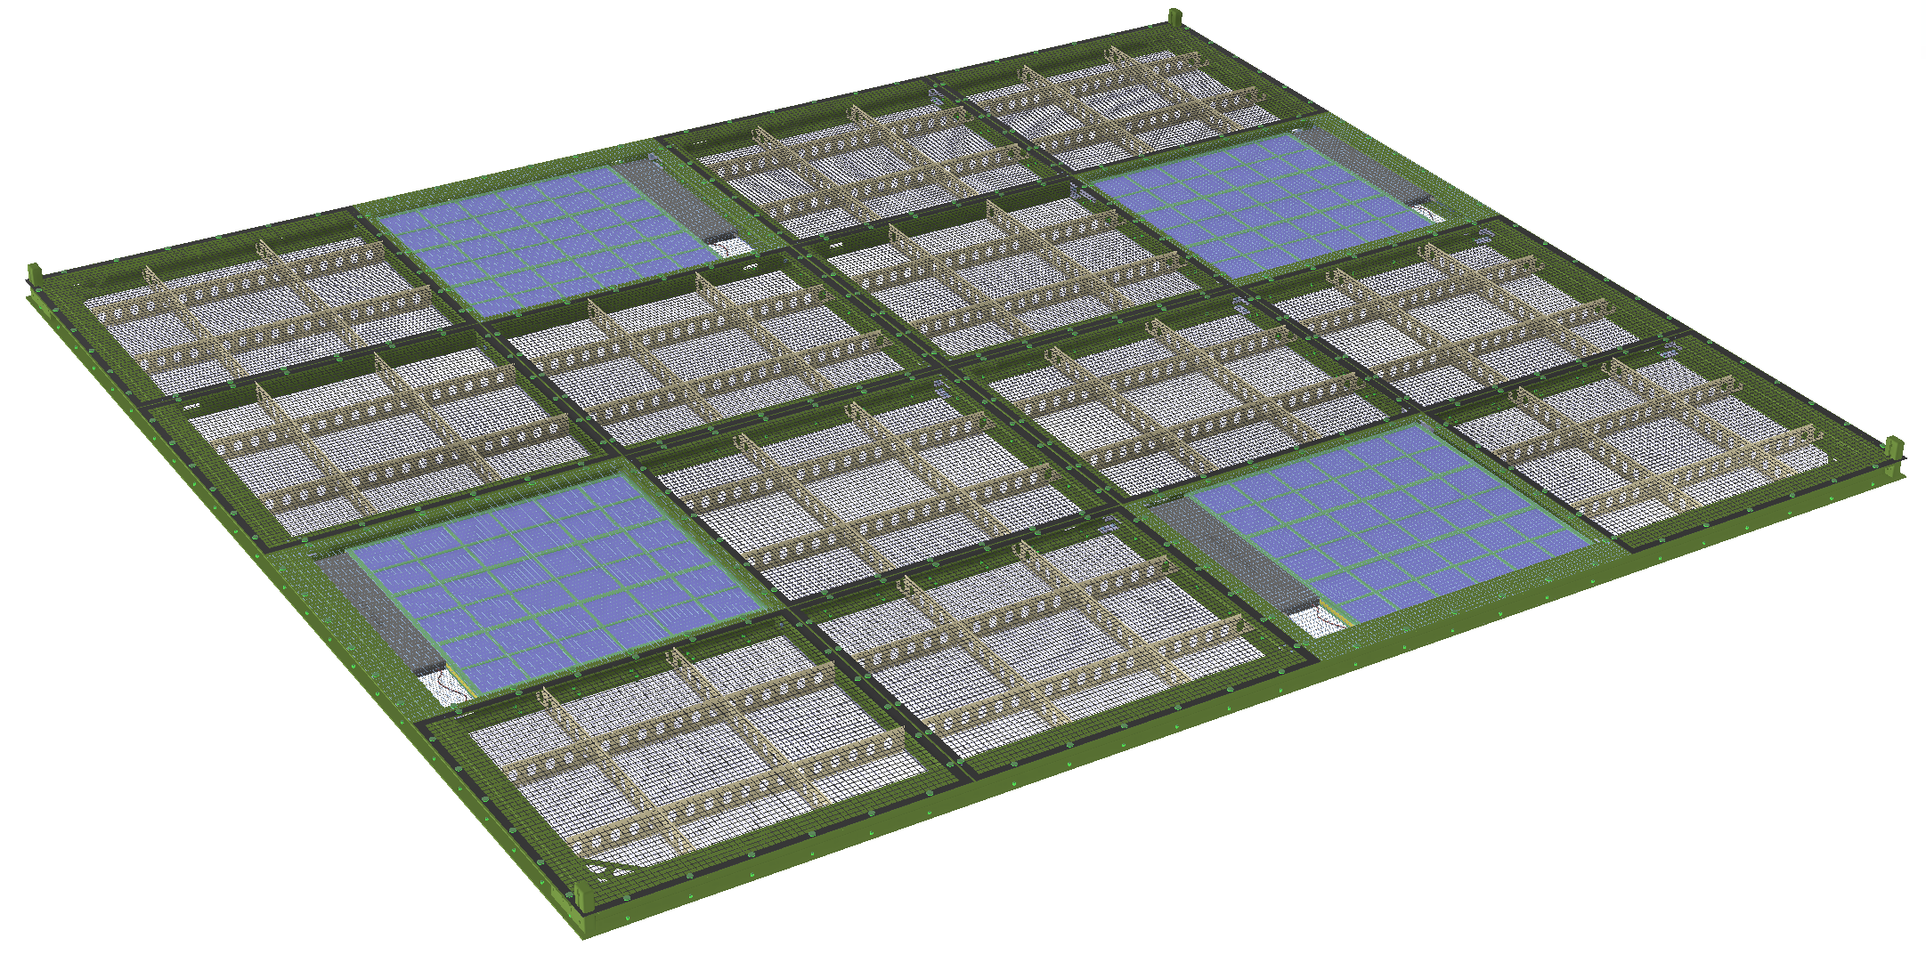
Cathode Module
4 X-Arapuca modules in each cathode module.
Conductive wire meshes covering the X-Arapuca modules
Perforated resistive sheets (4M/square) covering the rest of the frame openings
Cathode size: 3.4m x 3m x 5cm
“Balun” = common mode inductance for multiple leads, not affecting transmission line properties

Slide 4
Field Cage and HV Bus Design Concept
(by Bo Yu)
The field cage stack as a whole is a 13m high object facing the cryostat wall about 0.6m away. Each profile is placed at a vertical pitch of 6cm. The resistance between each profile/node is 2.5Gohm. The nominal voltage drop is 3kV (assuming 500V/cm field). In the horizontal direction (along the beam direction), each field cage module is 3m long. The capacitance from each profile to the cryostat wall is about 1.3pF/m. The capacitance from a profile to the rest of the profiles (above and below) is about 38.9pF/m. So the total capacitance of a profile near the center of the field cage is about 40.2 pF/m, or 120pF over the 3m width of the field cage module.
The HV bus in present concept is made from a series of HV cable segments interconnected by a series resistance. For the vertical drift detector, the total current from the power supply is about 0.1mA. this current is split into two branches to feed two paths along the TPC. So each branch has 50uA current. At 300kV cathode voltage, we need to maintain 1% E field uniformity. We can tolerate about 1kV drop along the bus (~ 0.3 % of drift voltage). A resistance of less than 1.66 Mohm between the nodes (24 on each branch) would satisfy this drift field uniformity requirement (with some margin), taking advantage of the diminishing current along each branch. We choose R=1.5 Mohm for this analysis.

Slide 5
EM properties of HV bus
Inductance of a bus segment for a length/diameter ratio l/d>>1, and µ=1:
For l=300cm, d=5 mm (as in FD1), L≈3.4 µH ; (L is weakly dependent on l/d, but for approximate estimates, L ≈1 µH/m, or 10 nH/cm can be used).
EM propagation time is proportional to (LC)^1/2 per segment of this 24-segment lumped parameter transmission line, with C=120 pF/segment and L=3.4 µH/segment, so that the propagation time along each branch would be approximately,
With a large resistance (≥1Mohm) added to each bus segment, EM mode becomes completely suppressed, as this resistance is several orders of magnitude higher than the critical damping resistance 2(L/C)^1/2≈340 ohm, and the discharge transient propagation along the bus is determined by the field cage node capacitance and the added bus series resistance.
----------------------------
Note: Inductance of the bus is likely to be lower than the above calculated values due to the proximity of any metal objects, making t_{D} shorter.

Slide 6
HV Bus Equivalent RC line
1. HV Bus and Equivalent RC – line Parameters:
number of bus segments = 48
resistance per bus segment = R_{s} =1.5 Mohm
eq. resistance per unit length = R =1.5/3= 0.5 Mohm/m
capacitance per segment = C_{s} =120 pF
eq. capacitance per unit length = C = 120/3= 40 pF
line (HV bus) length = l =48 segments x 3 m= 144 m (=2x60+2x12m)
HV bus segment time constant = 1.5 Mohmx120 pF= 180 µs
Point of discharge
2. Variables:
- normalized time:
3. RC – line response is described by 1D diffusion equation:
- normalized position, origin in the middle of the line,
x=0 (opposite of point of discharge):
- normalized position range:
4. Equivalent RC -- line time parameters:

Slide 7
RC – Line Response to Step Function at Point of Discharge, ξ=1/2, (x=l/2)
RC – line response is described by 1D diffusion equation, which arises in many different fields (e.g., heat conduction in solids):
Eq.(1)
While there has been no general solution to this equation, special cases can be solved given initial (boundary) conditions. The response to a (voltage) step V(0+) applied at the point of discharge:
Eq.(2)
156 ms
This series converges rapidly, and the solution for the potential in the middle of the line (ξ=0, opposite to the point of discharge) can be approximated by,
Potential in the middle of RC-line (ξ=0) as a function of time after applying a step at the point of discharge. Eq.(3) with dominant time constant , describes charging of entire HV bus. Charging near point of discharge is given by Eq.(2).
Eq.(3)

Slide 8
RC – Line Response to Step Input vs position and time (ξ , Θ)
156 ms
Ref.: H.S. Carslaw and J.C. Jaeger, Conduction Of Heat in Solids, p.101, Clarendon Press 1959
520 µs
HV Bus: one branch=24 segments; Single segment time constant: R_{s}C_{s}=1.5 Mohm x120 pF=180 µs
Point of discharge: ξ=x/l=1/2

Slide 9
Summary of Voltages on Cathode (log time 100 ms)
V(k1)
V(k2)
V(k3)
V(k4)
V(k5)
0KV
V(k1)
V(k2)
-30KV
V(k3)
-60KV
V(k4)
-90KV
-120KV
V(k5)
-150KV
R-C diffusion on cathode
R-C diffusion along HV bus
-180KV
Capacitive transient from FC to cathode strips
-210KV
-240KV
-270KV
-300KV
100ns
1µs
10µs
100µs
1ms
10ms
100ms

Slide 10
Discussion:
Discharge transient propagates from a single segment along each branch (24 segments) of the HV bus with a dominant time constant,
Transfer of charge from segment to segment is limited by the resistance connecting the segments. The single segment time constant = 1.5 Mohm x 120 pF= 180 µs
The energy dissipated in a single point discharge is limited to a single segment, C_{s}=120 pF, HV=3x10⁵ V, CV²/2=5.6 joules.
As the voltage transient propagates and the entire bus discharges, the energy from the (48-1) segments dissipates in the connecting resistors.

