Slide 1
FD2-VD Discharge
Effects on Cathode and X-ARAPUCA Modules
Sergio Rescia, Veljko Radeka, Bo Yu
and the BNL Team
BNL Dune FD2-VD Workshop
13 Apr 2022

Slide 2
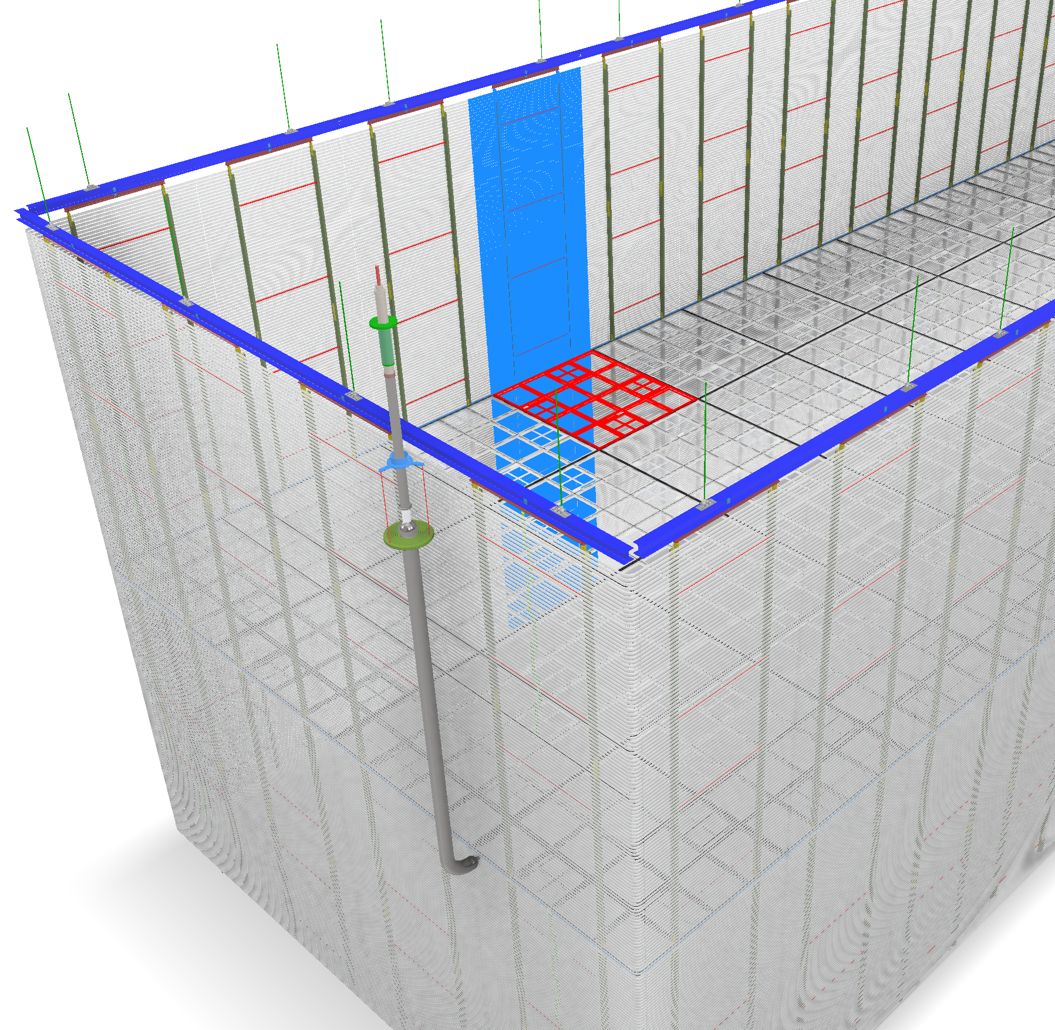
FD2 High Voltage System Components
60m
TPC sensitive volume: 60m x 13m x 13.5m
The cathode plane: 60m x 13.5m
The field cage is 13m tall (6.5m double sided drift). Each field cage column (with own resistive divider chain) is ~ 3m (3.4m) wide. The resistance between nodes is 2.5Gohm.
The anodes (CRPs) are at the top and bottom of the cryostat.
The nominal cathode voltage is about -300kV.
Field cage
HV Feedthrough
Cathode
13.5m
Field cage
Field cage
HV Extender
13m

Slide 3
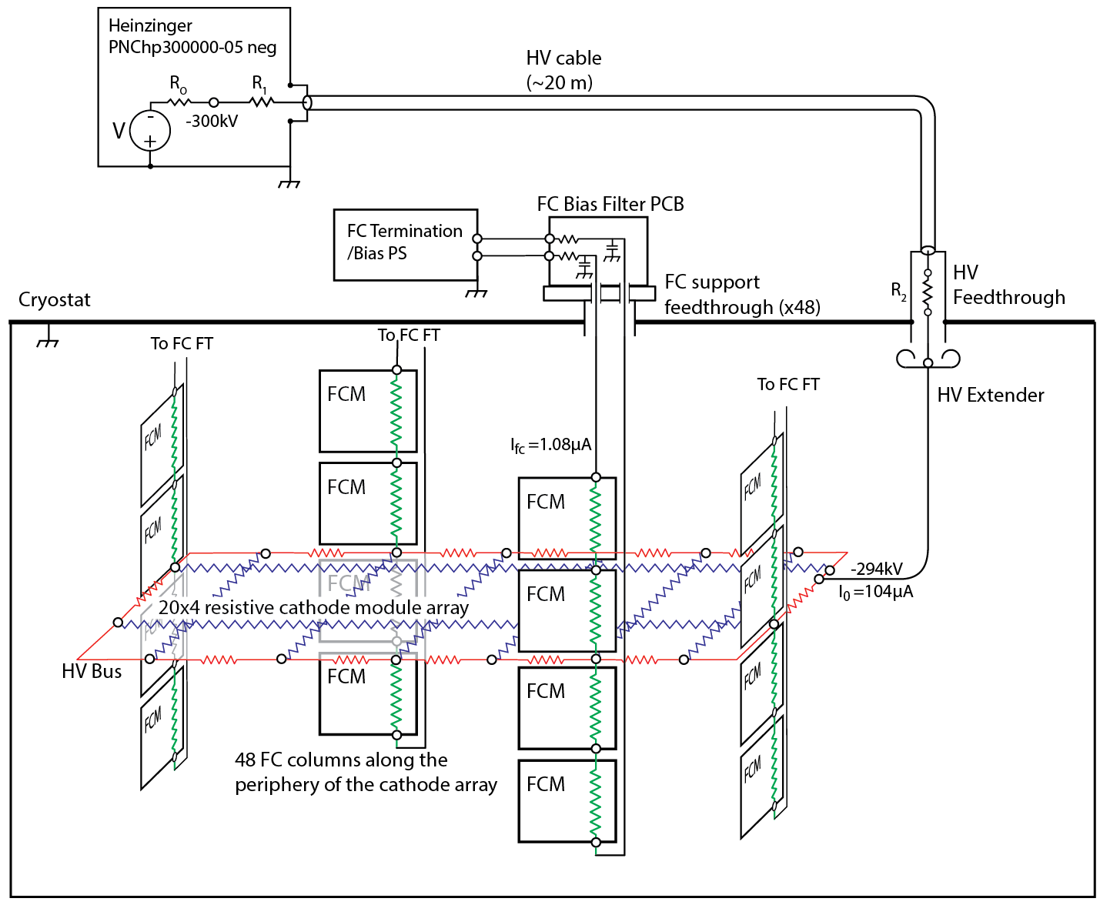
FD2 High Voltage System Schematic Diagram
The total capacitance of a profile near the center the field cage is about
40 pF/m, or 120pF over the 3m width of the field cage column.
There are 48 FC columns along the periphery of the cathode array. 2x20 columns are 3 m wide; 2x4 columns (at the cryostat ends) are 3.4 m wide.
There are about 192 FC modules , each 3m (3.4m) wide and 3m high.
not to scale

Slide 4
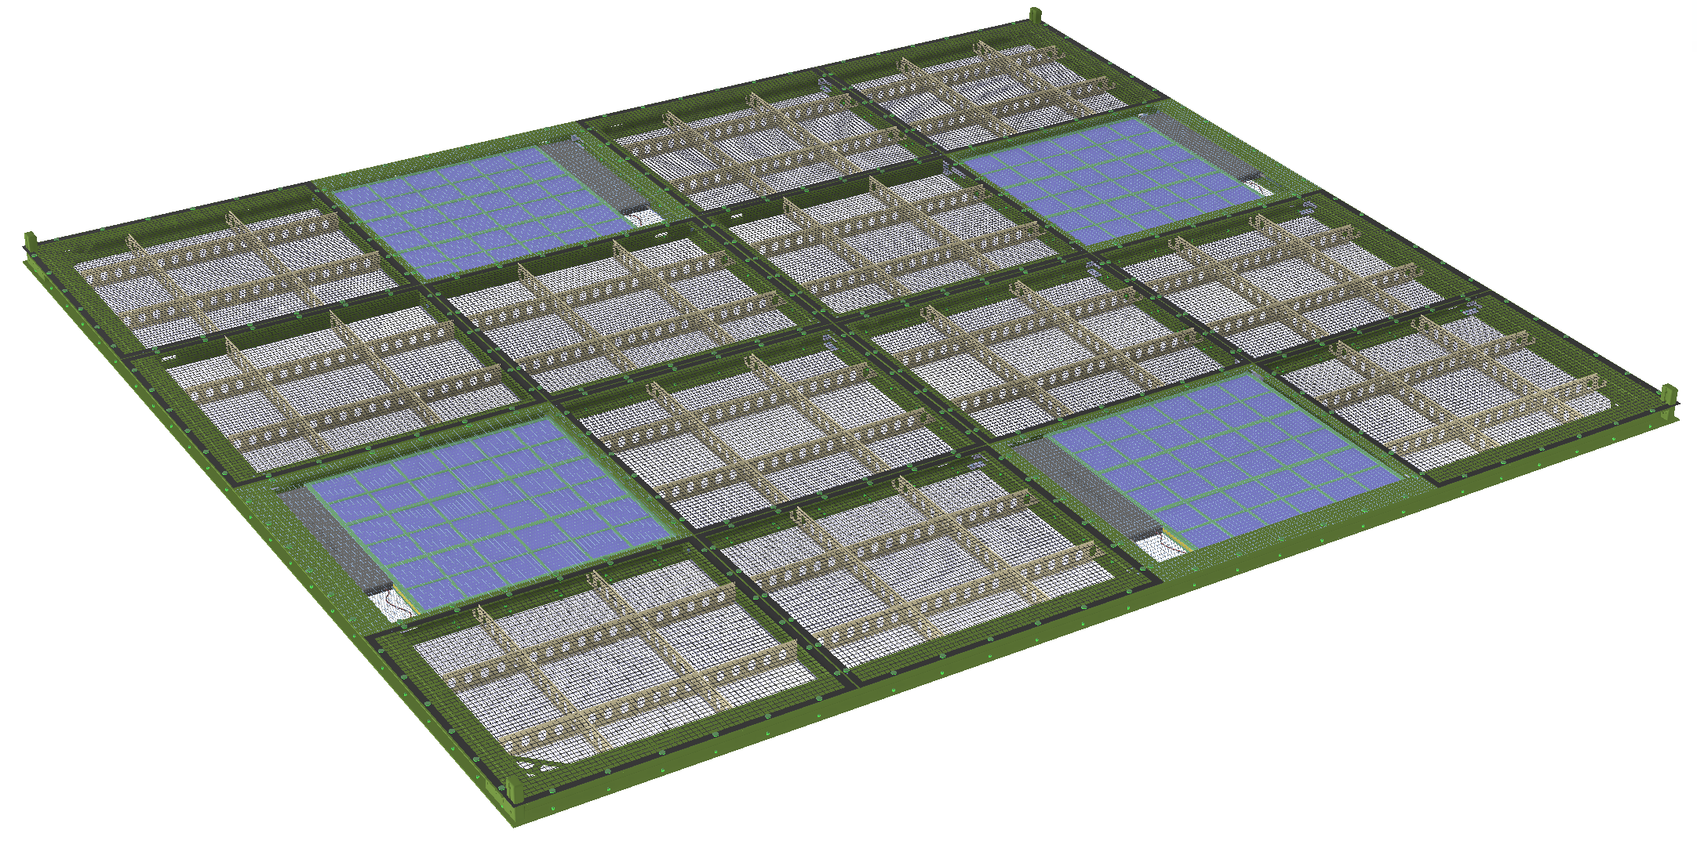
Cathode Module
Strips for analysis
There are 4x20=80 cathode modules, each 3.4m x 3m x 5cm
4 X-Arapuca modules in each cathode module (~25 % of the cathode light sensitive)
Conductive wire meshes covering the X-Arapuca modules
Perforated resistive sheets (4Mohm/square) covering the rest of the frame openings
0.4m
Cathode “strip”
3m
60cm
60cm
electronics
3.4m

Slide 5
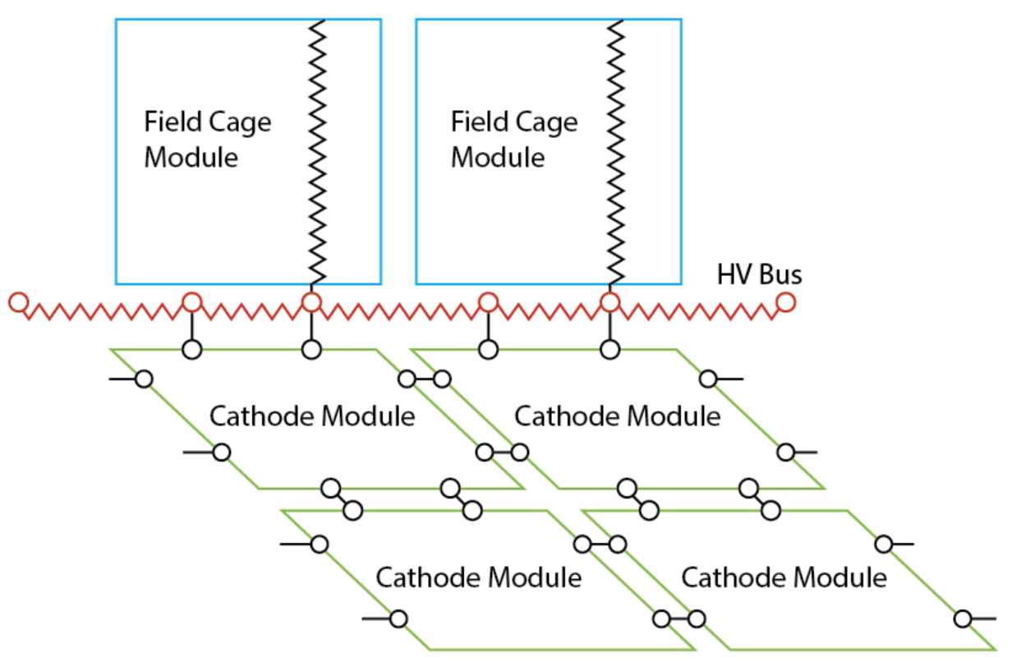
Discharge Transient: time scale
3m
Field Cage discharge from HV~300kV to zero; time scale 10 ns
Transient propagation along resistive HV bus is only diffusive;
time scale 10-100 ms
Transient propagation on the cathode; there are three time scales:
a) Capacitive coupling FC-cathode – 10 ns;
same time scale as “spark”
b) cathode R-C diffusive – 0.1 ms;
c) entire cathode-HV bus diffusive -- ~ 100 ms
CFK
C FC - cathode
(FC)
FC0
3.4m
13.5m
cath strip
cath strip
cath strip
cath strip
cath strip
cath strip
cath strip
CKA
C cathode-anode
HV Bus

Slide 6
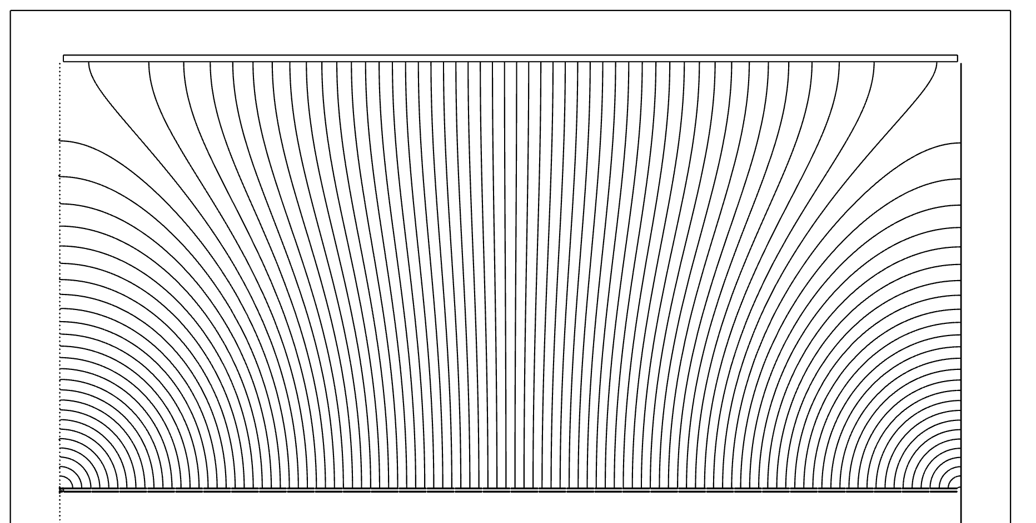
Illustration of capacitive coupling among FC-cathode-anode by weighting field lines from the cathode with respect to FC and anode (top half shown)
Anode (0V)
field cage (0V)
field cage (0V)
CFK dominate near FC
in the middle only CKA
CFK
CKA
cathode (1V)

Slide 9
FC discharge model (voltage simulating discharge on FC0)
DISCHARGE HAPPENS QUICKLY
DETAILS OF DISCHARGE DO NOT AFFECT RESULTS
600nH is the minimum.
More realistic ~several uH
Risetime ~tens of ns
Charge Q≈ tr x Ipeak
with L_{ser}=600nH
ERZV20D182$3SP2$cryo
UFC1
RFC1
1.25G
HV
RF1
CHVF1
RF2
nFC0
CFC2
nFC1
VHV
50Meg
1n
10Meg
CFC0
174p
CFC1
Lser
7.8p
7.8p
600n
Rshort
0.1
ncontrol
SWshort
No L_{ser}; “step” slowed down to ~10ns to match
the rise time of the case with Lser on FC0
Vcontrol

Slide 10
FC Discharge Effect on Resistive Cathode: Resistive Cathode Equivalent Circuit
ERZV20D182$3SP2$cryo
UFC1
Add box & transparent bkgd
RFC1
1.25G
RF1
CHVF1
RF2
CFC2
107 FC
profiles
HV
nFC0
nFC1
VHV
50Meg
1n
10Meg
CFC0
174p
CFC1
Lshort
7.8p
7.8p
600n
Rshort
Field Cage Transient “driven” from FC0
(worst case)
0.1
ncontrol
Vcontrol
Vdisch_FC0
Sshort
Add a note of CK1FCtotal
RK1
“strip” R
CKA1
560k
K1
CK1FCt
Cathode
0.34p
Rk2
96p
CKA2
560k
CK2FCt
K2
0.86p
24p
32 Cathode Strips (42 cm wide, ½ X-Arapuca)

Slide 11
Current in XARAPUCA Shield caused by FC-cathode-anode capacitances
CFK2
CFK4
CFK6
Simulates 2 cathode strips with maximum transient current in the shield of X-ARAPUCA ( in the 2nd row from the HV bus).
nFC0
nFC0
nFC0
24p
5.5p
1.9p
CFK1
CFK3
CFK5
CFK7
nFC0
nFC0
nFC0
nFC0
96p
10.8p
3.1p
1.2p
nFC0
RK1
RK2
RK3
RK4
RK5
RK6
R0
K1
K2
K3
K4
K5
K6
K7
V_{discharge}
CKA1
0.3p
CKA2
0.9p
CKA3
1.4p
CKA4
1.8pF
CKA5
2.3p
CKA6
2.7p
CKA7
3.0p

Slide 12
Summary of Voltages on Cathode (log time 100 ms)
V(k1)
V(k2)
V(k3)
V(k4)
V(k5)
0KV
V(k1)
V(k2)
-30KV
V(k3)
-60KV
V(k4)
-90KV
-120KV
V(k5)
-150KV
R-C diffusion on cathode
R-C diffusion along HV bus
-180KV
Capacitive transient from FC to cathode strips
-210KV
-240KV
-270KV
-300KV
100ns
1µs
10µs
100µs
1ms
10ms
100ms

Slide 13
Summary of Voltages on Cathode (25μs)
V(k1)
V(k2)
V(k3)
V(k4)
V(k5)
V(k6)
V(k7)
30KV
0KV
V(k1)
V(k2)
-30KV
V(k3)
-60KV
-90KV
V(k4)
-120KV
V(k5)
-150KV
V(k6)
-180KV
-210KV
V(k7)
-240KV
-270KV
-300KV
0.0µs
2.5µs
5.0µs
7.5µs
10.0µs
12.5µs
15.0µs
17.5µs
20.0µs
22.5µs
25.0µs

Slide 14
Summary of Voltages on Cathode (1us)
V(k1)
V(k2)
V(k3)
V(k4)
V(k5)
V(k6)
V(k7)
30KV
0KV
V(k1)
V(k2)
-30KV
V(k3)
-60KV
V(k4)
-90KV
-120KV
V(k5)
-150KV
-180KV
V(k6)
-210KV
V(k7)
-240KV
-270KV
-300KV
0.0µs
0.1µs
0.2µs
0.3µs
0.4µs
0.5µs
0.6µs
0.7µs
0.8µs
0.9µs
1.0µs

Slide 15
Potential Difference between Cathode Strips (1us)
V(K1,K2)
V(K2,K3)
V(K3,K4)
V(K4,K5)
V(K6,K7)
55KV
Max ≃50kV difference between strip 4 and 5
50KV
V(k4)-V(k5)
45KV
40KV
V(k3)-V(k4)
V(k6)-V(k7)
35KV
30KV
25KV
V(k2)-V(k3)
20KV
15KV
10KV
V(k1)-V(k2)
Note: it’s the CHARGE and current that matters for possible damage to XARAPUCA
5KV
0KV
-5KV
0.0µs
0.1µs
0.2µs
0.3µs
0.4µs
0.5µs
0.6µs
0.7µs
0.8µs
0.9µs
1.0µs

Slide 16
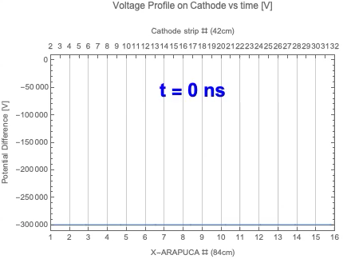

Slide 17
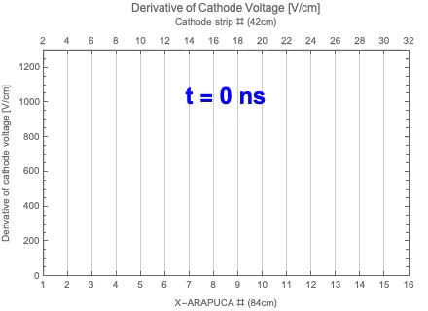

Slide 18
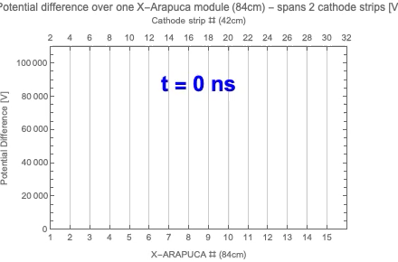
Potential difference (gradient) over the width of one X-ARAPUCA module (84cm) [V]
(charge difference is small)

Slide 19
Current through X-ARAPUCA Shield (linear scales)
Displacement Current I(CKA3)+I(CKA4) scaled to X-ARAPUCA
Area Charge ~ 0.8 µC
This is for 10ns discharge: for slower discharge,
max current would be reduced

Slide 20
Current through XARAPUCA Shield (log-log scales)
Displacement Current I(CKA3)+I(CKA4) scaled to X-ARAPUCA Area
Diffusion current is very low.

Slide 22
Discharge Simulation: Charge Capacitively Coupled to X-ARAPUCA
3m
CFK
C FC - cathode
(FC)
FC0
3.4m
13.5m
cath strip
cath strip
cath strip
cath strip
cath strip
cath strip
cath strip
CKA
C cathode-anode
HV Bus

Slide 23
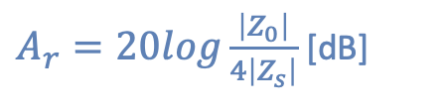
Shielding Effectiveness: Reflection + Absorption of Thin Shield in LAr
A_{r} thick shield t>>δ
A _{tot}
A_{r} thin shield t<<δ
$A_{r}=20log\frac{\left|Z_{0}\right|}{4\left|Z_{s}\right|}$ [dB]
Redrawn from from: H.W. Ott

Slide 24
Conclusions:
Risk to X-ARAPUCA is best measured by the discharge charge capacitively coupled to its shield, and thus it is entirely determined by the capacitances among field cage, cathode
and anode
Discharge at any single HV bus segment may create ~100 kV potential transient on the cathode but with very high source impedance of a few pFs. Average current through the shield is negligible, but there may be an up to ~ 20 A spike due to capacitance to the anode CKA ; the charge in the spike is less than 0.5 µC.
Risk mitigation (assuming uniform distribution of X-ARAPUCAs):
* X-ARAPUCA in the cathode module connected to the bus should have independent POF and fiber readout
* X-ARAPUCAs in the cathode modules in the center (6 m x 54 m, 36 modules) less at risk (farther away: smaller charge coupled capacitively). Electrical connection of several
X-ARAPUCAs could be considered
Next Step: design and test of X-ARAPUCA Faraday cage shield and optically transparent grid to withstand a charge of ~1 µC (to provide some margin) over <50 ns discharge duration

Slide 25
Supplemental Slides

Slide 26
Maxwell Matrix
Add how Maxwell matrix is calculated
Some “representative” values
Drawing of electrodes
Cut and paste some portion of Maxwell matrix
Maxwell matrix: partial capacitances => model the coupling of electrodes

Slide 27
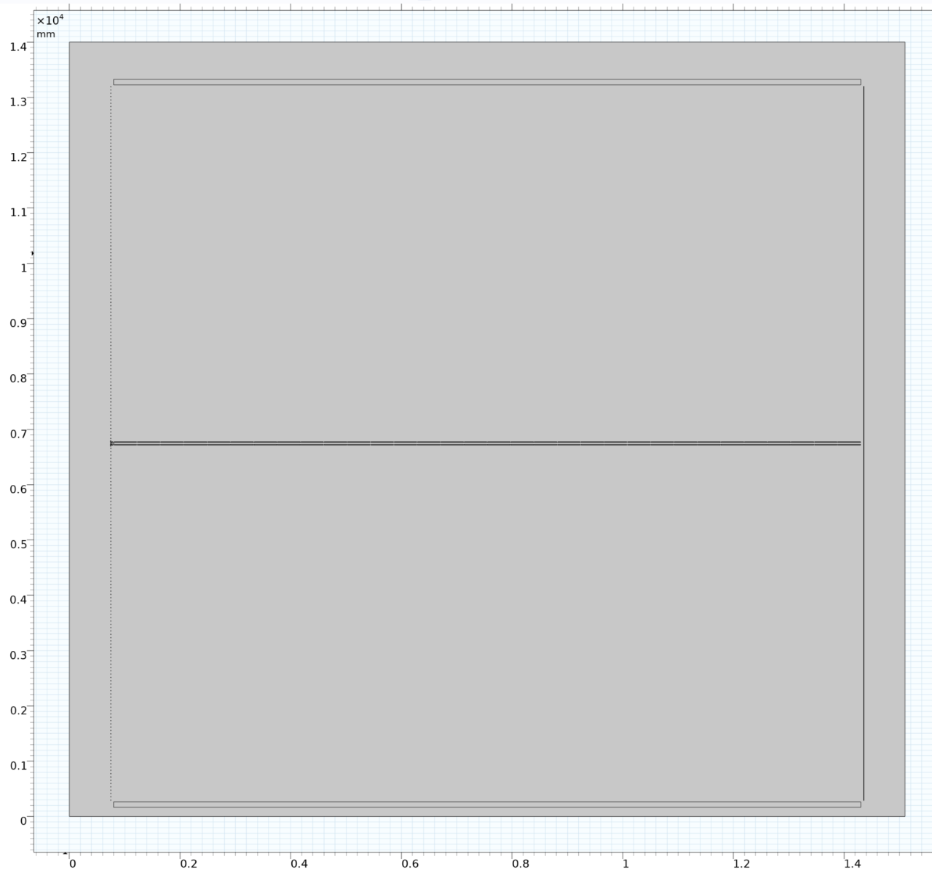
FD2-VD Geometry used for Maxwell Matrix Calculation (Bo Yu)

Slide 28
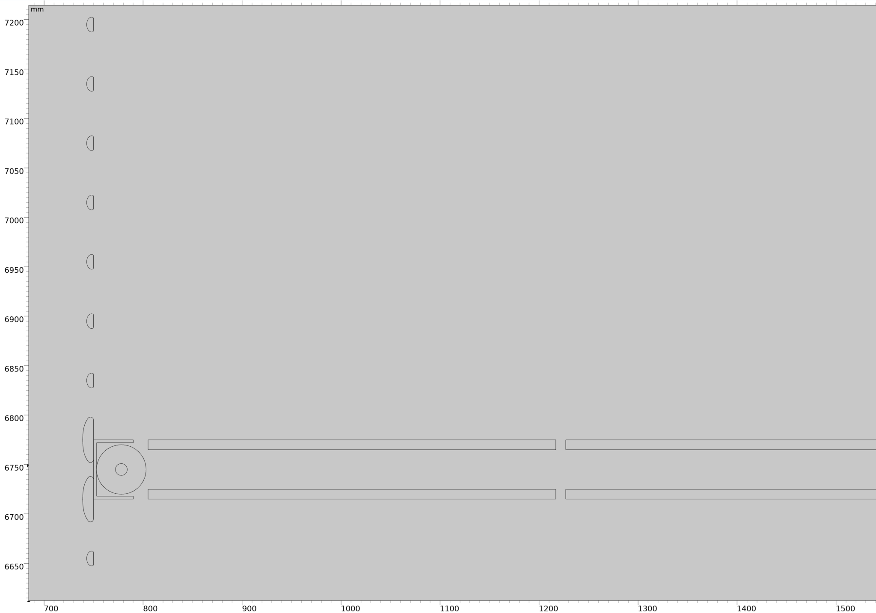
FD2-VD Geometry used for Maxwell Matrix Calculation (Bo Yu): detail

Slide 29
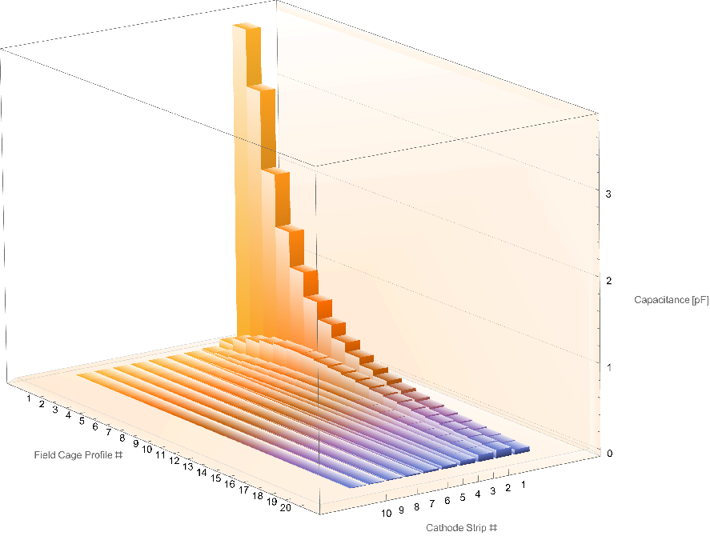
Maxwell Matrix Capacitance FC profiles to Cathode strips: K1 to K10

Slide 30
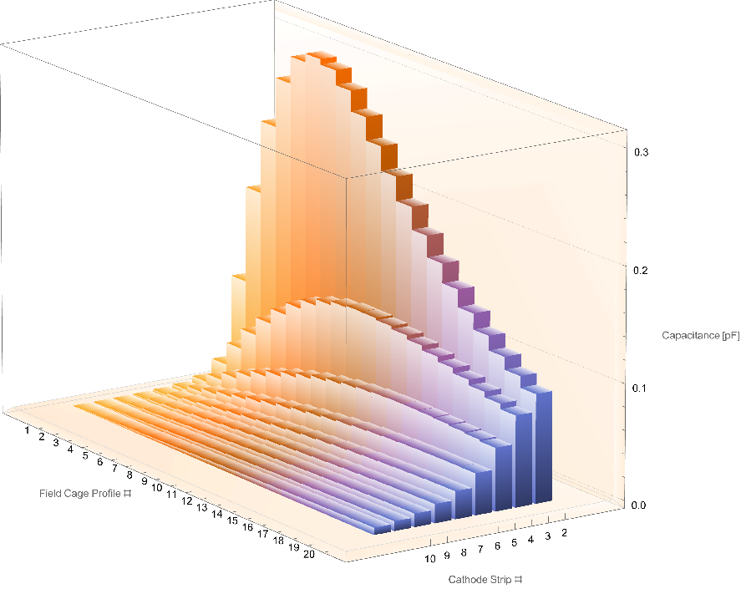
Maxwell Matrix Capacitance FC profiles to Cathode strips: K2 to K10
Dropping K1
(zoomed in)

Slide 31
Maxwell Matrix
Maxwell capacitance (F/m) | HV Bus | F0 | C1 | C2 | C3 | C4 | C5 | C6 | C7 | C8 | C9 | C10 | C11 | C12 | C13 | C14 | C15 | C16 | C17 | C18 | C19 | C20
F1 | - 23.6E-15 | - 15.0E-12 | - 3.8E-12 | - 89.8E-15 | - 19.6E-15 | - 7.3E-15 | - 3.5E-15 | - 1.9E-15 | - 1.2E-15 | - 763.9E-18 | - 523.4E-18 | - 372.6E-18 | - 273.2E-18 | - 205.0E-18 | - 156.8E-18 | - 121.7E-18 | - 95.7E-18 | - 75.9E-18 | - 60.7E-18 | - 48.9E-18 | - 39.6E-18 | - 32.1E-18
F2 | - 8.3E-15 | - 3.2E-12 | - 3.1E-12 | - 172.9E-15 | - 39.0E-15 | - 14.6E-15 | - 7.0E-15 | - 3.9E-15 | - 2.4E-15 | - 1.5E-15 | - 1.1E-15 | - 750.3E-18 | - 550.3E-18 | - 413.1E-18 | - 316.0E-18 | - 245.3E-18 | - 192.8E-18 | - 153.1E-18 | - 122.5E-18 | - 98.6E-18 | - 79.8E-18 | - 64.8E-18
F3 | - 3.2E-15 | - 1.3E-12 | - 2.2E-12 | - 235.7E-15 | - 56.4E-15 | - 21.4E-15 | - 10.3E-15 | - 5.7E-15 | - 3.5E-15 | - 2.3E-15 | - 1.6E-15 | - 1.1E-15 | - 817.0E-18 | - 613.4E-18 | - 469.3E-18 | - 364.5E-18 | - 286.5E-18 | - 227.5E-18 | - 182.0E-18 | - 146.6E-18 | - 118.6E-18 | - 96.4E-18
F4 | - 1.5E-15 | - 676.1E-15 | - 1.6E-12 | - 278.3E-15 | - 71.8E-15 | - 27.8E-15 | - 13.5E-15 | - 7.5E-15 | - 4.6E-15 | - 3.0E-15 | - 2.1E-15 | - 1.5E-15 | - 1.1E-15 | - 812.8E-18 | - 622.1E-18 | - 483.2E-18 | - 379.9E-18 | - 301.7E-18 | - 241.4E-18 | - 194.4E-18 | - 157.4E-18 | - 127.8E-18
F5 | - 796.8E-18 | - 406.3E-15 | - 1.2E-12 | - 301.8E-15 | - 84.9E-15 | - 33.8E-15 | - 16.6E-15 | - 9.3E-15 | - 5.7E-15 | - 3.7E-15 | - 2.6E-15 | - 1.8E-15 | - 1.3E-15 | - 1.0E-15 | - 774.0E-18 | - 601.4E-18 | - 473.0E-18 | - 375.6E-18 | - 300.7E-18 | - 242.1E-18 | - 196.0E-18 | - 159.3E-18
F6 | - 476.4E-18 | - 264.4E-15 | - 874.8E-15 | - 309.1E-15 | - 95.5E-15 | - 39.2E-15 | - 19.5E-15 | - 11.0E-15 | - 6.8E-15 | - 4.4E-15 | - 3.1E-15 | - 2.2E-15 | - 1.6E-15 | - 1.2E-15 | - 924.9E-18 | - 718.9E-18 | - 565.5E-18 | - 449.2E-18 | - 359.6E-18 | - 289.7E-18 | - 234.6E-18 | - 190.6E-18
F7 | - 306.4E-18 | - 181.2E-15 | - 669.2E-15 | - 304.5E-15 | - 103.6E-15 | - 43.9E-15 | - 22.2E-15 | - 12.6E-15 | - 7.8E-15 | - 5.1E-15 | - 3.5E-15 | - 2.5E-15 | - 1.9E-15 | - 1.4E-15 | - 1.1E-15 | - 835.5E-18 | - 657.5E-18 | - 522.4E-18 | - 418.3E-18 | - 337.0E-18 | - 272.9E-18 | - 221.7E-18
F8 | - 208.2E-18 | - 128.6E-15 | - 519.9E-15 | - 291.7E-15 | - 109.2E-15 | - 48.0E-15 | - 24.6E-15 | - 14.1E-15 | - 8.8E-15 | - 5.8E-15 | - 4.0E-15 | - 2.9E-15 | - 2.1E-15 | - 1.6E-15 | - 1.2E-15 | - 951.0E-18 | - 748.6E-18 | - 595.0E-18 | - 476.5E-18 | - 384.0E-18 | - 311.0E-18 | - 252.8E-18
F9 | - 147.5E-18 | - 93.7E-15 | - 409.5E-15 | - 274.0E-15 | - 112.6E-15 | - 51.4E-15 | - 26.8E-15 | - 15.5E-15 | - 9.7E-15 | - 6.4E-15 | - 4.5E-15 | - 3.2E-15 | - 2.4E-15 | - 1.8E-15 | - 1.4E-15 | - 1.1E-15 | - 838.8E-18 | - 666.9E-18 | - 534.3E-18 | - 430.7E-18 | - 348.8E-18 | - 283.5E-18
F10 | - 108.1E-18 | - 69.5E-15 | - 326.8E-15 | - 253.8E-15 | - 114.1E-15 | - 54.2E-15 | - 28.8E-15 | - 16.9E-15 | - 10.6E-15 | - 7.1E-15 | - 4.9E-15 | - 3.5E-15 | - 2.6E-15 | - 2.0E-15 | - 1.5E-15 | - 1.2E-15 | - 928.2E-18 | - 738.2E-18 | - 591.6E-18 | - 477.0E-18 | - 386.4E-18 | - 314.1E-18
F11 | - 81.3E-18 | - 52.3E-15 | - 263.7E-15 | - 232.7E-15 | - 113.8E-15 | - 56.3E-15 | - 30.6E-15 | - 18.1E-15 | - 11.5E-15 | - 7.7E-15 | - 5.3E-15 | - 3.8E-15 | - 2.8E-15 | - 2.2E-15 | - 1.7E-15 | - 1.3E-15 | - 1.0E-15 | - 808.3E-18 | - 648.0E-18 | - 522.6E-18 | - 423.5E-18 | - 344.3E-18
F12 | - 62.6E-18 | - 39.8E-15 | - 215.1E-15 | - 211.8E-15 | - 112.2E-15 | - 57.8E-15 | - 32.0E-15 | - 19.2E-15 | - 12.2E-15 | - 8.2E-15 | - 5.8E-15 | - 4.2E-15 | - 3.1E-15 | - 2.3E-15 | - 1.8E-15 | - 1.4E-15 | - 1.1E-15 | - 877.1E-18 | - 703.4E-18 | - 567.4E-18 | - 459.9E-18 | - 374.0E-18
F13 | - 49.1E-18 | - 30.6E-15 | - 177.6E-15 | - 192.2E-15 | - 109.7E-15 | - 58.8E-15 | - 33.3E-15 | - 20.2E-15 | - 13.0E-15 | - 8.8E-15 | - 6.2E-15 | - 4.5E-15 | - 3.3E-15 | - 2.5E-15 | - 1.9E-15 | - 1.5E-15 | - 1.2E-15 | - 946.5E-18 | - 759.4E-18 | - 612.7E-18 | - 496.8E-18 | - 404.1E-18
F14 | - 39.1E-18 | - 23.6E-15 | - 147.7E-15 | - 173.7E-15 | - 106.2E-15 | - 59.2E-15 | - 34.3E-15 | - 21.1E-15 | - 13.7E-15 | - 9.3E-15 | - 6.5E-15 | - 4.7E-15 | - 3.5E-15 | - 2.7E-15 | - 2.1E-15 | - 1.6E-15 | - 1.3E-15 | - 1.0E-15 | - 813.3E-18 | - 656.5E-18 | - 532.4E-18 | - 433.1E-18
F15 | - 31.6E-18 | - 18.4E-15 | - 123.9E-15 | - 156.6E-15 | - 102.0E-15 | - 59.1E-15 | - 35.0E-15 | - 21.8E-15 | - 14.3E-15 | - 9.7E-15 | - 6.9E-15 | - 5.0E-15 | - 3.7E-15 | - 2.8E-15 | - 2.2E-15 | - 1.7E-15 | - 1.4E-15 | - 1.1E-15 | - 866.0E-18 | - 699.2E-18 | - 567.2E-18 | - 461.6E-18
F16 | - 25.9E-18 | - 14.4E-15 | - 105.0E-15 | - 141.4E-15 | - 97.7E-15 | - 58.8E-15 | - 35.6E-15 | - 22.5E-15 | - 14.8E-15 | - 10.2E-15 | - 7.2E-15 | - 5.3E-15 | - 3.9E-15 | - 3.0E-15 | - 2.3E-15 | - 1.8E-15 | - 1.4E-15 | - 1.1E-15 | - 919.4E-18 | - 742.7E-18 | - 602.7E-18 | - 490.6E-18
F17 | - 21.4E-18 | - 11.3E-15 | - 89.5E-15 | - 127.5E-15 | - 93.1E-15 | - 58.1E-15 | - 36.0E-15 | - 23.0E-15 | - 15.3E-15 | - 10.6E-15 | - 7.5E-15 | - 5.5E-15 | - 4.1E-15 | - 3.2E-15 | - 2.4E-15 | - 1.9E-15 | - 1.5E-15 | - 1.2E-15 | - 971.0E-18 | - 784.6E-18 | - 636.9E-18 | - 518.6E-18
F18 | - 17.9E-18 | - 8.9E-15 | - 76.8E-15 | - 114.9E-15 | - 88.2E-15 | - 57.1E-15 | - 36.1E-15 | - 23.5E-15 | - 15.8E-15 | - 11.0E-15 | - 7.8E-15 | - 5.8E-15 | - 4.3E-15 | - 3.3E-15 | - 2.6E-15 | - 2.0E-15 | - 1.6E-15 | - 1.3E-15 | - 1.0E-15 | - 825.2E-18 | - 670.1E-18 | - 545.7E-18
F19 | - 15.1E-18 | - 7.1E-15 | - 66.5E-15 | - 103.9E-15 | - 83.6E-15 | - 55.9E-15 | - 36.2E-15 | - 23.8E-15 | - 16.2E-15 | - 11.3E-15 | - 8.1E-15 | - 6.0E-15 | - 4.5E-15 | - 3.4E-15 | - 2.7E-15 | - 2.1E-15 | - 1.7E-15 | - 1.3E-15 | - 1.1E-15 | - 866.8E-18 | - 704.1E-18 | - 573.6E-18
F20 | - 12.9E-18 | - 5.7E-15 | - 57.8E-15 | - 93.9E-15 | - 78.9E-15 | - 54.5E-15 | - 36.1E-15 | - 24.1E-15 | - 16.5E-15 | - 11.6E-15 | - 8.4E-15 | - 6.2E-15 | - 4.7E-15 | - 3.6E-15 | - 2.8E-15 | - 2.2E-15 | - 1.7E-15 | - 1.4E-15 | - 1.1E-15 | - 906.3E-18 | - 736.5E-18 | - 600.2E-18
F30 | - 3.6E-18 | - 800.6E-18 | - 18.4E-15 | - 37.6E-15 | - 42.0E-15 | - 37.3E-15 | - 29.8E-15 | - 22.8E-15 | - 17.2E-15 | - 13.0E-15 | - 9.9E-15 | - 7.6E-15 | - 5.9E-15 | - 4.6E-15 | - 3.7E-15 | - 2.9E-15 | - 2.3E-15 | - 1.9E-15 | - 1.5E-15 | - 1.2E-15 | - 1.0E-15 | - 834.6E-18
F40 | - 1.5E-18 | - 222.1E-18 | - 7.9E-15 | - 17.8E-15 | - 22.8E-15 | - 23.4E-15 | - 21.4E-15 | - 18.3E-15 | - 15.1E-15 | - 12.2E-15 | - 9.8E-15 | - 7.9E-15 | - 6.3E-15 | - 5.1E-15 | - 4.1E-15 | - 3.3E-15 | - 2.7E-15 | - 2.2E-15 | - 1.8E-15 | - 1.5E-15 | - 1.2E-15 | - 998.8E-18
F50 | - 744.2E-21 | - 100.5E-18 | - 4.1E-15 | - 9.6E-15 | - 13.2E-15 | - 14.8E-15 | - 14.7E-15 | - 13.6E-15 | - 12.1E-15 | - 10.4E-15 | - 8.7E-15 | - 7.3E-15 | - 6.1E-15 | - 5.0E-15 | - 4.1E-15 | - 3.4E-15 | - 2.8E-15 | - 2.3E-15 | - 1.9E-15 | - 1.6E-15 | - 1.3E-15 | - 1.1E-15
F60 | - 423.5E-21 | - 55.9E-18 | - 2.3E-15 | - 5.6E-15 | - 8.1E-15 | - 9.6E-15 | - 10.1E-15 | - 9.9E-15 | - 9.2E-15 | - 8.3E-15 | - 7.3E-15 | - 6.3E-15 | - 5.4E-15 | - 4.6E-15 | - 3.9E-15 | - 3.3E-15 | - 2.7E-15 | - 2.3E-15 | - 1.9E-15 | - 1.6E-15 | - 1.3E-15 | - 1.1E-15
F70 | - 258.6E-21 | - 34.0E-18 | - 1.4E-15 | - 3.5E-15 | - 5.2E-15 | - 6.3E-15 | - 6.9E-15 | - 7.1E-15 | - 6.9E-15 | - 6.4E-15 | - 5.8E-15 | - 5.2E-15 | - 4.6E-15 | - 4.0E-15 | - 3.4E-15 | - 2.9E-15 | - 2.5E-15 | - 2.1E-15 | - 1.8E-15 | - 1.5E-15 | - 1.2E-15 | - 1.0E-15
F80 | - 163.9E-21 | - 21.5E-18 | - 910.3E-18 | - 2.3E-15 | - 3.4E-15 | - 4.2E-15 | - 4.8E-15 | - 5.0E-15 | - 5.0E-15 | - 4.8E-15 | - 4.5E-15 | - 4.1E-15 | - 3.6E-15 | - 3.2E-15 | - 2.8E-15 | - 2.4E-15 | - 2.1E-15 | - 1.8E-15 | - 1.5E-15 | - 1.3E-15 | - 1.1E-15 | - 909.8E-18
F90 | - 104.3E-21 | - 13.7E-18 | - 580.2E-18 | - 1.4E-15 | - 2.2E-15 | - 2.8E-15 | - 3.2E-15 | - 3.4E-15 | - 3.5E-15 | - 3.4E-15 | - 3.2E-15 | - 3.0E-15 | - 2.7E-15 | - 2.4E-15 | - 2.2E-15 | - 1.9E-15 | - 1.6E-15 | - 1.4E-15 | - 1.2E-15 | - 1.0E-15 | - 871.6E-18 | - 735.4E-18
F100 | - 64.3E-21 | - 8.4E-18 | - 358.2E-18 | - 894.9E-18 | - 1.4E-15 | - 1.8E-15 | - 2.0E-15 | - 2.2E-15 | - 2.3E-15 | - 2.3E-15 | - 2.2E-15 | - 2.0E-15 | - 1.9E-15 | - 1.7E-15 | - 1.5E-15 | - 1.3E-15 | - 1.2E-15 | - 1.0E-15 | - 867.4E-18 | - 741.6E-18 | - 630.8E-18 | - 533.9E-18
F101 | - 61.2E-21 | - 8.0E-18 | - 341.1E-18 | - 852.3E-18 | - 1.3E-15 | - 1.7E-15 | - 1.9E-15 | - 2.1E-15 | - 2.2E-15 | - 2.2E-15 | - 2.1E-15 | - 2.0E-15 | - 1.8E-15 | - 1.6E-15 | - 1.5E-15 | - 1.3E-15 | - 1.1E-15 | - 970.8E-18 | - 835.4E-18 | - 714.5E-18 | - 607.9E-18 | - 514.7E-18
F102 | - 58.5E-21 | - 7.7E-18 | - 325.8E-18 | - 814.3E-18 | - 1.2E-15 | - 1.6E-15 | - 1.9E-15 | - 2.0E-15 | - 2.1E-15 | - 2.1E-15 | - 2.0E-15 | - 1.9E-15 | - 1.7E-15 | - 1.6E-15 | - 1.4E-15 | - 1.2E-15 | - 1.1E-15 | - 937.1E-18 | - 806.8E-18 | - 690.2E-18 | - 587.4E-18 | - 497.5E-18
F103 | - 56.1E-21 | - 7.4E-18 | - 312.4E-18 | - 781.1E-18 | - 1.2E-15 | - 1.5E-15 | - 1.8E-15 | - 1.9E-15 | - 2.0E-15 | - 2.0E-15 | - 1.9E-15 | - 1.8E-15 | - 1.7E-15 | - 1.5E-15 | - 1.4E-15 | - 1.2E-15 | - 1.0E-15 | - 907.7E-18 | - 781.7E-18 | - 669.0E-18 | - 569.6E-18 | - 482.4E-18
F104 | - 54.4E-21 | - 7.1E-18 | - 302.9E-18 | - 757.6E-18 | - 1.2E-15 | - 1.5E-15 | - 1.7E-15 | - 1.9E-15 | - 1.9E-15 | - 1.9E-15 | - 1.9E-15 | - 1.8E-15 | - 1.6E-15 | - 1.5E-15 | - 1.3E-15 | - 1.2E-15 | - 1.0E-15 | - 888.6E-18 | - 765.5E-18 | - 655.4E-18 | - 558.1E-18 | - 472.8E-18
F105 | - 53.9E-21 | - 7.1E-18 | - 300.4E-18 | - 751.5E-18 | - 1.2E-15 | - 1.5E-15 | - 1.7E-15 | - 1.9E-15 | - 1.9E-15 | - 1.9E-15 | - 1.9E-15 | - 1.8E-15 | - 1.6E-15 | - 1.5E-15 | - 1.3E-15 | - 1.2E-15 | - 1.0E-15 | - 889.3E-18 | - 766.4E-18 | - 656.3E-18 | - 559.0E-18 | - 473.7E-18
F106 | - 57.1E-21 | - 7.5E-18 | - 318.0E-18 | - 795.7E-18 | - 1.2E-15 | - 1.6E-15 | - 1.8E-15 | - 2.0E-15 | - 2.1E-15 | - 2.1E-15 | - 2.0E-15 | - 1.9E-15 | - 1.7E-15 | - 1.6E-15 | - 1.4E-15 | - 1.2E-15 | - 1.1E-15 | - 950.1E-18 | - 819.0E-18 | - 701.6E-18 | - 597.7E-18 | - 506.6E-18
F107 | - 80.2E-21 | - 10.5E-18 | - 446.9E-18 | - 1.1E-15 | - 1.7E-15 | - 2.2E-15 | - 2.6E-15 | - 2.8E-15 | - 2.9E-15 | - 2.9E-15 | - 2.8E-15 | - 2.7E-15 | - 2.5E-15 | - 2.2E-15 | - 2.0E-15 | - 1.8E-15 | - 1.6E-15 | - 1.3E-15 | - 1.2E-15 | - 996.3E-18 | - 849.1E-18 | - 719.9E-18
Sum{F1-F20) (F/m) |  |  | - 16.0E-12 | - 4.1E-12 | - 1.8E-12 | - 917.2E-15 | - 518.1E-15 | - 315.7E-15 | - 204.2E-15 | - 138.5E-15 | - 97.6E-15 | - 70.8E-15 | - 52.7E-15 | - 40.0E-15 | - 30.8E-15 | - 24.1E-15 | - 19.0E-15 | - 15.2E-15 | - 12.2E-15 | - 9.8E-15 | - 8.0E-15 | - 6.5E-15
CFK (F) |  |  | - 96.0E-12 | - 24.4E-12 | - 10.8E-12 | - 5.5E-12 | - 3.1E-12 | - 1.9E-12 | - 1.2E-12 | - 831.1E-15 | - 585.4E-15 | - 425.0E-15 | - 316.2E-15 | - 239.9E-15 | - 185.0E-15 | - 144.6E-15 | - 114.2E-15 | - 91.0E-15 | - 73.1E-15 | - 59.0E-15 | - 47.9E-15 | - 38.9E-15
Total Capacitance from Field Cage profiles FC1-20 to Kathode strip C_{i} Multiply by 6 (x 3m x 2 top & bottom FC in parallel)

Slide 32
Summary of Voltages on Cathode (100ms)
0KV
V(k1)
V(k2)
V(k3)
V(k4)
V(k5)
V(k1)
V(k2)
-30KV
V(k3)
V(k4)
V(k5)
-60KV
-90KV
-120KV
-150KV
-180KV
-210KV
-240KV
-270KV
-300KV
0ms
10ms
20ms
30ms
40ms
50ms
60ms
70ms
80ms
90ms
100ms

Slide 33
Interpolation zero, first, second order

Slide 34

Shielding Effectiveness: Reflection + Absorption in Air
A _{tot}
A_{r} thick shield t>>δ
A_{r} thin shield t<<δ
$A_{r}=20log\frac{\left|Z_{0}\right|}{4\left|Z_{s}\right|}$ [dB]
Redrawn from from: H.W. Ott

