Slide 1
Estimate the Coupling to SiPMs on Cathode Mounted PD Module
Bo Yu
Brookhaven National Laboratory
April 13, 2022

Slide 2
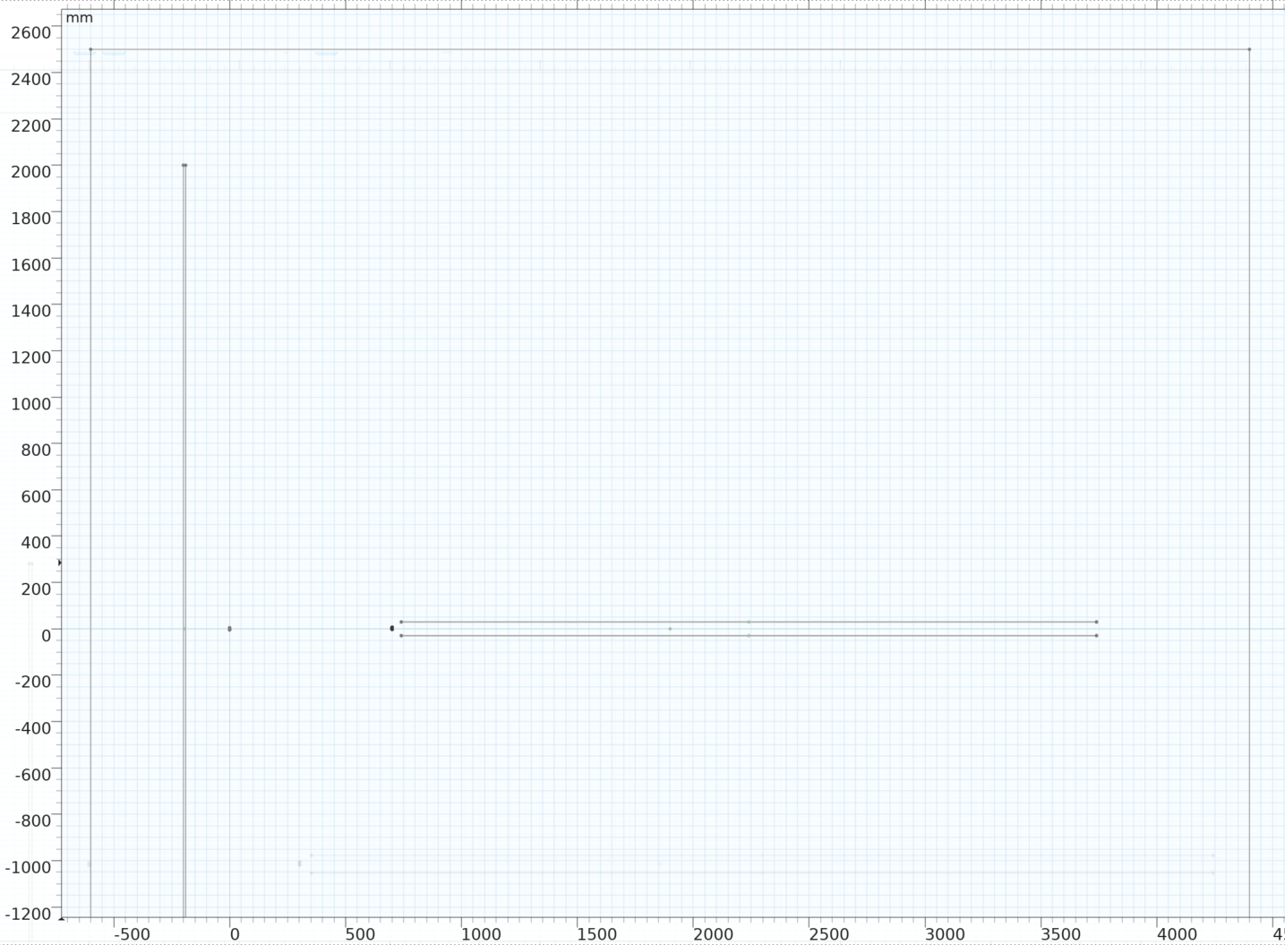
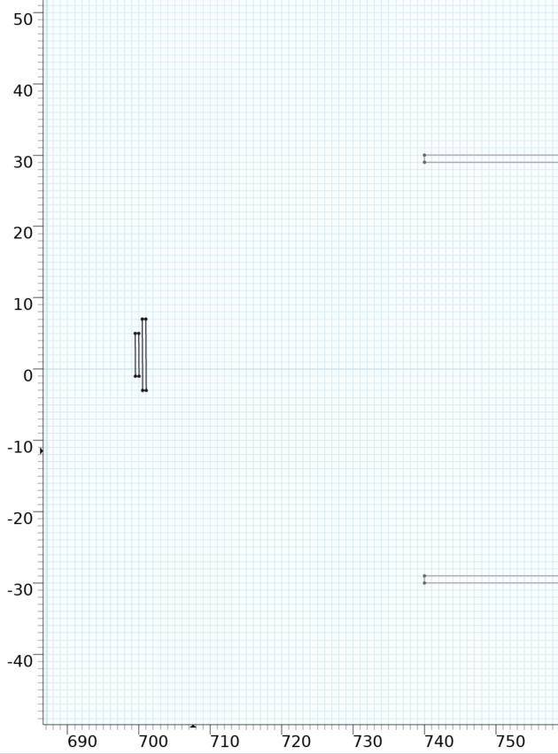
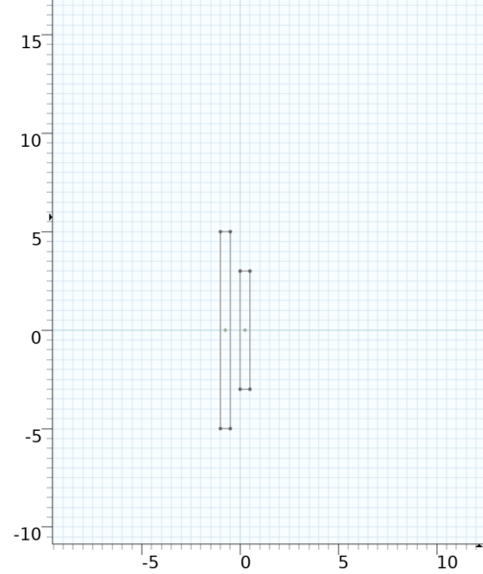
Reference Model: Minimal Shielding
A corner of a TPC with a partial FC wall, two SiPM bands 70cm apart, a portion of the resistive cathode surfaces
Grounded walls
Field cage wall
SiPM_R
Resistive cathode sheets
SiPM_L
Resistive cathode sheets
Grounded PCB
Grounded PCB

Slide 3
Capacitance Matrix (reference model)
Maxwell capacitance (F/m)
 | FC | SiPM_L | SiPM_R | Cathode
FC | 2.13E-10 | -4.03E-12 | -8.86E-13 | -1.75E-11
SiPM_L | -4.03E-12 | 2.08E-10 | -5.30E-14 | -5.92E-13
SiPM_R | -8.86E-13 | -5.30E-14 | 2.09E-10 | -4.87E-12
Cathode | -1.75E-11 | -5.92E-13 | -4.87E-12 | 9.04E-11
A 300kV swing on FC would inject 1.2uC of charge to 1m long SiPM_L.
A 100kV swing on Cathode would inject 0.5uC of charge to 1m long SiPM_R

Slide 4
Shield Model 1: Conductive Wire Mesh
An 1D wire grid (0.6mm OD x 12.7mm pitch) is added above and below the SiPM bands
Resistive cathode sheets
Grounded wire mesh

Slide 5
Capacitance Matrix (shield model 1)
Maxwell capacitance (F/m)
 | FC | SiPM_L | SiPM_R | Cathode
FC | 2.34E-10 | -2.13E-13 | -1.93E-14 | -1.05E-11
SiPM_L | -2.13E-13 | 2.10E-10 | -2.01E-17 | -5.47E-15
SiPM_R | -1.93E-14 | -2.01E-17 | 2.10E-10 | -8.07E-13
Cathode | -1.05E-11 | -5.47E-15 | -8.07E-13 | 1.19E-10
A 300kV swing on FC would inject 64nC of charge to 1m long SiPM_L.
A 100kV swing on Cathode would inject 81nC of charge to 1m long SiPM_R
Compared with the Minimal Shielding case:
FC to SiPM_L is reduced by a factor of 19
Cathode to SiPM_R is reduced by a factor of 6

Slide 6
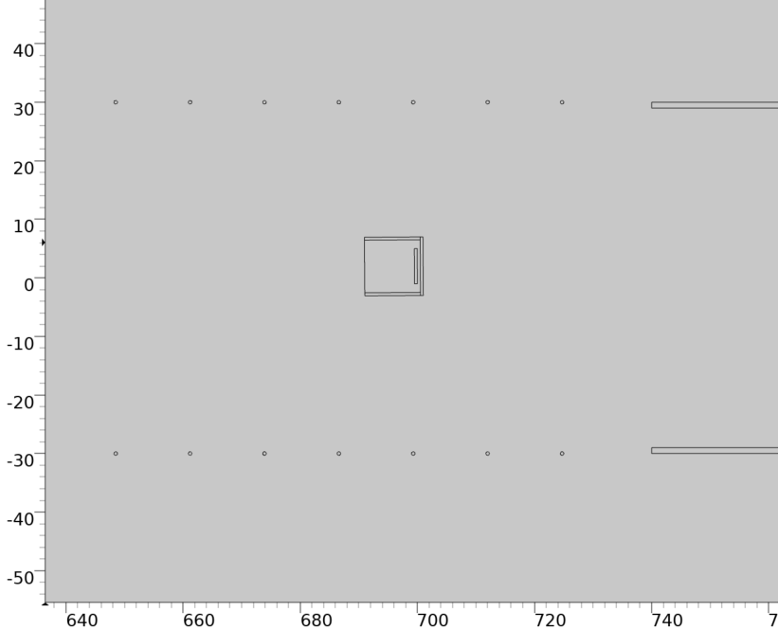
Shield Model 2: Shallow C channels Shield
A conductive C-channel (1cmx1cm) is added to shield the SiPM bands
Grounded C-channel
Resistive cathode sheets
Grounded wire mesh

Slide 7
Capacitance Matrix (shield model 2)
Maxwell capacitance (F/m)
 | FC | SiPM_L | SiPM_R | Cathode
FC | 2.34E-10 | -6.00E-15 | -8.02E-16 | -1.05E-11
SiPM_L | -6.00E-15 | 2.24E-10 | -3.47E-20 | -2.20E-16
SiPM_R | -8.02E-16 | -3.47E-20 | 2.24E-10 | -1.49E-14
Cathode | -1.05E-11 | -2.20E-16 | -1.49E-14 | 1.19E-10
A 300kV swing on FC would inject 1.8nC of charge to 1m long SiPM_L.
A 100kV swing on Cathode would inject 1.5nC of charge to 1m long SiPM_R
Compared with the previous wire mesh only case:
FC to SiPM_L is reduced by a factor of 35
Cathode to SiPM_R is reduced by a factor of 54

Slide 8
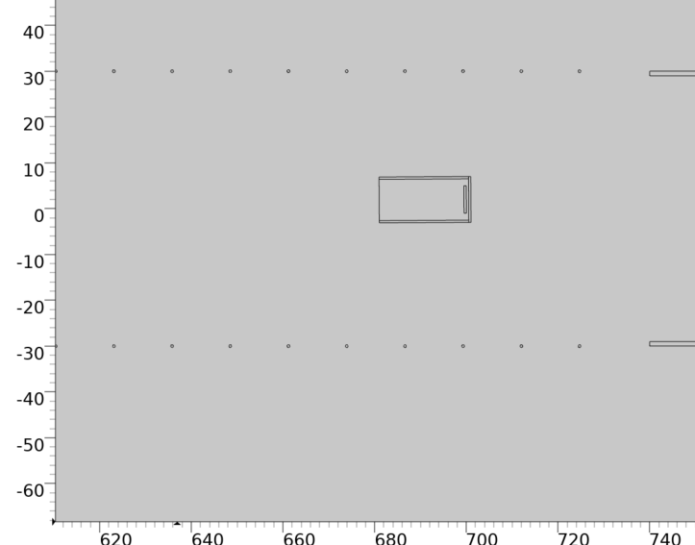
Shield Model 3: Deeper C channels Shield
The conductive C-channel is made deeper (2cm wide) to shield the SiPM bands
Grounded C-channel
Resistive cathode sheets
Grounded wire mesh

Slide 9
Capacitance Matrix (shield model 3)
Maxwell capacitance (F/m)
 | FC | SiPM_L | SiPM_R | Cathode
FC | 2.34E-10 | -1.49E-16 | -2.44E-17 | -1.05E-11
SiPM_L | -1.49E-16 | 2.24E-10 | -3.20E-23 | -6.76E-18
SiPM_R | -2.44E-17 | -3.20E-23 | 2.24E-10 | -2.67E-16
Cathode | -1.05E-11 | -6.78E-18 | -2.67E-16 | 1.19E-10
Compared with the previous 1x1 C channel case:
FC to SiPM_L is reduced by a factor of 40
Cathode to SiPM_R is reduced by a factor of 56

Slide 10
Shield Model 4: Deeper C mesh channels
The conductive C-channel is made deeper (2cm wide), but using two wire grids for the legs of the C-channel to shield the SiPM bands
The mesh strips are 0.6mm wire @ 2mm pitch, 70% transparent @ normal incident angle.
Grounded mesh strips
Resistive cathode sheets
Grounded wire mesh
Grounded PCB strip

Slide 11
Capacitance Matrix (shield model 4)
Maxwell capacitance (F/m)
 | FC | SiPM_L | SiPM_R | Cathode
FC | 2.34E-10 | -5.16E-15 | -3.87E-16 | -1.05E-11
SiPM_L | -5.16E-15 | 2.18E-10 | -8.19E-21 | -1.13E-16
SiPM_R | -3.87E-16 | -8.20E-21 | 2.18E-10 | -2.24E-14
Cathode | -1.05E-11 | -1.13E-16 | -2.24E-14 | 1.19E-10
Compared with the 1x1 C channel case:
FC to SiPM_L is reduced by 14%
Cathode to SiPM_R is increased by a factor of 1.5

Slide 12
Shield Model 5: Double outer mesh density
The outer wire mesh density is doubled, without a local C-channel
The mesh density is 0.6mm wire @ 6.35mm pitch
Resistive cathode sheets
Grounded wire mesh with double density
Grounded PCB strip

Slide 13
Capacitance Matrix (shield model 5)
Maxwell capacitance (F/m)
 | FC | SiPM_L | SiPM_R | Cathode
FC | 2.35E-10 | -9.78E-14 | -6.56E-15 | -1.03E-11
SiPM_L | -9.78E-14 | 2.10E-10 | -2.42E-18 | -1.93E-15
SiPM_R | -6.56E-15 | -2.42E-18 | 2.10E-10 | -4.86E-13
Cathode | -1.03E-11 | -1.93E-15 | -4.86E-13 | 1.30E-10
Compared with the 1x1 C channel case:
FC to SiPM_L coupling increased by a factor of 16
Cathode to SiPM_R coupling increased by a factor of 32

