Slide 1
X-ARAPUCA HV Discharge Tests
Eric Raguzin, Veljko Radeka, Sergio Rescia
4/13/2021

Slide 2
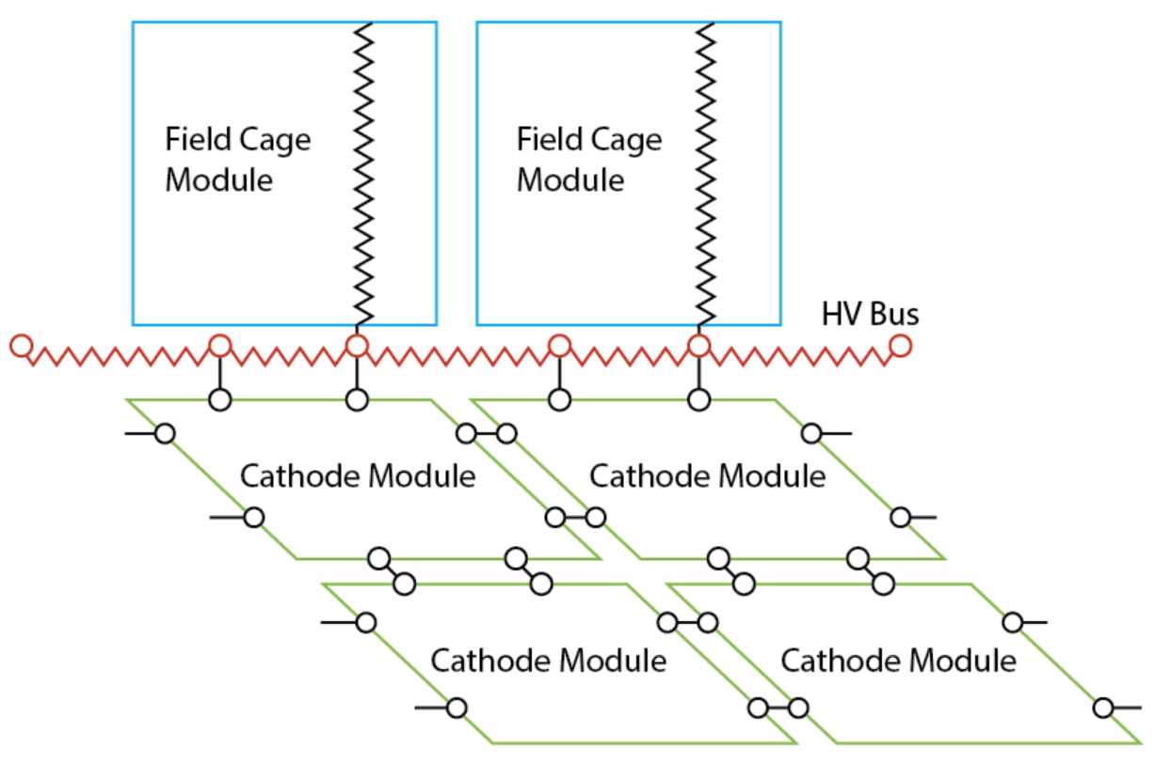
Discharge Simulation: Charge Capacitively Coupled to X-ARAPUCA
3m
CFK
C FC - cathode
(FC)
FC0
3.4m
13.5m
cath strip
cath strip
cath strip
cath strip
cath strip
cath strip
cath strip
CKA
C cathode-anode
HV Bus

Slide 3
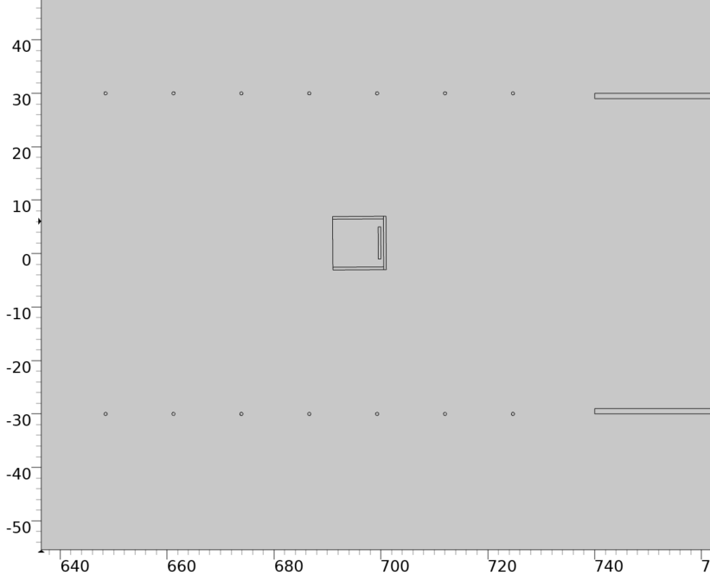
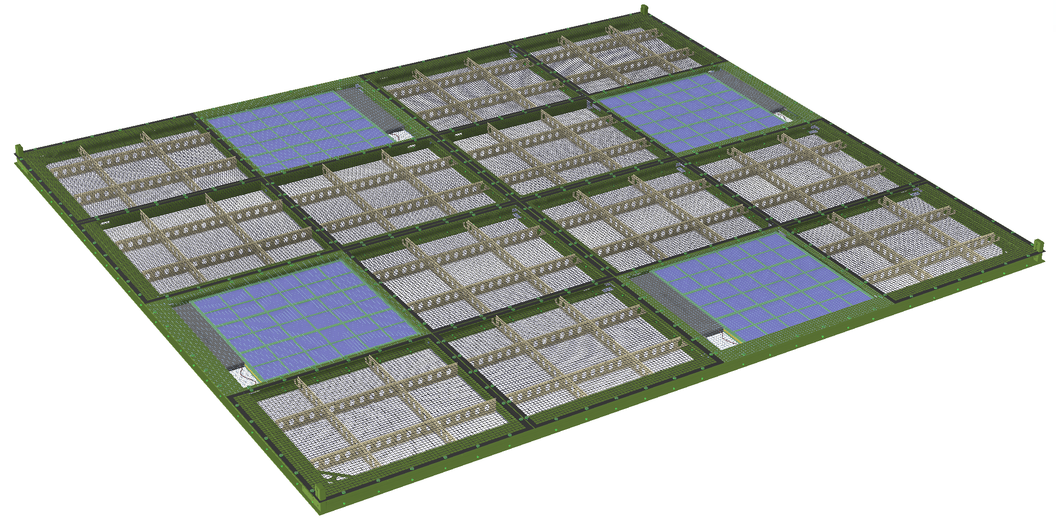
ARAPUCAs with common electrical connections
LV, HV power and data links are delivered to one module through fiber and then connected to one or two others via copper.
There’s risk that a HV discharge to one module could also affect other modules through this connection.
A solution would be the inclusion of a common mode inductance (“balun”) to attenuate potential HV discharge current. Its effectiveness must be evaluated.
Note that this can be avoided with “Power over Fiber” connections – although with higher cost.
Grounded C-channel
Grounded
wire mesh
Resistive
cathode sheets

Slide 4
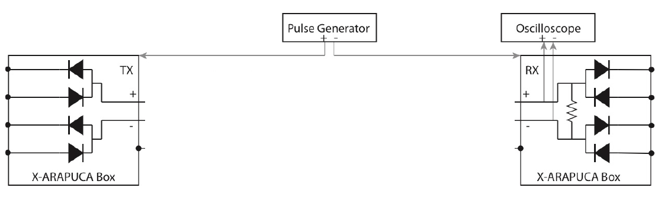
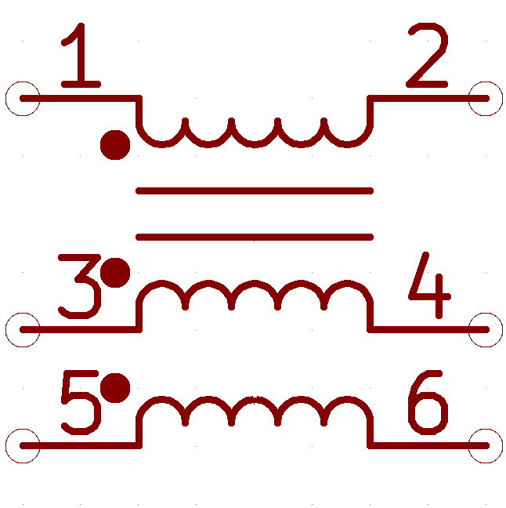
Testing Overview
BAV99 diodes – part of the cold electronics design to attenuate ESD
Twinax cable with shielding to be used for electrical connection
Break in cable for balun with common winding core for both power conductors and shield – essence of “common mode choke”
Receiving box with oscilloscope connection to measure magnitude of attenuated current
No shield connection to box
Shared common core
Shield connection to box

Slide 5
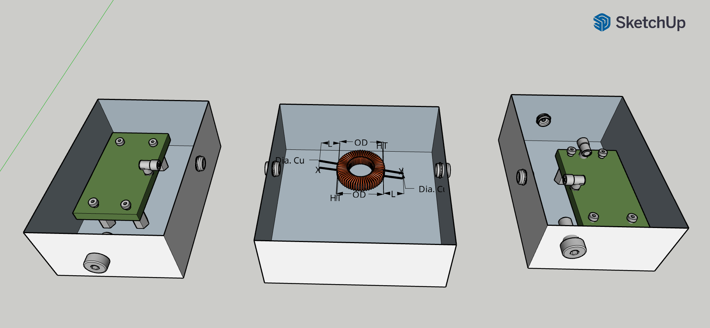
Physical Implementation

Slide 6
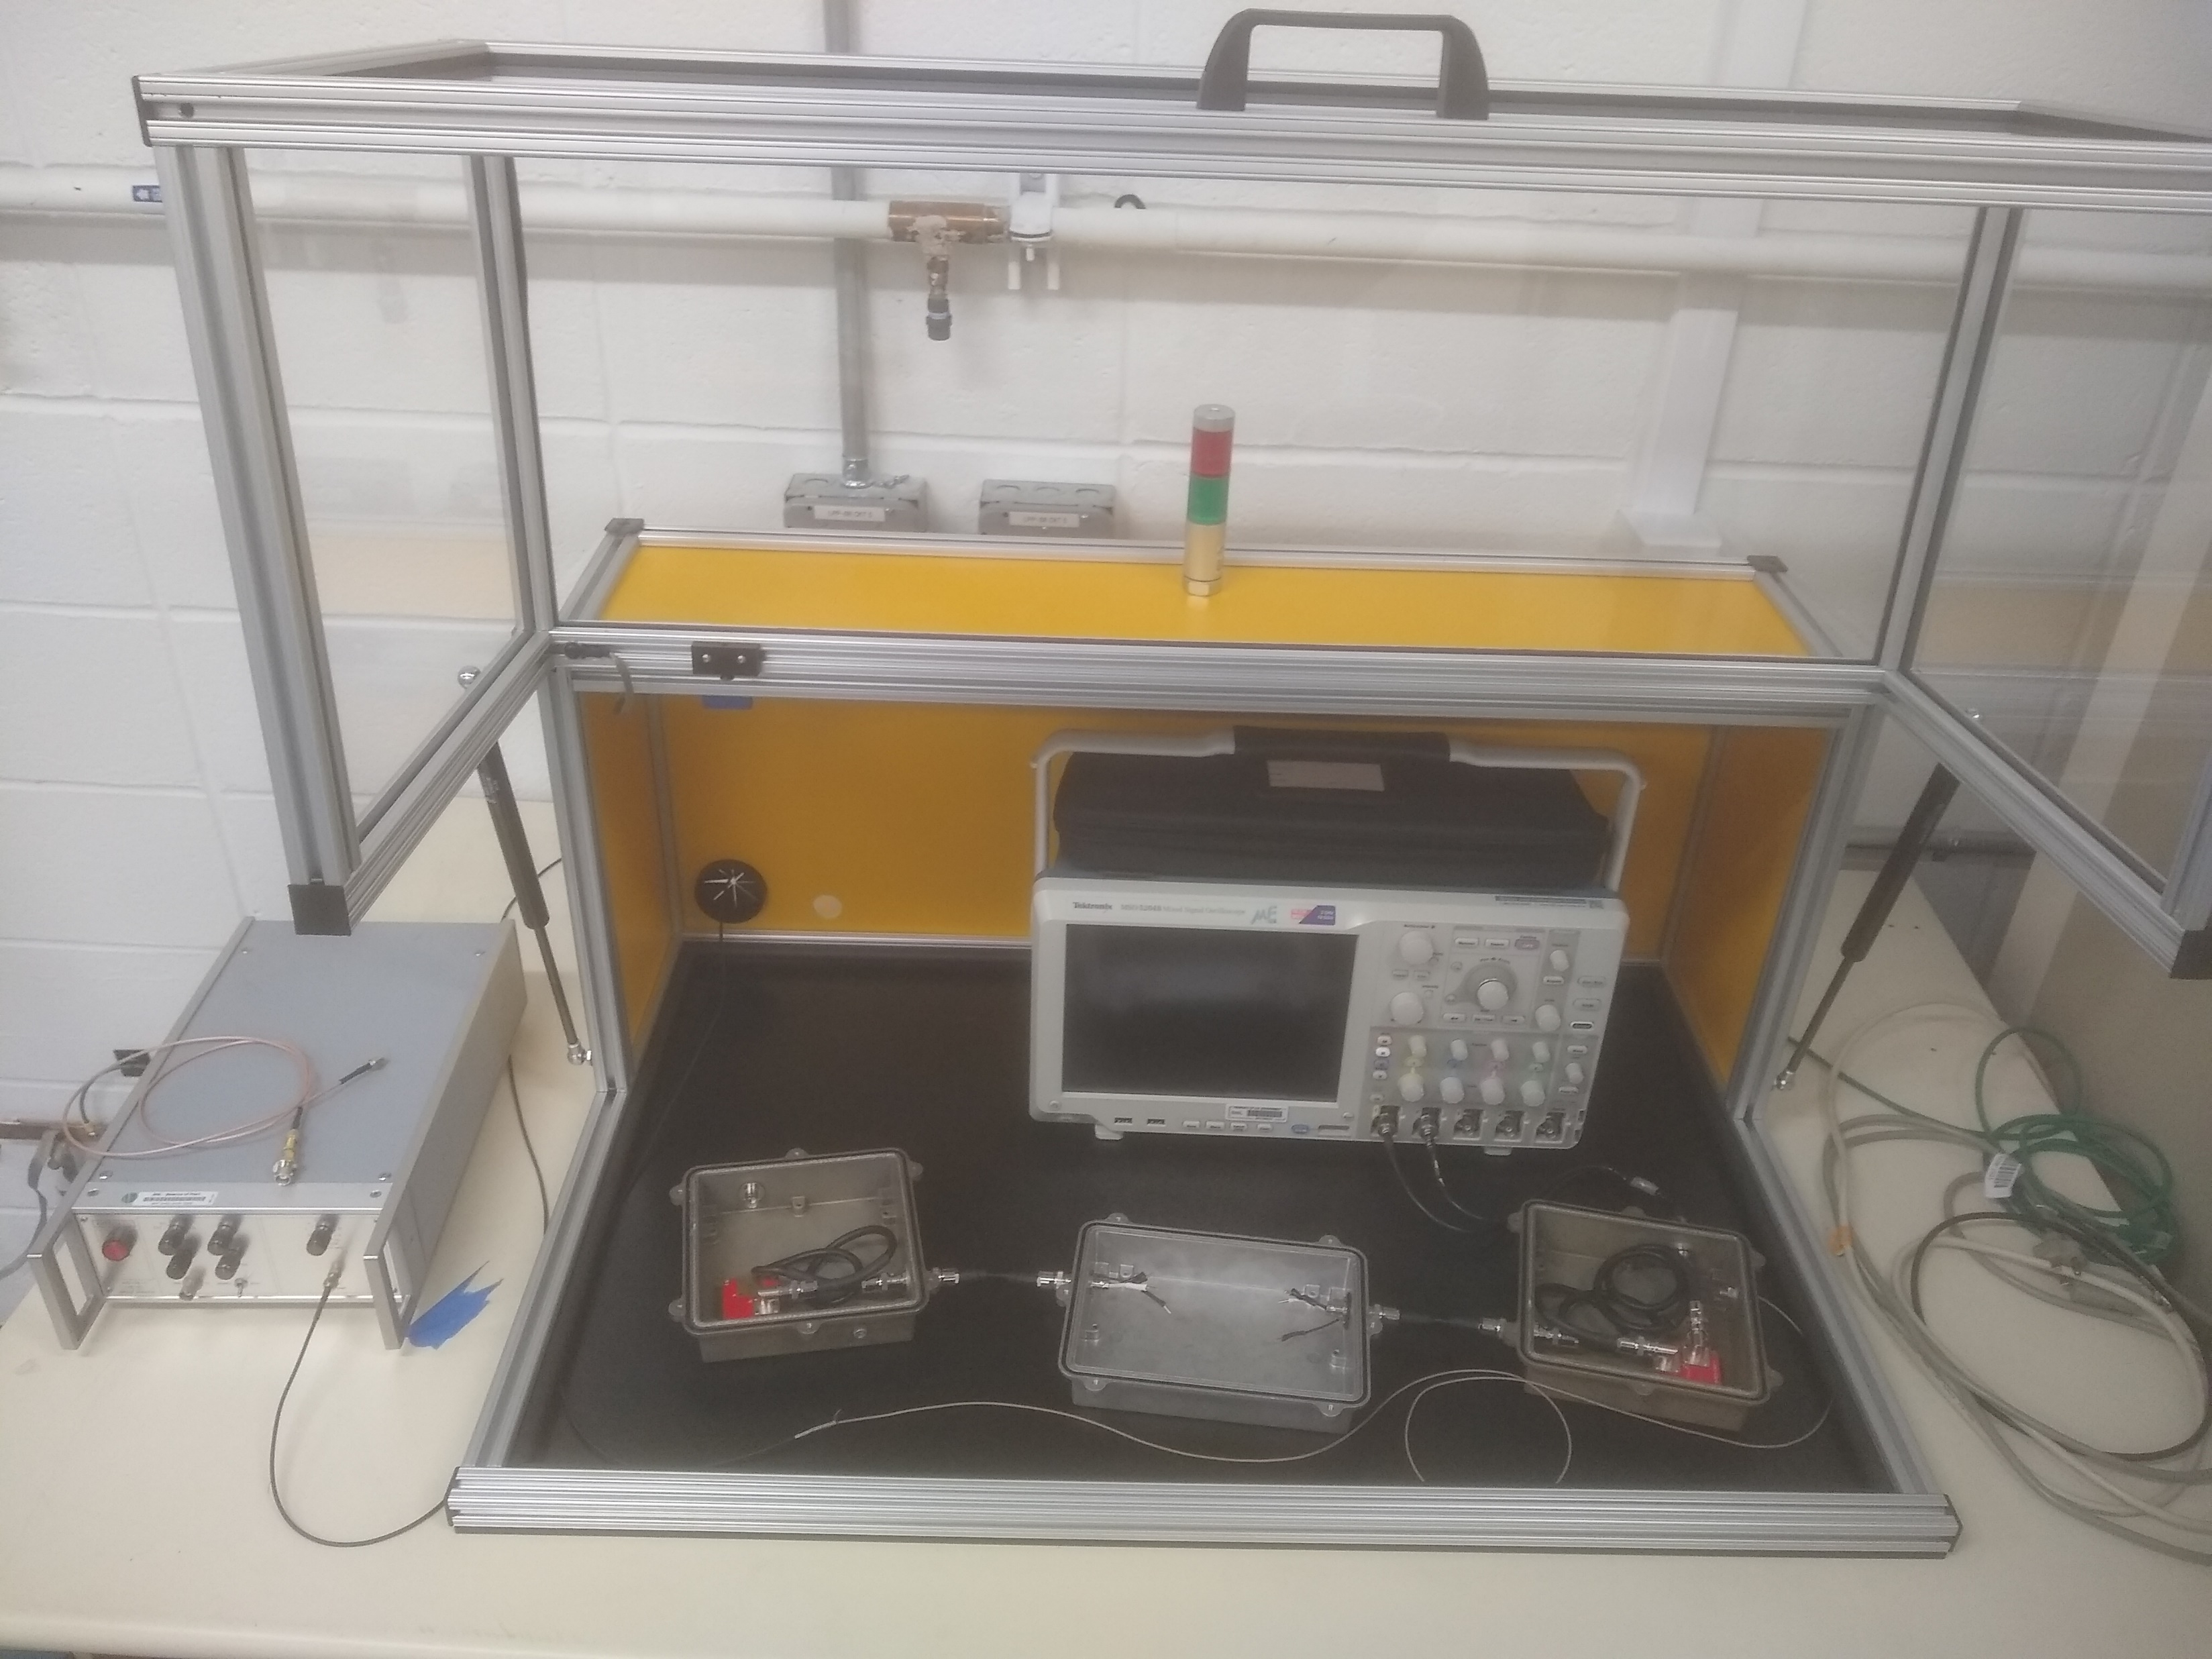
Bench Setup
Enclosure allows safe testing, interlock will switch off exposed HV when opened
Test boxes will be covered and function as complete Faraday cages with penetrating feedthroughs properly connected
HV Pulser applies voltage/current across shield of each “module”, simulating a discharge
Discharge path runs through BAV99 diodes, shielded twinax cable, common mode choke. Attenuated signal read out on the scope.

Slide 7
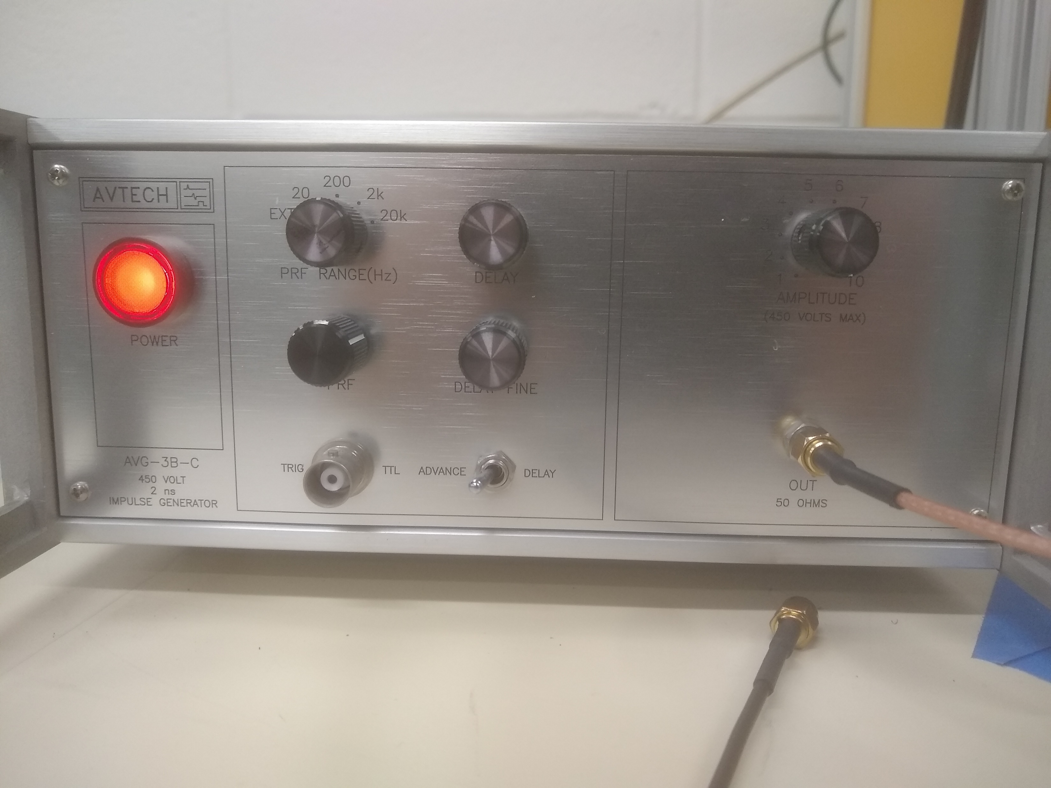
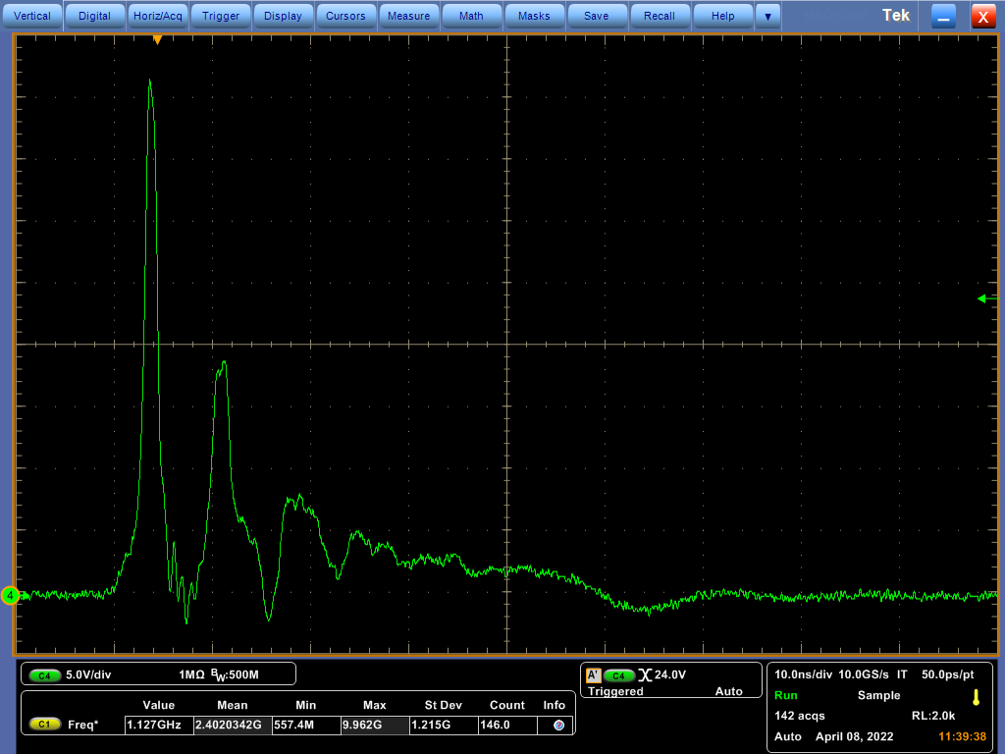
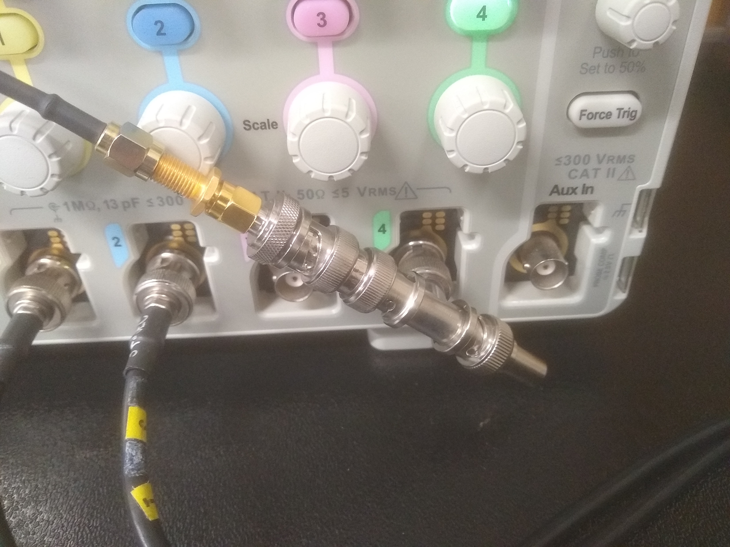
HV Pulser Characterization
Set to 1/10th Full Scale (nominal FS is 450 V)
Peak is ~42V, first pulse is ~2 ns FWHM
2 ns FWHM
50 ohm out, 50 ohm terminated
Scope is in high impedance mode

Slide 8
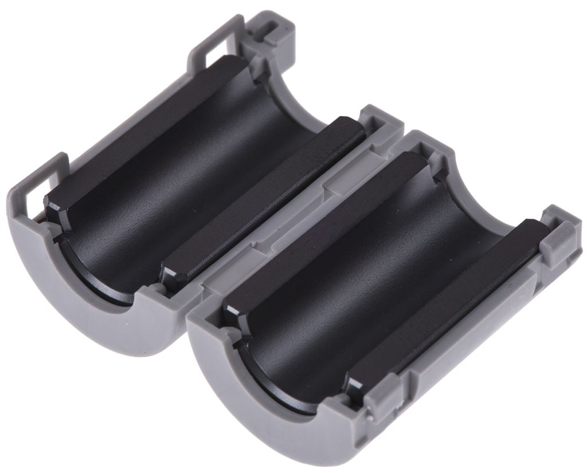
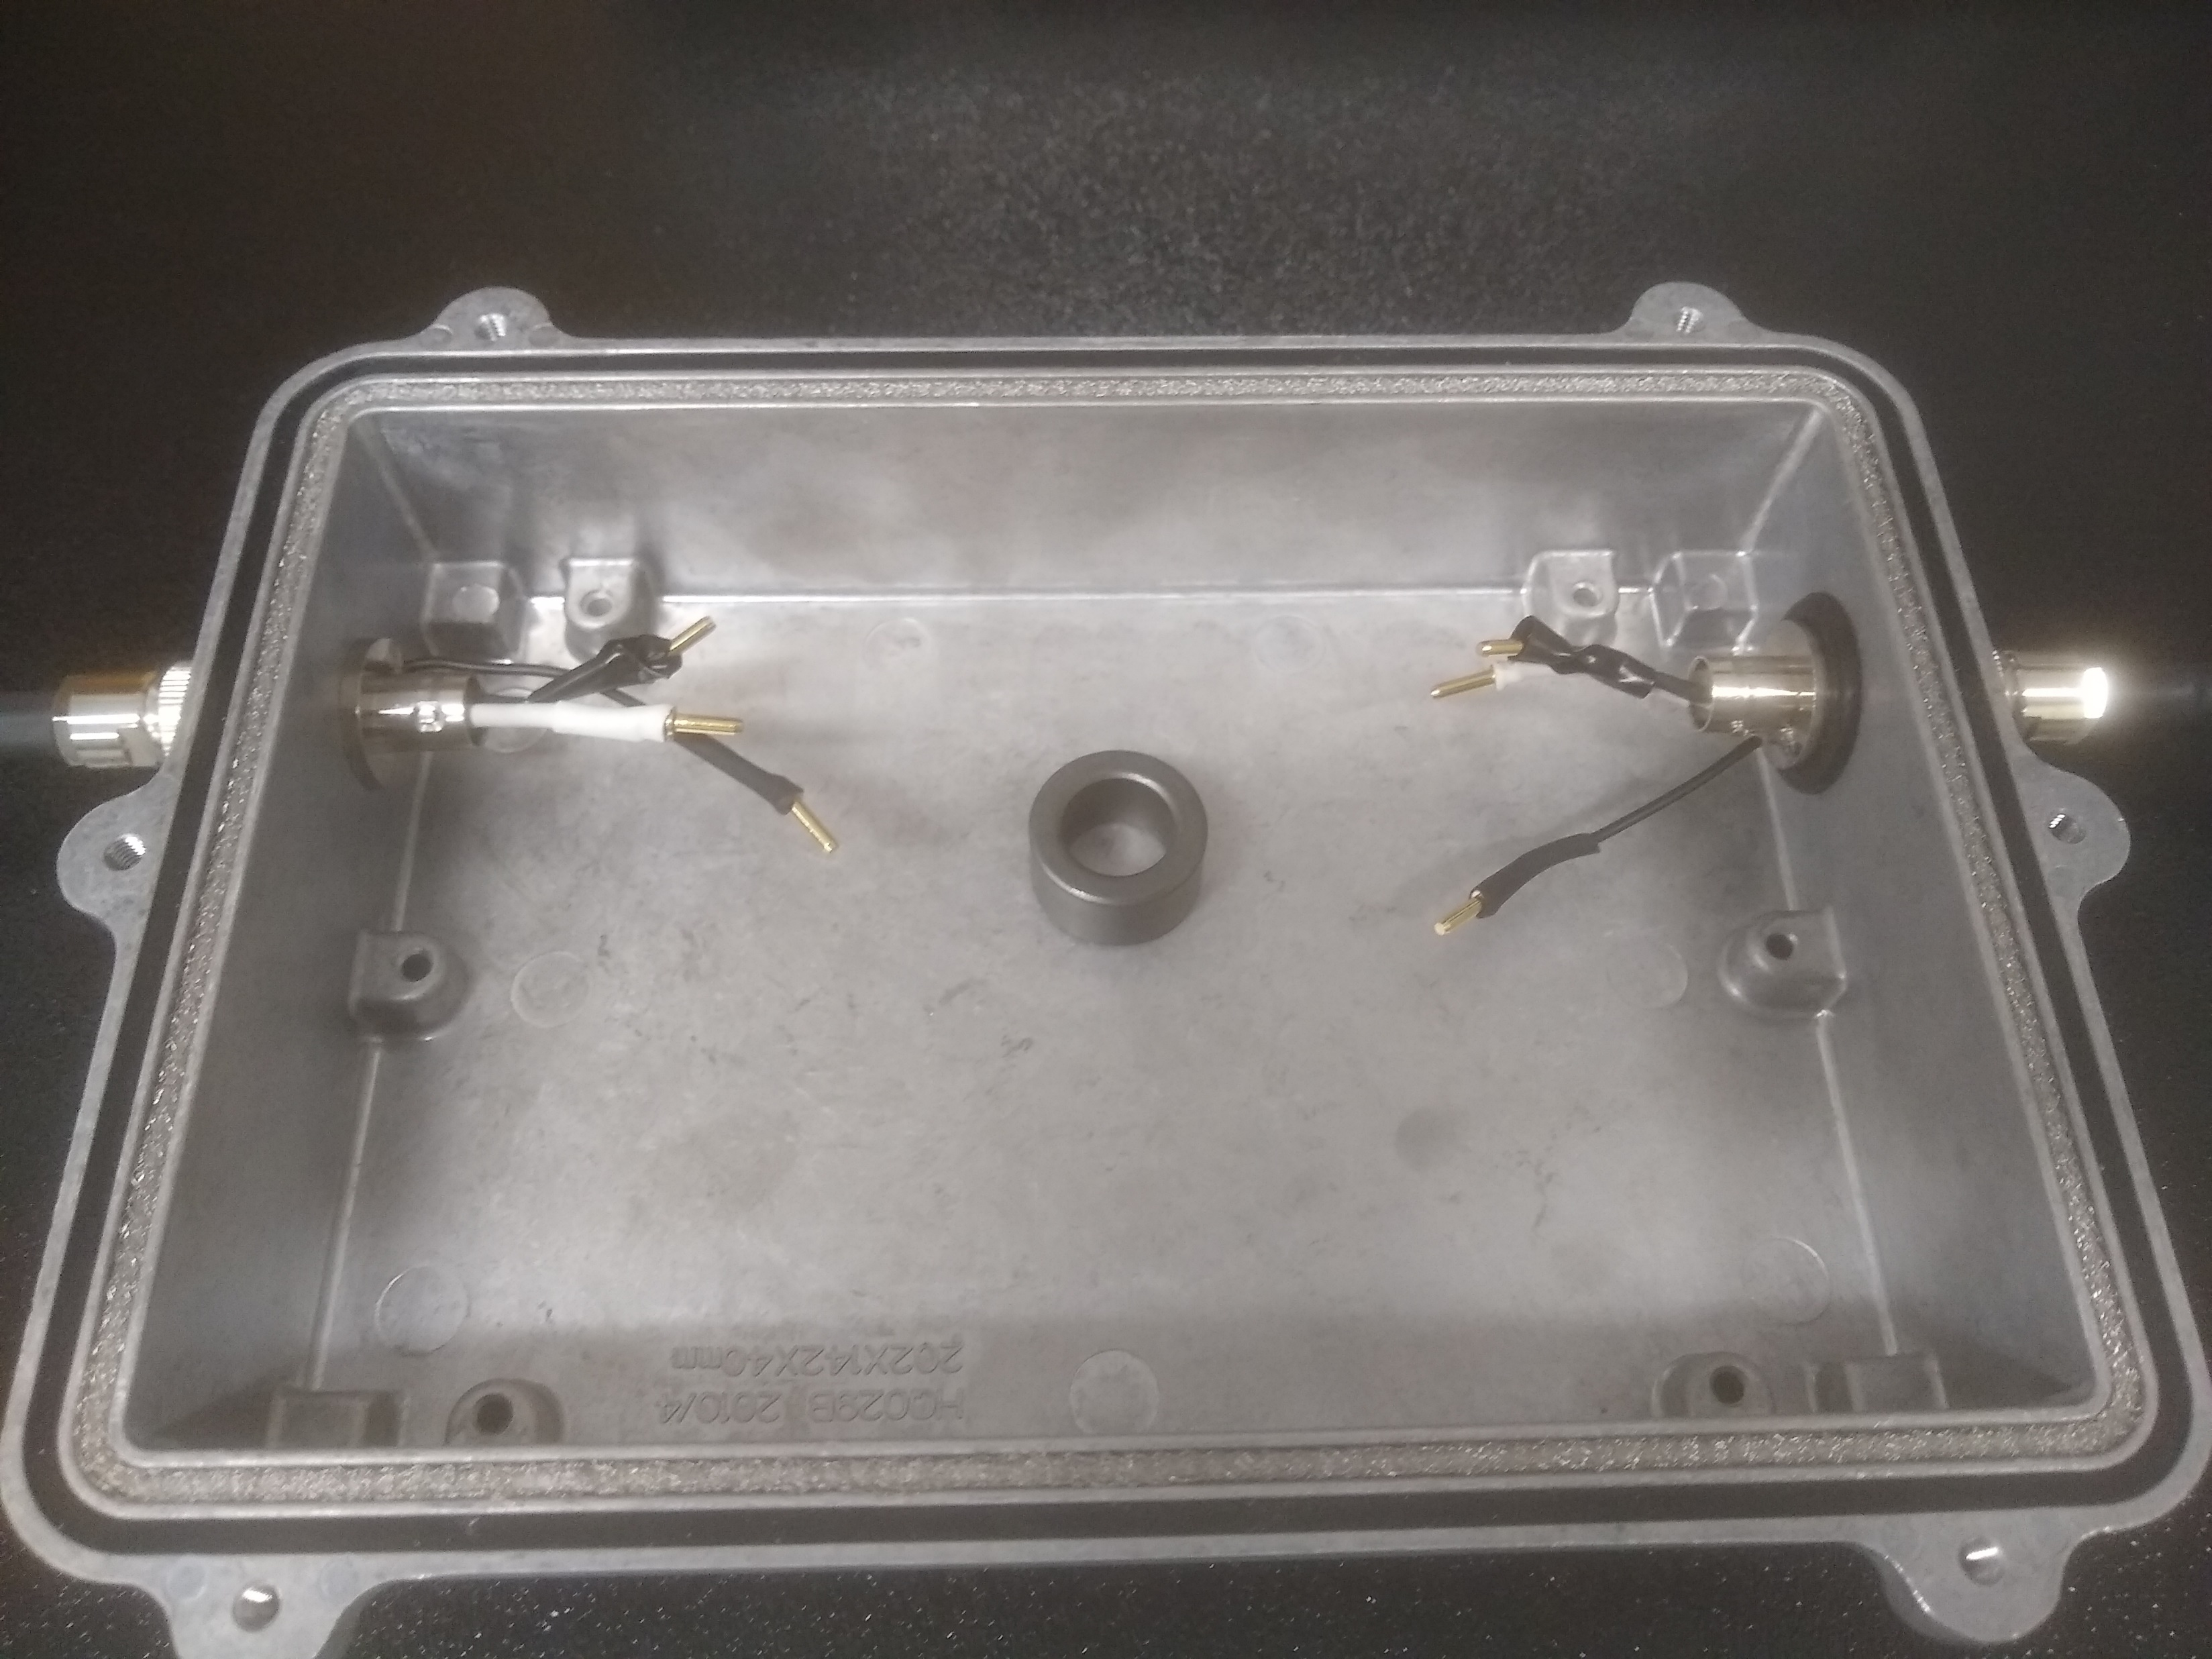
Measurements
With low impedance HV pulser output, we can emulate expected current pulses
The common mode choke will be swapped out with different coils
Externally clamped ferrite beads will be tested as well
Oscilloscope will read out attenuated signal seen by second X-ARAPUCA module
Ensure that discharge will not affect electronics in second module
Best performing coils and beads will characterized in LN2

Slide 9
Backup Slides

Slide 10
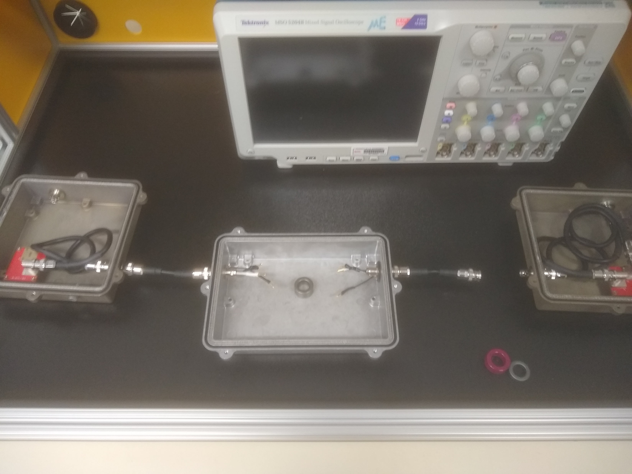
Closer look
Board with ground connected to shield, red PCBs with BAV99 diodes
Middle box to be filled with different coils to characterize effectiveness of common mode attenuation

Slide 11
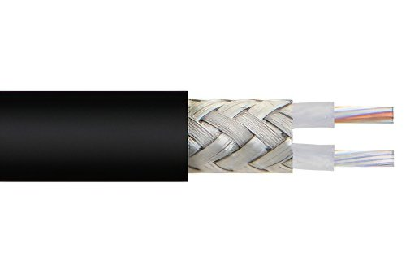
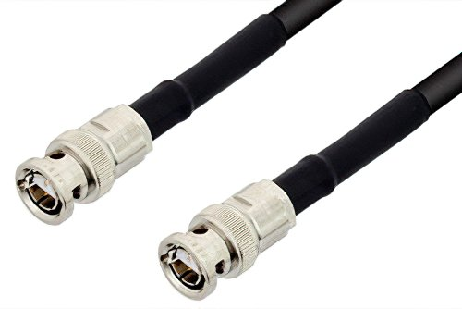
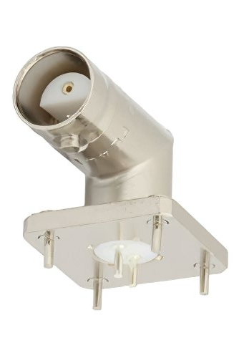
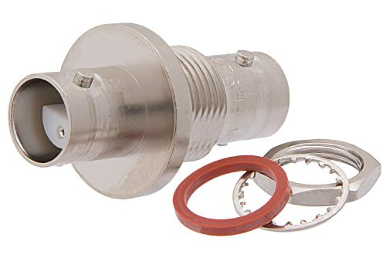
Cable
BNC Twinax uses RG 108
Rated up to 1kV
Standardized connectors and feedthroughs

