Slide 1
Progress of Analog Readout Design
David Christian
Fermilab
April 14, 2022

Slide 2
Development started 14 months ago
Five joint meetings were held with DARKSIDE in Feb-Mar 2021
DARKSIDE was developing an optical analog readout
Goals: Fast rise time (<8 ns), SNR>10 (1PE=20mV at receiver), dynamic range = 100 (2V max at receiver)
Light source = 1300 nm InGaAs LED (SiPMs are blind to 1300 nm light)
Extreme requirement on radiopurity
Problems included LED nonlinearity at LN2 and poor light coupling to the fiber.
At Fermilab, we started by exploring the use of COTS parts (SFP+ modules) in the context of a digital readout option.
(following work done earlier at SMU for DUNE (Jingbo Ye’s group) and in consultation/collaboration with the SMU group)
The group at APC, Paris (Sabrina Sacerdoti, et al.) decided early on to concentrate on the analog readout option.

Slide 3
FNAL: Mixed Success with COTS Optical Parts
None of the SFP+ modules that we tested worked in LN2
At least one type of module transmitted successfully (10 Gbps) in LN2 if turned on at RT and then cooled down, but none worked after a power cycle in LN2
The Rx side of all modules failed in LN2.
We decided to test individual components and relatively quickly identified a number of 1310 nm laser diodes and at least one commercial laser driver that worked well in LN2.
Two types of 1310 nm laser diodes are made, examples of each work in LN2:
Fabry-Perot (FP) & Distributed Feedback (DFB)
The diode characteristic (light vs bias current) is very different in LN2
Much less current is required in LN2 than at RT

Slide 4
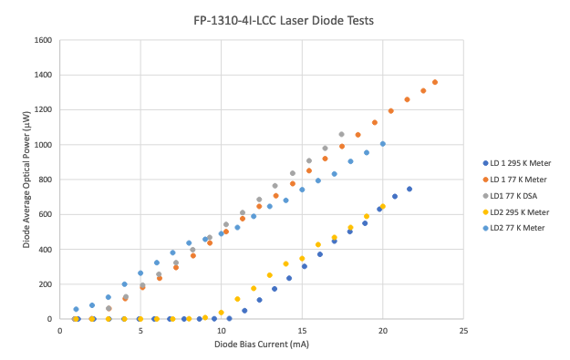
Laser Diode Characteristic (Room Temp & LN2)
These are some of the earliest measurements we made; response is very linear both warm and cold.

Slide 5
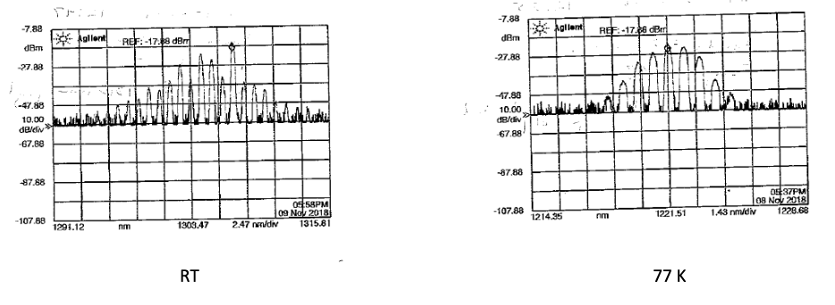
Aside: laser frequency also changes
Measurements of a Newport Fabry-Perot pigtailed LD

Slide 6
APC: Focus on analog readout
DUNE specs will differ from DARKSIDE
Single PE SNR>4
Dynamic Range goal = 2000 PE
Rise time < 100 ns
Bandwidth ~ 5-35 MHz
Power consumption < 100 mW
Design focus:
Laser driver
Also testing laser diodes
VCSELs (most did not work well in LN2)
1310 nm (results agreed with FNAL tests)
Identified a commercial warm photodiode board (Koheron PD100)

Slide 7
Joint APC/FNAL Development (May, 2021 - …)
Concentrated on 1310 nm laser diodes from a number of vendors
Pigtailed lasers are available only coupled to single mode fibers
Multimode fiber is preferred (50 micron core vs 7 micron core)
Converged on Lasermate lasers in FC receptacles
First circuit near-final (APC design “Argon”) presented on June 9:
Input = 1 – 4 hybrid-ganged group of 20 SiPMs
THS4131 amplifies signal from SiPMs
OPA354 opamp and SiGe bipolar transistor form the laser driver
“Argon 2x2” finalized mid-August
First FNAL layout – mounting holes for Lasermate FC or pigtailed laser diodes
2 channels (sufficient for a 60cm x 60cm X-Arapuca with 160 SiPMs (2 x 4 x 20)

Slide 8
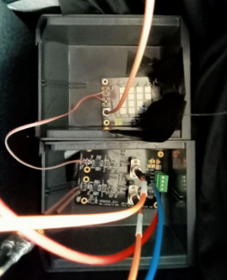
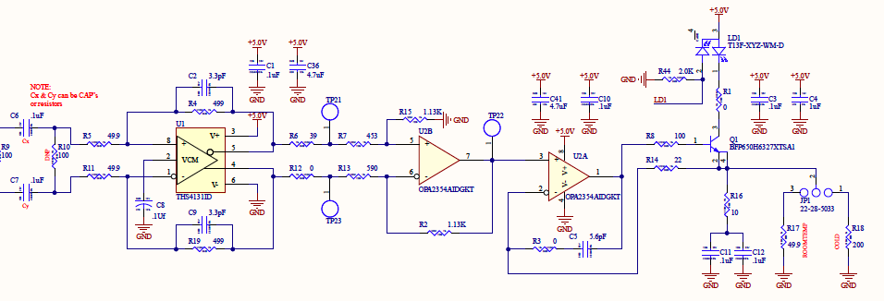
Argon 2x2
20 SiPM test board
Argon 2x2 under test in Paris in early September, 2021
Jumper option sets laser bias either for warm or cold operation

Slide 9
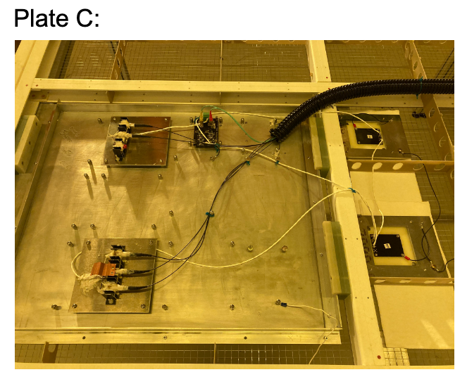
At CERN in late September, 2021 (on the VD Coldbox cathode)
Argon 2x2
PoF for Argon 2x2
“Mini Arapucas”
PoF for SiPM bias

Slide 10
Focus since the first coldbox test
Refinement of the Argon 2x2 circuit
Facilitate testing/optimization by enabling separate control of LD bias and total channel gain (proven unnecessary in the process)
Redesign board to facilitate mounting on the cathode (right angle mount for laser diodes to allow large fiber bending radius)
Enable automatic mode switching (warm/cold)
Include PoF and DC/DC converters on the same PCB as Argon 2X2
Enables compact self contained package next to X-Arapuca
Allows for the possibility of distributing SiPM bias and LV power to other cathode-mounted modules.

Slide 11
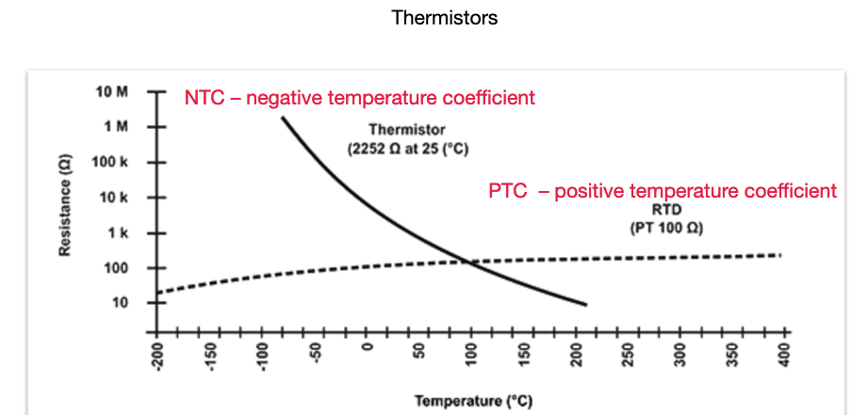
Automatic mode switching
Solution suggested and demonstrated by Alex Kish
Use resistors with large temperature dependance of passively switch between “warm” and “cold” configurations

Slide 12
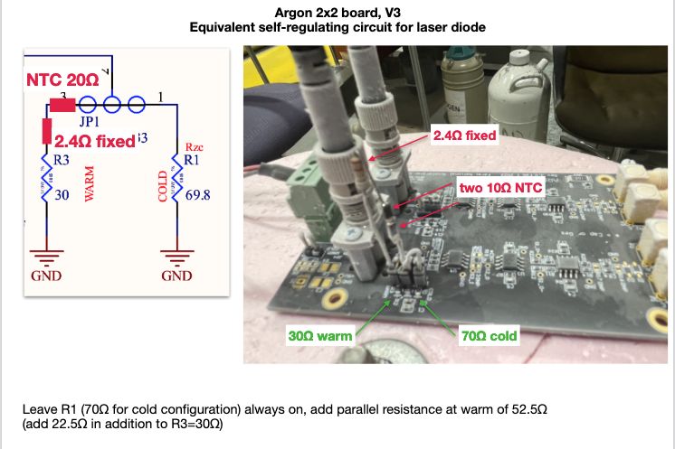
Proof of Concept

Slide 13
New PCB for “Coldbox 3” Test in July
DC/DC converters in SIMM connectors
Up to 8 PoF Photovoltaic receivers (silicon or Gas)
Argon 2x2 with lasers & laser driver on daughter card

Slide 14
Longevity
THS4131 “fabricated using Texas Instruments state-of-the-art high voltage complementary bipolar process.”
Same family as the amplifier used in the HD PD cold electronics.
Should have a very long lifetime in liquid argon.
SiGe bipolar transistor & laser diode both also should have very long lifetime at cryogenic temperature.
OPA2354 is a CMOS opamp.
Its longevity will need to be demonstrated or we will need to find an alternative part.

