Slide 1
Principal findings of CMOS lifetime studies
Veljko Radeka
BNL
April 14, 2022
Extensive literature: ~100 references since ~1983 Basics
Studies at Georgia Tech, since ~ 2006 - “
“ “ BNL “ ~ 2008 - “
“ “ FNAL with SMU “ ~ 2010 - “
“ BNL ~ 2018 - COTS

Slide 2
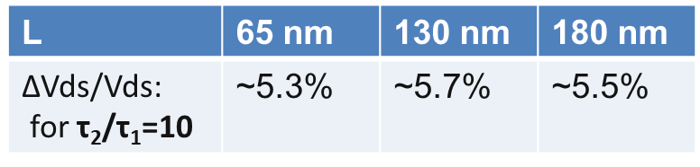
Findings: HCE vs T in CMOS
HCE behavior is the same for technology nodes, 180nm, 130 nm and 65 nm) from TSMC, Global Foundries and IBM.
Identical steep slope of HCE lifetime log τ vs 1/ V_{ds} → Reducing V_{ds} by ~ 6% makes the lifetime an order of magnitude longer in all three nodes [2, 6, 7]:
HCE Lifetime of digital circuits (ac operation) is extended significantly by the inverse duty factor compared to dc operation (analog circuits) at equal Vds.
Based on the results of these studies, and the validity of lifetime dependence on 1/Vds, it has become possible to design and perform accelerated stress tests for some COTS without detailed information about their design.
HCE Lifetimes well in excess of anticipated long duration of the planned long term physics experiments can be achieved. L
65 nm [
130 nm
180 nm

Slide 3
CMOS HCE “lifetime” vs “reliability”
Lifetime due to aging: A limit defined by a chosen level of predictable monotonic degradation in e.g., drain current, transconductance, due to a well understood mechanism. The device “fails” if a chosen parameter gets outside the specified circuit design range. This aging mechanism does not result in sudden device failure.
Random failures (“reliability”): At high temperatures (300-400K) there are several mechanisms of complete device failure strongly temperature dependent (e.g., electromigration, stress migration, time-dependent dielectric breakdown), which become negligible at low temperatures,
“Physics-of-failure” modeling [8] for CMOS technology in LAr is reduced to study of hot-carrier effects (HCE) as the dominant aging mechanism.
Thermal expansion/contraction is studied separately, not related to HCE.

Slide 4
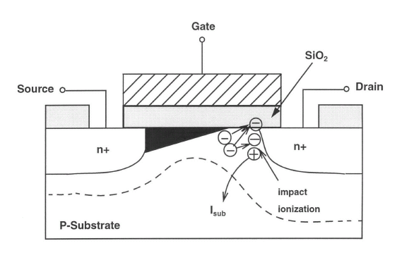
Overview of Basics on Hot-electron effects (HEC) and NMOS lifetime (1)
In deep submicron NMOS (L<0.25µm) electrons can become “hot” at any temperature, by attaining energy E>kT.
Some hot electrons exceed the energy required to create an electron-hole pair, resulting in impact ionization. Electrons proceed to the drain. The holes drift to the substrate. The substrate current,
(1)
A very small fraction of hot electrons exceeds the energy required to create an interface state (e.g., an acceptor-like trap), in the Si-SiO₂ interface, for electrons (~4.6eV for holes). This causes a change in the transistor characteristics (transconductance, threshold, intrinsic gain). The time required to change any important parameter (the changes in different parameters are correlated) by a specified amount (e.g., gm by -10%) is defined as the device lifetime. It can be calculated as,
(2)
q = electron charge
λ= electron mean free path
E_{m}= electric field
q λ E_{m}= mean hot electron energy
I_{ds}= drain-source current
W= channel width
C₁, C₂ - constants

Slide 5
Overview of Basics on Hot-electron effects (HEC) and NMOS lifetime (2)
It has been widely recognized in the literature (e.g., [1] and [2]) that I_{sub} is a monitor for all hot-electron effects and it is the best predictor of device lifetime.
The reason that device lifetime or degradation may be predicted from the substrate current I_{sub} is that both observable hot electron effects (electrical and optical) are driven by a common driving force – the channel electric field, or more specifically the maximum channel electric field E_{m} , which occurs at the drain end of the channel.
The substrate current is connected to the lifetime (defined by any arbitrary but consistent criterion) by the relation {obtained by cancellation of qλE_{m} between Eqs, (1) and (2)},
(3)
The constant H [As/µm] is a function of the channel length L, the device technology (interface quality, details of drain doping, etc.) and the criterion used for definition of the lifetime (e.g., 10% decrease in transconductance, g_{m}, as used in industry).

Slide 6
Overview of Basics on Hot-electron effects (HEC) and NMOS lifetime (3)
Lifetime τ vs I_{sub}/I_{ds} and I_{ds}/W
While the proportionality constant H will vary from case to case depending on the technology, channel length, temperature, the functional relationship
in Eq. (3) is most useful in lifetime measurements and predictions,
(4)
The exponent α is defined as the ratio of the critical electron energy to generate an interface trap and the critical energy to produce an electron-hole pair by impact ionization,
The ratio of these two critical energies defines the very steep dependence of the lifetime on the substrate current. This ratio is largely independent of temperature.

Slide 7
Measurement Type I: “I_{sub} Stress Plot”
Fig.1. This is an accelerated lifetime test where the transistor is placed under a severe stress, to reduce the lifetime due to hot-electron degradation to a practically observable range, by a drain source voltage considerably higher than the nominal voltage (1.8V for L_{min}=180nm). The measured points at both 300K and 77K are very close to the characteristic slope for the interface state generation, a≈3.

Slide 8
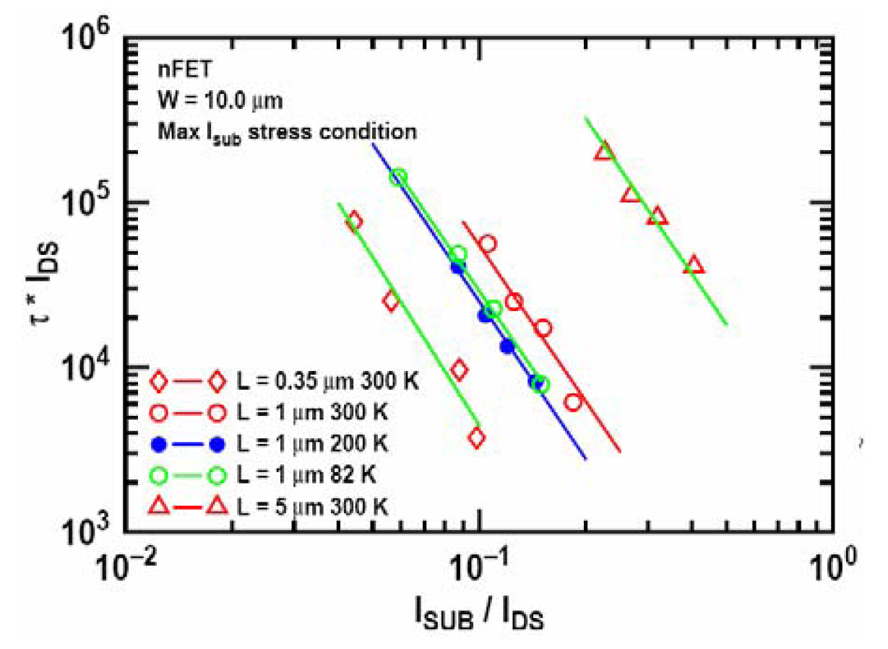
I_{sub} stress plots for IBM SiGe BiCMOS process J. Cressler, et al., Georgia Tech [2] confirming the slope:
L=0.18 µm 300K (BNL)
Fig.2.

Slide 9
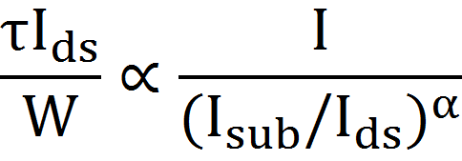
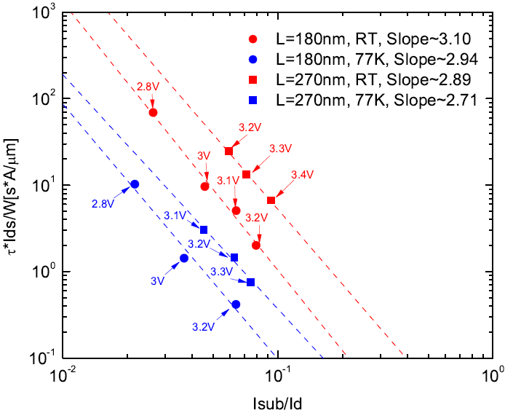
Lifetime vs substrate current (normalized to channel width and current): Slope for TSMC L=180 and L=270 nm
The slope is largely independent of the channel length and temperature.
For constant I_{sub}/I_{ds}, the lifetime increases with channel length.
Each stress point is a new (“fresh”) device sample (two different L devices, 13 samples in this plot).

Slide 10
Measurement Type II: Lifetime vs 1/V_{ds} from accelerated stress measurements (BNL [6])
ASIC design: Vds<1.5V
TSMC NMOS L=180nm, W=10µm (5x2µm); nominal core voltage 1.8V.
The projected lifetime at 300K is ~ an order of magnitude longer than at 77K. Reducing V_{ds} at 77K by ~ 6% makes the lifetime equal to that at 300K.

Slide 11
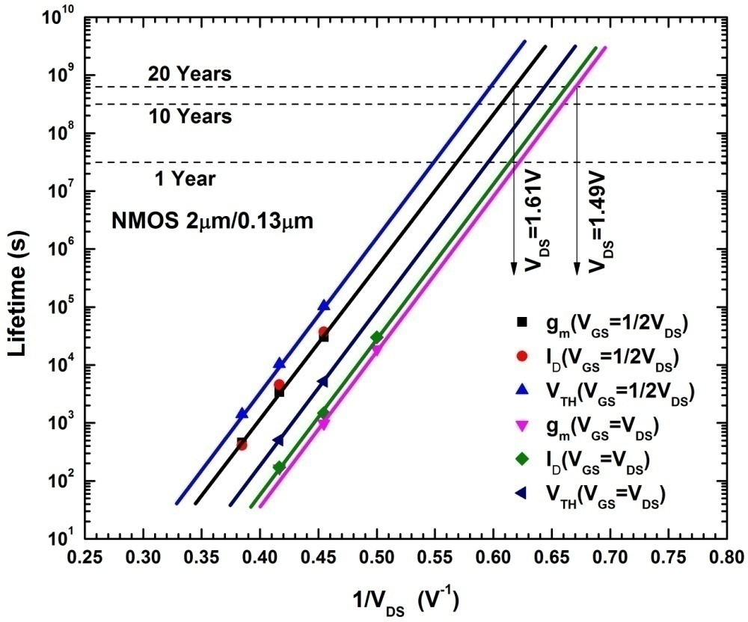
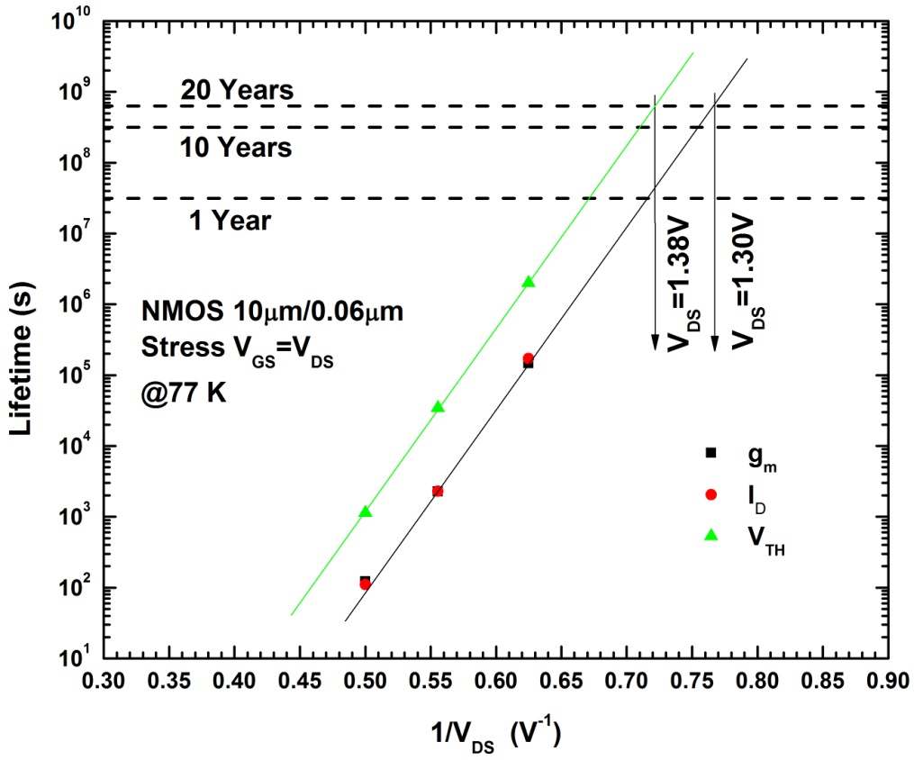
CMOS in dc Operation (180nm, 130 nm and 65 nm)
Reducing V_{ds} at 77K by ~ 6% makes the lifetime an order of magnitude longer in all three technologies → identical slope τ vs 1/ V_{ds} at respective nominal V_{ds}
L | 65 nm | 130 nm | 180 nm
∆Vds/Vds: for τ₂/τ₁=10 | ~5.3% | ~5.7% | ~5.5%
(Data for 130nm
and 65nm,
courtesy of
G. Wu_SMU)
130 nm
65 nm

Slide 12
Why is the dependence of Lifetime on V_{ds} so strong?
The lifetime is given by,
Electrons in the MOS channel reach energies well above thermal both at 300K and at 77K . However the mean electron energy, , at the electric field in the range E_{m} ≥100kV/cm. At 77K it is slightly higher,
Only a tiny fraction of “hot” electrons reaches the much higher energy required to create an interface state. This makes the exponent in the relation for the lifetime very large,
Since , the ratio of lifetimes for two slightly different values of V_{ds} is given by,

Slide 13
Measurement Type I: Substrate current I_{sub} vs 1/V_{ds}
Note that
lifetime:
ASIC design: Vds<1.5V
One order of magnitude in substrate current I_{sub} corresponds to three orders of magnitude in lifetime

Slide 14
LArASIC for MicroBooNE: I_{sub} and 1/V_{ds} distribution for all transistors (TSMC 180nm, 1.8V node)
L=270 nm; Vds=1.5V; Ids/W=2.4µA/µm
L=360 nm; -”- ; Ids/W=1.0µA/µm
L=9 µm
L=270 nm
LArASIC was designed
with low noise and low power as design goals -- long before lifetime studies were done
The result: All transistors in LArASIC are well below nominal voltage of 1.8V and at low I_{sub}
L=9 µm
1.5V 1.0V 0.5V

Slide 15
Designing CMOS for low power → long lifetime
Life time testing (stress) region (V_{ds}>1.8V)
Design region (approx.) for low power and long lifetime at 77K (moderate inversion)

Slide 16
CMOS in AC operation: Logic circuits and FPGAs
It has been long established (1994 [3]) that ac and dc hot-carrier induced degradation is the same if the effective stress time is taken into account. This quasi-static model, confirmed recently (2006 [4]) considers the ac stress as a series of short dc stresses strung together.
The lifetime of a logic circuit driven at a clock frequency can be related to the lifetime of the NMOS transistor under continuous ac operation in terms of the ratio of the effective stress time during a change of state and the clock period. Thus the Lifetime of digital circuits (ac operation) is extended by the inverse duty factor compared to dc operation. This factor can be large (>100) for deep submicron technology and clock frequencies needed for TPC readout.
Design guidelines for digital circuits and FPGAs: Keep the inverse duty factor high. As an additional conservative measure, reduce V_{ds} by 6%, for each order of magnitude margin in the lifetime.

Slide 17
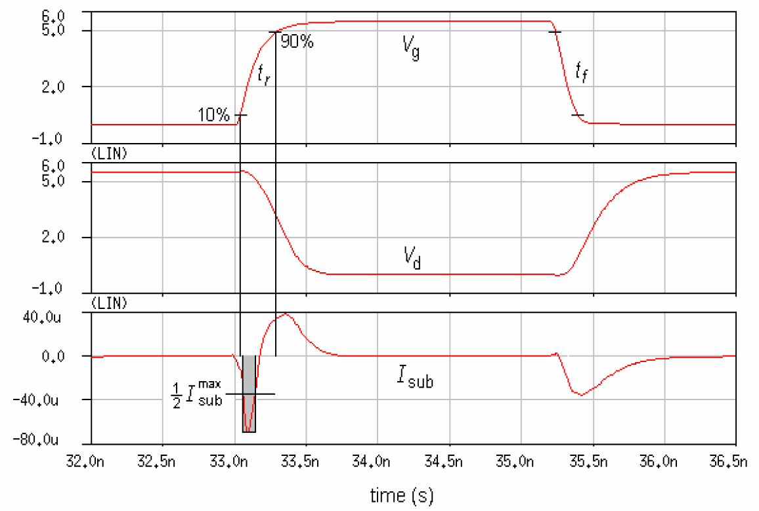
Effective Stress Time is a small fraction of the Clock Cycle:
Standard method for accelerated stress testing of FPGAs: Observe ring oscillator frequency under severe Vds stress.
(Degradation of Ids leads to increased rise (propagation) time and reduced ring oscillator frequency.)
Hot-carrier induced degradation occurs only when the substrate current is high, i.e., high Vds and high Ids.

Slide 18
Principal findings and design guidelines
1. Several studies of hot-electron effects on the device lifetime have been performed on TSMC and Global Foundries NMOS 180nm, 130 nm and 65nm nodes at 300K and 77K. Due to a common strong 1/Vds dependence, a lifetime margin of several orders of magnitude can be achieved for the cold electronics TPC readout. The low power ASIC designs for MicroBooNE and DUNE fall naturally into this domain, where hot-electron effects can be made negligible.
2. Lifetime of digital circuits (ac operation) is extended by the inverse duty factor compared to dc operation. This factor can be large (>100) for deep submicron technology and clock frequencies needed for TPC. As an additional margin, V_{ds} may be reduced by ~ 6% per decade.
3. COTS lifetime determination by accelerated stress testing is feasible if the device is known to be CMOS based (FPGA, ADC). [Shanshan Gao].
4. Principal guideline for noble liquid detectors: do not design for 10, 20, 30 years: the strong dependence on 1/Vds, makes adding orders of magnitude margins feasible (30 years x 10=300 years).

Slide 19
References (only a few key references; more in [6] and [7])
C. Hu, S. C. Tam, F.-C. Hsu, P.-K. Ko, T.-Y. Chan, and K. W. Terrill, “Hot-electron-induced MOSFET degradation-model, monitor, and improvement”, IEEE Journal of Solid-State Circuits, vol. sc-20, no. 1, pp. 295-305, Feb. 1985.
T. Chen, C. Zhu, L. Najafizadeh, B. Jun, A. Ahmed, R. Diestelhorst, G. Espinel, and J. D. Cressler, “CMOS reliability issues for emerging cryogenic Lunar electronics applications,” Solid-State Electronics, vol. 50, pp. 959-963, 2006.
K. N. Quader, E. R. Minami, W.-J. Huang, P. K. Ko, and C. Hu, “Hot-Carrier-Reliability Design Guidelines for CMOS Logic Circuits”, IEEE Journal of Solid-State Circuits, vol. sc-29, no. 3, pp. 253-262, March 1994.
J. Wang, E. Olthof, and W. Metselaar, “Hot-Carrier Degradation Analysis Based on Ring Oscillators”, Microelectronics Reliability, 46, pp. 1858-1863, 2006.
A. Duncan, U. Ravaioli, and J. Jakumeit. “Full-band Monte Carlo investigation of hot carrier trends in the scaling of metal-oxide-semiconductor field-effect transistors”. IEEE Trans. Electron Devices, 45, April 1998.
S. Li, J. Ma, G. De Geronimo, h. Chen, and V.Radeka, “LAr TPC Electronics CMOS Lifetime at 300 K and 77 K and Reliability Under Thermal Cycling”, IEEE Trans. Nucl. Sci. Vol. 60, No. 6, Dec. (2013) 4737-4743.
J.R.Hoff, G.W.Deptuch, G.Wu, P.Gui, “Cryogenic Lifetime Studies of 130 nm and 65 nm nMOS Transistors for High-Energy Physics Experiments”, IEEE Transaction on Nuclear Science, vol. 62, no. 3, (2015), pp. 1255-1261 .
M. White and J.B. Bernstein, “Microelectronics Reliability: Physics-of -Failure Based Modeling and Lifetime Evaluation”, JPL Publication 08-5 2/08.
Note: Manuals for each CMOS technology node provided by major foundries are devoted to guidelines how to maximize transistor lifetime. An instructive example is IBM’s ~300 page manual for the 90nm node.

Slide 20
Electric field at channel/drain boundary
Electric field parallel to the interface in the region close to the channel/drain boundary from Monte Carlo Simulation [Duncan, et al.]. Device bias conditions: source Vs = 0V , substrate Vb = 0V , gate Vg = 3V , drain Vd = 3V.

