Slide 1
ICARUS commissioning and operations
A. Fava
SBN Oversight Board meeting 06/10/2022

Slide 2
Timeline of ICARUS commissioning and operation
Detector in nominal operating conditions since August 28th 2020, overall excellent stability.
24/7 shifts since February 14th 2020, remote only since March 17th 2020.
Run Coordinator and Deputy changing every 2 months; currently F. Varanini (INFN-Padova) and Valerio Pia (University of Bologna). Shift team includes also one remote expert per each subsystem, one remote shift operation expert and one onsite expert.
Part-time data taking with neutrino beams since mid-March 2020, aside of commissioning.
First BNB neutrino Full time (24/7) neutrino beam run May 31st - June 27th 2021: “RUN-0”.
7 pm - 7 am weekdays and full weekends minimum time (~ 65%) dedicated to beam data collection since the restart of beams on Nov 5th.
CRT installation completed on Dec 10th 2021. CRT components in data since Feb 17th 2022.
3m thick concrete overburden installation completed on June 7th 2022.
2020
2021
2022
Aug 28, 2020
Detector activation
Mar 2021
First neutrinos
June - Oct 2021
Beam shutdown
Dec 10, 2021
CRT installation complete
June 7, 2022
Completion of
overburden
Dec 9-11, 2020
ORR
June 2021
RUN-0
Nov 5, 2021
Beginning of second beam
Feb 17, 2022
CRT components
in data

Slide 3
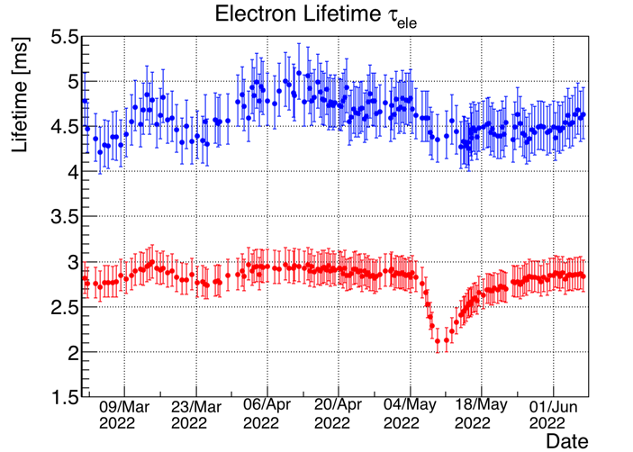
Status of the cryogenic system
Cryogenics/purification systems running steadily since detector activation. Some failures occurred with no impact on detector operation, thanks to the high level of redundancy. All functional parameters meet the design values.
Free electrons lifetime 𝜏 ~ 3/5 ms in West/East cryostats.
Although better than initial values
(𝜏 ≤ 1 ms in Sept 2020) and within
the design, lower than past ICARUS
operations at LNGS and unequal
between the two cryostats.
East cryostat
During next summer shutdown regeneration of the liquid recirculation filters of the West module, possibly resulting in an improvement and equalization of the purity.
West cryostat

Slide 4
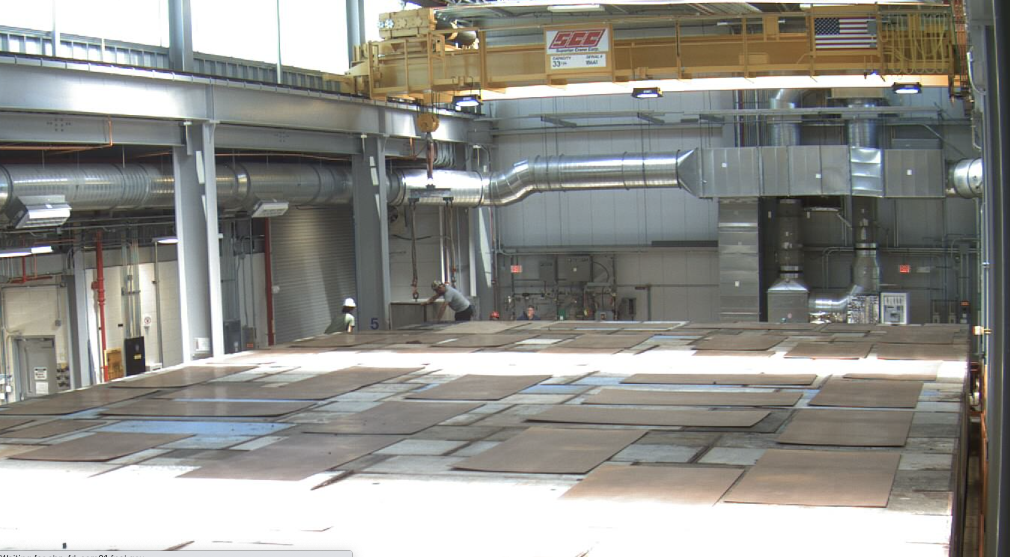
Installation of the overburden
Installation of overburden completed on June 7th 2022.
2.85 m thickness of concrete in 3 layers, total mass 2.6 kt.
At the North end:
non-uniform empty gap between first layer and pit;
second and third layer 1 foot (30 cm) shorter than first.
Workarounds under investigation, yet negligible impact on physics (4 m beyond the end of the active volume).
Installation of the last block of the overburden
North-end of the overburden

Slide 5
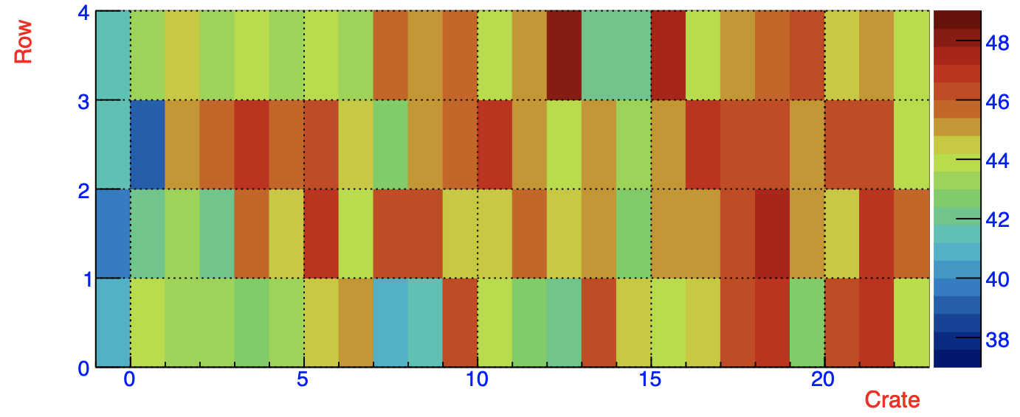
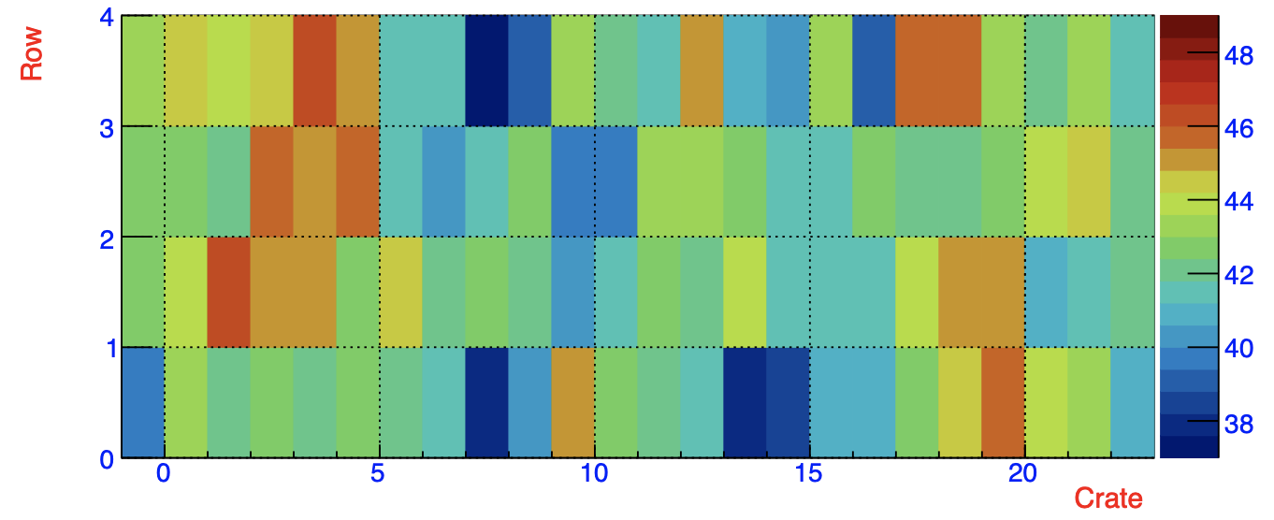
TPC power supply temperatures
High temperatures on TPC power supplies and front-end boards can impact noise and baseline, and/or force to switch off TPCs to avoid damage.
After the installation of the top CRT and even more after the first overburden layer, air flow on the ICARUS top strongly decreased – combined with warmer weather – resulting in an increase of several degrees on the TPC-PS (up to 49°C).
DAQ had to be stopped or ran without a complete TPC readout in several instances.
Starting on May 12, situation greatly improved thanks to lab support (rebalancing of building HVAC and installation of fans). No temperature over 47°C observed since then.
A more complete HVAC refurbishing will take place during summer shutdown.
TPC PS temperatures: May 10
TPC PS temperatures: May 15

Slide 6
Commissioning of the Cosmic Ray Tagger (CRT)
Side and top CRT have been taking cosmic and neutrino data steadily with TPC and PMT systems, for one year for side CRT and three months for top CRT. Bottom CRT DAQ still needs to be integrated with the entire system.
Rates without overburden for top CRT: 260/610 Hz for side/top. For side CRT, rates ~ few kHz, except for higher 20 kHz rate for North module, due to interference with cryogenic pumps.
Rates for top CRT decreased to 180/330 Hz for side/top with 3 m overburden .
Rates for horizontal modules of top CRT
Rates for vertical modules of top CRT
Beginning of
overburden installation
End of installation

Slide 7
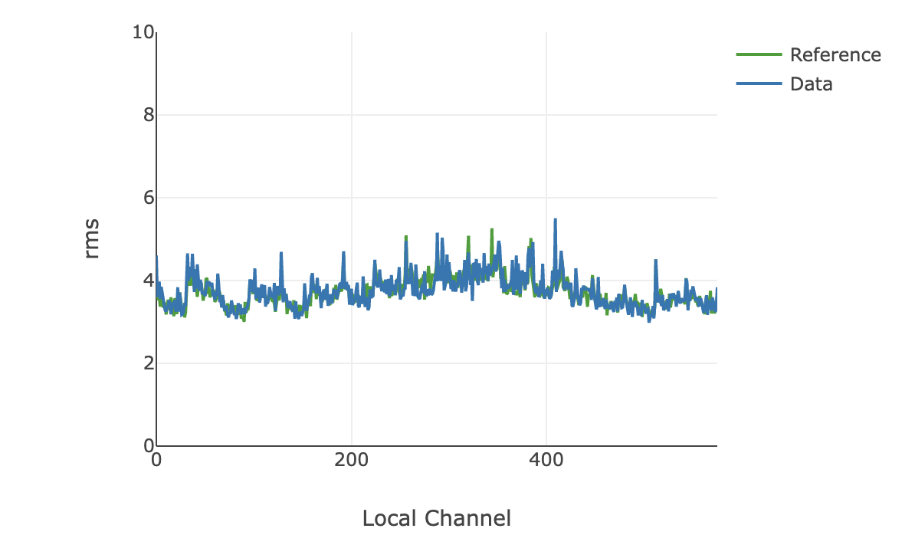
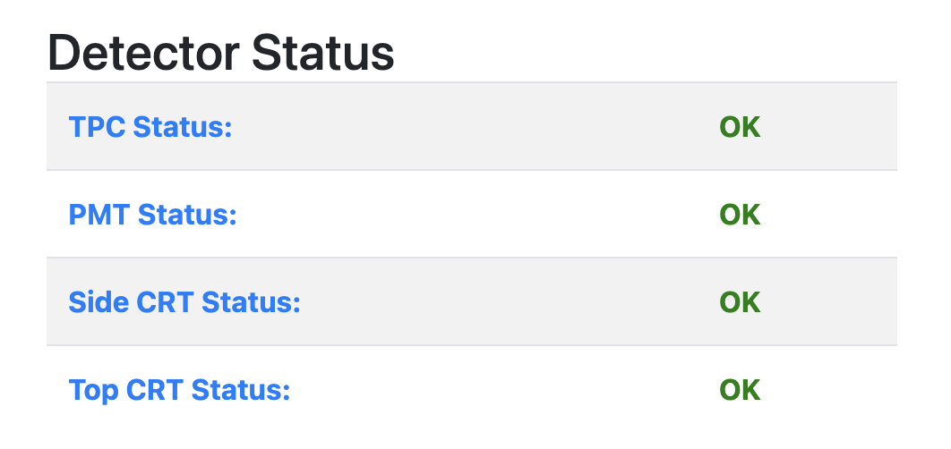
Data Quality Monitoring
Real-time monitoring of data quality (DQM) from all subdetectors is crucial for physics.
DQM receives data from DAQ, produces metrics from TPC/PMT/CRT and plots them on a front-end website:
  Channel status
  Noise RMS
  Waveforms
  Higher level (e.g. LAr purity, …)
Example of DQM for TPC: rms of noise
This information is summarized as a “detector status” with corresponding alarms.
Recently fully integrated and made available to shifter for continuous monitoring.

Slide 8
Data taking with BNB and NuMI beams
Replace
Average repetition rate 4Hz. Short successful test at 5 Hz on June 3rd 2022.
Overall efficiency of beam data collection >85%, despite part-time operation!
Main trigger: majority of the discriminated pairs of PMT signals (LVDS) in coincidence with the spill gates of BNB (1.6 μs) and NuMI (9.5 μs). Additional triggers: without any request on the scintillation light for a subset of the beam spills (Min-Bias), and outside of the beam spills (Off-Beam).
Data collected so far instrumental for calibrating the detector and tuning simulation and reconstructions tools.

Slide 9
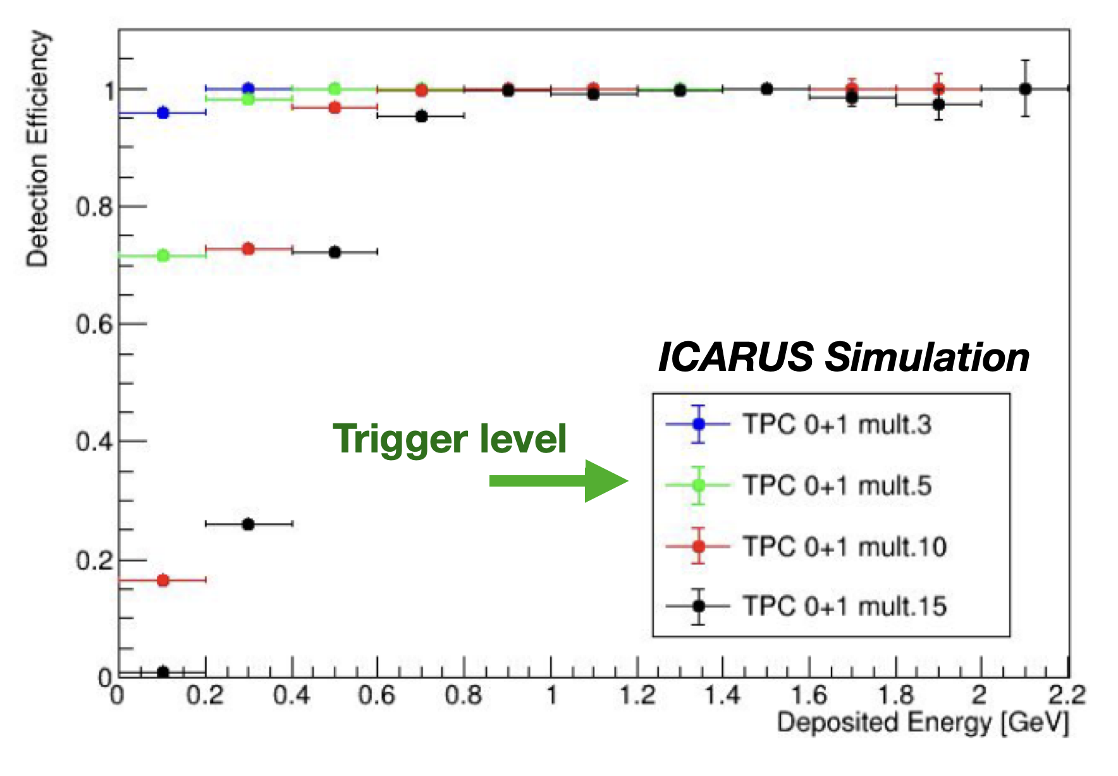
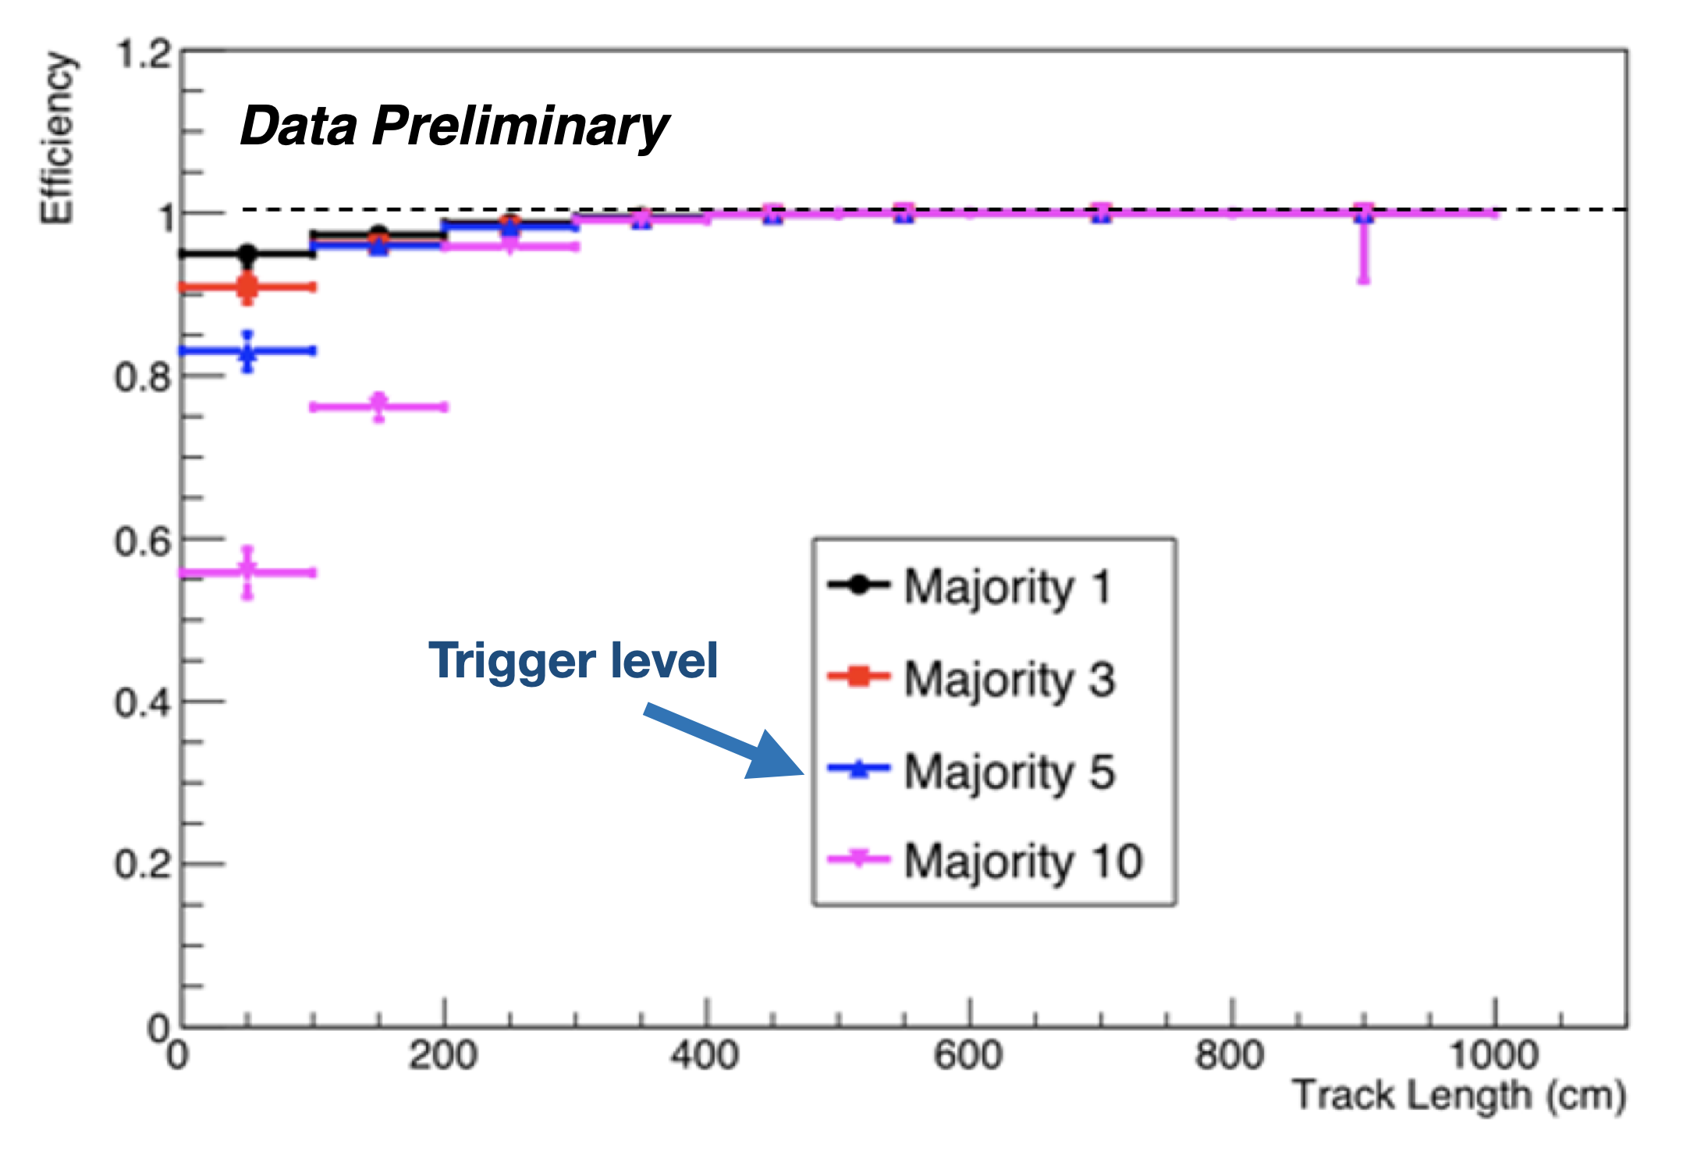
Trigger performance
Rates for the main trigger (13 photoelectrons PMT threshold, majority of 5 PMT LVDS signals): 164/187 mHz for BNB/NuMI.
Corresponding offbeam rates 123/119 mHz, compatible with ~ 14 kHz cosmic rate.
Additional 0.2 Hz of minimum-bias triggers, for a total rate < 1 Hz.
Efficiency: MonteCarlo simulation predicts > 97% for ν_{μ}CC with E_{dep} > 300 MeV.
Measurement on cathode-crossing μ tracks: 97% efficiency reached at 300 MeV.
Data collected with minimum-bias trigger, software emulation of hardware trigger based on recorded PMT waveforms
Trigger efficiency on ν_{μ}CC from MonteCarlo
Trigger efficiency measured on crossing cosmic μ

Slide 10
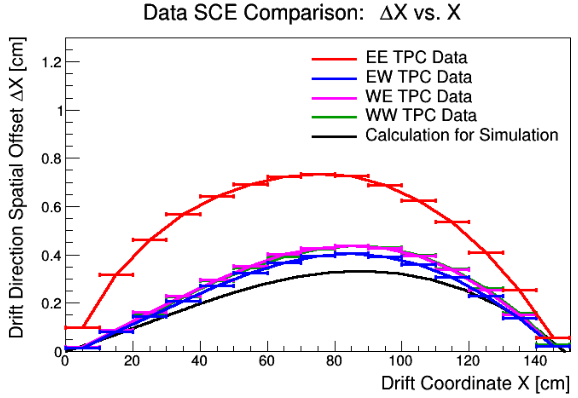
Tuning of detector modeling
Update to TPC noise model in simulation to better match data, applying scale factors scale factors plane by plane. Much better agreement.
Study of TPC wire response modeling on average waveform at the anode across many anode-cathode-crossing tracks.
Space charge effects (SCE) measured as spatial distortions in drift direction for anode-to-cathode cosmic μ. Good agreement with simulation, apart from one TPC where E field distortions associated with possible field cage short are being investigated.
TPC intrinsic noise
Data
Collection wire signal response
Space charge distortions in drift direction
MC after
tuning
MC before
tuning

Slide 11
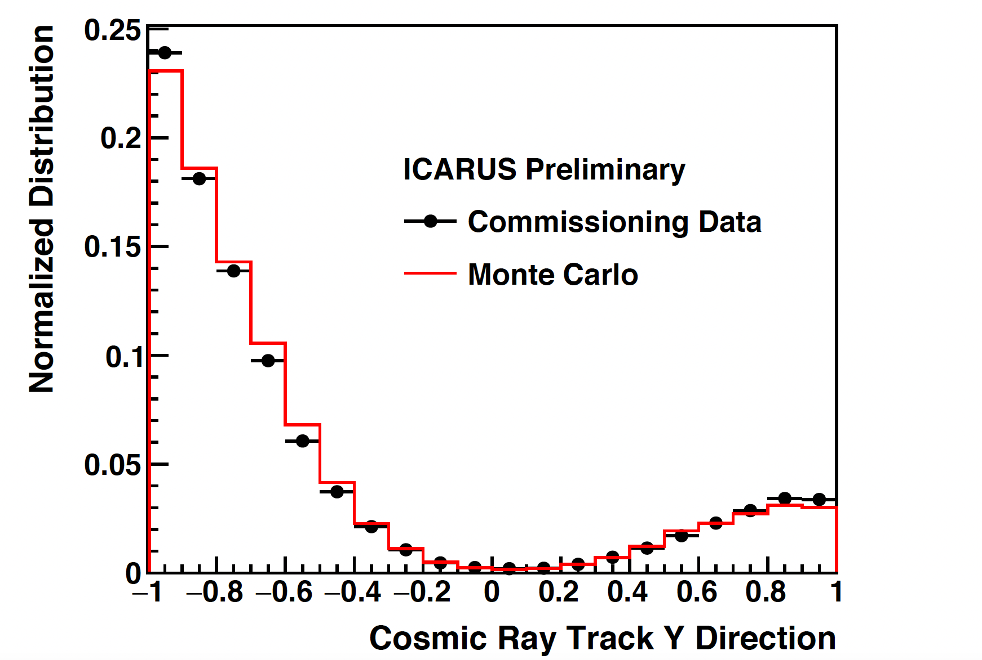
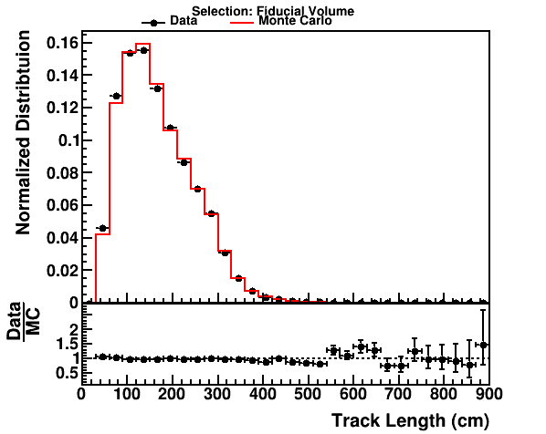
Track reconstruction: data/MC comparison
Comparison of cosmic events reconstructed in data and MC. Several reconstructed quantities have been studied to understand the features of the reconstruction.
Ongoing parallel study of shower reconstruction in cosmic rays for data and MC.
Preliminary indications of good end to end processing chain for both data and simulation.

Slide 12
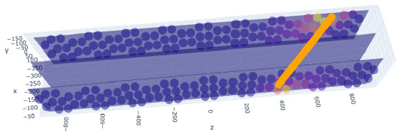
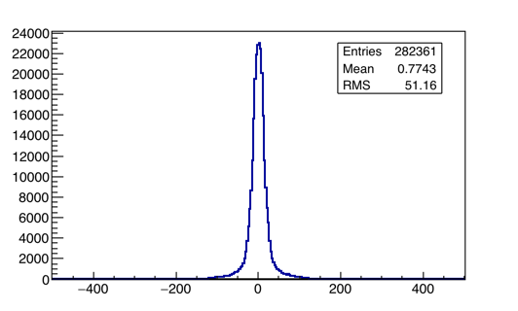
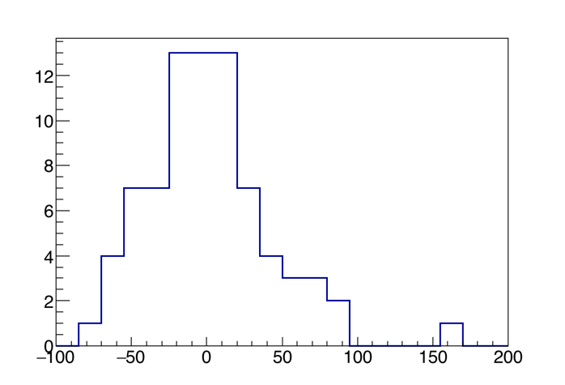
PMT-TPC association for cathode crossing μ in data
Simplified algorithm to compare track and light barycenter (z_{TPC}, z_{PMT}) along the longitudinal z axis.
Validation on data from RUN-0: cathode crossing cosmic μ and 78 BNB 𝜈_{μ}CC candidates with L_{μ} > 50 cm identified by scanning
Good association within Δz~1m.
PMTs (behind the wires)
Muon track
Central cathode
PMTs (behind the wires)
z axis
Fired PMTs
Cosmic muons
BNB 𝜈_{μ}CC candidates
#events
#events
rms=41 cm
z_{TPC}-z_{PMT} (cm)
z_{TPC}-z_{PMT} (cm)

Slide 13
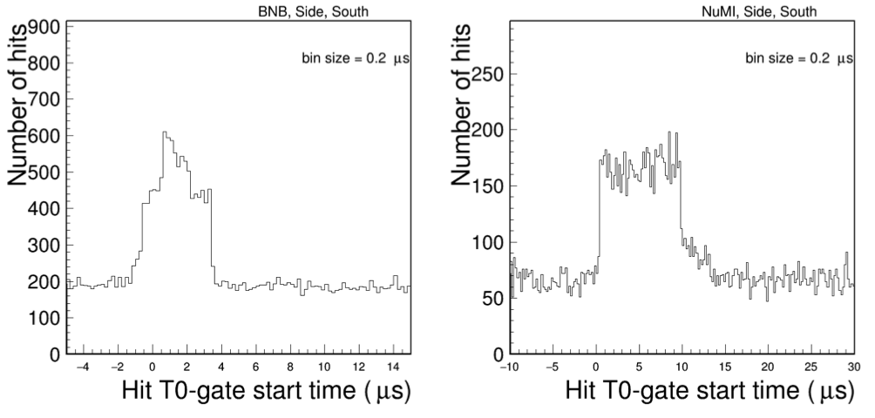
CRT timing
Side CRT time reconstruction relative to the gate start time
1.6 μs
BNB beam spill
9.5 μs
NuMI beam spill
4 μs trigger gate
12 μs trigger gate
Coincidence gate windows larger than beam gates: 4 μs (BNB) and 12 μs (NuMI).
Excess of CRT activity during the gate is due to trigger bias, the beam activity is visible as a further activity during the 1.6 μs/9.5 μs beam spill arrival time for BNB/NuMI.

Slide 14
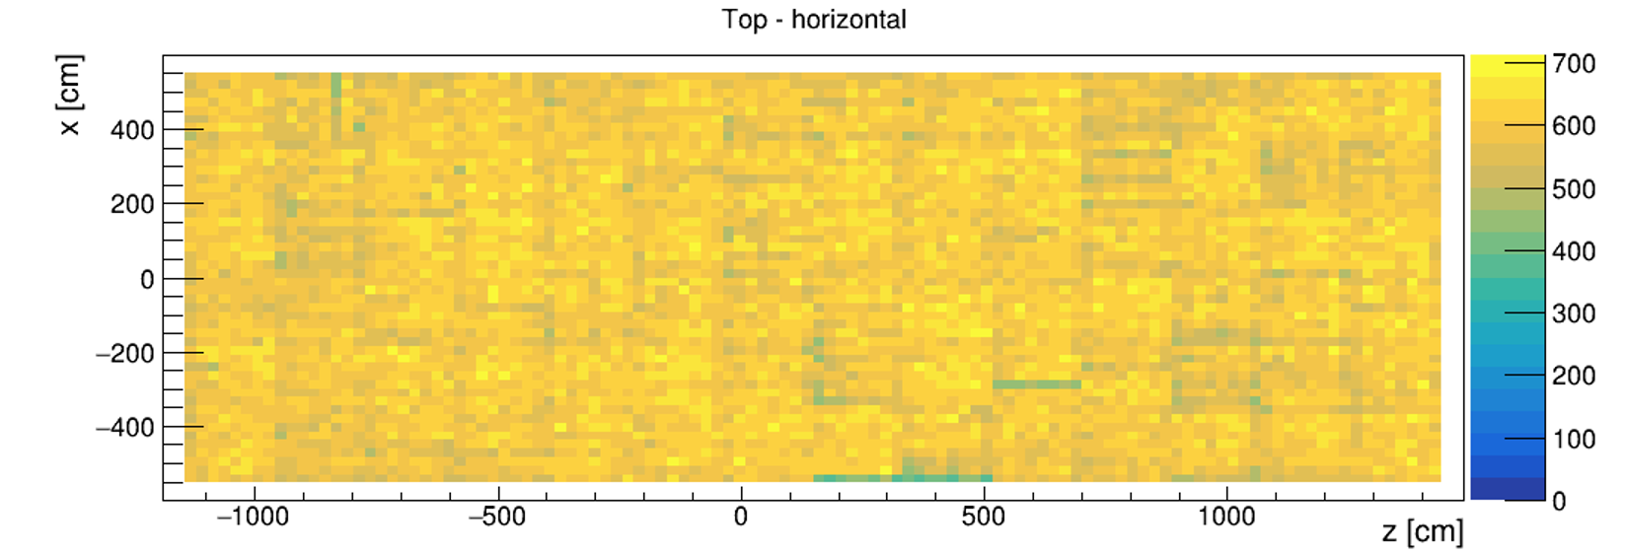
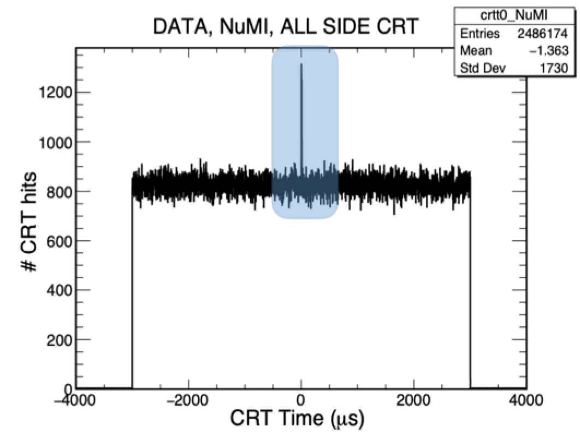
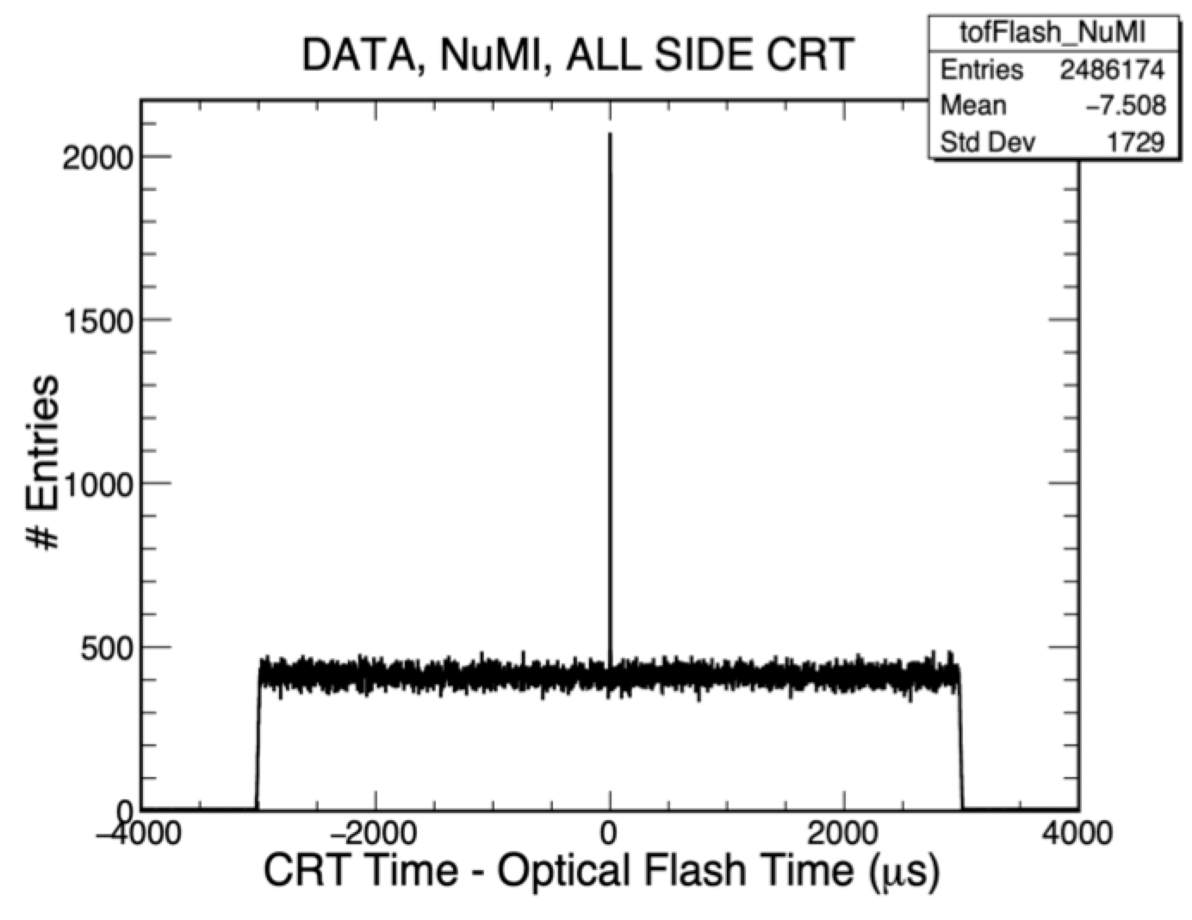
CRT reconstruction
Validation of the time reconstructed by the CRT. Initial studies confirm the match of side CRT and PMT in events collected triggering only on the NuMI beam spill. The detailed study of the time resolution is ongoing.
Geometrical distribution of cosmic rays detected by the TOP CRT
x (cm)
z (cm)
CRT-PMT
± 3 ms
± 3 ms
CRT Time (μs)
CRT Time - Optical Flash time (μs)

Slide 15
Strategy for assessing completeness of commissioning
A checklist was prepared by the Technical Coordination team to survey the status of completion of the commissioning for all detector sub-components.
The assessment matrix contains the obtained performance compared to expectations, the stability and possible improvement plans for several operational parameters .
Each working group filled out the information on the sub-component they were responsible for.
The checklist was then discussed first in a dedicated meeting of the Technical Board (extended to the Run Coordinators and the Analysis Coordinators) on April 13th 2022, and then in the ICARUS Collaboration Meeting on April 20th 2022.

Slide 16

Overview of the checklist (I)
Completed
In progress
Cryogenics
TPC
PMT
CRT
LAr purity
Cryostat absolute pressure stability
Temperature stability
Dead channels
Full noise
Intrinsic noise
Signal to noise
Dead channels
Gain
Time response
Channel-to-channel time synchronization
Rate
Efficiency
Dead channels
Rate (top, side)
Rate (bottom)
Efficiency
Efficiency (bottom)
Channel-to-channel time synchronization
Timing w.r.t. PMT
Improvement plans include:
  CRYOGENICS leak search and filter regeneration
  TPC survey of full noise level and possible mitigations;
  PMT possible improvement of the channel-to-channel time synchronization

Slide 17
Overview of the checklist (II)
Completed
In progress
DAQ & data processing
Trigger & timing
Slow controls
Integration of sub-components
Uptime
Event building efficiency
Maximum rate
Online storage
Throughput to offline
Throughput to CNAF
Monitoring of metrics
Sources of trigger
Rate
Efficiency
Synchronization of beam signals
Clock distribution
Cryo controls
Cathode HV
PMT HV
PMT readout crates
TPC wire bias
TPC readout
Impedance monitor
CRT power supplies
White rabbit
PDU
Improvement plans include:
  DAQ debug of occasional issues and integration of TPC compression firmware
  TRIGGER tuning of configuration based on measurements of efficiency
  SLOW CONTROLS adding control and alarm to TPC components

Slide 18
Summary
The ICARUS detector has continued to operate with excellent stability, taking data with BNB and NuMI beams part-time as installation/commissioning progressed.
From the technical point of view, all sub-components are in a steady operational state and have for the most part met, if not exceeded, the expected performance.
The most relevant pending tasks are:
  integration of the bottom CRT in the data taking;
  possible tuning of trigger configuration based on the output of the measurements of trigger efficiency on data samples;
  re-assessment of the stability of the detector operation after completing the installation of the overburden.
The data collected so far with both cosmic rays and neutrinos from BNB and NuMI have been instrumental for calibrating the detector and tuning simulation and reconstructions tools.
The ICARUS detector is well on its way for intriguing physics searches in the SBN Program and beyond!

