Slide 1
Cable Tray discussion
April 2022

Slide 2
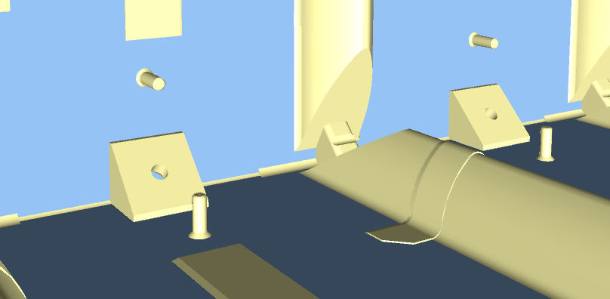
Fundamental Design Considerations
40 cable trays to be installed on the sides of the cryostat
Connections are limited to the support points at both the top and bottom of the cryostat
All materials to be LAr compatible and designed to withstand cryogenic operating temperatures
Each cable tray will need to support 8 cable bundles with a total cable mass of 360 kg per tray
Thermal contraction a significant design consideration
Different material properties will lead to differential contraction between the cable tray structure and the supported cables
Top of Cryostat
Bottom of Cryostat

Slide 3
FD2-VD Cryostat BDE Cold Cable Information
40 total cable trays required to supply 40 feedthroughs
Each feedthrough will supply cabling to 2 bottom CRP assemblies (80 total)
A bottom CRP has 24 FEMBs (CE boxes)
Each CE box will require 1 set of 25m long cables (power and data)
1 cable tray will need to carry 48 sets of cable
If divided into 8 bundles, each bundle would carry 6 sets of cable
A cable bundle is approximately 40mm in diameter and has a mass of 45kg
Each cable tray will carry 8 bundles of cable
360kg total mass of cables to be supported per cable tray

Slide 4
FD2-VD Cryostat Cold Cable Information
Cable tray width dependent on layout of cables
A single layer of cable bundles would likely need a 24” wide tray
24” allows for almost 6” of space on each side of cable tray
18” wide might be too narrow
16” for BDE cables and 8” for any PD fibers?

Slide 5
FD2-VD Cryostat Cold Cable Information
Cable thermal properties based upon experimental results
A SAMTEC data cable was immersed in liquid nitrogen for 1 minute to simulate effect of thermal contraction
Original cable length at room temperature (20°C): 45 3/4” [1162.0mm]
Cable temperature at liquid nitrogen temperature (-196°C): 7/32” [5.6mm]
Shrinkage Rate
(0.21875”) / (45.75”) / {20°C - (-196°C)} = 2.2 e-5/°C
(0.21875”) / (45.75”) = 0.00478 dL/L

Slide 6
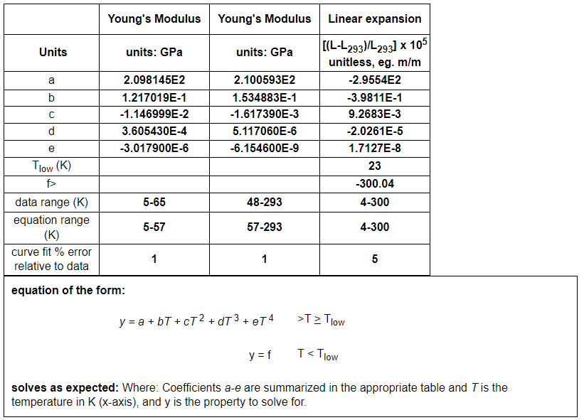
Cable Tray Material Considerations (Data from Cryogenic Material Properties Database, NIST)
304 Stainless Steel
Linear expansion at 88K: -0.00272 dL/L

Slide 7
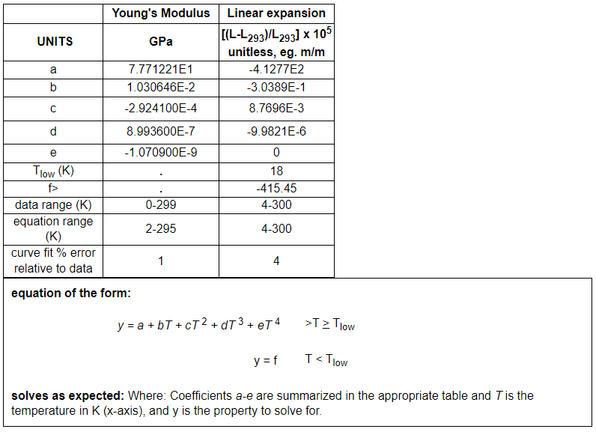
Cable Tray Material Considerations (Data from Cryogenic Material Properties Database, NIST)
6061-T6 Aluminum
Linear expansion at 88K: -0.00378 dL/L

Slide 8
Cable Tray Installation Location
Maximum clear space
26cm
Does the cryostat membrane construction limit the maximum cable tray width?
If we intend to fit the cable tray between the “knuckles” of the membrane, the tray will need to be made deeper to support all 8 cable bundles
Max Clear gap is 26cm.
What are the limitations for cable placement?
How far from the membrane can the cables be?
What distance must the cables and cable tray maintain from the HV elements in the cryostat?

Slide 9
Attachment of Cable Tray to Cryostat
Connections are limited to the support points at both the top and bottom of the cryostat
360kg per cable tray for BDE cables plus PD cables and sensors.
Connections will act as anchor points for thermal contraction
Cable tray width and placement to determine if one or two sets of attachment bolts are used

Slide 10
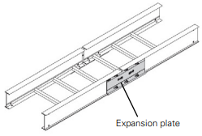
Cable Tray Types: Ladder
Ladder cable trays typically used for vertical cabling applications
Provide stronger cross section for load bearing
Design may provide more options for interfacing with a PD sensor
Bracket could be designed to connect cable tray to cryostat support points
Manufacturers can provide expansion plates for thermal expansion/contraction

Slide 11
Cable Tray Types: Wire Basket
Wire baskets not typically designed to handle large loads
360kg cable load likely to be an issue with this type of cable tray
Custom design might be needed
Custom solutions required to handle unique design challenges
Attachment of wire basket to cryostat support points
How to account for thermal contraction of wire basket due to LAr operating temperature

Slide 12
Cable Tray Types: Truss
Potential alternative to standard commercially available cable tray designs
Truss inner diagonals not typically designed to handle load
Effects of thermal contraction would need to be thoroughly analyzed
Pipes provide an easy surface to clamp to for supporting PD sensors
Bracket could be designed to connect truss to cryostat support points
Bolting plate options available at ends of truss could facilitate this attachment

Slide 13
Cable Tray Budget
Total budget allotted for cable trays: $55,000
$1,375.00 per cable tray (40 total trays required)
Major factors for cost:
Cable tray material
Cable tray size
Attachment bracket design
Design of thermal contraction elements

