Slide 1
Stato sensori e maschere
7/4/22 INFN Bologna

Slide 2
Modello Camera in simulazione
Camera da 1024 canali
Usata in tutte le ultime simulazioni
~ 180 x 180 x 22mm
~500 Fori quadrati da 2.71mm con bordo 0.2mm
Spessore fronte 0.1mm
Numerose varianti con fori diversi, pattern diversi, sensori diversi
https://baltig.infn.it/dune/sand-optical/geometry

Slide 3
Sensore
Sensore 32x32 pixel
Dati performance come Hamamatsu S14160-3050
https://www.hamamatsu.com/content/dam/hamamatsu-photonics/sites/documents/99_SALES_LIBRARY/ssd/s14160_s14161_series_kapd1064e.pdf

Slide 4
Detector Response
The goal is to perform a detailed simulation of the response of a SiPM sensor matrix and DAQ, including SiPM internal noise and electronics effects.
This tool can be used to perform optimization studies considering different SiPM models or ASICS.
An example parameter file:
https://baltig.infn.it/dune/sand-optical/detector-response-gpu/-/blob/master/config/config1.xml

Slide 5
SiPM waveform simulation
Input from GEANT4
list of simulated photon hit positions and times on the sensor surface
Each photon is assigned to the corresponding matrix SiPM (pixel)
Matrix borders and dead area between pixel is considered
An output waveform is simulated for every pixel
Subsequent photons are summed into the waveform
Can choose waveform length here. Longer is more GPU expensive
Intermediate output (not saved)
Full "analog" waveform (floating point, very high sample rate)

Slide 6
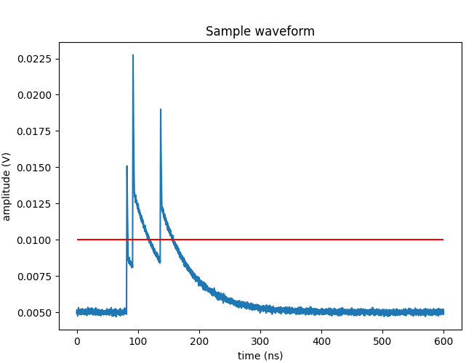
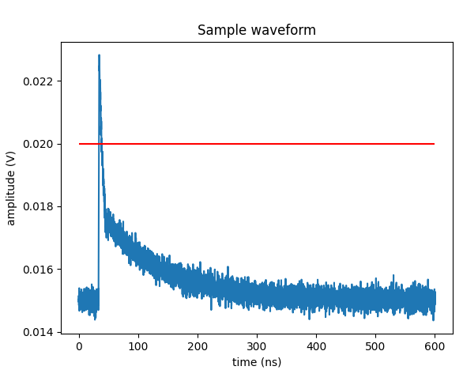
SiPM waveform simulation examples
SiPM characteristics and noise effect included:
1 p.e. gaussian amplitude distribution
PDE: fixed value or depending on photon wavelength (wip)
Single photon time resolution
noise: dark count rate, afterpulses, crosstalk, white and rf noise
threshold
threshold

Slide 7
Electronics simulation
Simulation of multiple ASIC types implemented so far:
Charge integrator ADC + leading edge TDC (TRIROC-like, used with warm demonstrator)
Multiple TDCs for time-over-threshold (ALCOR) [wip]
Simple peak sensing [wip]...
Included effects:
Analog bandwidth [wip]
Amplifier gain and saturation
Quantization error (ADC resolution)
TDC time resolution
Output format: DRDF (binary png-like) and List-of-hits (for Sand reco)

Slide 8
Actual prototypes
Warm demonstrator
8x8 channels, 1mm pitch S13615
17x17 hole mask
Warm readout with TRIROC
Test results:
SiPM and ASIC work OK
TRIROC demo DAQ board is poor
Can reconstruct one bright point source, struggles with two
Survived LN2 bath
Cold demonstrator [wip]
16x16 channels, 3mm pitch S14160 like in simulation
Readout with 8xALCOR
Expect 34x34 mask ~ 10 cm wide
Status:
Waiting for PCB
Firmware in progress
Mechanics tbd

Slide 9
Backup

Slide 10
