Slide 1
CLARA: Initial interference scans in SRW
Jonathan Jarvis
IOTA Run#4 preparations
04-01-2022

Slide 2
Basic setup of initial simulations:
Beam energy shifted to 135 MeV to closely match the ongoing interferometer setup and testing.
Single f=1m lens at 3.5m from the undulator center.
500-800 nm bandpass filtering and R=20mm circular aperture at lens.
Detector in focal plane 1.4 m from the lens.
Mesh is rescaled (by 0.5x) four times while propagating to detector; this ends up clipping some long-wavelength content (see final slides)

Slide 3
135 MeV for max compatibility with interferometer testing

Slide 4
… with 500-800 nm bandpass; used for delay scans

Slide 5
Spectrum vs wavelength

Slide 6
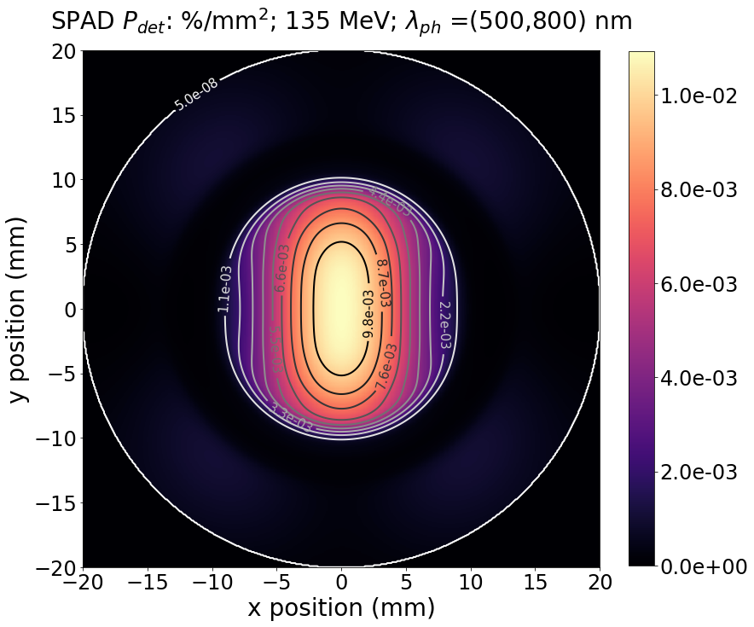
Restriction of effective aperture due to bandpass
Full spectrum
500-800 nm

Slide 7
Wide bandwidth restricts visibility at large delay
Simulated interference scan by summing E(ω) with copy of itself
Each freq. component of the copy is rotated in the complex plane by appropriate phase advance to translate the entire pulse in time domain

Slide 8
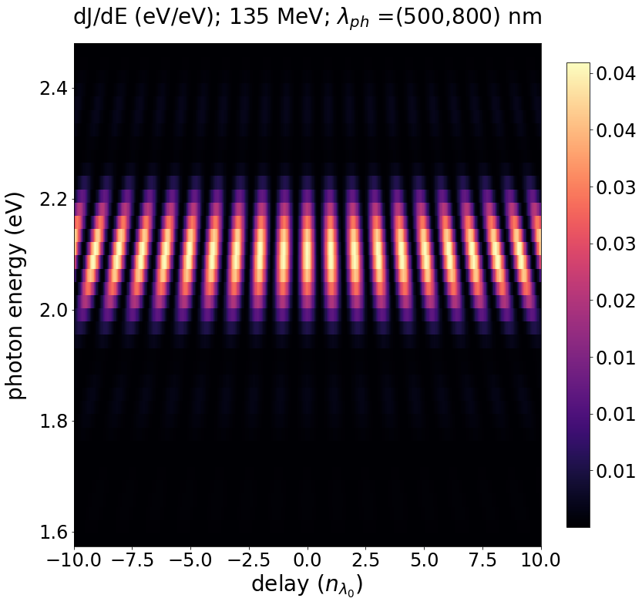
Wide bandwidth restricts visibility at large delay
Previous plots are the sum of these maps along the vertical

Slide 9
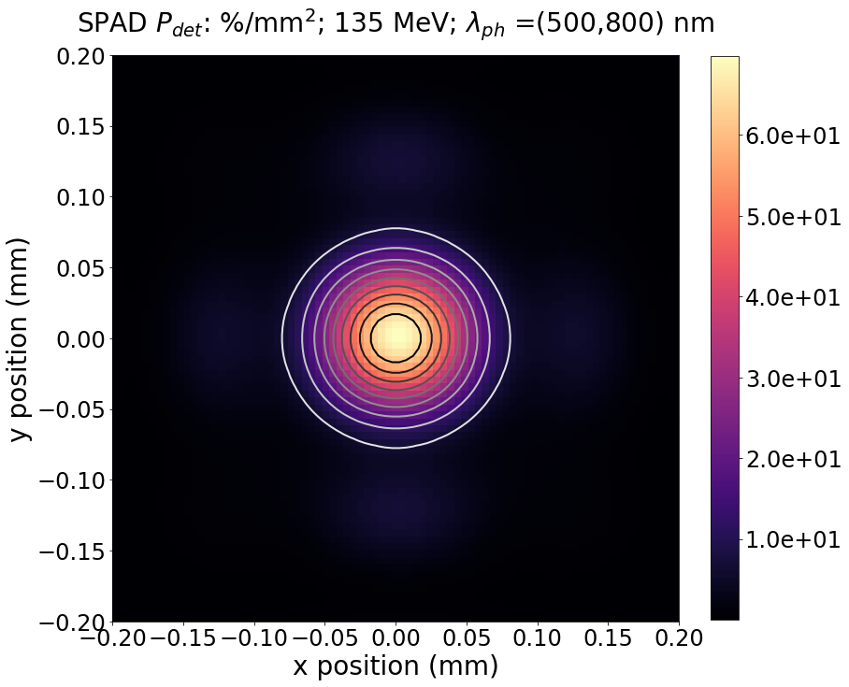
Refocused with single lens for scans at SPAD
Single lens 1-m focal length; do = 3.5m; di = 1.4m
Scaling mesh cuts off additional low-frequency (and 2nd harmonic) content at large angles; ~same as aperturing at lens plane

Slide 10
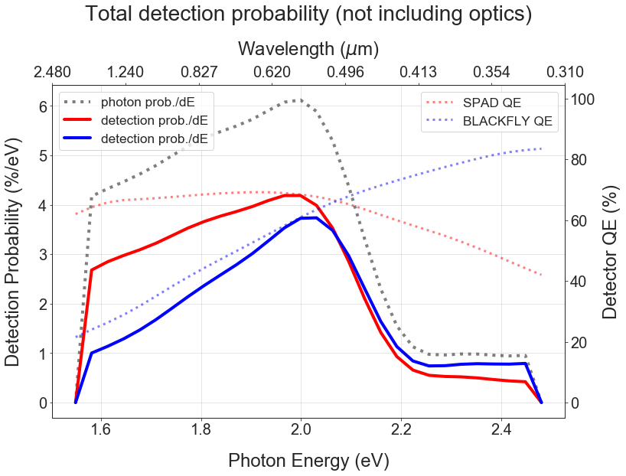
Restricted spectrum from rescaling

Slide 11
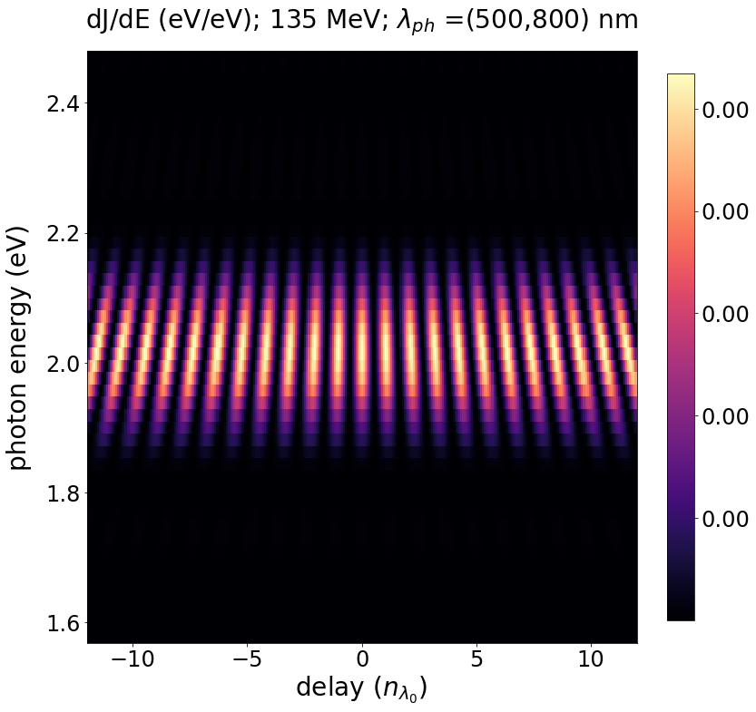
“Full” spectrum
Center few pixels

Slide 12
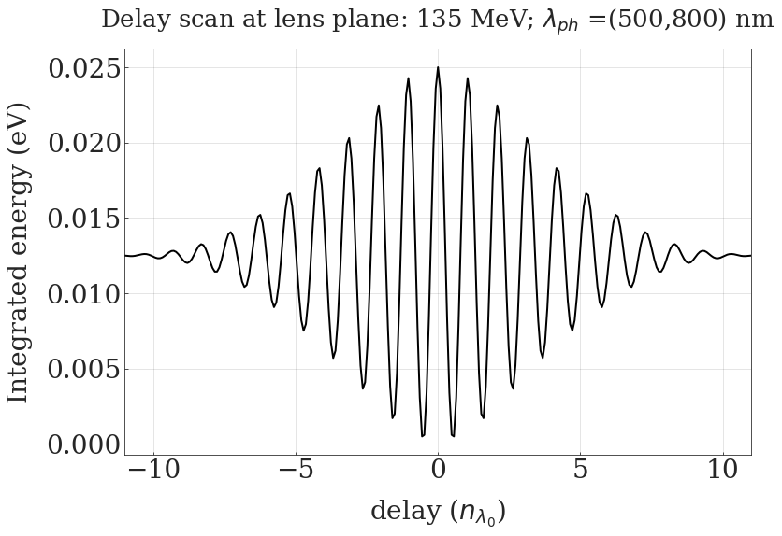
Restricted spectrum result approaches that for central value
* Plan to redo the interference summation in the time domain, just to confirm expected behavior

