Slide 1
HL-LHC status and plan
Lucio Rossi
HL-LHC project coordinator
With inputs from S. Meyer and O. Bruning

Slide 2
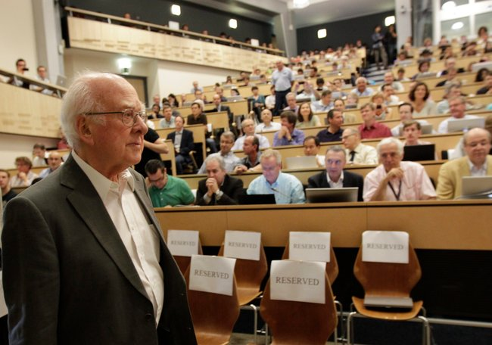
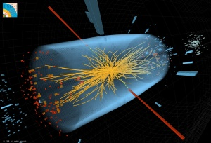
Latest news
The Higgs is there ! (and not not only Mr Higgs)
Better characterization (unexpected properties?) triggered a 3-months shift in the shutdown LS1: not yet included in the pictures and plots of the talk!
The possible LS1.5 mentioned “here and there” has been dropped (but 6 week longer Xmas break for CMS tracker, if required, at end 2016-beg.2017)

Slide 3
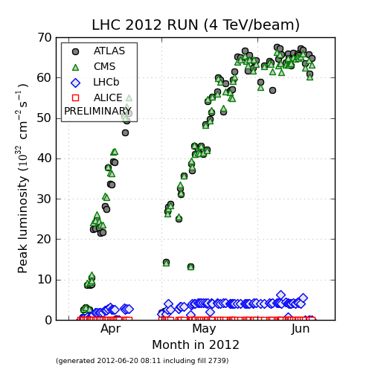
Performance LHC 2012
Luminosity: ∝ rate of collisions
Equiv 7 TeV
Data last 3 weeks before MD- Tech Stop

Slide 4
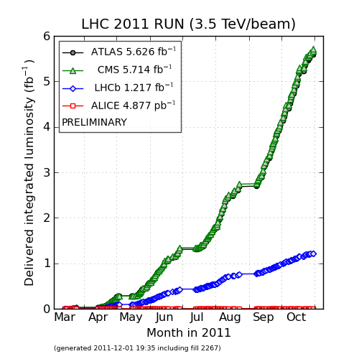
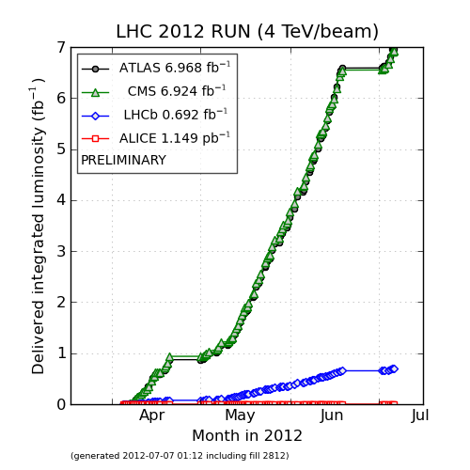
The light we shed to find the boson…
Integrated lumi: ∝ # of collisions
Promised minimum 2011 : 1 fb⁻¹
Promised 2012 : 15 fb⁻¹

Slide 5
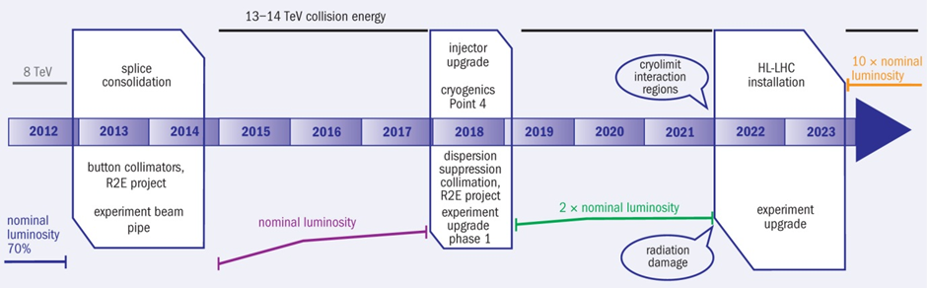
CERN 10-y plan
LHC baseline plan for the next ten years. In terms of energy of the collisions (upper line) and of luminosity (lower lines). The first long shutdown 2013-14 is to allow design parameters of beam energy and luminosity. The second one, 2018, is for secure luminosity and reliability as well as to upgrade the LHC Injectors.

Slide 6
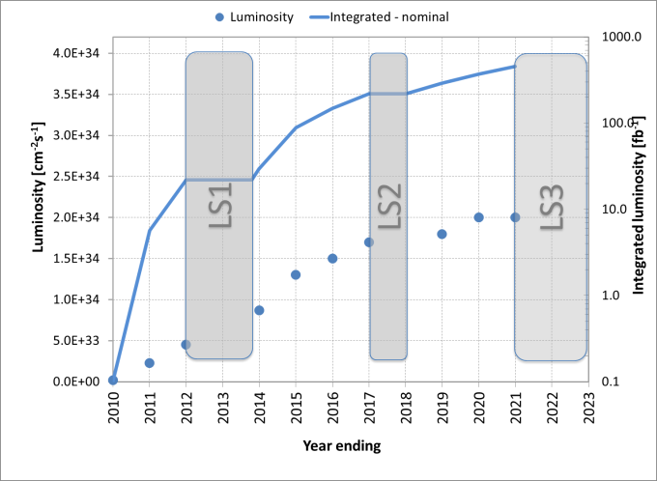
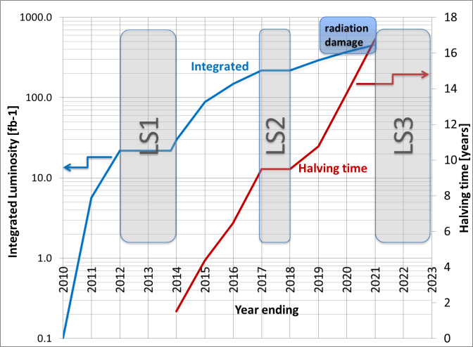
Lumi evolution, an educated guess
possible peak luminosity evolution (till the so-called “ultimate” limit) with best forecast consequent integrated luminosity.
Integrated luminosity and running time to reduce by a factor two the statistical error based on flat luminosity (halving time).
In one decade we expect to saturate performance and to hit rad-dam requiring consolidation in the IRs IP1-IP5

Slide 7
The High Luminosity project
In 2010 critical revision of the CERN plan
  For Injectors:
    stop of PS2-SPL plan
    OK for Linac4, PSB-2GeV, PS improvement, SPS upgrade (high harmonic RF system and perhaps coating of the bean pipe): LIU set up
  For LHC
    Stop Phase 1 (and future Phase 2) upgrade; implementation of DS «cold» collimation after 2018 and no magnet displacement
    HL-LHC project set up
The main objective of High Luminosity LHC is to determine a set of beam parameters and the hardware configuration that will enable the LHC to reach the following targets:
A peak luminosity of 5×10³⁴ cm⁻²s⁻¹ with levelling, allowing:
An integrated luminosity of 250 fb⁻¹ per year, enabling the goal of 3000 fb⁻¹ twelve years after the upgrade. This luminosity is about ten times the luminosity reach of the first twelve years of the LHC lifetime.

Slide 8

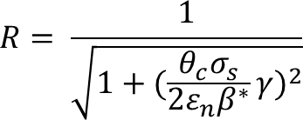
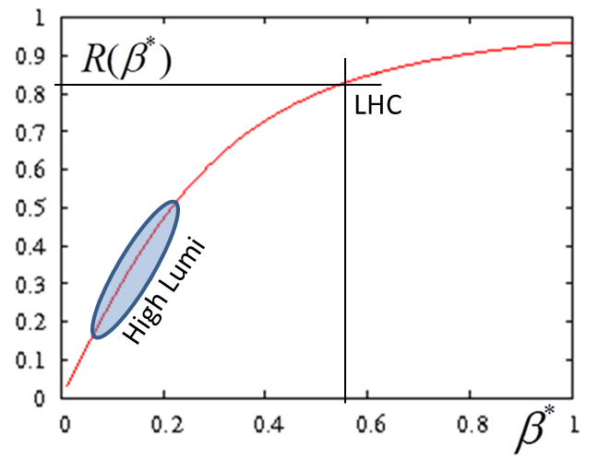

Luminosity: main ingredients
Beam current
energy
Beam size
Beam current and emittance: involve Inj chain and whole ring
β∗ involve «only» 2 IRs, 600 m.
Unit of lumi through the talk
LHC has been designed for L₀ but all systems have almost possibiltiy of ultimate 2L₀

Slide 9
High Luminosity LHC project
To push the performance above the ultimate, to 5 10³⁴ or more
  If pile up allows it. Today we have 35-40, experiments design upgrade for 140 evts/crossing
  If energy deposition by collision debris in the nearest SC magnets (low.β triplet quads) allows it
  If R2E effects and other will allow it
Use of lumi levelling to maximize integrated luminosity for a given max lumi.
Work for increasing efficientcy/availabality of the LHC
Final goal is : 3000 fb⁻¹ by 10-12 years

Slide 10
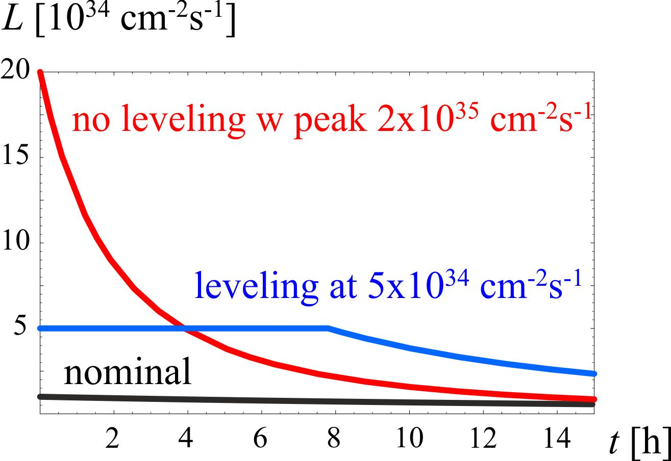
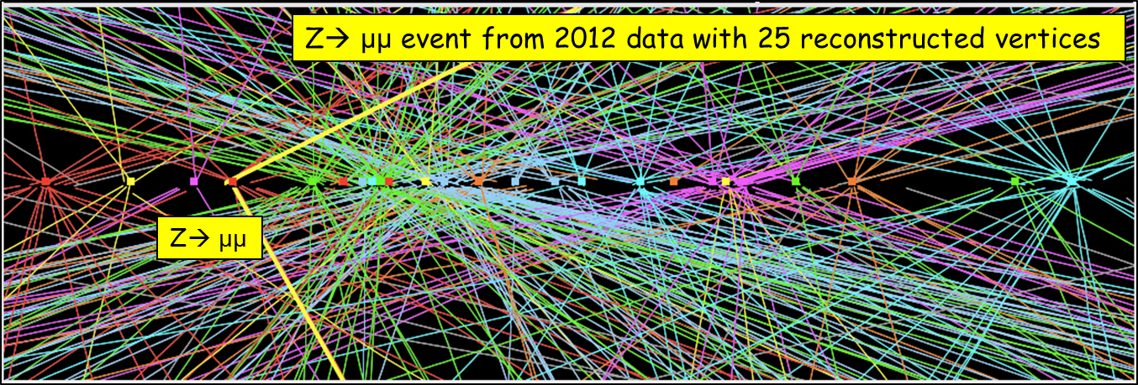
Levelling : the principle
Lumi decreases for proton burning (neglecting effects like emittance growth due to b-b, IBS, etc…)
Total number of collisions ∫Ldt in a run is limited by number of stored protons
⇒ store a lot of protons but keep instantaneous lumi «low» by detuning one (or more) parameter.
⇒keep the lumi constant by re-tuning the paramter(s) to compensate proton loss (and possibly any other effect).

Slide 11
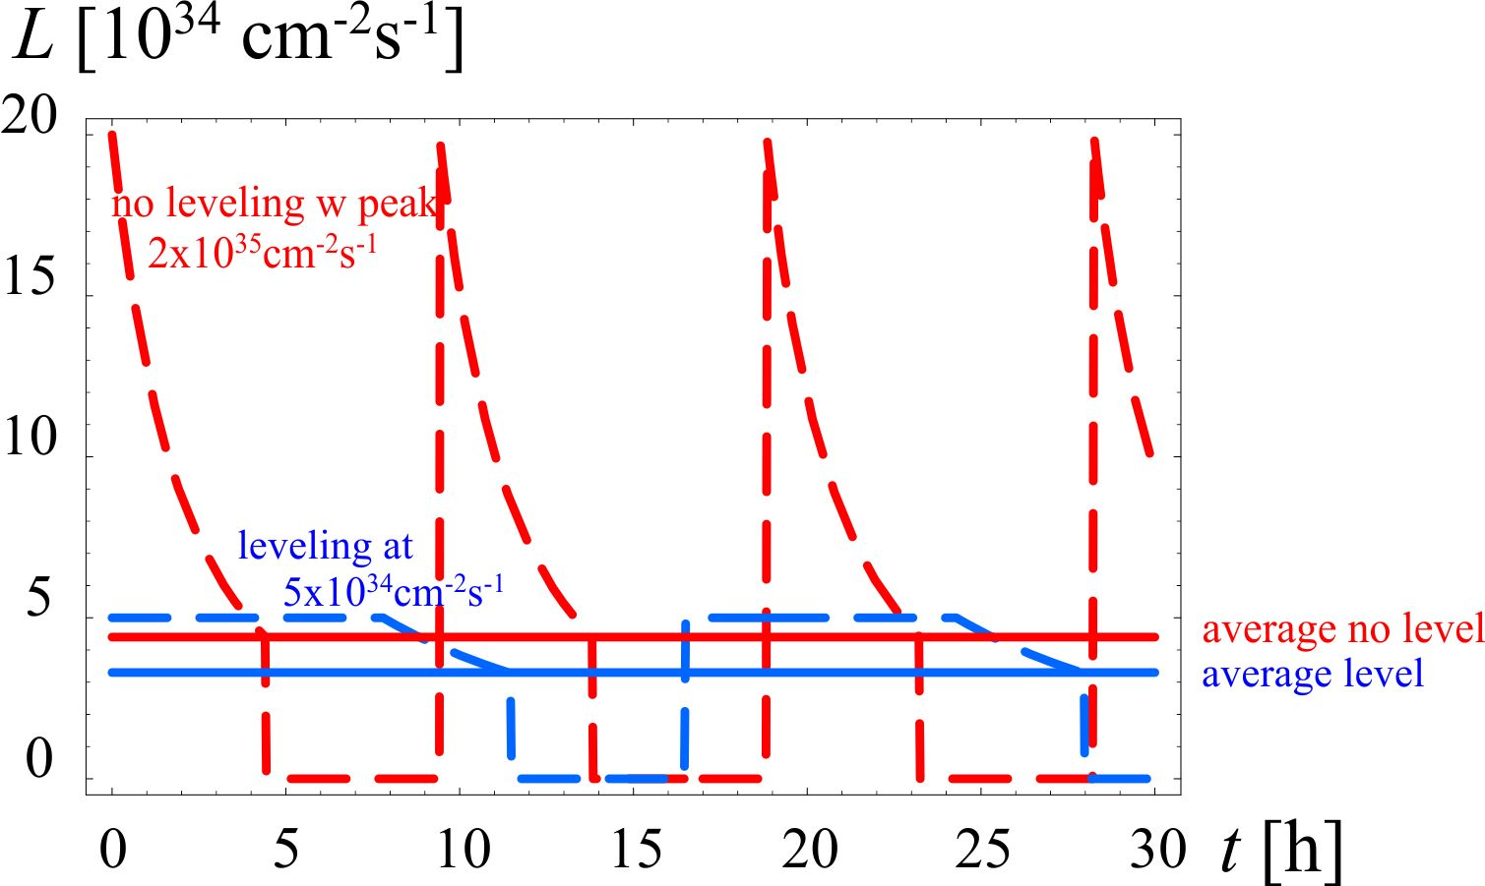
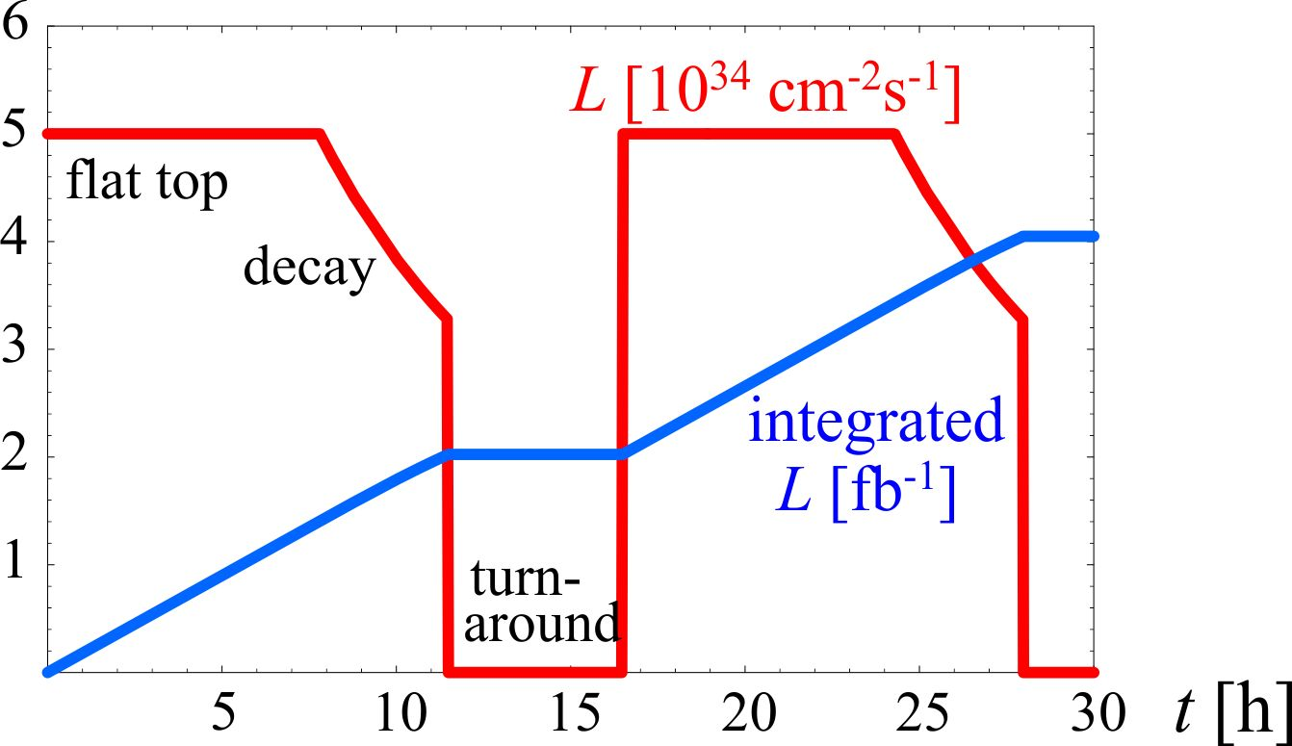
HiLumi operation with levelling cycle
The average collision rate is about the same but the «strain» on hardware is much less (design cost ∼ peak lumi) and better data quality for exp.
We aim at 2 fb⁻¹/store, i.e. , 3.5 fb⁻¹/day!

Slide 12
Target parameters for HL-LHC run
Efficiency is defined as the ratio between the annual luminosity target of 250 fb⁻¹ over the potential luminosity that can be reached with an ideal cycle run time with no stop for 150 days: t_{run}= t_{lev}+t_{dec}+t_{turn}. The turnaround time after a beam dump is taken as 5 hours, t_{decay} is 3 h while t_{lev} depends on the total beam current
Parameter | Nom. 25 ns | Stretched 25 ns | Stretched 50 ns | Baseline 25 ns | Baseline 50 ns
N_{b} [10¹¹] | 1.15 | 2.2 | 3.5 | 2.0 | 3.3
n_{b} | 2808 | 2808 | 1404 | 2808 | 1404
I [A] | 0.56 | 1.12 | 0.89 | 1.02 | 0.84
θc [µrad] | 300 | 590 | 590 | 590 | 590
β∗ [m] | 0.55 | 0.15 | 0.15 | 0.15 | 0.15
ε_{n} [µm] | 3.75 | 2.5 | 3.0 | 2.5 | 3.0
ε_{s} [eV s] | 2.5 | 2.5 | 2.5 | 2.5 | 2.5
IBS hor [h ] | 111 | 15 | 14 | 16 | 15
IBS long [h ] | 65 | 21 | 16 | 22 | 17
Piwinski | 0.68 | 3.12 | 2.85 | 3.12 | 2.85
R red.fact. | 0.81 | 0.31 | 0.33 | 0.31 | 0.33
b-b/IP[10⁻³] | 3.1 | 3.3 | 4.7 | 3 | 4.5
L_{peak} (no crab) | 1 | 7.4 | 8.5 | 5.3 | 7.6
Crabbing | no | yes | yes | yes | yes
L_{peak virtual} | 1 | 24 | 26 | 20 | 23
Lumi level | = | 5 | 2.5 | 5 | 2.5
Pileup L_{lev}=5L₀ | 19(27) | 140 | 140 | 140 | 140
Eff.†150 days | = | 0.39 | 0.77 | 0.39 | 0.77

Slide 13
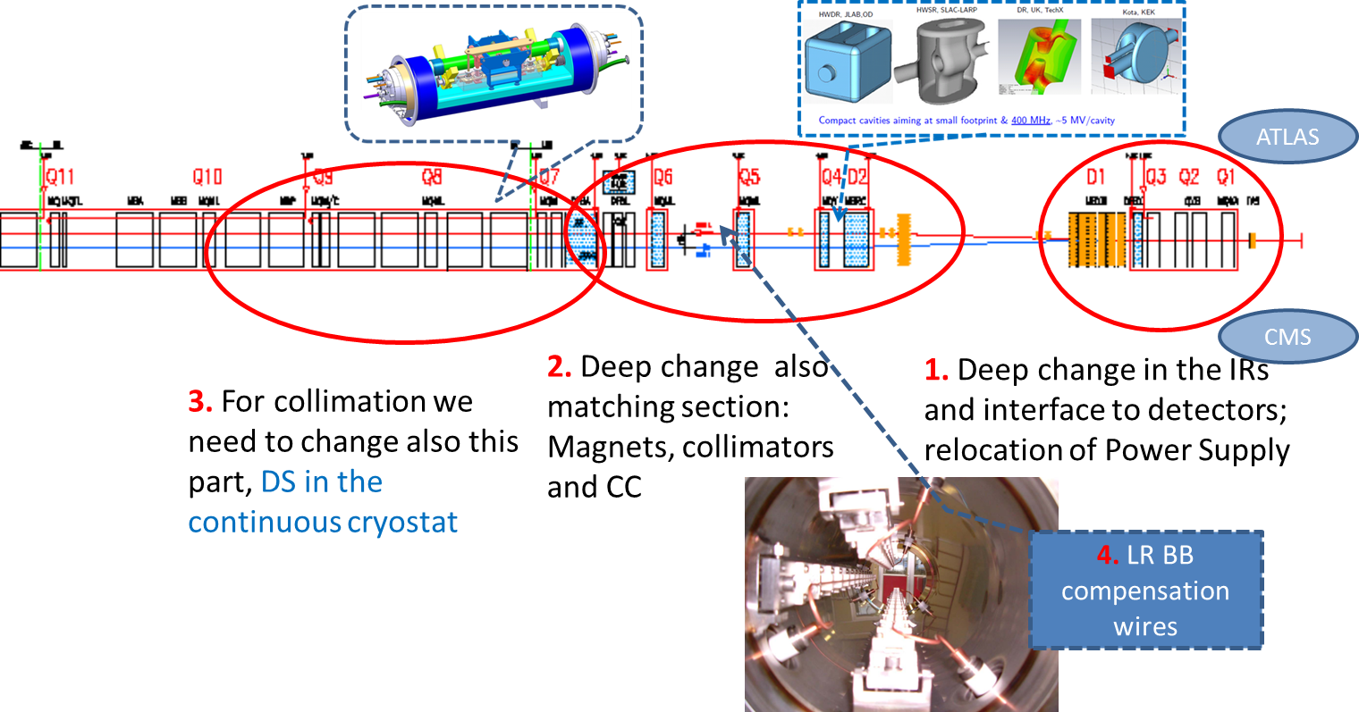
Changing 300x2 m both ATLAS & CMS (+LHC-b & Alice …)
1.2 km of LHC !!

Slide 14
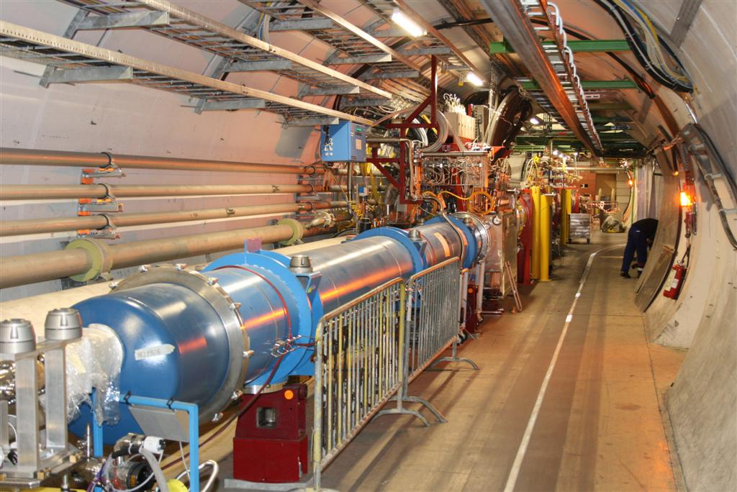
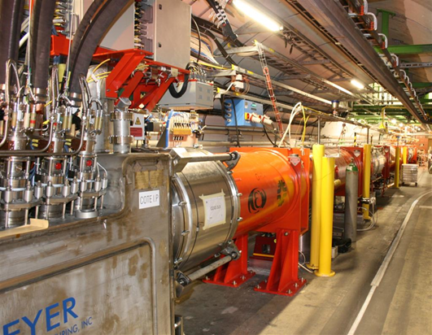
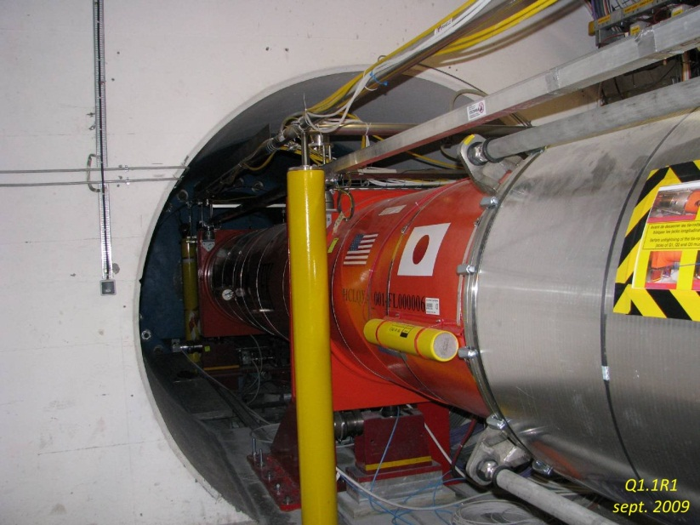
Here the magnets for the low β and IRs
(equipment from BNL, LBNL, Fermilab)

Slide 15
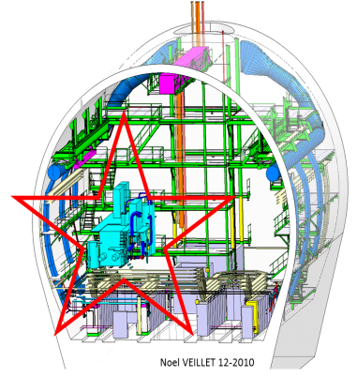
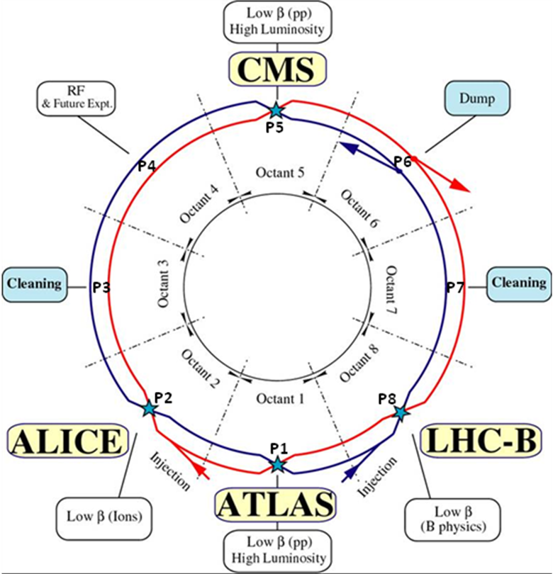
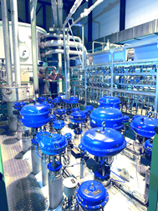

HL-LHC installation all around the ring…
6.5 kW@4.5K cryoplant
2 x 18 kW @4.5K cryoplants for IRs

Slide 16

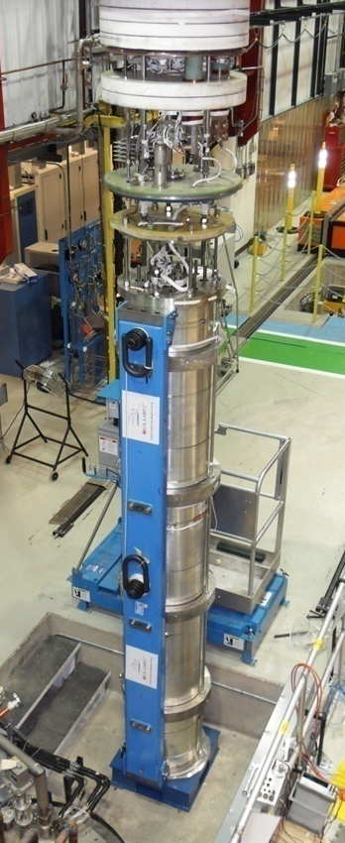
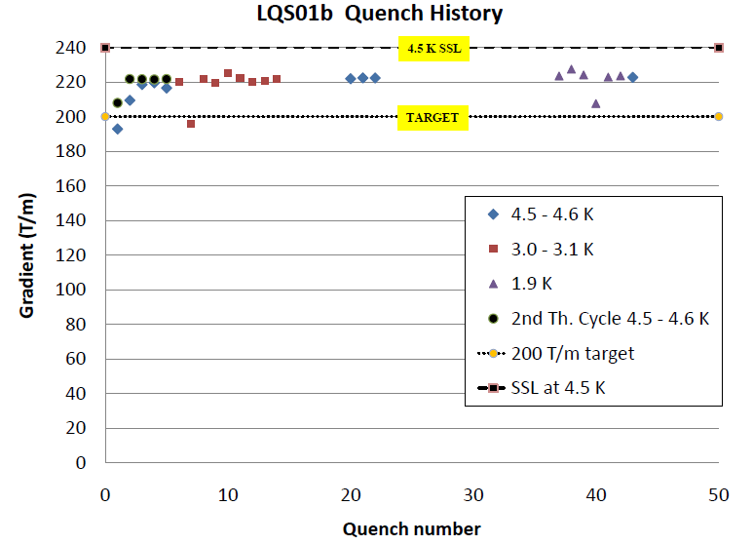
Results LARP LQ - 2010
(90 mm vs 70 mm LHC)
LHC equivalent today
G. Ambrosio, FNAL

Slide 17
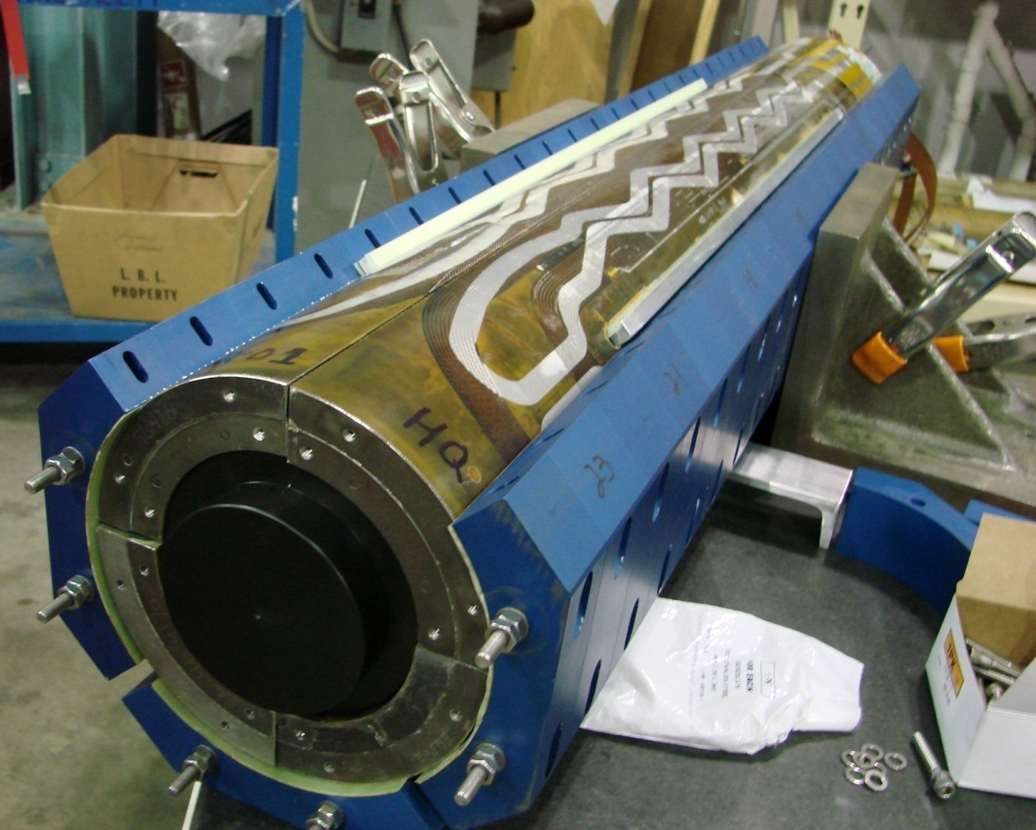
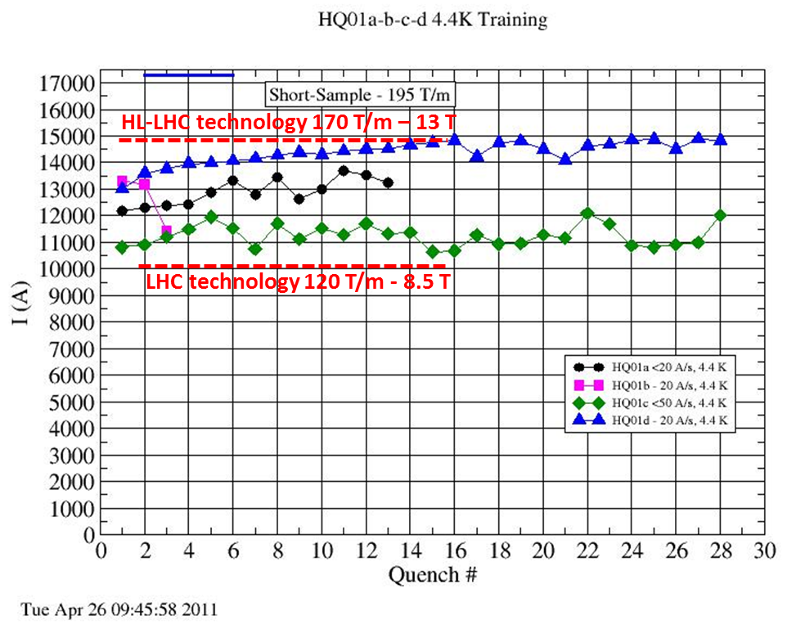
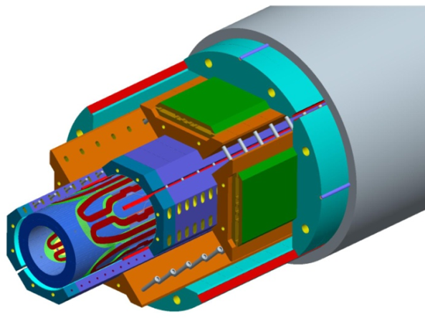
LARP HQ (120 mm- 13 T)
S. Caspi , LBNL
Not updated, results 2011

Slide 18
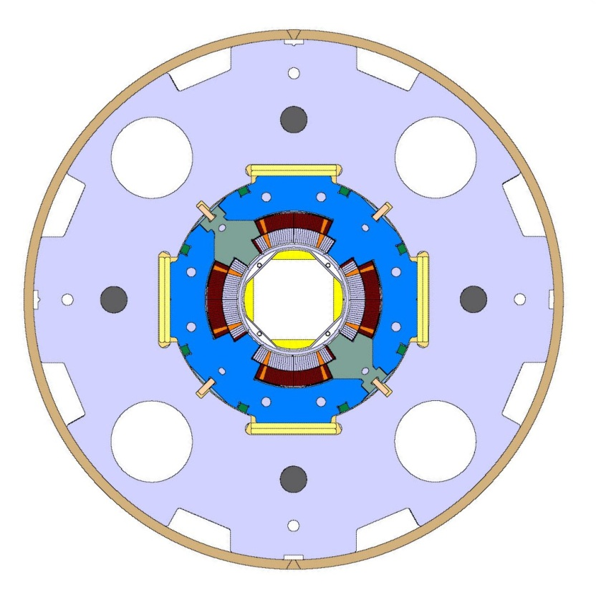
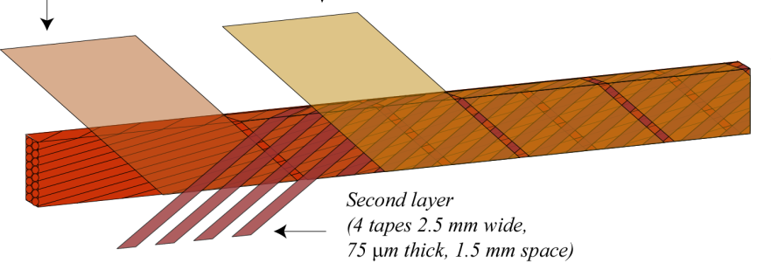
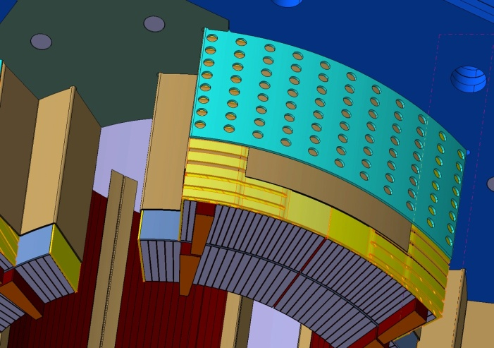
Improved Nb-Ti technology for MS magnets and for Low-β quads back-up plan
new insulation scheme, more porous in the coils and in the structure
Higher heat removal (matching the gap to NbSn ?)
To be tested soon

Slide 19

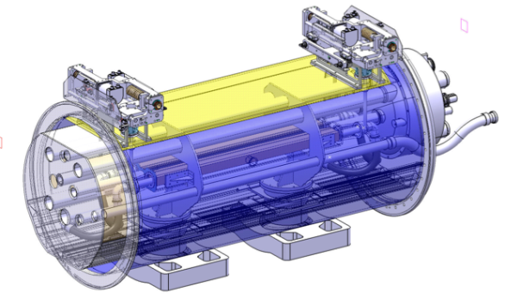
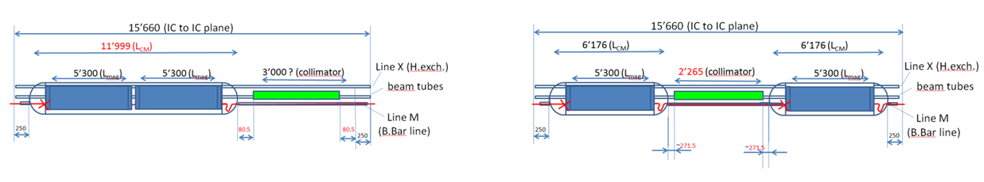
Avoid off-momentum protons on SC dipoles (diffractive)
5.5 m Nb₃Sn
3.5 m Collim
5.5 m Nb₃Sn
5.5 m Nb₃Sn
3.5 m Collim.
5.5 m Nb₃Sn

Slide 20

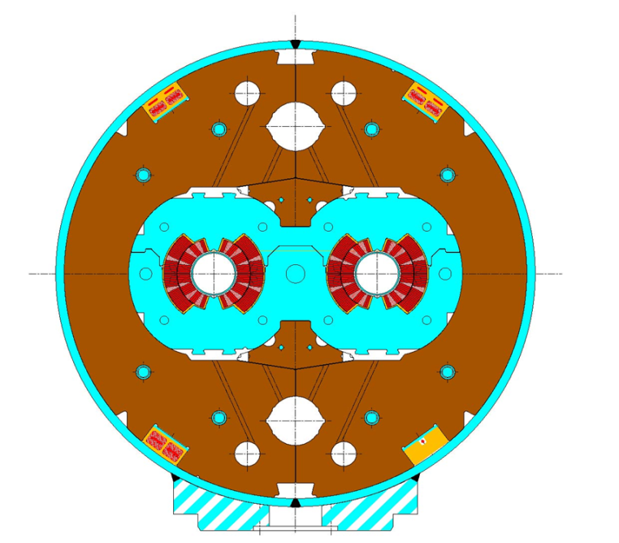
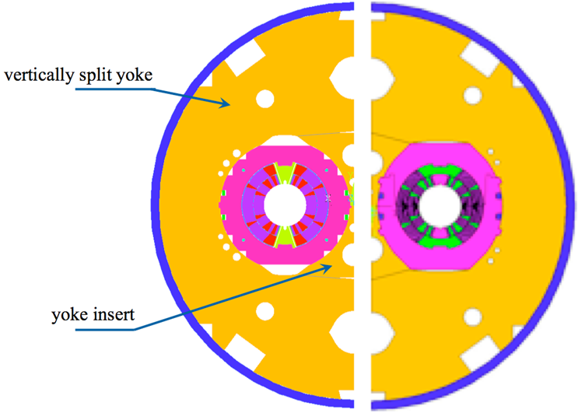
11 T-11 m dipole
CERN-FNAL collaborations
Series to LHC dipoles: BL/I =120Tm/11.85kA
  Cable, strand constrained
  Nested power supply ±300 A
Field quality
  Fe saturation 6.5→0.5
  Pers. Current (40 μm fil. Size): 44 →20→10? Enough (few magnet)
Forces, energy 70% higher in same envelope
Demo (single, 2 m) by 2012; Proto by 2013-14
1 unit = 2x5.5m⇒straight
First NbSn in operation?
LHC
11 T

Slide 21
The long term DOE NB3Sn basic program has opended the way to higher field
Performance
Peak field
Cost
J_{C} (kA/mm²)
1
1.5
Target performance:
Jc > 3 kA/mm²
D_{fil} < 20 μm
RRR > 100
2
2.5
PIT
3
3.5
target
Magnetization Field Quality
Stability
4
10
200
20
150
50
100
100
50
RRP
RRR (-)
D_{fil} (μm)
Stability Protection

Slide 22
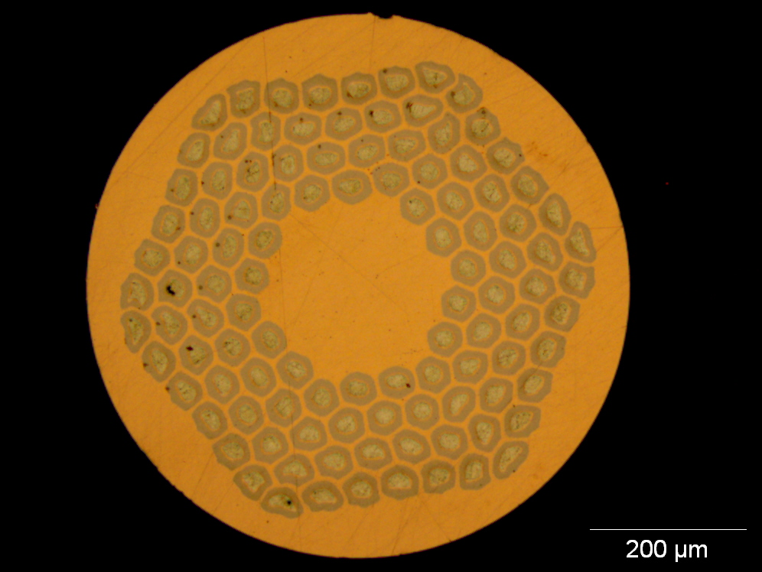
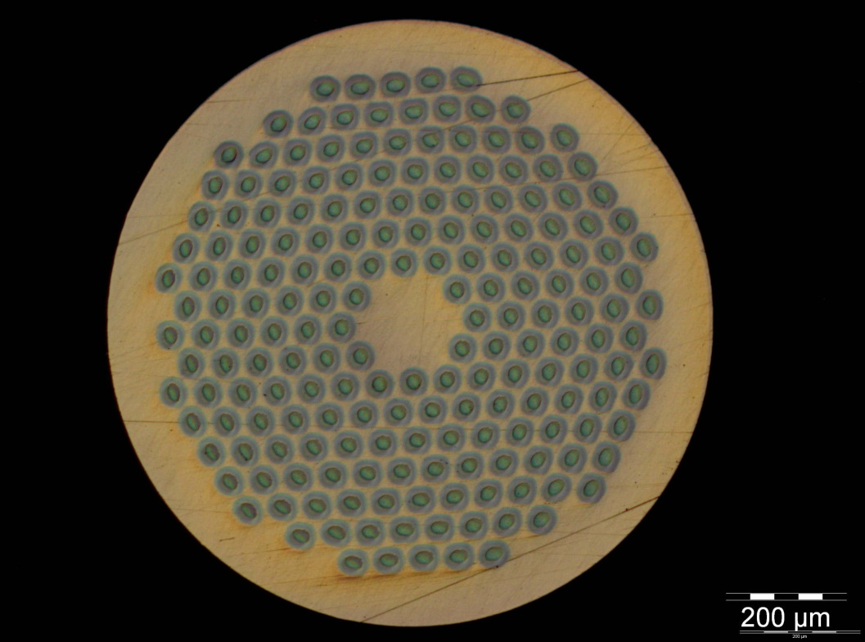
The EU FP6-FP7 and the CERN program is coming but still 20-25% behind! CERN/CEA is purchasing USA wire
0.7 mm, 108/127 stack RRP from Oxford OST
1 mm, 192 tubes PIT from Bruker EAS
Work is on-going on a new strand architecture (169 stack) to reduce the filament diameter to 52 μm at 1 mm strand diameter, and 35 μm at 0.7 mm strand diameter
R&D started for an alternative architecture with filaments of 30 μm at 0.7 mm strand diameter

Slide 23
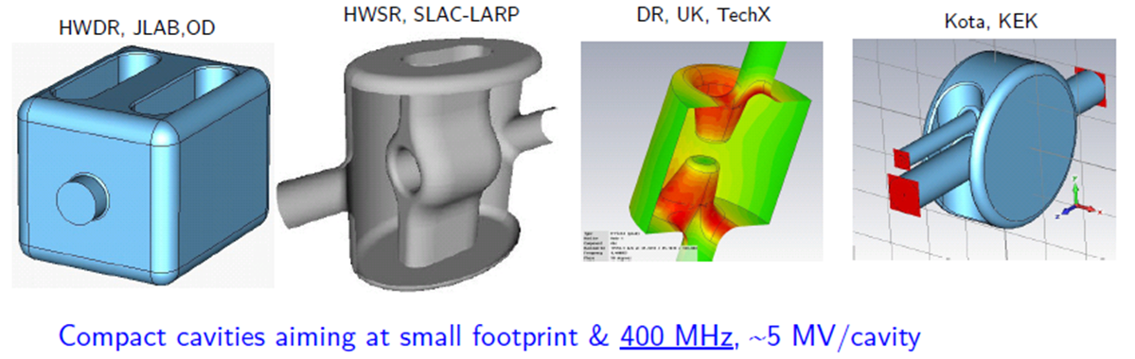
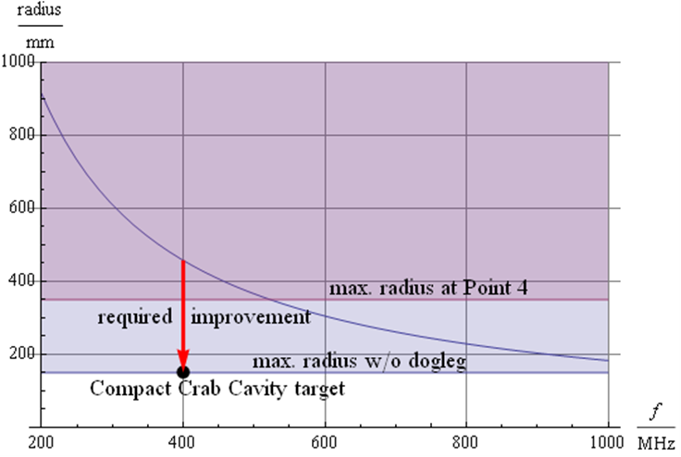
Crab Cavity, for p-beam rotation at fs level!

Slide 24
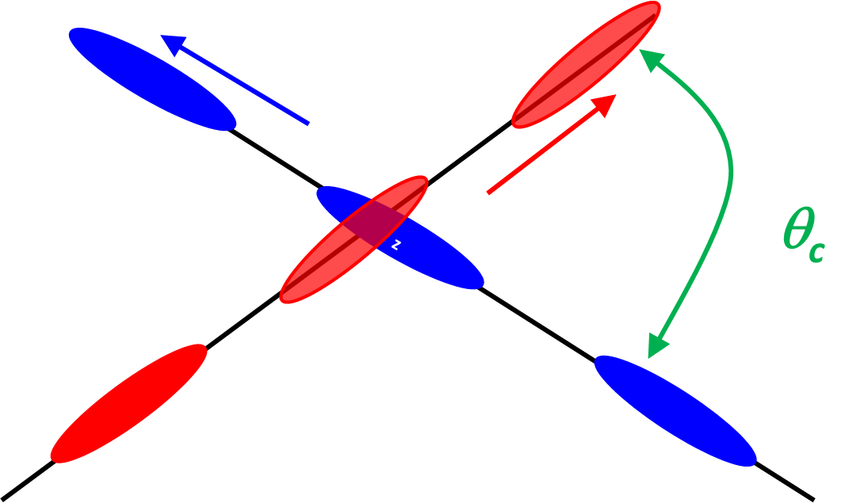
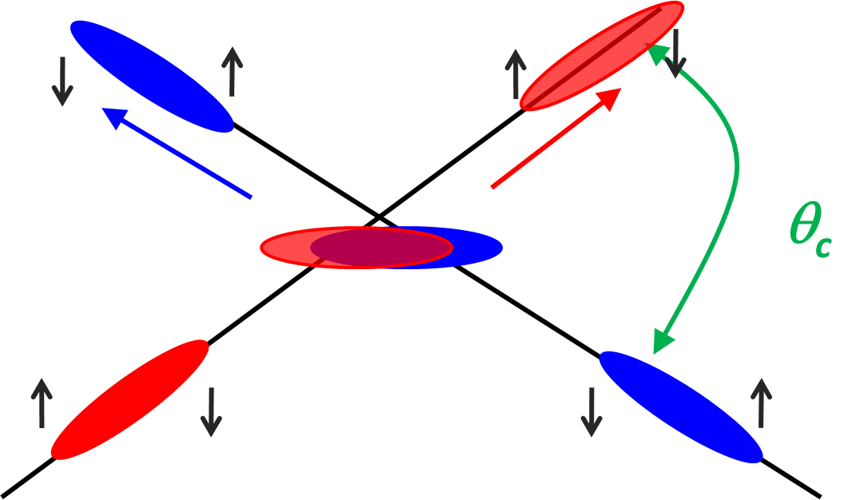
Effect of the crab cavity
RF crab cavity deflects head and tail in opposite direction so that collision is effectively “head on” and then luminosity is maximized
Crab cavity maximzes the lumi and can be used also for lumimosity levelling: if the lumi is too high, initially you don’t use it, so lumi is reduced by the geometrical factor. Then they are slowly turned on to compensate the proton burning

Slide 25
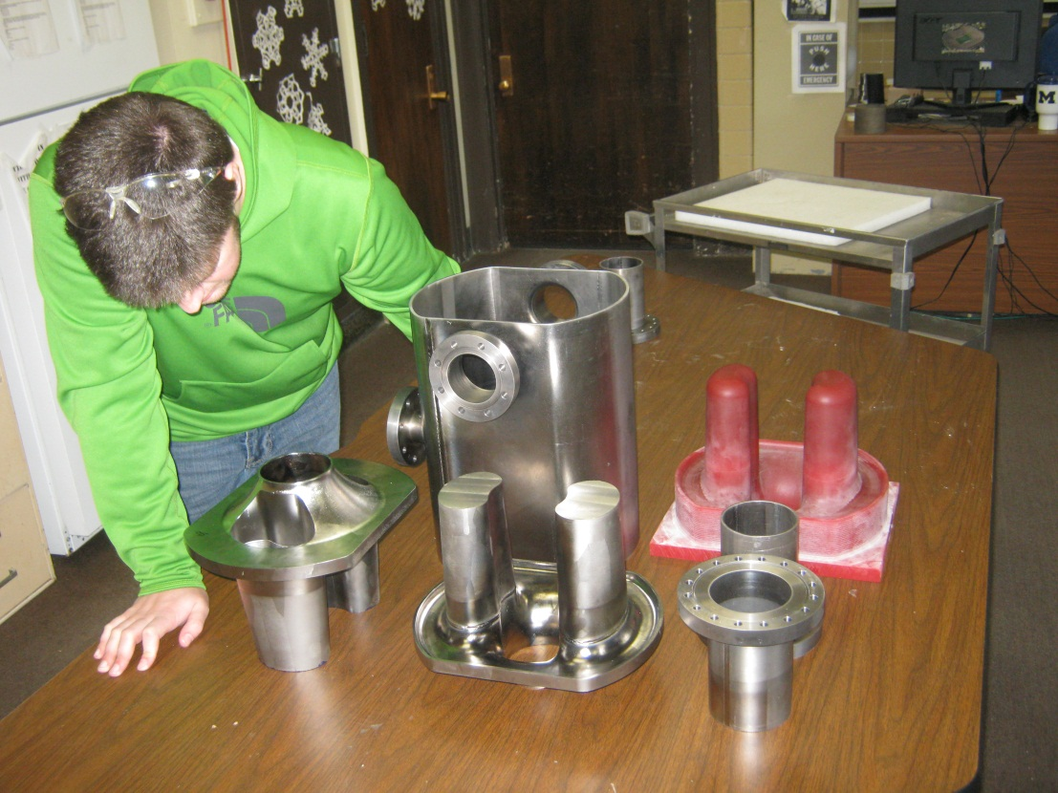
Crab Cavity:
Effort going on at SLAC-ODO/Jlab and in BNL, USA
Effort going on in Daresbury (Cockcroft Institute and STCF) with CERN.

Slide 26
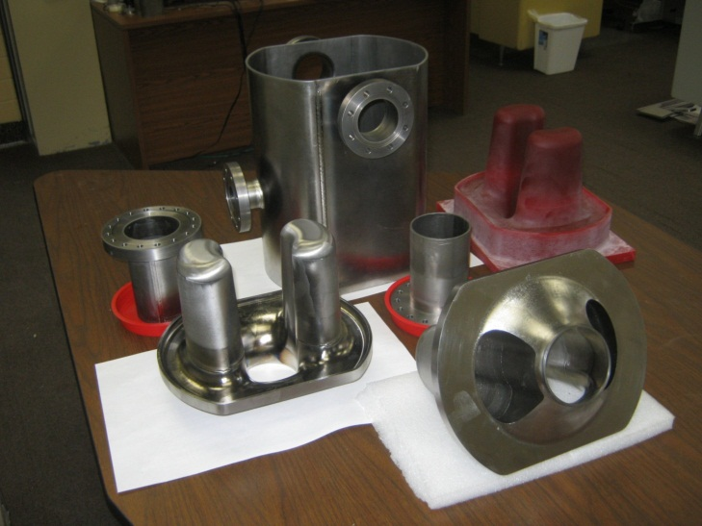
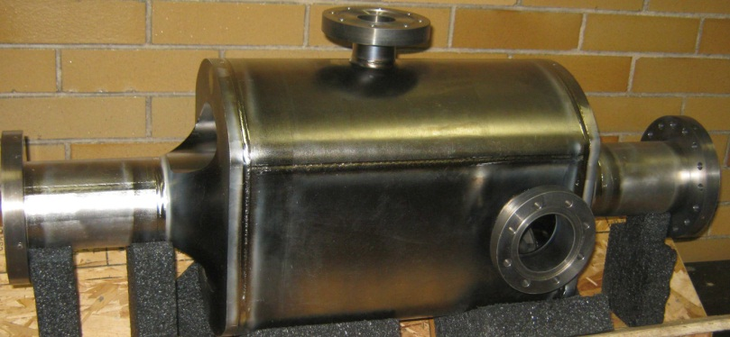
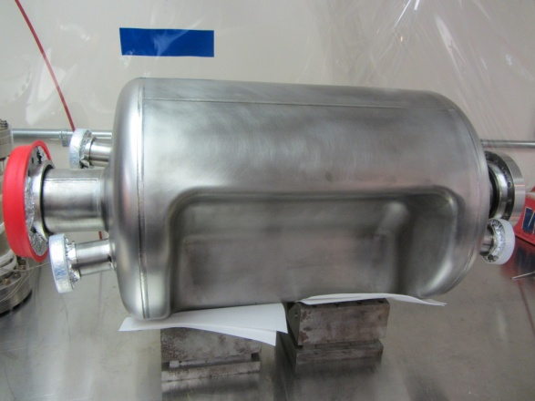
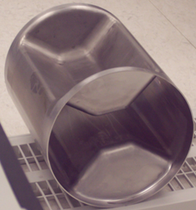
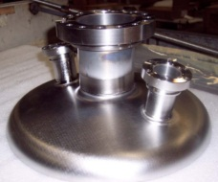
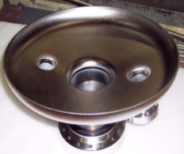
Progress in SC Crab Cavities: downselection needed (in USA and then globally)
UK - Cockcroft
Finished cavity at Niowave
Jan 2012
May 2012
USA (ODU)
BNL proto under way, few months behind

Slide 27

SC Links
Layout at Point 1
∼3.6 m
DFBL
I
I
4.5 K
4.5 K
1.9 K
DFBA
Q6
Q5
Q4,D2
D1
DFBX
Q3,Q2,Q1
Q11, Q10…Q7
TAN
TAS
IP1
IP 8
∼12 m
∼3 m
RR 13
UJ 13

Slide 28
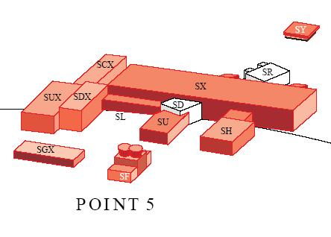
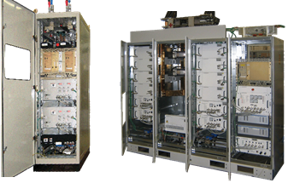
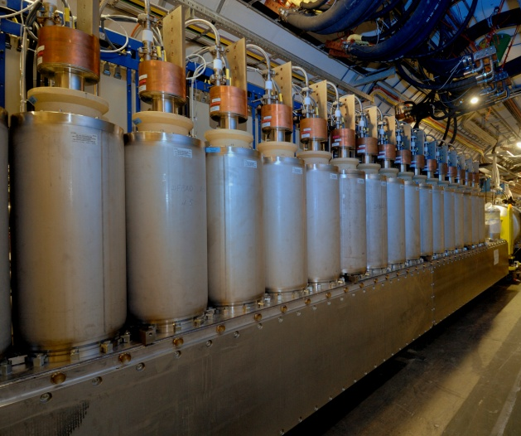
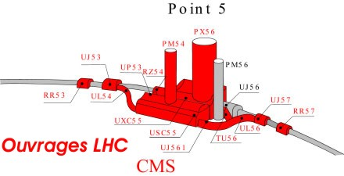
Cold powering system:
1) Current leads in a distribution cryostat (near the power converters);
2) Hor./Vertical electrical transfer (link);
3) Cryogenic fluid supply and control;
4) Interconnection to the magnets bus;
5) Protection of link and current leads.
2×100 kA

Slide 29




SC Link: twisted pair for use of tapes
NbTi:5 mJ/cm³, MgB2: 500, YBCO: 5000

Slide 30



PLAN: baseline : MgB2 round wire
First installation SC link 2017?
Nexan Cryoflex® line
(20 m long cryostat of link) procured and
installed in the CERN
SM-18 laboratory
20 kA – 4 to 80 K test
Horizontal SC link in P7: RR with many 600 A EPCs in RR just downstream betatron cleaning

Slide 31

Beam Diagnostic & Instrumentation
BPM capable to withstand more intense beam
Cryo BLM
Long range beam wire for LRBB compensation
E-lens ??
Experiments in SPS and RHIC demonstrated ability to affect the beam (destroy it) but not yet to cure it
(we can only do i LHC)
It is a collimator like device: 10 σ or less form beam

Slide 32


LS2 - 2018
Cryogenics P4 ⇒ separation between SC Magnets and RF Cavities cooling circuit
5-6 kW plant
crab cavity test P4
LRBB wire test?
e-Lens? Or crystal coll?

Slide 33
LS2 – 2018 (probably 1.5 y)
DS Cryo-collimation with 11 T in one IP: priority NOT yet decided: IP1,IP5 or IP2 ?
Vertical SC links in RRs of P1, P5 (stand-alone)
Improve triplet cooling
Some Beam diagnostics
Some Collimators
INJECTORS! LIU Project
  Linac4
  PSB up from 1.4 to 2 GeV
  Improvement on PS
  SPS upgrade: low-γ_{t} optics; higher harmonic RF system + beam pipe coating for e-cloud

Slide 34
LS3: the big one
Triplets + D1-D2 (including disinstallation after 300 fb⁻¹!)
TAS + Exp-interfaces
New cryo in IP1-IP5 with separation Arc-IR
New MS magnets (Q4-Q5) and correctors
CC cavities with its local cryo
Vertical links for all new magnets IP1-IP5
New collimators
Diagnostics & wigglers

Slide 35



FP7 HiLumi Design Study application 25 Nov 2010 – approved start 1Nov2011
Using funds of LARP or other existing R&D programs

Slide 36
Staff HiLumi with 377 p-m by US Labs
163 FTE-y

Slide 37


HiLumi is the focal point of 20 years of converging International collaboration
The collaboration with US on LHC upgrade started during the construction of LHC
With Hi-Lumi the coordination makes a step further: from coordinated R&D to a common project
Managed like a large detector collaboration (with CERN in special position as owner of LHC)

Slide 38
HL-LHC management

Slide 39

HL-LHC including DS HiLumiLHC (and HE-LHC R&D

Slide 40
First budget plan made in summer 2011
CtC : Cost-to-Completion) – MATERIAL only

Slide 41
Revision May 2012 – Personnel added split enhanced consolidation+ full performance
MTP approved by Council June 2013
MTP (and LTP) Revision expected in spring 2013
AFTER based on EU strategy update

Slide 42


CtC May 2012: personnel evaluated «roughly»:
¼ of material like LHC: real assessment in 2013
CERN management will take a decision on financing after the EU strategy update under way: we expect that HL-LHC be approved as priority program of HEP for next decade
The intellectual contribution of USA is already a key element of the upgrade
The in-kind contributions from USA (and JP) are necessary for the project

Slide 43
Priority envisaged by CERN of in-kinds
Low-β quads: 16 cold masses + spares;
  Aperture is decided 150 mm; (120 mm will be a back up)
  Split length configuration (risk reduction)
  Cost CERN (material, including constructuon labour): ca. 160 MCHF (NbTi 70 MCHF for ∅120mm)
D2 rec-sep dipole (4 +spares)
D1 rec-sep dipole (4+spares) JP?
SPS broad band feedback system
Crab Cavity: baseline. Final decision on use after validation on beam
  Cost CERN ca. 60 MCHF (cryomodules ready to install, no powering and no llrf control)
Items reasonably certain also
in case of only consolidation

Slide 44
Priority list for in-kinds – cont.
11 T for DS collimation (or other use)
  An 11 m unit per side per IP (11m=2x5.5m)
  ⇒ minimum TWO 11 m units (if only IP2) probably in 2018.
  ⇒ maximum TEN 11 m units (2, 1 &5,7,3), of which 8 in 2022.
  Spring 2013 probably review of the need of the collimation system ⇒ decision!
E-lens :Necessity, competitivity (tune mod.? Reactive feedback? LR bb scraping?, scrapers?) and impact on LHC not yet fully assessed. Process under way, probably inside the collimation review
Rotatable collimators: ready to qualify in HiRadMat with impact test (2014?)
Irradiation test in BNL are proposed by S. Redaelli

Slide 45
In-kinds final comment
The studies on accelerator physics – HiLumi or LIU – are highly appreciated. Solid ties with Oliver, Roland and myself and WP coords can only help
The long term visitor program is really an in-kind and we acknoledge this. It should also support the study and scientific mangement of HL-LHC (WP co-coordinators and task leaders)
We appreciated the redirection of the APUL (SC-D2 spares, 1 full cryodipole and 1 CM)
I think LHC and its upgrade is also a great opportunity for US acclerator community to preserve competence in designing and in construction of Large Projects

Slide 46
Thanks for your attention
Question ?

