Slide 1

LHQ Program & Nb₃Sn Technology Demonstration
Giorgio Ambrosio
Fermilab
BNL - FNAL - LBNL - SLAC
LARP – DOE review 2012
SLAC
July 9-10, 2012
LHQ Task Leaders:
Coil Fabrication + Instrum & Traces – J. Schmalzle (BNL), R. Bossert (FNAL), TBD (LBNL)
Mechanical Structure & Assembly – H. Felice (LBNL)
Test preparation and test – G. Chlachidize (FNAL)
Materials – A. Ghosh (BNL) and D. Dietderich (LBNL)

Slide 2
Outline
Main features and success criteria
Design features
Schedule
Radiation hard coils
Budget
Conclusions

Slide 3
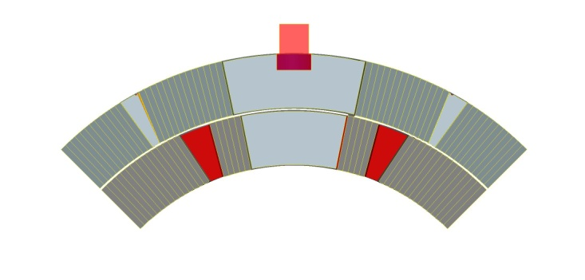
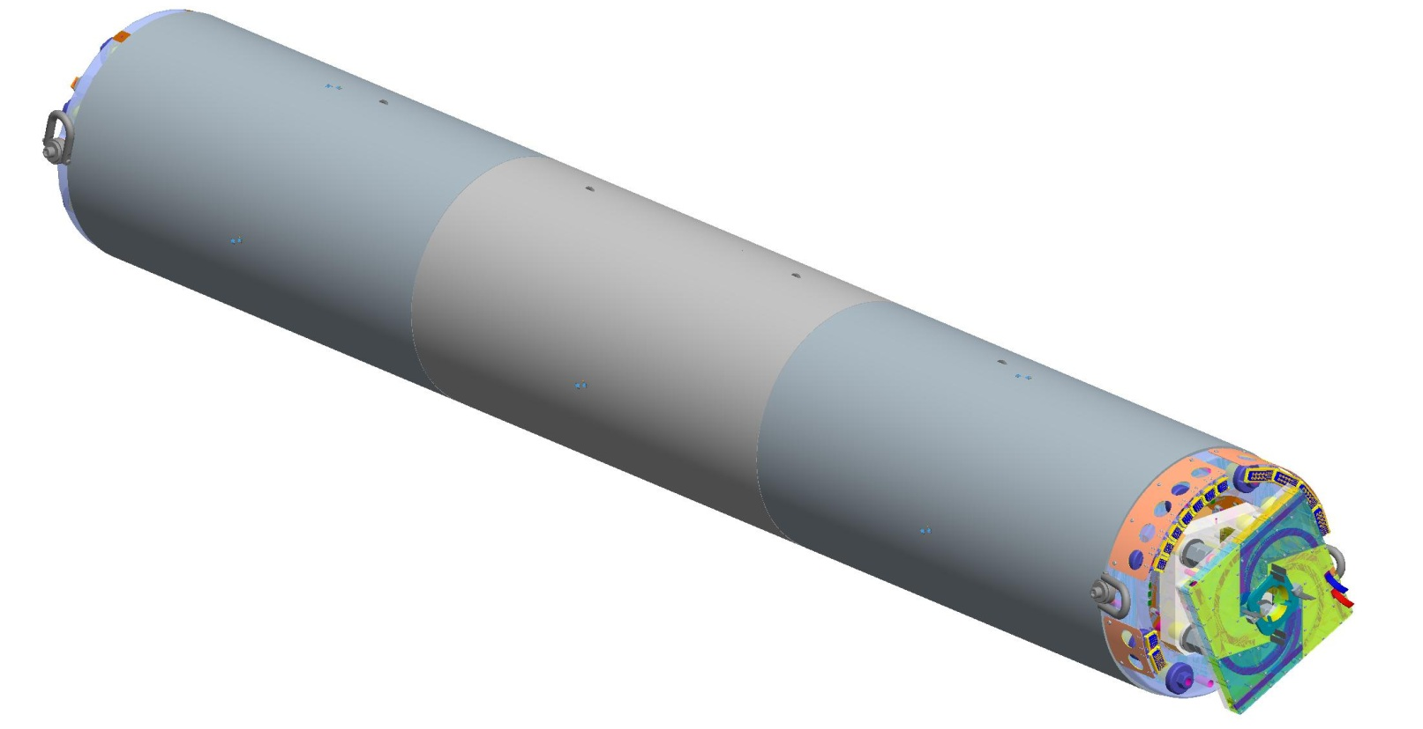
LHQ Features & Success Criteria
LHQ is the main “Nb₃Sn technology demonstrator”
  For technology selection for the LHC IR upgrade
  Deadline: 2014-15
Aperture: 120 mm (as HQ)
Coil x-section: 2nd generation HQ
Coil length: 3.4 m (~as LQ)
Success criteria:
  Nominal gradient: ~160/175 T/m (@ 4.2/1.9 K)
    MQXE (120 mm aper.) has G = 170 T/m
  Quenches to nominal gradient: 3
  Quenches to 110% of nominal gradient: 10
  Quenches to nominal gradient after therm. cycle: 1
  Magnetic requirements from HL-LHC Design Study

Slide 4
LHQ Features & Success Criteria (cont.)
First Long Nb₃Sn Magnet with Accelerator Quality features:
  Alignment
    From coils to aluminum shell
  Field Quality features
    Through all coil fabrication and magnet assembly processes
  Cooling features
    Demonstrate introduction (not optimized for operation)
  Radiation hardness
    Demonstrate option/s (TBD)

Slide 5
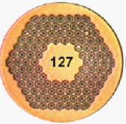
Conductor and Insulation
Cable:
  With 25 um stainless steel core
    As in “2nd generation” HQ coils
Insulation:
  0.1 mm per side
  Baseline: braided S2 glass
    Tests in progress at NEEW.
Strand:
  0.778 mm
  OST RRP 108/127
    Jc: > 2650 A/mm² (4.2K 12T)
    Jc: > 1400 A/mm² (4.2K 15T)
    Cu/non_Cu: 1.22
    Effective Filament size: ~52 um
  Ta or Ti doping
    Ta for practice coils
    5 UL with Ta for LHQ01
    5 UL with Ti for LHQ02

Slide 6
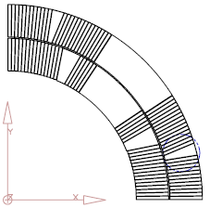
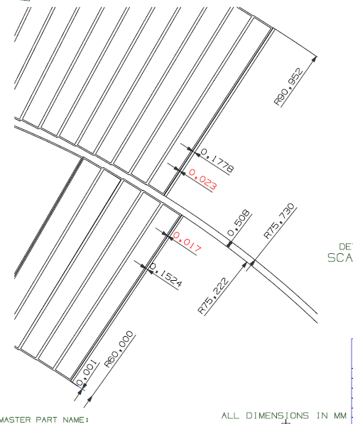
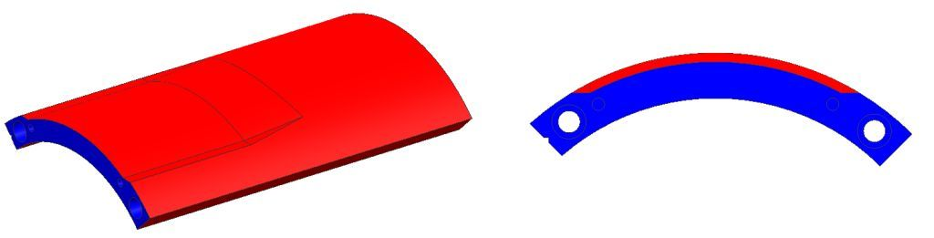
Cross Section
LHQ X-Section = Revised HQ X-Section
  thinner and less wide cable
  Improved insulation strength:
    500 um layer-layer insulation
    Coating of metal parts
    Thicker insulation under protection heaters
  New design of saddle extensions for electrical connections

Slide 7
Coil Fabrication Technology
Same coil fabrication technology of revised HQ:
  winding (Ti-Al-V pole parts)
  curing of ceramic binder (CTD 1202)
  potting (CTD 101K)
  reaction (T = 210, 400, 650 °C)
    650 °C plateau for 48 hours
Long coil features based on LQ & HQ:
  gaps among pole pieces (for longitudinal diff. CTE)
    4 mm/m as in latest HQ coils
  Lifting and handling procedures used for LQ coils

Slide 8
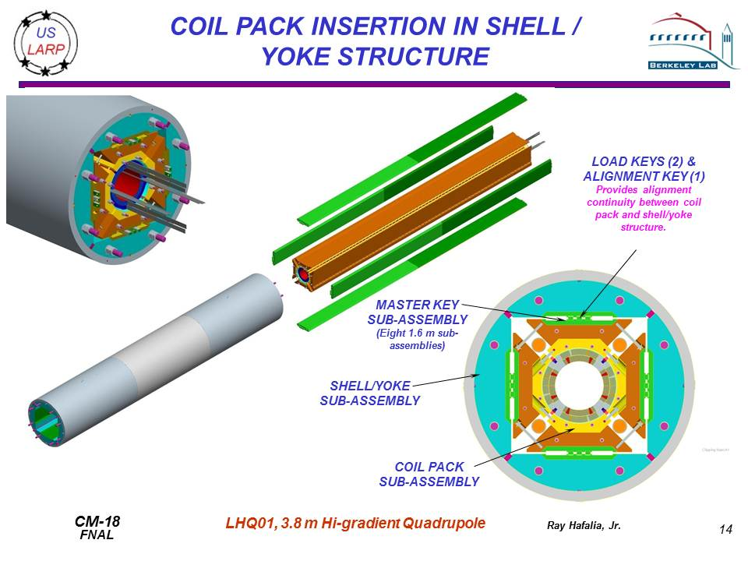
Supporting Structure
Based on HQ
Extended as LQ
Made of 3 or 4 modules (TBD)

Slide 9
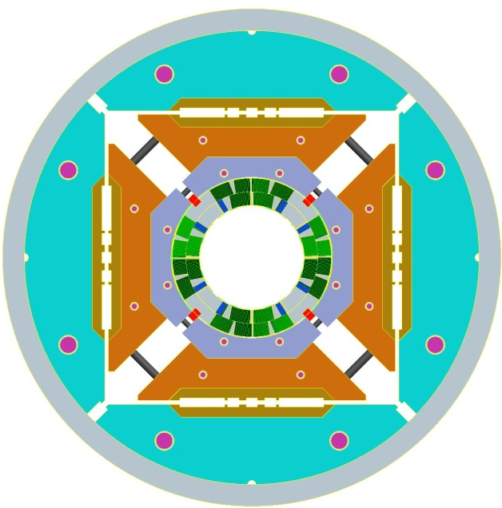
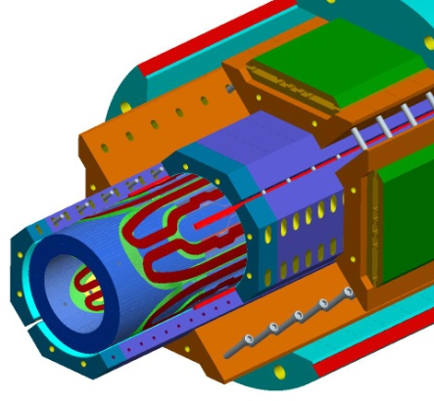
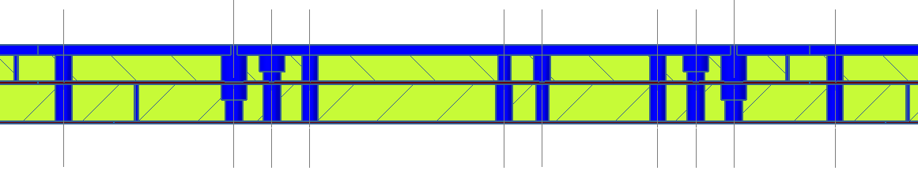
Cooling channels through poles & keys
Demonstrate that cooling paths can be provided:
  using existing holes in poles
  through pole keys
  preserving ground insulation strength
Middle key: 6 holes usable for cooling (4 are for permanent pins)

Slide 10
Quench Protection
LHQ quench protection is more challenging than LQ:
  More energy / coil volume
  Higher inductance
  Higher copper / non-copper ratio
LQ experimental data used for fine-tuning QP codes:
  ➔LHQ can be protected by extracting some energy and using LQ type heaters on coil ID and OD
    T peak < 400 K (without quench back)
    V max < 1000 V
HQ latest experimental data suggests that:
  It may be possible to protect LHQ w/o dump and w/o heaters on coil ID
  Tests on LHQ will be very useful for new IR Quads design

Slide 11
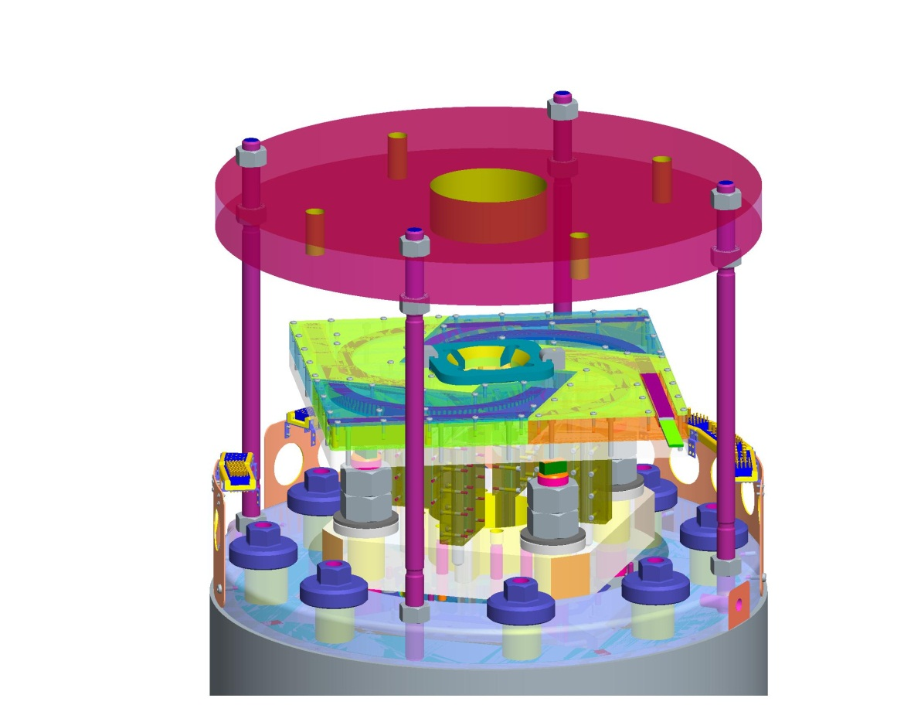
Test
Test at FNAL VMTF:
  T = 4.6 – 2.3 K
    no superfluid He with present top head
    ➔ plans to add lambda-plate to present top head
  support similar to HQ test at CERN
  new He recovery line
  new warm bore for magnetic measurements:
    63-68 mm ID
FNAL structural plate
FOUR SUSPENSION RODS

Slide 12
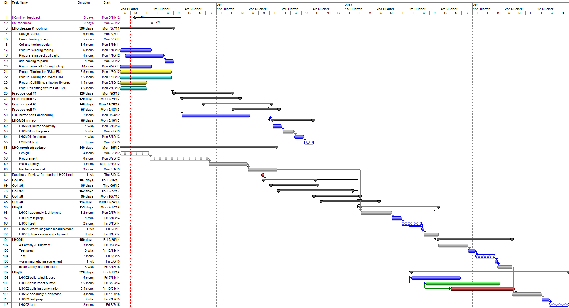
LHQ Schedule
| 2012 | 2013 | 2014 | 2015
Tooling and parts procurement
Practice coils
Coil test in mirror
Structure develop. & mech. model
LHQ01 coils (5)
LHQ01 assembly & test
LHQ01b assembly & test
LHQ02 coils (5), assembly & test
Window for 2 radiation-hard coils and test in mirror

Slide 13
Radiation-Hardness & Techn. Demo
Many factors are going to contribute to the decision:
Present epoxy with “thick” tungsten liner vs.
More rad-hard material with “thin” liner
Decision
Irradiation Simulations
Mat prop. before & after irradiation
Coil fabrication
FEM: requirements for 150 mm aperture
If decision is taken by mid 2013, it can be implemented in LHQ

Slide 14
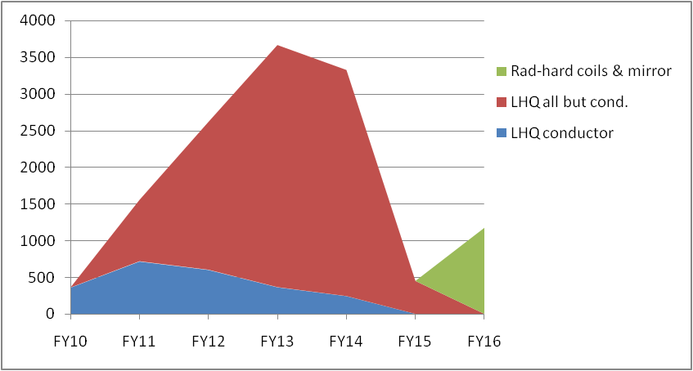
LHQ Budget
LHQ Budget Profile ($K)
  FY10-12 actual
  FY 13-16 projected
coils # |  |  | 4 | 6 | 4 |  | 2 | 16
 | FY10 | FY11 | FY12 | FY13 | FY14 | FY15 | FY16 | TOTAL
LHQ conductor | 360 | 720 | 604 | 366 | 244 |  |  | 2294
LHQ all but cond. |  | 837 | 2019 | 3307 | 3089 | 450 |  | 9702
Rad-hard coils & mirror |  |  |  |  |  |  | 1177 | 1177
 | 360 | 1557 | 2623 | 3673 | 3333 | 450 | 1177 | 13173

Slide 15
Conclusions
The LHQ is LARP last step for demonstrating Nb₃Sn technology for the LHC Luminosity Upgrade
It builds upon the whole LARP R&D (HQ, LQ, …) with contributions from other programs
LHQ magnet test results are expected in 2014 - 15
➔ For more Luminosity at the LHC!

Slide 16
Additional slides

Slide 17
Fabrication and Test Plan
Cable:
  Cabling: LBNL
  Insulation: NEEW (or other vendor)
Coils:
  Winding & curing: FNAL
  Reaction & potting: BNL, LBNL
  Instrumentation: BNL, FNAL, LBNL
  Shipment structure (long version of HQ one): BNL
Structure:
  Pre-assembly & magnet assembly: LBNL
  Shipment similar to LQ
Test:
  Warm and cold measurements: FNAL

Slide 18
Insulation Irradiations
Fiber-reinforced VPI systems
  CTD-101K (epoxy)
  CTD-403 (cyanate ester)
  CTD-422 (CE/epoxy blend)
Insulation performance
  Shear strength most affected by irradiation
  Compression strength largely un-affected by irradiation
Ongoing irradiations
  Ceramic/polymer hybrids
  CTD-403
  20, 50, & 100 MGy doses
  Expect to complete by 8/07

Slide 19
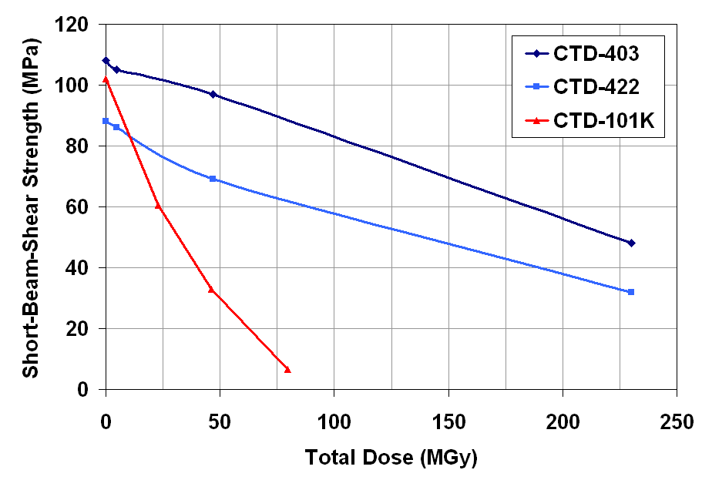
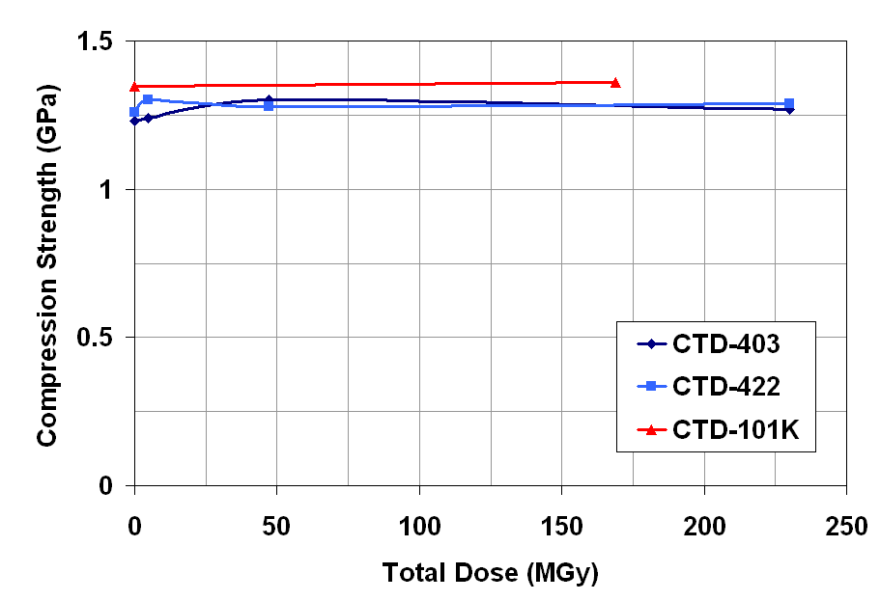
Radiation Resistance
2009 data
Insulation irradiations at Atomic Institute of Austrian Universities (ATI)
  CTD-403 (CE)
  CTD-422 (CE/epoxy blend)
  CTD-101K (epoxy)
CTD-403 shows best radiation resistance
CTD-422 is improved over epoxy, but lower than pure CE
Irradiation conditions
  TRIGA reactor at ATI (Vienna)
  80% gamma, 20% neutron
  340 K irradiation temperature
77 K
77 K

