Slide 1
VD BDE/PDS Feedthrough

Slide 2
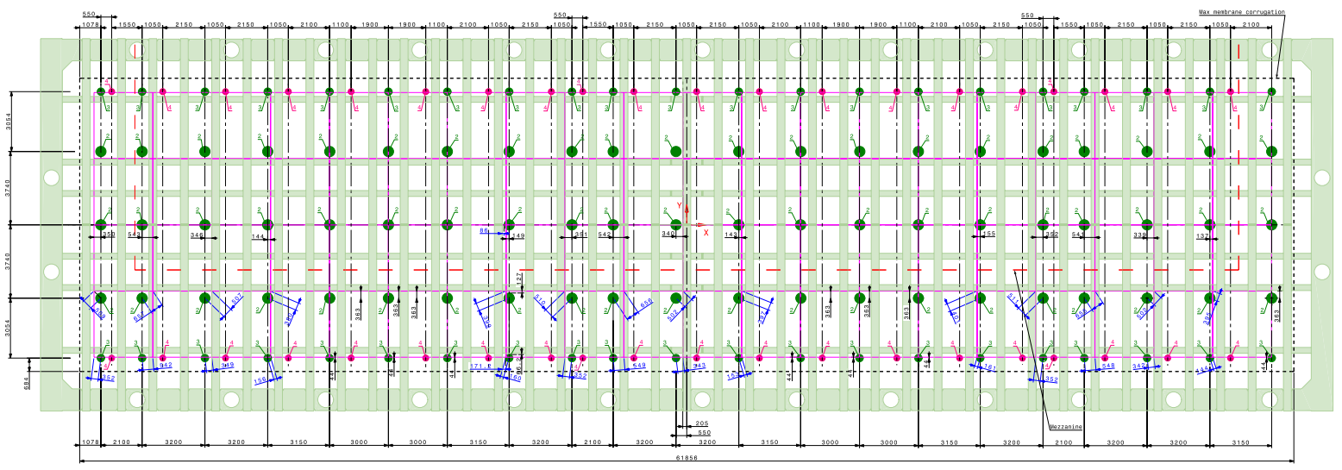
VD Feedthroughs
https://edms.cern.ch/file/2443589/4/LBNF_VD_SE_Penetrations_Cable.pdf

Slide 3
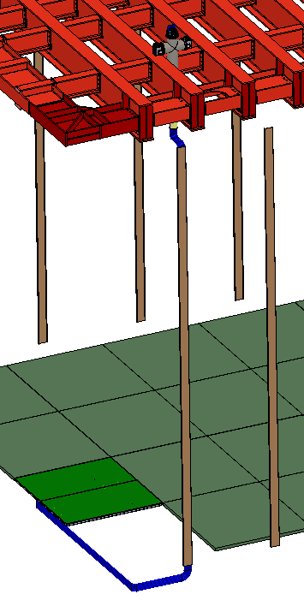
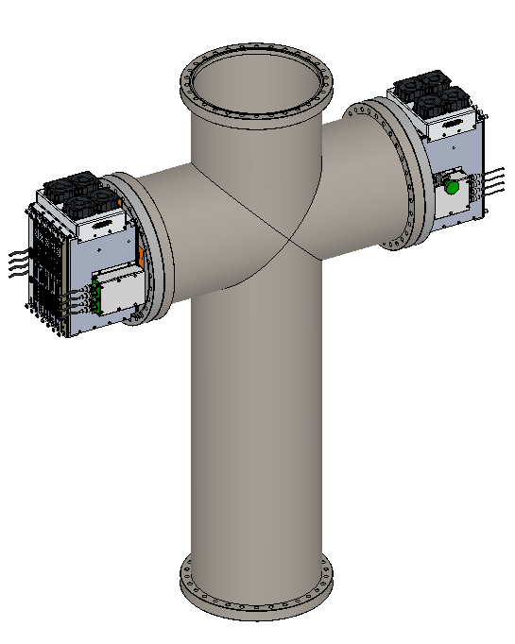
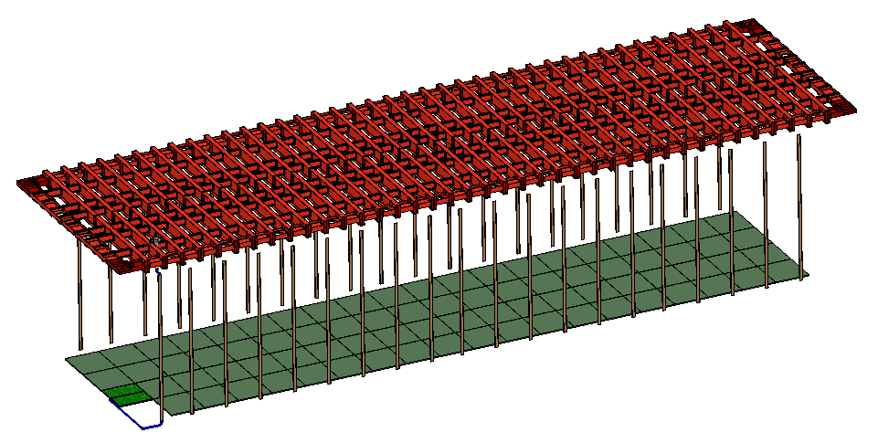
DUNE VD BDE/PDS Cable Routing
80 CRPs (4x20 CRPs, 160 CRUs) are installed on the cryostat floor. 40 feedthroughs on the cryostat are available for CE flanges to cable these FEMBs. The top port of the feedthroughs are reserved for PDS flanges.
Top port for PDS flange
2 WIECs mounted

Slide 4
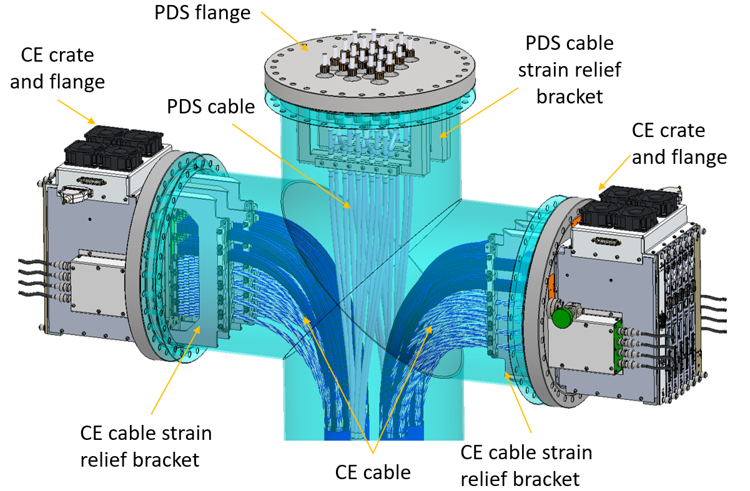
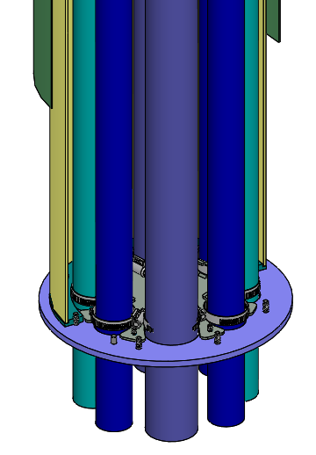
DUNE HD Signal Feedthrough
A CE signal feedthrough is installed on the flange of a cryostat crossing tube and consists of a CE crossing tube (CECT) and a cross-shaped spool piece (CSSP).
A CSSP provides three flanges for installing two CE crates and one PDS flange. The CE cables are connected to the CE flanges and strain relieved on the CE cable brackets. Cable clamp plates are mounted on the bottom flange of the CECT to provide secondary cable support.
CSSP
Cryostat crossing tube
Cable clamp plates
CECT

Slide 5
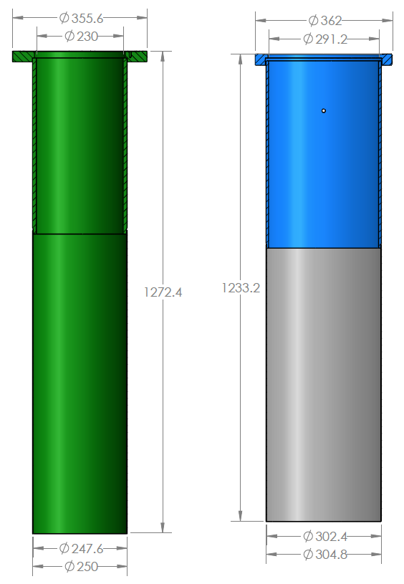
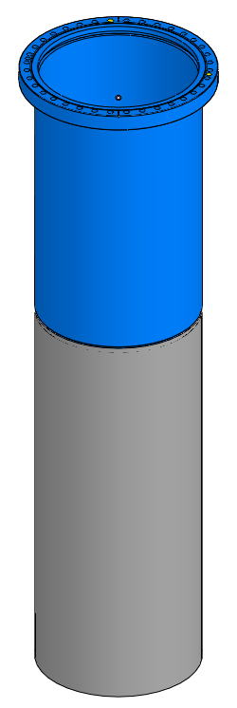
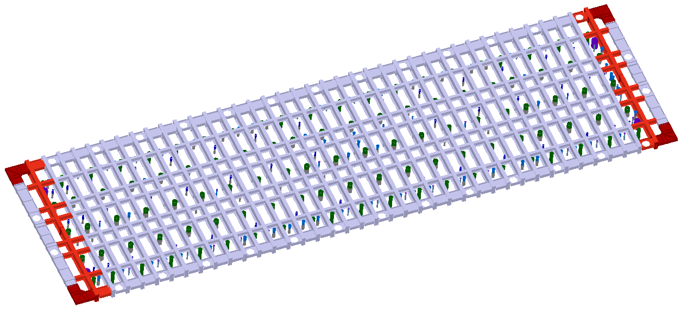
HD vs VD Feedthrough
HD feedthrough
VD feedthrough

Slide 6
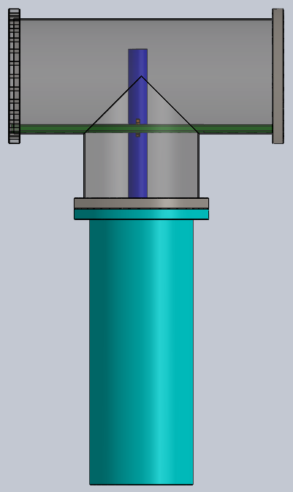
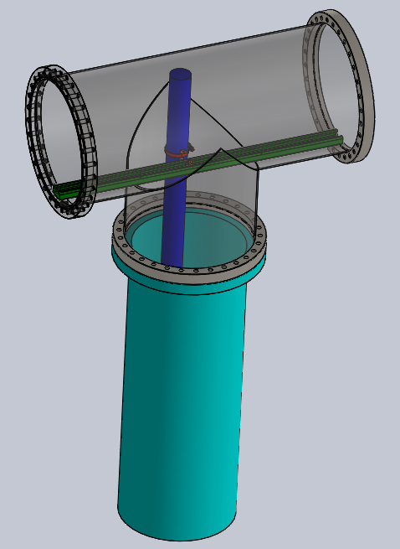
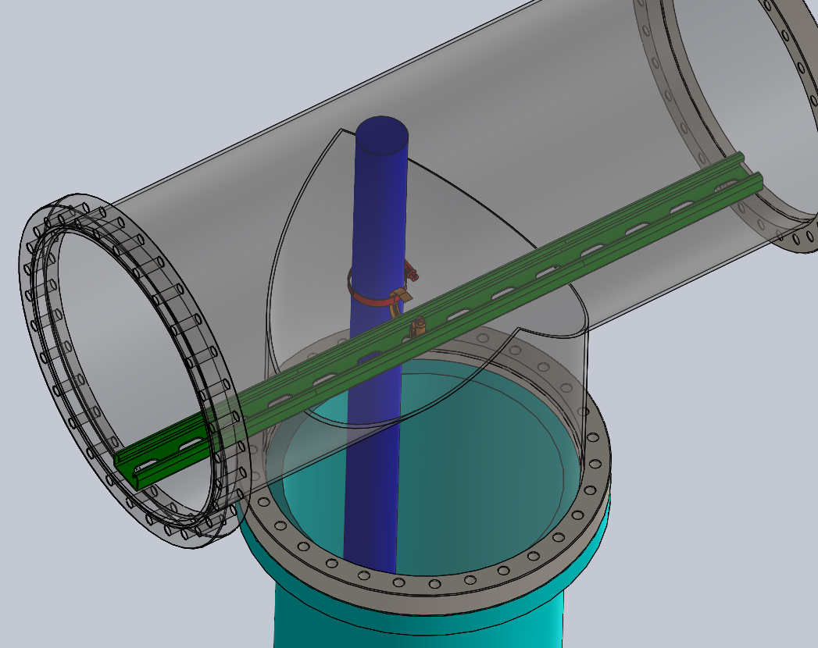
Secondary cable support in cold box tests
Instead of using CECT and cable clamp plate, a bar was used to provide secondary cable support in CRP cold box test and APA cold box test.

