Slide 1
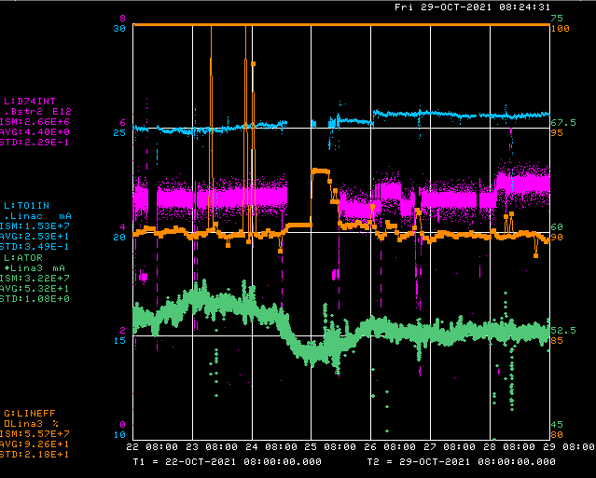
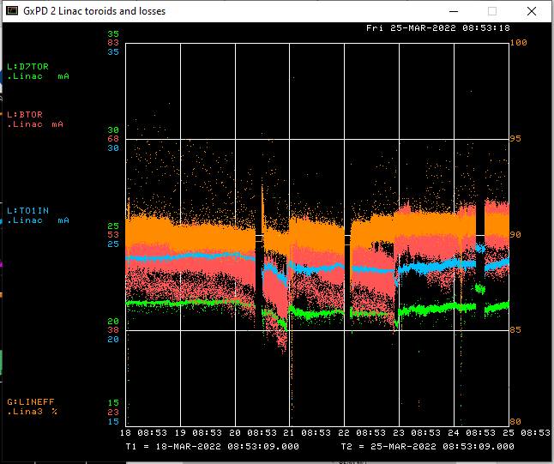
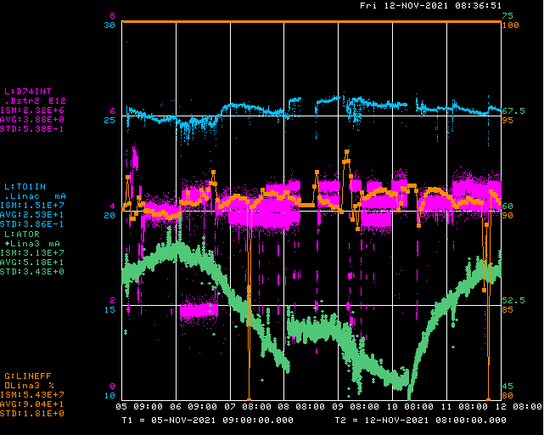
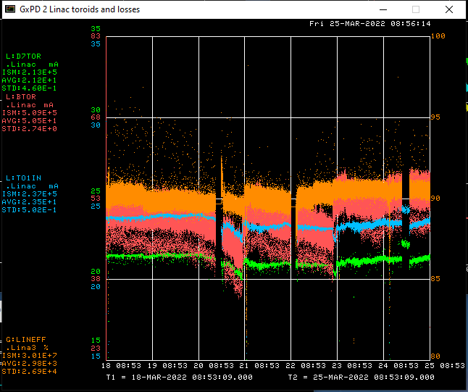
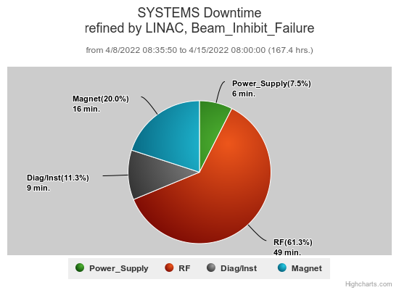
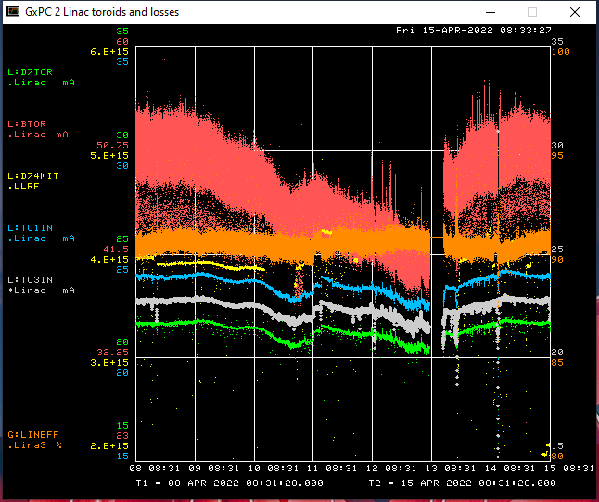
Preacc/Linac Weekly Performance
Wednesday Replaced Marx Cell during Booster access
All week:
Preacc emittance scans

Slide 2
Current Conditions/Plans
Source B – 50.8 mA
Linac input – 24 mA
Linac output – 21.75 mA, 4.7E12 /pulse
Downtime requests
~30 min to remove EE support diagnostics from LRF 4

