Slide 1
Main Injector/Recycler Machine Report
Marty Murphy
AD 0900 Scheduling Meeting
15 April 2022

Slide 2
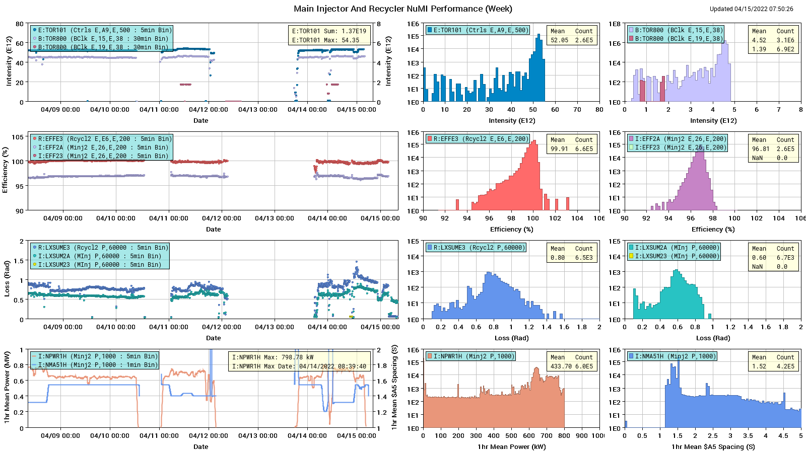
HEP Beam to NuMI

Slide 3
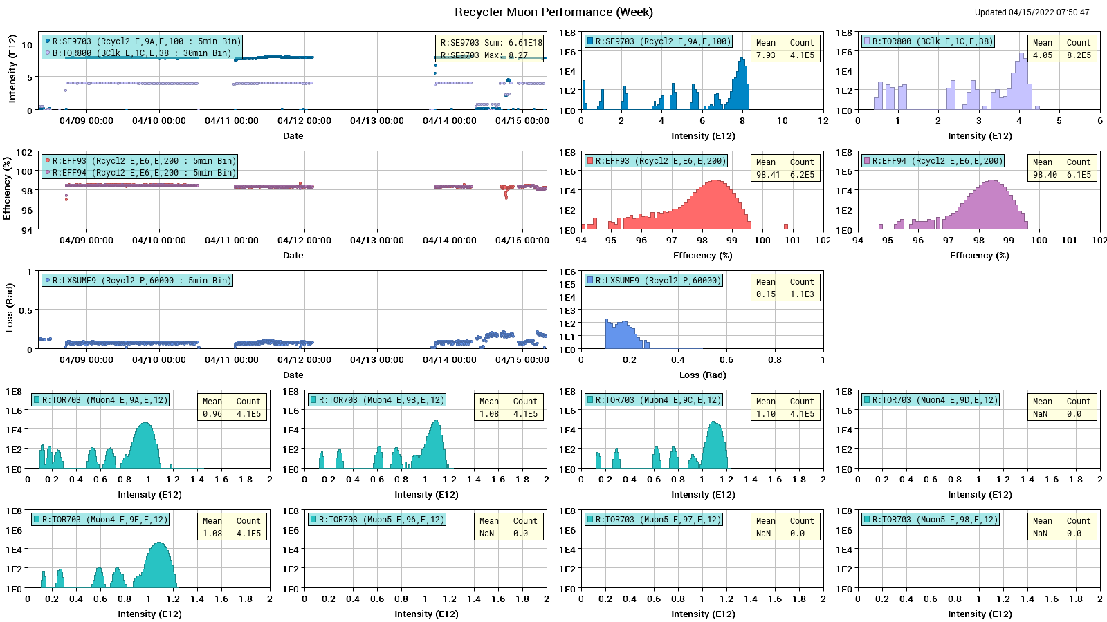
Protons to g-2

Slide 4
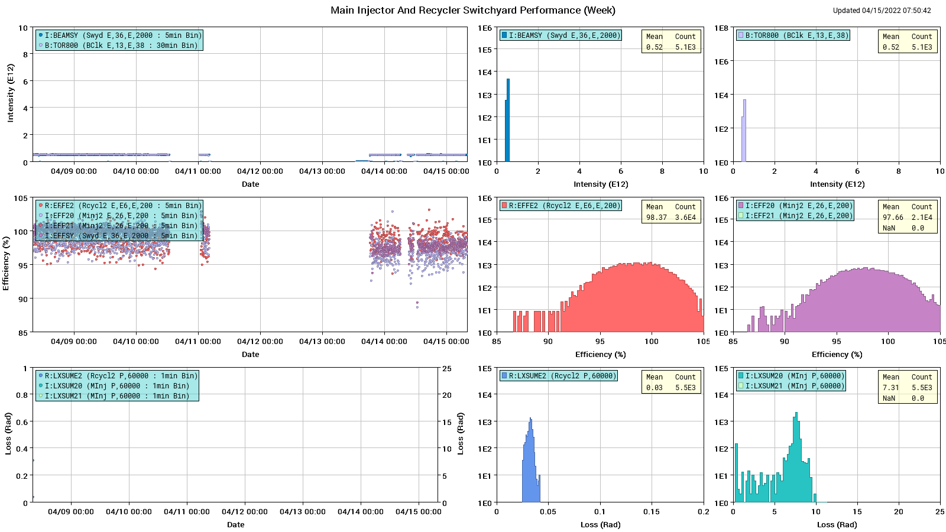
Protons: MI to SY

Slide 5
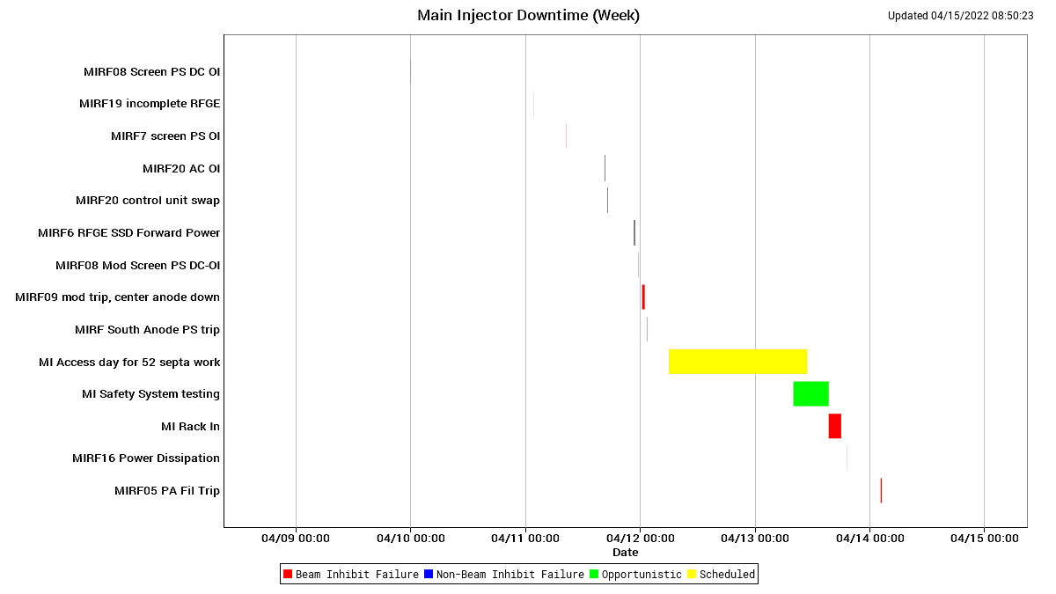
MI Down Time

Slide 6
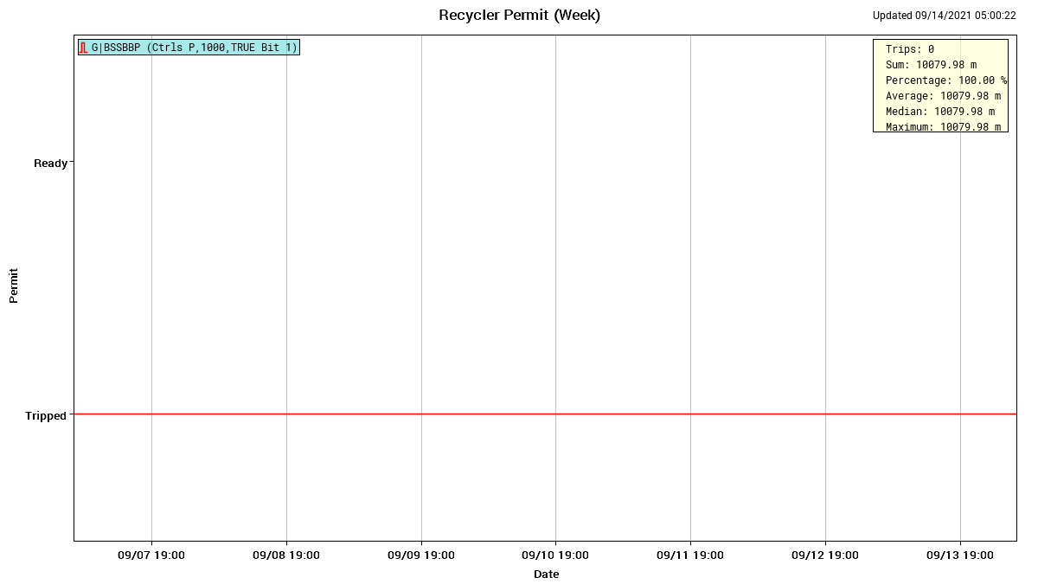
RR Down Time

Slide 7
This Week
MI Extraction Septa Ground Fault
  Monday AM the Upstream SY septa tank indicated ground fault, turning off beam to SY.
  An access was made on Tuesday to open the tank and a broken wire at the down stream end of the tank was identified removed.
  On Wednesday final leak checks were performed and the tank was high potted.
MI 20-62 Enclosure safety system failure Tuesday owl shift.
  A faulty relay was identified & replaced and complete safety system tests were done for all MI enclosures on Tuesday PM and Wednesday.
Overnight Today:
  Vacuum front end (CLX56E) was rebooted; simultaneously (within a second) the NuMI beam rad-tripped at the Hobbit Door.
  Currently suspect NuMI BV100 or BV112 closed causing the trip. Normally rebooting this FE does not cause valves to close; it should affect device readbacks only.
  Investigation continues…
Supported Studies:
  Booster cogging module upgrade test.
  NuMI beam line dispersion measurements.

Slide 8
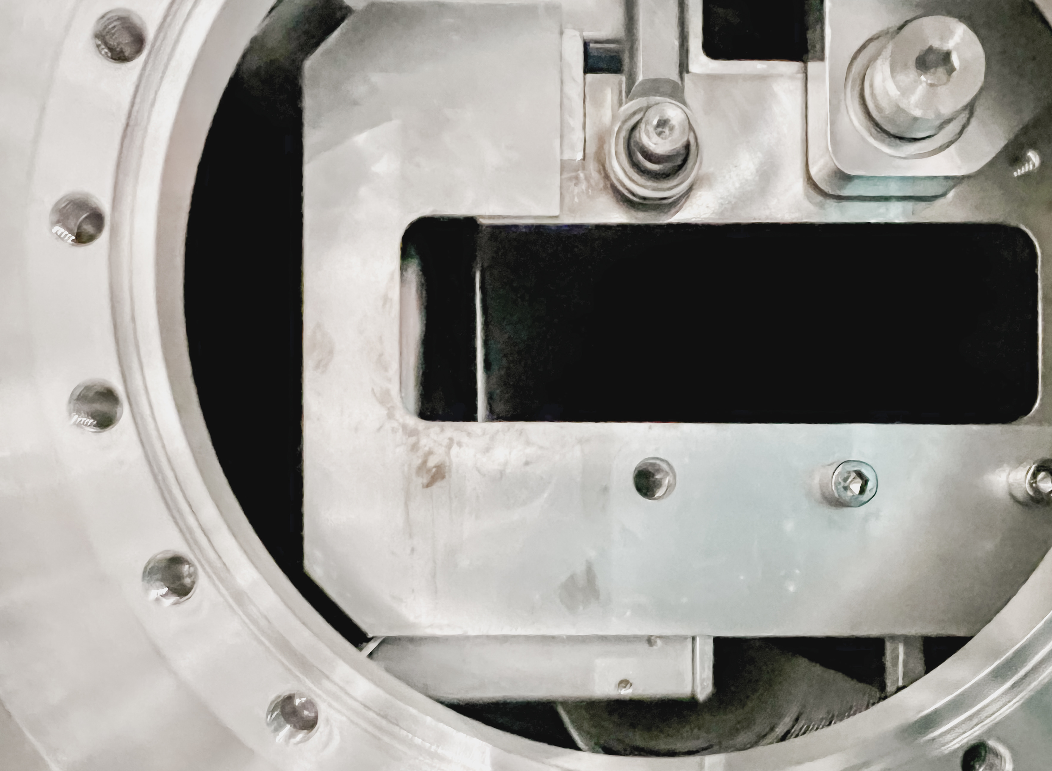
Septa Tank Picture – looking up-stream from the down-stream end
Vacuum chamber
Wire plane
cathode

Slide 9
Current Conditions & Plan
Current Conditions:
  NuMI Power: ~650 KW to NuMI
  Protons to SY120 users
  Beam to g-2
Ongoing studies:
  MI: $2E studies – beam transfer function measurement from RR to MI
  RR: $E0 under the MI SY event. Tune scans
Next week:
  Continue various beam studies and tuning.
Thanks to MSD, EES & ES&H for their efforts in the solving problems this week.
Thanks to Ops for help with tuning and making MI & RR better in general.
Thanks to Proton Source for increased beam intensity.

