Slide 1
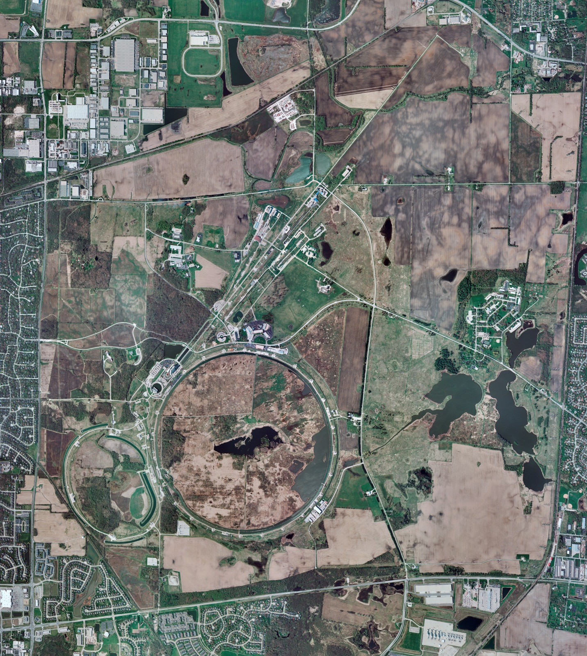
Helium Cryogenics
Status 4/15/2022 J.Makara
CMTF: SCP cryo system cooldown in progress
CMTS: 1.3 GHz HECM installation almost complete with leak checking in progress
PIP2TS: SSR1 at RT
HB650 installation prep continues
MCTF: cryo system shut down at RT except LN2 Tank cold
MDB/HTS: at RT
MDB/STC: at RT
MDB Magnet: at RT
NML/FAST: Cryo system startup in progress with Comprs running on Purifier
CC1/CC2/CM: CC1, CC2, and CM at RT with cave reconfigured for ODH=1
IB1: cryo system cold and running fine with test stands at 5 K and 2 K
HAB: BA comprs and Fridge shut down at RT and isolated; system under dry N2 purge
STF: isolated and not active
Muon Campus: A0 comprs (3) online with MC-1 g-2 cryogenic system cold at 5 K and running fine, though magnet trip due to LN2 supply low pressure excursion
MISC: LN2 deliveries have been “just in time”, thus causing anxieties.
Helium deliveries in liquid dewars or gas cylinders are allocation limited, again causing anxieties.

