Slide 1
C³ - How Many Detectors?
Martin Breidenbach, James Brau
C3 Fermilab Workshop
May 2022

Slide 2
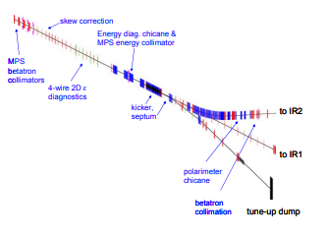
Basics
Detectors are expensive: 10-20% of C³-250
Beam delivery systems are expensive - ½ the length of C³ is beam delivery. Some of it could be used in common for multiple IP’s.
Linear Collider beams are not reusable; n detectors get < 1/n of the total luminosity.
ILC decided a long time ago to go with two detectors
ILC would have one IP and interchange the detectors.

Slide 3
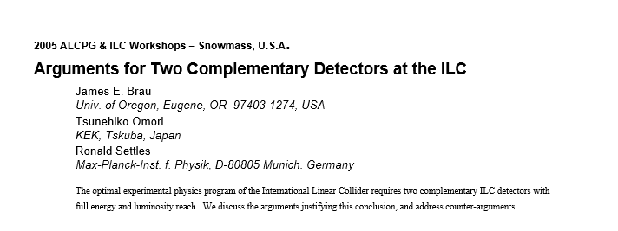
Discussion at Snowmass 2005

Slide 4
Why two detectors??
Cross checks and scientific redundancy:
Critical discoveries require confirmation
Precision measurements require redundancy
Independent datasets, complementary analyses, different systematics
Detectors have technical risk.
The superconducting solenoids store enormous energy - GJ. An accident causing damage to the super-coil could require 3-5 years to repair, with enormous political consequences if the full complex was idle.
Two detectors can be complimentary - e.g. PID vs better calorimetry or TPC vs Si tracking.
Two detectors engage more people more effectively (unless the community is very small).
Two detector collaborations will compete and complement each other.
Two detectors (probably) control systematics better than one.

Slide 5
Why one detector?
One detector costs ~½ of two
One detector gets all the luminosity without the losses of detector change-overs.
The accelerator complex need only accommodate one detector.

Slide 6
How to do two detectors?
Two final focus systems; detectors are stationary.
Fewer detector alignment concerns
No time lost due to moving detectors
No costs associated with moving detector platforms.
Cost of duplicating the final focus system O(1 km) of magnets, etc.
Perhaps necessary to move magnets to steer beam into the two different beamlines. Very little study.
~one final focus; shuttle detectors.
This is the approach adopted by ILC.
Reasonably understood, but still debate over QD0 location.

Slide 7
L*
The value of L* (front face of final quad to ip) remains controversial.
The traditional wisdom is that a large L* will cost luminosity. This means an L* ~ 4 m, with QD0 supported by the detector and inside the detector.
CLIC is pushing for QD0 to be on a very large concrete block outside the detector to better control vibrations. There does not appear to be a reasonable push-pull solution for the large L* configuration. Reasonable (for me!) includes the detector beampipe staying at UHV.

Slide 8
Ordered ILC recommendation from Snowmass 2005
1. 2 Instrumented IRs / 2 detectors
2. 1 Instrumented IR / 2 detectors(in push-pull configuration) + 1 Non-Instrumented IR for future instrumentation
3. 1 Instrumented IR / 2 detectors(in push-pull configuration)
4. 1 Instrumented IR / 1 detector(with push-pull capability for a future additional detector)
5. 1 Instrumented IR / 1 detector + 1 Non-Instrumented IR for future instrumentation
6. 1 Instrumented IR / 1 detector (the minimal program)

Slide 9
Not a lot has changed, but…
The costs, particularly of 2 IR’s vs 1 IR with Push/Pull were never carefully evaluated, and the costs of dealing with two detectors of different beamline elevations are pretty big.
My preference:
Two detectors
Evaluate relative costs for the IP options

Slide 10
Push Pull Detector Assumptions from TILC09
•The detectors are self-shielded.
•The beamline has portable shielding (Pacmen) that have a section meeting the tunnel mouth that is common with the other detector.
•Liquid He (4K) is delivered by a permanently connected flex line to the detector. 2K He is made by a system that moves with the detector, and all the QD0 plumbing moves with the detector.
•All detector power and data cables are permanently connected to the detector.
•The detector is designed so that small distortions of the steel do not change stresses on the cryostat, which in turn isolates the support of the calorimeters and tracker.
•The wavelength scanning interferometer system checks alignment for the barrel and relates the endcap positions.
•The full detector position is adjustable in X and Y to 1 mm. The Y range will need to be determined to accommodate floor motion.
•Roller and drive system designed for 1-5 mm/s.

Slide 11
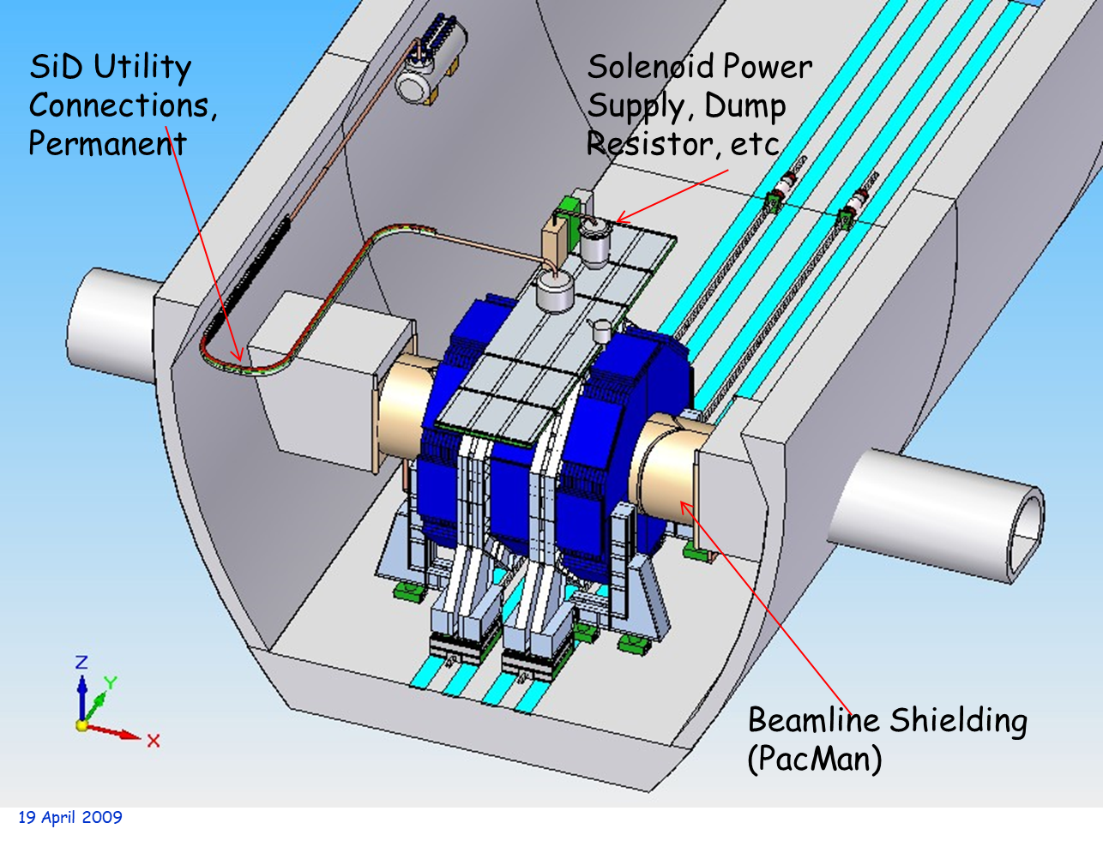
SiD Design

Slide 12
First Steps
•Secure accelerator: de-energize and lock critical BDS components.
•Ramp down magnet. Assume LdI/dt = 100V, then ramp time = 0.5 hours.
•Open Pacmen. This also gets access to the beamline connections between QD0 and QF1.
•Disconnect beamlines:
– Close isolation valves
Vent to dry Nitrogen
Remove spool pieces
Remove QD0 longitudinal restraints

Slide 13
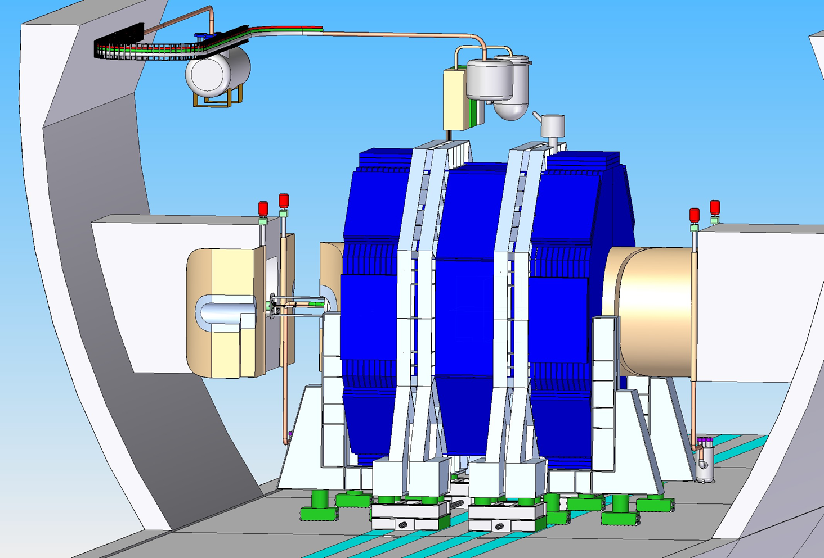

Slide 15
SiD Drive Studies
•SiD prefers roller sets under each leg. The roller set is integrated with hydraulic jacks for Y motion, and may have a fine X adjustment.
•The doors are carried by the barrel.
•The rollers run on hardened steel rails. The rails could be shared with the other detector, or arranged to be independent.
•The drive force is applied to the roller sets and is balanced to minimize stress of the detector steel.
-Kinematic support of the solenoid within the steel and of the tracker within the calorimeters is being studied.
-Frequency scanning interferometers are envisioned to measure any internal deformations of the detector, and to measure the position of SiD relative to ILC coordinates.
•A travel velocity of ~ 5 mm/sec is assumed, ~1 hour for 20 m.
•Three drive mechanisms have been considered:
•

Slide 16
Drive Methods

