Slide 1
Low-Level RF
Future of Colliders workshop — CCC R&D
Carlos Serrano, Daniele Filippetto & Larry Doolittle— LBNL
Wednesday, May 18 2022

Slide 2
Outline
Introduction
LLRF implementation for LCLS-II
Areas for development
Conclusions

Slide 3
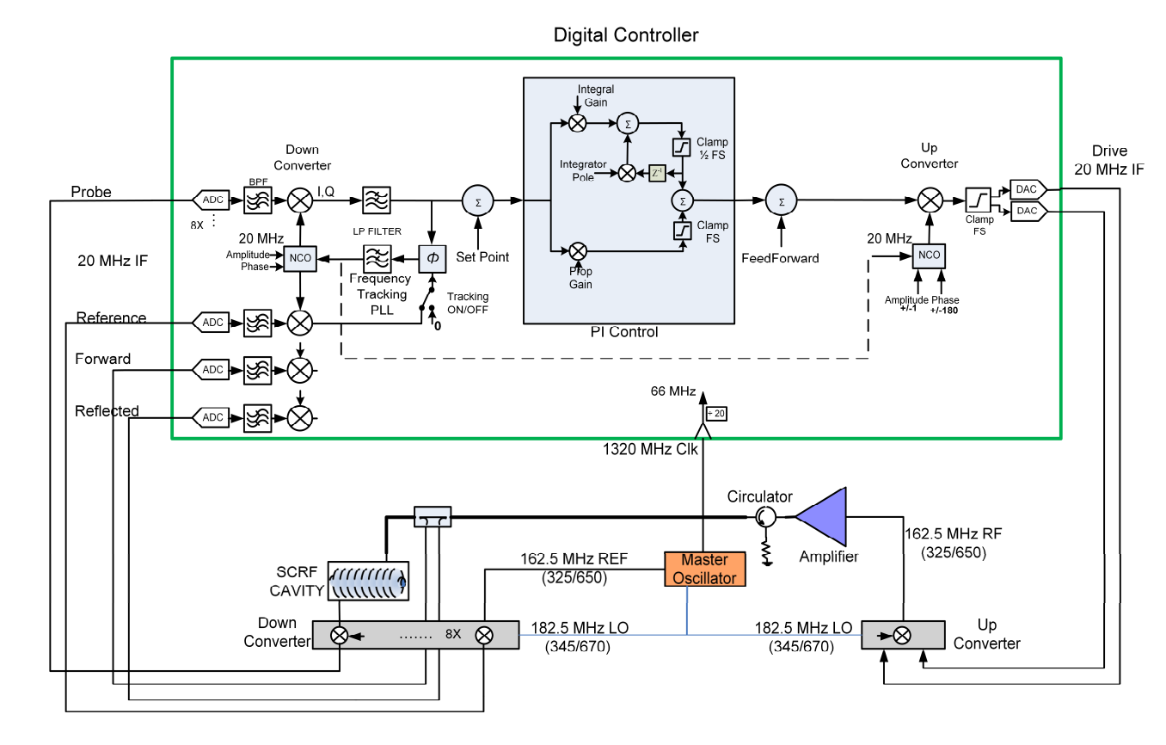
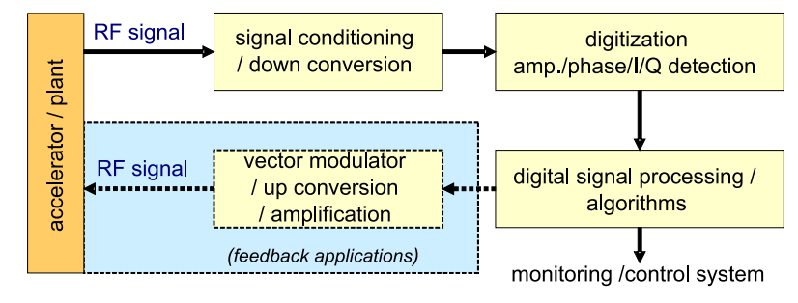
RF detection and feedback
RF + Analog + Digital
Credit: FNAL LLRF team

Slide 4
RF detection and controls sensitivities
What are our knobs and sensitivities today
Analog front-end
Stability of RF filters & Linearity
Drift: temperature sensitivities
Channel-to-channel gain differences: think a 4-button BPM
Channel-to-channel isolation: think an RF correction signal bleeding into (polluting) the detected RF signal (same frequency)
LO stability and distribution
Pick a commercial ADC (the ones we picked 5 years ago are still the best for us!)
Sampling rate
Bandwidth
Noise characteristics
Pick a commercial FPGA and program it: Digital Signal Processing (DSP)

Slide 5
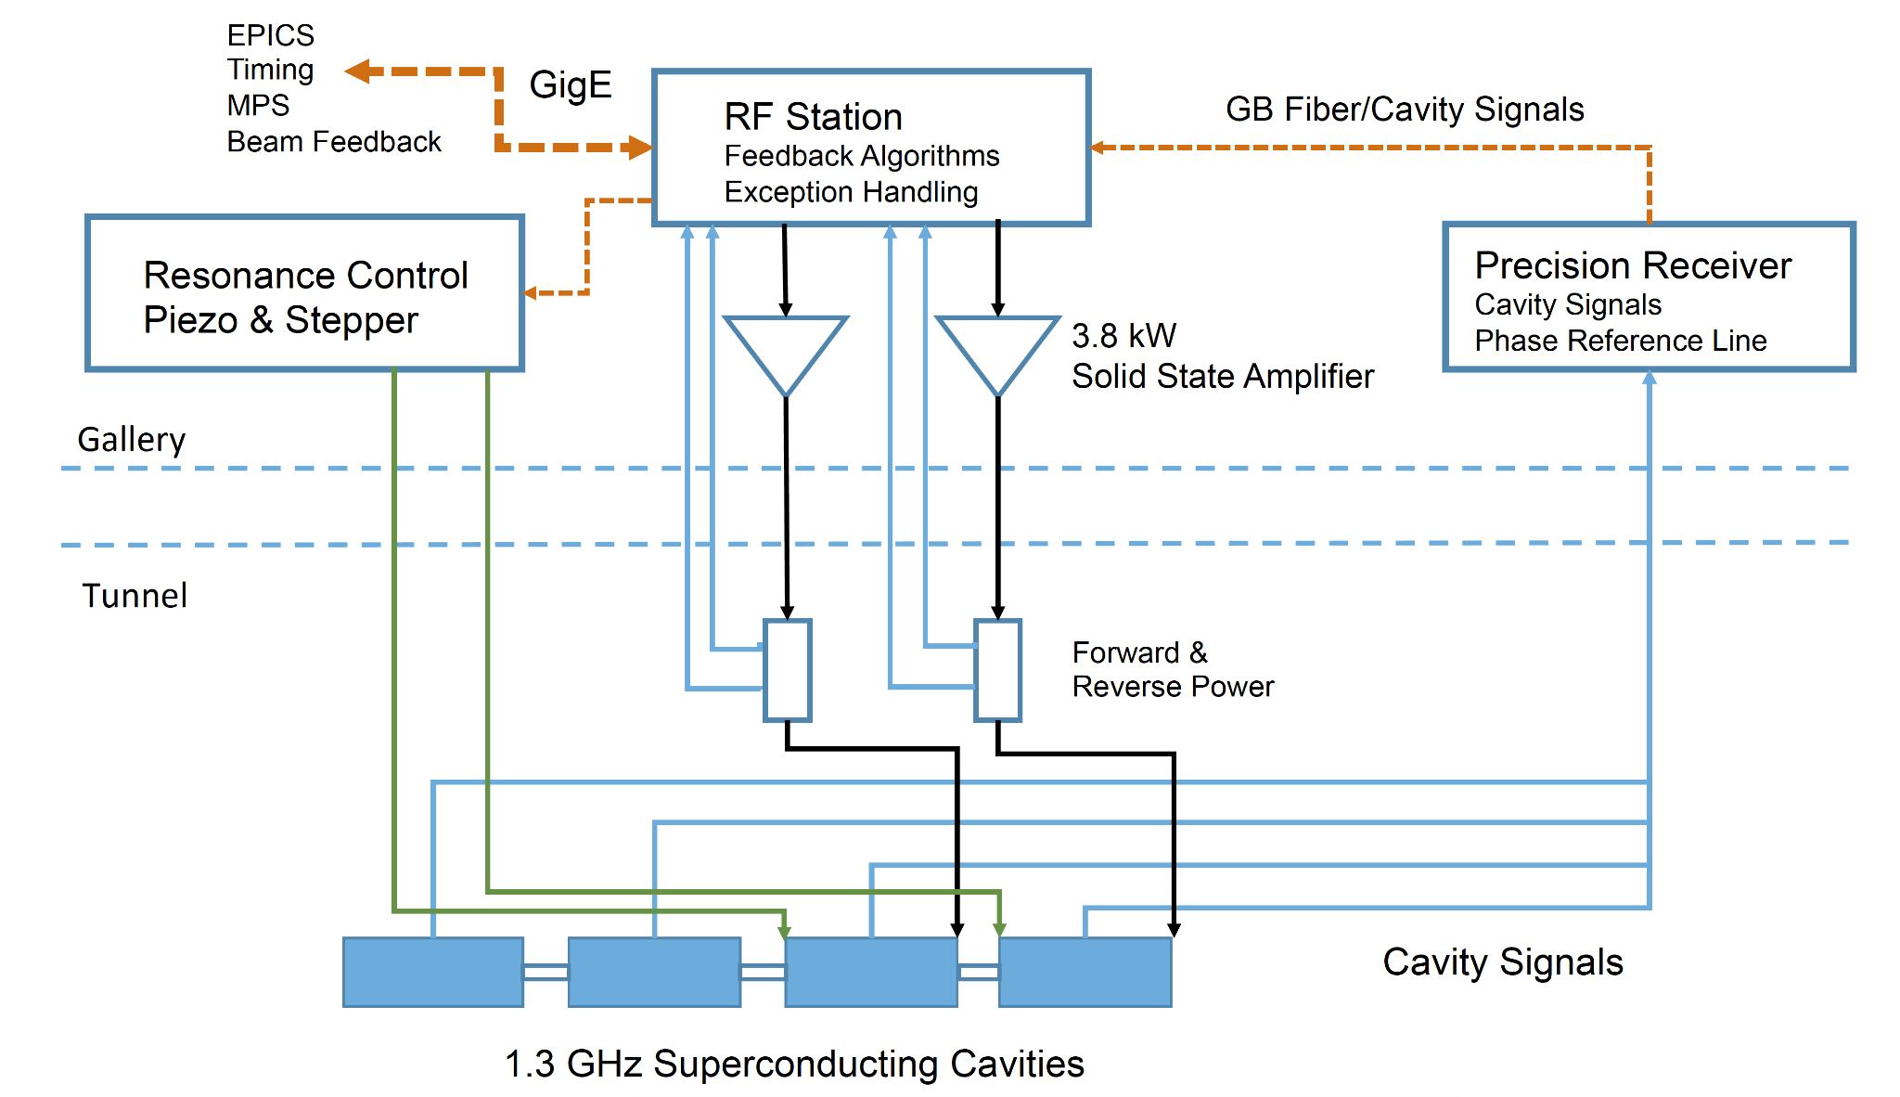
LCLS-II Architecture

Slide 6
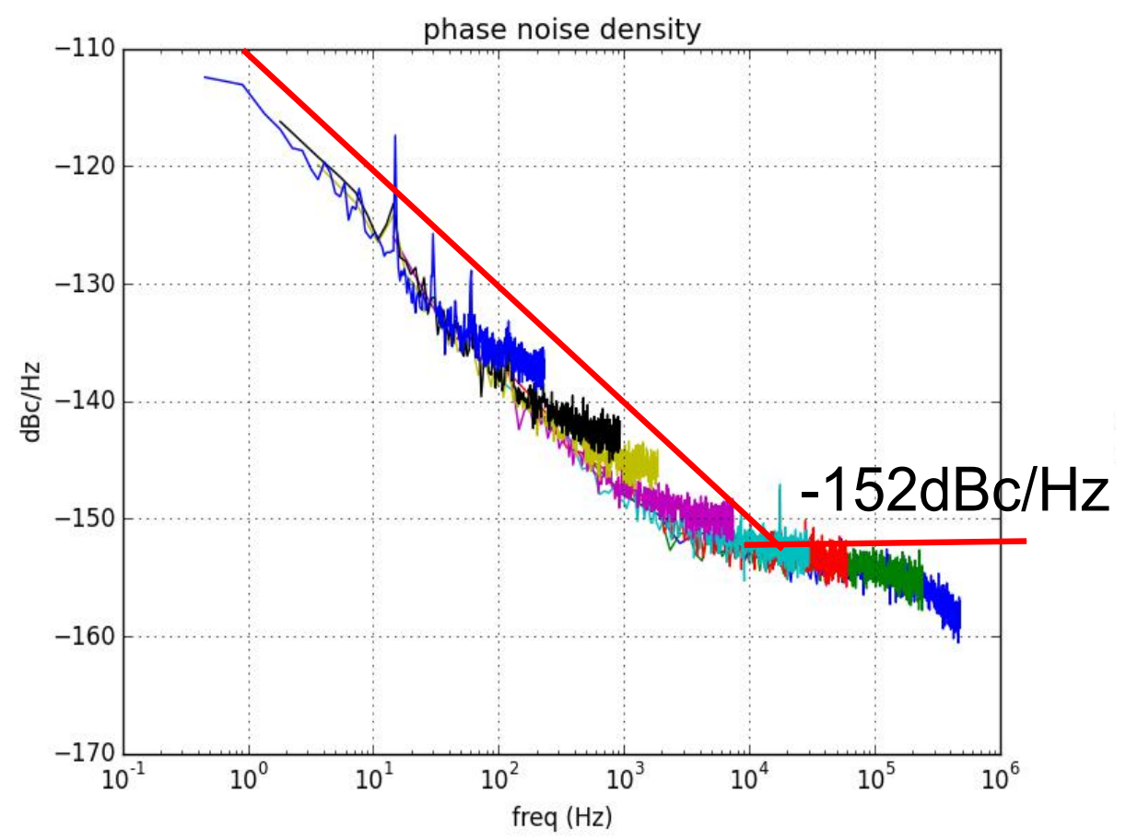
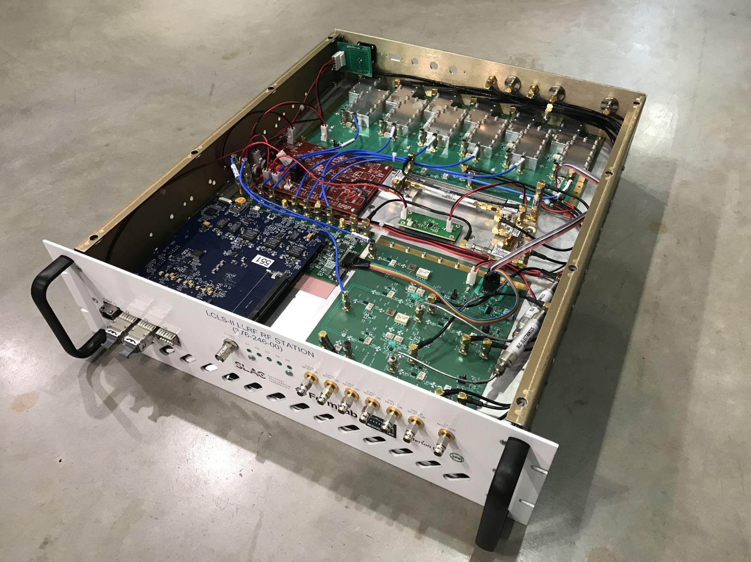
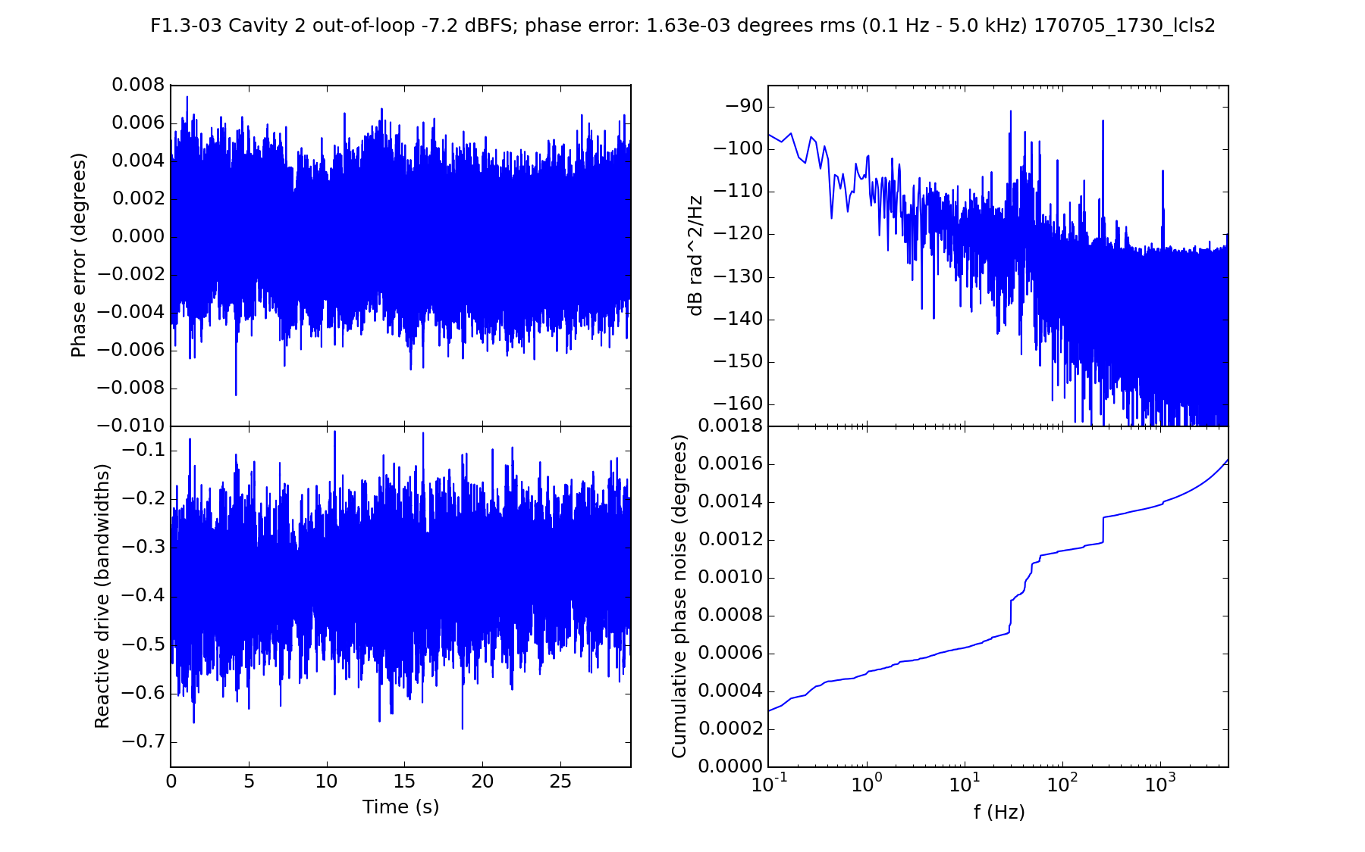
LCLS-II Hardware

Slide 7
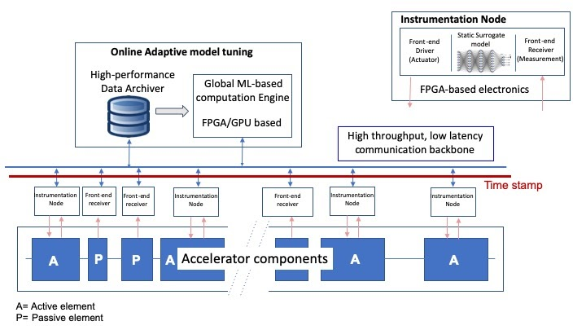
Controls in future accelerators

Slide 8
Areas for development: Custom ICs
Inventing new knobs by developing new capabilities
Maximizing performance by merging selected components into a single IC:
Analog front-end
Sampling ADC
Digital Signal Processing
RF ICs for Physics:
Design custom ADCs for Physics applications
Include analog components within IC (e.g., LO distribution & mixing)
Make analog chains more stable and better integrated
Consider properties not relevant for telecom (e.g., 1/f noise)
Throw in DSP chains into the IC itself (e.g., data reduction typically in an FPGA)
Received internal LBNL funding this year to research potential performance improvements

Slide 9
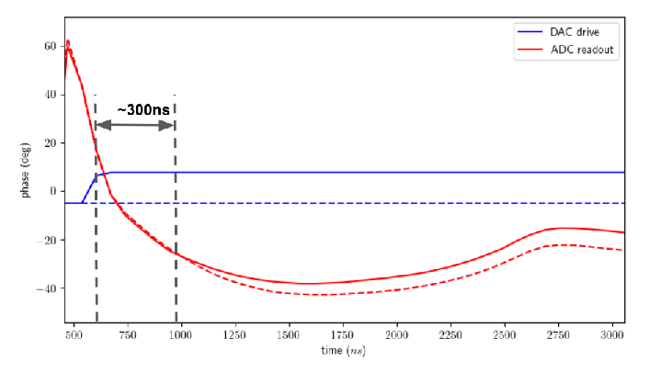
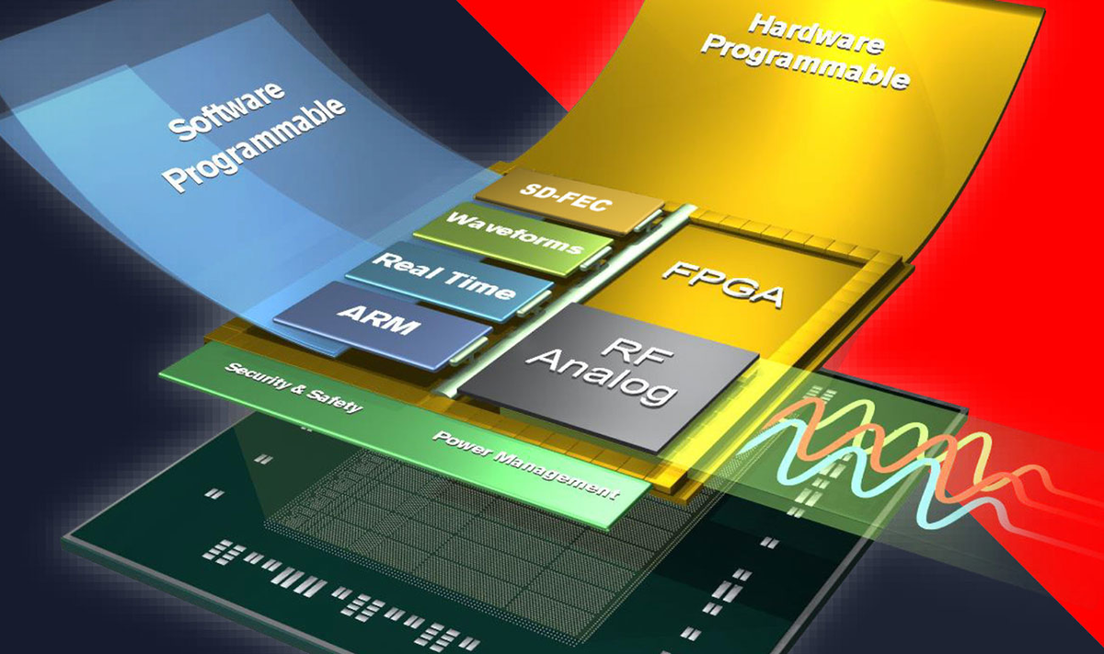
Areas for development: Low latency solutions
“Going back” to analog
Reduce latency in digital <-> analog conversions
Study possibility of “cool” electronics & other form factors to minimize cable lengths
Develop configuration and data acquisition scheme to continuously tune and calibrate analog system digitally
RFSoC technology
Up to: 7 GHz BW and 10 GSPS (sub-μs latency)
Not optimized for RF accuracy
Developments start now for deployment in accelerators (e.g. ALS-U BPM electronics)
These areas would need development for use in LLRF applications
Credit: Larry Doolittle (LBNL) & Michalis Bachtis (UCLA)

Slide 10
Conclusion
LLRF today
0.01% 0.01 deg RMS is achieved with convencional electronics parts
All (or most) modern systems are digital (FPGA based)
Heterodyne detection offers the best RF measurement accuracy
1 μs is typical for loop latency
Machines with short bunches/pulses perform inter-pulse feedback feedback (e.g., Fermi@Elettra)
Noise performance of ~100 MSPS ADCs seem to have stalled (Telecom going a different direction with 5G)
Low-latency applications
Any technical implementation will require (a lot of) development for a LLRF application
RFSoCs start making it into accelerators, offering medium latency at high sampling rates and bandwidth, without necessarily improving RF measurement accuracy. They might improve going forward, but industry is not heading towards that direction (optimizing for higher sampling rate, size, and power, all bad for RF applications)
Custom IC development is already done in Physics experiments and is starting in LLRF
A digitally controlled/tuned/calibrated analog feedback system seems to be the best positioned for RF performance of low-latency LLRF applications if deemed necessary for CCC

Slide 11
Thank You
Questions?

