Slide 1
9 O’Clock Meeting
Keymonty Bullock
MCR Crew Chief
Wednesday, April 20, 2022

Slide 2
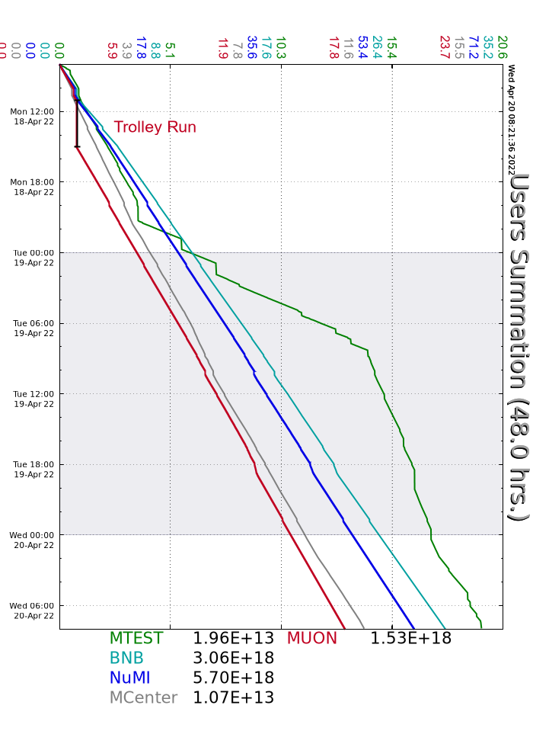
Since Monday…
Mostly smooth running
Walkthroughs on off-shifts
Studies ran when requested
F1 prepared for access for sump work
Beam to NuMI, BNB, Muon

