Slide 1
Lens prototyping
Lea Di Noto
on behalf of the Genova group
GRAIN WG meeting
April, 21th 2022

Slide 2
Planned tests
Tests in water (in progress)
Cryogenic tests:
For checking material
For checking gas leakage
Tests in ARTIC:
3 prototypes under construction

Slide 3
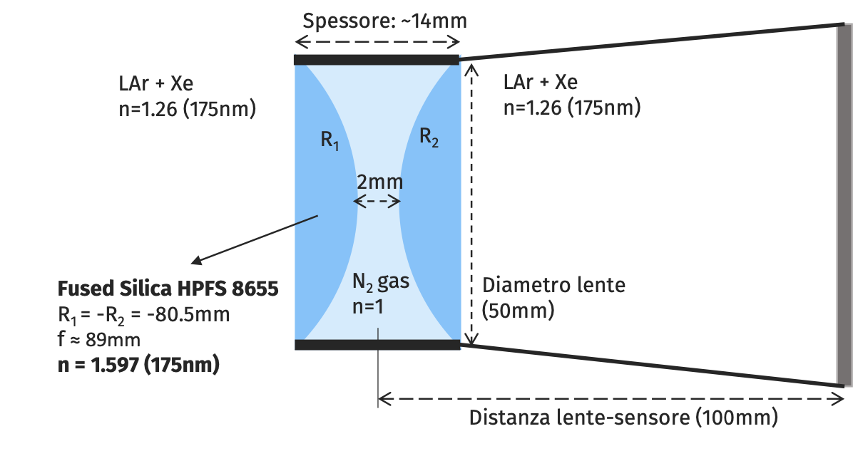
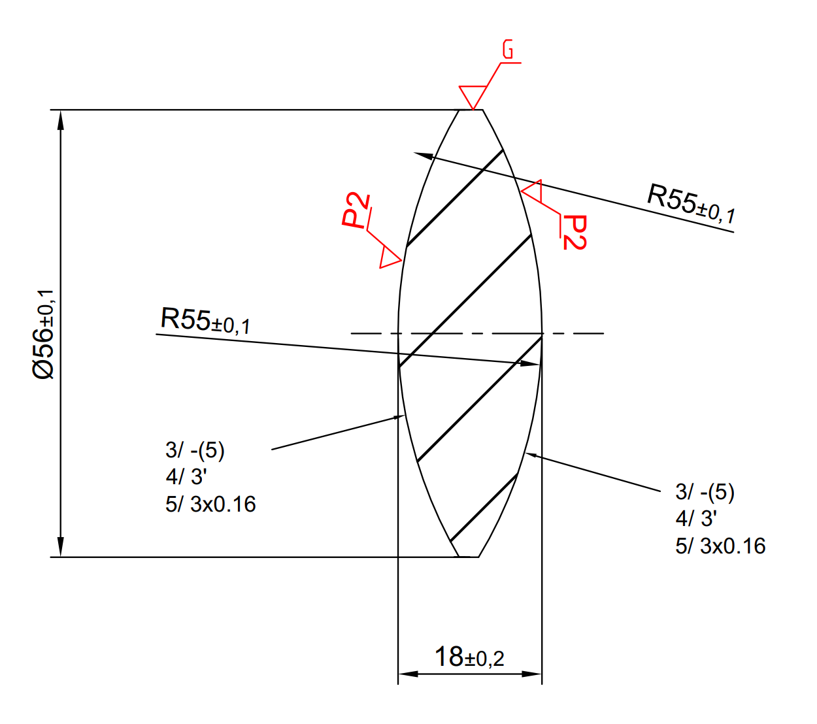
Lens prototype
total width 14 mm
Test in ARTIC:
3 prototypes:
Type A: the same of the simulations (focal 89 mm)
Type A: similar (focal 89 mm) but bigger $∅=$ 60 mm
Type B: Single bi-convex lens (focal 64 mm)
sensor
plane
Diameter 50 mm
lens-sensor plane distance = 10 cm
TYPE A
TYPE B

Slide 4
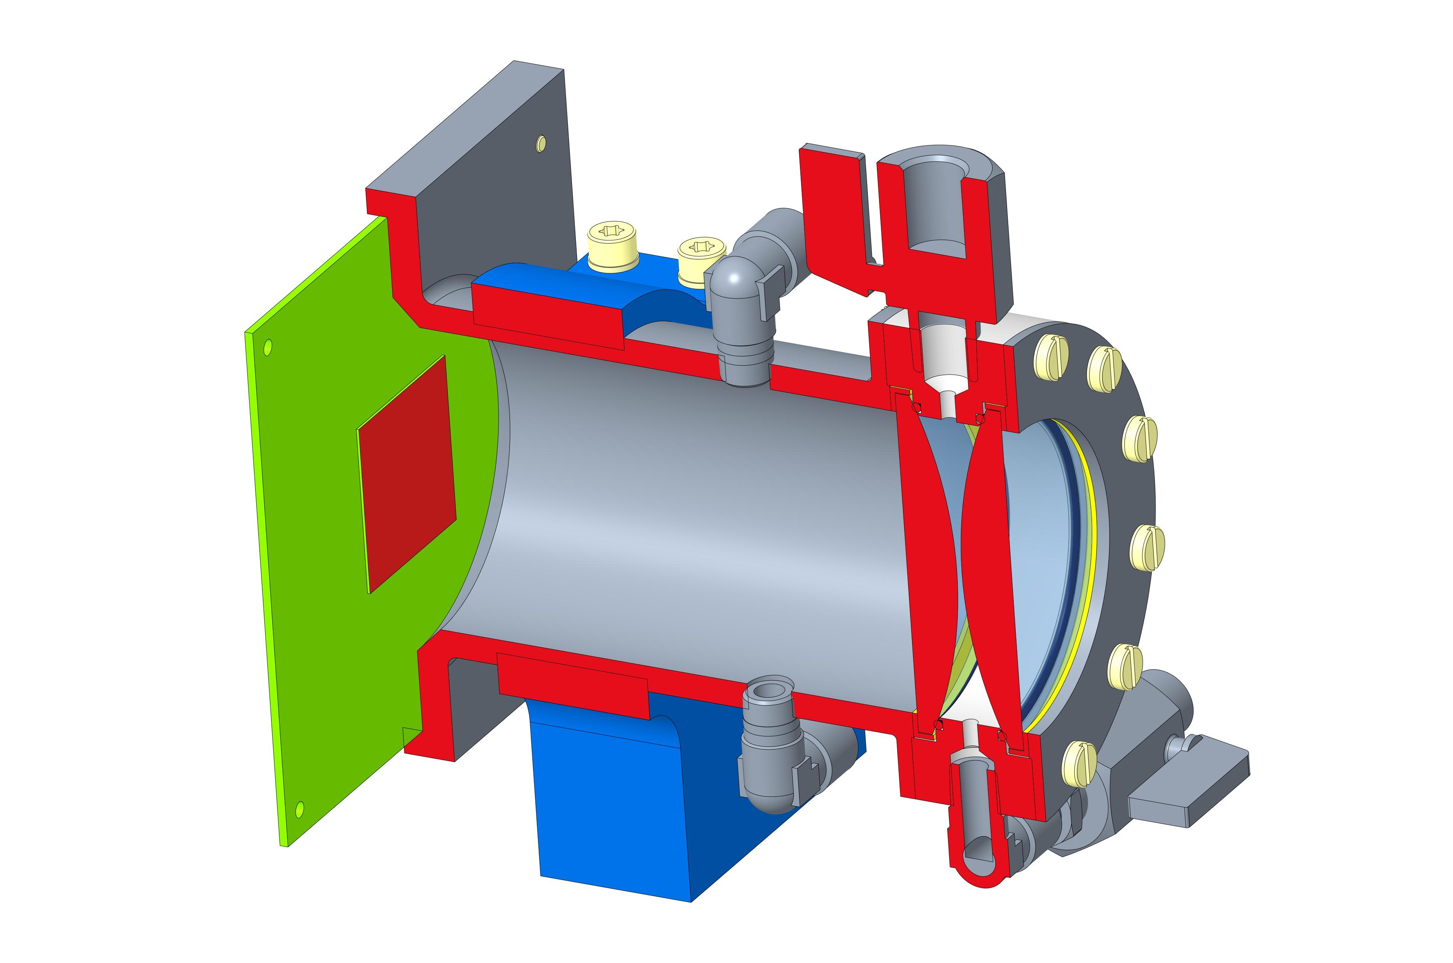
Mechanics for lens prototype
Drawing completed for type A:
ready by the end of June
Drawing in progress for type B

Slide 5
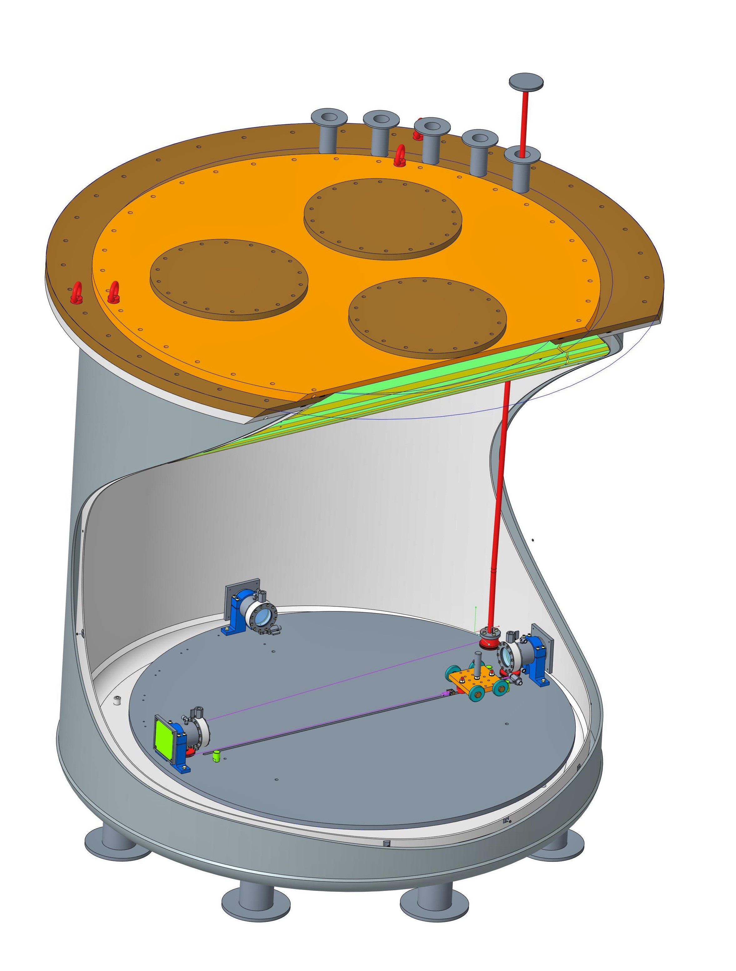
Goals 1st phase: in LAr and with artificial source
Build a first simple working set up
(readout, reflections, cryogenics)
Tune simulation parameters
Check current simulation results
Evaluate:
the Point Spread Function by point source light
the reconstruction capability by using two faced detectors
Lens cameras
1.3 m
Movable system
of the light source
along a rail

Slide 6
Goals 2st phase: in Lar + Xe (using scintillating light)
Test with cosmics
with more detectors (3 or more?)
…many things to be done…
-- NOT BEFORE SUMMER 2023 --
Lens cameras
1.3 m
Movable system
of the light source
along a rail

