Slide 1
Strong Back Temperature Distribution - 3D analysis SSR1 Cryomodule

Slide 2
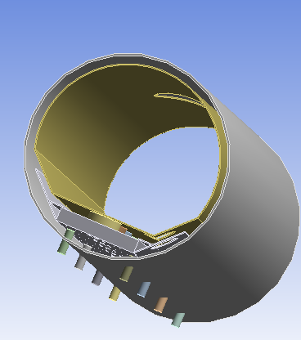
3D Model
The model for the thermal analysis is made from the SSR1 file received from Tom
Materials are taken as G-11 for support posts and Stainless steel for other parts
Outer vacuum
vessel
Support posts
Strong-back
Support pins

Slide 3
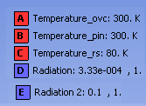
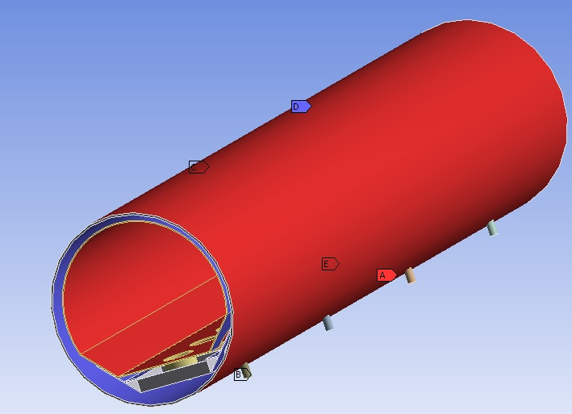
Loading Details
Radiation-conduction boundary conditions are applied
Equivalent emissivity between the surfaces are used to include the effect of multilayer insulations.
Average thermal conductivities are used

Slide 4
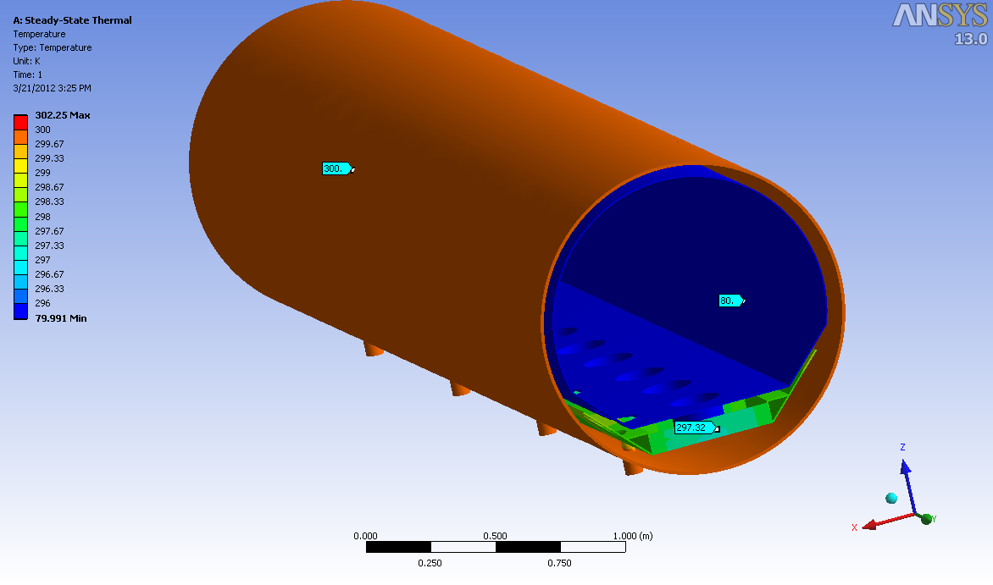
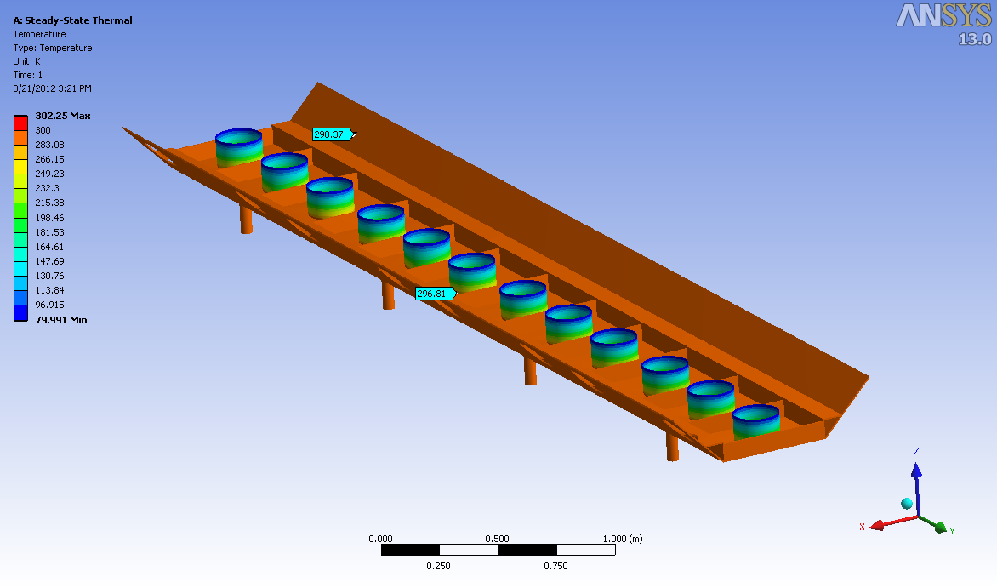
Temperature Distribution
Details analysis is being done to find out the temperature
Temperature plot shows that the maximum thermal gradient is at the support posts

Slide 5
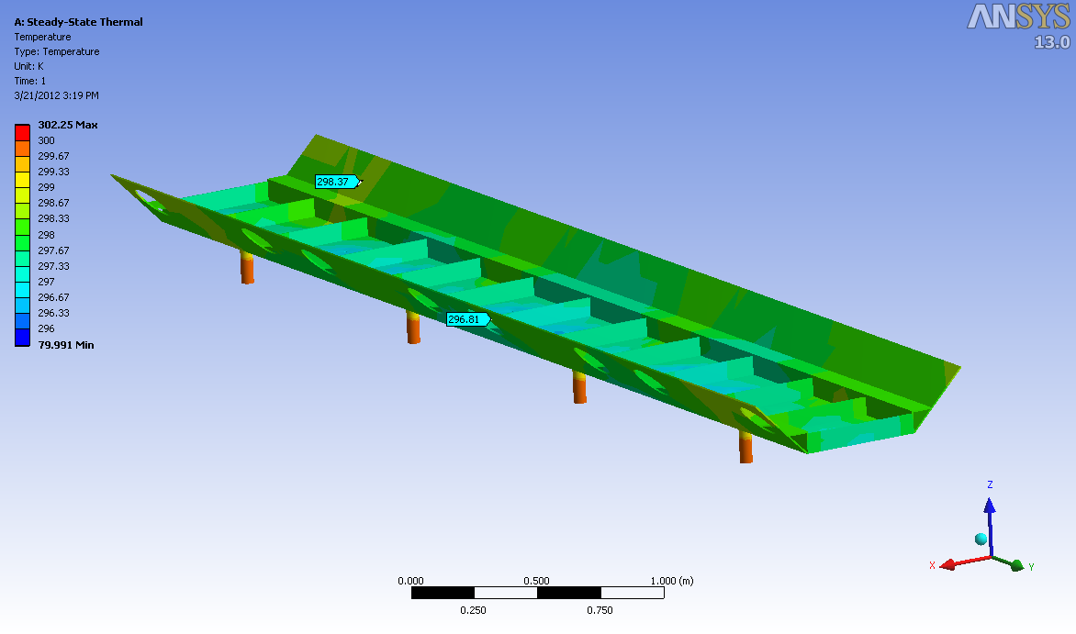
Strong-back temperature distribution
Strong back material is taken as Stainless steel
Maximum temperature : 298 K
Minimum temperature : 296 K

Slide 6
Conclusion & discussion
The model and methodology for calculating the temperature of strong back is made
Analysis is going on for two strong back materials – Stainless steel and Aluminium and the results will be sent soon
Nonlinear material properties will be included in the analysis
Question to Tom: Whether helium chamber design is more-or-less finalised or not : If so, send us the design so that we can start the stress analysis work

Slide 7
Thank you !

