Slide 1
Radiation Safety at Fermilab
Maddie Schoell & Matt Quinn
DOE RPP Review
2-6 May 2022

Slide 2
Applicable Regulations
Fermilab is an accelerator facility, governed by DOE O 420.2c Safety of Accelerator Facilities, 10 CFR 835 Occupational Radiation Protection, and DOE O 458.1 Radiation Protection of the Public and the Environment.
DOE O 420.2c requirements are implemented via the Fermilab Environment, Safety and Health Manual (FESHM) by Chapter 2010, Planning and Review of Accelerator Facilities and Their Operation.
DOE O 420.2c requires:
Accelerator Safety Envelope (ASE)
approved by Director and FSO Manager, Rev. 12 approved 9/29/2020.
Safety Assessment Document (SAD)
reviewed by the SAD Review Subcommittee, approved by D/S Head(s) & CSO
Ultimately approved by Director, Rev. 21 approved 11/2/2020.
Unreviewed Safety Issue (USI) Process
Accelerator Readiness Review (ARR) Program

Slide 3
Applicable Regulations (continued)
10 CFR 835 and DOE O 458.1 requirements are implemented via the Fermilab Radiological Control Manual (FRCM), which is specified as part of the FESHM by Chapter 11001, Radiation Safety Program.
10 CFR 835 requires a Radiation Protection Program (RPP) to demonstrate facility means of compliance to be signed by DOE.
Fermilab’s most recent RPP was approved by FSO 12/3/2018.
DOE O 458.1 requires an Environmental Radiological Protection Program (ERPP) to demonstrate means of compliance.
Fermilab has utilized the RPP and Environmental Monitoring Plan (EMP) to satisfy this requirement. 2021 DOE review of the RPP and ERPP determined that this approach is not appropriate.
Fermilab has developed a stand-alone ERPP. Sent to FSO 1/10/22.

Slide 4
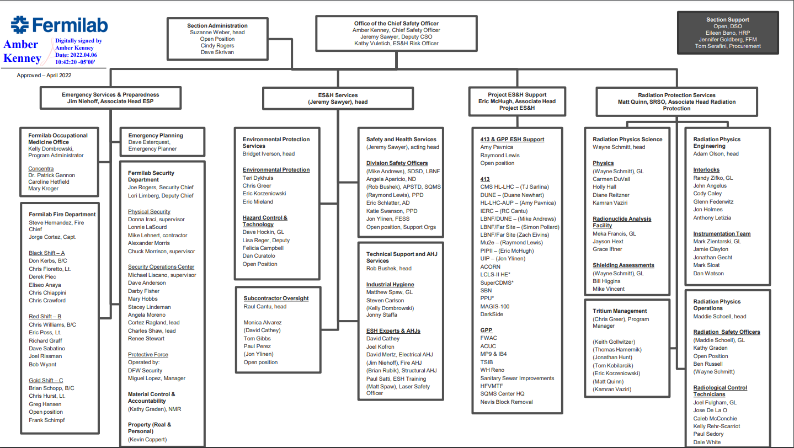
Radiation Safety Organization – ES&H Section Org. Chart

Slide 5
Radiological Control Organization (RCO)
The 2016 ES&H Reorganization brought all Radiation Safety Officers (RSOs) and Radiological Control Technicians (RCTs) into the same Department.
Enhanced communication between all RSOs and RCTs.
Increased consistency in reviewing, managing and covering radiological work.
Each area/building is assigned a Primary RSO, providing the same level of coverage for all aspects of radiological safety in their assigned areas.
Rather than being assigned based on Divisions/Sections, RSOs now assigned based on machine. Provides more continuity between primary beamlines and experimental areas.
Multiple RSOs, able to have backups in place if Primary RSO is unavailable.

Slide 6
RPE, RPS & RPO Activities
Radiation Physics Engineering (RPE)
Safety Systems installation & testing
Radiation protection instrumentation development, calibration and maintenance
MUX system operation, installation and maintenance
Radiation Physics Science (RPS)
Shielding design, radiation dose calculations, shielding verification studies, shielding assessment review & assistance
Radioactive air/water emission calculations and measurement.
Radionuclide analysis
Dosimetry

Slide 7
RPE, RPS & RPO Activities
Radiation Physics Operations (RPO)
Perform radiological surveys
Work Planning & Control (WPC) – job reviews, ALARA plans, radiological coverage, etc.
System Start-Up Sign-Off Process, generate Beam Permits & Running Conditions
Configuration Control of accelerator critical devices
Participate and/or lead reviews: ARRs, ORCs, etc.

Slide 8
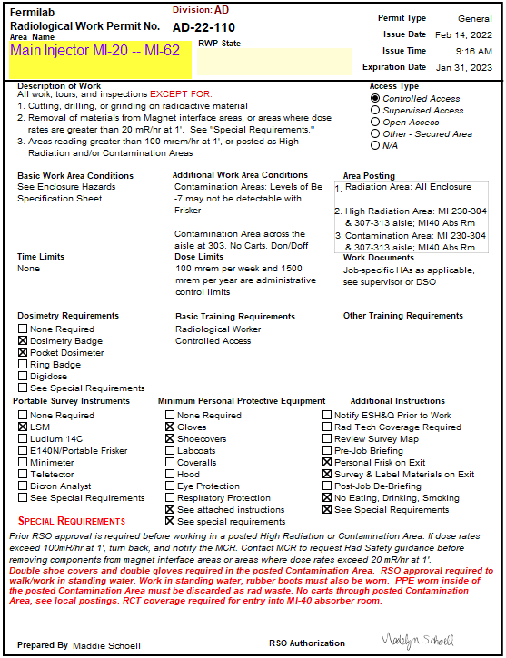
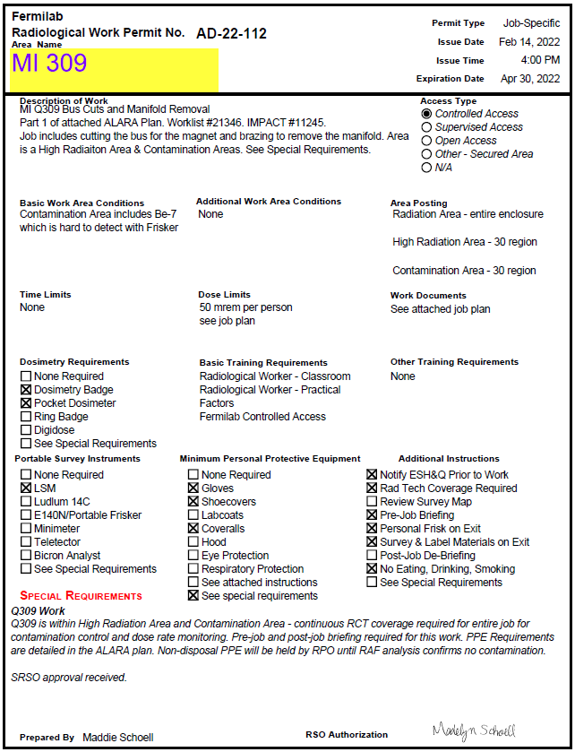
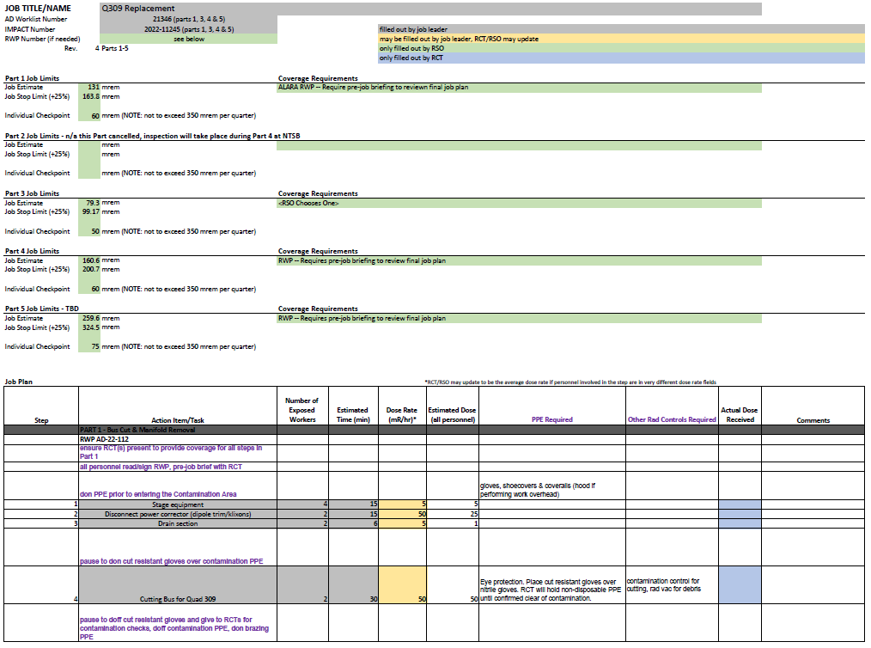
Work Planning & Control (WPC) for ALARA/Radiological Work
RSO ensures all radiological approvals (RSO/SRSO) are received and approves of work in the AD Worklist/IMPACT
RSO generates job-specific RWPs to authorize work as needed
General enclosure RWPs exist to allow for some amount of work
Jobs that require RWPs have RCT coverage to monitor work and track personnel dose, ensuring it stays within specified limits
General Enclosure RWP
Job-Specific RWP with Dose/ALARA Plan

Slide 9
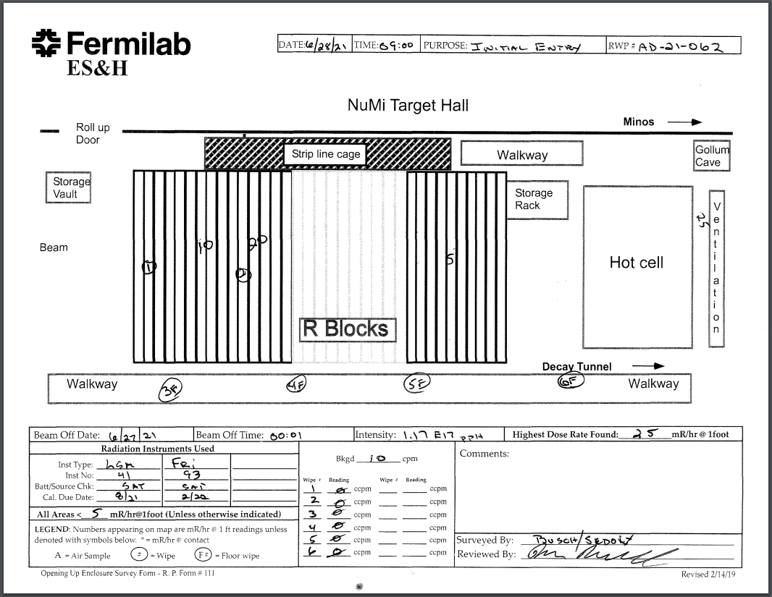
Radiological Surveys
Radiological Control Technicians (RCTs) perform, and Radiation Safety Officers (RSOs) review and approve, multiple radiation surveys in support of accelerator operations:
Routine Monitoring
Surveys of service buildings and other Lab
facilities
Ensures no spread of contamination,
improper storage of radioactive material,
etc.
Enclosure Opening Up
Required to place enclosures into
Supervised Access mode

Slide 10
Radiological Surveys
Pre-Job
Dose-rate surveys performed as needed to develop ALARA plans and pre-job dose estimates
Decontamination and pre- & post- surveys performed as needed
Others include:
Contamination build-up surveys
Extent of condition surveys
Surveys to support various Technical Bases
Excavation surveys

Slide 11
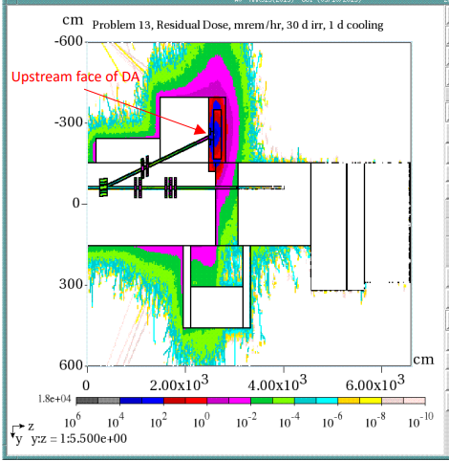
Radiation Safety in Accelerator Operations
Shielding Assessments
Assesses both normal and accident conditions, shielding,
protection measures, etc.
Component of the Safety Assessment Document (SAD)
Assessments are reviewed for appropriate methodology,
completeness, and compliance with FRCM
Assessments are:
Prepared by line organizations with ES&H assistance
Reviewed by the Shielding Assessment Review Panel (SARP)
SARP is a constituent of the Radiation Safety Subcommittee, with members from ES&H and line organizations, and an FSO observer
Approved by the Senior Radiation Safety Officer (SRSO)

Slide 12
Radiation Safety in Accelerator Operations
Accelerator Safety Envelope (ASE)
Describes Credited Controls identified in the SAD
The ASE is:
Updated by ESH, based on updated SAD Chapters
Reviewed by the SAD Review Subcommittee
An Appendix of the Fermilab SAD
Approved by the Director and DOE Fermi Site Office (FSO) Manager

Slide 13
Work Planning & Control (WPC) for ALARA/Radiological Work
Total Effective Dose has decreased even as beam power has increased over the history of the lab.

Slide 14
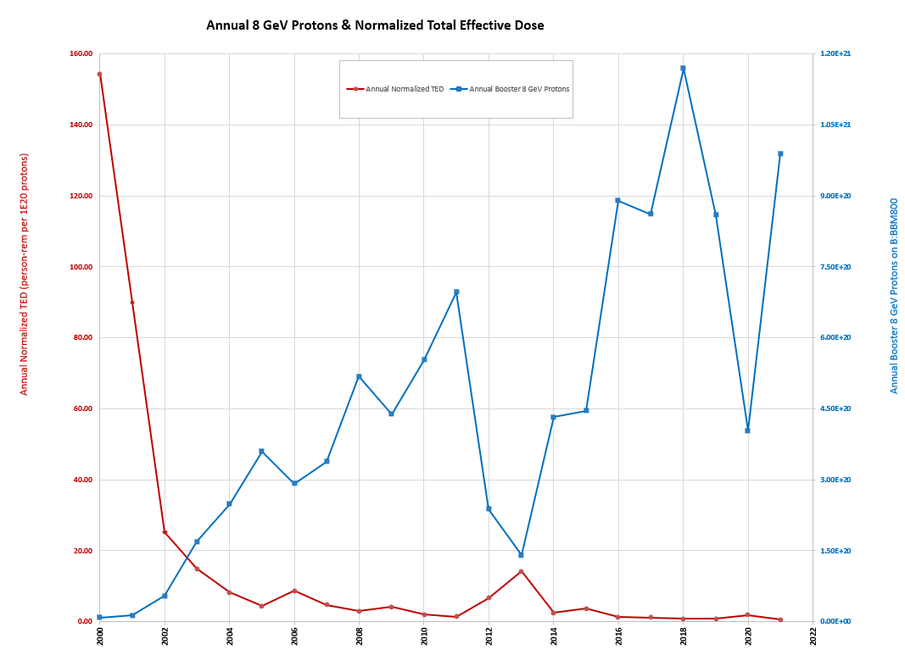
Work Planning & Control (WPC) for ALARA/Radiological Work
Although annual Booster 8 GeV Protons (blue) has increased over the years, WPC has been effective in maintaining dose to personnel (red) ALARA.

Slide 15
DOE RPP Assessment
April 2021
Criterion 1 - The FNAL RPP meets the requirements of 10 CFR 835, Occupational Radiation Protection: Met
Criterion 2 - The FNAL ERPP meets the requirements of DOE O 458.1, Radiation Protection of the Public and Environment: Not Met
Criterion 3 - Routine and non-routine radiological contamination control monitoring is performed for fixed and removable contamination, as needed to characterize radiological conditions and ensure safety of personnel: Met
Criterion 4 - Radiological activities at FNAL are conducted such that exposures to onsite residents and members of the public are less than DOE dose limits: Not Evaluated

Slide 16
DOE RPP Assessment
Finding L1-1: The Fermilab ERPP as currently established does not address the requirements of Attachment 1 to DOE O 458.1, Chg 4, Radiation Protection of the Public and the Environment.
Use of the EMP and RPP to satisfy the ERPP requirement fails to recognize that the RPP only addresses radiological concerns within Controlled Areas whereas the ERPP is supposed to address the radiological concerns in uncontrolled areas.
Finding L1-2: The FNAL process to determine that material may be released to the public for unrestricted use does not comply with DOE O 458.1 Attachment 1, paragraph 2.k Release and Clearance of Property
Property is not appropriately monitored for residual radioactivity as required by paragraphs 2.k.(3) and 2.k.(8) of the CRD.
A documented evaluation process for determination of process and historical knowledge used in decisions to release property for unrestricted use has not been implemented as required by paragraph 2.k.(5) of the CRD.
Authorized Limits used by FNAL to release property have not been submitted to DOE for approval, nor has FNAL obtained approval from DOE to use DOE pre-approved Authorized limits as required by paragraph 2.k.(6) of the CRD.

Slide 17
DOE RPP Assessment
Suspend release of scrap metal from the Railhead for recycling (4/9/21). Scrap released from Railhead is not allowed to originate from Radiological areas, but this step was taken to ensure 458.1 requirements are being met. The program was reviewed by HQ in a 2011 assist visit and found that “DOE policies have been applied in a very conservative manner.”
Detailed crosswalk of O 458.1 requirements established, beginning with CRD subpart 2.k Release and Clearance of Property. Team included SRSO, RPO department manager, FSO, QA representative. Review plan included crosswalk of entire order, with specific lines of inquiry for each element. Focus was on meeting each requirement, not justifying current practices. Identified over 200 items to implement or improve.
Reached out to other DOE labs for ERPP documents and material release program materials. Collected those to inform analysis and corrective actions to be implemented.
Hired a new Health Physicist to serve as “ERPP Manager” 11/2021.
We are adopting standard approaches. Want clear defensibility for environmental and occupational programs.

Slide 18
Material Release / ERPP
ERPP drafted, signed by FRA staff.
Sent to FSO 1/10/22. Revised version addressing DOE comments sent to FSO 3/9/22.
Addresses review finding L1-1
Uses 458.1 crosswalk that was performed after RPP review.
Updated FRCM Chapter 11 Environmental Radiation Monitoring and Control, FRCM Chapter 7 Radiological Records to better align with O458.1
Release program document, technical basis, clearance survey SOP .
Signed by RP teams. Received DOE comments 4/18/22. FRA working on responses.
The program document outlines the processes for radiological release and clearance of personal property (materials and equipment). It includes responsibilities, a material release documentation form (including process knowledge), final survey definition, and describes compliance with MARSAME process. Addresses review finding L1-2.
Lots of work on implementation details (survey forms, MMR updates, labels, communication strategy, clearance survey training syllabus).

Slide 19
Material Release / ERPP
MEI/ASER SOP drafted, signed by FRA staff.
Received FSO comments 3/30/22. FRA working on responding to comments.
Details onsite and offsite MEI calculations for inclusion in ASER.
Includes radiological parameters (MEI, collective dose, cleared material, biota dose, unplanned releases)
Environmental ALARA Program Plan drafted, signed by FRA staff.
Sent to FSO 4/27/22.
Systematically verify and document that potential radiological exposures to environment and members of the public are ALARA.
Triennial assessments: Proposals received from vendors to perform 10 CFR 835 assessments.
Finalizing procurement details. Looking to have review at the end of May.
Addresses review findings L3-3,4,5

Slide 20
Material Release / ERPP
Updating FRCM chapters to address review findings L3-6:11.
Clarifying responsibilities
Evaluating “should” vs “shall” usage
Removing “procedures” from manual
Tightening up requirements around surveys and contamination control
Updated Chapters:
5 Radiological Health Support Operations
7 Radiological Records
11 Env. Radiation Monitoring and Control
2 Radiological Standards
In progress:
3 Conduct of Radiological Work
4 Radioactive Materials
8 Radiation Shielding
10 Radiation Safety Interlock Systems
Continue related efforts for review of all posted RMAs.
Survey plans for areas to be down posted drafted. Surveys in progress.
Finalized Job ALARA Review SOP.
Procedure to implement FRCM Ch 5 ALARA program requirements for job review.
136 CAPs closed
77 open

Slide 21
Questions, comments
We are adopting standard approaches. Want clear defensibility for environmental and occupational programs.
Thank you

