Slide 1
DSS Interfaces
Benoit LACARELLE
DUNE FD1 DSS PDR
10 May 2022

Slide 2
Outline
APA supports ST1393276_01
CPA supports ST1477544_01
Support Rod Assembly (SRA) design and details and components ST1311056_01
End walls short beam supports ST1444786_01
Ground planes ST1238648_01
List of what belong to DSS and what belong to Consortia

Slide 3
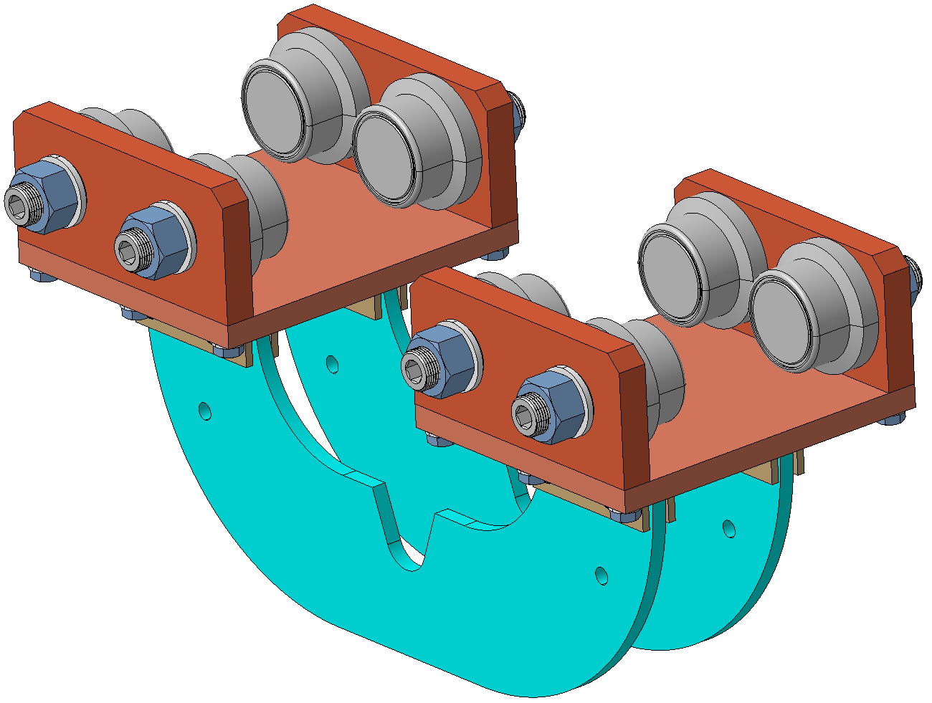
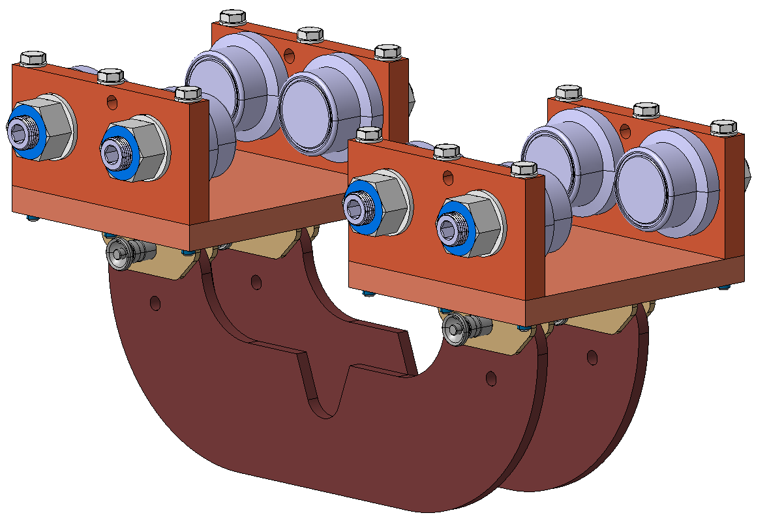
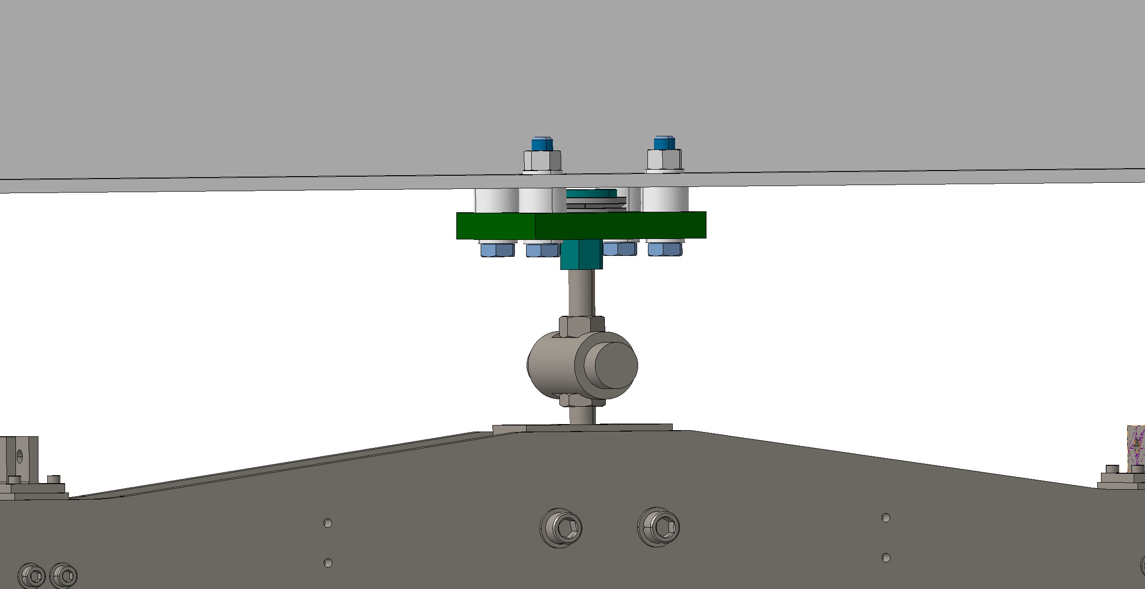
APA supports
Bolts inverted
Trolley (complete)
Main rail interface
Installation sequence (Quick) and vertical adjustment
One pin
only
Spherical washer added

Slide 4
Trolley (complete)
Trolley 1= 19.5kg
Complete
wheel plate
=5.8kg
Trolley 2=19.5kg
Bottom plate
=7.2kg
APA support plate
=4kg
Yoke groove

Slide 5
Main rail interface
I-beam
Spherical washer
4x Struts
2mm gap
Bottom plate
4x bolts+nuts+washers M16
Main nut
35mm (Was 40 previously)
Bolt M20
APA

Slide 6
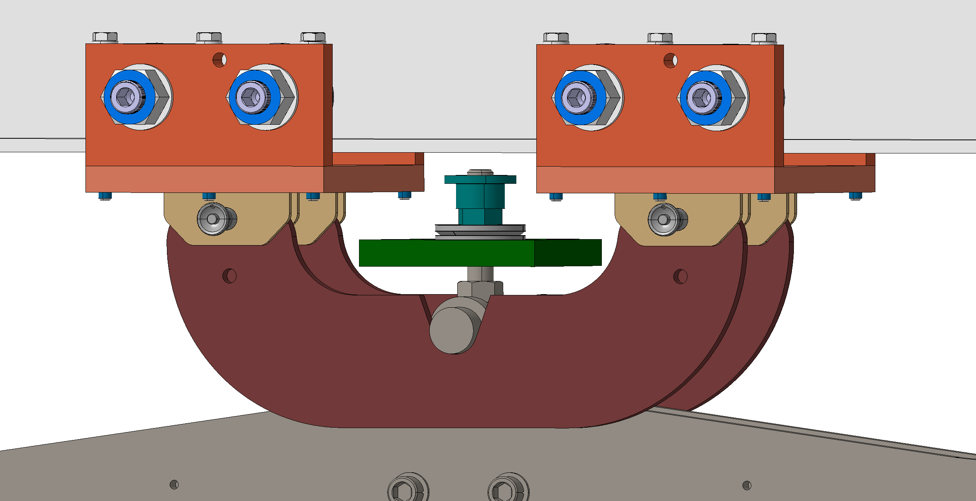
Installation sequence
Main nut and plate
placed on the APA
M20 bolt.
Free to move.
Ready to roll

Slide 7
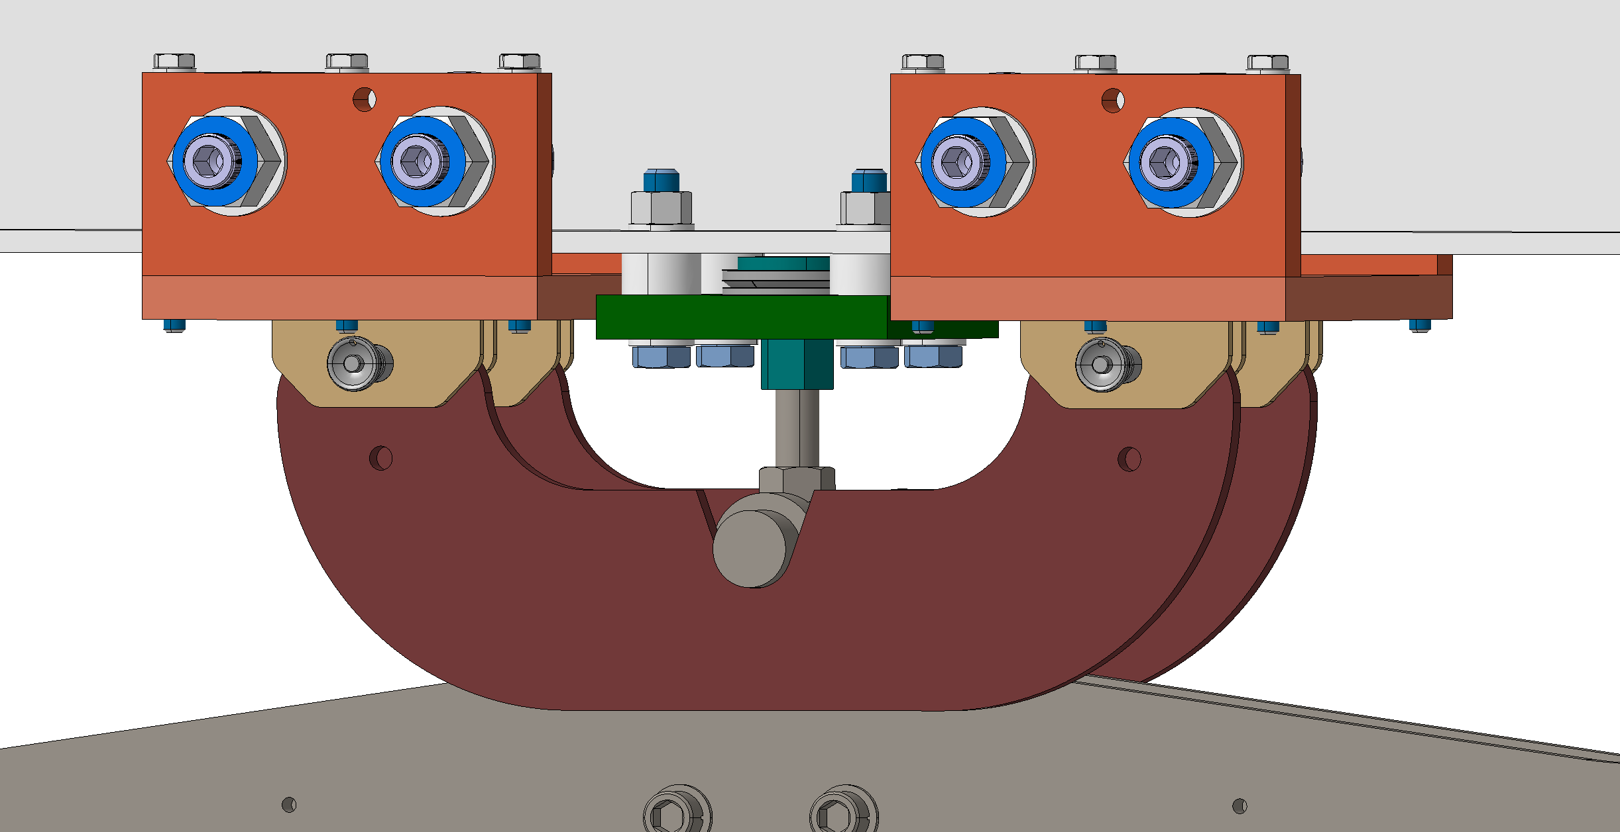
Installation sequence
Bottom plate fixed by bolts
Main nut ready to be rotated
in order to transfer the load
APA in position

Slide 8
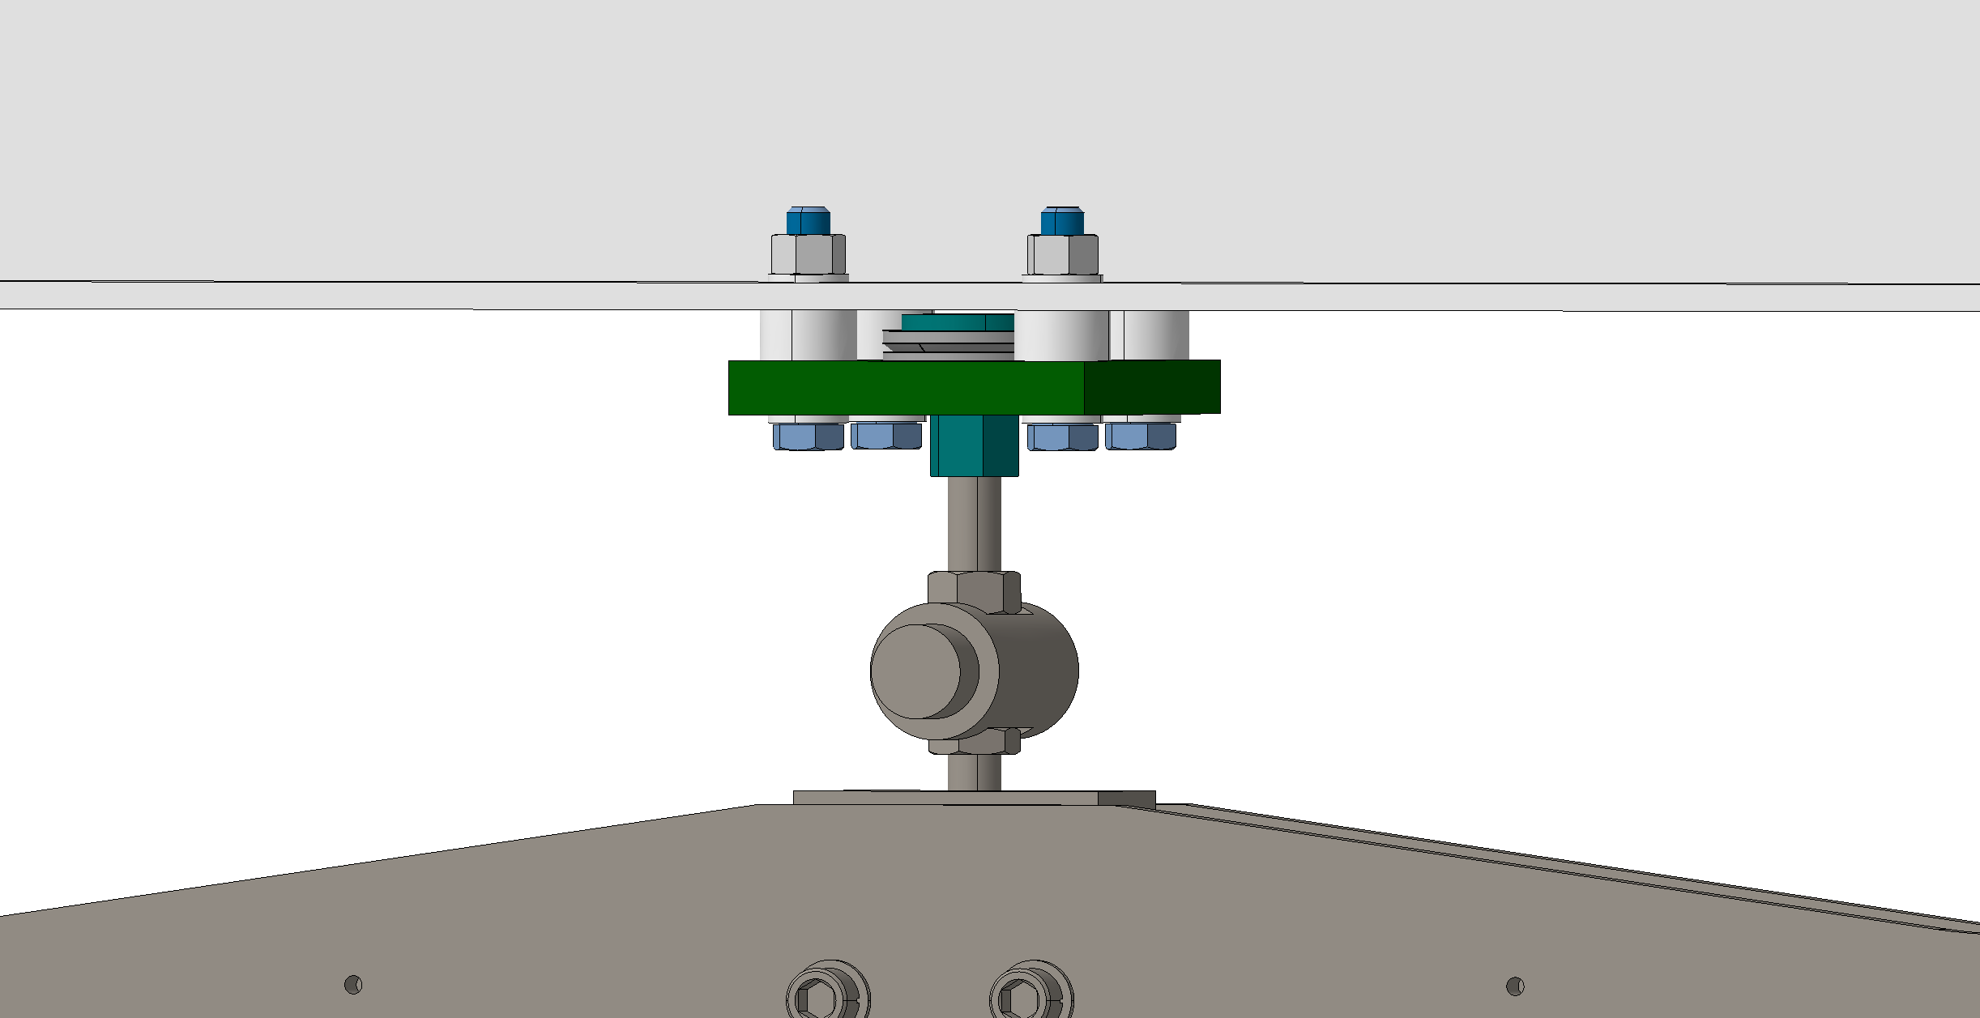
Installation sequence

Slide 9
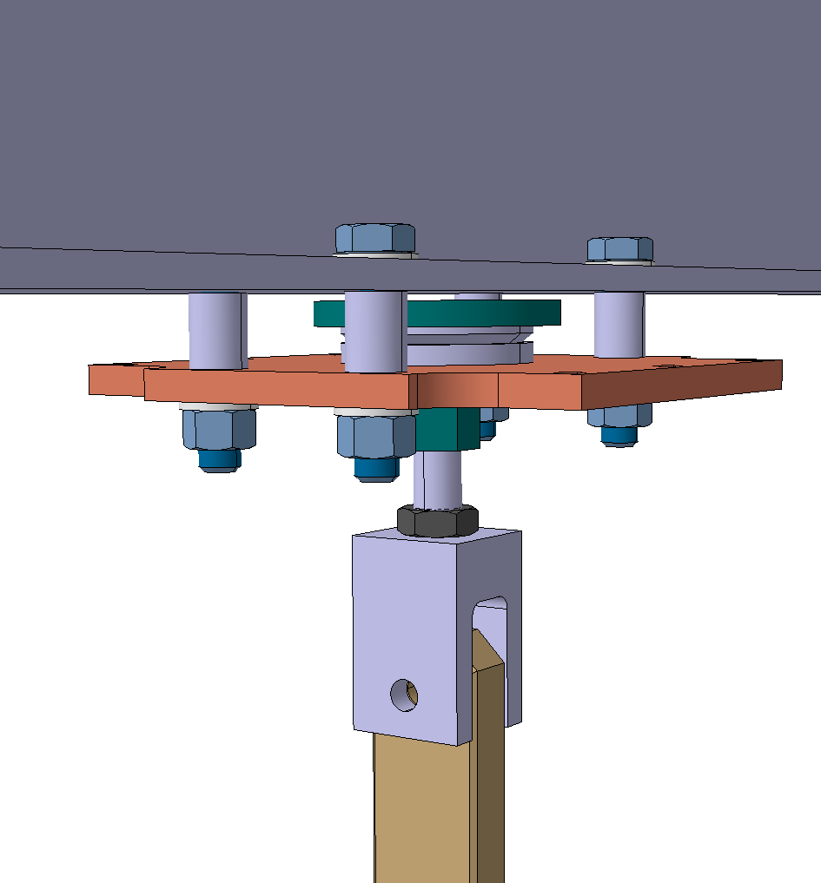
CPA supports
Main nut similar to APA trolley
trolley (complete)
main rail interface
Installation sequence (Quick) and vertical adjustment
Thicker
Bottom
plate

Slide 10
Trolley (complete)
Main nut
Spherical washer
Complete
wheel plate
=5.5kg
4x bolts + nuts + washers M16
4x Struts
Pin Ø13
Clevis

Slide 11
Main rail interface
3mm gap
20mm
(was 28.5)
Threaded rod
M20
24.5mm

Slide 12
Installation sequence Step 1
Ready to roll

Slide 13
Installation sequence Step 2
Once CPA in place
Bolts installation
Ready to remove trolley elements

Slide 14
Installation sequence Step 3
Bottom plate fixed by bolts
Main nut ready to be rotated
in order to transfer the load

Slide 15
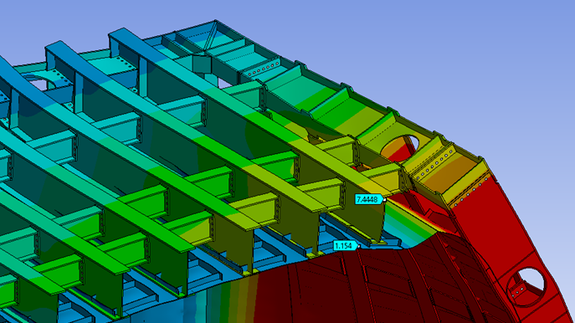
SRA (tertiary membrane disconnected) design and details and components
Cryostat support system
External adjustment system
Top blocking system
Argon separation system
Load bearing system
Displacement locking system
Main rail interface
Due to movements of the
tertiary membrane with respect to the main structure, we prefer to
decouple the feedthrough from
the tertiary membrane.

Slide 16
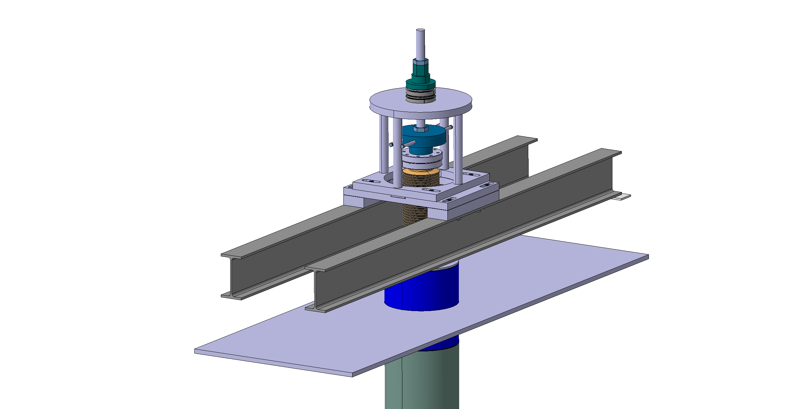
Cryostat support system
Sliding on Teflon plates
Welded to main structure
64mm
120mm

Slide 17
External adjustment system
Counter nut
Threaded rod M24
Z
Main nut
-Z
Z
Thrust ball bearing
SKF 51110
Added
Spacer
Counter nut
Added
Spherical joint
Emile Maurin
23_391_36_O
Central nut
Counter nut
Bellow
Stainless steel bar
extremities M24
Z stroke= +/-50mm
-Z

Slide 18
Spherical joint

Slide 19
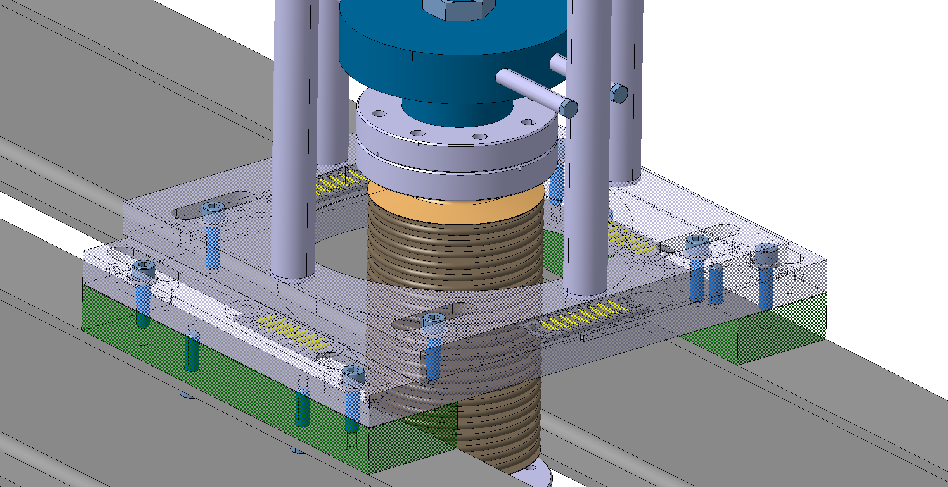
External adjustment system
Z/-Z (See previous slide)
Linear bearing
THK FT3525-75
-Y
Top surface machined
In order to ease
the rollers displacement
Bolted to the I beam
X
-X
Y
X and Y stroke= +/-20mm

Slide 20
Top blocking system
Anti-rotational system
8x bolts

Slide 21
argon separation system
Gas tight bellow allows:
- GAr to be contained
- Z adjustments
- X and Y adjustments
55mm
GAr out

Slide 22
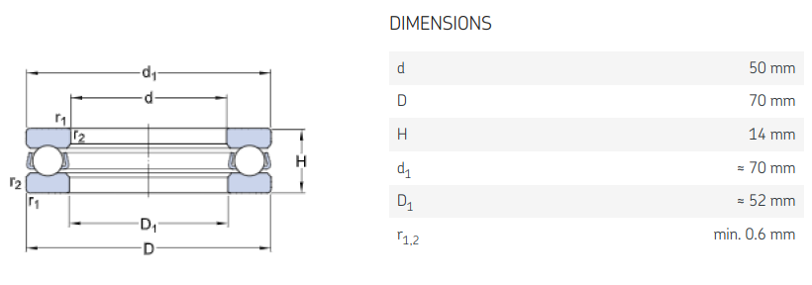
Load bearing system
Linear bearing
THK FT3525-75
X / Y translation →
Thrust ball bearing
SKF 51110
Z rotation →

Slide 23
Displacement locking system
Y
-X
-Y
X
Y
-X
Clamps
X
-Y
Free to move until final positioning
of the top system. And blocked by bolting.

Slide 24
Main rail interface
Counter nut
Clevis TOP
Clevis BOTTOM
Pin Ø24
2x reinforcement plate
4x
bolts M16
+washers
+nuts

Slide 25
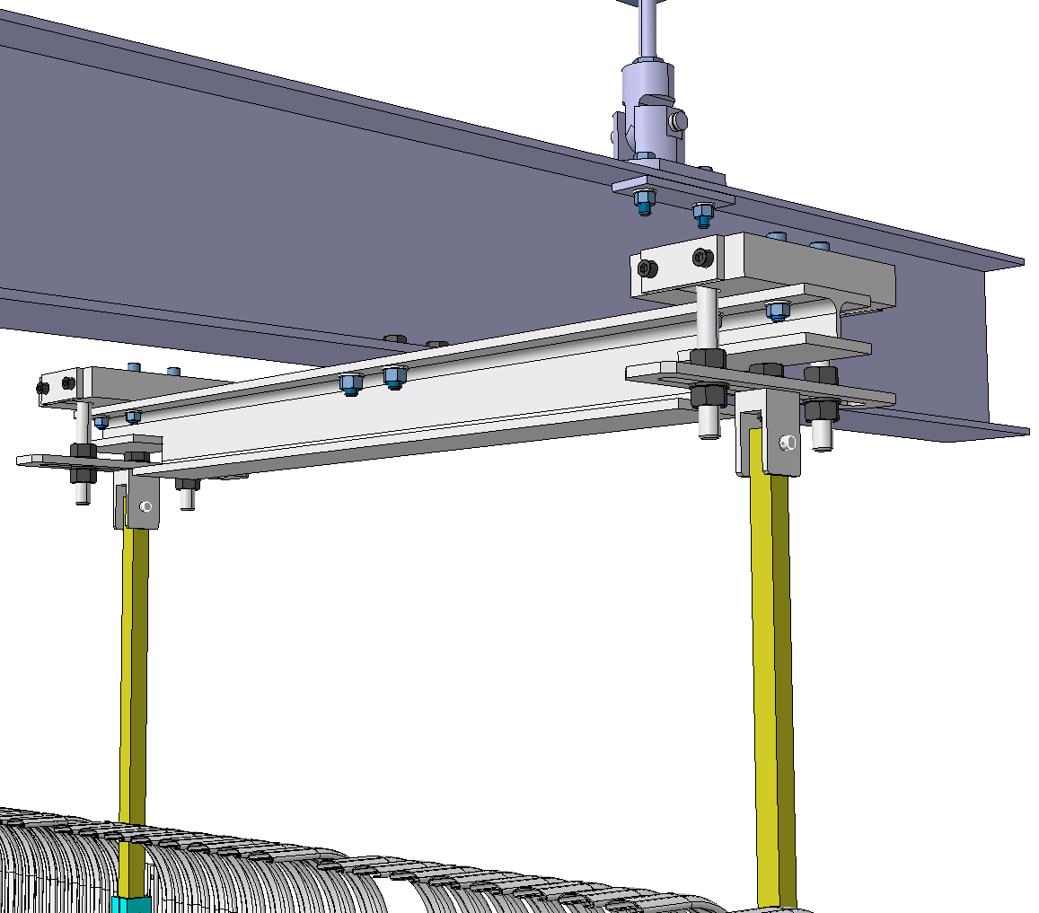
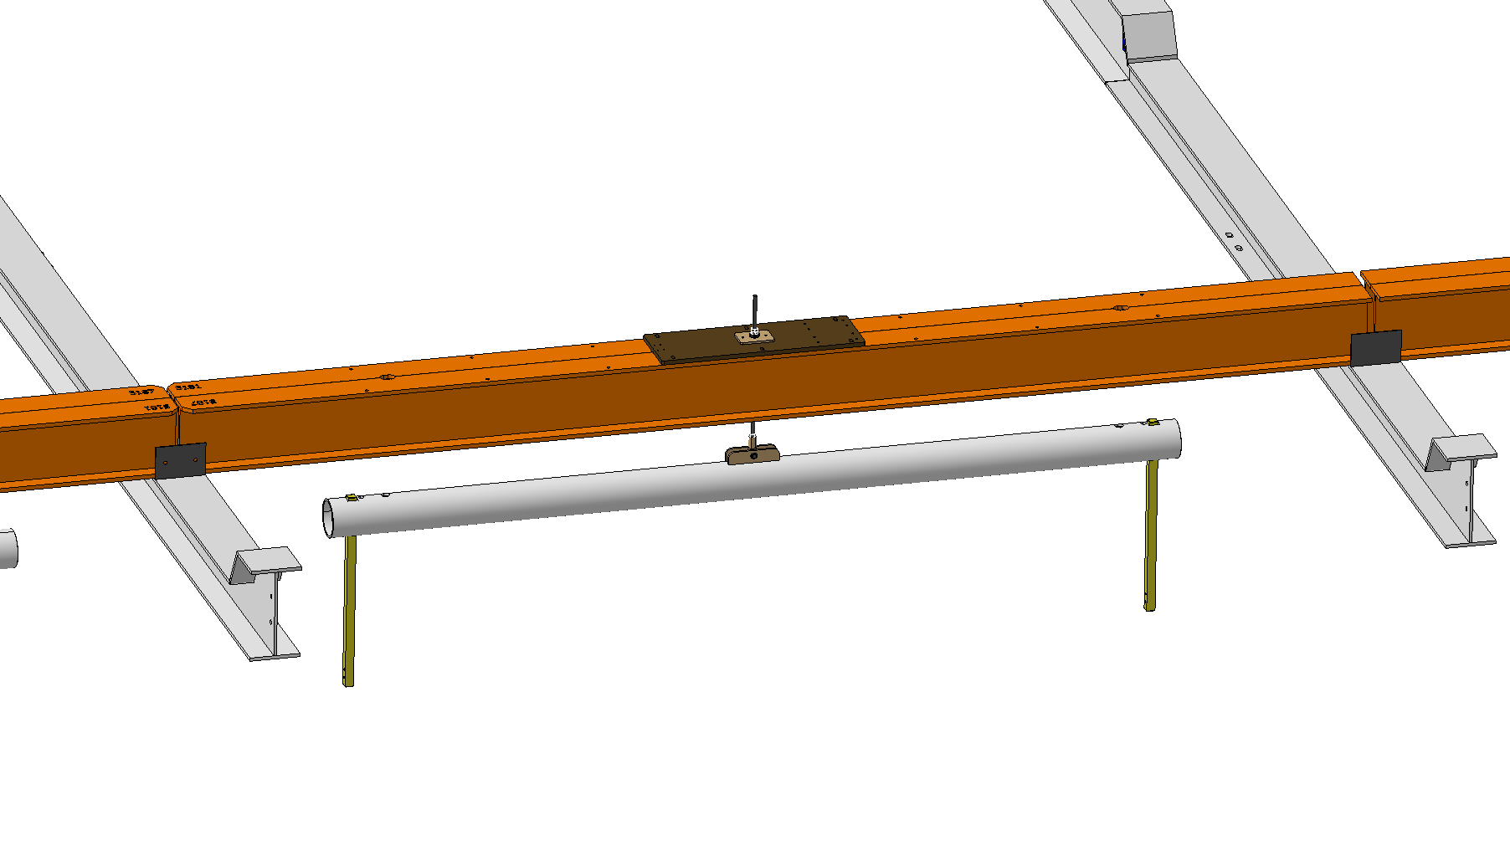
Endwall short beam support - Interface
Main rail interface
System definition

Slide 26
Main rail interface
Main beams (G10) =31kg each
Main plate=12.1kg
203.2mm
203.2mm
SS pipe
Ø114.3mm
Th=6.35mm

Slide 27
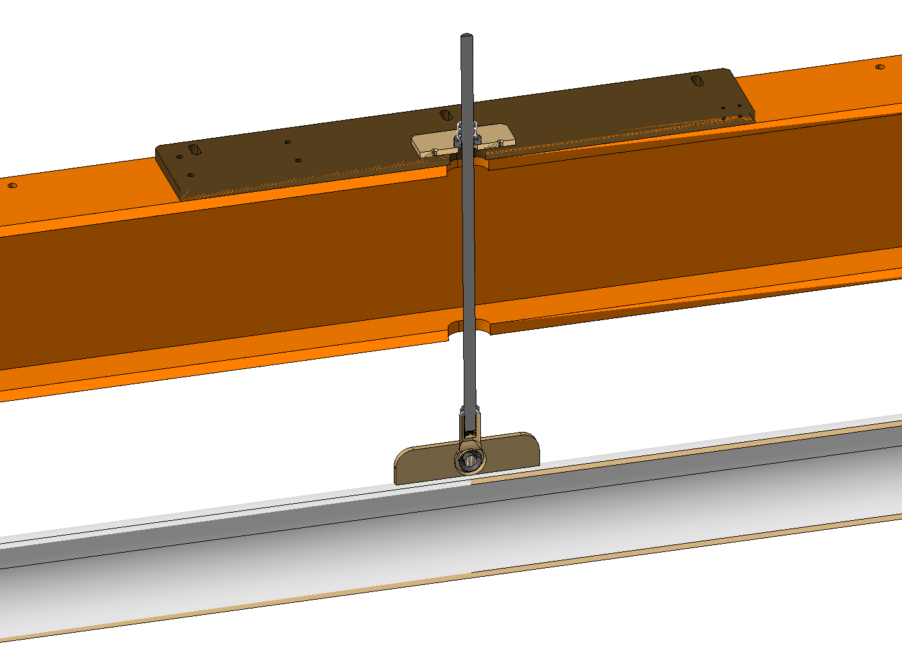
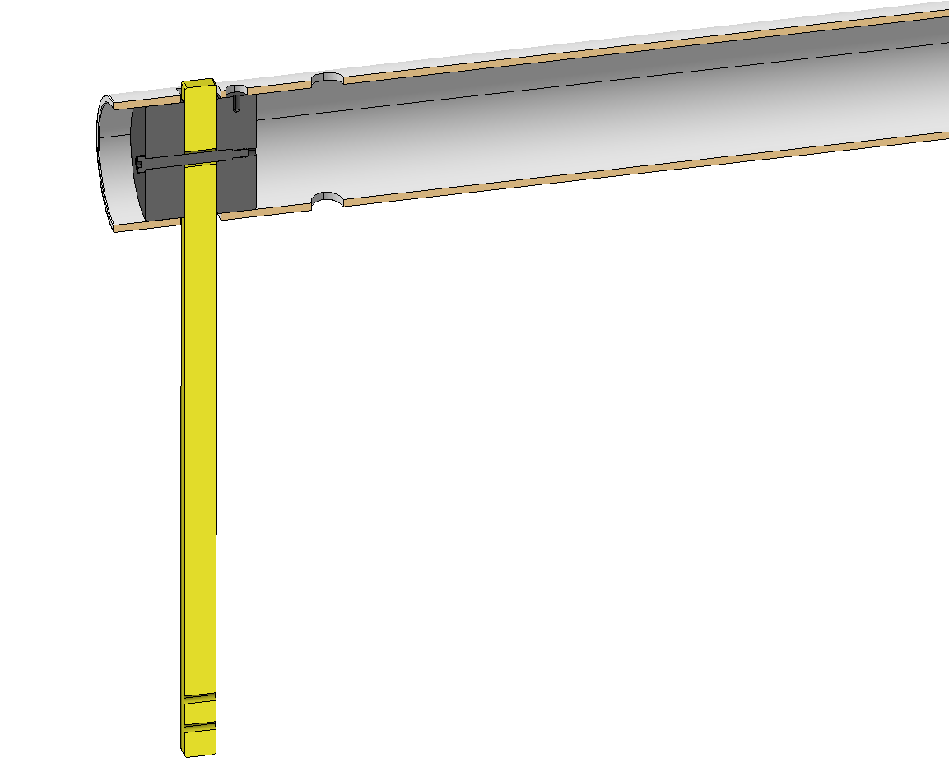
System definition (for information)
Threaded rod M12.7
Blocking cylinder
Pin Ø12.7
Counter nut
2x plates welded to the tube
Ball joint

Slide 28
List of what belong to DSS and what belong to the Consortias
SRA DSS
Rail DSS
APA the yoke bolt and all below is on the consortia
CPA the G10 bar and all below is on the consortia

Slide 29
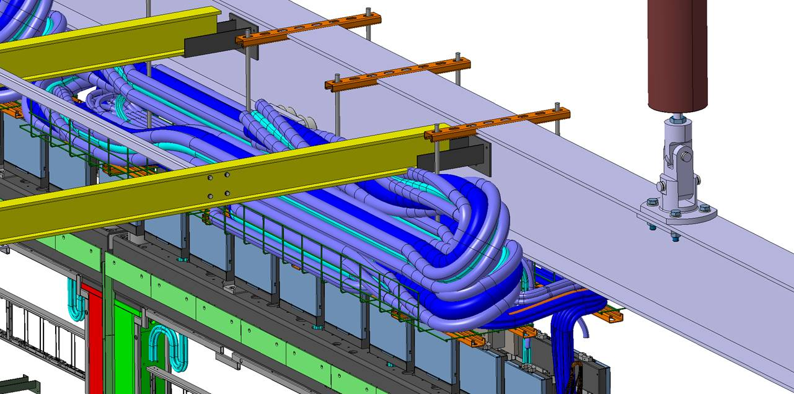
List of what belong to DSS and what belong to Consortia
Endwalls short beam support
the G10 bar and all below
is on the consortia
Cables basket Consortia

Slide 30
Thank you !

