Slide 1
DSS Structural Analysis
Gianluigi BUCCINO
DUNE FD1 DSS PDR
10 May 2022

Slide 2
Outline
Design codes and standards
Materials
Load cases
Rails
Support Rod Assembly
APA trolley/support
CPA trolley/support
Rail stability
Summary

Slide 3
Design codes and standards
List of standards applicable for DSS design:
  EN 1990: Eurocode – Basis of structural design
  EN 1993-1-1: Eurocode 3: Design of steel structures – Part 1-1: General rules for buildings
  EN 1993-1-4: Eurocode 3: Design of steel structures – Part 1-4: General rules -Supplementary rules for stainless steels
  EN 1993-1-8: Eurocode 3: Design of steel structures – Part 1-8: Design of joints
  EN 1993-6: Eurocode 3: Design of steel structures – Part 6: Crane supporting structures
  EN 1090-1: Requirements for conformity assessment for structural components
  EN 1090-2: Technical requirements for the execution of steel structure
  EDMS 2470582 (link): Equivalency between European and US standards for the execution, inspection, and installation of steel structures
  EDMS 2733866 (link): White Paper - Acceptance of Steel and Aluminium Structures Designed per the EUROCODES at FERMILAB

Slide 4
Materials
List of materials used for the analysis;
  Rail Invar36
  SRA Stainless steel 304L
  Fasteners Stainless steel; Grade A4-80
  Pins Nitronic 60 steel
  Rail Connections Stainless steel 304L
All material strength properties for calculation are taken from the respective European standards or manufacturer catalogue.
Strength properties considered are taken for room temperature despite the strength increase in cryogenic temperature.
Thermal properties as a function of temperature from the range of 80K up to 293K have been obtained from NIST: National Institute of Standards and Technology or from manufacturer catalogue.
All suitable for a cryogenic environment and used previously in NP02 and NP04.

Slide 5
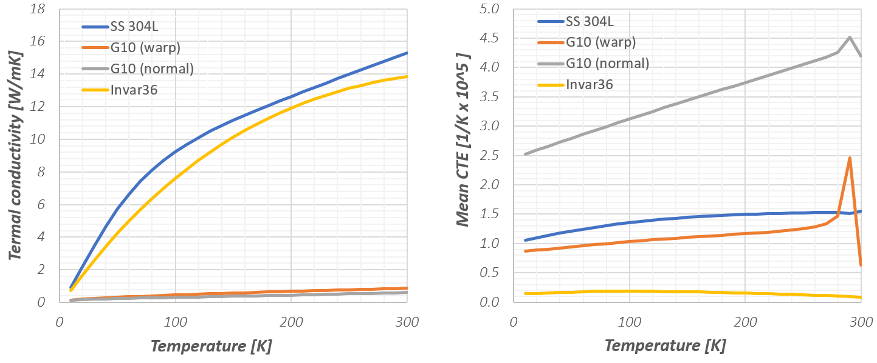
Materials
Table 1 Summary of material properties (Invar36, Stainless steel 304L, A4-80 fasteners, Nitronic 60 steel)
Table 2 Material properties pultruded FRP profile
Thermal properties for selected materials (NIST)
The matrix material plays a key role in estimation of thermal expansion coefficient which varies from (10-17) x10^-6 1/K.

Slide 6
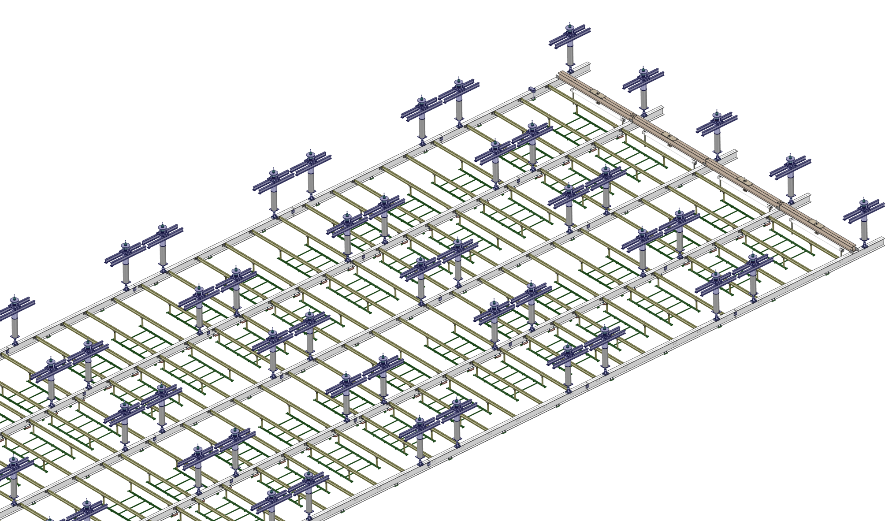

Load cases
The following load cases are considered:
· TCO to Switchyard
· Assembled detector dry
· Detector installation
· Operational

Slide 7
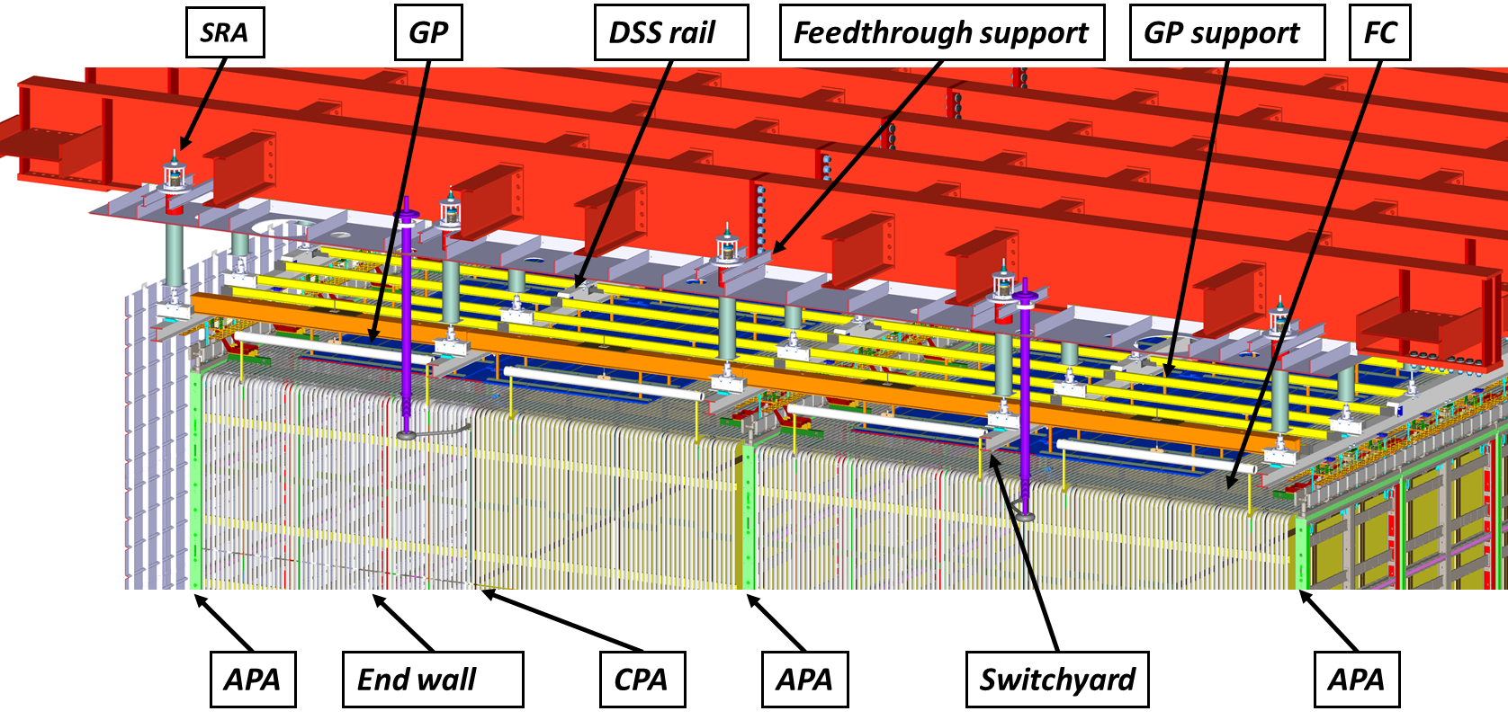
Load cases - Loading
Loads described in the table below are considered for the loading of the main DSS structures:
Mass per support, both dry and wet, of all detector elements (Endwall, top/bottom FC, APA, CPA) - (https://edms.cern.ch/document/2281422)
Mass contingency has been considered
Loading used for the structural stress/resistance assessment is enlarged with appropriate safety factor in accordance with Eurocode 3
Scenario | Rail # | Component | Mass per support [kg]
 |  |  | Dry | Wet
Installation | all | APA | 1537
 |  | CPA+2xFC+GP | 378
 |  | EW | 218
Detector Deployed | 1 | APA+1FC | 1596 | 844
 |  | EW | 218 | 111
 | 2 | CPA+2FC | 281 | 78
 |  | EW | 436 | 223
 | 3 | APA+2FC | 1655 | 867
 |  | EW | 436 | 223
 | 4 | CPA+2FC | 281 | 78
 |  | EW | 436 | 223
 | 5 | APA+1FC | 1596 | 844
 |  | EW | 218 | 111

Slide 8
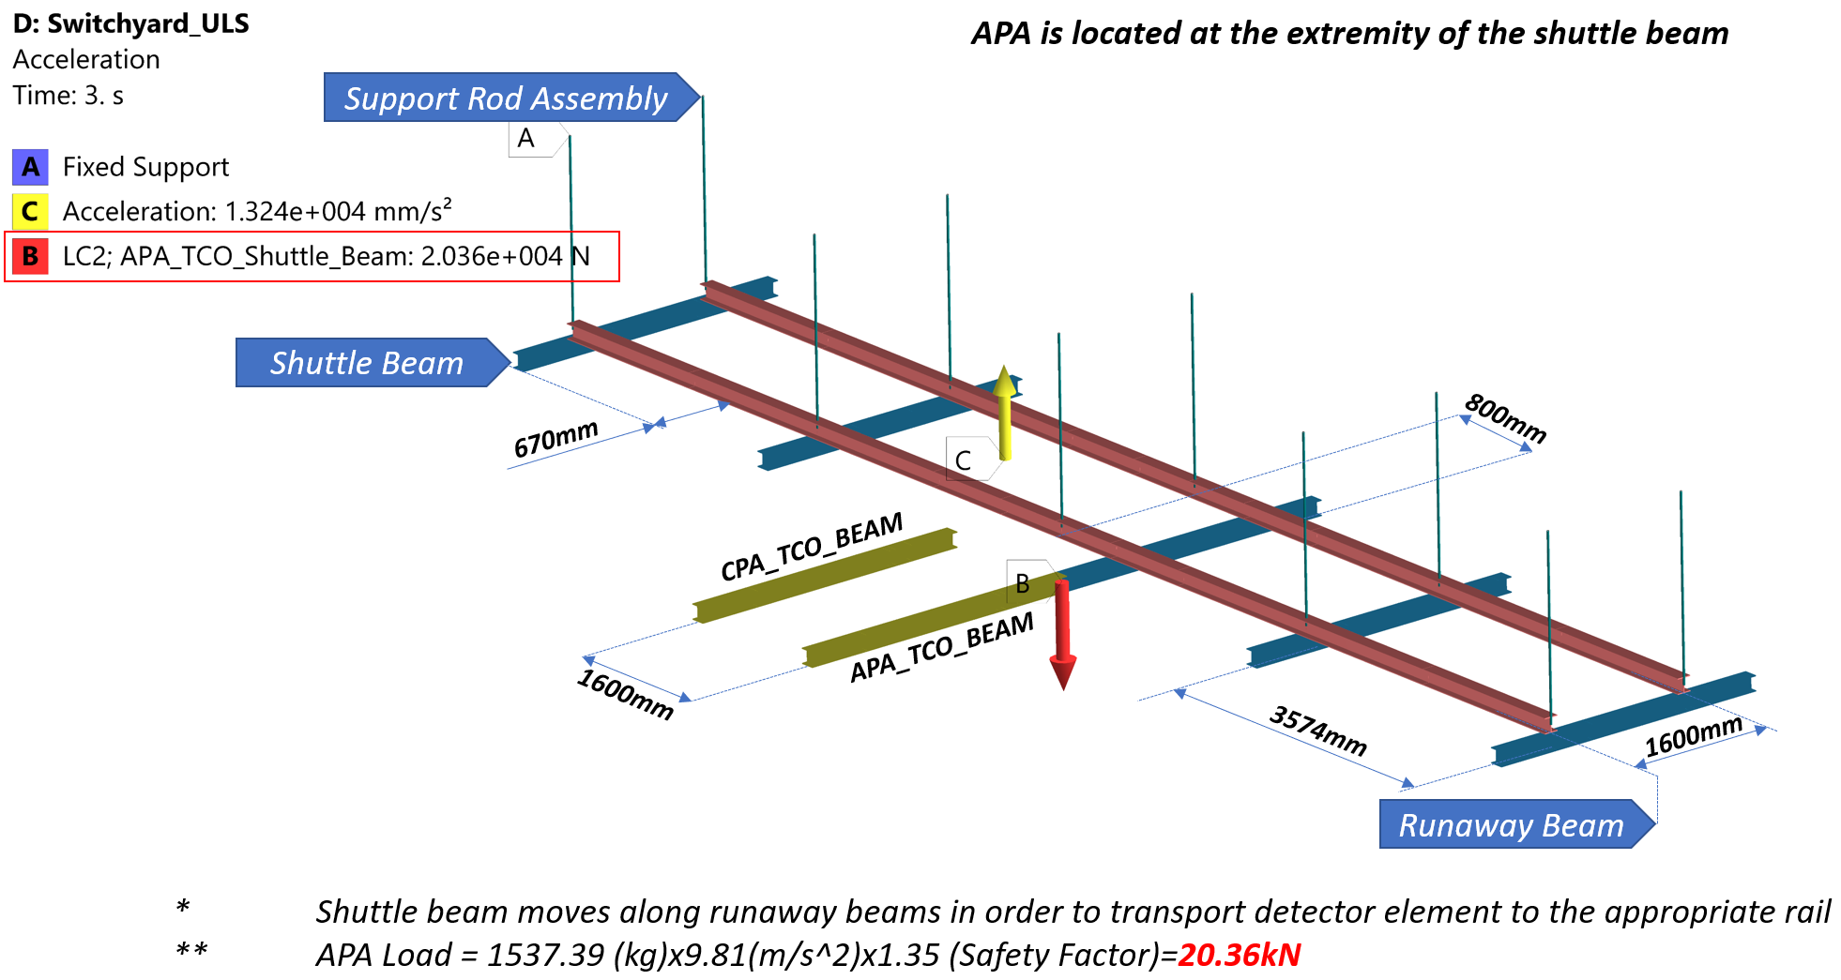
Load cases - Switchyard

Slide 9
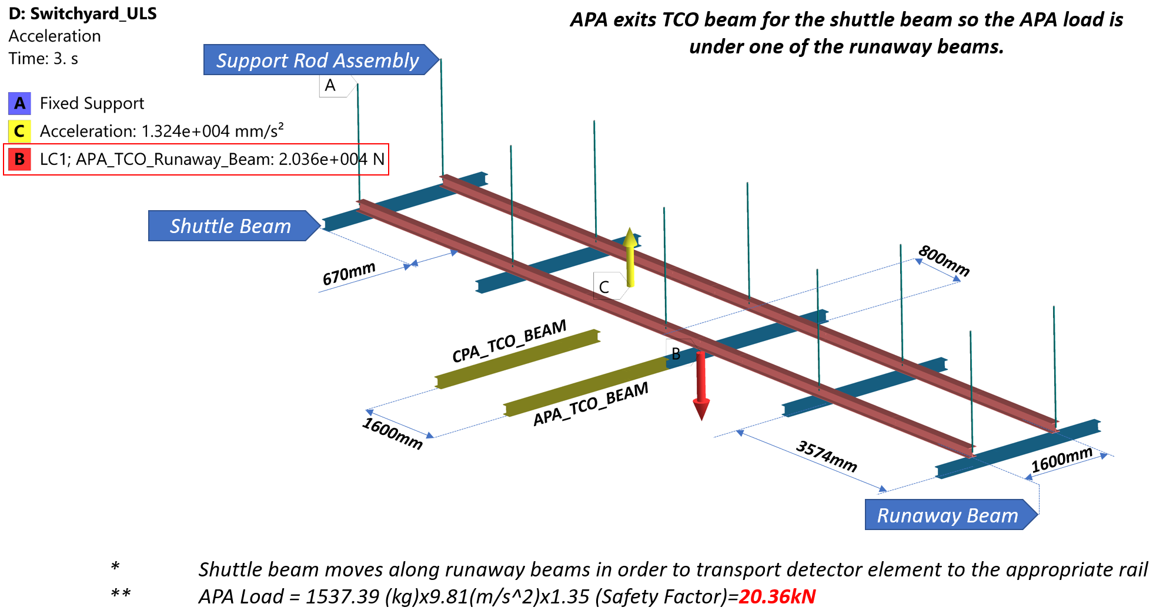
Load cases - Switchyard

Slide 10
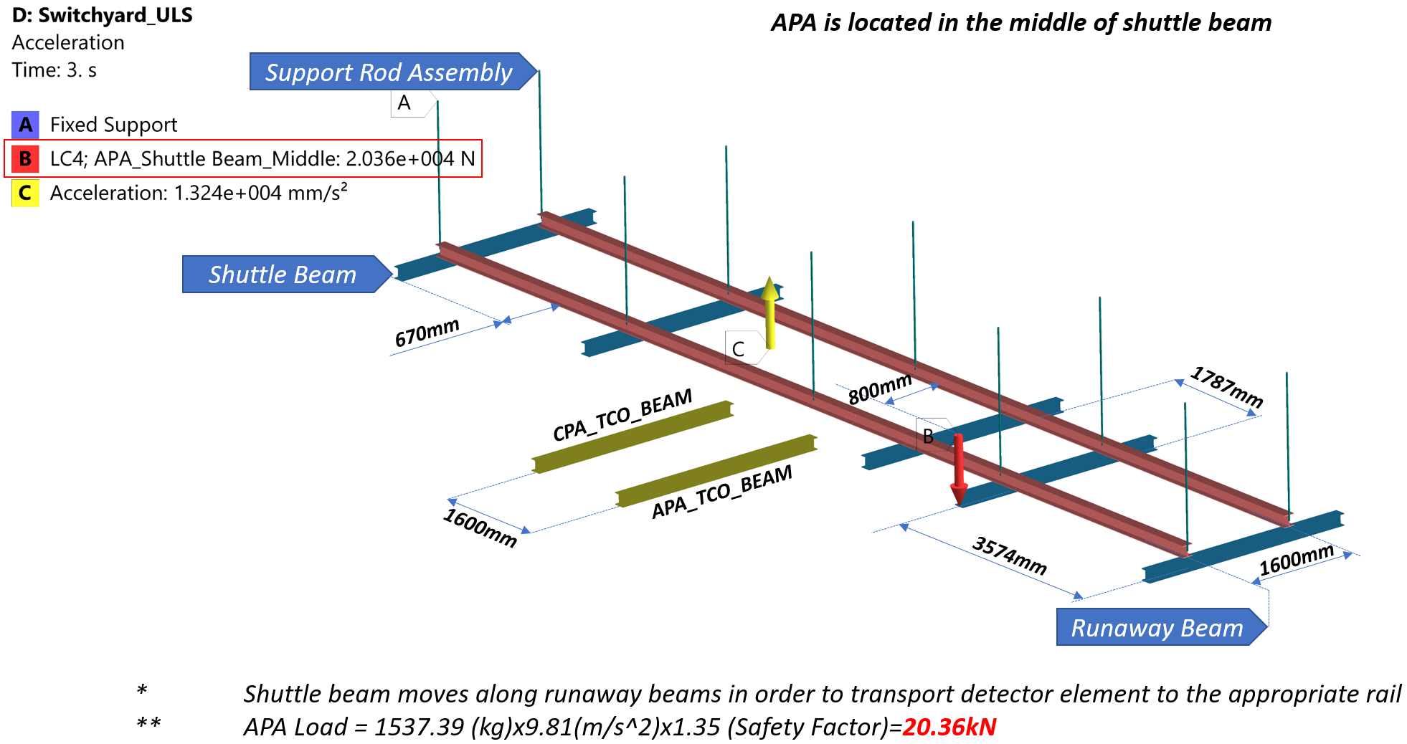
Load cases - Switchyard

Slide 11
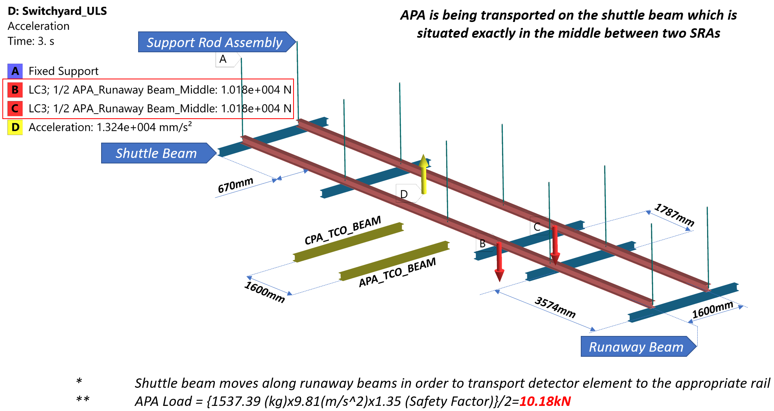
Load cases - Switchyard

Slide 12
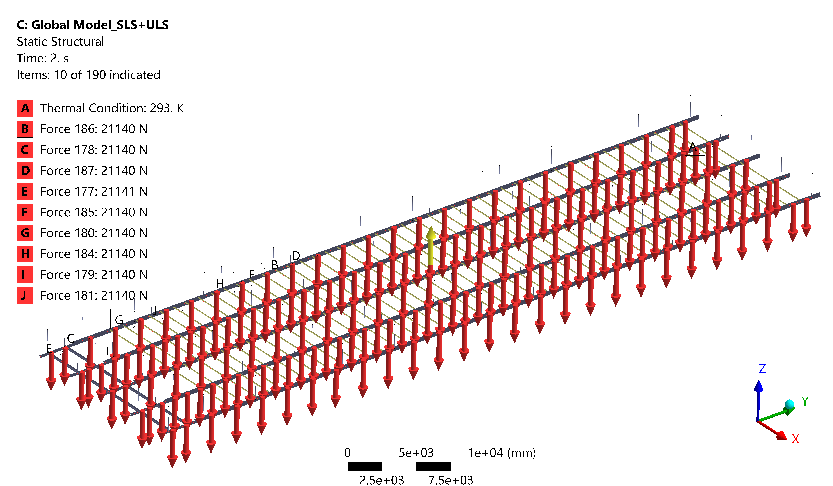
Load cases – Detector dry
The load has been applied in the final position for each detector component support

Slide 13
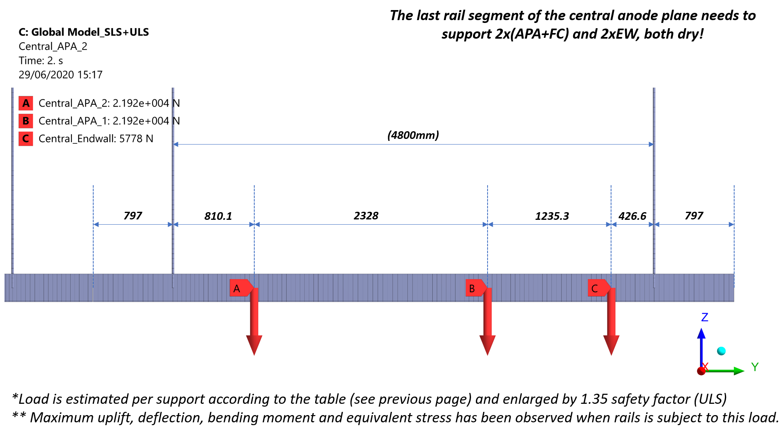
Load cases – Detector dry
The last segment of the anode plane rail is subjected to the highest load between two supports

Slide 14

Load cases – Cooldown/Operation
Loads have been reduced due to buoyancy forces
DSS is subjected to uniform temperature of saturated argon (88K)

Slide 15
Load cases – Installation
Central Anode Plane is subjected to the highest load.
The final position of the APA has been used
Load stepping has been used according to the installation procedure and detector deployment.
Load have been applied as follows;
  1 Endwall is installed on the rail (cavern side) – 436kg
  2 The first APA arrives at its final position – 1’537kg
  3 Field cages and Ground planes are deployed and attached to the first APA – 1’655kg
  4 Second APA arrives – 1’537kg
  5 Field Cages and Grounds planes are attached to the second APA – 1’655kg
  6 Rail segment is populated with APAs and disconnected form adjacent rail.
  7-54 Loading continues the same way presented in step 2-6 until the last APA is installed
  55 Endwall at TCO side is installed – 436kg

Slide 16
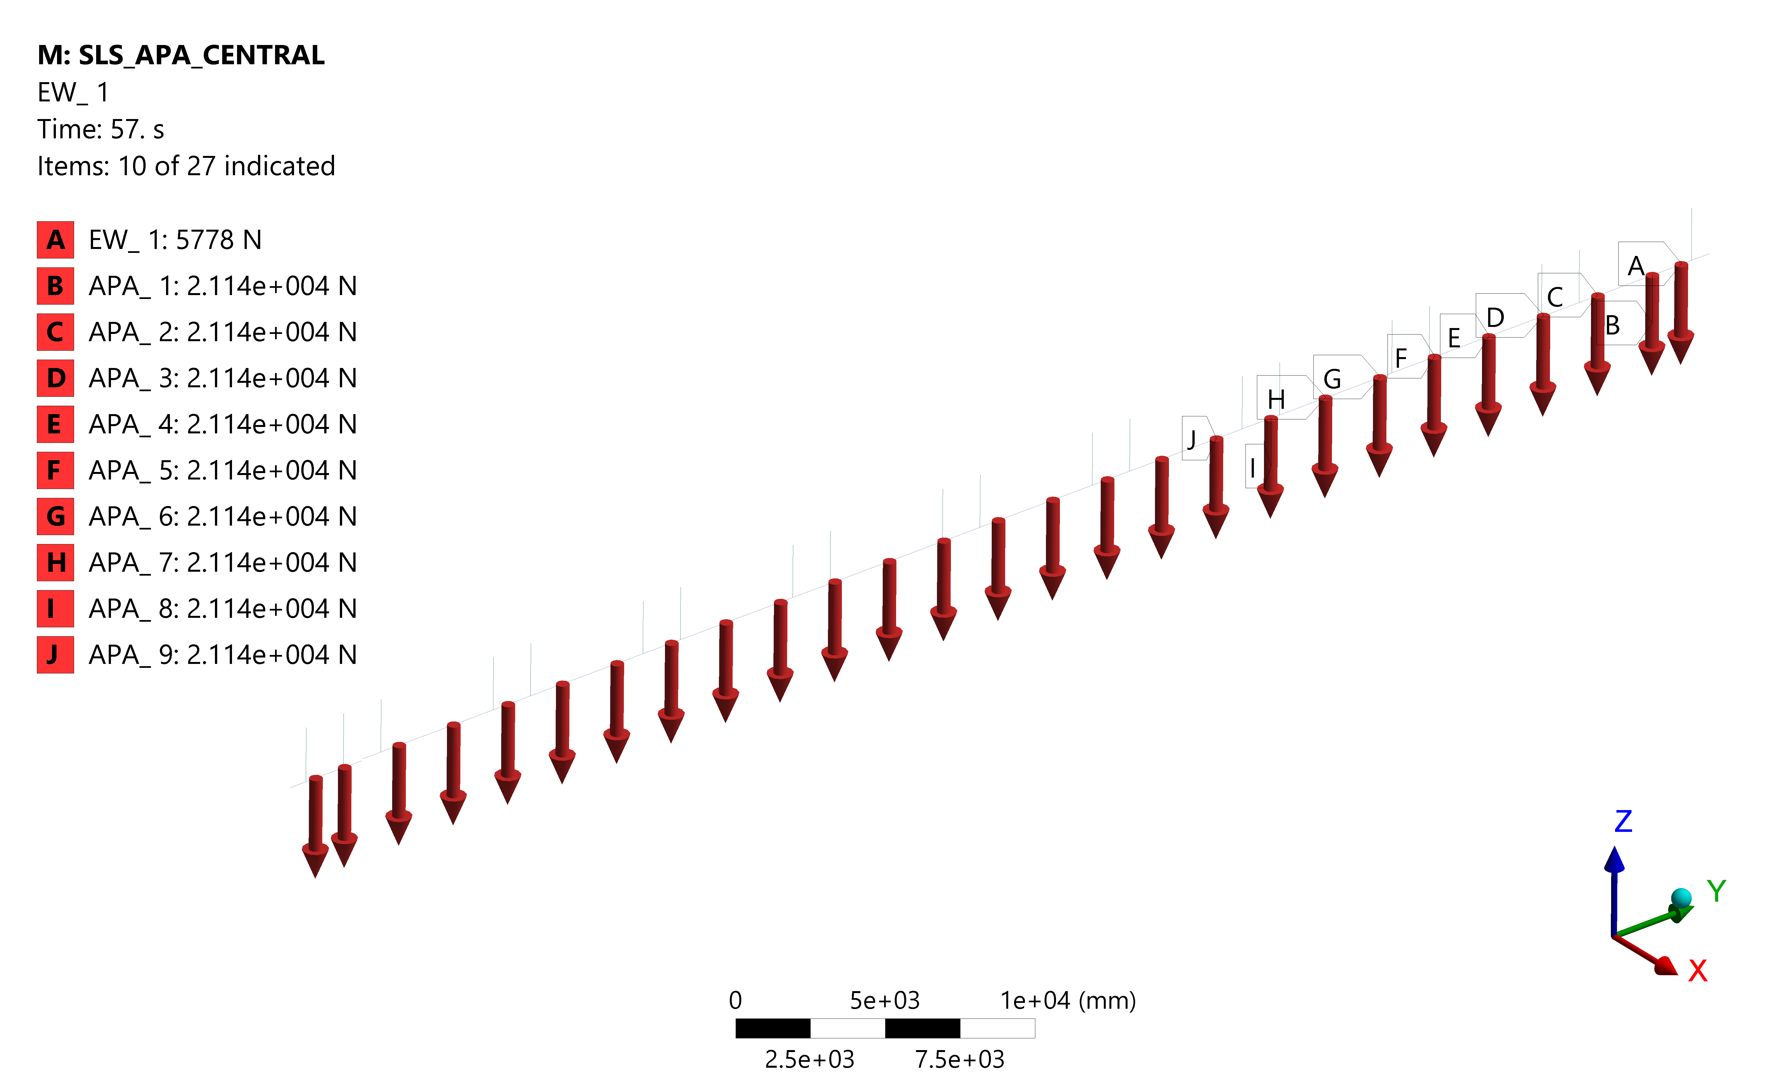
Load cases – Installation

Slide 17
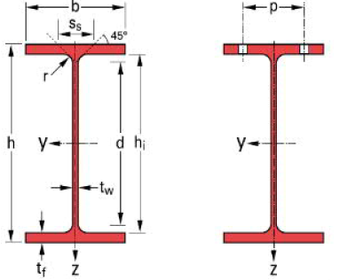
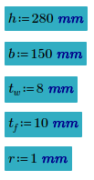
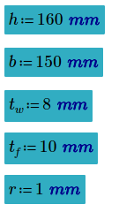
Rails
DSS rails is made of custom laser welded Invar36 profiles
2 sizes;
- Main Rail - Shuttle/Runaway Rail

Slide 18
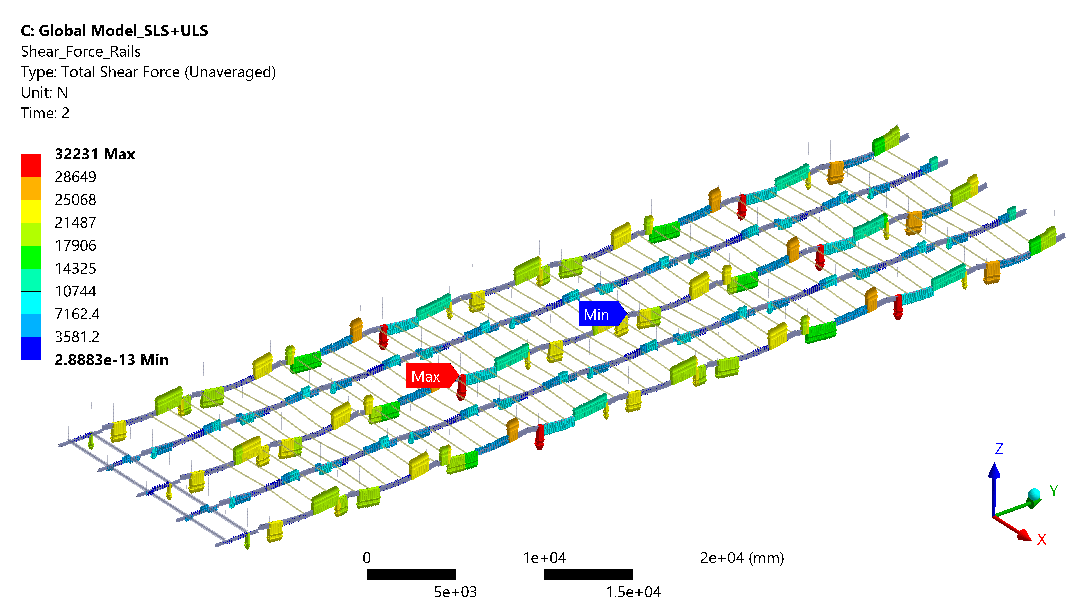
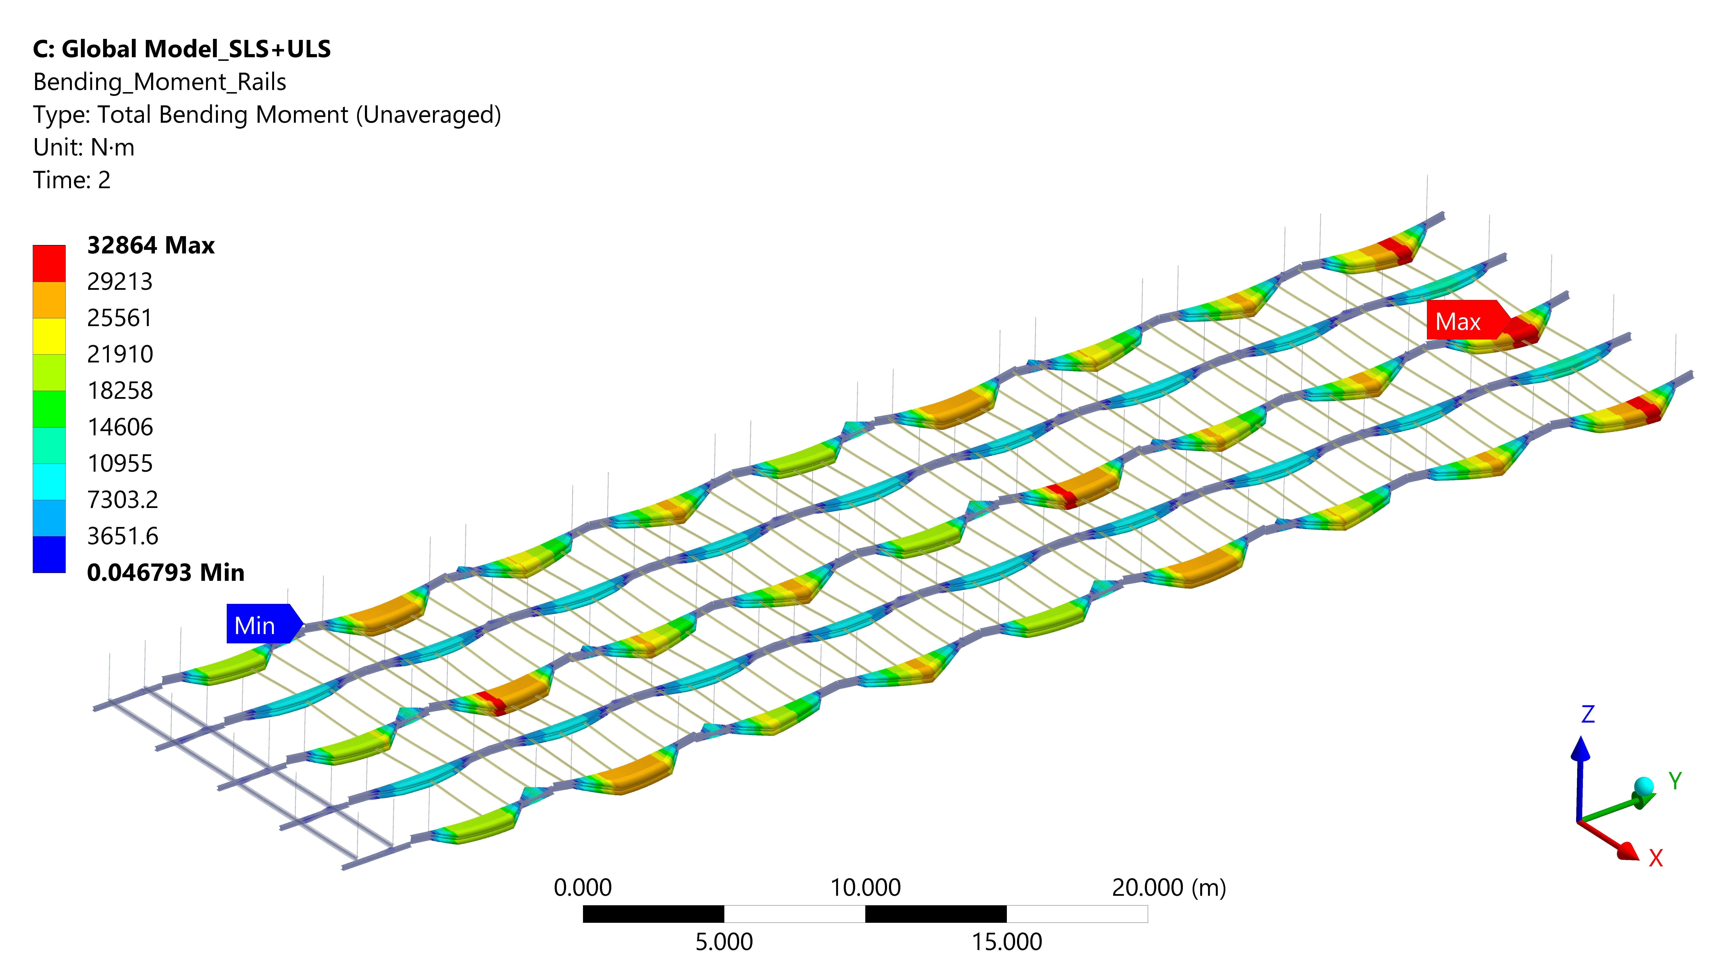
Rails – Main Rail Assessment
Evaluated in accordance with Eurocode 3
Forces and Moment obtained from FE analysis has been compared with a profile resistance
Shear Force Bending Moment

Slide 19
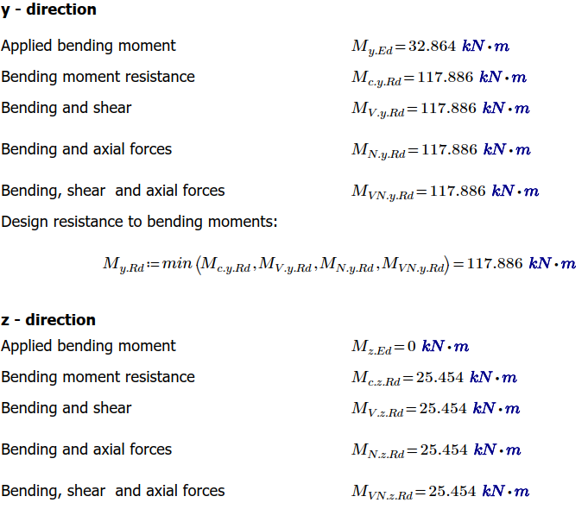
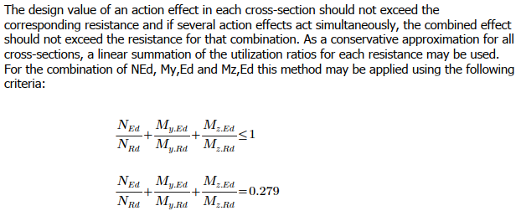
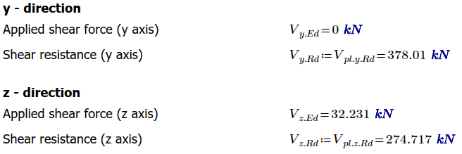
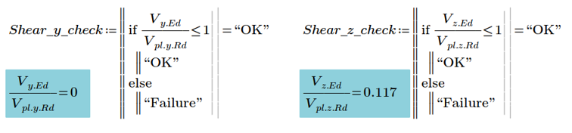
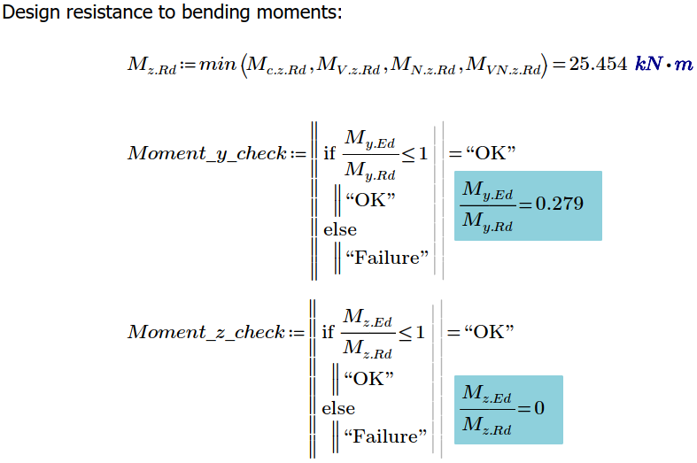
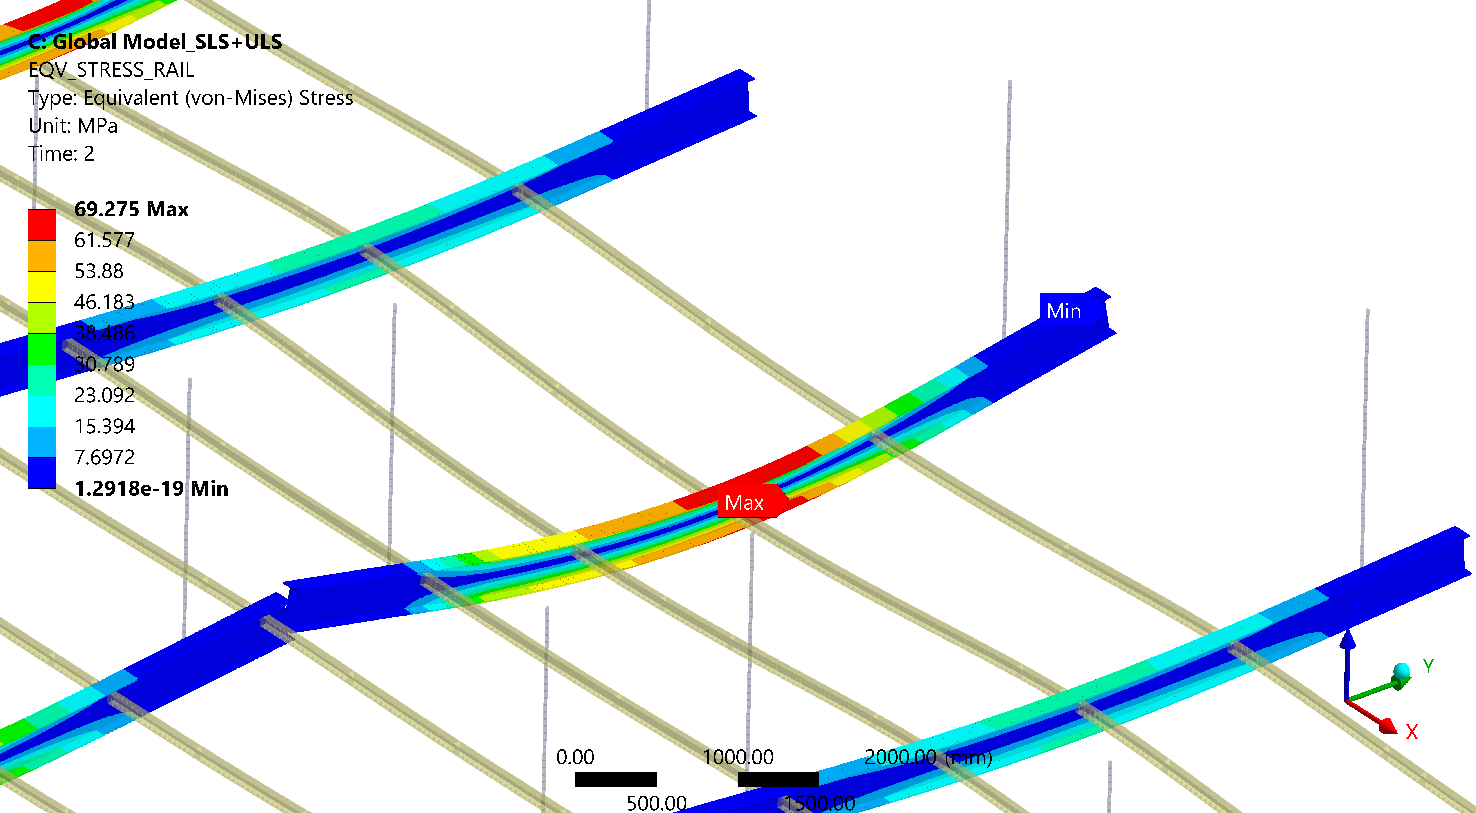
Rails – Main Rail Assessment
Shear Check Moment Check General Check
The DSS Main Rail is utilized
to 28%

Slide 20
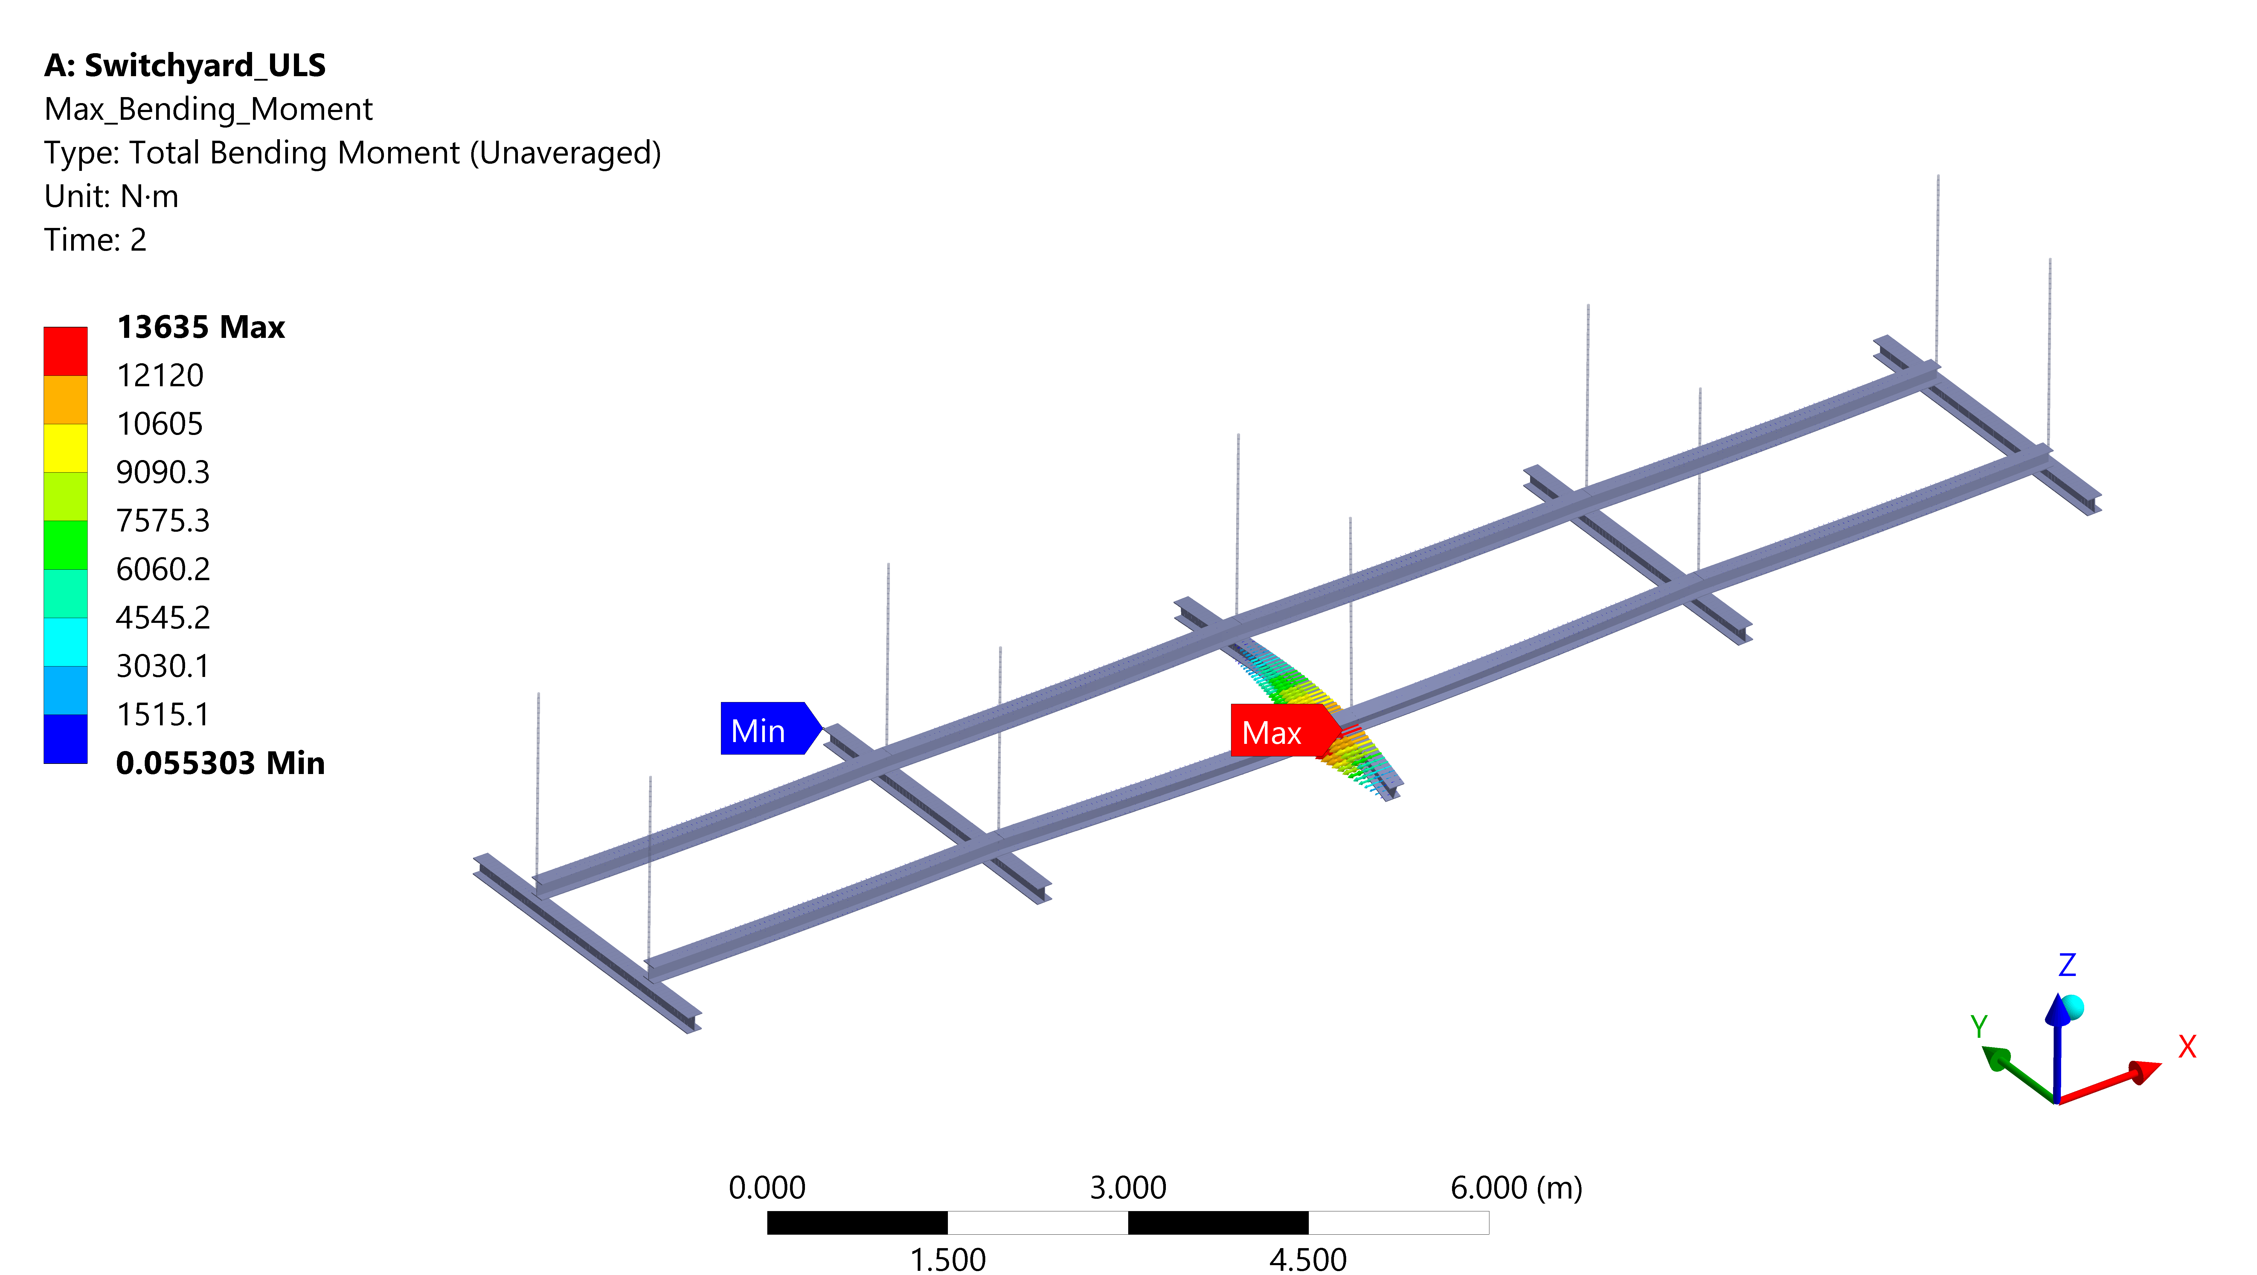
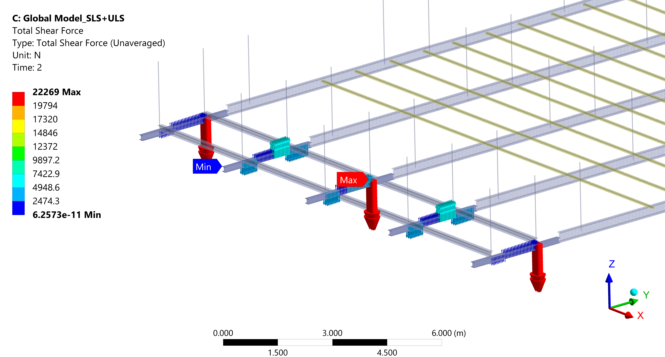
Rails – Switchyard Rail Assessment
Evaluated in accordance with Eurocode 3
Forces and Moment obtained from FE analysis has been compared with a profile resistance
Shear Force Bending Moment

Slide 21
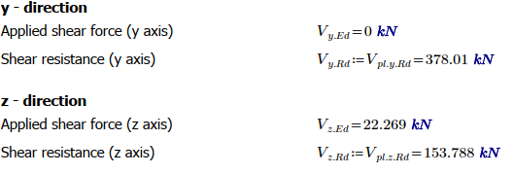
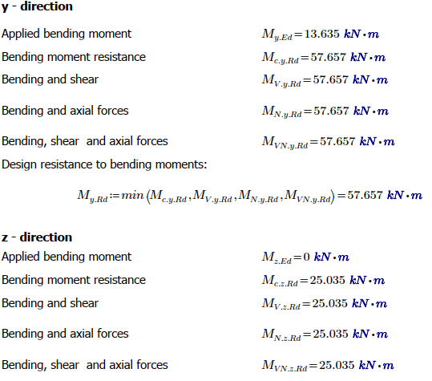
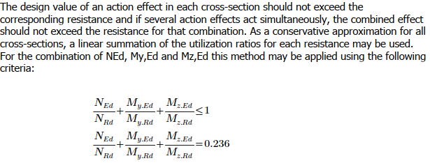
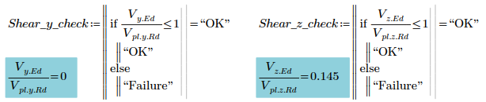
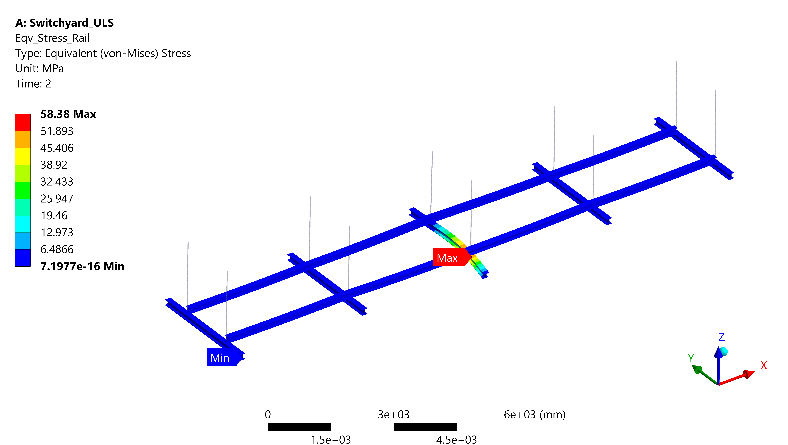
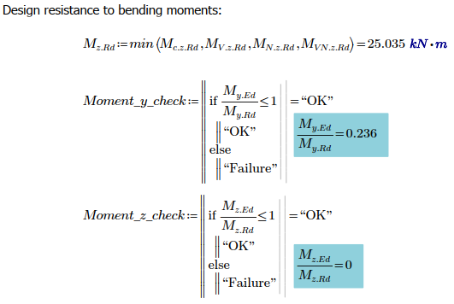
Rails – Switchyard Rail Assessment
Design load case – APA at the shuttle beam extremity
Shear Check Moment Check General Check
The DSS Shuttle/Runaway Rail
is utilized to 24%

Slide 22
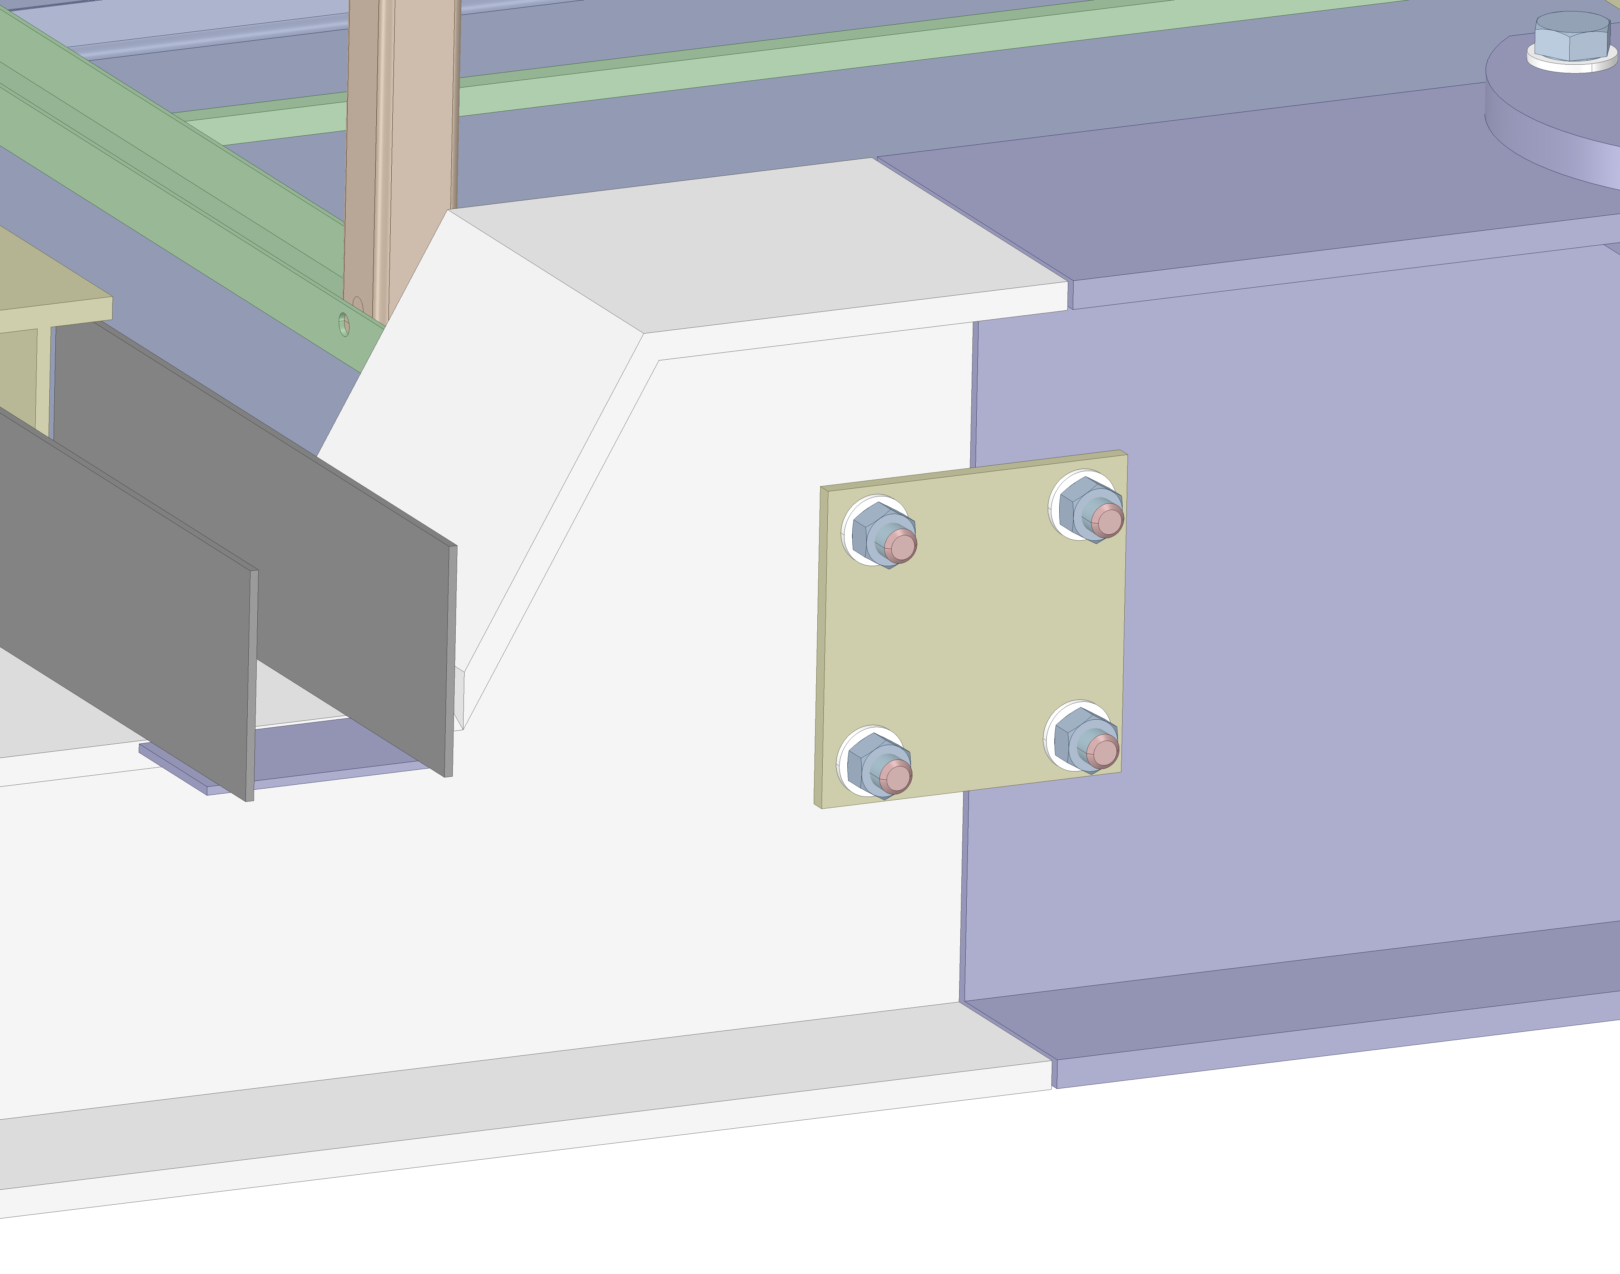
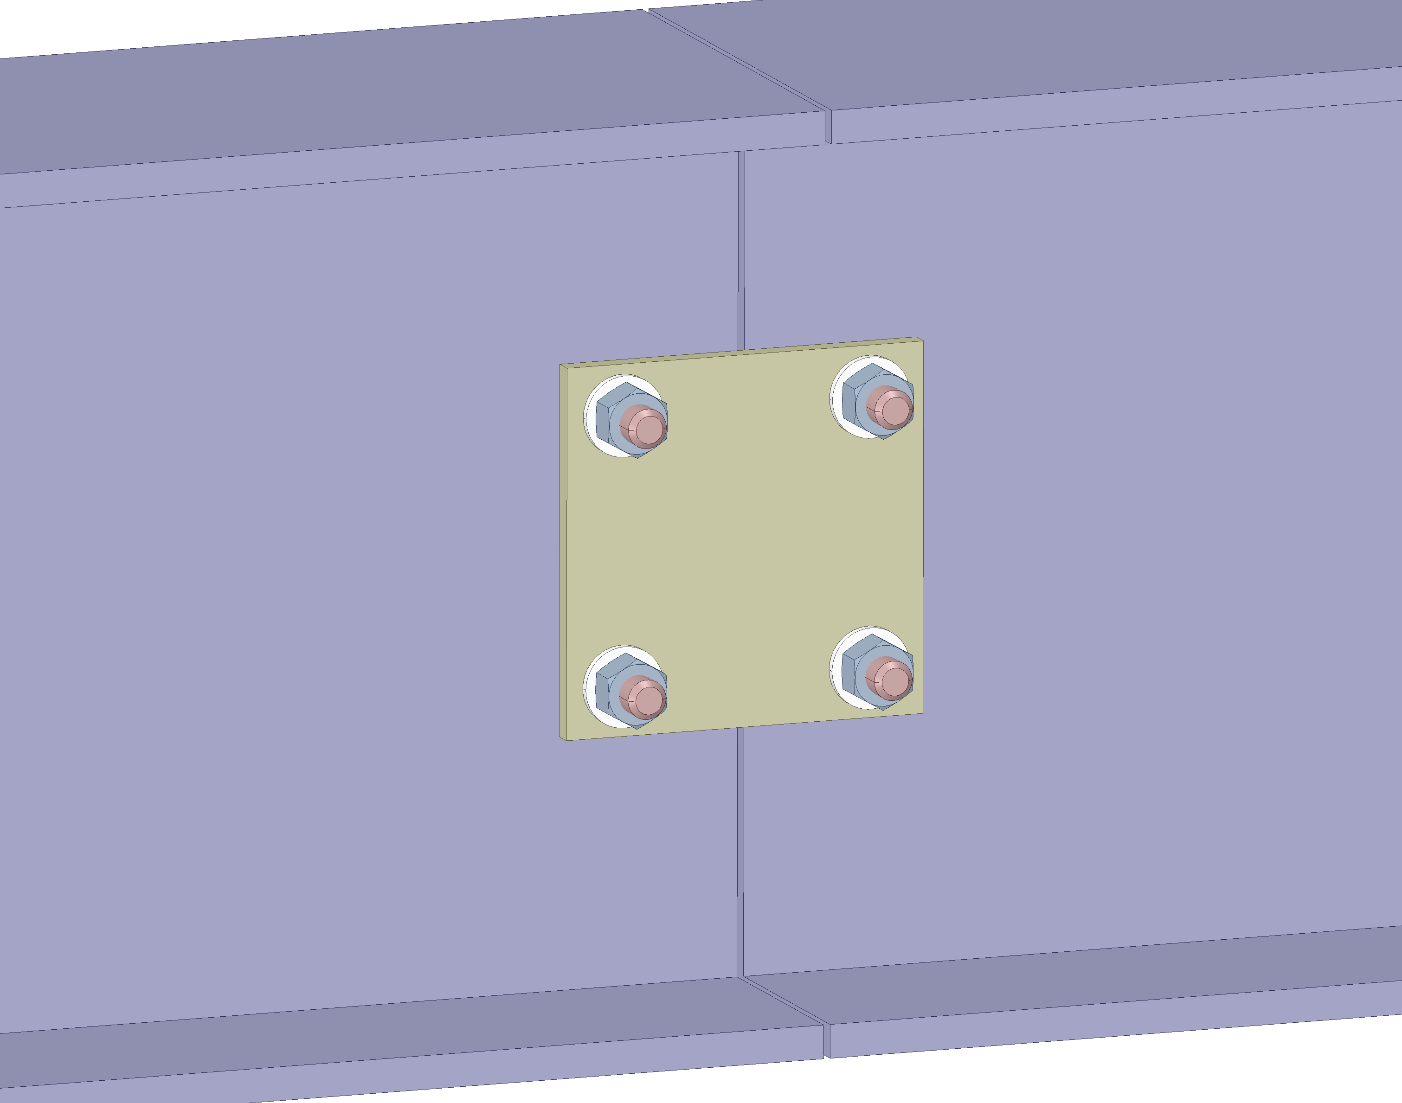
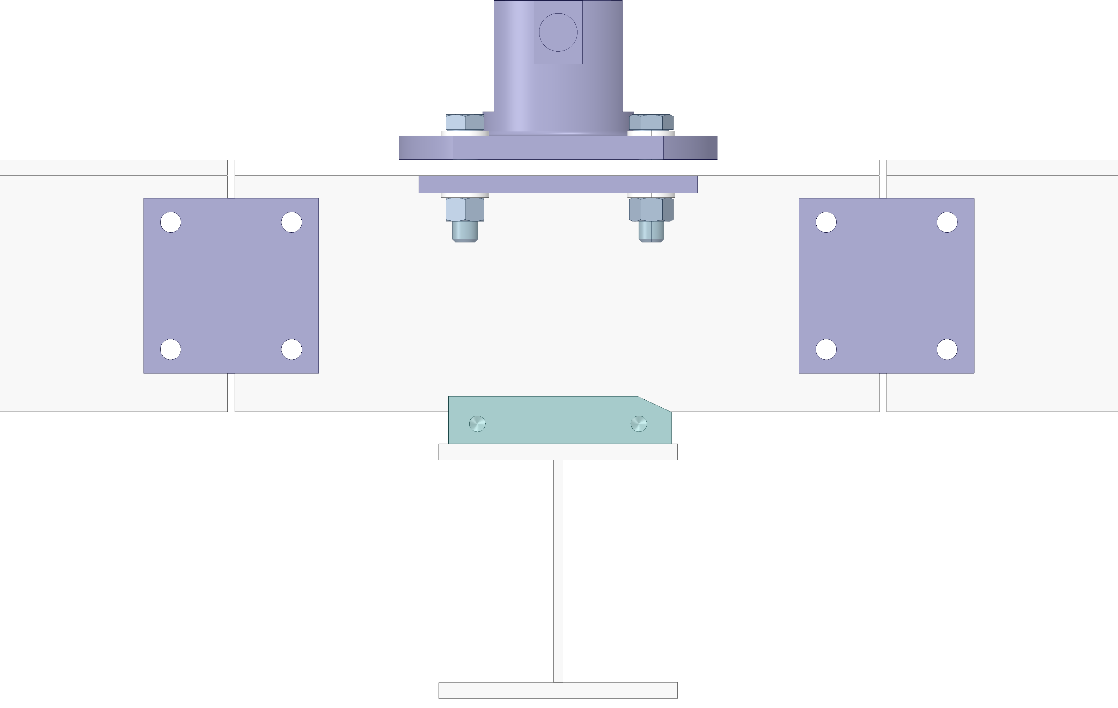
Rails – Main Rail Joint Assessment
Rails will be connected during installation with a splice joint, it is used in four locations:
  To fix temporary runaway beams to the feedthrough portion of a rail,
  To secure shuttle beam to the main rail,
  Between main rails.
Temporary Runaway beams
Shuttle to Main rail
Between Main rails

Slide 23
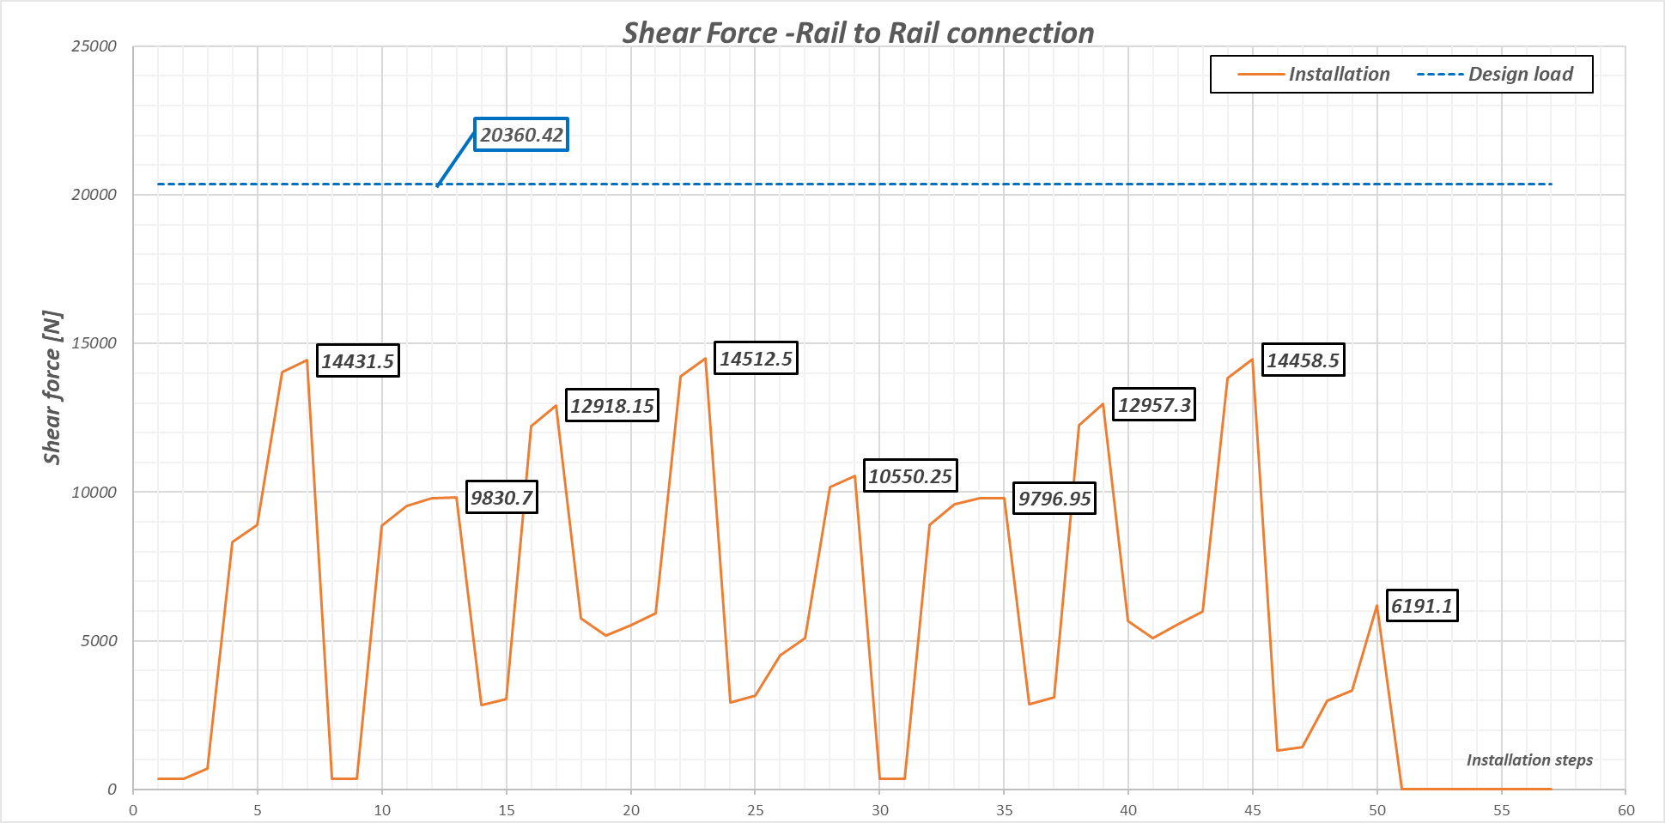
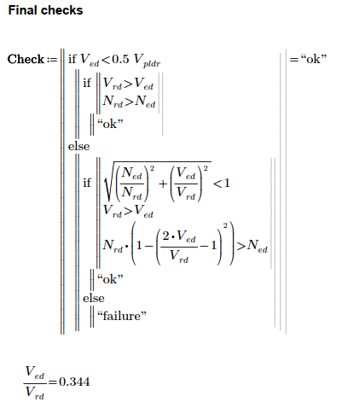
Rails – Main Rail Joint Assessment
Design load - APA passing by the connection
Forces and Moment obtained from the installation load case has been compared with the design load.
Evaluated in accordance with Eurocode 3

Slide 24
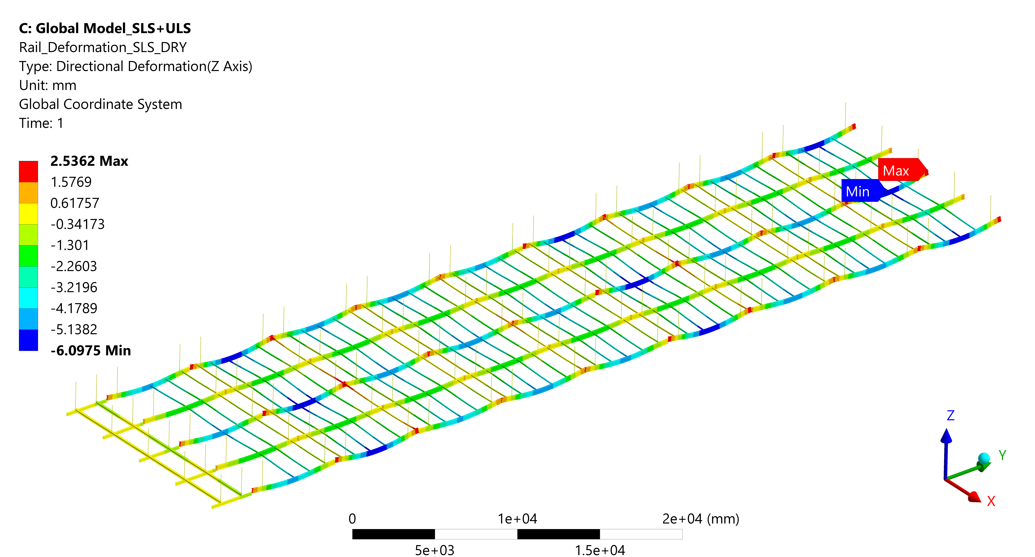
Rails – Deflection – Detector (Dry)

Slide 25
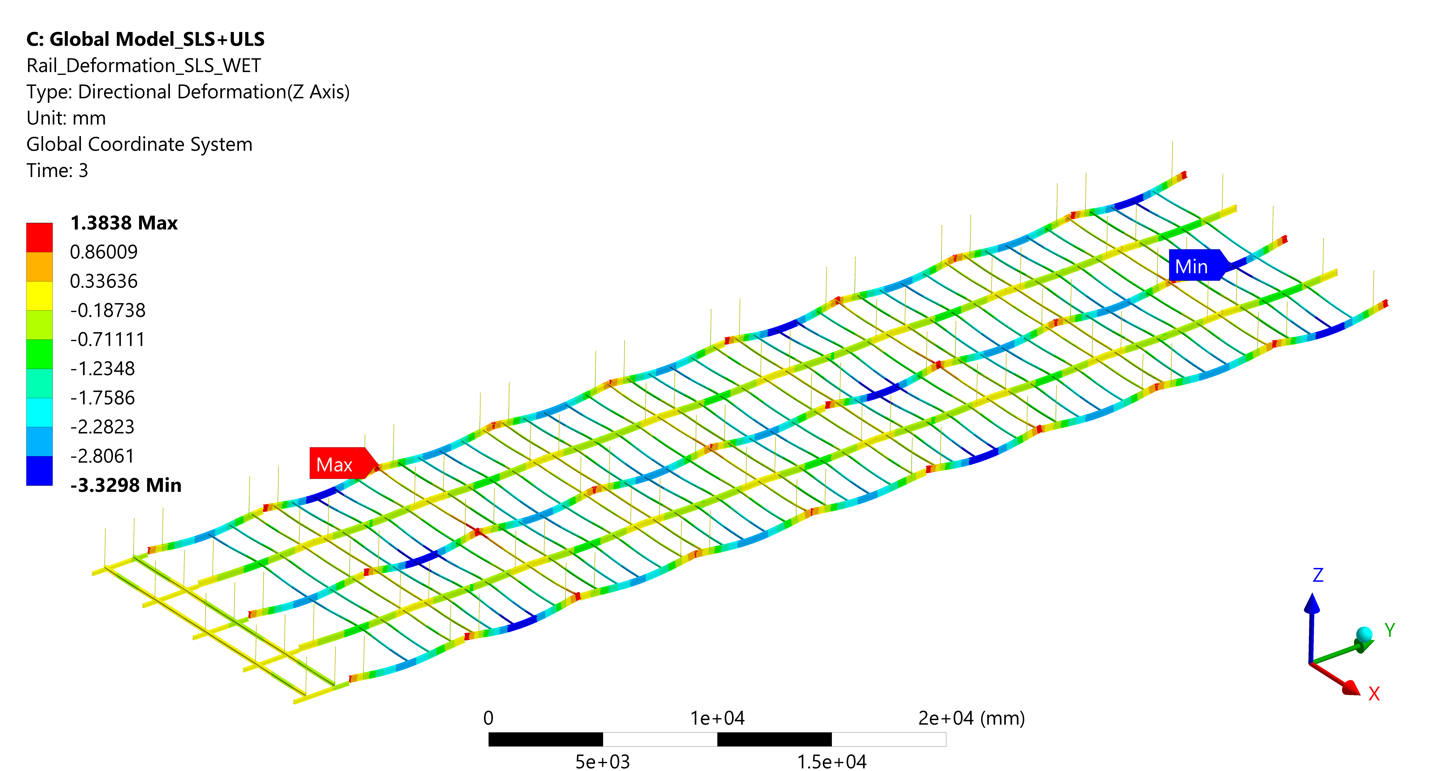
Rails – Deflection – Detector (Wet)

Slide 26
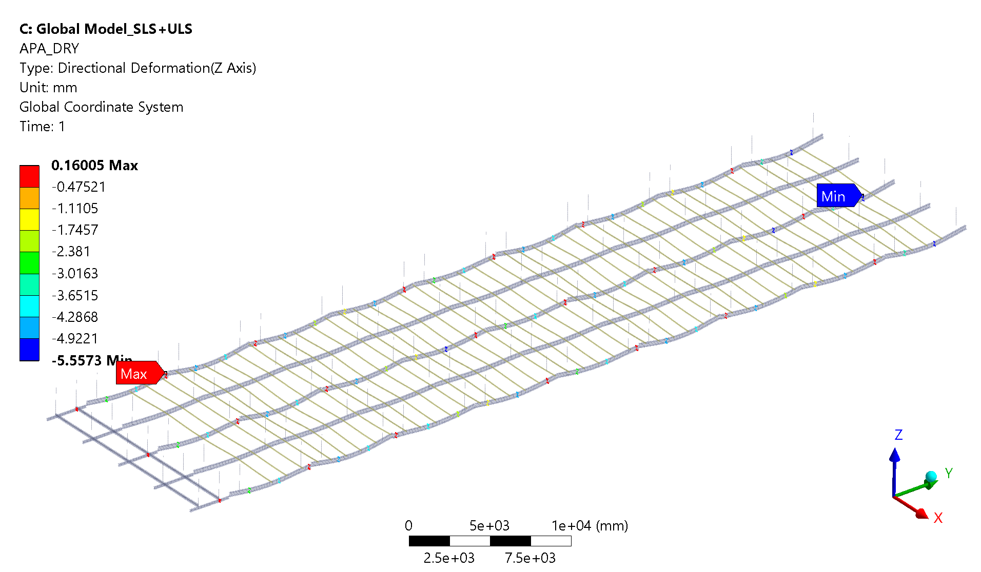
Rails – Detector (DRY) – APA
∆APA Vertical=5.72mm

Slide 27

Rails – Detector (WET) - APA
∆APA Vertical=3.17mm

Slide 28
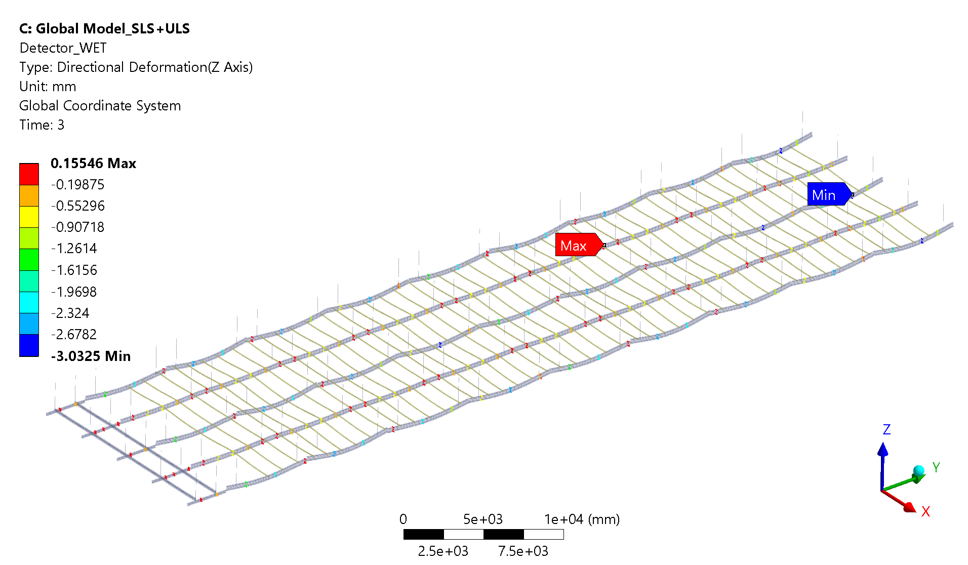
Rails – Detector (WET)
∆Detector Vertical=3.19mm

Slide 29
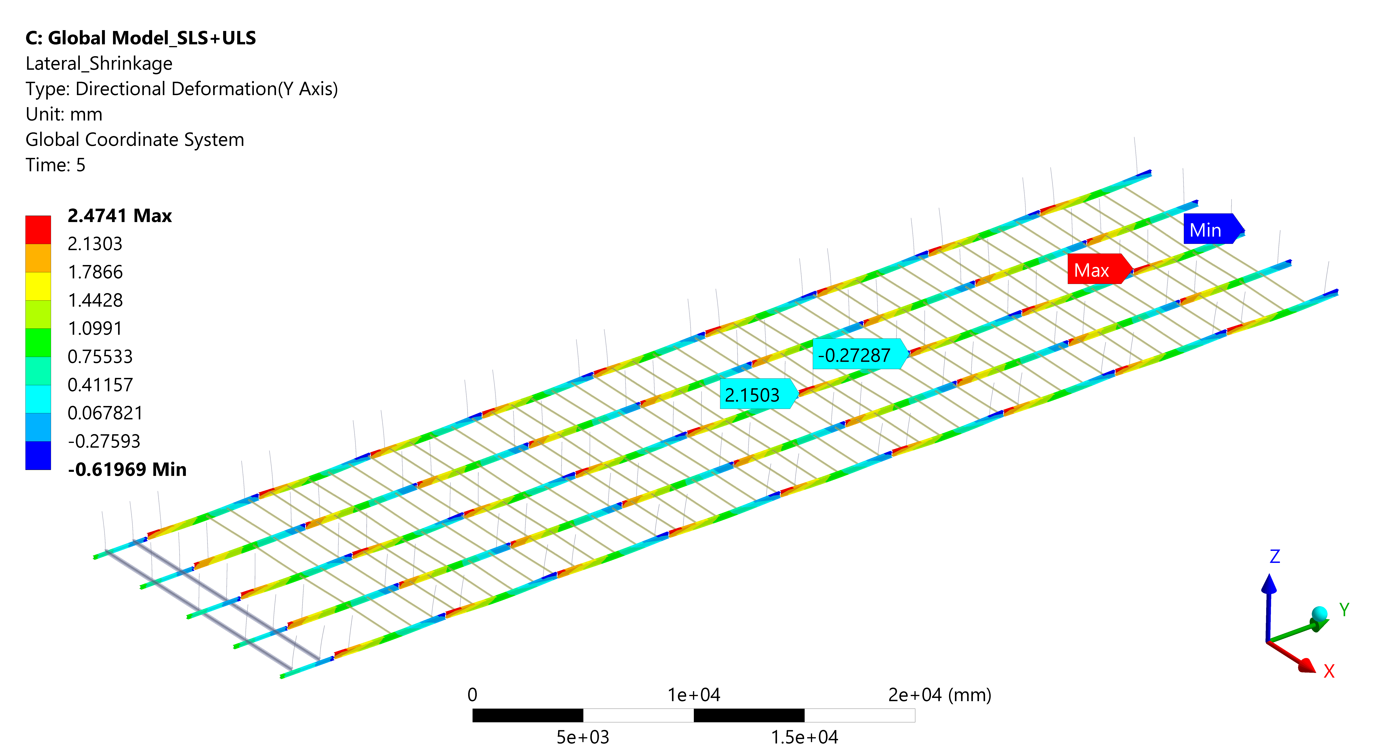
Rails – Shrinkage (Lateral)

Slide 30
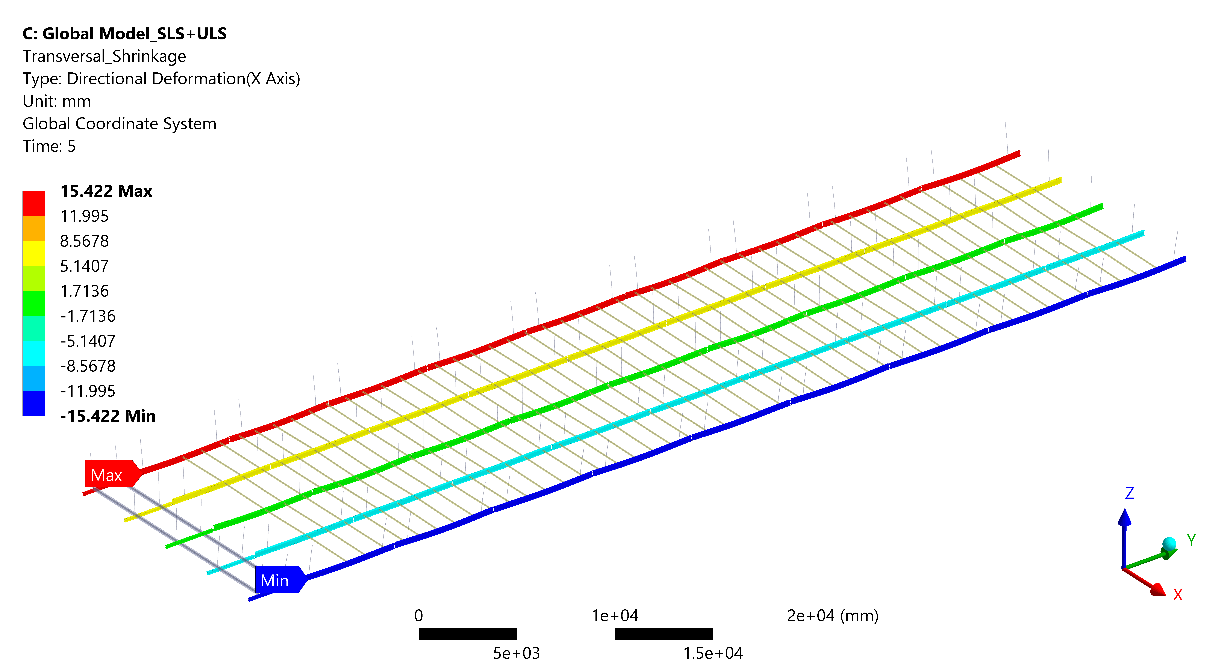
Rails – Shrinkage (Transversal)

Slide 31
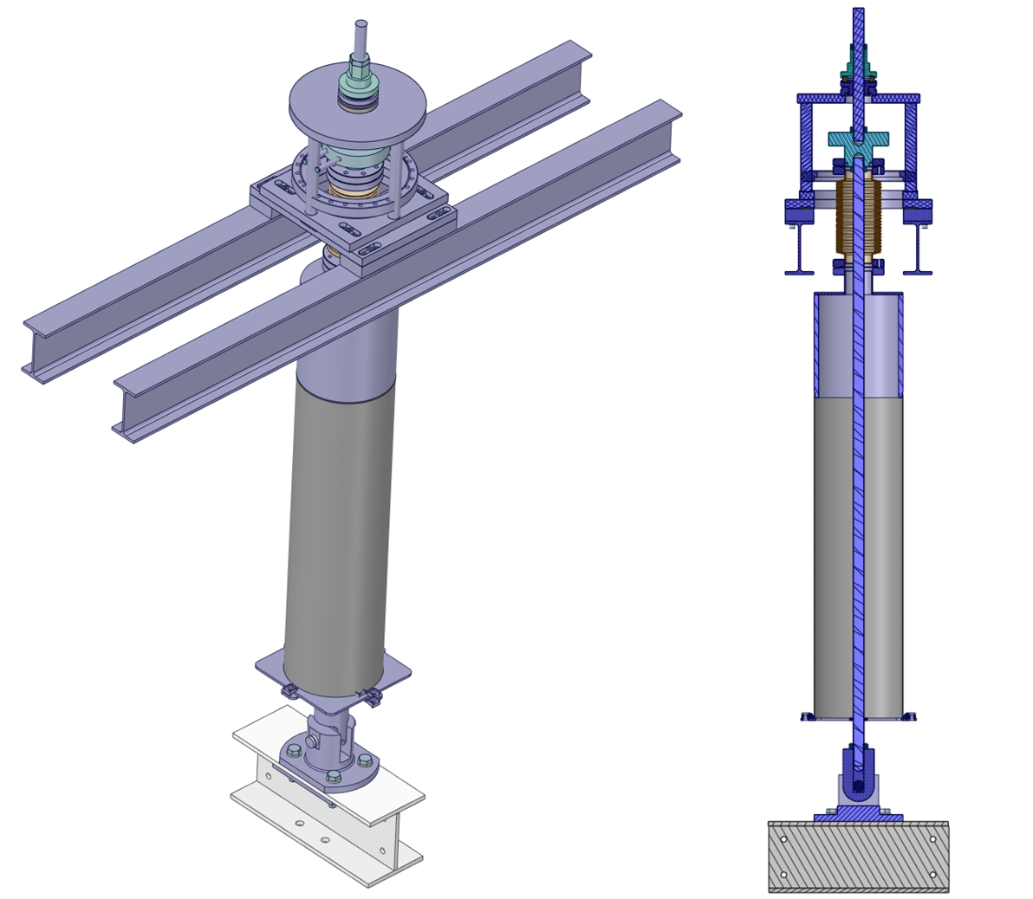
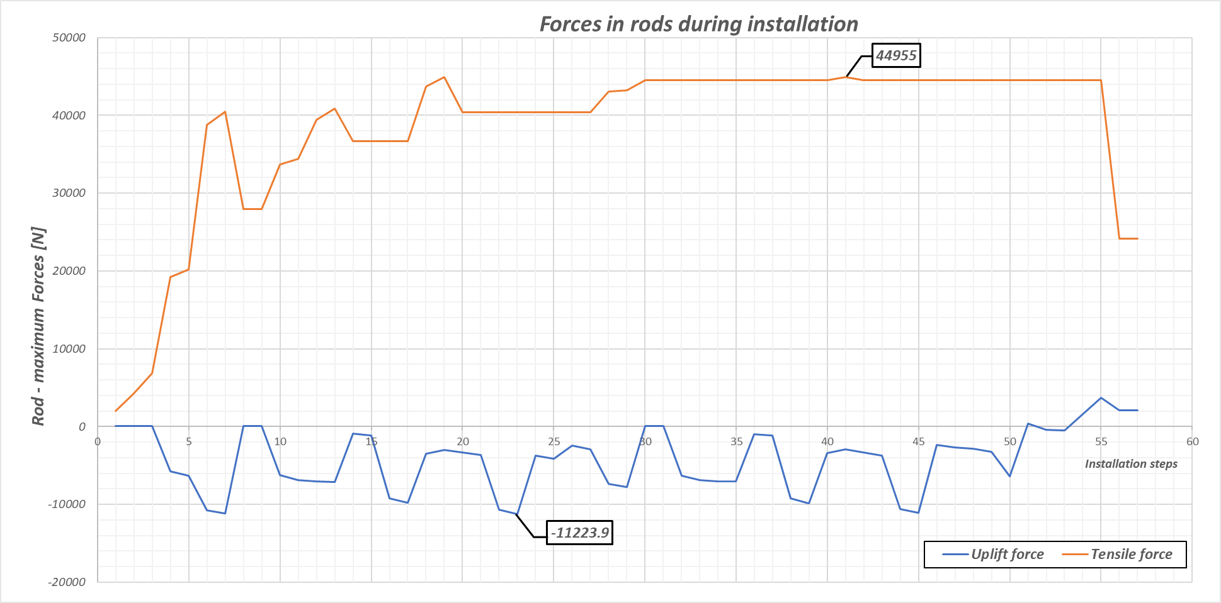
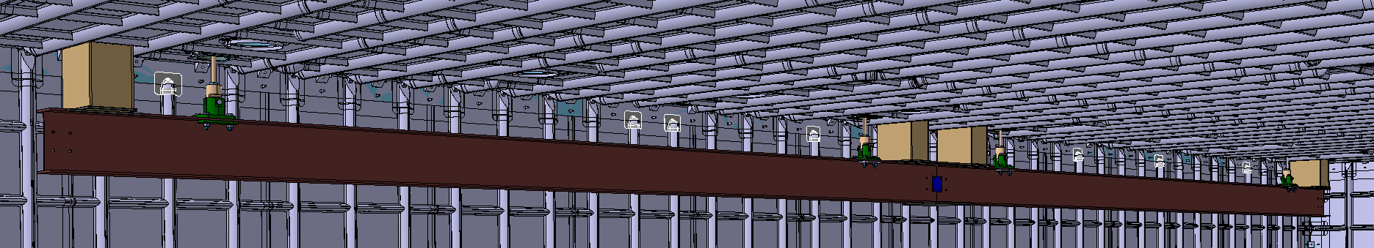
Support Rod Assembly
Design load case – the most severe load has been chosen for detailed simulation of the Support Rod Assembly (SRA) based on the highest value found in the installation analysis
Uplift force has been observed (Rod works in tension and his buckling resistance is rather low)
Spacer (Polyurethane)

Slide 32
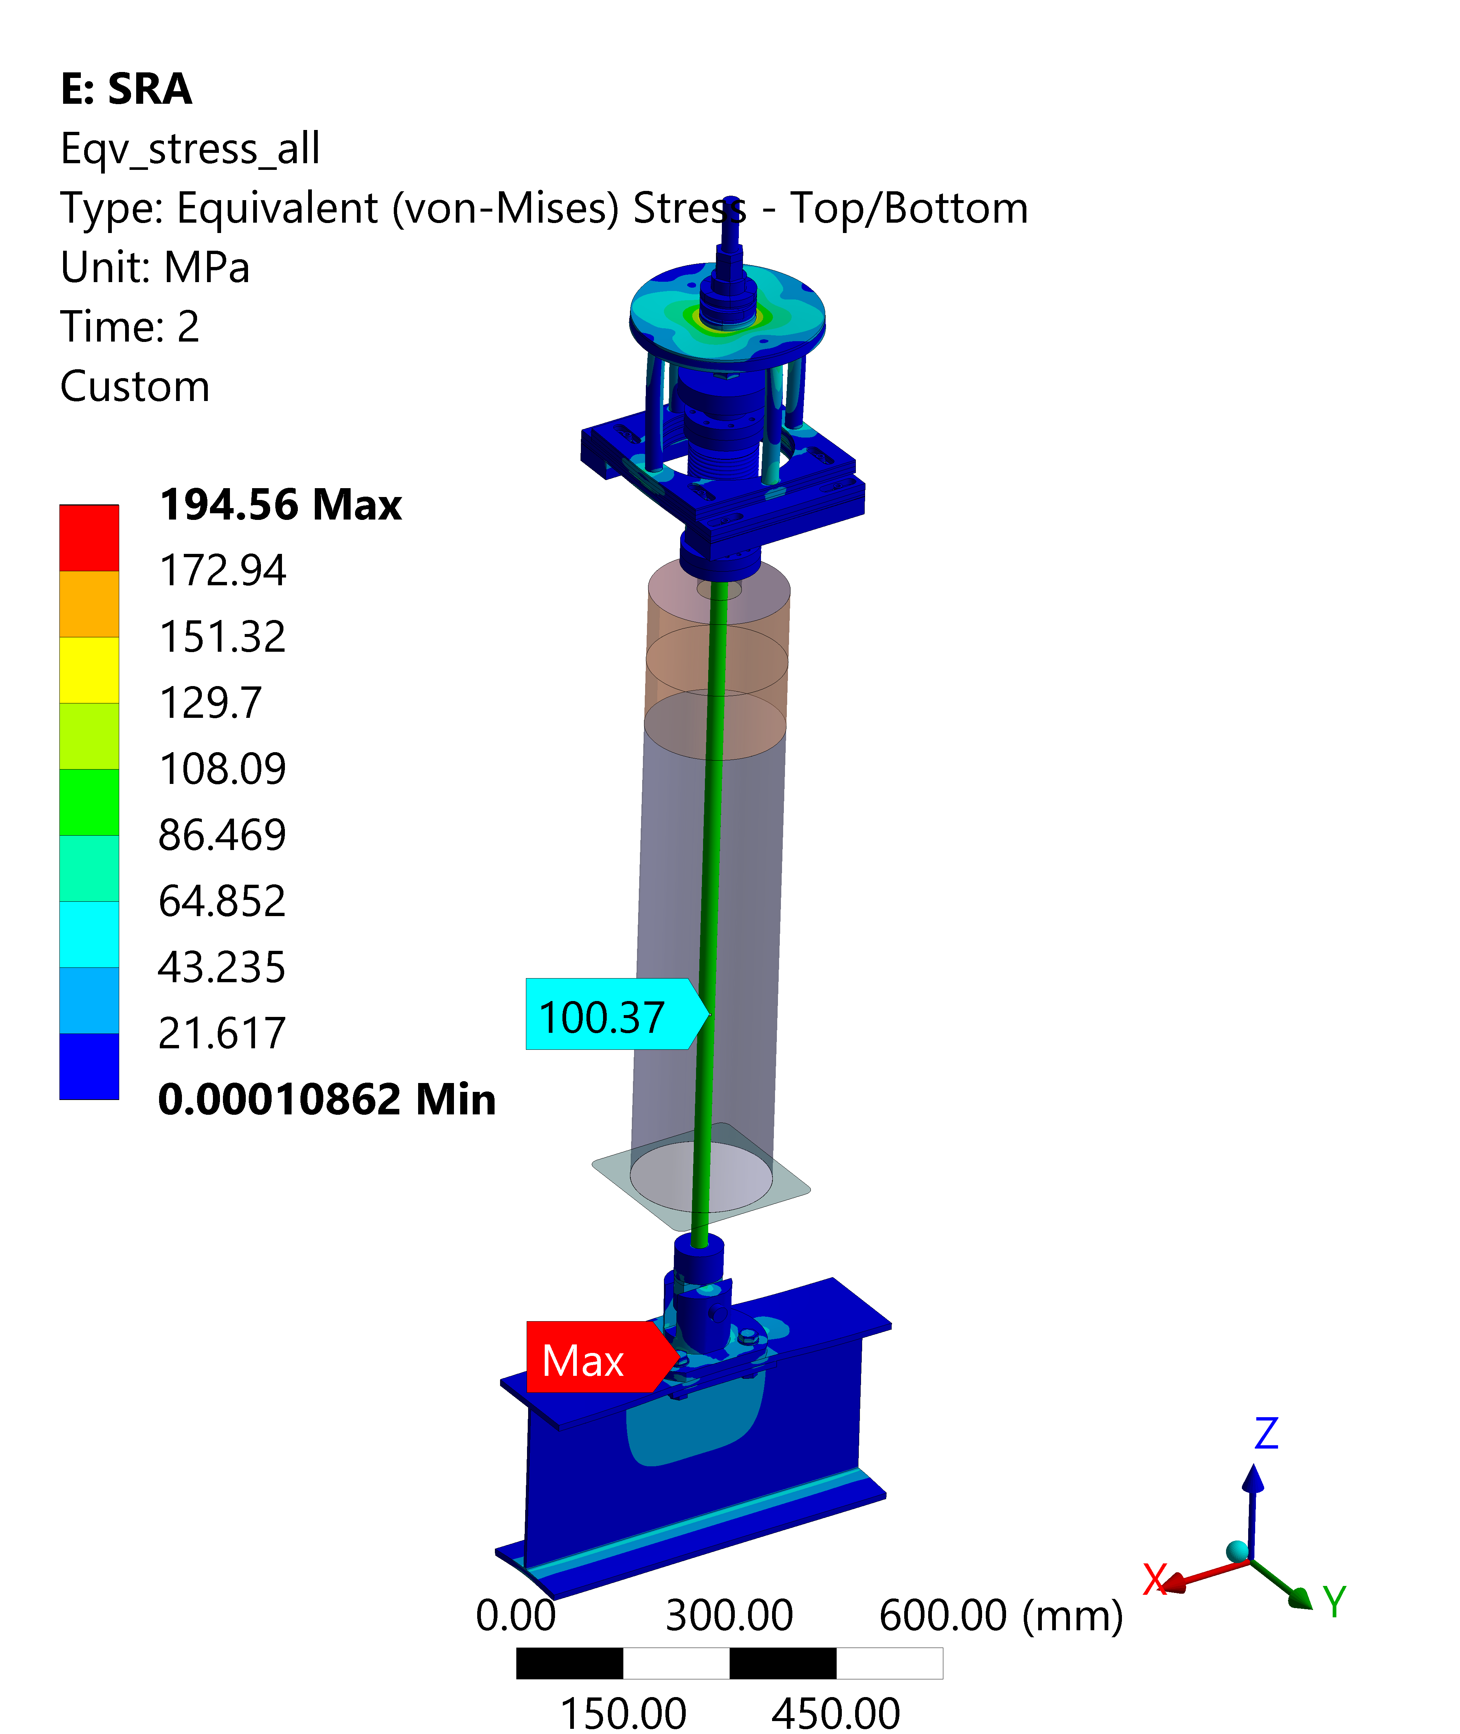
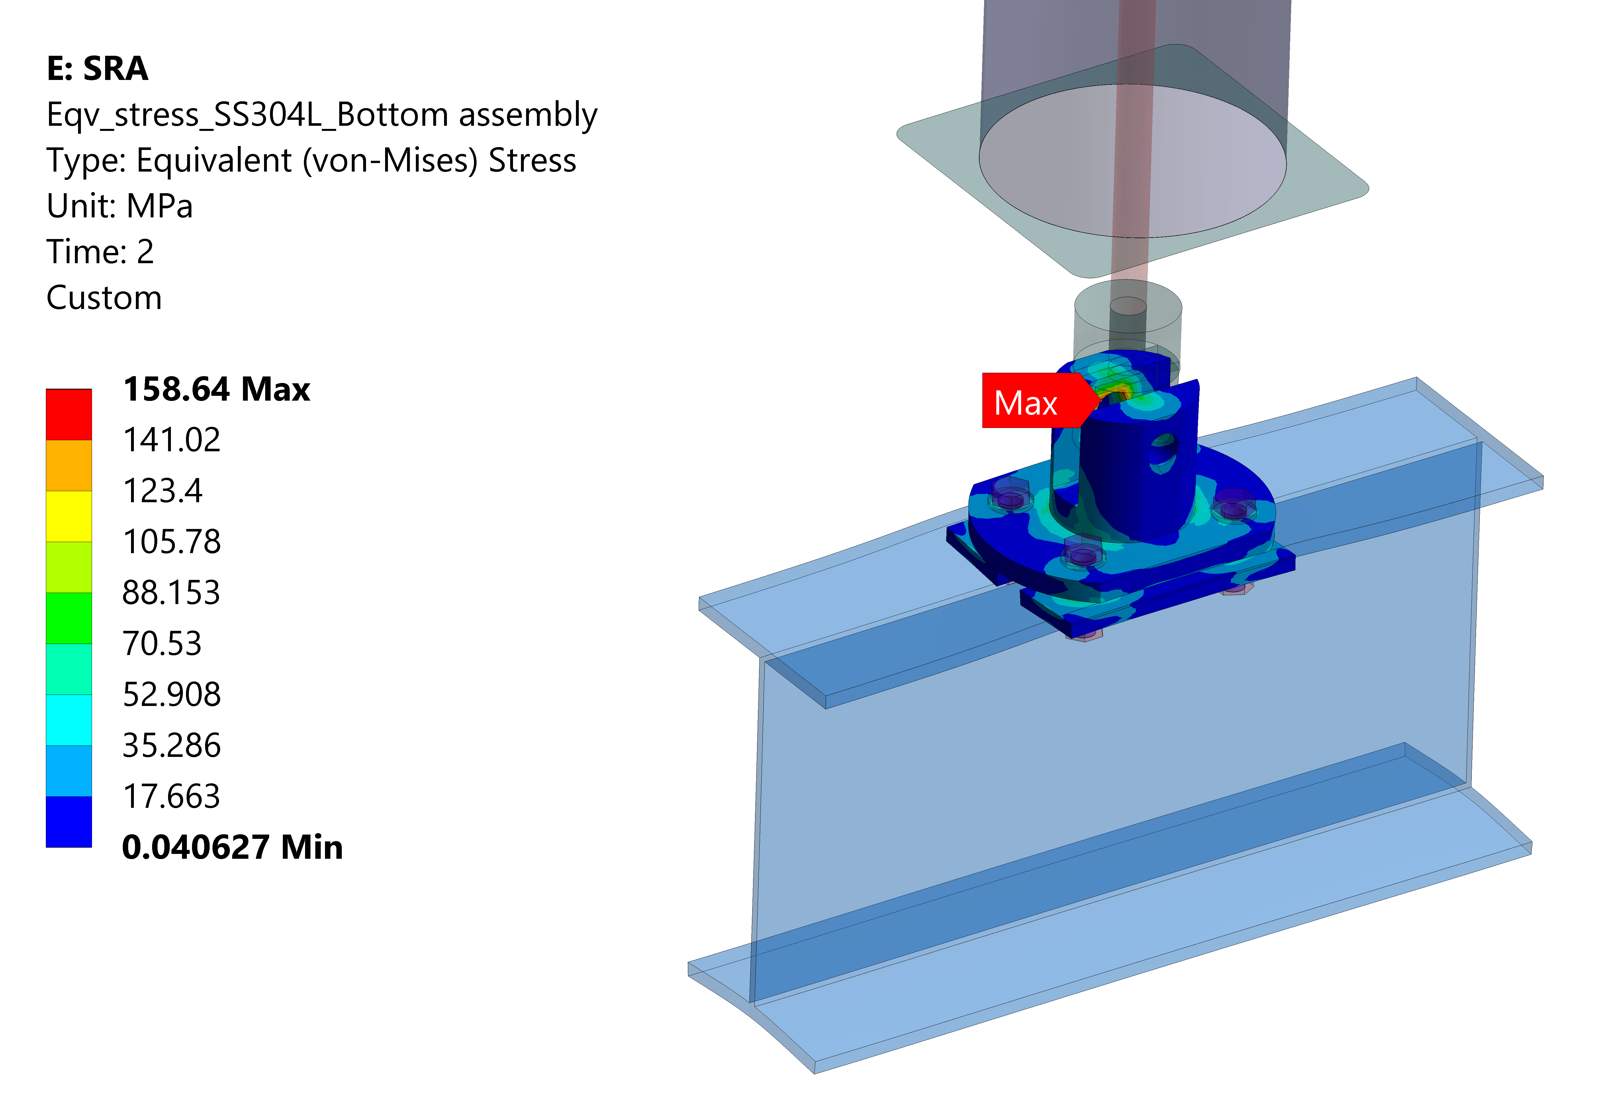
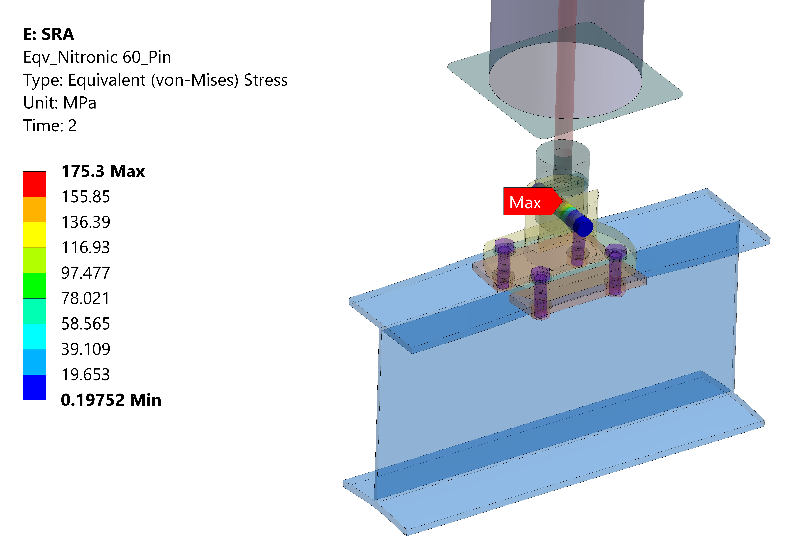
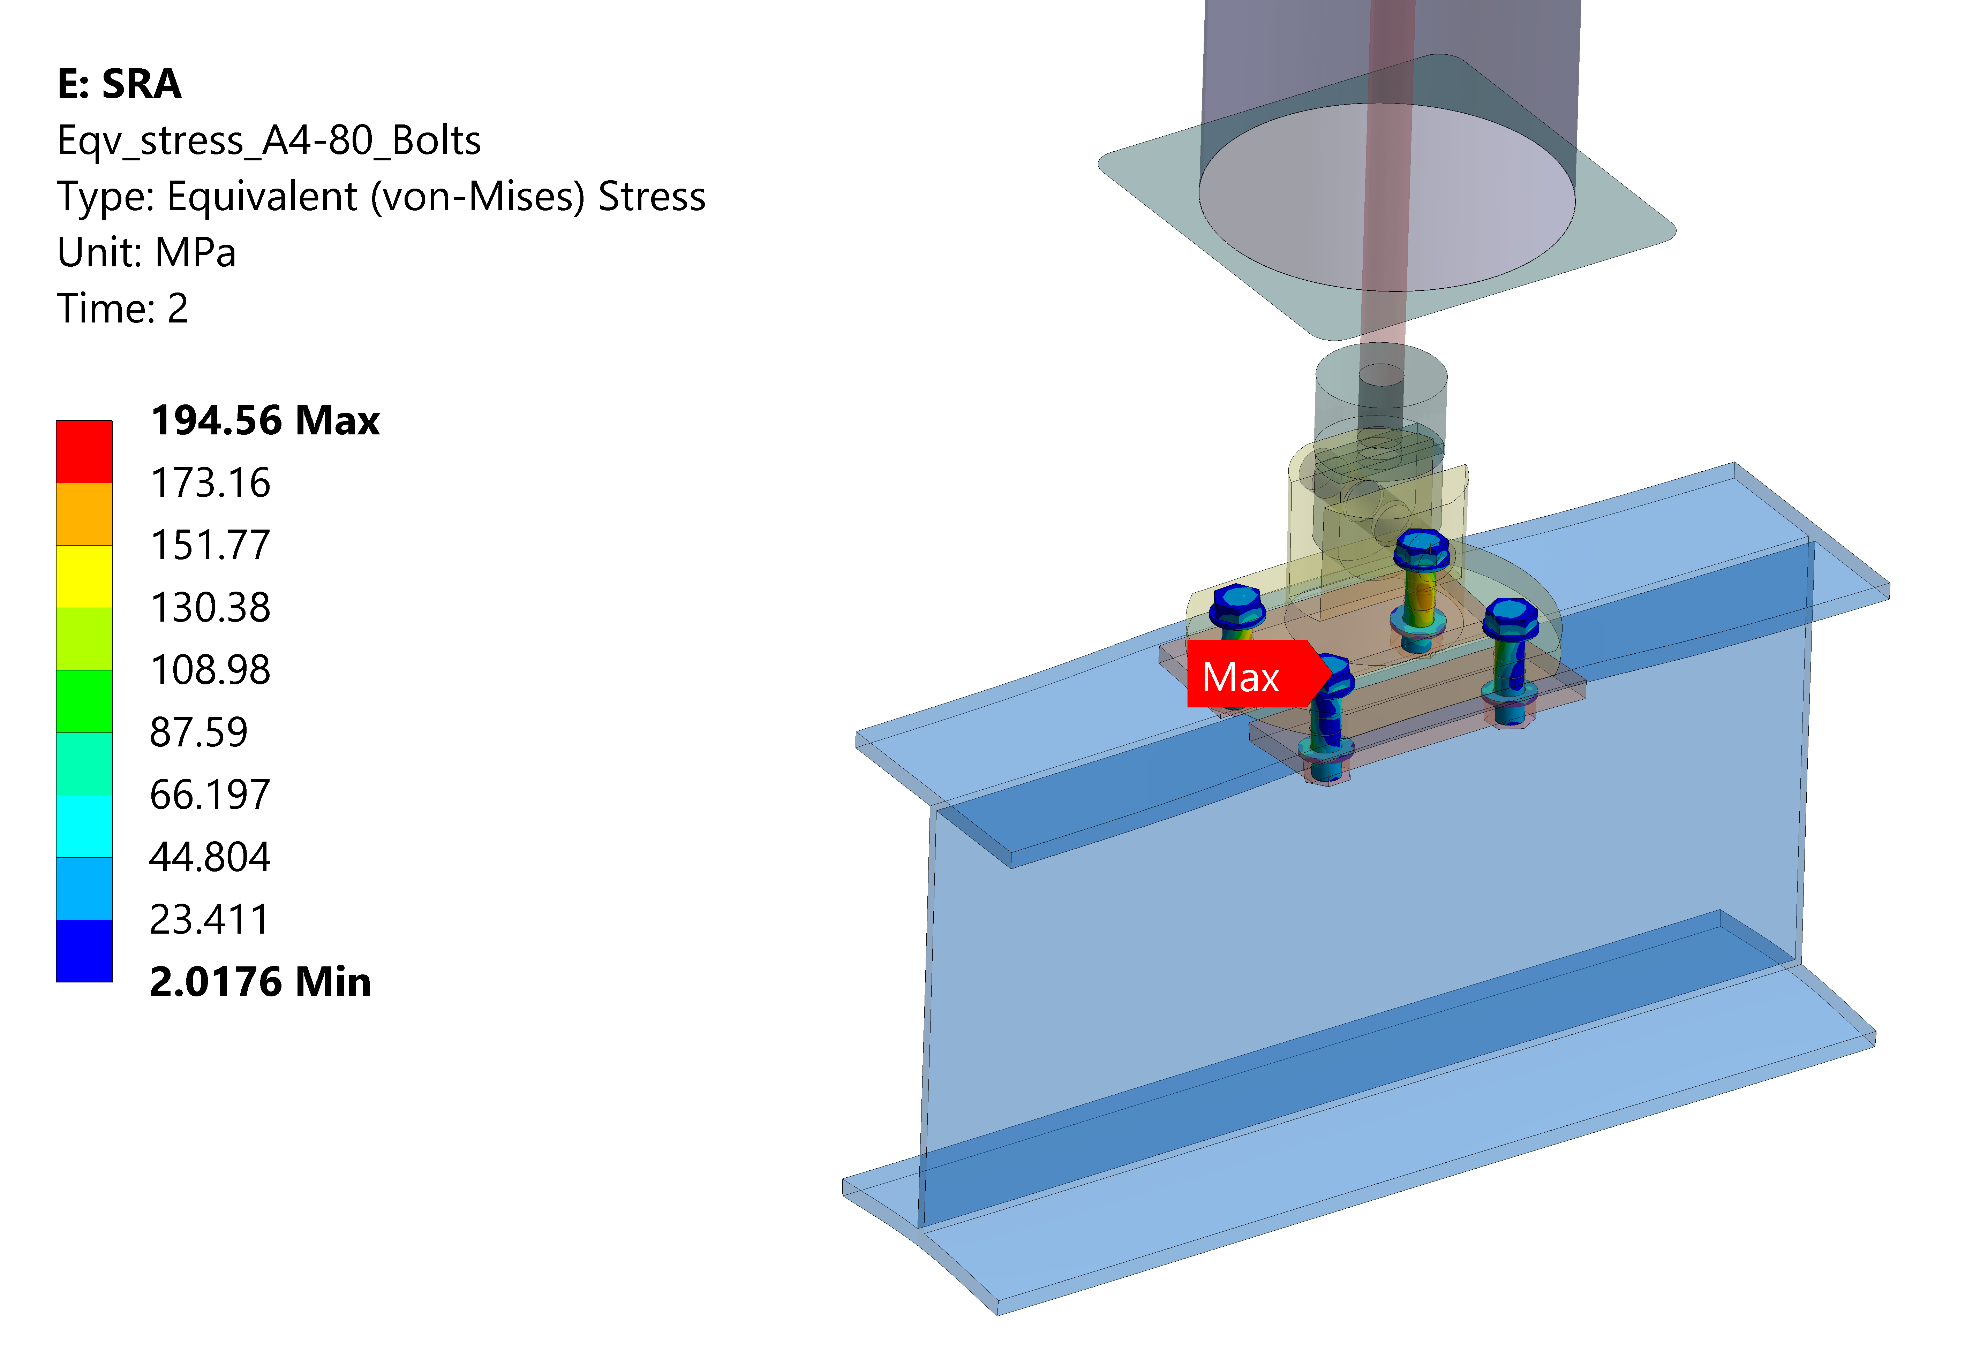
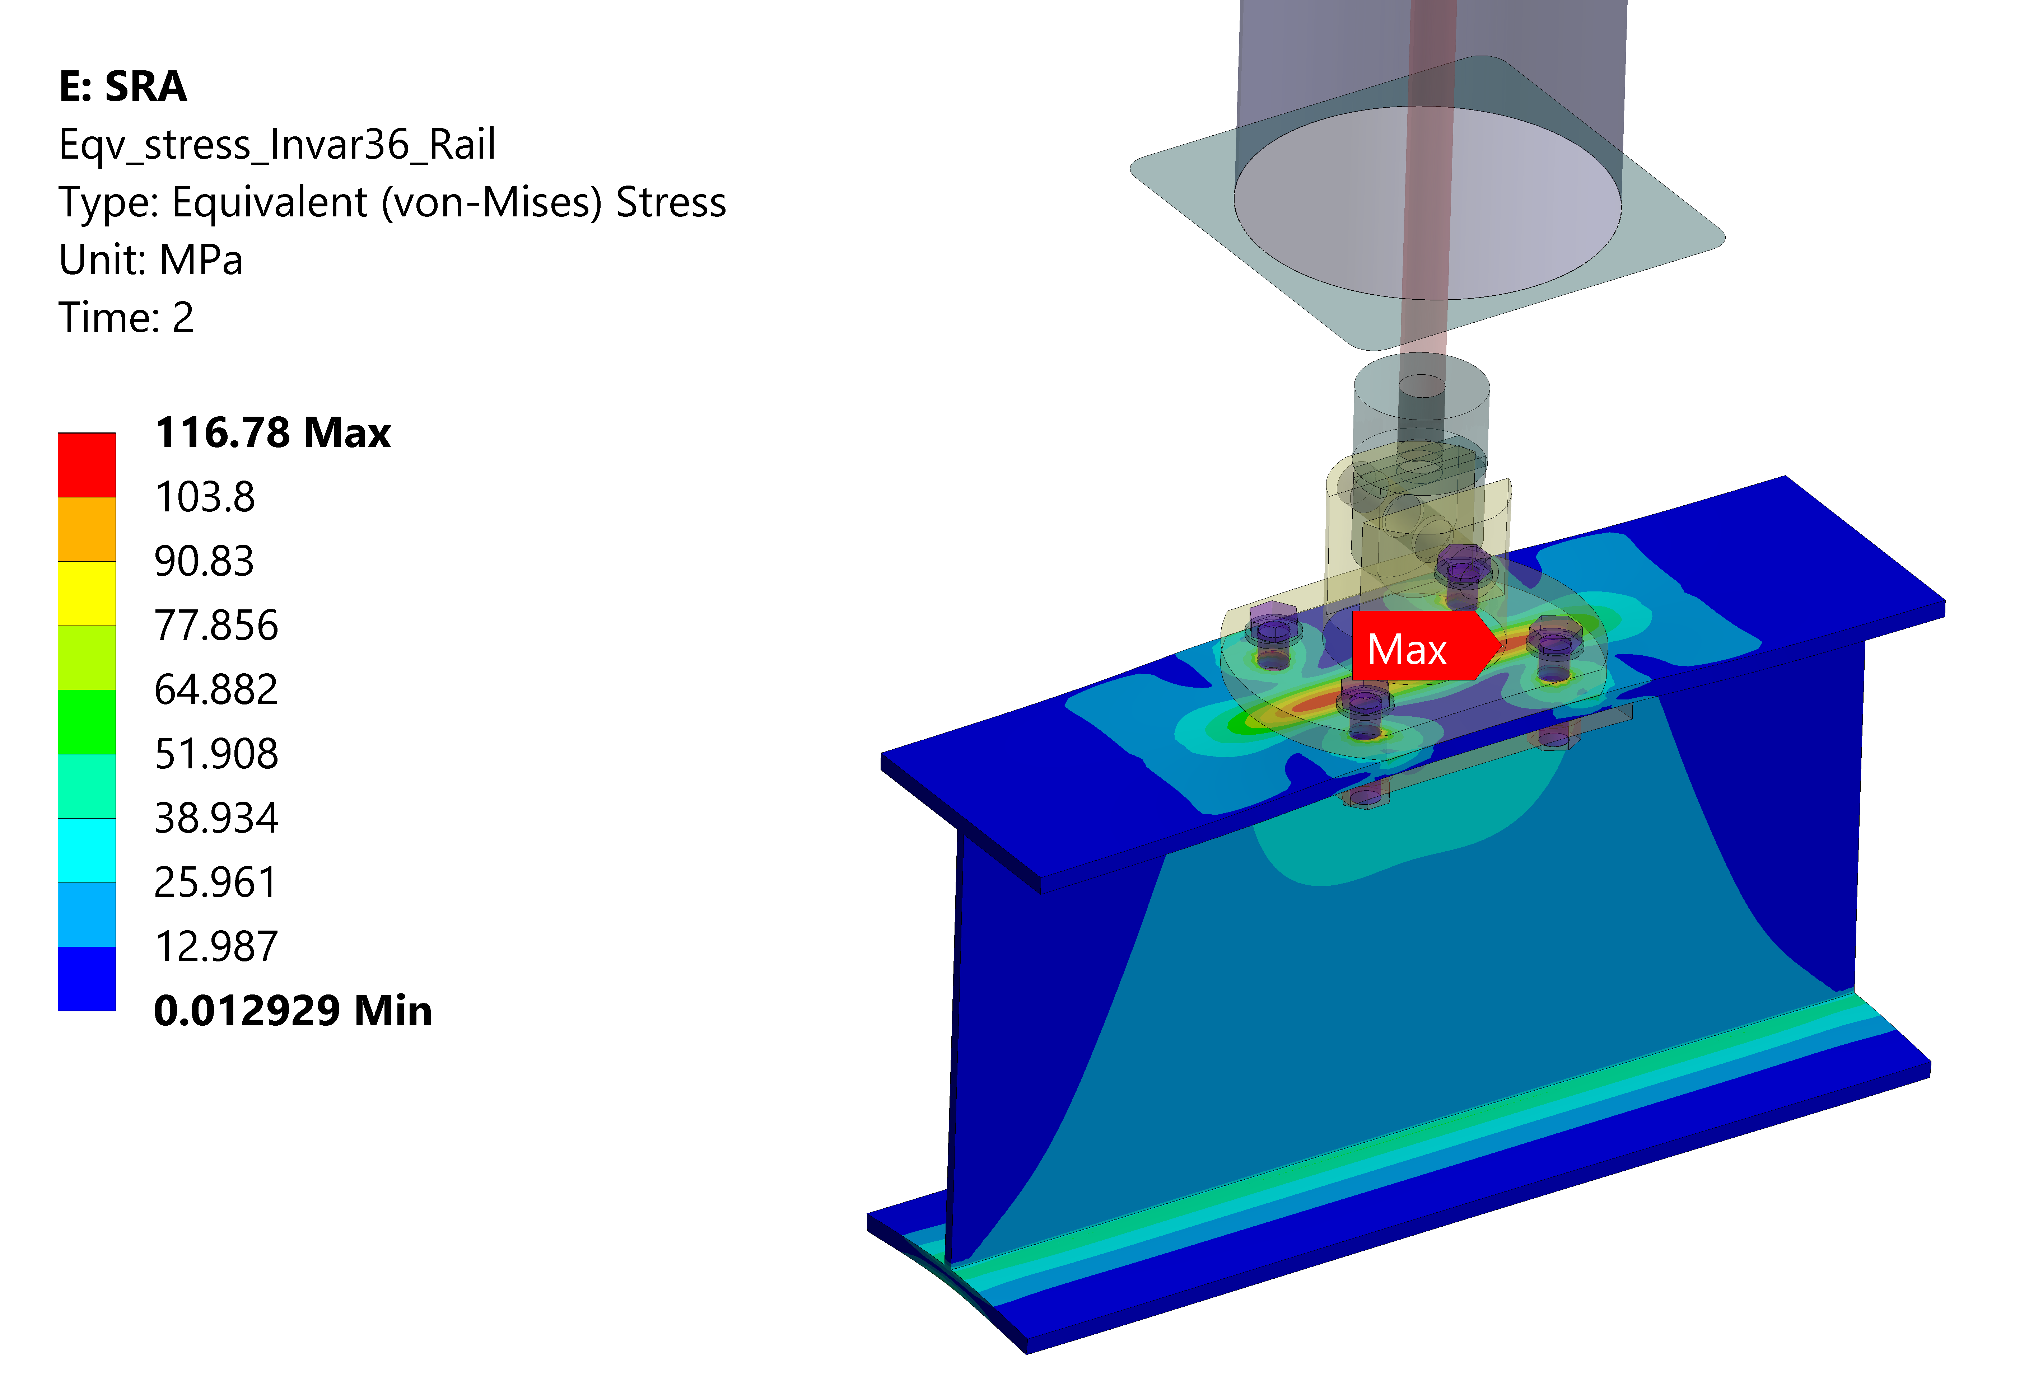
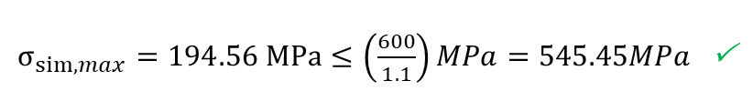
Support Rod Assembly
$σ_{sim,max}=194.56 MPa≤\left(\frac{600}{1.1}\right)MPa=545.45MPa$

Slide 33
Support Rod Assembly
Verification according to EC3 has been carried out for:
  Bolted connection between the rail and SRA
  Pinned joint
  Threaded connection between clevis and rod
Maximum forces/moments has been compared with allowable values provided by manufacturer:
  Axial bearing
  Flat rollers
Maximum utilization factor was found for pin assessment = 84%

Slide 34
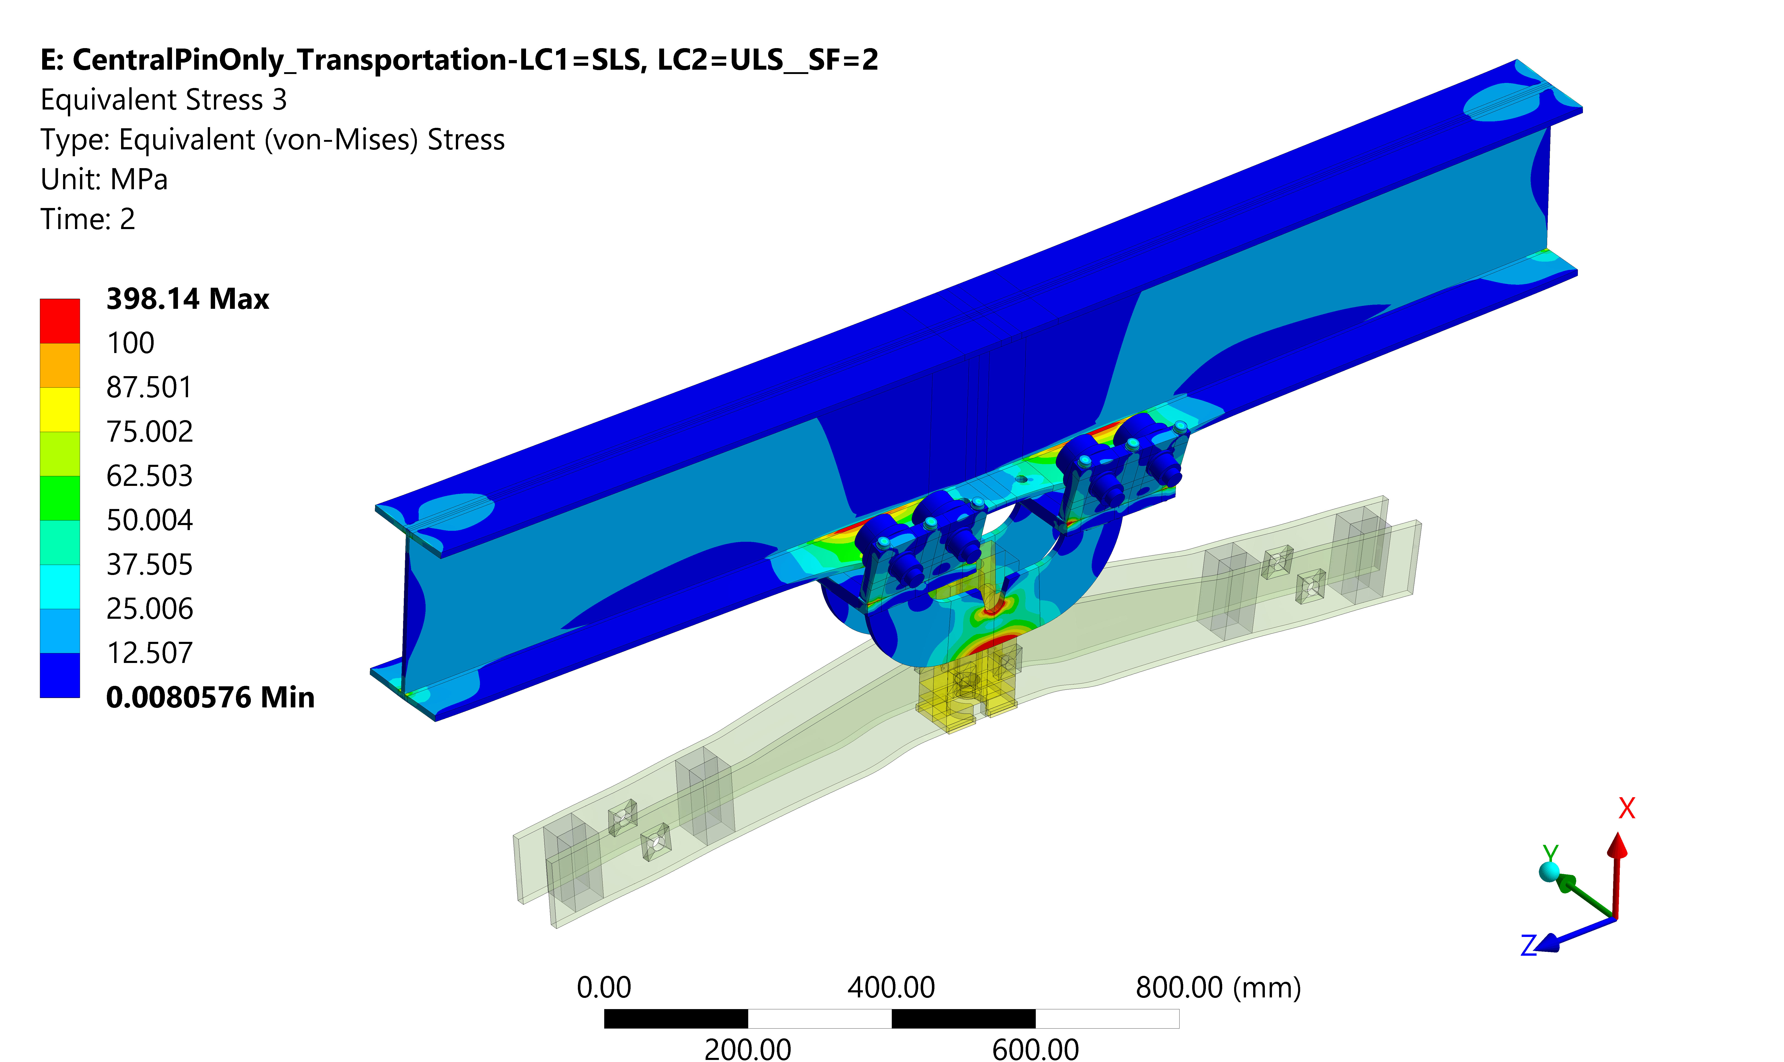


APA Trolley
Load: APA (1537kg)x SF (2)
Maximum stress found is found on the M10 screws
Stresses are well below allowable values
Eqv. Stress observed at the bottom flange is around 120 MPa (due to the bending)
$σ_{sim,max}=398.14 MPa≤σ_{allowable}=\left(\frac{600}{1.1}\right) MPa=497.7 MPa$ 

Slide 35



APA – DSS coupler
Load: APA+2FC (1655kg)x SF (1.35)
Maximum stress is found on the M16 bolts
Stresses are well below allowable values
Eqv. Stress observed at the bottom flange is around 83MPa (due to the bending)
$σ_{sim,max}=145.75MPa≤\left(\frac{600}{1.1}\right) MPa=497.7 MPa \text{Π}$

Slide 36



CPA Trolleys (single)
Load: CPA+2FC+GP (378kg)x SF (2)
Maximum stress is found on the M10 screw
Stresses are well below allowable values
Eqv. Stress observed at the bottom flange is around 70MPa (due to the bending)
$σ_{sim,max}=227.88 MPa≤\left(\frac{600}{1.1}\right) MPa=497.7 MPa$ 

Slide 37



CPA – DSS coupler
Load: CPA+2FC+GP (378kg)x SF (1.35)
Maximum stress of 142 MPa found on the clevis
Stresses are well below allowable values
Pinned connection check (EC3) shows 41% utilization factor.
$σ_{sim,max}=142 MPa≤σ_{allowable}=\left(\frac{345}{1.1}\right) MPa=313.6MPa$ 

Slide 38


Couplers shrinkage
Stainless steel components are bolted to Invar rail
Very conservative approach has been chosen for FE analysis contact modelling, where bolts and holes were adjusted to touch (no gap).
Small values of plastic strain was observed, less than 2% (considering yield strength at room temperature)
It should be mentioned that Invar and Stainless-steel strength is increased at 88K.

Slide 39



Buckling
Flexural-torsional buckling occurs because bending places the top flange of a beam into compression. Just like a column in compression, the compression flange of a beam can buckle. The web & tension flange of the beam force the compression flange to buckle sideways, which results in the whole section twisting (hence “torsional” buckling).

Slide 40




Slide 41



Buckling
Local bow imperfections were taken into account in member
Shape of the elastic critical buckling mode of the structure was applied as a unique global and local imperfection. The amplitude of this imperfection was determined from:
Material model adopted for the numerical analysis – Elastic – “perfectly” plastic
Large deflection has been taken into account along with a numerical stabilization (post-buckling)

Slide 42


Buckling
Workflow for the analysis:
Top flange in compression

Slide 43


Buckling
Plastic deformation

Slide 44




Buckling
Sensitivity analysis has been carried out to get better inside how sensitive a buckling resistance of the profile is to cross-section changes.
Flange thickness Flange width Profile height

Slide 45



Test

Slide 46





Test

Slide 47




Test

Slide 48



Test

Slide 49

Test vs FEA

Slide 50


Structural analysis documentation on EDMS

Slide 51


Finite element models on EDMS

Slide 52
Conclusions
The latest weight estimation of detector components were used for the analysis
Each DSS component has been studied considering most severe loading conditions
FE beam model has been done for global analysis and installation scenario
Detailed model of the APA/CPA trolleys, APA/CPA couplers and SRA have been created
Connections have been assessed in accordance with Eurocode 3
All studied components meet the requirements of Eurocode 3
Buckling analysis has been presented and the proposed model shows good agreement with the experimental test
It is planned to further improve the global DSS model adding simplified detector

Slide 53

Backup Slides

