Slide 1
Fermilab’s Neutrino Experiment Program
Steve Brice
Neutrino Theory Network (NTN) Workshop
Thursday 23 June 2022

Slide 2
Overview
Neutrino Science
  Why are Neutrinos Important
  Neutrino Science in 2022
  The Big Neutrino Questions and Fermilab’s Role
Experiments: Operations Complete
  MINERvA
  MicroBooNE
Experiments: Operating
  NOvA
  ANNIE
  ICARUS
Experiments: Building
  SBND
  DUNE
It all leads to DUNE

Slide 3
What is not in this talk
Neutrino Facilities
  I’ll talk about R&D, but not the facilities like PAB and the new labs in the Edwards Building (IERC) that enable them
Neutrino Projects
  I’ll talk about DUNE, but not the LBNF/DUNE 413b Project that is building the facility and experiment
Neutrino Personnel
  I’ll mention theorist work by name, but not the experimentalists
  I’ll not discuss hiring strategy and demographic plans for neutrino personnel at the lab
  I’ll not talk about the Neutrino Physics Center (NPC) or other initiatives to promote Neutrino Science

Slide 4
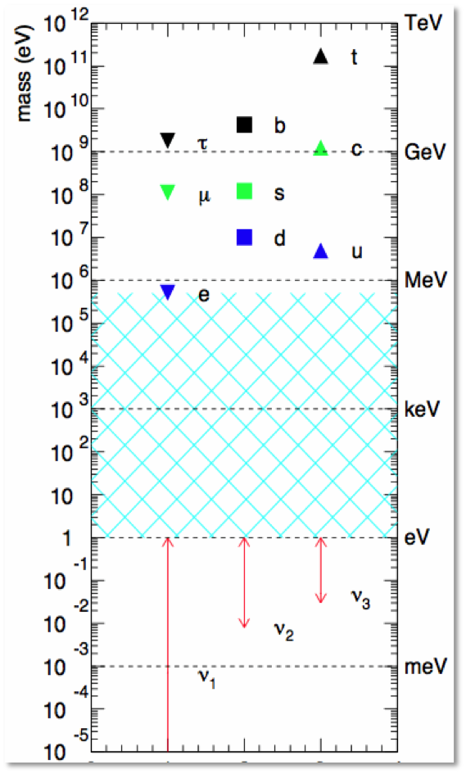
Why are Neutrinos Important
Particle Physics has made great progress in the last half century probing the quark half of the fundamental particles. We are now in a position to propose doing similar for the neutrinos.
Neutrinos are the real oddities of the fundamental particles (only interact Weakly, ultra small, but non-zero masses). Science often advances when studying the oddities
4

Slide 5
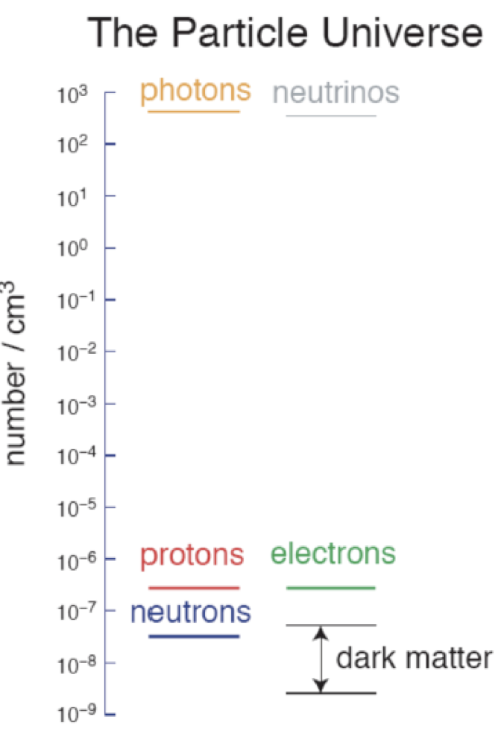
Why are Neutrinos Important?
Neutrinos may only interact Weakly, but they are the most abundant particle in the universe with a pivotal role in the evolution of our universe
A difference between how the neutrino types mix and how the antineutrino types mix is postulated to be the reason why matter dominates over anti-matter in our universe (i.e. why we exist)

Slide 6
Neutrino and Quark Mixing and Masses
Neutrino Masses < 2 eV
Quark Masses = 3x10⁶ eV
to
1.7x10¹¹ eV
Very different
No idea why, but it is probably important

Slide 7
The Present Neutrino Landscape
Δm₂₁² = 7.42 ^{+0.21}_{-0.20} x 10⁻⁵ eV²
|Δm₃₂²| = 2.51 ^{+0.027}_{-0.027} x 10⁻³ eV²
m(ν_{e}) < 0.8 eV (90% CL)
Normal ordering
Inverted ordering
(m₃)²
(m₂)²
Δm²₂₁
(m₁)²
ν_{e}
θ₁₂ = 33.45 ^{+0.77}_{-0.75} deg
θ₂₃ = 42.1 ^{+1.1}_{-0.9} deg
θ₁₃ = 8.62 ^{+0.12}_{-0.12} deg
Δm²₃₂
ν_{μ}
ν_{τ}
Δm²₃₁
(m₂)²
θ₂₃ octant = ?
Sign Δm₃₂² = ?
δ = ?
m_{lightest} = ?
Δm²₂₁
(m₁)²
(m₃)²
m²_{lightest}
m²_{lightest}
1σ uncertainties, normal ordering assumed, Th. Schwetz, Neutrino 2022, Esteban, Gonzalez-Garcia, Maltoni, Schwetz, Zhou, JHEP’20 [2007.14792]

Slide 8
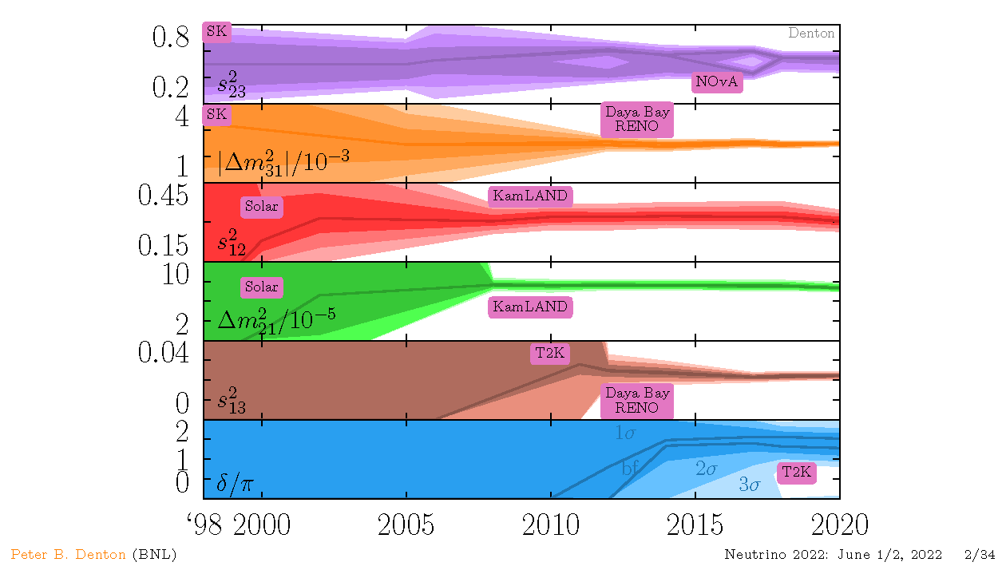
The Last 20 Years

Slide 9
Experimental Thrusts in Neutrino Physics and Fermilab’s Role
Reveal the pattern of neutrino masses and mixings
  In which octant is θ₂₃? NOvA → DUNE
  How are the masses ordered? NOvA → DUNE
  Is CP violated? DUNE
  What are the neutrino masses? No plans to address at Fermilab
  Are neutrinos their own anti-particles? No plans to address at Fermilab
Discover if the situation is more complex than 3 neutrinos with Standard Model interactions
  Do neutrinos interact with matter in any non-standard ways? MINERvA, NOvA, MicroBooNE → SBND, ICARUS → DUNE
  Are the LSND and MiniBooNE anomalies new physics? MicroBooNE → ICARUS, SBND
Carry out the neutrino engineering measurements that make 1) and 2) possible
  MINERvA, ANNIE, MicroBooNE, SBND, ICARUS

Slide 10
Recent, Current, and Planned Fermilab Neutrino Experiments
Beamline | Experiment | Neutrino Operations Status | Main purpose(s)
NuMI | ArgoNeut | Completed 2010 | ν-Ar xsecs, LAr TPC technology
NuMI | MINOS(+) | Completed 2016 | Confirm atmospheric ν oscillations, measure ν mixing parameters
NuMI | MINERvA | Completed 2019 | ν xsecs
NuMI | NOvA | Running | Measure ν mixing parameters, determine ν mass ordering, ν xsecs
BNB | SciBooNE | Completed 2008 | ν xsecs, look for SBL ν_{μ} disappearance
BNB | MiniBooNE | Completed 2012 | Look for SBL ν_{e} appearance, ν xsecs
BNB | MicroBooNE | Completed 2020 | Study ν_{e}-like events, ν-Ar xsecs, LAr TPC technology
BNB | ANNIE | Running | Neutron production in ν interactions, LAPPD technology
BNB | ICARUS | Running | Look for SBL ν_{e} appearance, ν-Ar xsecs, LAr TPC technology
 | SBND | Expected Late 2023 | Look for SBL ν_{e} appearance, ν-Ar xsecs, LAr TPC technology
LBNF | DUNE | Seeking CD1RR 2022 | Search for CP violation, probe 3ν mixing, supernova νs, proton decay

Slide 11
Rough Neutrino Experiment Timeline
FY20 | FY21 | FY22 | FY23 | FY24 | FY25 | FY26 | FY27 | FY28 | FY29
NOvA
MicroBooNE
MINERvA
ICARUS
SBND
DUNE ND
DUNE FD
Detector R&D
Testbeam, ICEBERG, PAB, ANNIE all folded into Detector R&D
The beginning and termination times are deliberately vague
It all culminates in DUNE
Design & construction
Operations & analysis
Analysis

Slide 12
Overview
Neutrino Science
  Why are Neutrinos Important
  Neutrino Science in 2022
  The Big Neutrino Questions and Fermilab’s Role
Experiments: Operations Complete
  MINERvA
  MicroBooNE
Experiments: Operating
  NOvA
  ANNIE
  ICARUS
Experiments: Building
  SBND
  DUNE
It all leads to DUNE

Slide 13

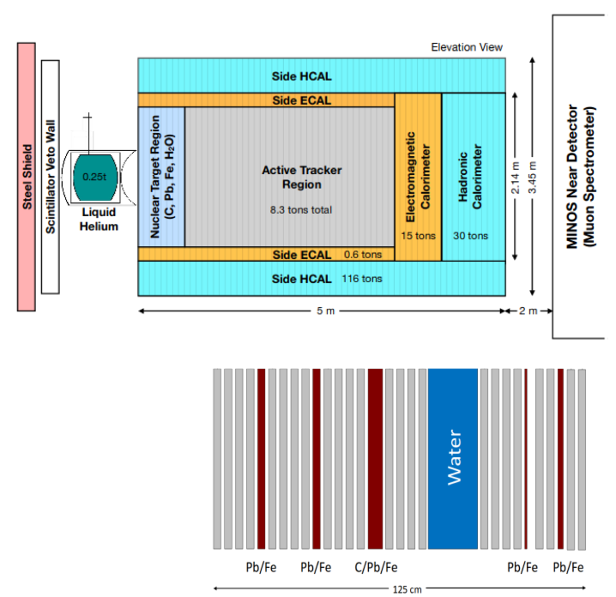
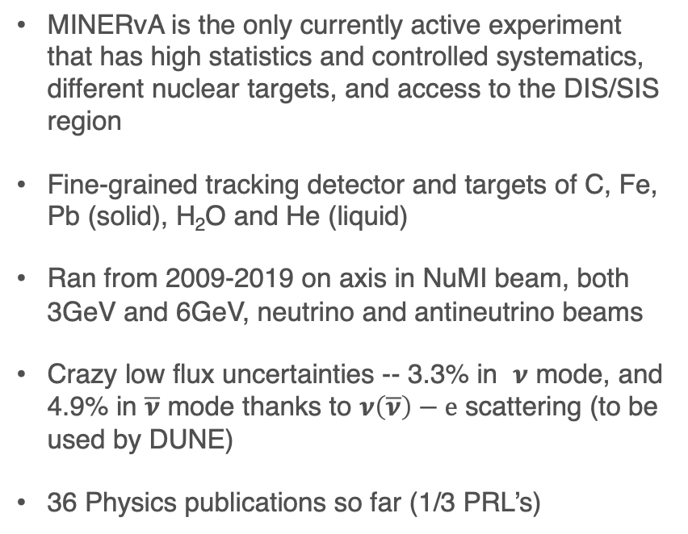
MINERvA Overview
MINERvA is the only currently active experiment that has high statistics and controlled systematics, different nuclear targets, and access to the DIS/SIS region
Fine-grained tracking detector and targets of C, Fe, Pb (solid), H₂O and He (liquid)
Ran from 2009-2019 on axis in NuMI beam, both 3GeV and 6GeV, neutrino and antineutrino beams
Crazy low flux uncertainties -- 3.3% in $ν$ mode, and 4.9% in $\overline{ν}$ mode thanks to $ν\left(\overline{ν}\right)−e$ scattering (to be used by DUNE)
36 Physics publications so far (1/3 PRL’s)

Slide 14
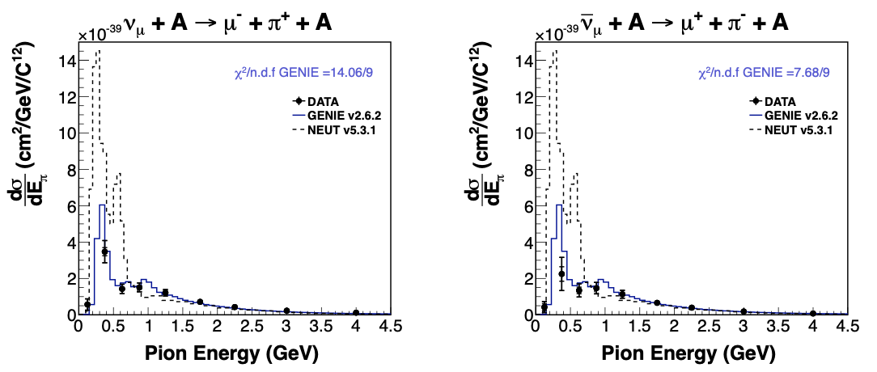
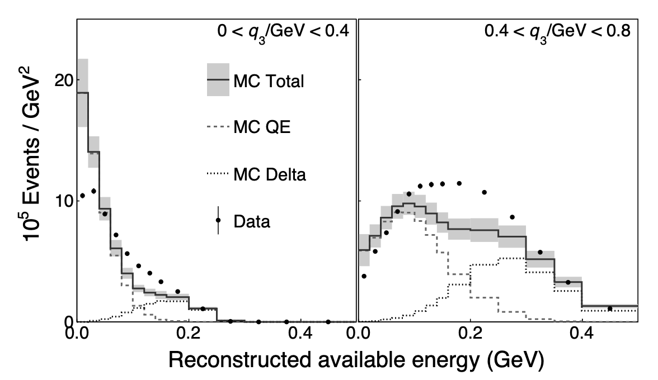
Previous MINERvA Accomplishments
“solved” the coherent pion SciBooNE mystery and provided a model down-selection and tune
Phys. Rev. Lett. 113, 261802 (2014)
showed experimental evidence for a strong multinucleon effect (presumably the reason for the MiniBooNE high axial mass result)
provided a way for experiments (NOvA) to constrain multinucleon its effect in oscillation measurements.
Phys. Rev. Lett. 116, 071802 (2016)
Many exclusive channel measurements, neutrino and antineutrinos, quantifying several different effects of the nucleus on neutrino scattering.
Notes:
Top plots: the original models for coherent pion production assumed a very different pion energy spectrum than what MINERvA actually measured (neutrinos on the left, antineutrinos on the right). Models of this process have been improved since then., the NC channel is important because it is a nu_e appearance backgrounds.
Bottom plot: this was the first big indication that there was a process missing from the standard neutrino event generators: this is the event rates as function of visible hadronic energy for two different bins of low momentum transfer. The multinucleon “peak” is between the quasielastic peak to the left and the resonance (Delta) production on the right. NOvA uses this same technique to measure and simulate their multinucleon effects at 2GeV.
For the low energy results we were more concerned with black and white plots for publications…

Slide 15
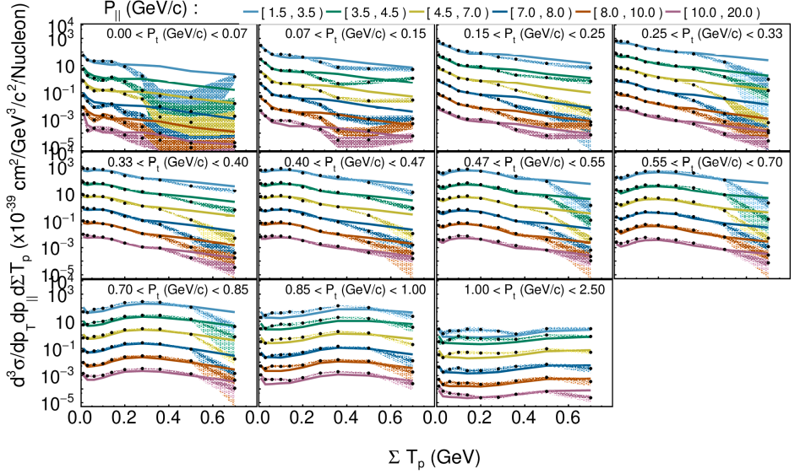
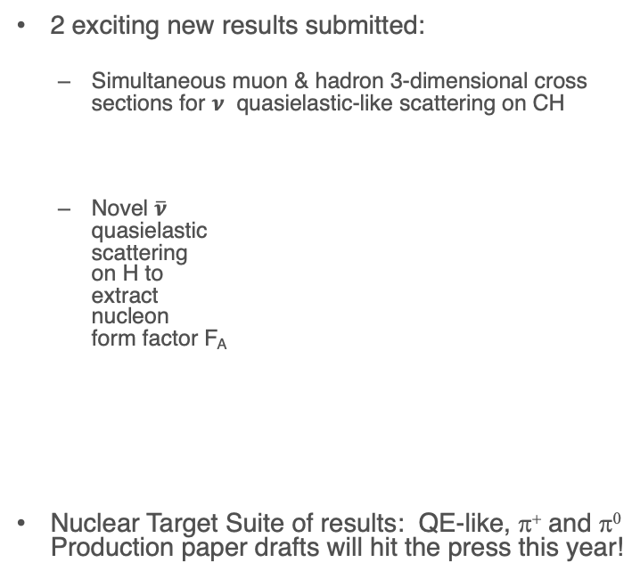
Future MINERvA Physics Program
2 exciting new results submitted:
  Simultaneous muon & hadron 3-dimensional cross sections for $ν$ quasielastic-like scattering on CH
  Novel $\overline{ν}$
  quasielastic
  scattering
  on H to
  extract
  nucleon
  form factor F_{A}
Nuclear Target Suite of results: QE-like, π⁺ and π⁰ Production paper drafts will hit the press this year!
https://arxiv.org/abs/2203.08022
Data Preservation product under construction:
To ensure the community can extract more physics from these data after collaboration stops operating (a la Astronomical Observatory Data Releases)
Notes:
Plot on the left is the result of the fit to our cross section to extra the ratio of the cross section we measure compared to what you would expect from a dipole form factor. The red curve is a fit of our data—we can’t show the actual data because it’s under embargo.
The plot on the right is our quasielastic-like cross section in three dimensions: muon longitudinal momentum versus the sum of proton kinetic energys on the horizontal axis, and different colors show different longitudinal momentum bins (which is a proxy for neutrino energy).

Slide 16
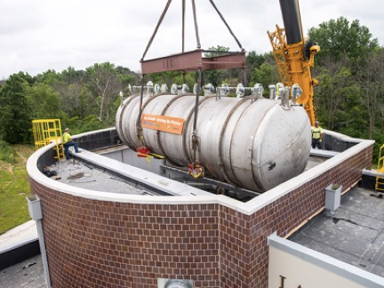
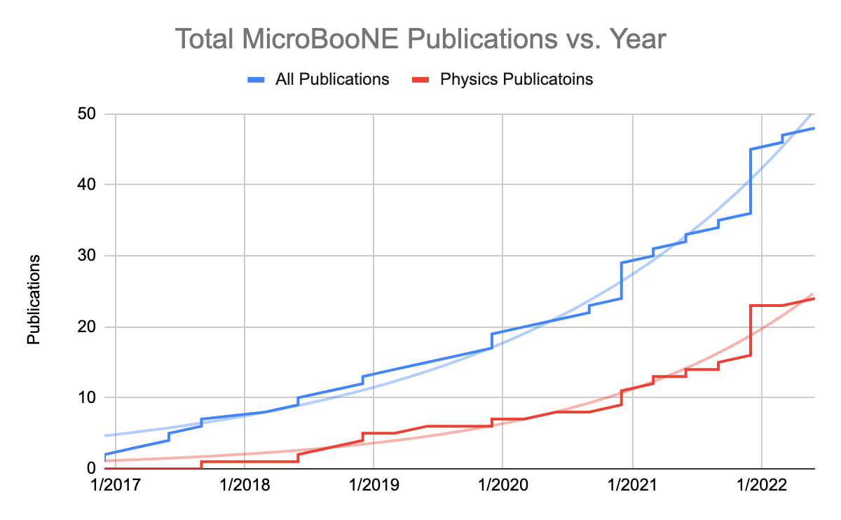
MicroBooNE
MicroBooNE is the longest running liquid argon neutrino detector to date
Significant body of pioneering work
48 physics papers, 80 public notes
  Split 50/50 between technical & physics results
Large team of students and postdocs looking at this one-of-a-kind data in MicroBooNE and asking:
What can we learn about neutrinos with such high-definition detectors?
What is the source of the MiniBooNE anomaly?
Is there other new physics out there?
MicroBooNE is producing a lot of firsts & critical work for SBN, DUNE → training the next generation
16

Slide 17
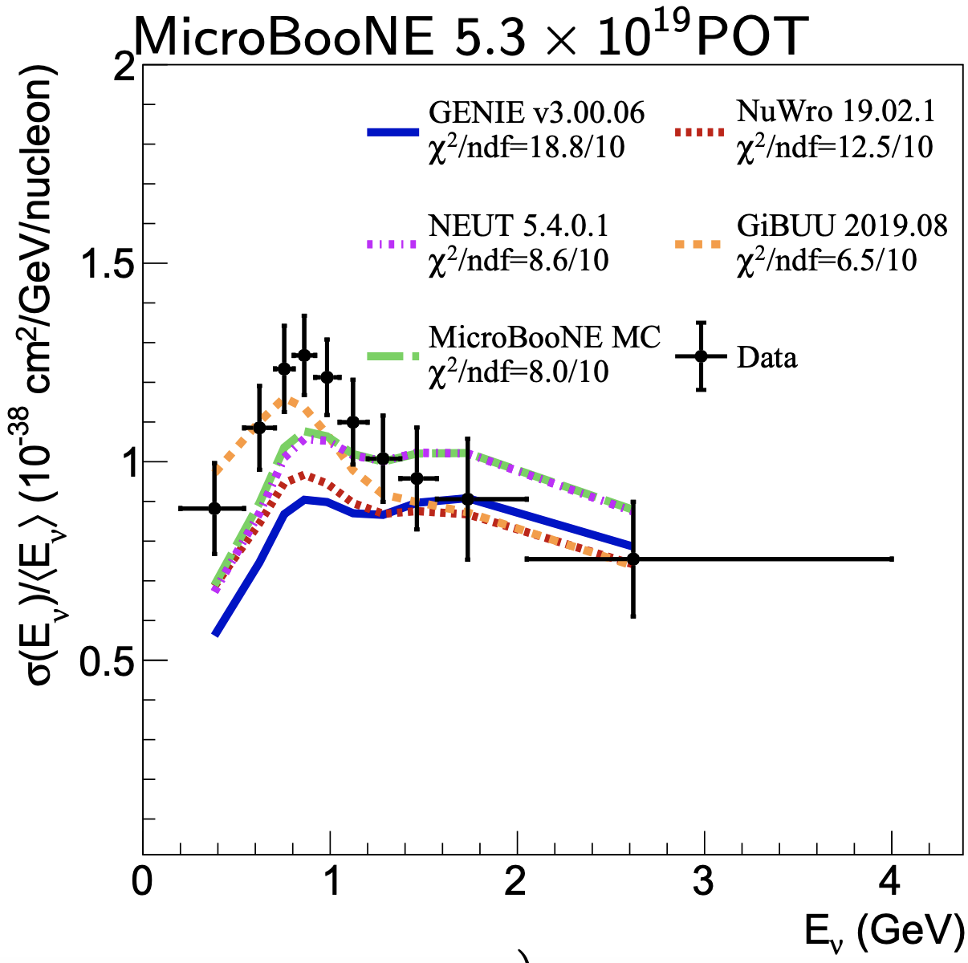
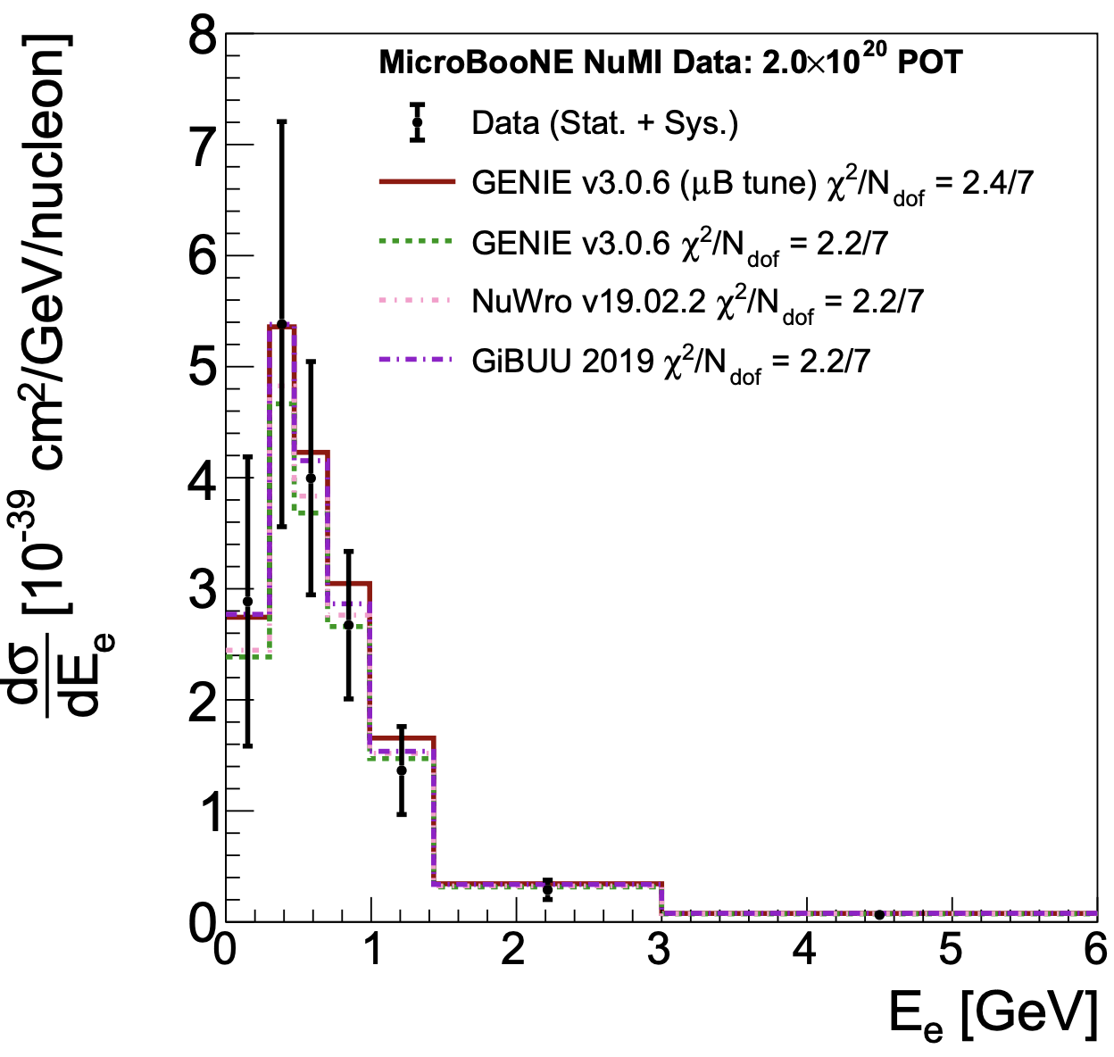
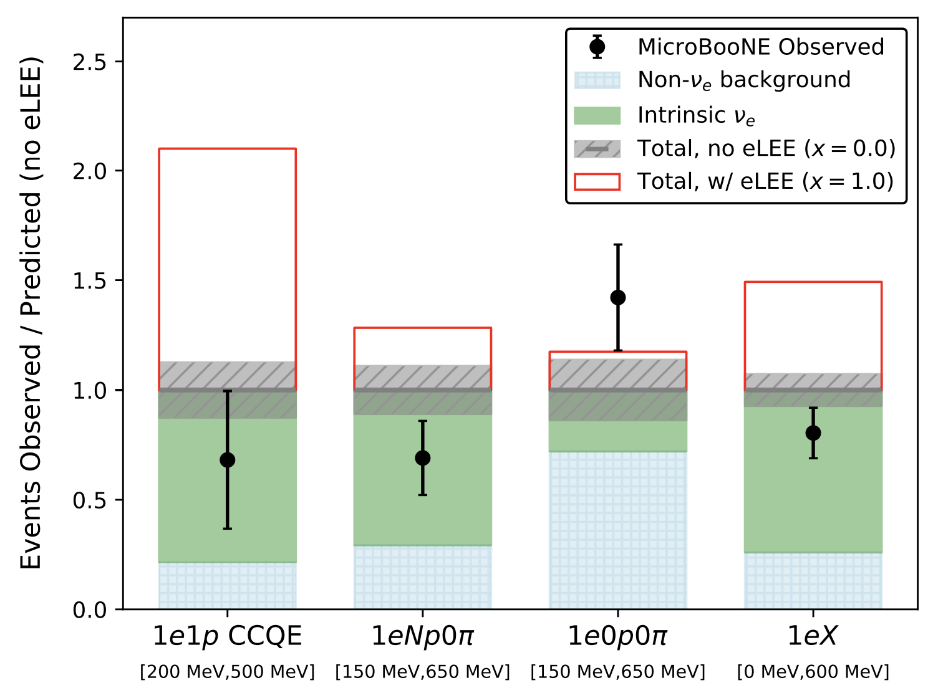
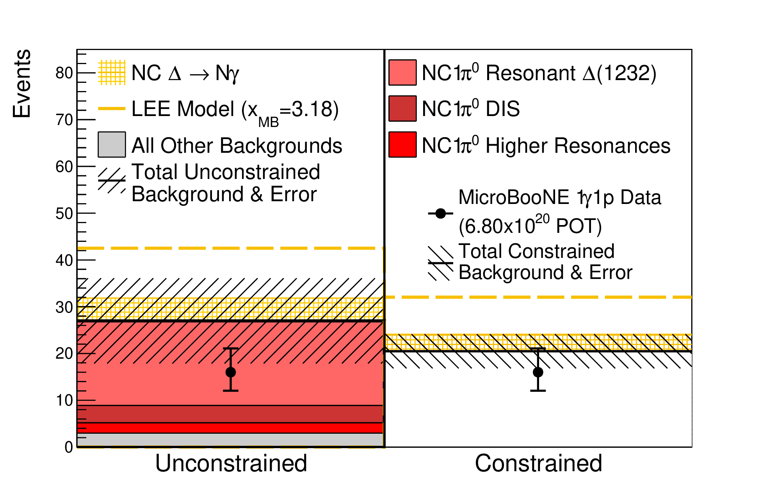
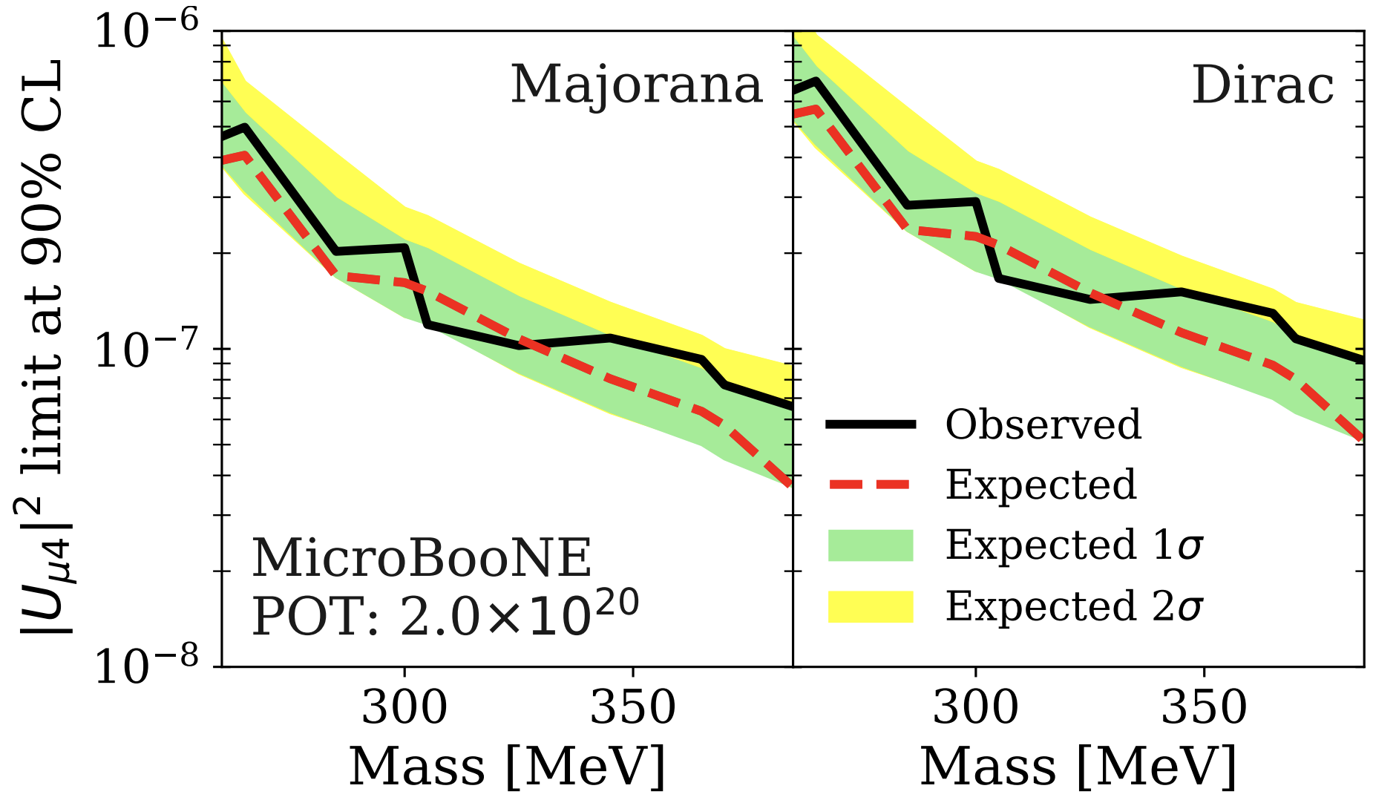
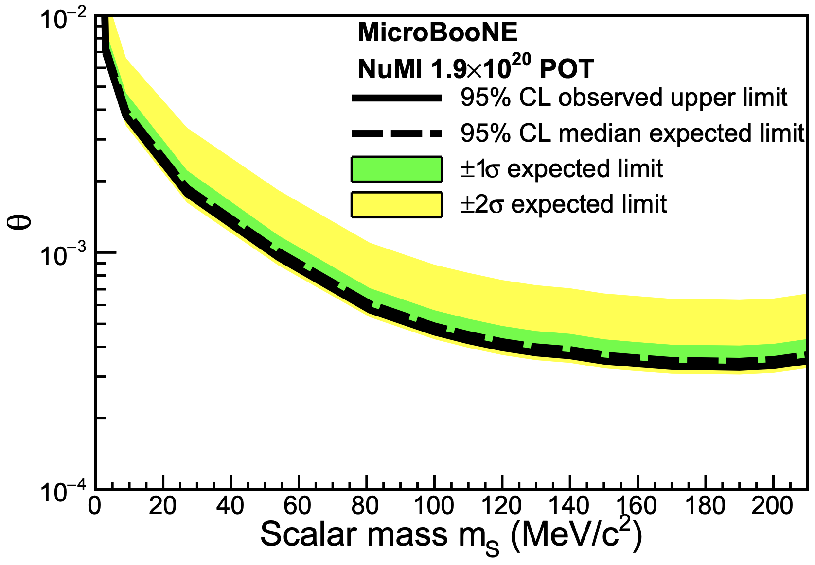
Past MicroBooNE science accomplishments
Extensive array of cross section measurements
Including many first measurements on argon
Groundbreaking results probing the MiniBooNE anomaly
No excess of ν_{e} or NC Δ → Nγ events observed
Reject x3.18 enhancement of NC Δ → Nγ rate at 94.8% C.L.
Reject hypothesis that ν_{e} CC interactions are fully responsible for the excess at >97% CL
Pioneering BSM program
First LArTPC limits on heavy neutral leptons
First LArTPC dark sector search for e⁺e⁻ final states
PRD 105, L051102 (2022)
PRL 128, 151801 (2022)
arXiv:2110.14054 (accepted by PRL)
PRL 128, 111801 (2022)
PRD 101, 052001 (2020)
PRL 127, 151803 (2021)
17

Slide 18
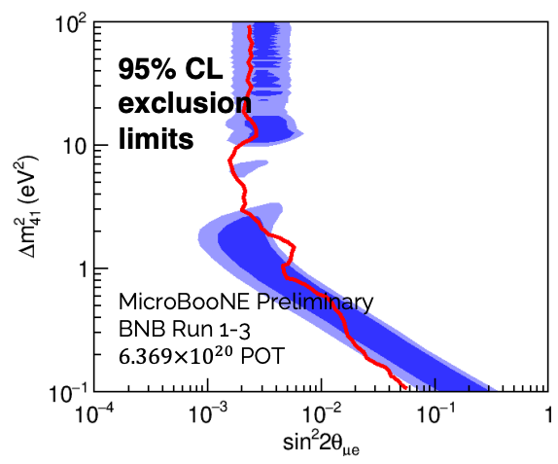
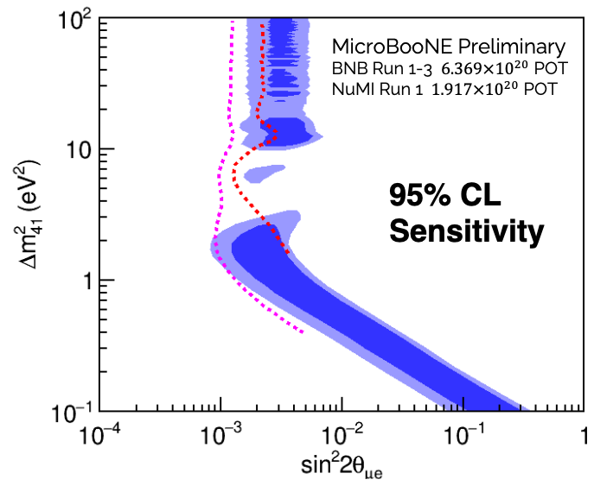
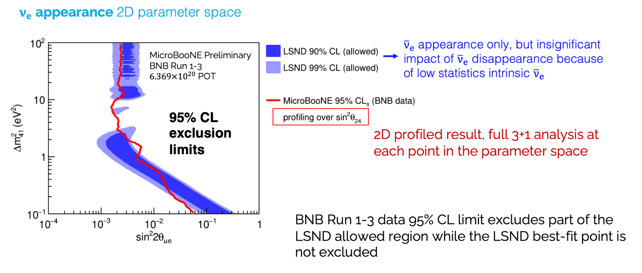

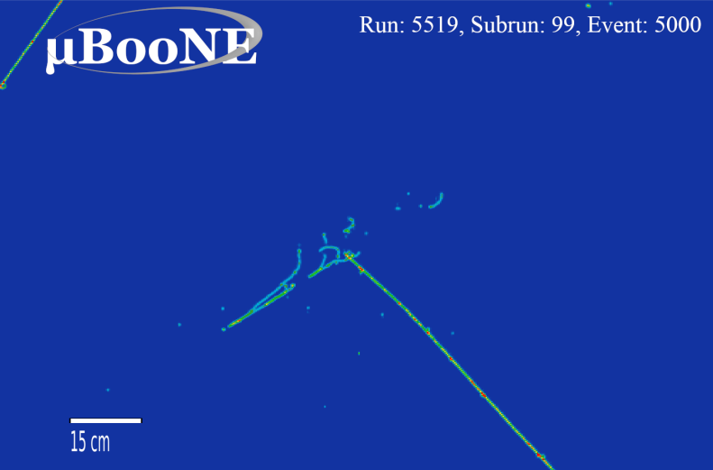
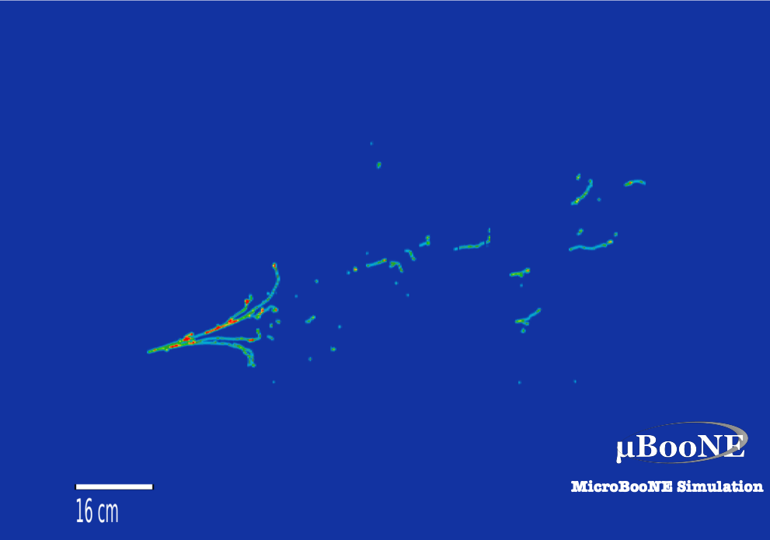
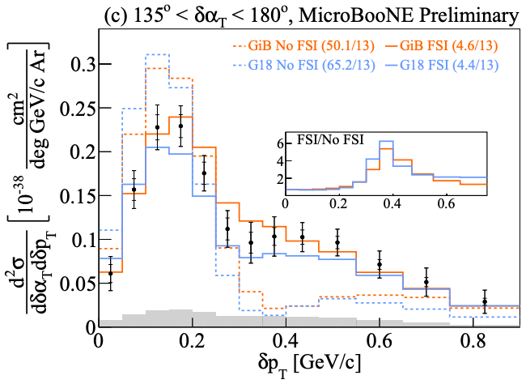
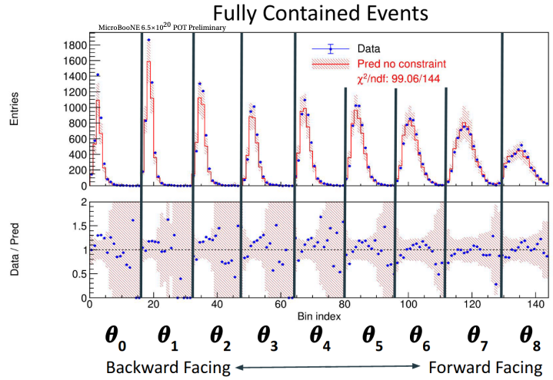
Future MicroBooNE science accomplishments
Projected Sensitivity
Oscillation fits
Sterile neutrino oscillation fits
New results for Neutrino 2022
Extend to full dataset, including off-axis NuMI beam data
Expanded BSM searches for the origin of the MiniBooNE anomaly, including single photon and e⁺e⁻ final states
Suite of legacy cross section results, including rare process and multi-differential measurements
MICROBOONE-NOTE-1116-PUB
MICROBOONE-NOTE-1103-PUB
MICROBOONE-NOTE-1108-PUB
MICROBOONE-NOTE-1110-PUB
18

Slide 19
Overview
Neutrino Science
  Why are Neutrinos Important
  Neutrino Science in 2022
  The Big Neutrino Questions and Fermilab’s Role
Experiments: Operations Complete
  MINERvA
  MicroBooNE
Experiments: Operating
  NOvA
  ANNIE
  ICARUS
Experiments: Building
  SBND
  DUNE
It all leads to DUNE

Slide 20
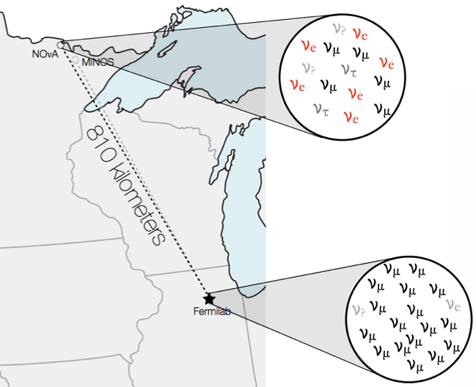

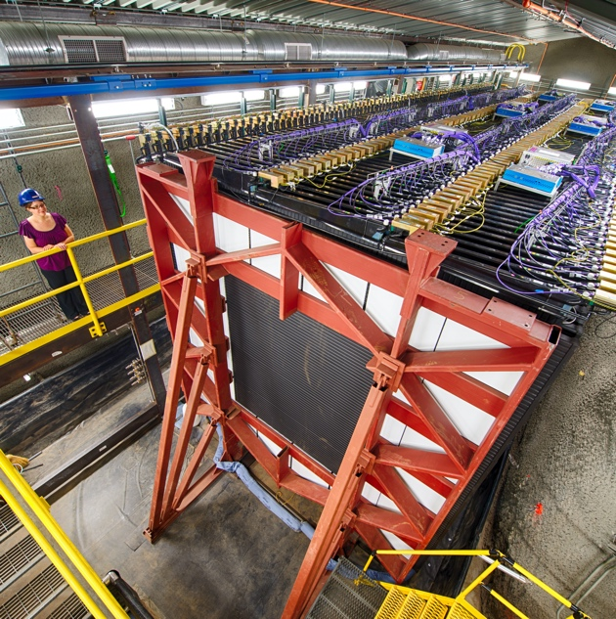
The NOvA Experiment
Long-baseline neutrino oscillation experiment
  2 functionally identical, tracking calorimeter detectors
  NuMI beam: ν_{μ} or ν̅_{μ}
  Off-axis, narrow beam
Broad physics program:
  3-flavor oscillations
  Exotic oscillations
  Neutrino scattering
  Astrophysics
  BSM physics
266 collaborators from 49 institutions in 8 countries
Far Detector:
14 kT, surface
Near Detector:
300 T, underground
20

Slide 21
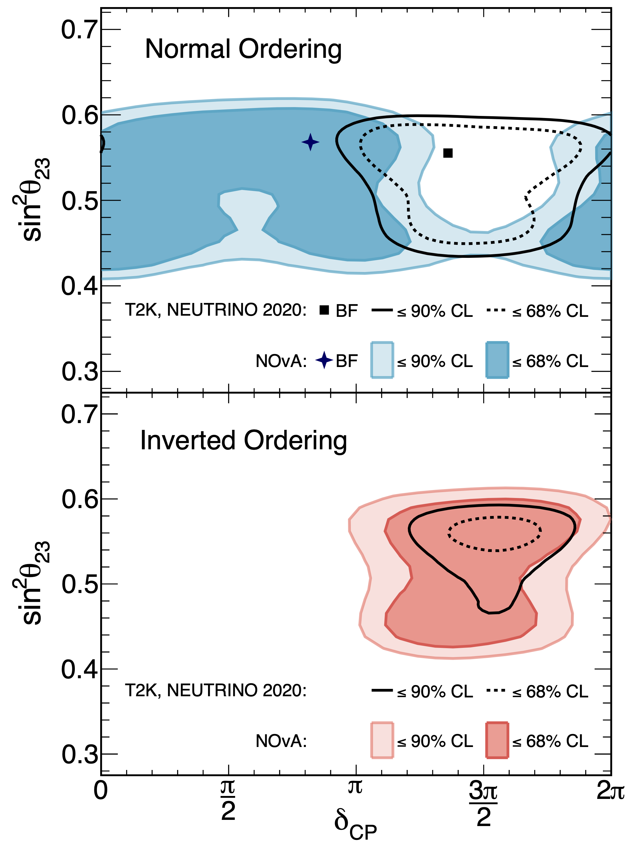
Past NOvA Accomplishments
High-impact measurements of 3-flavor neutrino oscillations
16 full collaboration publications (5 PRL, 9 PRD)
  Plus 1 more accepted, and 2 more in review
  Most cited: 280, 5 more >100
53 PhD and 12 Master’s theses
Groundwork for the future:
  First HEP experiment to use deep learning in a measurement
  Developed analysis framework now in common use
  HPC-enabled statistical analysis
  Experience operating high-power neutrino beams
21

Slide 22
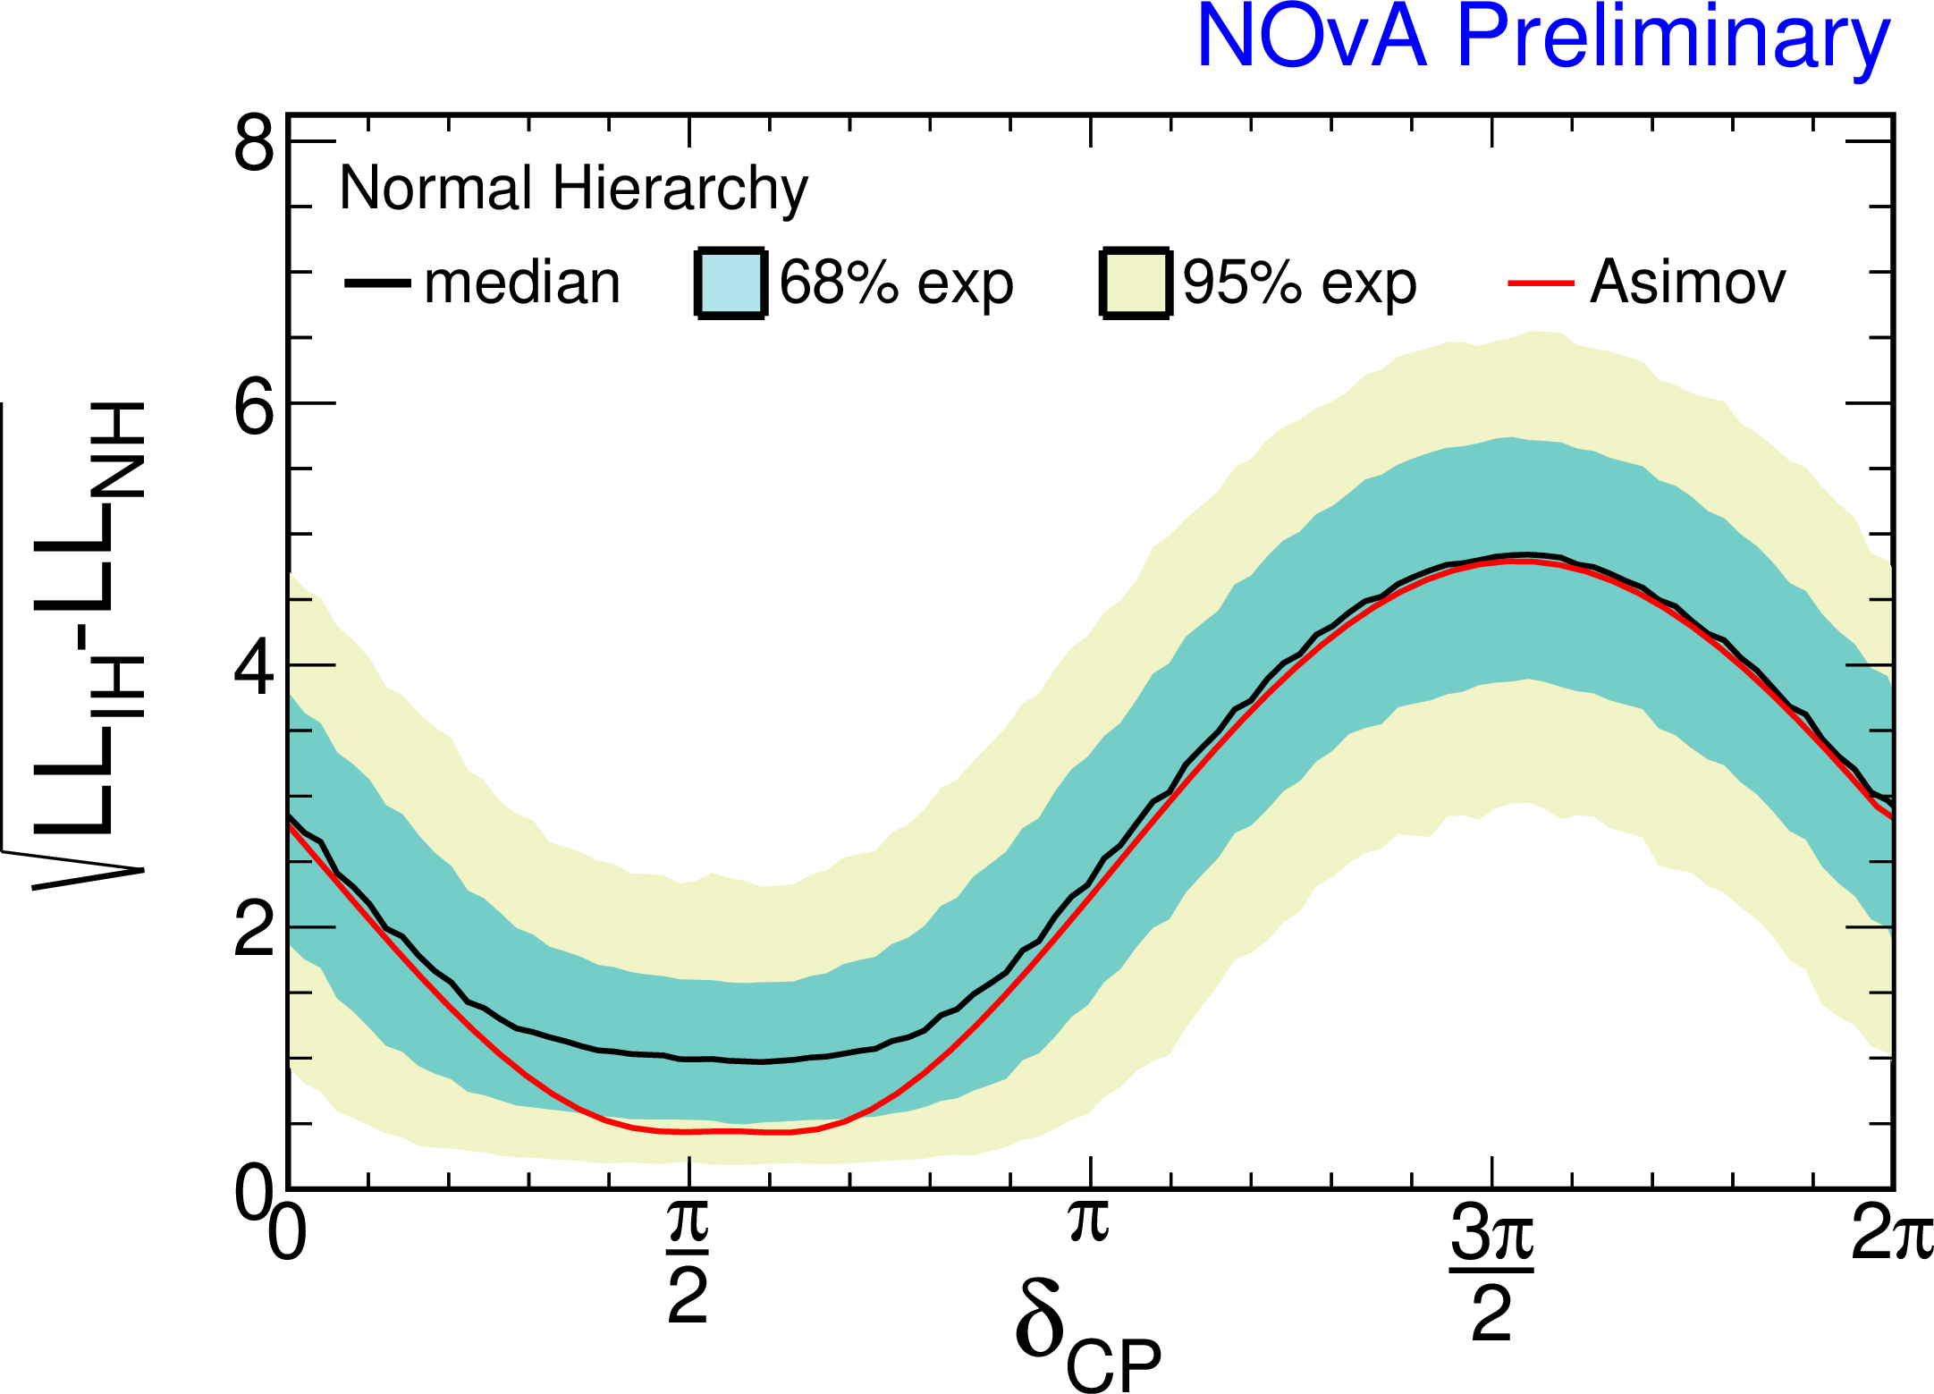
Future NOvA Goals: 3 Flavor
Expect to accumulate ~7×10²¹ POT by the long shutdown for LBNF.
  ~2.5 time more data than our last oscillation results.
Full exposure may allow a >3σ determination of the mass ordering.
  Precision on ν_{e}/anti-ν_{e} appearance asymmetry will improve from 21% to 14%.
  Mass ordering determination depends on true parameters in nature.
  Statistical errors will still dominate over systematics at the end of the run.
22

Slide 23
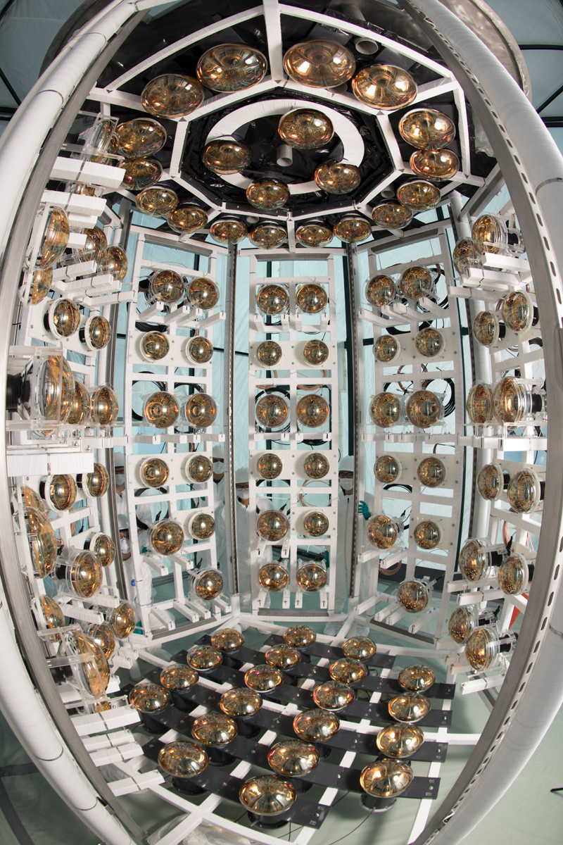
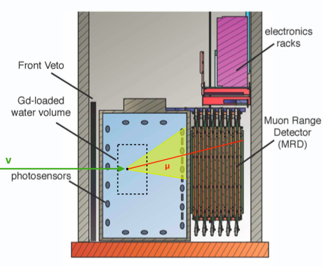
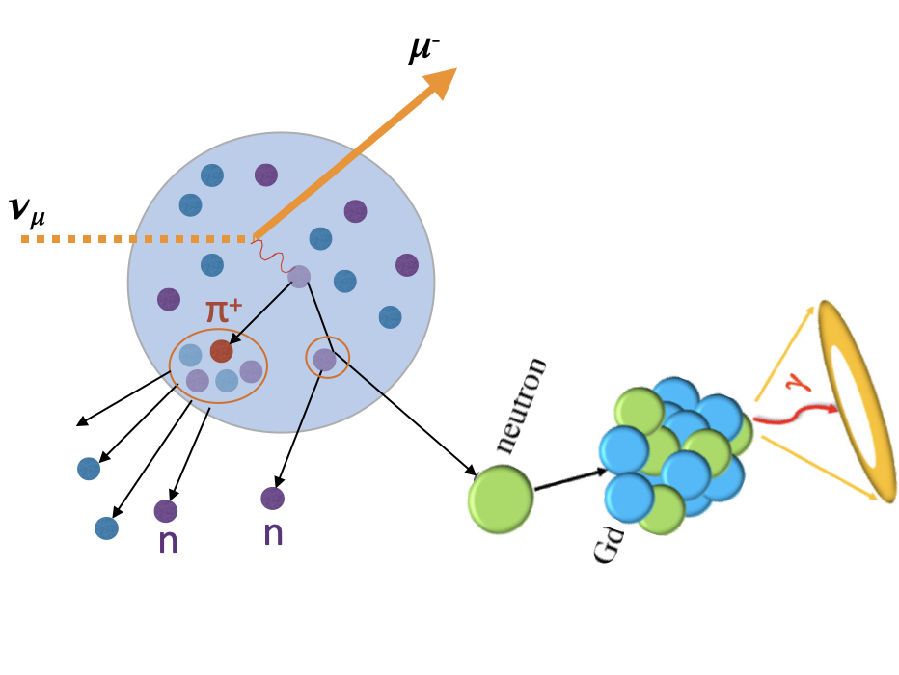
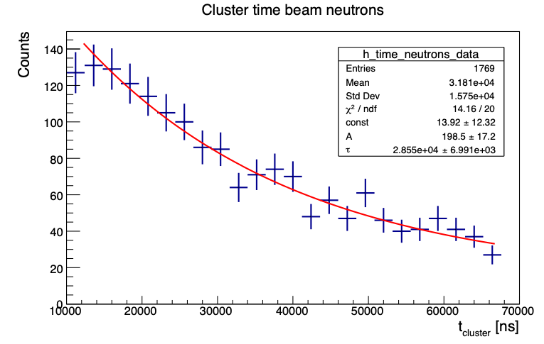
ANNIE Experiment
Accelerator Neutrino Nucleus Interaction Experiment
27-ton (Gd-loaded) Water Cherenkov Detector running in the BNB neutrino beam
Measurement of neutron mutiplicity and GeV neutrino differential cross-sections
Physics data taking started in early 2021
R&D program for new technologies
→ Gd-water → LAPPDs → WbLS
ANNIE
Detector
Layout
neutron capture time following beam events
τ = 29±7 µs
γ
neutron
Gd
23
6/22/22

Slide 24
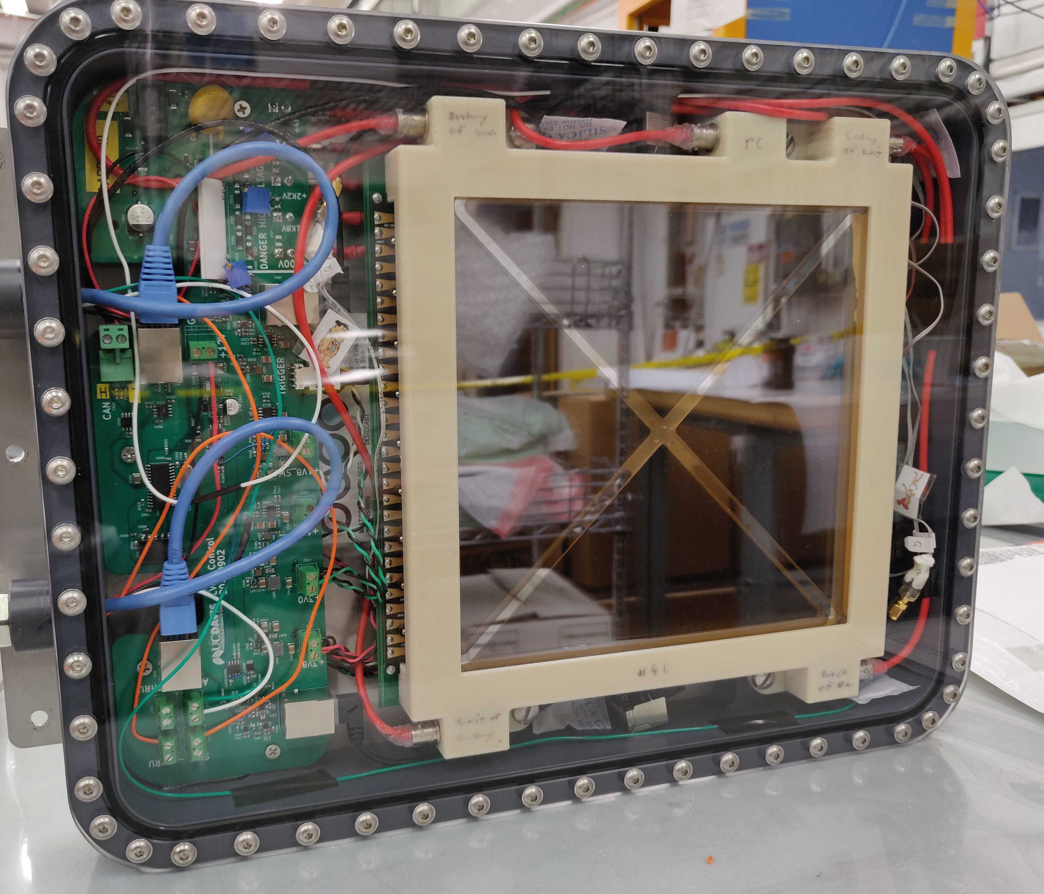
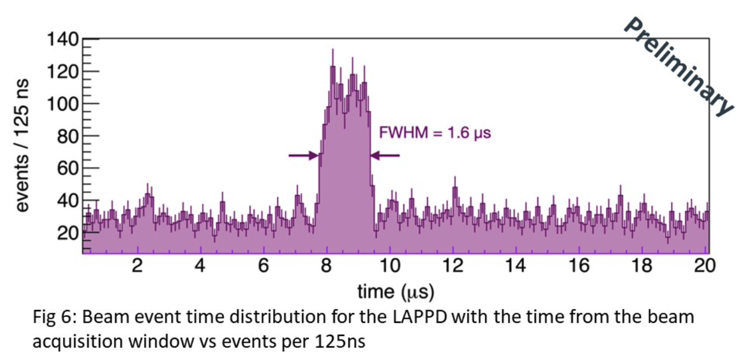
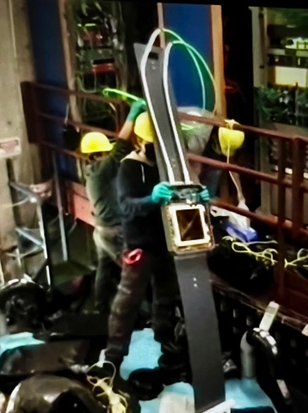
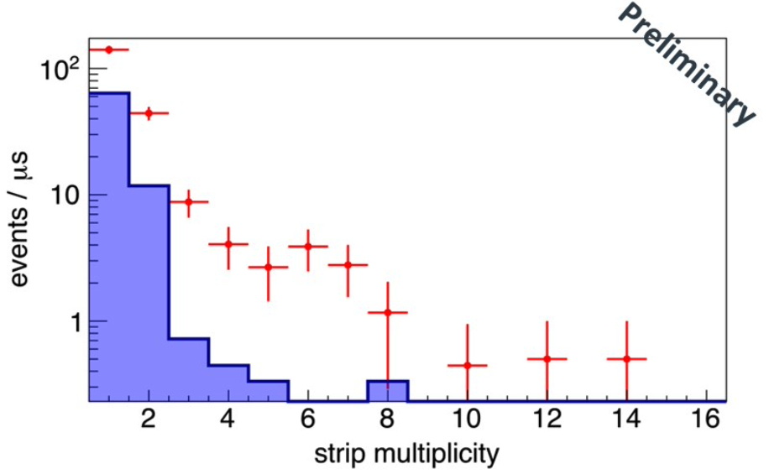
ANNIE: First LAPPD installed
LAPPD in waterproof housing
Major Milestone: World‘s first LAPPD installed in
March 2022, detected first light from neutrinos
In progress: in-situ timing calibration
Additional 4+ LAPPDs to be installed this summer
event time distribution
around the BNB beam spill
as observed by the LAPPD
hit multiplicity on
LAPPD strip readout
for on-beam and
off-beam events
first
LAPPD
24
6/22/22

Slide 25
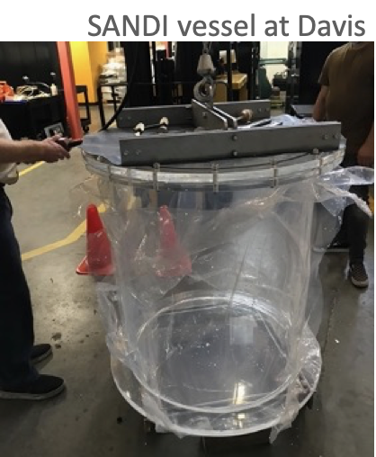
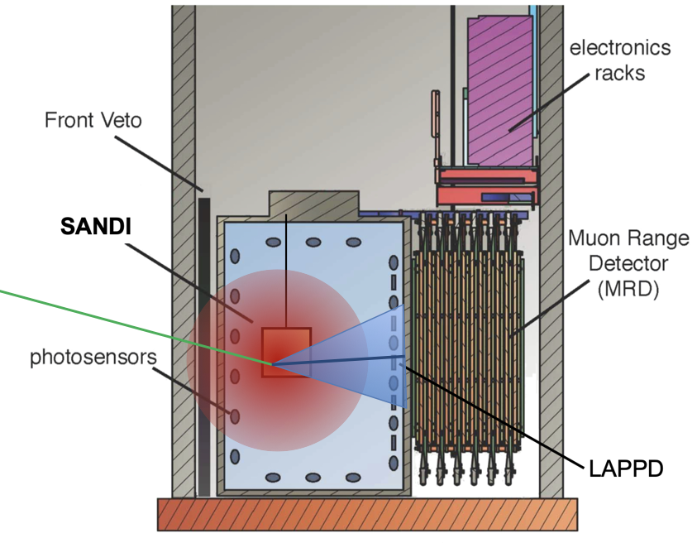
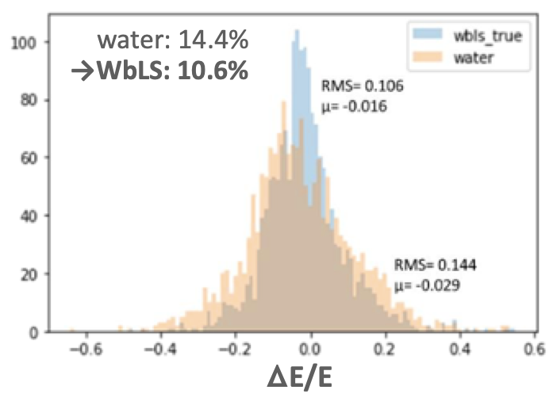
ANNIE+SANDI: WbLS test deployment
Next step: SANDI
acrylic vessel with 365 kg of WbLS submerged in ANNIE
Resolve scintillation light from hadronic recoils,
improve neutrino energy determination
Higher light output for neutron captures on gadolinium
→ improved neutron detection efficiency & vertex reco
Study C/S separation for neutrinos with LAPPDs
→ test WbLS performance for future use in long-baseline exp.s!
ANNIE vs. SANDI WbLS vessel
WbLS
Preparations are on-going
3‘ x 3‘ vessel already on-site at Fermilab
(Gd-loaded) WbLS to be produced at BNL (M. Yeh)
MC with idealized reco
and machine learning
water
25
6/22/22

Slide 26
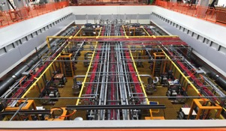
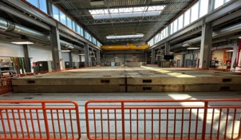
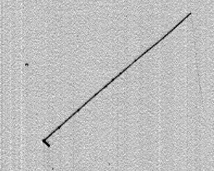
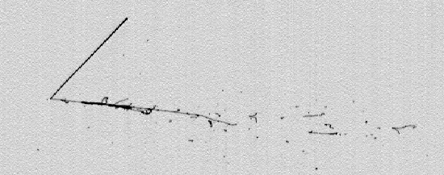
ICARUS Installation and Commissioning
Aug. 28th 2020:
start of TPC/PMT operation
Dec. 2021:
completion of CRT installation
June 2022:
completion of overburden installation
                Steady data taking with BNB, NuMI beams since March 2021, in parallel with commissioning activities. Cosmics,ν_{μ} , and ν_{e} samples collected for trigger/calibration/reconstruction studies.
  BNB CC QE muon neutrino candidate, E_{DEP} ~ 200 MeV
COLLECTION View
  Contained NuMI CC QE electron neutrino candidate, E_{DEP} ~ 800 MeV
COLLECTION View
Upward going exiting muon , L∼80 cm
Stopping upward going hadron, L ∼43 cm
Started data taking for Physics with BNB and NuMI beams mid-June 2022
0.64 m Drift direction
76 cm Drift direction
Vertex
Vertex
Downward going proton, L ∼3 cm
Electron developing into e.m. shower
0.6 m Wires
72 cm Wires

Slide 27
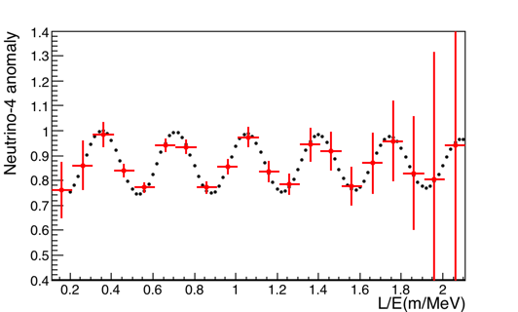
ICARUS Physics Program
During initial ICARUS only data period, further investigate two independent (~7 eV²) sterile ν searches of Neutrino-4 oscillations claim for:
^{Prediction} ^{for Neutrino-4 best fit} ^{(black)}
^{Expected} ^{measured oscillation pattern} ^{in} ^{L/E steps of 0.1}
^{and statistical errors (red)}
  Oscillation produced disappear pattern of ν_{µ} and ν_{e} in BNB and NuMI, focusing on contained, quasi-elastic CC interactions;
  The known contribution of Dark Matter of 26.4%, of the total energy of the Universe may be due to the Neutrino-4 expected sterile neutrino signal of 24% (+ 5% , -3%)
ν_{μ} survival oscillation probability w/ 3 mths data at BNB for Neutrino-4 best fit Δm²₁₄=7.25 eV², sin²2θ₁₄=.26
LSND-scale (~1 eV²) sterile ν search: Jointly with SBND - study the ν oscillation at BNB, covering the LSND mass/mixing angle parameter region with 5σ significance by measuring simultaneously the ν_{μ} disappearance and ν_{e} appearance channels.
Further exploit the NuMI beam:
  High statistics (~10⁵ ν_{e} events/year) measurements of ν-Ar cross sections and interaction models in the few hundred MeV to few GeV energy range important for SBN and DUNE.
  Develop a rich Beyond Standard Model search program: Higgs portal scalar, ν tridents, light dark matter, heavy neutral leptons …

Slide 28
Overview
Neutrino Science
  Why are Neutrinos Important
  Neutrino Science in 2022
  The Big Neutrino Questions and Fermilab’s Role
Experiments: Operations Complete
  MINERvA
  MicroBooNE
Experiments: Operating
  NOvA
  ANNIE
  ICARUS
Experiments: Building
  SBND
  DUNE
It all leads to DUNE

Slide 29
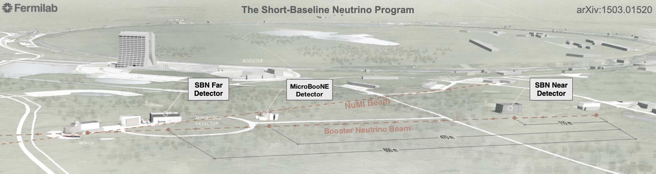

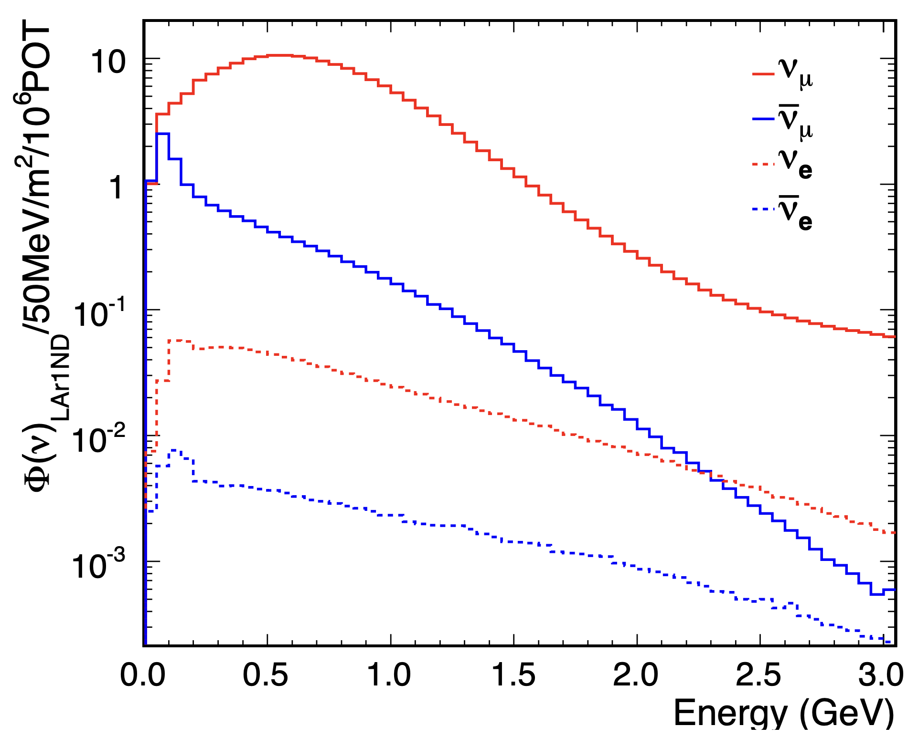

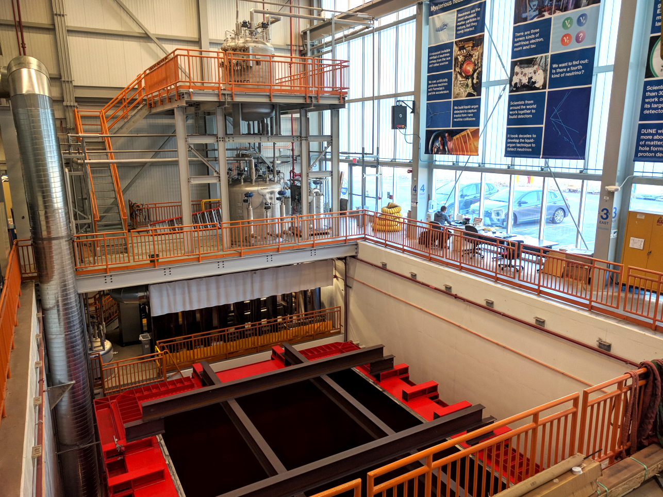
Short-Baseline Near Detector (SBND)
SBN Far Detector: ICARUS-T600
SBN Near Detector
Neutrino
Target
Booster Neutrino Beam
SBND is a 112-ton LArTPC only 110 m from target
SBND
SBND is the near detector in the Short-Baseline Neutrino (SBN) Program at Fermilab.
eV-scale sterile neutrinos: SBND measures the neutrino flux close to the source enabling very sensitive searches for neutrino oscillations in the FNAL Booster Neutrino Beam.
Other new physics scenarios: BSM physics program is an evolving landscape, with new search ideas emerging from collaboration with theory community.
Neutrino-argon cross sections: SBND will record 20-30x more neutrino-argon interactions than is currently available.
SBND Experimental Hall
BNB Neutrino Fluxes at SBND

Slide 30
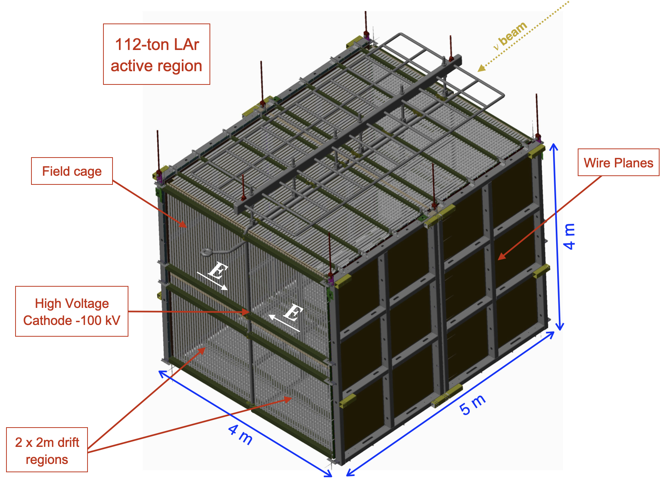
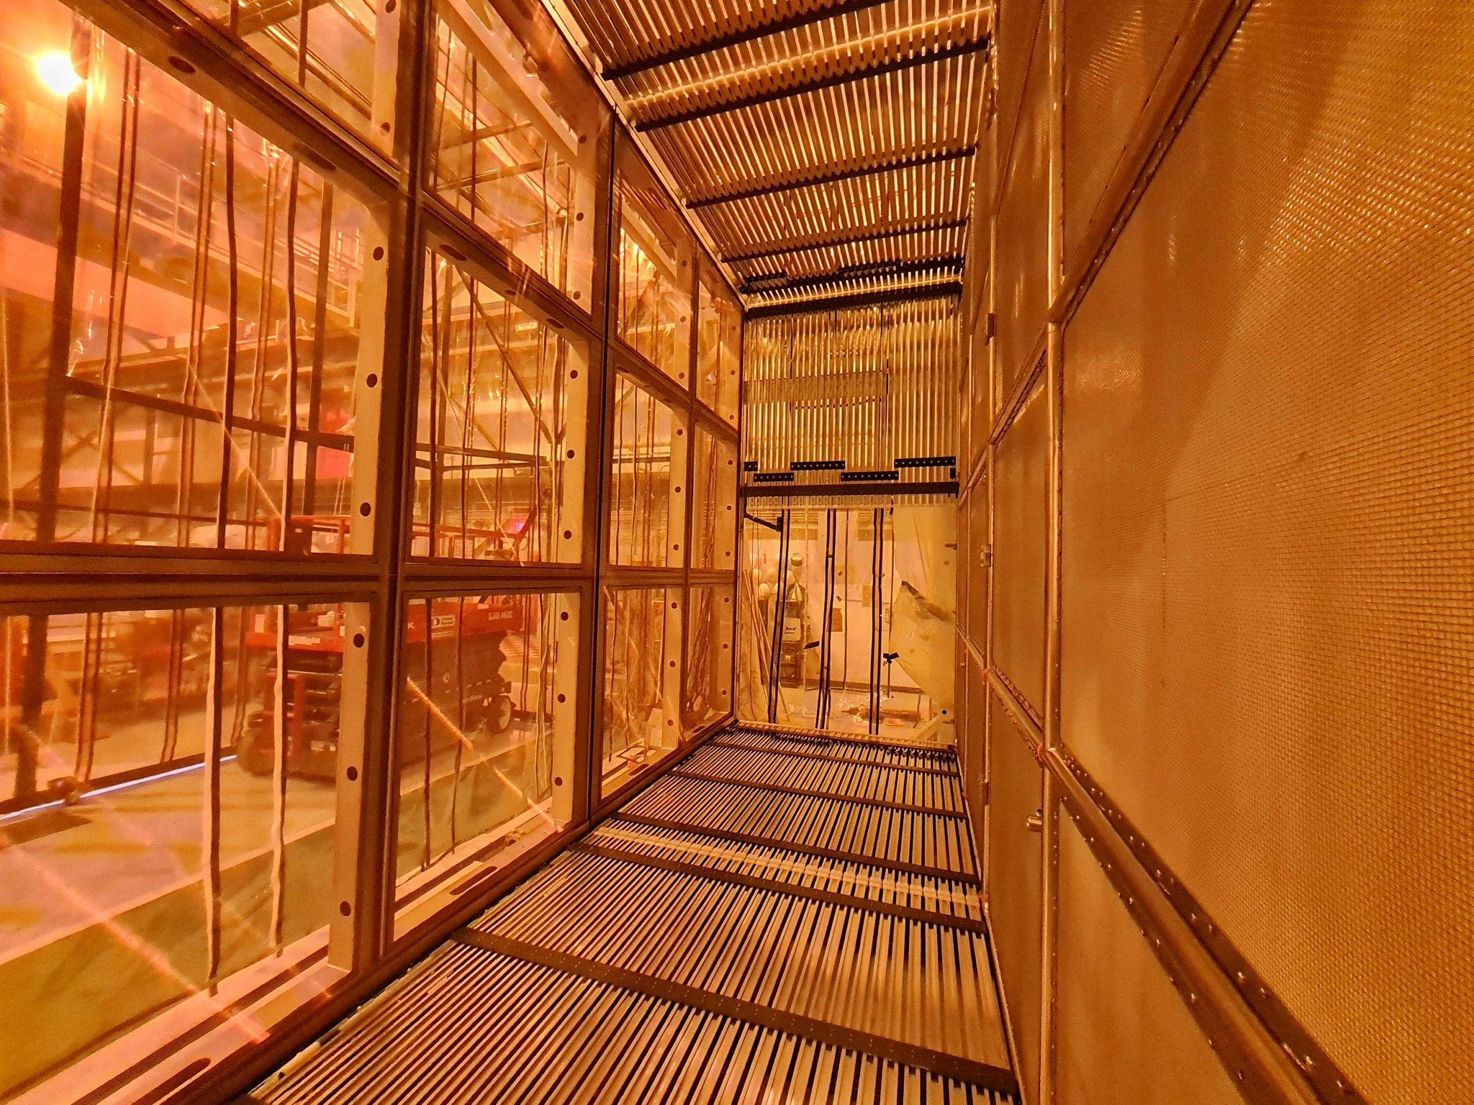
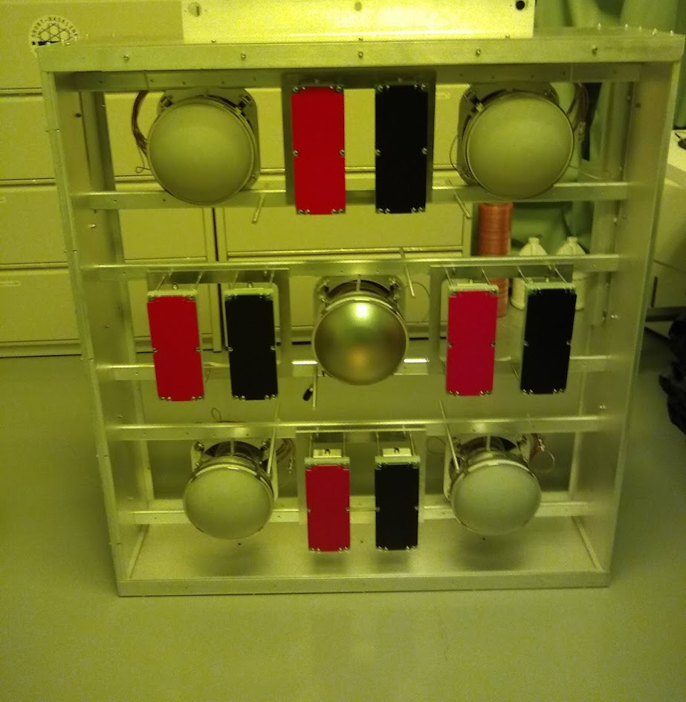


SBND assembly is well underway at Fermilab
Ready for LAr fill and commissioning in mid-2023.
TPC Assembly at Fermilab
May 2022
TPC Cold Electronics Installation
TPC Cold Electronics Installation
Membrane cryostat construction, May 2022
2m drift region
Photon Detection Module (x24)
PMTs and X-ARAPUCAs

Slide 31


Large SBND Datasets for ν-Ar Physics
∼5000 𝜈 events/per day!
SBND data will enable a generational advance in the study of neutrino-argon interactions in the GeV energy range, with low thresholds for particle tracking and calorimetry and enormous event rates (every ~3 months, SBND will collect a full MicroBooNE BNB 5-year dataset)
SBND expects to receive between 8-16x10²⁰ POT over a 3-4 year run (2024-2027). This amounts to order 10 million total events (CC+NC), including around 50,000 𝜈_{μ} CC events above 2 GeV and 50,000 𝜈_{e} CC events
In addition to multi-dimensional investigations of inclusive and dominant channels with <1% statistical errors per bin, SBND data enables measurements of more rare processes such as kaon and lambda production (1000s of events) and ν-electron scattering (100s of events)

Slide 32



SBN Oscillation Sensitivity
SBND + ICARUS will test the light sterile neutrino hypothesis
  Can cover the parameter space favored by past anomalies with 5𝜎 significance
Having Near + Far detectors enables sensitive searches for both 𝜈_{e} appearance
and 𝜈_{μ} disappearance within the same experiment.
SBN oscillation probability
SBN 𝜈_{e} appearance
SBN 𝜈_{μ} disappearance
example oscillation at peak energy
P. Machado et al, arXiv:1903.04608V11
MicroBooNE 𝜈_{e} appearance (2022)
SBN 3σ
SBN 3σ
MicroBooNE alone (BNB)
2σ
SBN 5σ
SBN 5σ
(SBN sensitivities for 6.6 x 10²⁰ protons on the BNB target)

Slide 33


DUNE Physics Goals
May 2018
Unambiguous, high precision measurements of Δm²₃₂, δ_{CP}, sin²θ₂₃, sin²2θ₁₃ in a single experiment
Discovery sensitivity to CP violation, mass ordering, θ₂₃ octant over a wide range of parameter values
Sensitivity to MeV-scale neutrinos, such as from a galactic supernova burst
Low backgrounds for sensitivity to BSM physics including baryon number violation

Slide 34
DUNE Oscillation Advantages
The DUNE neutrino oscillation program is exceptional due to several key features of the experiment and facility design :
  The 1300 km baseline between Fermilab and SURF location for the far detectors enables an unambiguous measurement of the neutrino mass ordering (mass hierarchy)
  The detector’s on-axis location provides for a wide-band energy spectrum of neutrinos to be seen in the near and far locations enabling detailed fitting of the oscillation parameters
  The liquid argon detector technology enables precise reconstruction of the neutrino interactions
  The Near Detector complex at Fermilab will support near detectors that will provide unprecedented control of systematic uncertainties in the prediction of the un-oscillated neutrino flux

Slide 35


DUNE ν_{μ} Disappearance
T2K - 2020
DUNE is a 3rd generation ν_{μ}
disappearance experiment
K2K - 2000
1e20 POT
DUNE ~ first two years
MINOS – 2004 - 2013
NOvA - 2020
13.6e20 POT
Unprecedented precision achievable
in small amount of running time
Slide taken from Gina Rameika’s 4/26/22
“DUNE International Context” talk

Slide 36

DUNE ν_{e} Appearance
DUNE is a 2nd generation
accelerator ν_{e} appearance
experiment
NOvA - 2020
T2K - 2020
DUNE ~ 3 - 5 years
with unique capability to
determine the mass
ordering
Slide taken from Gina Rameika’s 4/26/22
“DUNE International Context” talk

Slide 37


DUNE CP Violation
5σ discovery potential for CP violation over >50% of δ_{CP} values
7-16º resolution to δ_{CP} with external input only for solar parameters

Slide 38
It All Leads to DUNE

