Slide 1
DAPHNE tests with differential input
David Christian
Fermilab
April 20, 2022
Updated April 27, 2022

Slide 2
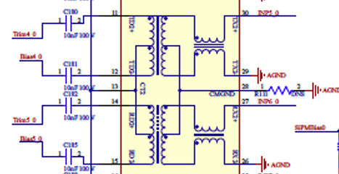
This should have been obvious, but…
As was pointed out to me by Esteban and further explained by Deywis, the Ethernet chip used at the input of DAPHNE has 2 functions:
there is a transformer that allows the “ground” of the cable shield to be distinct from the analog ground of DAPHNE.
This is followed by a balun which converts the differential input to a single-ended signal.
One side of the single-ended signal is connected directly to analog ground.
The other side needs to be terminated with 100 Ohms to match the cable impedance and the 50 Ohm termination on each wire of the twisted pair.

Slide 3
AFE gain configuration
If I understood Claudio correctly, he said that the cold amplifier saturates at a differential output of 800 mV.
My waveform generator allows one to form a differential input by setting channel 2 to output an inverted copy of channel 1.
I set each channel to output a ~2 MHz sine wave 400 mV_{pp}
Frequency = 1.99890136719 MHz so that 131 complete cycles fit in 4096 ADC samples.
I set LNA gain = 12 dB, PGA gain = 24 dB, and Vcntrl = 0.765V. I also disabled the PGA clamp, set the LNA clamp to 1.15V, and set OFFSET to yield 2.2V (~ 0 offset)
Reg 4 = 24, Reg 51 = 128, Reg 52 = 16896, VGAIN = 2040
Reg 4 = 24 (MSB first, Offset 0 format) because Jamieson’s firmware reads the 14-bit serial data from the AFEs into 16-bit words.
For display purposes, I subtract 8192 so that the mid-point is 0 in my plots.
CFG OFFSET CH # GAIN 2, WR OFFSET CH # V 1100

Slide 4
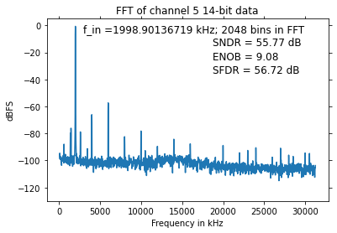
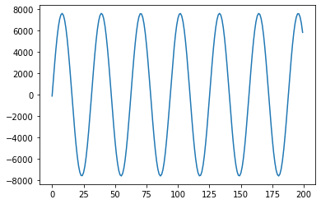
With 2x 400mV_{pp} input & 100 Ohm external termination
(5 FFTs averaged)

Slide 5
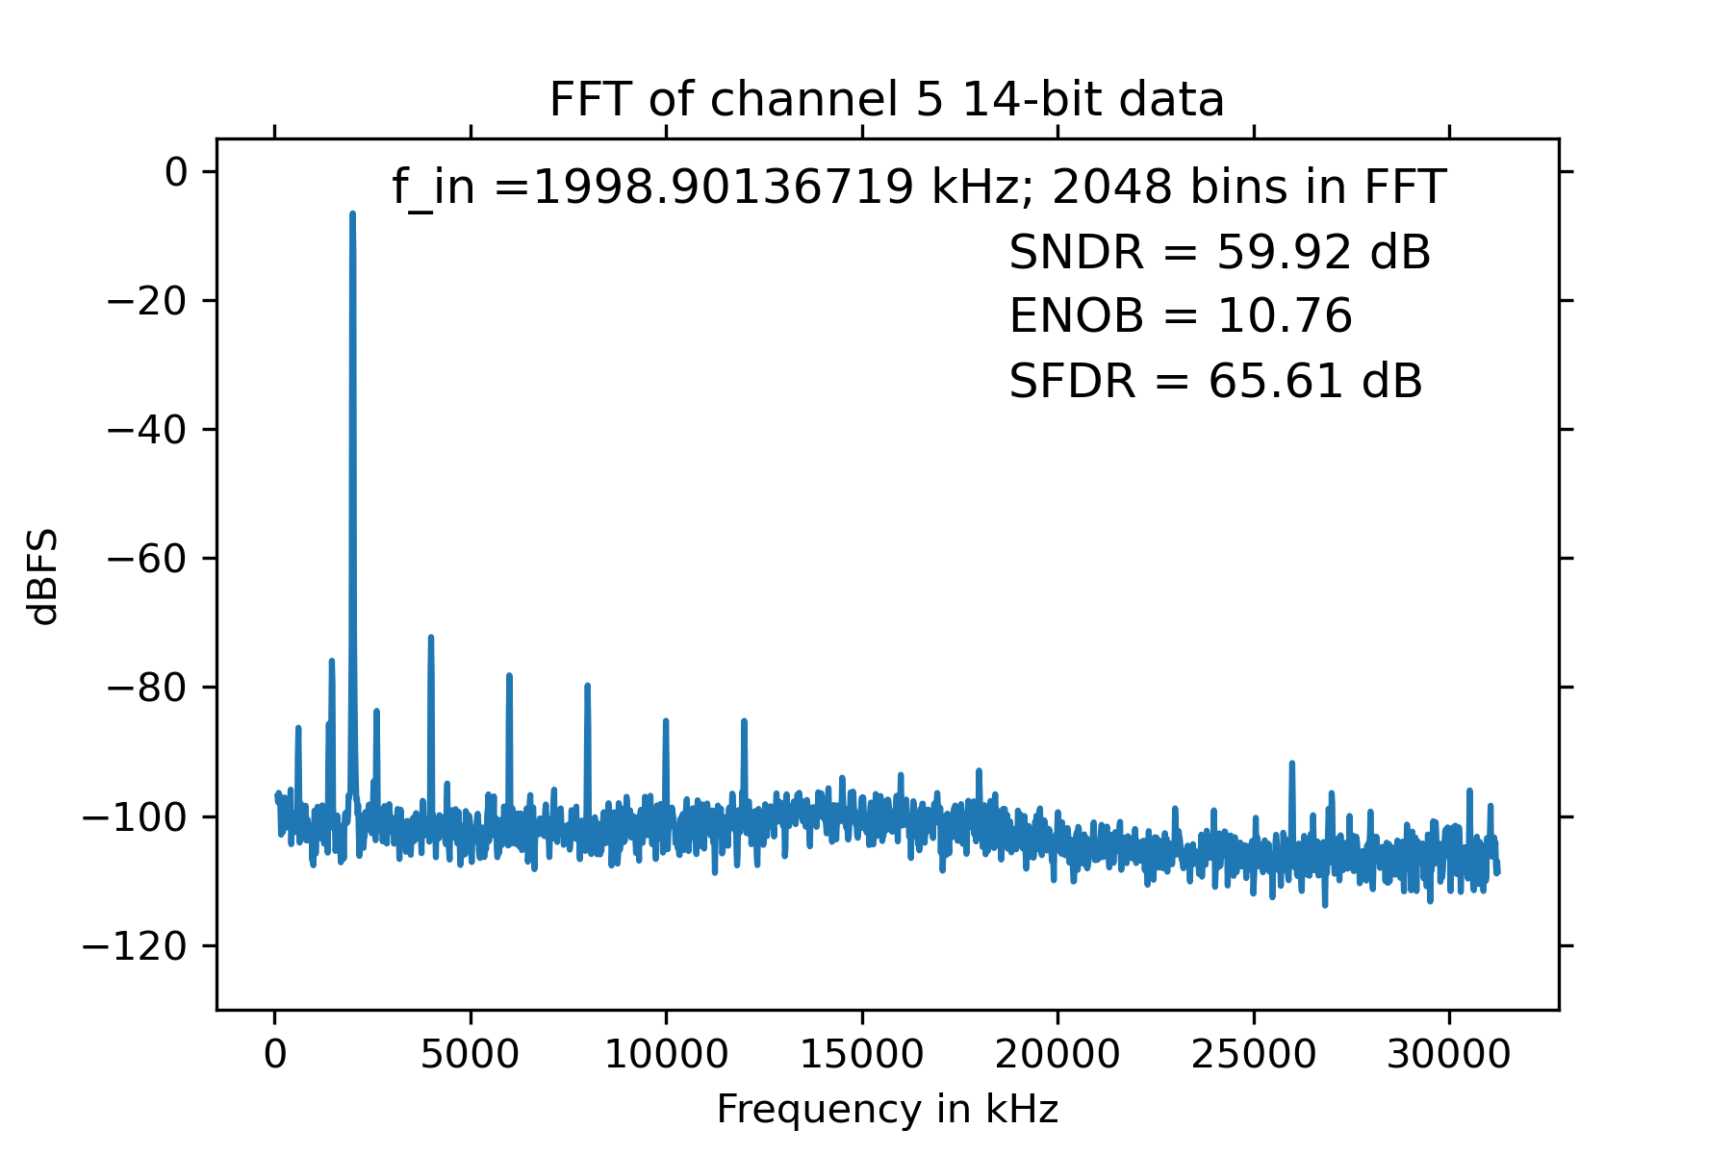
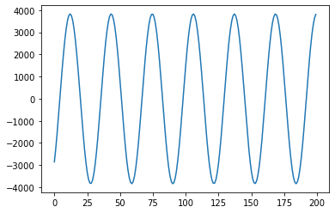
With 2x 200mV_{pp} input & 100 Ohm external termination
Linearity is significantly better in central part of ADC range (consistent with evaluation board measurements)
(5 FFTs averaged)

Slide 6
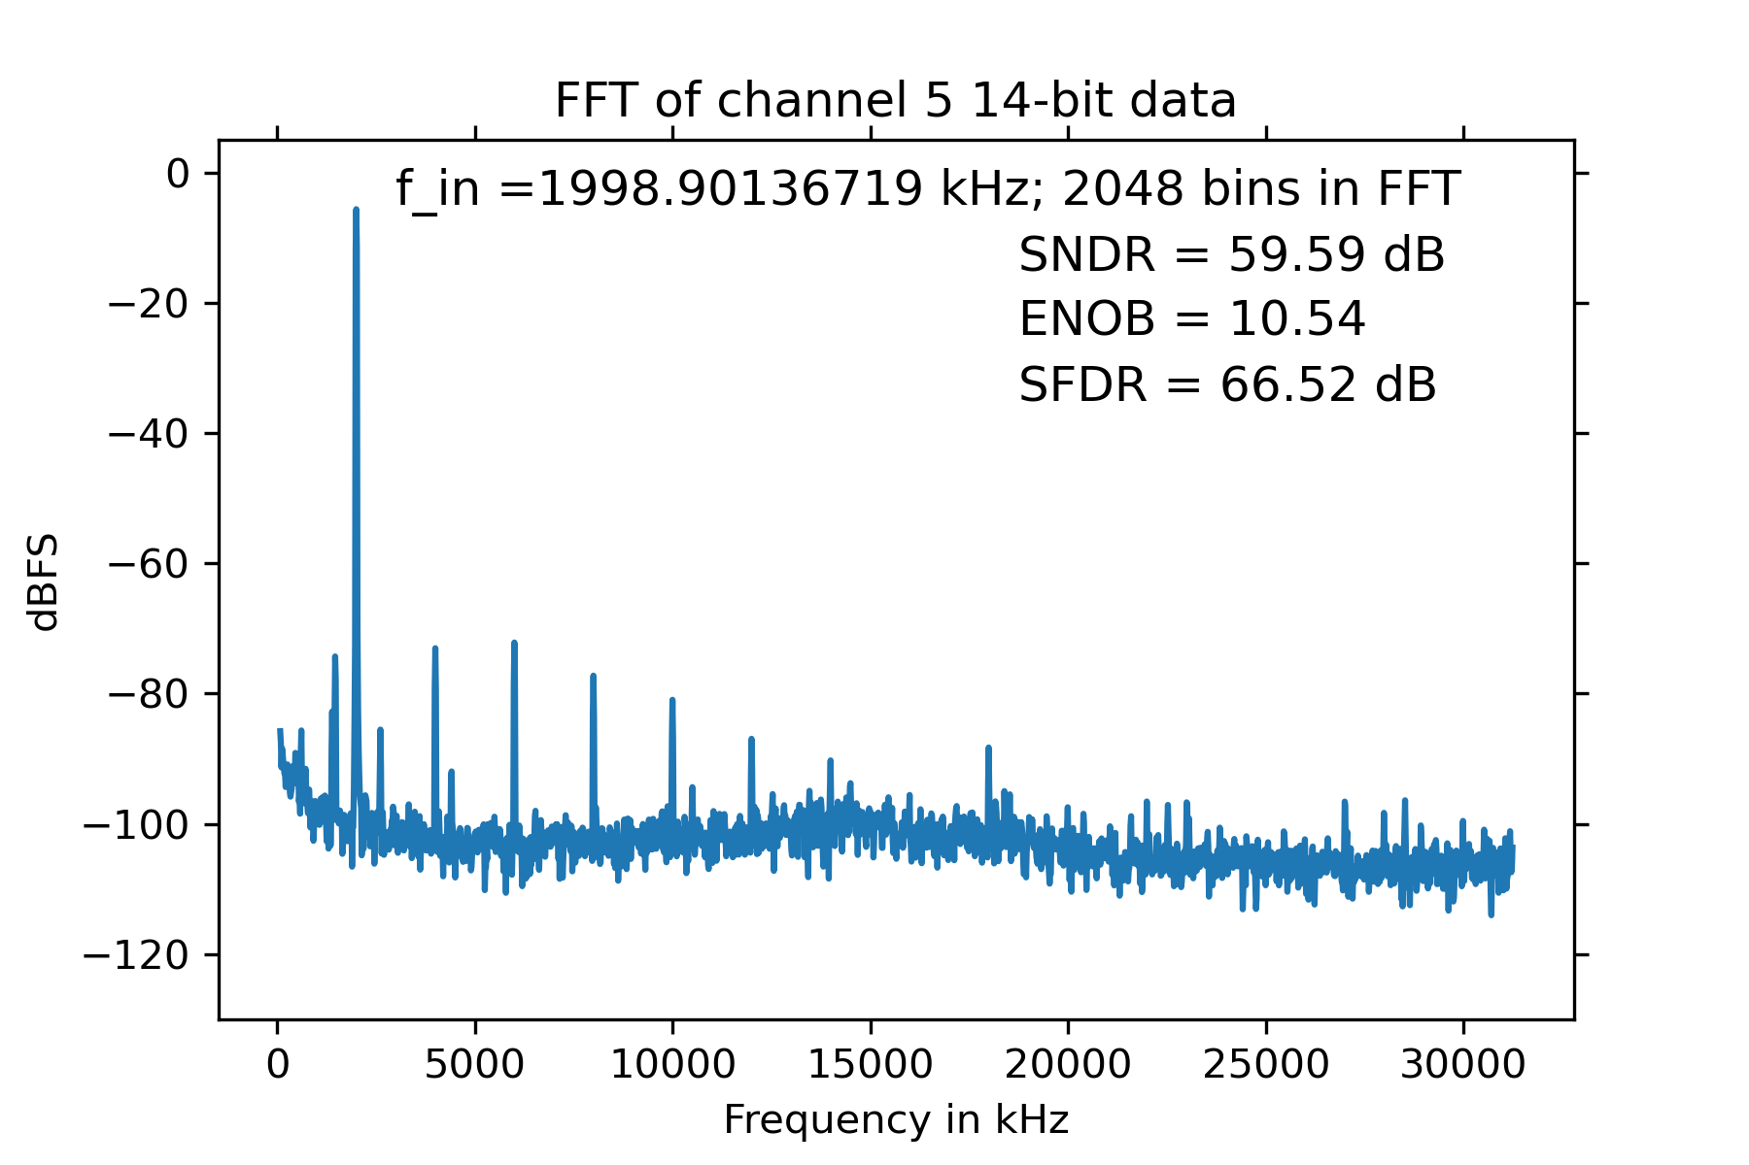
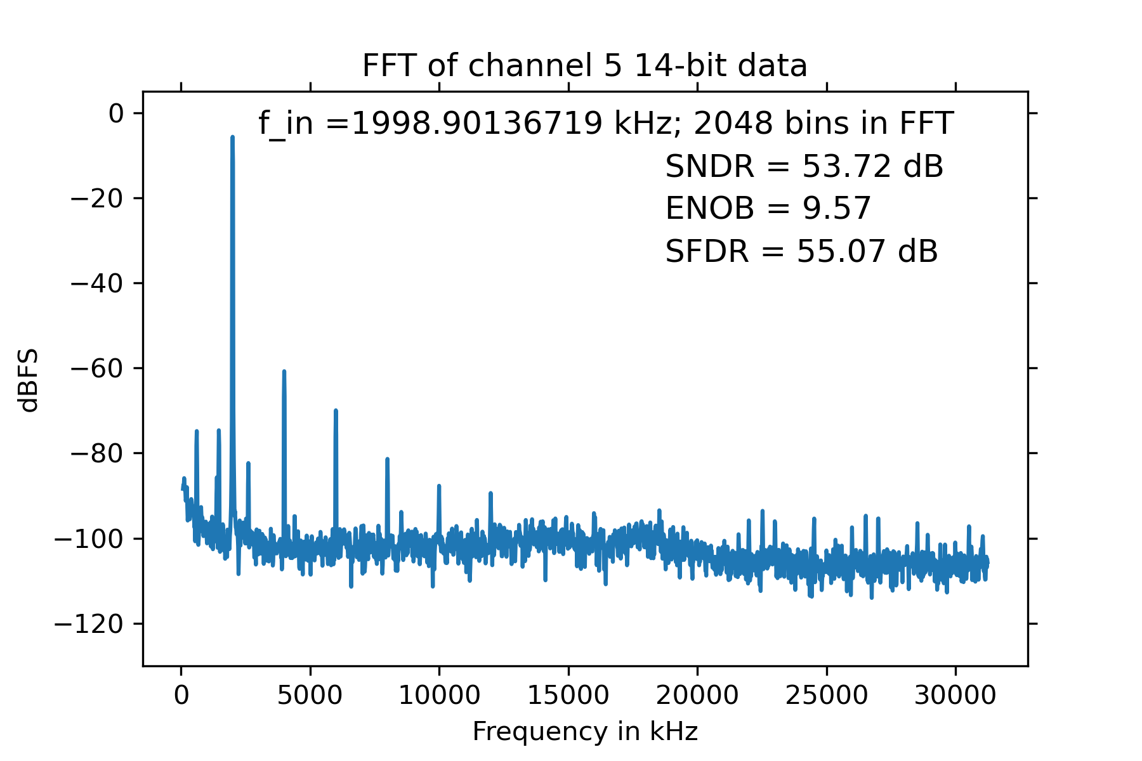
Now with offset integrators disabled and OFFSET used to move the pedestal away from 0
Reg 51 = 144, Reg 52 = 21504
OFFSET = 1100 (not tuned to yield ped = 0)
Sine wave is in [-4825,3736] with OIs off.
OFFSET = 1250 (~2.5V at DAC)
Sine wave is in [-589,7931]

Slide 7
Conclusions (April 20)
The DAPHNE analog channel performs well with differential inputs
Transformer CMNGND must be connected to analog ground.
Inputs must be terminated with 100 Ohms to analog ground.
Best configuration for stability & low noise is LNA=12dB, PGA=24 dB
to be confirmed again
The OFFSET control can be used to move the pedestal away from 0 if the offset integrators are disabled.
With differential inputs, I do not see the signal distortion with large OFFSET that I reported earlier.
In my tests, termination with external 100 Ohm resistors yields slightly better results than active (internal) 100 Ohm termination.
Difference is small (ENOB=10.40 vs 10.76 w/~1/2 scale input)
To be confirmed by adding external resistors to more channels
Next steps:
Use different frequency input – Added for April 28 report
Look at SiPM signals with CE amplifier
Look at single-ended inputs with transformer chip removed

Slide 8
ENOB as a function of frequency
Approx Freq (MHz) | ENOB
0.26 | 8.62
0.35 | 9.32
0.56 | 10.46
0.66 | 10.72
0.9 | 10.89
1.5 | 10.95
2 | 10.8
3.4 | 10.53
4.5 | 10.39
5.9 | 10.13
7.6 | 9.83
9.2 | 9.65
10.5 | 9.48
Consistent with results with an AFE5808A evaluation board (data taken with offset integrators on).

Slide 9
Gain as a function of frequency (noted by Esteban)
Approx Freq (MHz) | ENOB | Min | Max | Dif | Gain Relative to 1.5 MHz
0.26 | 8.62 | -3246 | 3239 | 6485 | 84%
0.35 | 9.32 | -3555 | 3549 | 7104 | 92%
0.56 | 10.46 | -3784 | 3772 | 7556 | 98%
0.66 | 10.72 | -3820 | 3811 | 7631 | 99%
0.9 | 10.89 | -3849 | 3839 | 7688 | 100%
1.5 | 10.95 | -3865 | 3854 | 7719 | 100%
2 | 10.8 | -3870 | 3857 | 7727 | 100%
3.4 | 10.53 | -3900 | 3889 | 7789 | 101%
4.5 | 10.39 | -3918 | 3907 | 7825 | 101%
5.9 | 10.13 | -3974 | 3963 | 7937 | 103%
7.6 | 9.83 | -4038 | 4030 | 8068 | 105%
9.2 | 9.65 | -4109 | 4104 | 8213 | 106%
10.5 | 9.48 | -4159 | 4151 | 8310 | 108%
Note that both offset integrators were on while these data were taken.

