Slide 1
AF7 - Subgroup RF –
Report Outline
May 3, 2022
Sergey Belomestnykh
Emilio Nanni
Hans Weise

Slide 2
AF7rf: RF
Updates:
  Solicited WP
  Now Reviewing
  17 WP to AF—rf (additional 9 relevant; probably more)
Plans include :
Working on outline for AF7-rf report; structure informed from submissions; community events
AF7 - Subgroup RF - miniWorkshop on RF Systems and Sources Follow-Up, https://indico.fnal.gov/event/52406/ , Jan. 11th, 2022
AF7 - Subgroup RF - miniWorkshop on Innovative Design and Modeling Follow-Up, https://indico.fnal.gov/event/52407/ , Jan 18th, 2022
AF7 - Subgroup RF - miniWorkshop on Cavity Performance Frontier Follow-Up, https://indico.fnal.gov/event/52408/, Feb. 1st, 2022

Slide 3
Snowmass Contributions Relevant to AF7 (26)
Does not include some facility concept WPs that we need to reach out to
Number | Lead Area | Title | Contact | Contact Email
1 | AF7-rf | Medium-Grain Niobium SRF Cavity Production Technology For Science Frontiers and Accelerator Applications | Ganapati Myneni | grmyneni@gmail.com
2 | AF3 | C3: A 'Cool' Route to the Higgs Boson and Beyond | Emilio Nanni | nanni@slac.stanford.edu
3 | AF7-rf | Understanding Vacuum Arcs and Gradient Limits | J. Norem
4 | AF7-rf | High Efficiency, Low Cost, RF Sources for Accelerators and Colliders | Lawrence Ives | rli@calcreek.com
5 | AF2 | An 8 GeV Linac as the Booster Replacement in the Fermilab Power Upgrade: a Snowmass 2021 White Paper | Sergey Belomestnykh | sbelomes@fnal.go
6 | AF7-rf | Advanced RF Sources R&D for Economical Future Colliders | Brandon Weatherford
7 | AF7-rf | Advanced RF Structures for Wakefield Acceleration and High-Gradient Research | Xueying Lu
8 | AF3 | The International Linear Collider: Report to Snowmass 2021 | Michael Peskin | mpeskin@slac.stanford.edu
9 | AF7-rf | Key Directions for Research and Development of Superconducting Radiofrequency (SRF) Cavities | Sergey Belomestnykh | sbelomes@fnal.gov
10 | AF7-rf | Next-Generation Superconducting RF Technology based on Advanced Thin Film Technologies and Innovative Materials for Accelerator Enhanced Performance & Energy Reach | Anne-Marie Valente | valente@jlab.org
11 | AF7-rf | Nb3Sn Superconducting Radiofrequency Cavities: a Maturing Technology for Particle Accelerators and Detectors | Sam Posen | sposen@fnal.gov
12 | AF7-rf | Adaptive Machine Learning for Time-Varying Systems: Towards 6D Phase Space Diagnostics of Short Intense Charged Particle Beams | Scheinker
13 | AF7-rf | C3 Demonstration Research and Development Plan | Emilio Nanni | nanni@slac.stanford.edu
14 | AF3 | Higgs-Energy LEptoN (HELEN) Collider based on advanced superconducting radio frequency technology | Sergey Belomestnykh | sbelomes@fnal.gov
15 | AF7-rf | The Need for Further Development of Magnetrons as RF Sources for HEP | Thomas Kroc | kroc@fnal.gov
16 | AF7-rf | High precision-high speed RF feedback and control systems for future linear colliders | Daniele Filippetto | dfilippetto@lbl.gov
17 | AF7 | Sustainability Considerations for Accelerator and Collider Facilities” | Thomas Roser | roser@bnl.gov
18 | AF3 | XCC: An X-ray FEL-based γγ Collider Higgs Factory | Tim Barklow
19 | AF3 | An Impartial Perspective for Superconducting Nb3Sn coated Copper RF Cavities for Future Linear Accelerators | Emmanuela Barzi | barzi@fnal.gov
20 | AF7-rf | Plasma Processing for In-Situ Field Emission Mitigation of Superconducting Radiofrequency (SRF) Cryomodules | Martina Martinello | mmartine@fnal.gov
21 | AF7 | Challenges and opportunities of srf theory for next generation particle accelerators | Alex Gurevich
22 | AF6 | Continuous and Coordinated Efforts of Structure Wakefield Acceleration (SWFA) Development for an Energy Frontier Machine | Chunguang Jing | c.jing@euclidtechlabs.com
23 | CommF1 | FLASH WP | Reinhard Schulte
24 | AF | The CLIC Project
25 | AF | Accelerator Modeling Community White Paper | Beam and Accelerator Modeling Interest Group | AccBeamModelSnowmass21@lbl.gov
26 | CommF1 | Nurturing the Industrial Accelerator Technology Base in the US

Slide 4
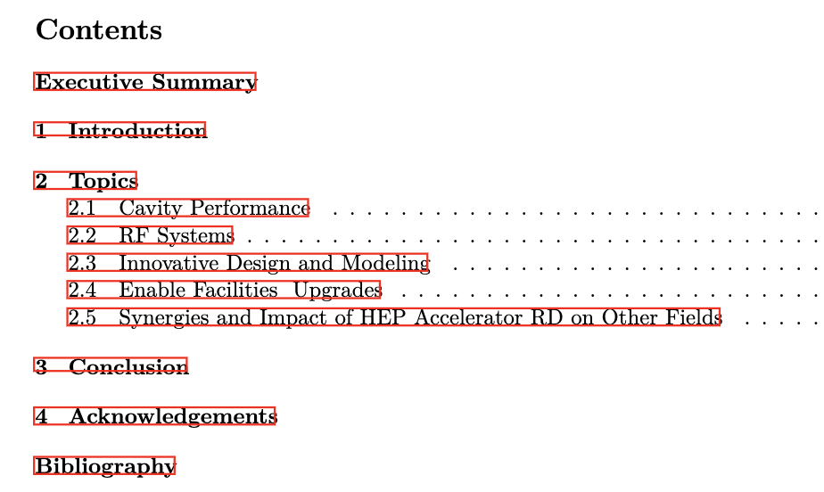
RF Accelerator Technology R&D
Report of AF7-rf Topical Group to Snowmass 2021
Planning on ~30-page Topical Group Report
Planning on ~4-page summary for AF Report (Need guidance)
Will make early draft available for comments in ~2 weeks (will send email with a link). Please send us comments/questions!
Near-final draft will be completed by the end of May

