Slide 1
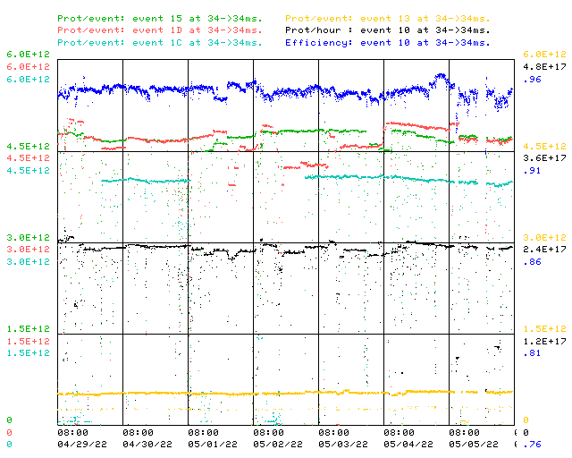
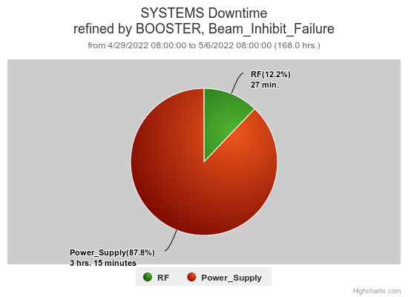
Booster Operations 04/29/22 – 05/06/22
F
F
F
Sa
Su
M
Tu
W
Th
MP02
Downtime:
~ 3 hours 42 minutes beam inhibit for the week
Several Minor RF trips
MP02 power supply
Also:
BRF16 requires access to determine its situation (aspirin tablet appears dissolved)
Thanks to FESS + for gallery temperature adjustments (winter/summer)
Thanks to Nick, Matt, Eric for MP02 repairs Thursday eve.
Thanks to Ops for diligence & tuning on the off shifts
Beam Studies Performed
Requesting 2ea $17’s per supercycle for 2 - 3 hours for studies as needed.
This week:
Booster running well, delivering lots of beam
Max protons/hr 2.47E17, total protons delivered 3.58E19
Beam to Numi $15 ~4.2E12 – 5E12 pushing for 56E12 on target
Beam to BNB $1D from ~4.2E12 – 5E12 –> up to 8.9E16P/Hr
Beam to Muon $1C ~4.0E12+ @14.4T for ~1E12 POT
Beam to SY $13 @2T

