Slide 1
Welcome and Charge
James Amundson
2022 Fermilab Computing Scrutiny Group
June 1, 2022

Slide 2
Welcome to the 2022 FCRSG!
Last year
It is our hope that the next FCRSG will be the first not to be constrained by COVID 19!
Purely virtual this year
Partially due to late date and travel constraints
Partially due to the Fermilab area once again reaching High COVID Transmission™
Partially due to desire to create a level playing field for the experiments
We are still learning to do hybrid well
It is our hope that the next FCRSG will be the first not to be constrained by COVID 19!

Slide 3
Changes to the 2022 FCRSG
Kept basic structure from last year
Only asked for updates to computing models
Asked experiments for information on past and future data challenges
Committee meeting with division to happen at a later date
Mostly due to scheduling
Also viewing as an experiment

Slide 4
Looking Forward to the 2023 FCRSG
Save the date!
February 15 and 16, 2023
Experiments will be asked to present estimated requests for up to five years
It is understood that the quality of predictions falls off rapidly with distance in time

Slide 5
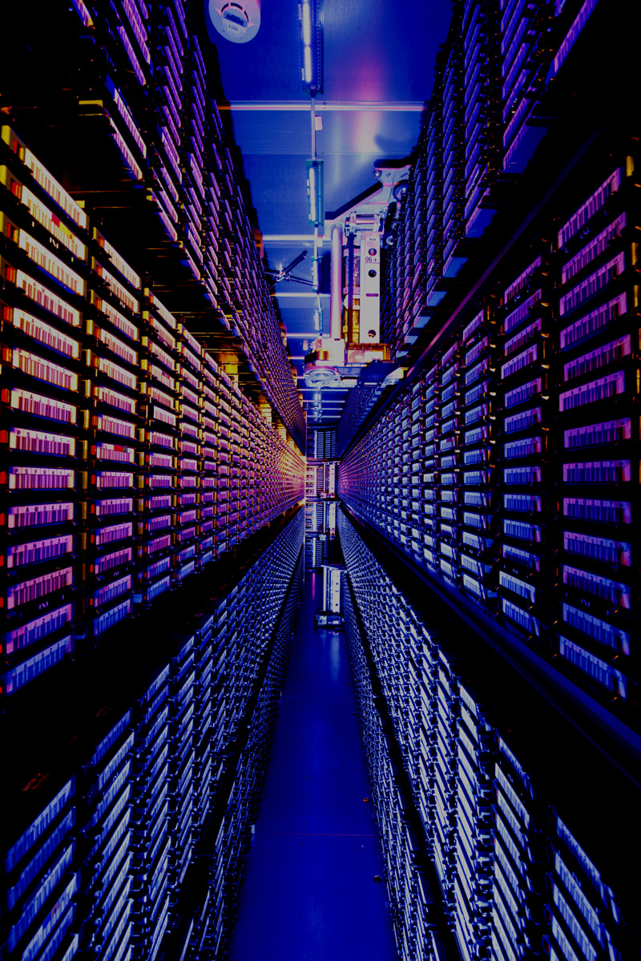
Fermilab Computing Strategy
Detailed View
Compute
Work towards getting a substantial fraction of US HEP computing from the Exascale/HPC machines
High-throughput computing at Fermilab will remain important
Utilize cloud resources when cost effective
Increase peak capacity
Access to non-standard hardware
Storage
Mass storage will remain the foundation of Fermilab’s computing capability
Tape libraries
Disk systems
Full-stack storage software
Including support for data lifetime management
Analysis
Build an elastic analysis facility taking advantage of industry tools and Fermilab storage
AI/ML
Provide GPU resources
Develop AI-enhanced operations
Software
Pursue community-wide solutions
Engage ASCR partners
Collaborate with CERN
Leverage industry-standard tools where available

Slide 6
Progress in the Last Year
Storage research and development
CTA (CERN Tape Archive) selected as the replacement for Enstore
Detailed transition plan in progress
New storage R&D staff hired
Started to deprecate existing NAS System
Working on Ceph-based replacement
Analysis Facility
Elastic Analysis Facility now available for beta testing
Hardware
New “Public” tape library
Substantial disk purchases
12 A100 GPUs
More detailed presentation of computing strategy at this year’s PAC meeting

Slide 7
Funding Outlook
Operations funding has remained mostly flat
Research has faired less well
Just received financial plan for FY22 (!)
Slightly better than fully flat
Recent push for enhanced operations funding from Office of Science
Starting in FY24
Billed as new normal
Requested DUNE analysis and operations support
Requested hardware and personnel for facility modernization
Roughly $4M (20%) additional funds requested
Not yet demonstrated to be real

Slide 8
Charge for this Review
Goal: evaluate usage requests, plan for future of computing at Fermilab
Not limited to M&S – SWF is the largest portion of our budget
Not limited to Computing and Detector Operations
Note, however, that CMS computing is separately reviewed
Not including Scientific Software development
Time frame: next year + experiment-specific horizon
Scrutiny should focus on incremental costs (SWF + M&S)
Including custom solutions in software, etc.

Slide 9
Finally
Thank you for your help
These reviews are very valuable to the division!
Questions?

