Slide 1
Facility Services
Glenn Cooper / Scientific Computing Facilities Department
2022 FCRSG
1–2 June 2022

Slide 2
SCD/SCF Department
What do we do? Shared, often underlying, services:
System administration, hardware + OS: install, monitor, fix, retire computing equipment for other services: compute, storage, databases, …
DAQ computing support: same, but focused on DAQ needs of specific experiments
Server & disk storage purchases: budget, specifications, procurement process
Scientific Linux, CentOS; high-level Linux support
Software container infrastructure, currently OKD/Kubernetes
Underlying tools: monitoring, configuration management, others; used by us and by other service providers

Slide 3
Key services for experiments (not discussed by Joe or Robert)
Interactive computing (“gpvm” and CMS LPC interactive nodes)
Online (DAQ) computing support
(Not the primary focus of FCRSG)
Scientific Linux; Linux OS consulting/support
Container infrastructure (more details later)
Jenkins CI/CD service

Slide 4
Linux future
Fermilab and CERN issued a joint statement in October 2021 recommending CentOS Stream
Our current plan is to migrate from SL 7 (end of support June 2024) to CentOS Stream 9 (EOS spring 2027) for most experiments
However, there is some dispersion in subsequent decisions:
CERN online will use RHEL
CMS will use AlmaLinux for cmssw

Slide 5
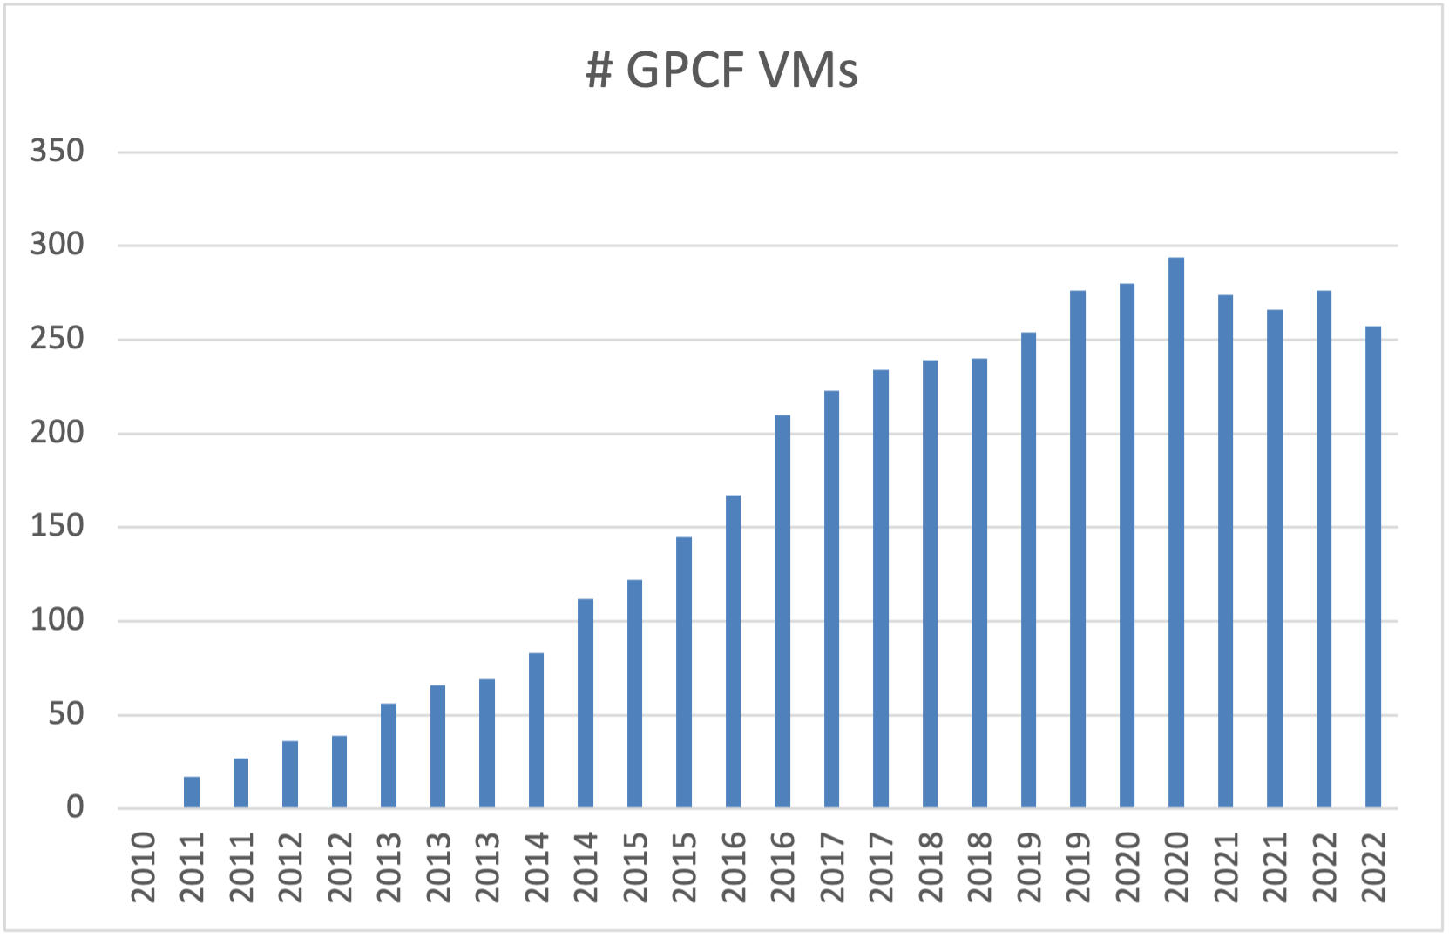
Interactive computing
GPCF (interactive General Physics Computing Facility; “gpvms”)
Used for a variety of purposes by most experiments (other than CMS)
Would other configurations be helpful, e.g., fewer nodes with more cores/memory?
~90 CMS LPC interactive nodes: also VMs, using same tools as GPCF

Slide 6
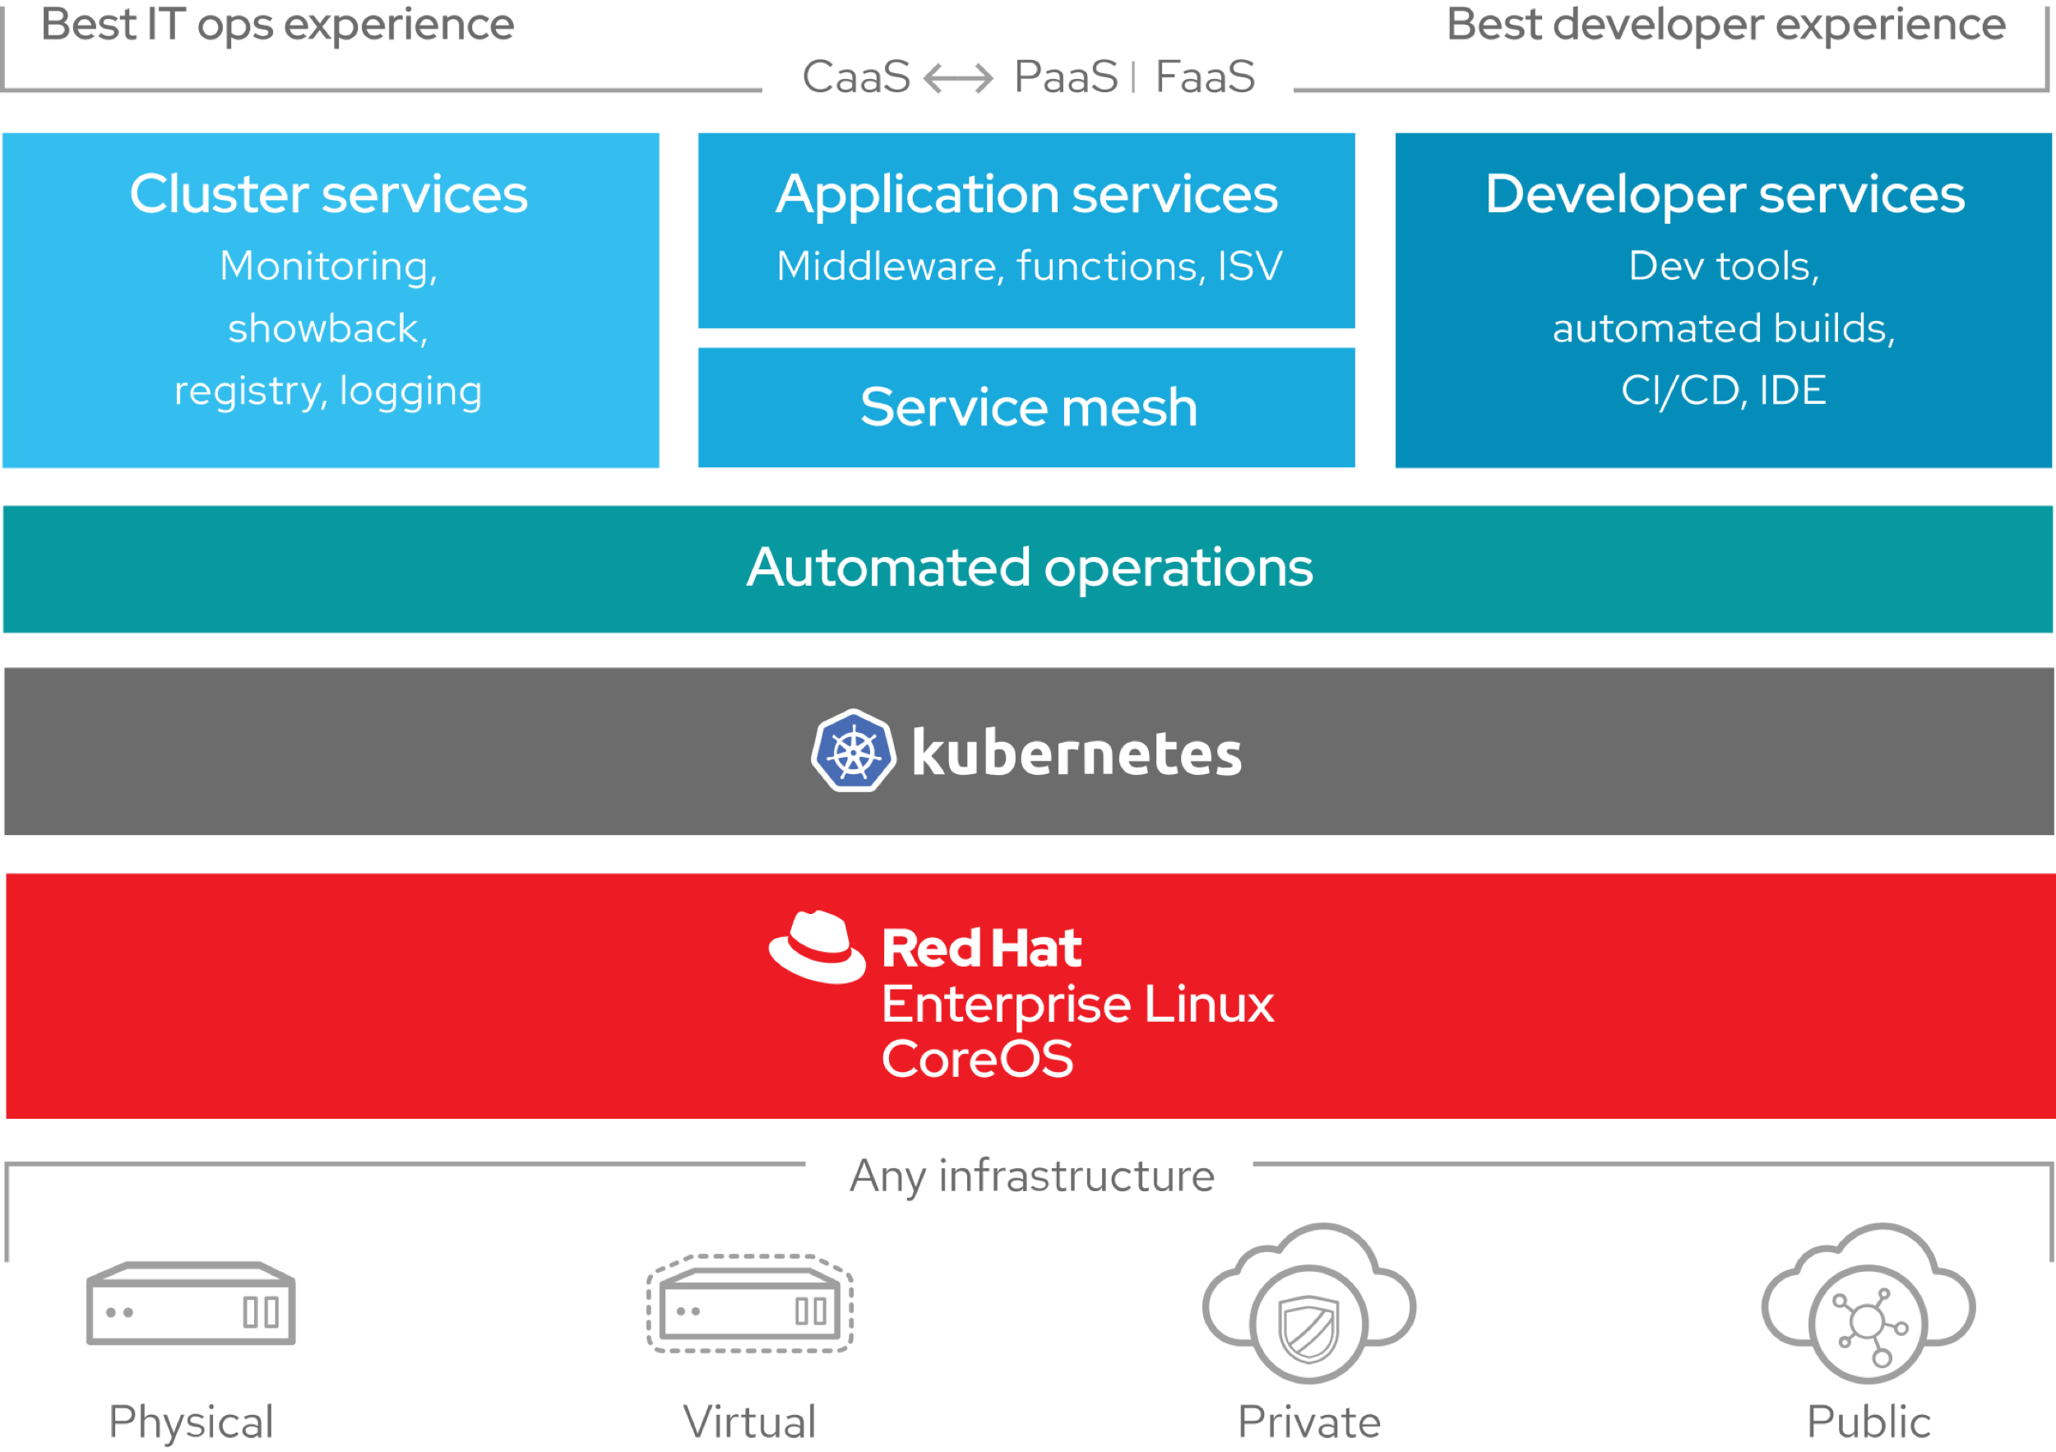
Container infrastructure
Running on OKD (open-sourced Red Hat OpenShift): multi-tenant container ecosystem

Slide 7
Container infrastructure
Used for:
SCD-supported services:
FTS3
Rucio
DUNE hardware database
others
User analysis facility https://analytics-hub.fnal.gov/; ~45 beta testers
JupyterHub, BinderHub Dask
Cabinetry DeterminedAI
ServiceX NVIDIA TritonRT
burst to batch farms

Slide 8
Jenkins CI / CD
Central dashboard to configure, run, and see status:
Hooks to local repos, GitHub, etc.
Linux nodes available (macOS no longer supported by SCD)

Slide 9
Conclusion
It’s always a balancing act to maintain/operate older hardware and services while also learning about and integrating newer ones.
Evolving to meet new demands and take advantage of new hardware and software. Input is always appreciated.

