Slide 1
Muon g-2 FCRSG 2022
Adam Lyon (FNAL/SCD) Representing the Muon g-2 Collaboration
2022-06-01

Slide 2
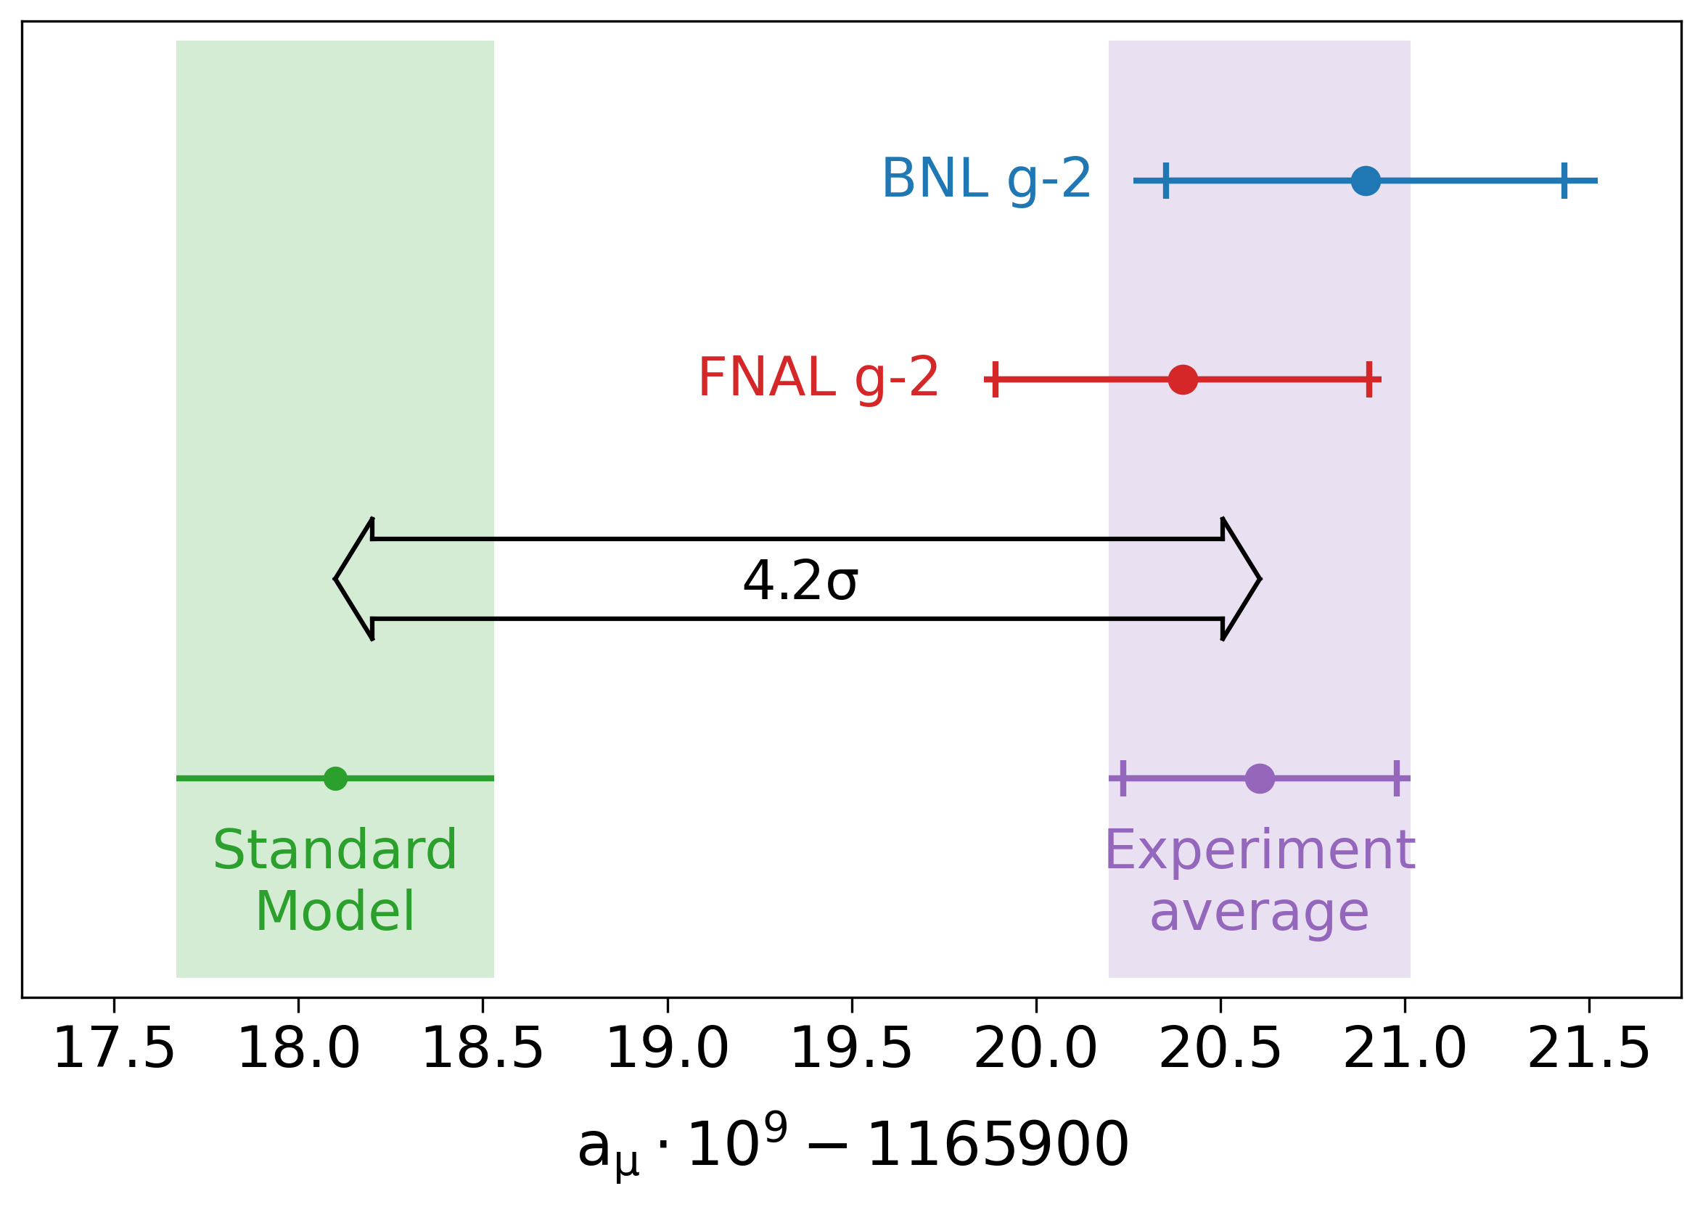
Excitement (April 7, 2021)

Slide 3
Experiment Organization Chart for Offline Computing
Spokes
Venanzoni (INFN)/Casey (FNAL)
Operations Managers Fred Gray (Regis), Polly (FNAL)
PPD Ops Liaison
Kiburg (FNAL)
Analysis Coordinator
Mott (BU/FNAL)
DAQ/Online Ops Mastroianni (INFN)
Offline Computing & Simulations Liang Li (Shanghai)/Walton (FNAL)
SCD Liaison
Lyon (FNAL)
Release Manager
Goodenough (FNAL)
Simulations
Fatemi (UKy)
Data Quality
Cotrozzi (INFN)
Production Manager
Girotti (INFN)/Oksuzinan (ANL)
Database
Walton (FNAL)
Nearline
La Bounty (UW)
Notes:
Is computing an afterthought or an integral part of the experiment.
Where is the R&D managed for moving to HPC, incorporating machine learning as needed, etc
The shift to HEPClould require more diligence on production teams to run an operations team to ensure Cloud and HPC hours are not wasted.
Is their build and release model supported, and are they evolving in a sustainable way? The division won’t be building specialized packages anymore. There are several legacy experiments that are still using NAS areas for builds instead of CVMFS. They don’t have the resources to modernize and the division doesn’t have the resources to support them as is.

Slide 4
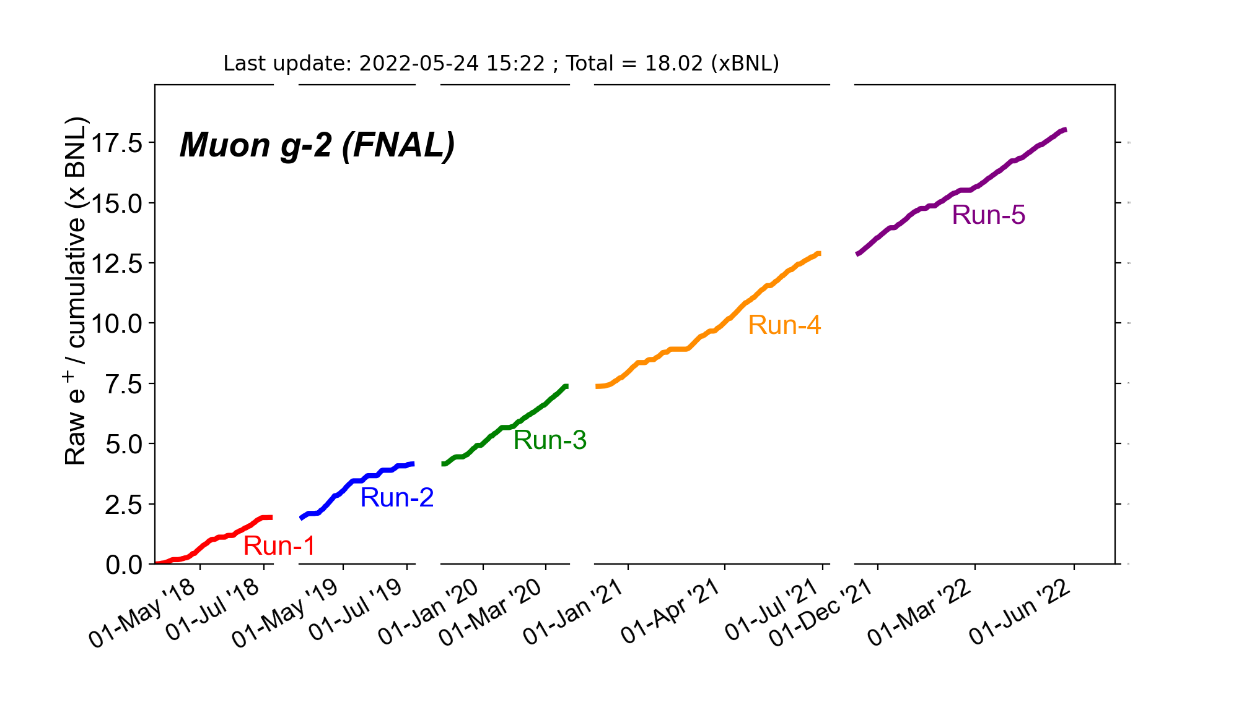
Progress
R6: First
$μ^{−}$ run
Run 6 is expected to be our last run
R5: Current run
Last $μ^{+}$ run
R4: Production starting soon
Plan to process R4/5 together
R2/3 processed
Analysis in progress
R1: published
Notes:
1.5 month left

Slide 5
Muon g-2 computing and SCD
Muon g-2 & SCD had a workshop on 3/2/22 to discuss future computing needs and support
See https://indico.fnal.gov/event/53346/
We want to complete processing as quickly as possible to reduce lag behind data taking
Muon g-2 asked analyzers to fill out a computing survey to better understand what people need as the dataset sizes increase
See that link for results
Will work with SCD to implement more powerful virtual machines

Slide 6
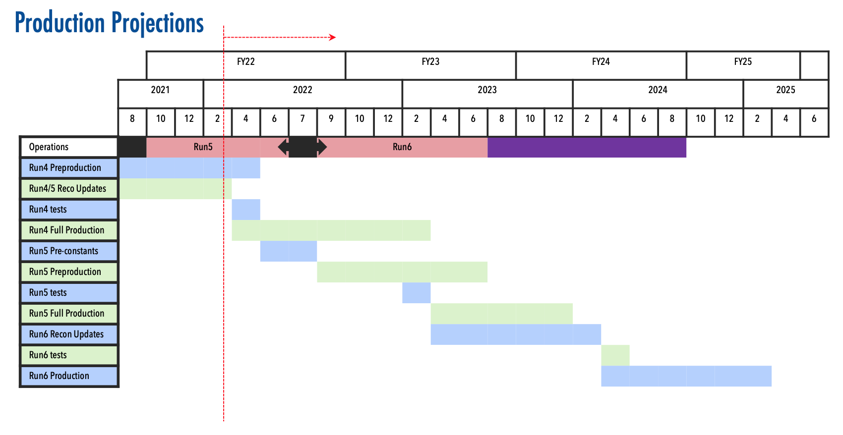
Schedule
Expect Run 2/3 Publication in 2023; Run 4/5 Publication in 2024; Run 6 Publication in 2025

Slide 7
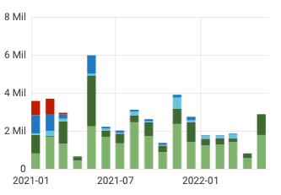
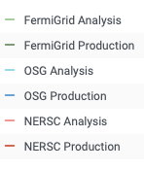
CPU - Experiment Usage Over the Last Year
CY20
CY21
CY22
2.05 Mil
2.19 Mil
13 K
NERSC production (simulation) uses
HEPCloud

Slide 8
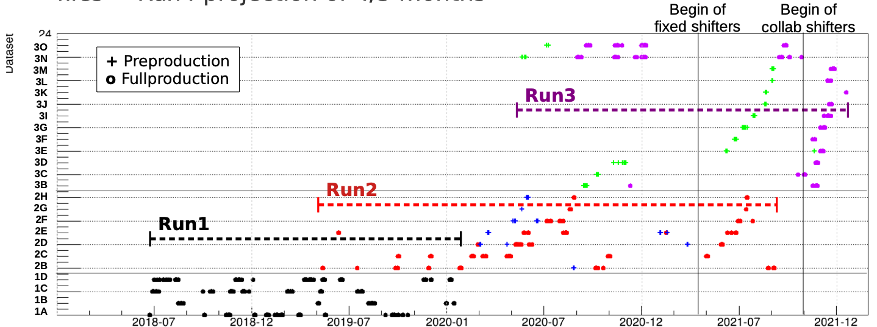
Production History
See slide notes for a tour of this slide!
Shifters have been key!!
Run 4 is 1M files, Run 5 will be 1.2M
15.7M CPU in 2020
9.2M CPU in 2021
We re-processed data from a calorimeter algorithm in Run 3 in May 2022 (0.2M CPU hours in 2 weeks)
We’ve completed Run 4 Preproduction and are about to start Full production (double the files of Run 3)
We’ll start Run 5 Preproduction soon
We continue to take Run 5 online data
Notes:
Here’s a guided tour of this complicated slide...
This plot shows the processing history of Run 1, 2 and 3 data (see slide 4 for the data taking periods). At present, we’re about to start full production for Run 4 and pre-production for Run 5. We’re still taking Run 5 data online.
We split up a Run into datasets (e.g. 2D). See the vertical axis.
The blobs show when pre-production and full production jobs were run
Run 1 only had full production (black blobs). You can see that we re-processed datasets many times.
Run 2 started with only full production (and many re-processings)
In 2020, we started the process of pre-production (to determine constants) followed by full production. For Run 2, a pre-production job is in blue. A full production job is in red.
Red blobs close together in time do not necessarily mean a re-processing was done. Rather, we probably had a gap in production jobs (perhaps waiting to pre-stage data).
For Run 3, pre-production is in green and full production is in purple. You can see that we re-processed datasets 3N and 3O many times before we thought we had it right.
Note the improvements in having shifters
The bottom shows the production CPU hours for that calendar year (outlined by the orange lines).
What to take away from this plot:
Shows that it takes a long time for us to be satisfied with our processed data
We reprocess often. Since we’re an ultra-precision experiment, we need to get it right.
We’re reprocessing less than we used to
Shifters have made a huge difference
Runs 4 and 5 will have a lot more data than we’re used to

Slide 9
Recent Production Improvements
1 PB dCache Read pool. Allows us to pre-stage files much more effectively (see later for a request to increase)
Production shifters (started with 8, then 6, now 3 (pre, full, data quality) -- Shifters come from the collaboration and get points -- Extremely successful -- Lots of standard procedures, checklists, and documentation
Improved memory usage (now < 2 GB most often)
Potentially move part of reconstruction to UK/NERSC (see later slide)

Slide 10
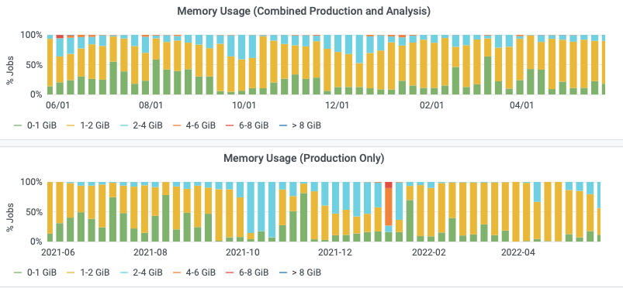
Memory Footprint Over the Last Year
We’ve worked to keep production memory < 2 GB
Some files require more

Slide 11
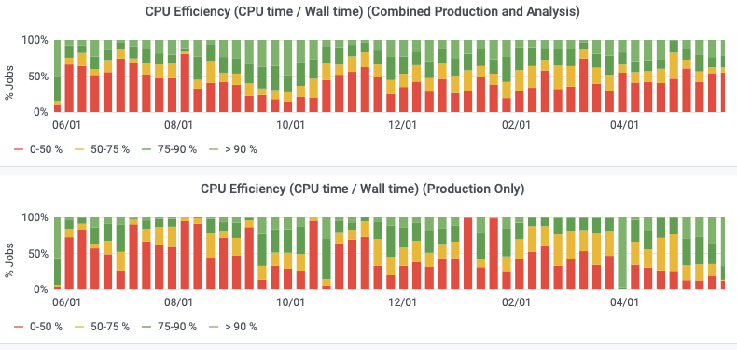
CPU and Memory Efficiency Over the Last Year
Many high-speed, low CPU job that are probably better suited for the analysis facility
Production has improved

Slide 12
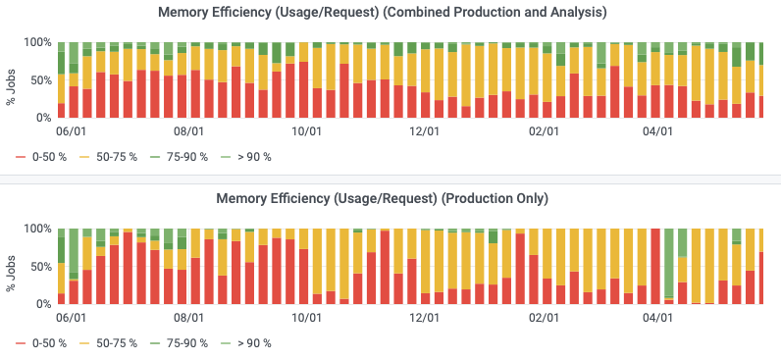
Memory efficiency

Slide 13
CPU - Prediction Going Forward and Accuracy of Your Predictions [units of Million (1 CPU, 2GB) wall hours per CY]
 | 2018 | 2019 | 2020 | 2021 | 2022 | 2023 | 2024
Requested | 17.34 | 21 | 33 | 45 | 60 Processing Run 3,4,5, sim, analysis | 60 Processing Run 5,6, sim, analysis | 40 Processing Run 6, sim, analysis
Actual Used | 13 | 29.2 | 40.5 | 27.5 | 8.5 To date | N/A | N/A
Efficiency | 54% | 79% | 70% | 70% | Maybe improve (see slides) | N/A | N/A

Slide 14
Potential improvements to CPU efficiency
The Read Pool has helped greatly (see next slides for a request)
Use a common skim (in the works)
Move the high speed, high i/o analyses to analysis facility

Slide 15
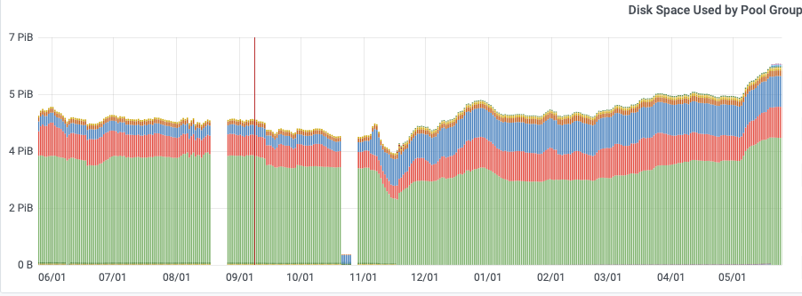
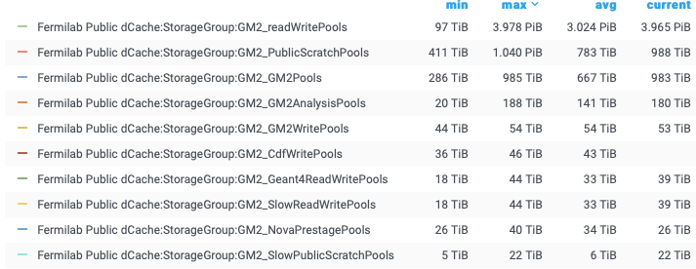
Disk: dCache Usage and Predictions (in TB)
 | Analysis (Persistent) | DAQ Write Pool | Read Pool
Current | 188 TB (actual) | 54 TB (actual) | 1 PB
2022 | 200 TB | 54 TB | >1.5 PB
2023 | 400 TB | 54 TB | > 1.5 PB
2024 | 500 TB | 54 TB | 1 PB

Slide 16
Read pool
The dCache Read Pool (now 1PB) has been crucial for timely production Pre-staging is much faster and more predicable
We only allow raw data for production in the Read Pool
Run 4 is 2 PB of raw data (Run 5 will be 2.2 PB)
We want to process more data at a time...
We submit jobs to process 100K files (~2.5 GB each). Takes about 2 weeks to process
We want to do 2 sets of 100K files (Run 4 and Run 5) – so we need 0.5 PB to hold them
While that’s running, we prestage the next 0.5 PB, so it’s ready when the current processing is done
We also want to keep the previous 0.5 PB of files for recovery, small reprocessing
Having 1.5 PB Read Pool would help make this easy and we can do Run 4 production and Run 5 pre-production together (we wouldn’t say no to 2 PB ☺ )

Slide 17
Tape - Usage and Predictions (in PB)
 | Total Added By End of Year
At end 2021 | 21.31 PB
2022 | +3.5 PB so far (Run 5 raw + Run 3 Proc) +0.5 PB to end Run 5 raw +2.5 PB Run4 Proc +1 PB Sim/Analysis = +7.5 PB total (Req)
2023 | +3 PB Run 5 Proc +2 PB Run 6 Raw +1 PB Sim/Analysis +1 PB Run 6 Proc = +7 PB total (Req)
2024 | +1.5 PB Run 6 Proc +2 PB Sim/Analysis = +3.5 PB total (Req)
Note that this uses a more optimistic schedule than slide 6
Req = our request
Notes:
Get plots and data from https://fifemon.fnal.gov/monitor/d/r6UDhH-iz/sppm-sc-pmt-prep?orgId=1

Slide 18
Disk: NAS Usage and Predictions (in TB Units)
 | App | Data
2022 | 10.6 | 12.3
2023 | 12 | 15
2024 | 15 | 20
Notes:
Get plot from https://fifemon.fnal.gov/monitor/d/r6UDhH-iz/sppm-sc-pmt-prep?orgId=1 after choosing experiment name at the top

Slide 19
Data Lifetimes
Every production/simulation version has its own file family
We can and have recycled obsolete production data
In 2022 (so far) we requested recycling tapes containing ~ 0.5 PB of data

Slide 20
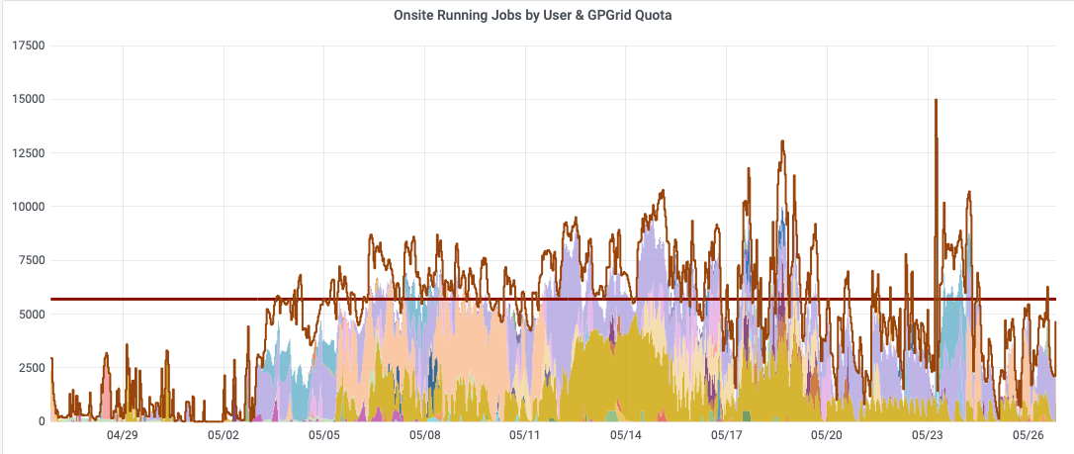
What Do You Want to Achieve in Computing Over Next Three Years
We want to process our data more quickly...
Lia wants to know what can be done and how SCD can help
The larger Read Poll will be a big help.
Increasing our production FermiGrid quota (now 5,800 jobs) to 7,500 would allow us to run more production jobs continuously and run simulation
Plot shows when we ran the Run 3 re-processing. Dark yellow are these production jobs. We want to do more jobs simultaneously.
Notes:
These are just examples. Please fill in the needs for your experiment. Looking for things that the experiment will be focused on and the things you need SCD to focus on.
This doesn’t have to fit all on one slide - use as many as you need.

Slide 21
Making production faster
We can speed up production computing by a factor of two by decoupling the calorimetry reconstruction from the tracking reconstruction
Tracking takes half of the total reconstruction time
Most analysis don’t use the tracking data
The raw tracking data is a small fraction of the total raw data size We can extract these data production into their own file ... then move to other sites for processing
Splitting off the Tracking data would not disrupt the main calorimetry processing and the main analyses

Slide 22
Processing tracking data
Our UK collaborators have grid resources for this purpose.
The art framework has been updated to handle merging the tracking data back in with the calorimetry data
Still working through some meta-data issues
Tracking reconstruction is also good candidate to move to NERSC
Would need SCD help to make this happen
We already use HEPCloud at NERSC for simulation, so infrastructure is already in place. There’s a good opportunity to get a NERSC allocation soon

