Slide 1
DUNE FCRSG 2022
Heidi Schellman for the Computing Consortium

Slide 2
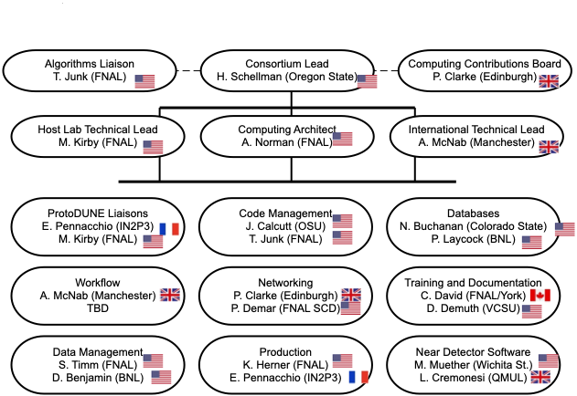
Experiment Organization Chart for Offline Computing
Notes:
Is computing an afterthought or an integral part of the experiment.
Where is the R&D managed for moving to HPC, incorporating machine learning as needed, etc
The shift to HEPClould require more diligence on production teams to run an operations team to ensure Cloud and HPC hours are not wasted.
Is their build and release model supported, and are they evolving in a sustainable way? The division won’t be building specialized packages anymore. There are several legacy experiments that are still using NAS areas for builds instead of CVMFS. They don’t have the resources to modernize and the division doesn’t have the resources to support them as is.

Slide 3
Important Dates to Remember
2022
2023
2024
Q1
Q2
Q3
Q4
Q1
Q2
Q3
Q4
Q1
Q2
Q3
Q4
COLD BOX RUNNING @ CERN
NP04 Beam run with cosmics to follow
NP02 beam run
DATA Challenges
Big DUNE DAQ commissioning starts in 2027, first “light” in 2029
Notes:
Optional one slide prior to this slide commenting on your major computing activities; define abbreviations to be used in this slide
EG, data taking periods, campaigns, reviews, conference deadlines. This is the slide that will show your physics goals in terms of computing.

Slide 4
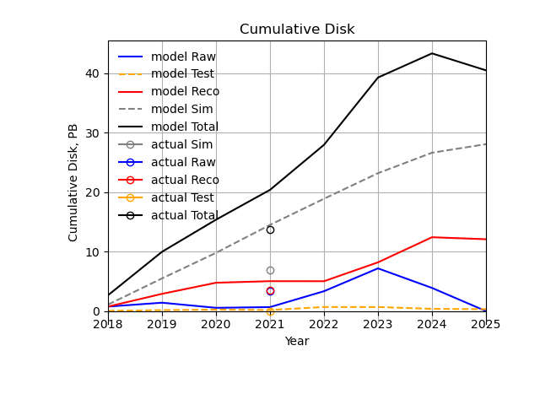
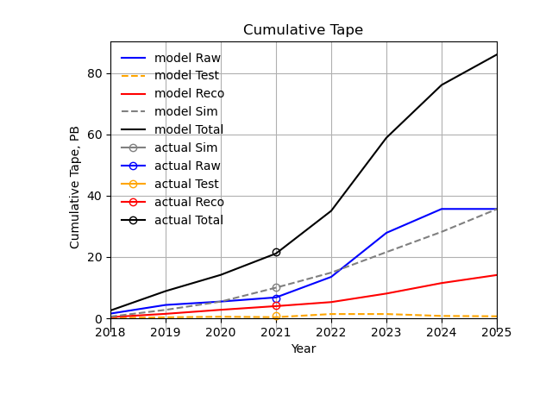
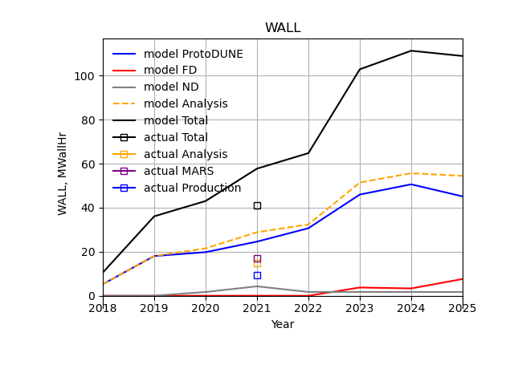
Data Model Calculations
Dune has a python based resource prediction model that is updated 1-2 times/year.
This shows total needs. Collaboration contributions are negotiated by the Computing Contributions Board each year

Slide 5
Important notes on DUNE CPU usage
17 MHrs of wall time/year is used for MARS which was not in our prediction models
MARS is pretty CPU and memory efficient
Analysis and production ran at about 80% efficiency at FNAL and used 27 MHrs of FNAL slot-weighted wall time according to Kibana – but typical jobs use 4-6 GB of memory because LAr data is BIG!!!!!
So average memory and CPU for DUNE are looking at 2 very different populations.
We now phrase our request as Model Wall time x 2 slots + MARS

Slide 6
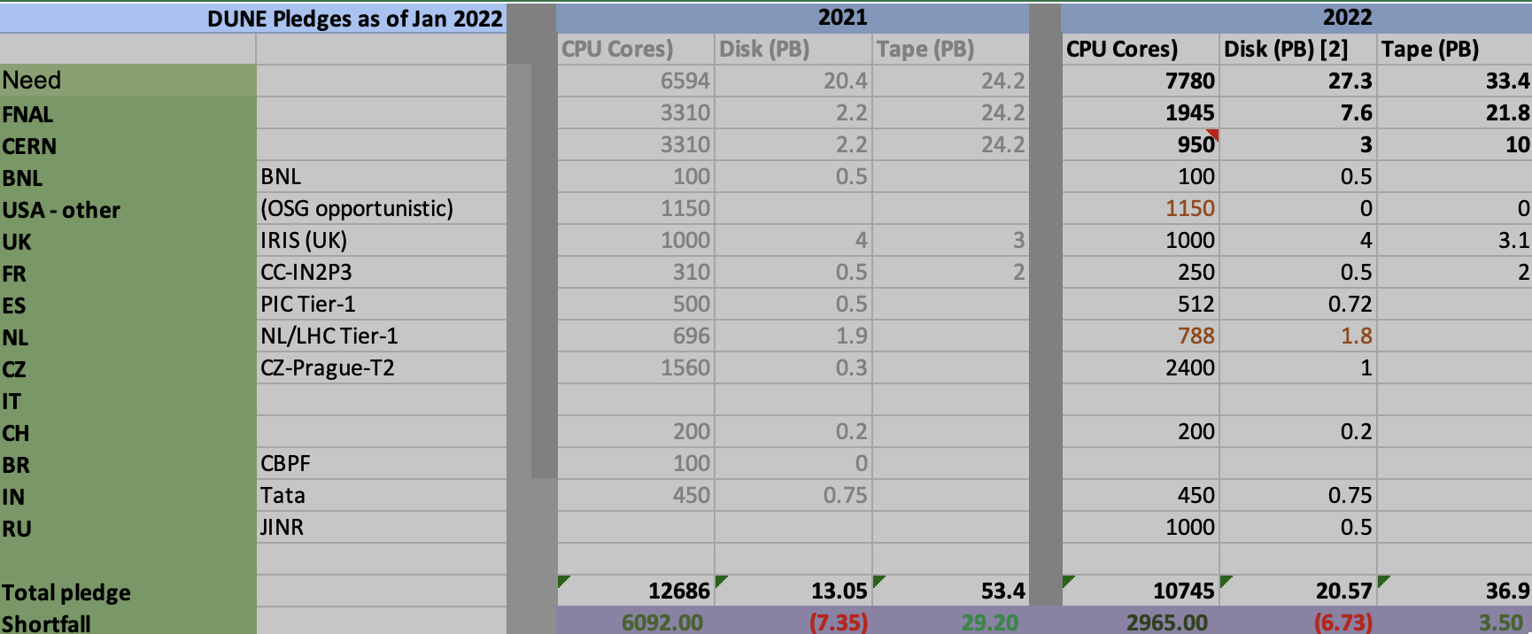
Making use of external resources
Goal is 25% FNAL 75% Collab
Except for raw tape which is 50% FNAL
International Pledges as of January 2022 CPU is not memory slot corrected.
2021
2022

Slide 7
Model based requests – updates May 2022
Change from Contributions board numbers is increased data size from PD
Wall hours are not corrected to slot Hrs in this table as many sites have > 2 GB/core
F means Fermilab, C means CERN, Collab means Collaboration
FNAL request for 2022 – 16 MHrs x2 mem + 17 Mhrs of Mars = 49 2GB Slot-hrs. Increase disk to 8.0 PB in 2022, 11.8 in 2023

Slide 8
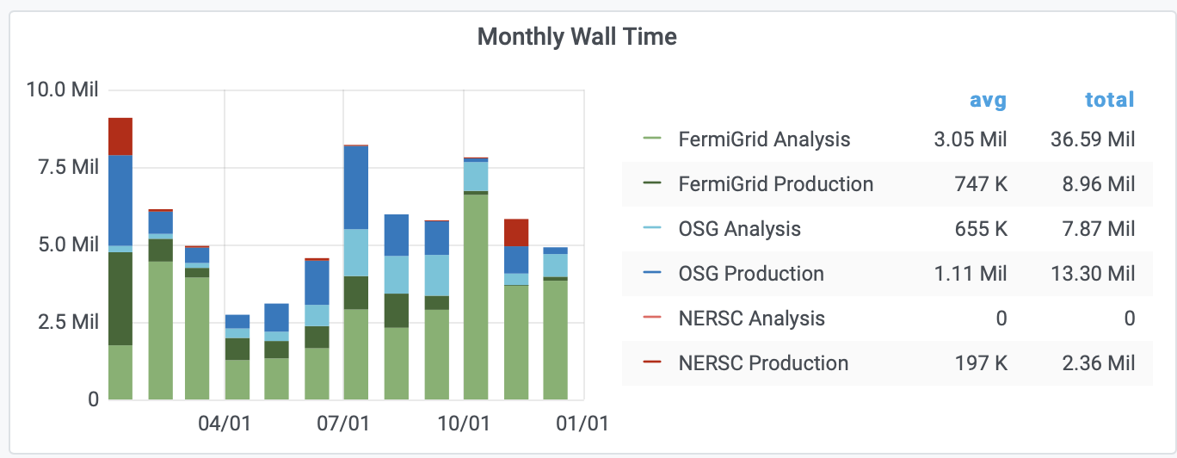
CPU - Experiment Usage Calendar 2021
Includes 17 MHrs of MARS
corrected for # of slots
What if this profile is not attainable?
Notes:
If you aren’t running offsite, why not?
Do you understand the peaks? What would have been the implications if the peak levels were not attainable?
Can you use HEPCloud HPC resources?
Get plot from https://fifemon.fnal.gov/monitor/d/r6UDhH-iz/sppm-sc-pmt-prep?orgId=1

Slide 9
Memory Footprint (Combined)
Notes:
Is the memory footprint contained?
Do you anticipate your memory footprint per cpu growing and if so how much?
This “Memory Usage” plot is showing the actual size of jobs run and doesn’t take into account the size of the request. On the next slide the ”Memory Efficiency” slide will show if jobs are using less than they’re requesting.
Get plots from https://fifemon.fnal.gov/monitor/d/r6UDhH-iz/sppm-sc-pmt-prep?orgId=1

Slide 10
CPU and Memory Efficiency Calendar 2021 (Combined)
How much waste is there and can it be reduce d?
What improvements are planned?
Notes:
Please explain the reason if these plots show your experiment jobs inefficiently using the memory or cpu requested.
Get plots from https://fifemon.fnal.gov/monitor/d/r6UDhH-iz/sppm-sc-pmt-prep?orgId=1

Slide 11
Memory: Production Only, Calendar 2021

Slide 12
Memory, Analysis Only, Calendar 2021
Most of the Green is MARS

Slide 13
CPU - Prediction Going Forward and Accuracy of Your Predictions [units of Million (1 CPU, 2GB) wall hours per CY]
 | 2020 | 2021 | 2022 | 2023 | 2024
Requested | 25 (FNAL) (36 Total) | 29 FNAL | 2*16 +17 FNAL =49 MSlotHrs +49*X offsite | 2*26 +17 FNAL =69 MSlotHrs +77*X offsite | 2*28 +17 FNAL = 73 MSlotHrs +84*X offsite
Actual Used | 29 (GPGrid) 42(WLCG+GPGrid) 3.85 (NERSC) | 36 FNAL 20 OSG+WLCG 2 NERSC | 14.1 FNAL YTD | N/A
Efficiency | % | %80 | N/A | N/A
Now includes MARS in request. Assume 2 slots/process except for MARS
Offsite often has more memory/slot so hard to compare
Aim is 25% FNAL, 75% offsite. MARS and 2 GB limit make this hard
Notes:
In units of Million (1 CPU, 2GB) hours per CY.
Pull cpu numbers from FCRSG_2022_CPU_hours.xlsx in 2022-prep view at:
https://fermipoint.fnal.gov/project/sppm/Working%20Group%20Documents/Forms/2022prep.aspx
The numbers from that spreadsheet are the usage on Fermigrid only.

Slide 14
CPU Adaptations Going Forward
How can experiment use OSG/HPC/Cloud/HEPCloud going forward? Also WLCG!
DUNE needs ~4 GB/process for reco and many analysis jobs.
> 50% and sometimes 75% of computing is done offsite.
We have cached ~4 PB of reconstructed/simulated data in Europe to make better use of European compute resources. This increased efficiency in Europe substantially and relieved pressure on FNAL tape drives.
DUNE has used NERSC mostly for MC simulation through joint FIFE allocation via HEPCloud. Will continue.
Plenty of GPU use cases, have some GPU allocation on Perlmutter this year
Have used GPUs in the cloud for inference as a service testing in collaboration with MIT
Notes:
What sites are available (an allocation does or will exist) for experiments to use?
What sites work well for what sort of workflows.
Experiment need to understand their compute needs so they can specify what percentage would fit on which HPC resources.

Slide 15
Disk: dCache Usage and Predictions (in TB)
 | Analysis (Persistent) | Dedicated (Write) | Total
Current | 900 TB (actual) | 5.1 PB (actual) | 6.0PB
2022 | 900 TB | 6.7 PB | 7.6 PB
2023 | 2000 TB | 9.8 PB | 11.8PB
2024 | 2000 TB | 9.9 PB | 11.9PB
Persistent + Other = Pledge
Numbers are from the model
Current:
Total r/w (tape backed): 5100 TB
Total scratch: 700 TB
Total persistent: 900TB
Will not track cache usage,
but need to know of unusual requests
Notes:
Get plots and data from https://fifemon.fnal.gov/monitor/d/r6UDhH-iz/sppm-sc-pmt-prep?orgId=1

Slide 16
Tape - Usage and Predictions (in PB)
 | Total Added By End of Year
At end 2021 | 18.5 PB (actual)
2022 | 22.6 PB
2023 | 36.9 PB
2024 | 48 PB
Numbers are from the model. ProtoDUNE will write a lot of data in 2023
Notes:
Get plots and data from https://fifemon.fnal.gov/monitor/d/r6UDhH-iz/sppm-sc-pmt-prep?orgId=1

Slide 17
Disk: NAS Usage and Predictions (in TB Units)
 | App | Data
2022 | 16.3TB | 60.6TB
2023 | 20.0TB | 62.0TB
2024 | 20.0TB | 62.0TB
Notes:
Get plot from https://fifemon.fnal.gov/monitor/d/r6UDhH-iz/sppm-sc-pmt-prep?orgId=1 after choosing experiment name at the top

Slide 18
Age of files in NAS
Notes:
Get plot from https://fifemon.fnal.gov/monitor/d/AjtawA5Wk/nas-volume-file-age?orgId=1
Go to bottom of page in table and click on your experiment name to populate the filter

Slide 19
Data Lifetimes
All new data added to DUNE data management will have a retention class and a retention lifetime from the beginning. Existing data retention strategy is based on data_tier and data_stream(type)
The model includes tape retention times for raw (100 yr), reconstructed (15 yr) and test data (0.5 yr)
Negotiating with current ProtoDUNE physicists to put short lifetimes on commissioning data (noise studies, pedestal studies, cold box data, etc.)
Hope to move major user samples to cataloged rucio controlled areas
There is a significant amount (~2PB) of old reconstructed data output that is scheduled to be purged off tape some point this year.

Slide 20
What Do You Want to Achieve in Computing Over Next Three Years
Goals | Where does the experiment need to contribute | Where does SCD need to contribute
Transition to new data and workflow management systems in production | Requirements and effort | Rucio quality of service, data transfer, monitoring, extensions to POMS and possibly Jobsub
Framework capable of handling very large data objects | Requirements and effort | High level expertise
Complete analysis and simulation of ProtoDUNE | Algorithms and code management, database design | Database support, networking, storage and personnel in DUNE leadership
Continue to support TDR efforts for near detector and vertical drift | Joint effort | Joint effort
Transition to SPACK packaging | Knowledge of software stack | SCD personnel expertise
Notes:
These are just examples. Please fill in the needs for your experiment. Looking for things that the experiment will be focused on and the things you need SCD to focus on.
This doesn’t have to fit all on one slide - use as many as you need.

Slide 21
Analysis facilities for > 1000 users
Current Analysis Facility
Still in development - early test of Elastic Analysis Facility are promising
Need enough fast disk for user samples
Future Analysis Facility
Want to build on the successful LPC Analysis Facility model within the FNAL Neutrino Physics Center
Important to have specific effort to support users and provide tutorials
large, fast disk with user quotas (not 100 PB over xrootd)
potentially combination of both HTC queue and dynamic, jupyter-based cluster (COFFEA style, Elastic AF)
GPU/accelerator availability
Currently using 17 GPVM’s for
LArSoft algorithm development
end stage root analysis of user generated samples
command-line grid submission
last 6 months, 50 active users submitting grid jobs
Need GPVM’s for
High memory testing of analysis – need more memory!!!
Debugging
Event display
Db access
Xrootd access to data

Slide 22
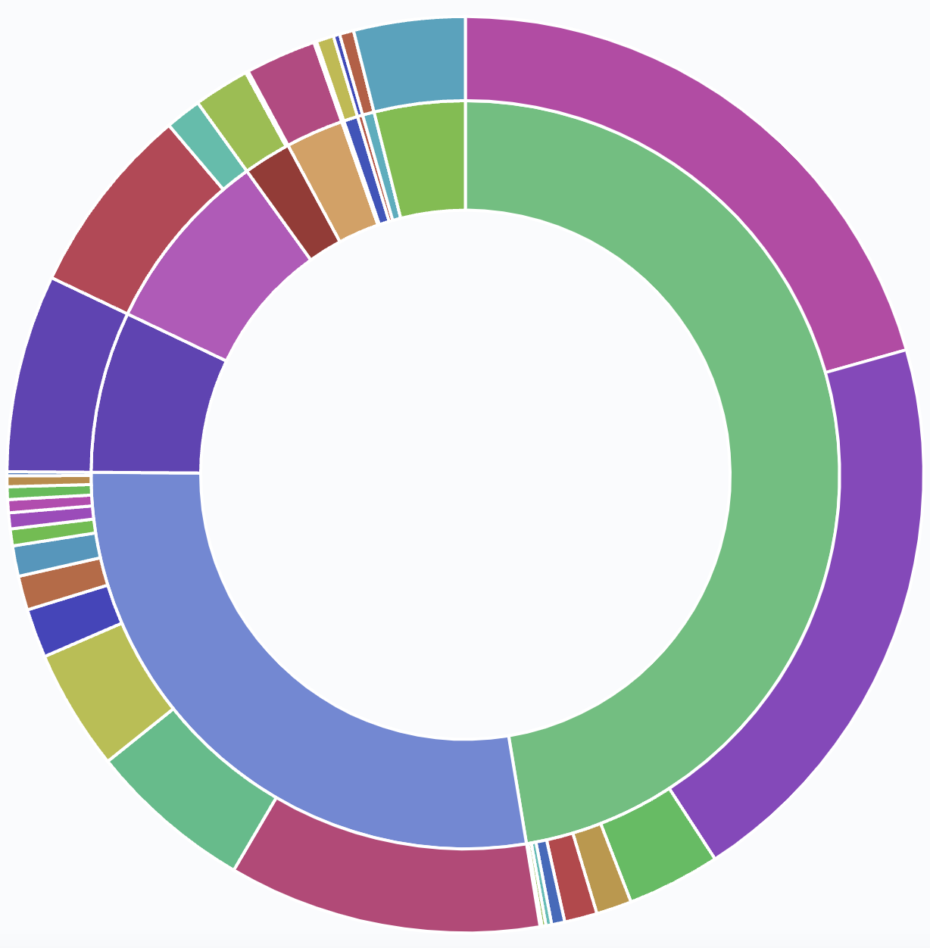
Anything else?
India has 6 GB/core and contributes a lot!
FNAL
Strong international effort to pool resources.
Production and now analysis are largely running offsite
Need lots of disk and >= 4GB/core!
US
Aug 2021
Notes:
Eg, unusual DB needs, online needs, etc.

