Slide 1
SBN FCRSG 2022: Resource Request
Chris Backhouseª, Wesley Ketchum^{b}, and Joseph Zennamo^{b}
(a) UCL, (b) Fermilab
01 June 2022

Slide 2
Organization for Offline Computing
ICARUS Sim and Reco Software
(Tracy Usher and Daniele Gibin)
SBN Analysis Infrastructure
Chris Backhouse, Wes Ketchum
SBND Physics and Analysis Tools
(Costas Andreopoulus, Bill Louis, and Andrzej Szelc)
Analysis Framework:
Gianluca Petrillo, Fernanda Psihas
Prod. & Data Mgmt.
Mateus Carneiro, Maya Wospakrik
Release Management: Sergey Matrynenko, Matthew Rosenberg
Release Management:
Miquel Nebot-Guinot
Sim. Infrastructure:
Marco Del Tutto, Alessandro Menegoli
Release Management: Fran Nicolàs
Production Management: Maya Wospakrik
Validation Framework:
Chris Hilgenberg
Workflow Mgmt:
Sophie Berkman, Herb Greenlee
Production Management: Mateus Carneiro
SBN Analysis
Daniele Gibin, Georiga Karagiorgi
Each experiment has an existing software and computing structure
Common SBN Analysis Infrastructure group to organize common needs and efforts
SBN numbers are presented jointly, though with breakdown by individual detector available
Work hand-in-hand with each detector’s groups and common SBN Analysis group

Slide 3
Overview Timeline
FY2022
FY2023
FY2024
Q1
Q2
Q3
Q4
Q1
Q2
Q3
Q4
Q1
Q2
Q3
Q4
ICARUS Final Commissioning w/ Neutrinos
ICARUS Full Operations
SBND Commissioning
SBND Full Operations
ICARUS Keep-up processing
SBND data processing
Software Release Preparation
SBN Production Run
Software Release Preparation
ICARUS + SBND Production Runs
ICARUS trigger commissioning complete; final cosmic-ray overburden being installed now → physics run
Have been taking neutrino data this whole year; various stages of detector commissioning
SBND to enter commissioning in FY2023-2024 and move (hopefully rapidly) to full operations
Major data production campaigns:
Ongoing first ‘large-scale’ campaign’
Expect two major production campaigns for FY2023, with a goal to begin one as early as October 2022

Slide 4
Updates in computing model
No major overhaul of ‘default’ computing model since last year
Our computing continues to be ‘Fermilab-centric’, though we have added data backup storage at CNAF and pursuing developments to use at HPC
Detector data production workflows rely heavily on inline (“keep-up”) processing of data
Reduces data volume, but there is a risk for re-processing
Data production campaigns
Assume two per year, but out-years assume only one major simulation production
Require campaigns to be ~90 days in order to be useful
Assume 10x statistics for major simulation samples, and have factored in increased POT/year estimates based on recent beam performance
Data lifetimes:
Raw (detector) data: permanent
Derived data: 1-2 years

Slide 5
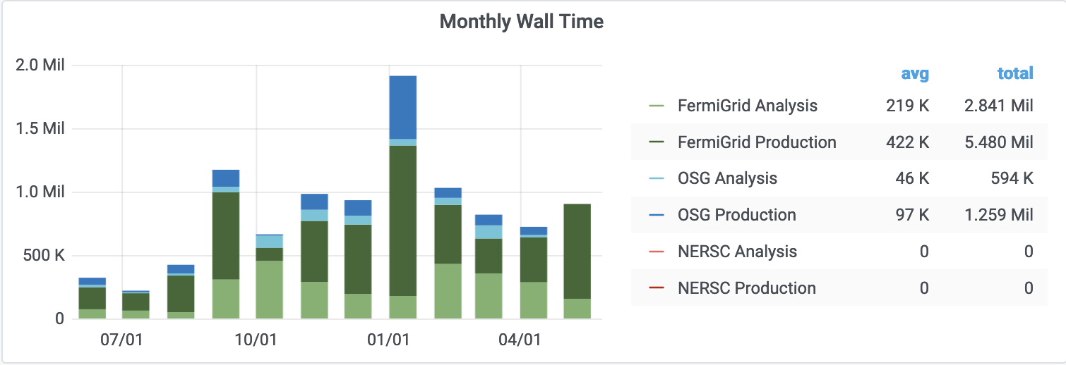
ICARUS CPU usage over last year

Slide 6
ICARUS Memory usage over last year

Slide 7
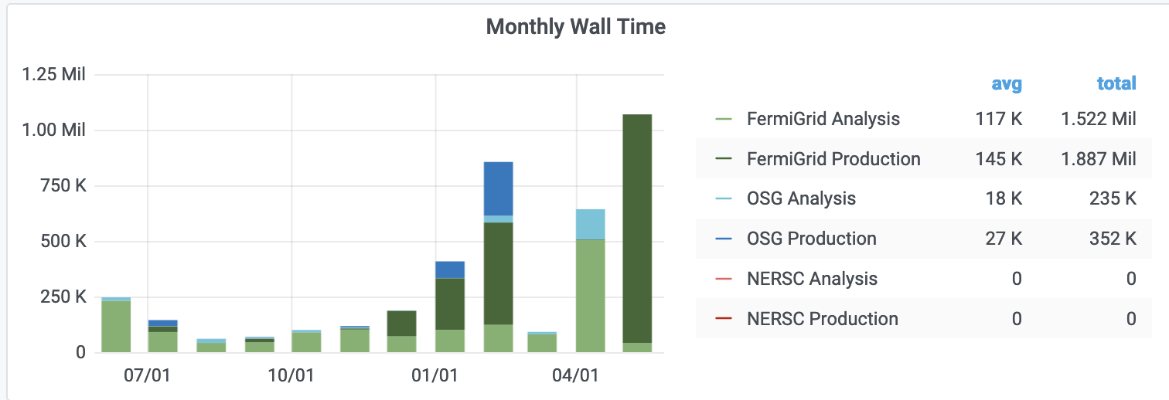
SBND CPU usage over last year

Slide 8
SBND Memory usage over last year

Slide 9
CPU and Memory usage notes
Memory usage and efficiency a continual concern
Getting to less than 2 GB will require significant work
ICARUS full cosmics simulation ~5 GB → can be offset in future by use of data-driven cosmic backgrounds, but at cost of I/O
SBND simulation needs 2-4 GB
Already have off-loaded optical simulation from look-up library to semi-analytic (CPU-heavy) model
Need to realistically assess capability of < 2 GB goal
Across SBN, CPU efficiency often limited by data I/O
Need improved workflow management and resources to improve/work around this
Production efficiency significantly improved this year with pushing consecutive stages to run on same worker node and making use of SBN data pool
More later…

Slide 10
SBN CPU usage history and prediction
Units of Million (1 CPU, 2 GB) wall hours per CY
 | CY2018 | CY2019 | CY2020 | CY2021 | CY2022 | FY2023 | FY2024
Requested | 9 | 13.2 | 16.5 | 19.5 | 27 | 42.8 | 45.3
Actual Used | 0.67 | 4.46 | 7.7 | 11.4 | 15 | N/A | N/A
Efficiency |  |  |  |  | ~80-90%

Slide 11
CPU Adaptations Moving Forward
We have used OSG resources, though often limited in availability due to high memory requirements
Will hope to use more as we improve workflows
We are interested in onboarding to HEPCloud, but has not been highest priority for us
And, importantly, no mechanism for funding yet identified
Significant work in SBN on use of HPC resources
SciDAC projects on optimizing signal-processing and hit-finding in reconstruction and final fits for HPC → demonstration tests with ICARUS data workflows ongoing
Previous UK efforts on containerized SBND cosmic simulation on ANL Theta → achieved additional processing capacity in recent production
Heterogeneous computing use currently not fully-factored in, though use of GPUs for ML training/inferences is being discussed

Slide 12
ICARUS and SBND dCache usage
ICARUS
SBND
SBND
NOTE! SBN Data Pool Double-Counted!

Slide 13
SBN Tape usage
ICARUS
SBND

Slide 14
SBN Tape usage and predictions
Units of PB
 | Total Added / Total Footprint By End of Year
Current | 11.2
Additional FY2022 end | +3.9 / 15.1
FY2023** | +0.6 / 15.7
FY2024 | +15.6 / 31.25
**Assumes aggressive data retirement, see next slide

Slide 15
Some notes on data usage
We continue to focus on driving down data volume needs in SBN
Previously saw large gains in SBND sim event sizes
ICARUS reconstruction workflows target dropping of raw data from reco files
Need to formally assess current data on tape for retirement
Bulk is ICARUS commissioning data, which was always planned to have limited lifetime
FY2023 additional added raw data volume is 13.2 PB → goal would be to offset that increase by retiring most current ICARUS commissioning data
We are using Rucio for data transfers to CNAF, but yet to fully integrate into data management system
Critically need SCD support for this

Slide 16
SBN dCache Requests
Anticipate needs to increase in persistent space to support increasing analysis activities
Requesting ~1 PB write volume to support SBND data-taking in FY2023
Received 2 PB allocation last year for “SBN data pool”
Target was for output of production: derived data, commonly used for analysis work, with medium-term lifetimes
Has had a major improvement on production efficiency and reduction in tape usage
 | Analysis (Persistent) | Other Dedicated (RW)
Current | 209 TB (actual) | 3000 TB (actual)
FY2022 | 250 TB | 3000 TB
FY2023 | 300 TB | 4000 TB + ?
FY2024 | 300 TB | 4000 TB + ?

Slide 17
More notes on data usage
A major computing problem for SBN continues to be data I/O
Estimate that in FY2023, we will need peak rates of 3.22 TB/hr read, and 3.95 TB/hr write (simultaneously) to support data-taking and production campaigns
For reference, our steady-state raw data write rate is ~0.7 TB/hr
By FY2025, this increases to 7.62 TB/hr and 7.34 TB/hr, respectively
This is after aggressive (but hopefully realistic) improvements on cutting down data usage
We consider SBN data pool to have been a major success and, as we discussed when we requested the resource, we will want to pursue how to expand
Still assessing how to optimize use patterns (using ongoing production as a test point), but would like to minimize using tape as a ~2-yr-lifetime data cache
Total derived data is ~8 PB in FY2023 → upper-limit scale for what would be used
Will plan to prepare presentation for SPPM to outline proposal
Aiming for later this summer

Slide 18
SBN NAS usage
ICARUS
SBND

Slide 19
SBN NAS usage and predictions
ICARUS
SBND
 | App | Data
current | 4.0 | 25
FY2023 | 5.0 | 30
FY2024 | 5.0 | 30
 | App | Data
current | 4.5 | 25
FY2023 | 5.0 | 30
FY2024 | 5.0 | 30
Units of TB
Needed to support areas for software development, tests, and analysis work
Modest increases support needs for onboarding new analyzers
Effort to help keep builds small, tools for cleaning up larsoft builds, etc. are often biggest drivers of efficient use (besides general cleanup)
[Astute observers will note we have not actually increased these over last years, and we try to continue to cleanup rather than ask for more …]

Slide 20
General concerns
LArSoft / framework support
We rely heavily (and contribute back to) LArSoft and the LArSoft ecosystem (e.g. mrb, art, etc.)
Improvements in CPU efficiency, memory usage, production and validation systems, HPC deployment, etc. rely on SCD support even when those activities have significant collaboration effort/leadership
We are worried about maintaining the level of support needed, especially when effort goes into new developments
Going from “realistic demonstrator” to “production-stable” infrastructure generally takes time, and general leads to dependence on “feature-frozen” software far longer than anticipated

Slide 21
Backup

Slide 22
ICARUS CPU usage prediction
Units of Million (1 CPU, 2 GB) wall hours per CY
 | CY2018 | CY2019 | CY2020 | CY2021 | CY2022 | FY2023 | FY2024
Requested | 0.5 | 4.8 | 12 | 15 | 20 | 17.9 | 16.7
Actual Used | 0.5 | 1.6 | 3.5 | 6.5 | 10.5* | N/A | N/A
Efficiency |  |  |  |  | ~80-90%
*extrapolation to end of CY

Slide 23
SBND CPU usage prediction
Units of Million (1 CPU, 2 GB) wall hours per CY
 | CY2018 | CY2019 | CY2020 | CY2021 | CY2022 | FY2023 | FY2024
Requested | 8.5 | 8.4 | 4.5 | 4.5 | 7 | 24.9 | 28.6
Actual Used | 0.2 | 2.9 | 2.2 | 4.9 | 4.5* | N/A | N/A
Efficiency |  |  |  |  | ~90-95%
*extrapolation to end of CY

Slide 24
ICARUS Tape usage and predictions
Units of PB
 | Total Added / Total Footprint By End of Year
Current | 10.3
Additional FY2022 end | +3.9 / 14.2
FY2023** | -0.2 / 14.0
FY2024 | +10.3 / 24.3
**Assumes aggressive data retirement of commissioning data

Slide 25
SBND Tape usage and predictions
Units of PB
 | Total Added / Total Footprint By End of Year
Current | 0.9
Additional FY2022 end | +0 / 0.9
FY2023 | +0.8 / 1.7
FY2024 | +5.3 / 6.9

Slide 26
Some 2021 Slides

Slide 27
General notes/concerns
ICARUS and SBND continue to make use of common tools for computing, and want to continue to do so but will need ongoing support
Software builds and releases: LArSoft, spack transition, continuous integration/validation tools
Strategic plan to use Rucio for data management / data transfers at risk due to lack of support
Missed first critical deadlines, working to avoid missing others
Working towards improving our computing model ensuring it continues to meet both joint analysis and individual analysis needs
Putting a focus on optimization of production workflows, in particular use of HPC in computing production given significant recent progress

Slide 28
Goals over the next three years
Goals | Where does the experiment need to contribute | Where does SCD need to contribute
Transition of ICARUS from commissioning to operations now, and in future for SBND | Detector commissioning, computing model, sensible physics plan | Support for optimization of onsite data transfers and data storage, processing of data
Deployment of Rucio for improved data management, inclugind automated data transfers (CNAF, other sites) | Collaboration support/effort, expertise on external sites and interfaces to external computing | Core development work, documentation, support
Increased usage of HPC resources, integrating into standard production workflows | Collaboration support/effort, algorithm development, workflow development | Expertise for development, support and expertise for transitioning to production
Large-scale production for single and multi-detector physics analyses | Software, data management, workflow development | (LArSoft) software support, profiling and optimization expertise, including on data storage and management

Slide 29
ICARUS CPU usage prediction
Units of Million (1 CPU, 2 GB) wall hours per CY
 | 2018 | 2019 | 2020 | 2021 | 2022 | 2023
Requested |  |  |  | 14.3 | 20.8 | 29.1
Actual Used |  |  |  | N/A | N/A | N/A
Efficiency | % | % | % | N/A | N/A | N/A

Slide 30
SBND CPU usage prediction
Units of Million (1 CPU, 2 GB) wall hours per CY
 | 2018 | 2019 | 2020 | 2021 | 2022 | 2023
Requested |  |  |  | 4.0 | 11.8 | 19.0
Actual Used |  |  |  | N/A | N/A | N/A
Efficiency | % | % | % | N/A | N/A | N/A

Slide 31
ICARUS Tape usage and predictions
Units of PB
 | Total Added / Total Footprint By End of Year
At end 2020 | 2.8
2021 | +10.9 / 13.7
2022 | +4.0 / 17.7
2023 | +6.5 / 24.2

Slide 32
SBND Tape usage and predictions
Units of PB
 | Total Added / Total Footprint By End of Year
At end 2020 | 0.4
2021 | +0.6 / 1.0
2022 | +3.6 / 4.6
2023 | +2.8 / 7.4

