Slide 1
DES+Rubin/LSST FCRSG 2022
Brian Yanny, Liz Buckley-Geer, Jim Annis, Tom Diehl
Notes:
think in calendar year, not fiscal year.
Presenting experiments *only* need fill out presentation - no spreadsheet.

Slide 2
Experiment Organization Chart for Offline Computing DES
Brian Yanny
DESDM Project Scientist
Analysis
COSMOSIS
Marc Paterno
Jim Annis
Photo-z
Huan Lin
DELVE
Alex Drlica-Wagner
Data Access
Database
Matias Carasco-Kind(NCSA)
Chris Pond(NCSA)
Science Portal
Luiz Da Costa(Linea)
Aurelio Carnero(Linea)
Adriano Pieres(Linea)
DESGW Production Operations
Ken Herner - Lead
Dillon Brout (Chicago)
Alyssa Garcia (Brandeis)
DES Production Operations
Brian Yanny - Lead
NCSA
Robert Gruendl - Lead
Michael Johnson – Prod.
Felipe Menanteau – Science Stack prep
Greg Daues – Stack build
Doug Friedel – Tape Backup
Reconstruction Software
Emmanuel Bertin(iFA Paris)
Erin Sheldon(BNL)
Gary Bernstein(Penn)
Matt Becker(ANL)
Calibration
Douglas Tucker - Lead
Eli Rykoff (SLAC/Stanford)
David Burke(SLAC)
William Wester
<number>
Notes:
Please show here the people in your experiment that support computing.
You can replace with a different style chart, but please make it as complete as possible.

Slide 3
Experiment Organization Chart for Offline Computing Rubin/LSST/DESC
Jim Annis,Brian Yanny
Rubin at FNAL Leads
Science Data Quality
Assurance
Huan Lin
Douglas Tucker
Alex Drlica-Wagner
Jim Annis
Brian Yanny
Nikolai Kuropatkin
Brian Nord
Data Access/Production
Data Bases
Michelle Gower(NCSA)
Nikolai Kuropatkin
Douglas Tucker
Brian Yanny
Jim Annis
Yuyi Guo
Jen Adelman-McCarthy
DBA group (FNAL)
Rubin/Rucio integration
R&D
Brian Yanny
Brandon White
Michelle Gower (NCSA)
Rubin Data Preview
Execution
Eric Neilsen
Douglas Tucker
Nikolai Kuropatkin
Huan Lin
Reconstruction Software, (DESC)
Marc Paterno
Ken Herner
Alex Drlica-Wagner
Data Movement
Douglas Tucker
Greg Daues (NCSA)
<number>
Notes:
Please show here the people in your experiment that support computing.
You can replace with a different style chart, but please make it as complete as possible.

Slide 4
Important Dates to Remember – DES
2022
2023
2024
Q1
Q2
Q3
Q4
Q1
Q2
Q3
Q4
Q1
Q2
Q3
Q4
Y6 Cosmo Prep
Y3 Gold catalog release
Y6 Cosmology release Y6 Gold Catalog release
<number>
Notes:
Optional one slide prior to this slide commenting on your major computing activities; define abbreviations to be used in this slide
EG, data taking periods, campaigns, reviews, conference deadlines. This is the slide that will show your physics goals in terms of computing.

Slide 5
Important Dates to Remember – Rubin
2022
2023
2024
Q1
Q2
Q3
Q4
Q1
Q2
Q3
Q4
Q1
Q2
Q3
Q4
Plan for Regular Distributed Processing
Data Facility Plan (SLAC Lead) ComCam (Early Data) from Mountain
Plan for Alert (fast turn around processing) Operations Start
<number>
Notes:
Optional one slide prior to this slide commenting on your major computing activities; define abbreviations to be used in this slide
EG, data taking periods, campaigns, reviews, conference deadlines. This is the slide that will show your physics goals in terms of computing.

Slide 6
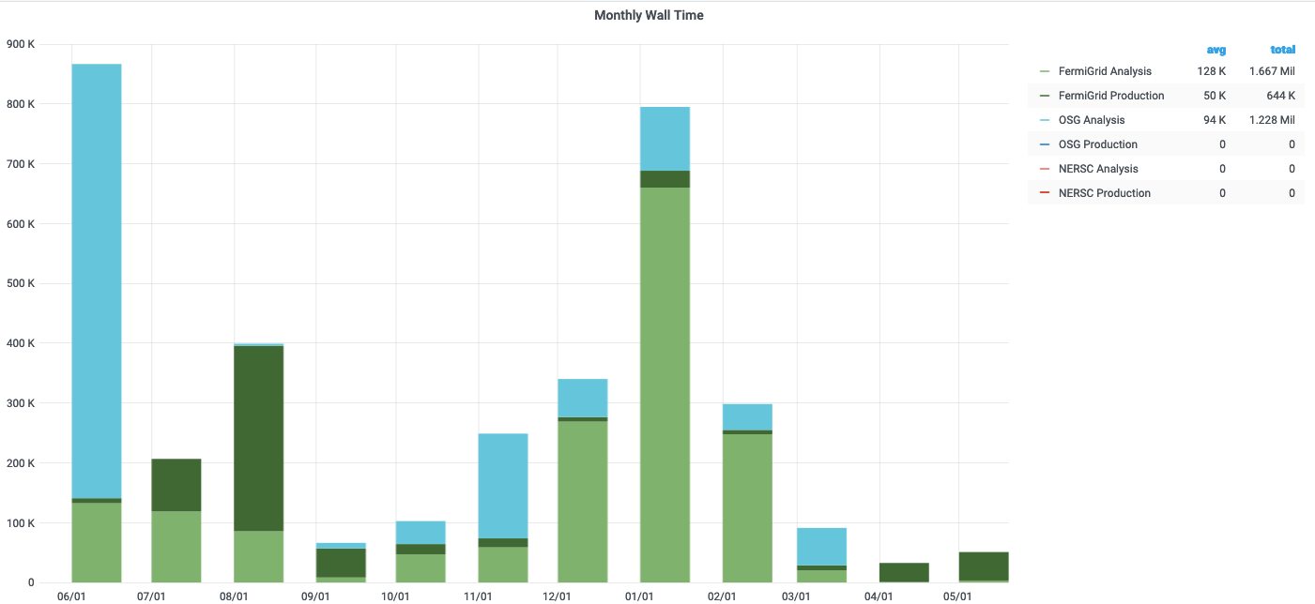
CPU - Experiment Usage Over the Last Year
DES (and minimal Rubin)
<number>
Notes:
If you aren’t running offsite, why not?
Do you understand the peaks? What would have been the implications if the peak levels were not attainable? Can you use HEPCloud resources for future peaks?
Get plot from https://fifemon.fnal.gov/monitor/d/r6UDhH-iz/sppm-sc-pmt-prep?orgId=1

Slide 7
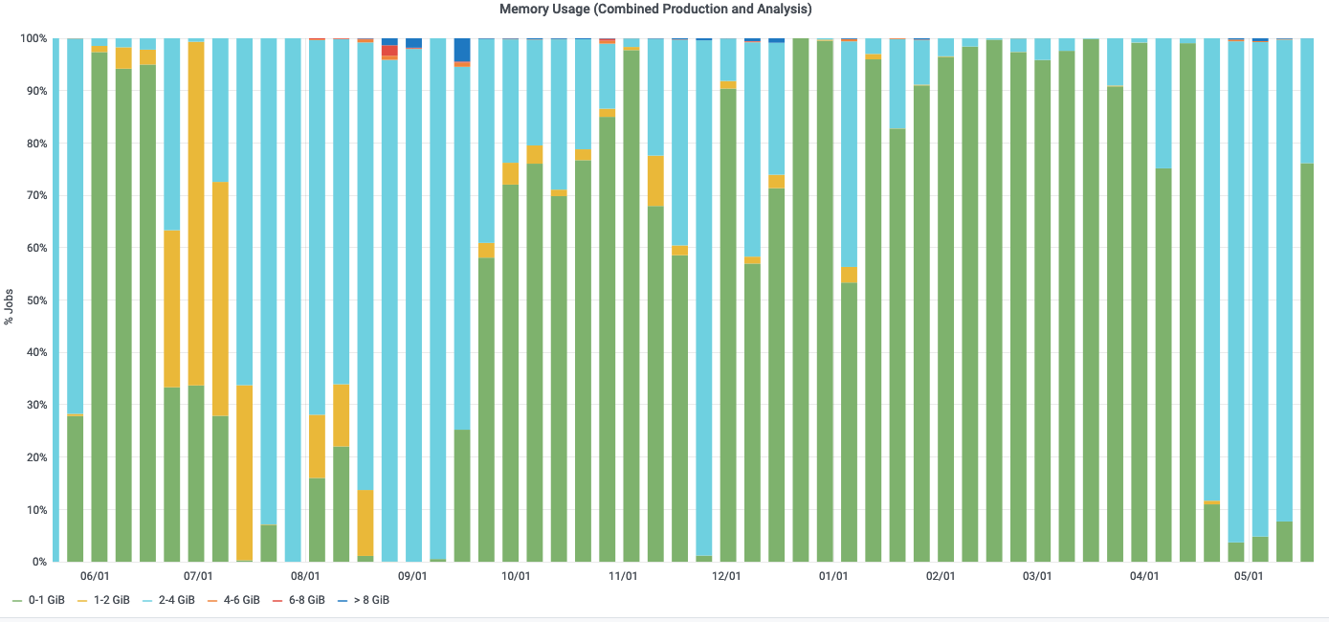
Dedicated DES grid nodes utilized for large memory footprint (>8GB) jobs
DES + Rubin testing/devel
<number>
Notes:
Is the memory footprint contained? Does it restrict the availability of offsite resources?
Compares slots vs weighted slots. Give an indication of what kind of offsite resources your experiment may need.
These plots are difficult to interpret. Is there something better that shows something like requested memory distributions?
Get plots from https://fifemon.fnal.gov/monitor/d/r6UDhH-iz/sppm-sc-pmt-prep?orgId=1

Slide 8
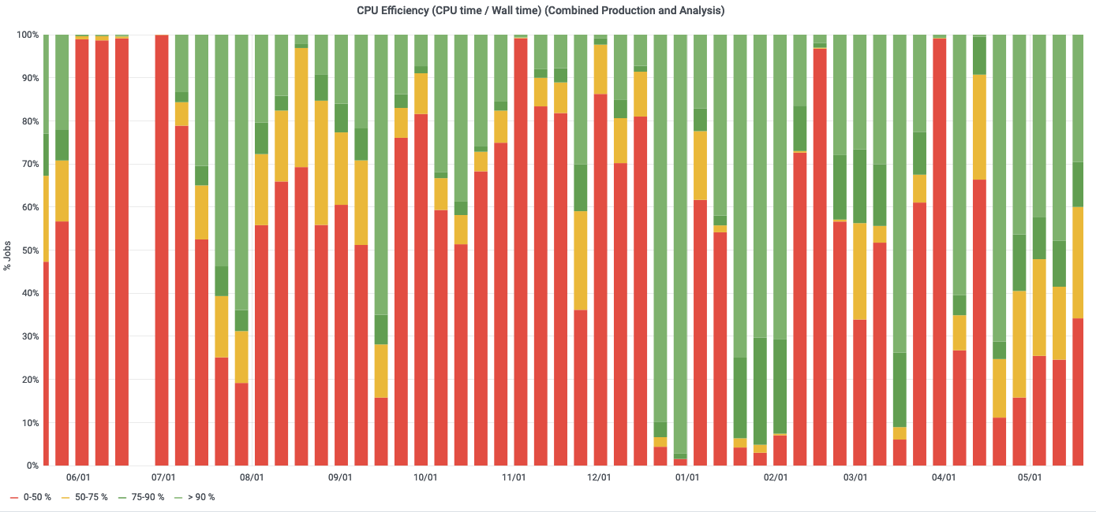
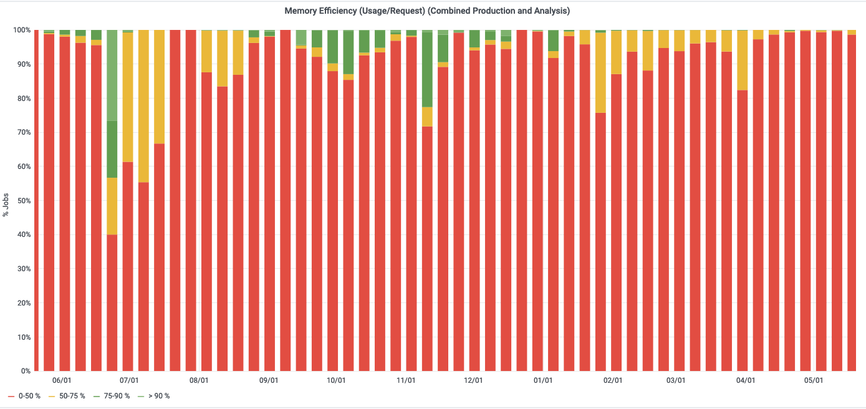
CPU and Memory Efficiency Over the Last Year
DES+Rubin
CPU efficiency improved lately
With Y6 DES Analysis
Memory Efficiency still low – perhaps over requesting GB/core
<number>
Notes:
What are they
Get plots from https://fifemon.fnal.gov/monitor/d/r6UDhH-iz/sppm-sc-pmt-prep?orgId=1

Slide 9
CPU - Prediction Going Forward and Accuracy of Your Predictions [units of Million (1 CPU, 2GB) wall hours per CY] (DES+Rubin). Note: Y6 ‘final data set’ analysis planning on sigificant expansion in CPU effort – plan to use most of 5 M cpu hour allotment for next 2 years.
 | 2018 | 2019 | 2020 | 2021 | 2022 | 2023 | 2024
Requested | 7.4 | 6 | 5 | 5.5 | 6 | 4 | 4
Actual Used | 4.0 | 3.0 | 2.1 | 3.4 | 3 (prediction)
Efficiency | 54% | 50% | 42% | 62% | 50% (prediction)
<number>
Notes:
In units of Million (1 CPU, 2GB) hours per CY.

Slide 10
CPU Adaptations Going Forward
How can experiment use OSG/HPC/Cloud/HEPCloud going forward?
DES will slowly transition off of its dedicated servers over the next 3 years – hope to transition users to a Analysis Facility for ongoing analysis.
DES has some applications AI/ML which could make use of GPUs – need a focused effort to learn how to use these efficiently.
Rubin will make use of Rubin/LSST provided resources at other locations,
Only minimal Rubin compute footprint at FNAL planned currently.
<number>
Notes:
What sites are available (an allocation does or will exist) for experiments to use?
What sites work well for what sort of workflows.
Experiment need to understand their compute needs so they can specify what percentage would fit on which HPC resources.

Slide 11
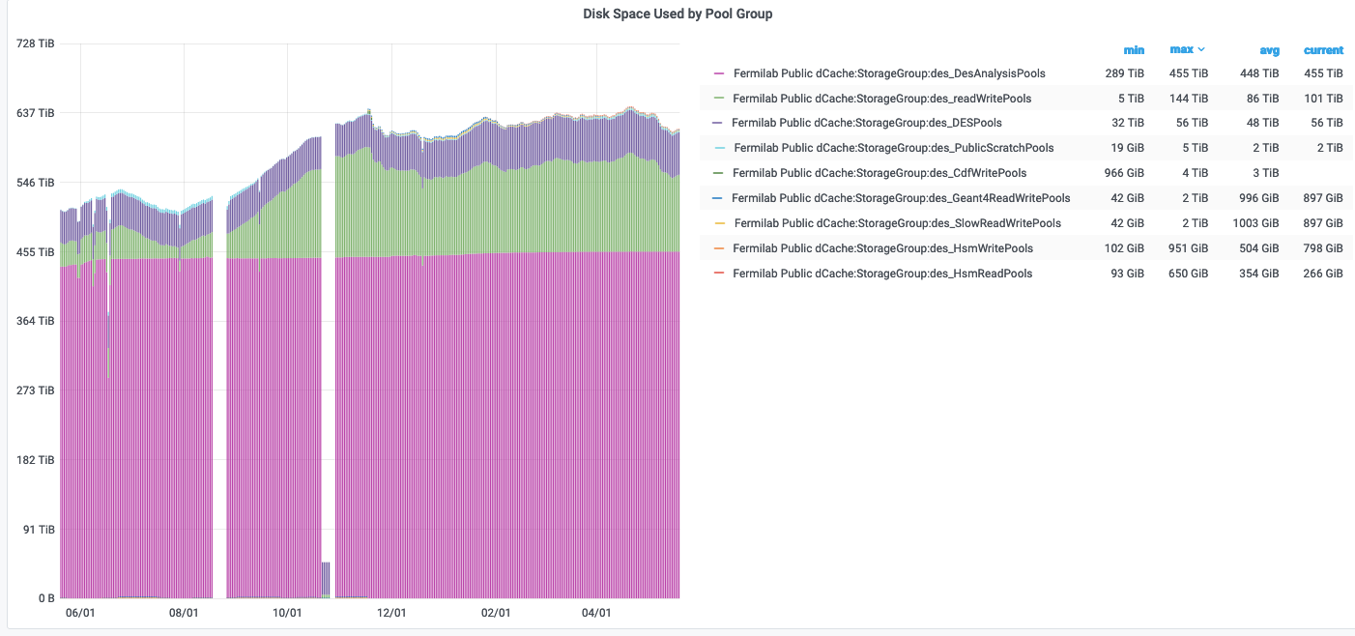
Disk: dCache Usage and Predictions (in TB)
 | Analysis (Persistent) | Other Dedicated (Write)
Current | 538 TB (Actual)
2022 | 538 T
2023 | 538 T
2024
We are self-managing Persistent dcache
Area of 538 TB (always 90% full). No increase planned/requested.
Total r/w (tape backed): 0TB
Total scratch: 20 TB
Total persistent: 538 TB
Total other: 0TB
Will not track cache usage,
but need to know of unusual requests
<number>

Slide 12
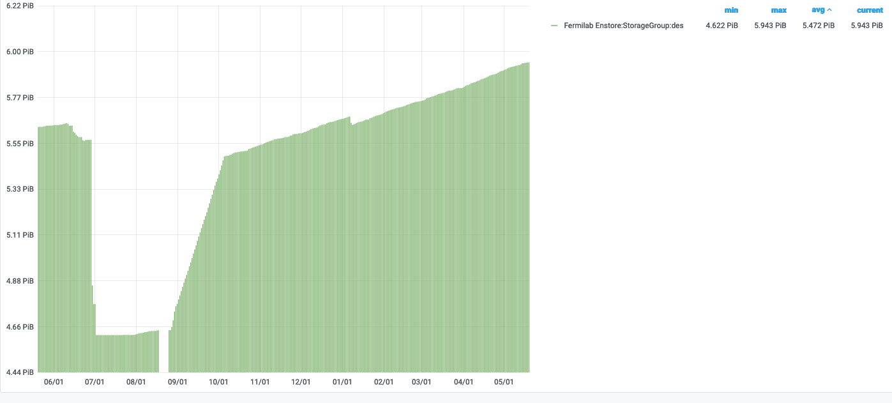
Tape - Usage and Predictions (in PB)
 | Total Added By End of Year
At end 2021 | 5.67PB (actual)
2022 | +600TB
2023 | +300TB
2024 | +300TB
Backup of DES Y6 analysis, DES DB backups, misc DES Analysis Backups
<number>

Slide 13
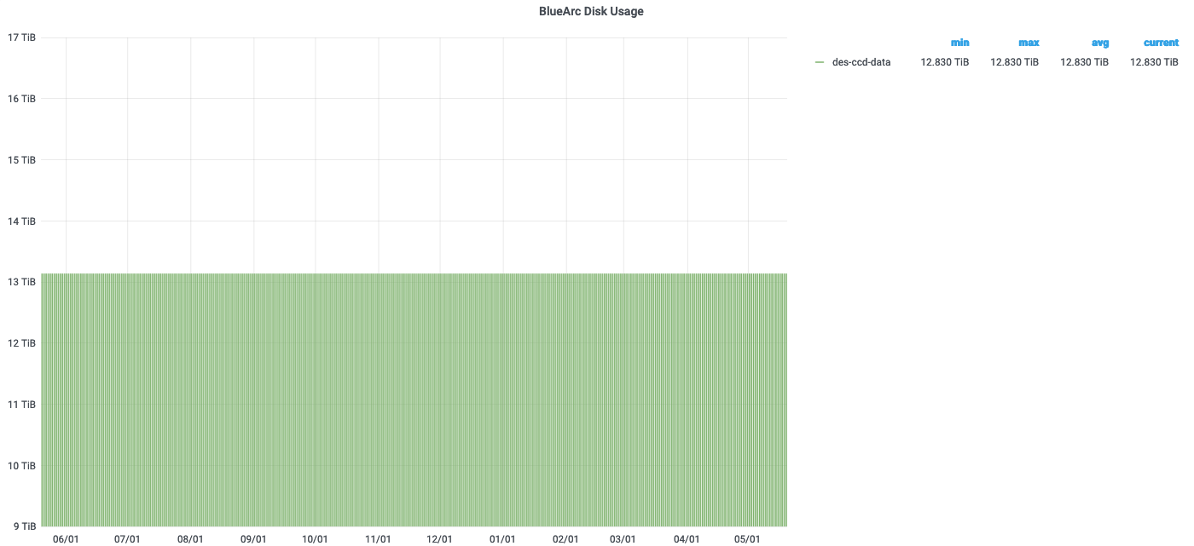
Disk: NAS Usage and Predictions (in TB Units)
 | App | Data
2022 |  | 12 TB Curr.
2023 |  | +0
2024 |  | +0
<number>
Notes:
Why are /grid items repeated? Are the /grid items here showing only the experiment’s usage within? If so, we need more columns in the table.
Get plot from https://fifemon.fnal.gov/monitor/d/r6UDhH-iz/sppm-sc-pmt-prep?orgId=1 after choosing experiment name at the top

Slide 14
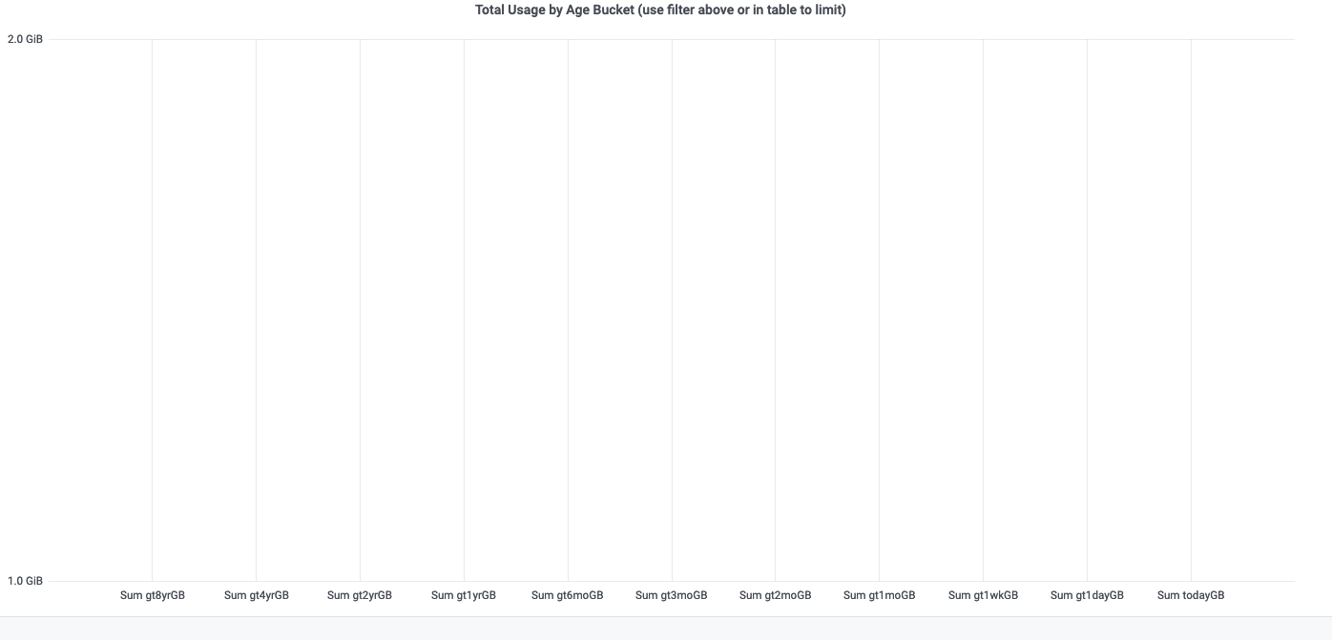
Age of files in NAS (DES Legacy)
No new files
<number>
Notes:
Get plot from https://fifemon.fnal.gov/monitor/d/AjtawA5Wk/nas-volume-file-age?orgId=1
Go to bottom of page in table and click on your experiment name to populate the filter

Slide 15
Data Lifetimes
Please describe your plans, if any, to delete any datasets
We have ~5PB DES archived data (raw and processed and Dbs) backed up to
Tape (ENSTORE). We will need this backup for some years, including media
migration if required.
Are datasets specified with a lifetime at creation? If not, why not?
Data not created with lifetime. Working on long term storage plan with partner institutions NCSA (Illinois), NOIRLab (Tucson) but not set currently.
<number>

Slide 16
What Do You Want to Achieve in Computing Over Next Three Years
Goals | Where does the experiment need to contribute | Where does SCD need to contribute
Complete DES Y6/DR2+ Analysis (Y6 Balrog, imsim, Deep Fields, Metadetect) | develop/update codes and run. | Continued support for DES nodes in grid, maint. Support for DES cluster boxes.
AI/ML analysis ‘stretch goals’: photo-zs, arc-finding,MCMC likelihood | Ramp up on GPUs | Access to Wilson Cluster.
Explore Rubin/FNAL coordination on Rucio | Coordinate communication | Access to Rucio expertise
Transisiton to Analysis Facility | Educate DES Users | Helping with transition/integration
<number>
Notes:
These are just examples. Please fill in the needs for your experiment. Looking for things that the experiment will be focused on and the things you need SCD to focus on.
This doesn’t have to fit all on one slide - use as many as you need.

Slide 17
Anything else?
DES is winding down, all data taken, and final cumulative analyses underway. By ~FY24 (?), there will be no further DES funding. However, some compute cpu and disk will still live on. We wish to continue using those until they fail. One possibility
Is for DES users to migrate to HEPCloud and Elastic Analysis Facility, and existing DES resources, if any value remaining, folded into these facilities.
<number>
Notes:
Eg, unusual DB needs, online needs, etc.

