Slide 1
Scientific Computing Services
Joe Boyd
FCRSG
01 June 2022

Slide 2
This Talk
Services provided by Scientific Computing Services dept
Compute resources available to experiments
Summary of experiment computing requests from their slides
Our planned work for the year
Things we need to accomplish goals

Slide 3
Scientific Compute Services
Services other than storage and hardware/sys admin
Batch systems (condor/slurm/CMS T1 & global/IF)
Production Operations Monitoring System (workflow management)
Landscape monitoring (grafana/kibana/elasticsearch/kafka/...)
HepCloud (ops and dev)
Jobsub (batch submission)
GlideinWMS
Onboarding new sites/use cases
Production support
Fermicloud
Continuous Integration
Efficiency reports/Naught User policy

Slide 4
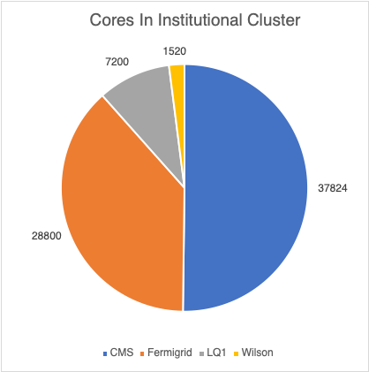
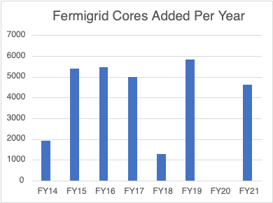
Resources – Institutional Cluster
Fermigrid Cluster
224M core hours available in Fermigrid, (another 28M for Rubin) 18M in Wilson
Turned off 9 & 10 year old nodes this year (~272 cores left of 2368 bought)
Wilson Cluster
Omnipath for parallel processing
Stepping stone to HPC resources
4 x 2 nvidia Tesla V100 GPUs
27 x 4 nvidia Tesla K40m GPUs
One power9 + 4 volta gpus (Oakridge Summit)
One KNL (NERSC Cori/ALCF Theta)
Bought 12 A100 Nvidia GPUs in 3 machines in FY21
To maintain 24000 cores we'd need about 300k per year to buy 5000 cores

Slide 5
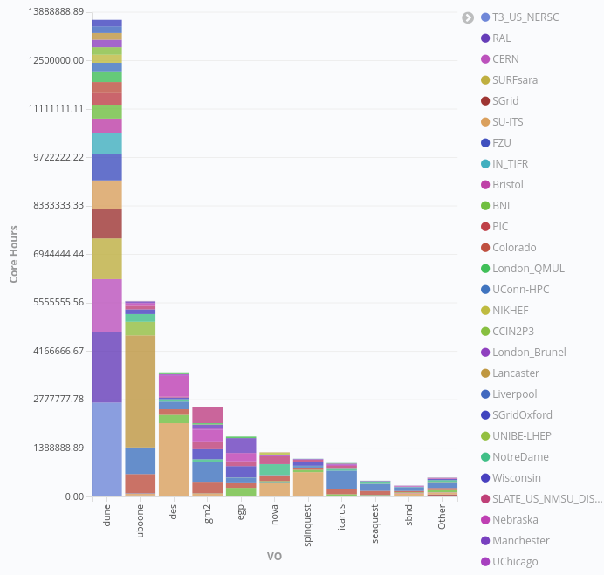
Resources – Outside our walls
HPC sites (allocations)
OSG (opportunistic)
GCE, AWS (paid)
If experiments have special agreements with collaborating sites we can enable access to their individual allocations
Containers should limit issues at remote sites
Some VO’s could push more offsite

Slide 6
Resources – Outside our walls (HPC Centers)
CMS
190M NERSC hours used on Cori in 2021 allocation year
NERSC Perlmutter CPU and GPU nodes are available but not much done yet
XSEDE - Have already used full June2021-June2022 allocation on TACC Stampede2, SDSC Expanse, PSC Bridges2
Frontera - 33% used thus far in allocation expiring March 2023
SDSC-Azure - 5M hours in June 2021(routed to MS Azure)
FIFE
DUNE and Muon g-2 have run on NERSC in the past year
MU2E commissioning now
NOVA using NERSC outside of HEPCloud

Slide 7
Summary of requests from experiments
Requests continue to climb. There may be contention for onsite resources this year. Experiments should be encouraged to submit offsite and use HPC resources.

Slide 8
Summary of requests from experiments
Individual requests can be off but as an aggregate they seem to average out
Hard to predict quantity of OSG resources an experiment will get when they’re submitting all job to all resources which can bring down predicted on-site usage

Slide 9
2022/3 Deliverables
NERSC Perlmutter (3-4x performance of Cori with GPUs) access via HepCloud being commissioned now
Conversion to tokens for authentication
FIFE Token Task Force has been meeting to discuss details
Experiments have been testing data access
Will be in a hybrid mode for some time still
FIFE job submission
Complete rewrite being tested by DUNE and mu2e soon
Token for submission, can send x509 for transfers
Plan is to enable direct access to schedd for all experiments with larger experiments getting their own schedds

Slide 10
What experiments should do (for HPC centers)
Experiments must understand how to make their workflows fit onto HPC machines
Huge scale of HPC machines can cause denial of service type issues not encountered on the GRID
Memory varies from 1/2GB to 2GB per cpu
Small pipes to some centers make pre-staging necessary; can’t rely on streaming, Globus online (separate path) really needed for fast ANL access
Execution times may be short (ANL)
Usually a shared filesystem, not local disk, so things like job tarballs on every cpu a bad idea, small IO bad
Multiprocessing and GPUs will be the big win on HPC machines
DUNE successful with smaller memory simulations – must watch the memory footprint
An experiment expert is likely needed for onboarding to HPC centers (testing things work before flooding queue)

Slide 11
What experiments should do (HPC allocations)
For DOE labs (NERSC, ANL,etc) we want a joint or aggregated allocation process
For NSF sites, VO needs to find collaborators to request the allocations
Engage with Fermicloud staff now if:
you have the opportunity to request an allocation at an HPC center
your workload will be large enough to require HPC center scale in the coming years
We want to make sure we fully use HPC allocations, if your workflow "fits" on HPC machines it would be desireable to run it there
Local FNAL based compute resources should be used for workflows unsuitable for HPC center machines

Slide 12
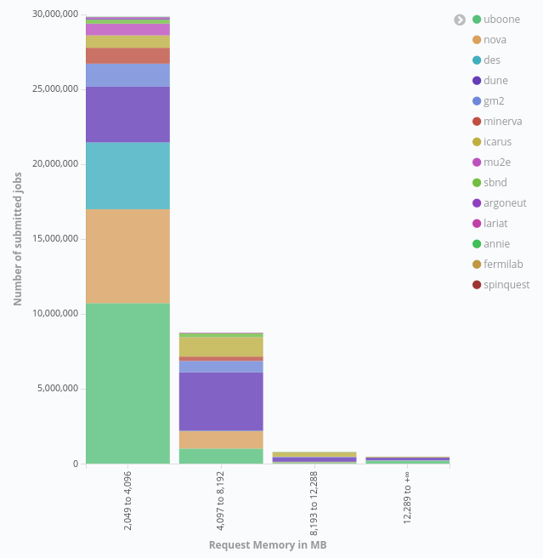
What experiments should do (general)
Don't "ifdh –force=gftp", had some problems switching ifdh default to https but plan to do that again
Is the interactive analysis cluster an efficiency win for your VO?
POMS is easier for users to debug their own problems than individual submissions
view logs in your browser
File delivery info
everything in one place

Slide 13
Takeaways
Onsite compute resource availability is going to be tight if everyone really requires what they’ve requested
Growth in the memory size of jobs needs to be watched
Are experiments running jobs on all available resources such as OSG slots and if not why?
What help/resources do the experiments need to take advantage of multiprocessing capability and GPUs?
What do the experiments need to reduce their memory footprint?

