Slide 1
Conventional Facilities
for the Far Detector Options
Assumptions and Cost Estimates
T. Lundin
April 25, 2012

Slide 2
Presentation Summary
Configuration Summary
Reference design
Phasing the reference design at SURF 4850L
SURF: 5, 17, and 33 KT at the surface
Soudan: 5, 17, and 33 KT at the 27L
Soudan: 5, 17, and 33 KT at the surface
Ash River: 5, 17, and 33 KT at the surface
Assumptions and Approach
Summary of Costs

Slide 3
Far Detector – Summary of Costs

Slide 4
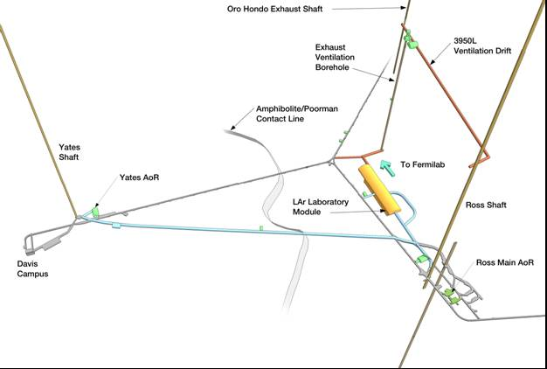
Far Detector – Reference Design
SURF (Homestake) at the 4850L

Slide 5
Far Detector – Options at the 4850L at SURF
Phasing the Reference Design at SURF at the 4850L
Building Block #1 - Infrastructure: Facilities put in place
to allow LBNE cavern excavation(s) to begin later
Building Block # 2: One 17 kT cavern is constructed
Building Block # 3: Second 17 kT cavern is constructed

Slide 6
Far Detector – SURF at the 4850L

Slide 7
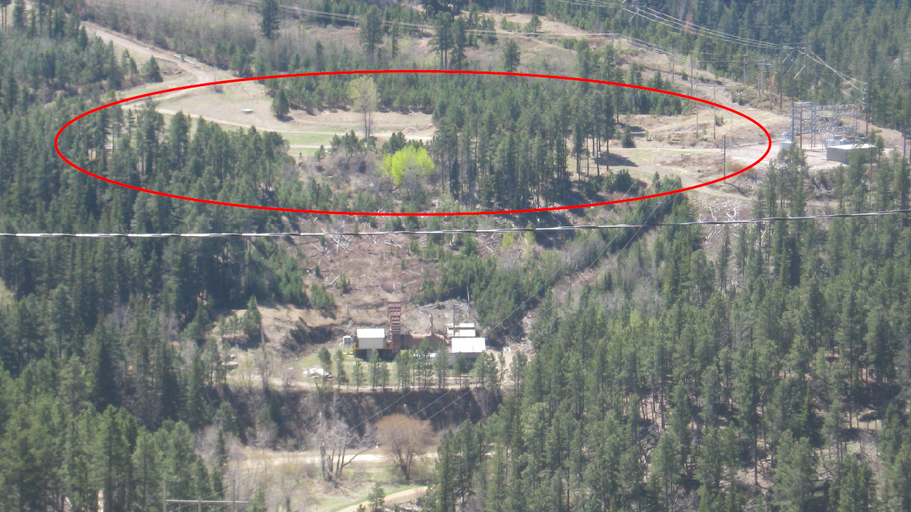
Far Detector – SURF at the Surface
5, 17, or 33 kT at the Surface (source: Josh Willhite)

Slide 8
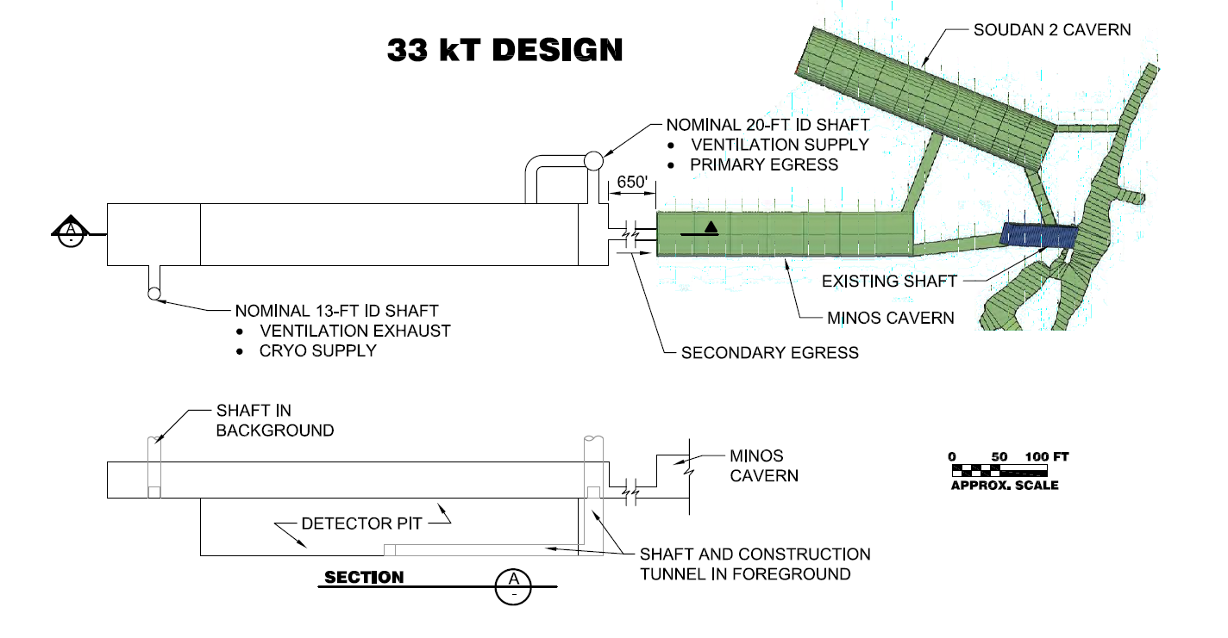
Far Detector – Options at Soudan, MN
5, 17, or 33 kT at the 27L (33 kT shown)

Slide 9
Far Detector – Options at Soudan, MN
5, 17, or 33 kT at the Surface (source: Marvin Marshak)

Slide 10
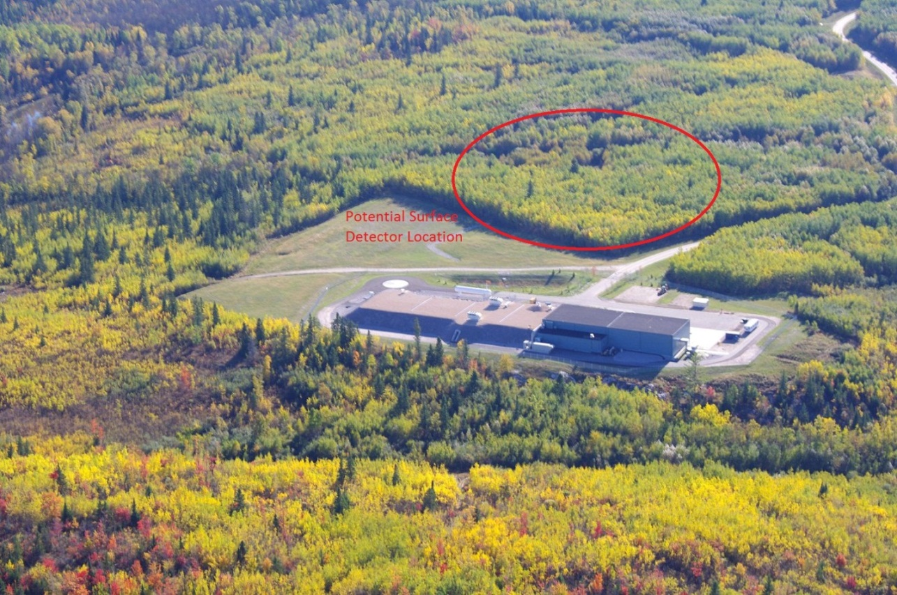
Far Detector – Options at Ash River
5, 17, or 33 kT at the Surface (source: Steve Dixon)

Slide 11
Far Detector – Assumptions and Approach
Geologic conditions and rock mass characteristics are reasonably similar at SURF, Soudan, and Ash River therefore rock excavation cost models are reasonably applied to multiple sites
Estimates of LAr facilities at depth (27L and 4850L) are scaled from the reference design at SURF
- cavern cost models used have been compared to actual costs for existing Soudan 2 and Minos hall excavations at Soudan
- all available shaft cost models have been considered

Slide 12
Far Detector – Assumptions and Approach
Surface locations of LAr facilities to be constructed at the surface have been sited by those most familiar with each location. Surface sites are of adequate size for 5, 17, and 33 kT options.
Estimates of LAr facilities at the surface are based on constructed costs for NOvA at Ash River (surface structure and detector pit). These are applied equally to LAr at Ash River, Soudan, and SURF with some “site adapt” costs added.
Underground Infrastructure (UGI) costs for LAr reference design are scaled appropriately and applied to all options

Slide 13
Far Detector – Assumptions and Approach
Yates and Ross shaft rehabilitation labor costs at Homestake assume that labor is in SURF budget and is “off project” and is therefore not included
The level of contingency applied to all options is the same as the LAr reference design: 35% for construction and 20% for design costs, geotechnical exploration, etc.
Cost models do not include: risk based contingency, PM “top down” contingency, or escalation
Base cost models have been de-escalated to FY10 dollars. Past costs have been escalated using Engineering News Record (ENR) Construction Cost Index (CCI)

Slide 14
Far Detector – Assumptions and Approach
Other than ENR cost escalation, no consideration of schedule issues or impacts has been made
No adjustments have been made for any differences in Davis Bacon prevailing wage rates between sites has been made
The CF cost models has been developed with considerable input/review from SURF staff. The model logic and most details have been presented/discussed with committee members McCluskey, Sims, Headley. We have also discussed MN options with Marshak.

Slide 15
Far Detector – Assumptions and Approach
Significant effort has been expended to develop Base Cost Models on an evenly considered basis across all options.
It is assumed that Base Cost Models will be reviewed by the Engineering / Cost subcommittee and adjusted in accordance with subcommittee recommendations. Additional options may be identified.

Slide 16
Far Detector – Summary of Costs

Slide 17
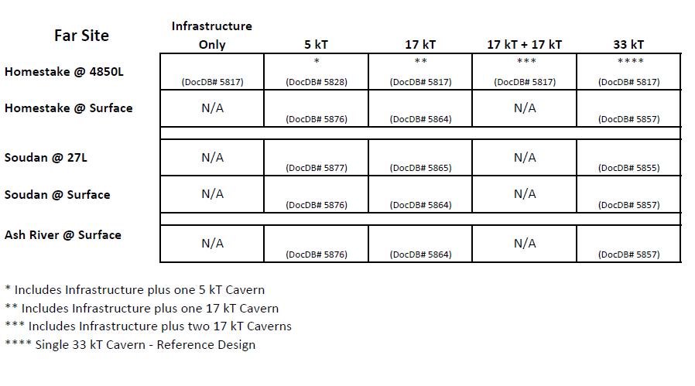
Far Detector – Summary of Documentation

Slide 18
Far Detector – Assumptions and Approach
Questions?

