Slide 1
LBNE Staging and Alternatives
Gina Rameika
April 25-26, 2012
LBNE Reconfiguration Workshop

Slide 2
Outline
LBNE Scientific Goals
– a new way to look at things
LBNE reach with smaller detectors
Options with the NuMI Beam
Summary and Conclusions

Slide 3
This
talk

Slide 4
Talks tomorrow by Mary Bishai and Kate Scholberg

Slide 5
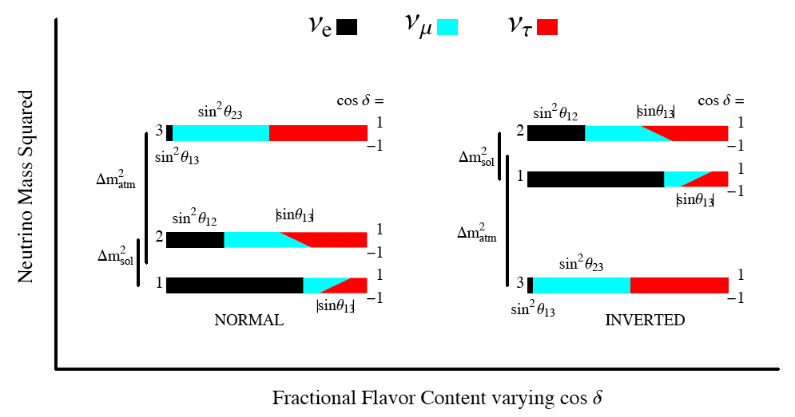
??

Slide 6
The Old Days, i.e. pre-fall 2011
We didn’t know
We wanted to measure
You want to know the mass hierarchy to eliminate degenerate solutions for
Baseline matters for the mass hierarchy

Slide 7
How do sensitivities depend on baseline?
Study done with a Wide Band Beam that is “tuned” to increase with energy
as the baseline increases
Curves moving in this direction is good
1300 km appears to be nearly optimum
if the Mass Hierarchy is unknown and

Slide 8
NOvA – in the unknown world

Slide 9
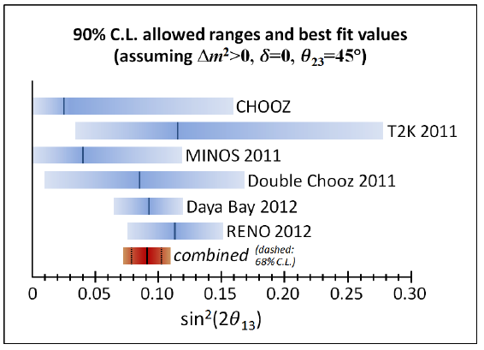
Winter 2012
Ryan Patterson

Slide 10
We can plot things differently now

Slide 11
NOvA + T2K

Slide 12
Beyond NOvA : LBNE
Huge Improvement
Mass hierarchy is easily determined; goal is to measure

Slide 13
Why we like long-baseline

Slide 14
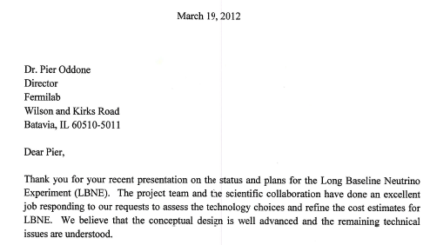

Slide 15
Options we have
We consider three 3 baselines :
1300 km : SURF @ Homestake
735 km : MINOS @ Soudan
810 km : NOvA @ Ash River
Other baselines?
1000 km?
2500 km?
Some discussion tomorrow in Mary’s talk

Slide 16
Introduction to Input to PWG for the Reconfiguration
Studies are done using GLoBEs
This is a great tool for making comparisons of different options
It is not a substitute for real Monte Carlo, reconstructions, etc.
We have used conservative efficiency inputs for LAr
Event scanning indicates higher efficiency; but needs further confirmation
Beam configurations will be somewhat different in reality
Absolute significances may be higher or lower than what is seen here, but these analyses are internally consistent
Definition of CP “significance” (p.49) slightly different than plots in Mary’s talk, but both are internally consistent

Slide 17
Plot formats
Three Formats :
Significance of measuring Mass Hierarchy vs. and significance of determining vs.
Fraction of vs. significance for MH and CP
1 sigma error in vs.
The three examples follow

Slide 18
Mass Hierarchy
Delta CP

Slide 21
Reminder of the options
Detectors at SURF (LBNE-Homestake)
2, 5, 10, 15 (34 kT for comparison)
Detectors in NuMI
5, 10, 15 kT (34 kT only for comparison)
Placement at Soudan, Ash River
For the NuMI option there will be an assumption about NOvA operations
Phase I : 3+ 3 years with the NuMI ME beam
Phase II : 5 + 5 years with the NuMI LE beam
For the NuMI option we need input from T2K to help resolve the Mass Hierarchy

Slide 22
Smaller detectors at LBNE-Homestake

Slide 23
CP reach at LBNE

Slide 24
Error in delta

Slide 25
LAr Detectors at Soudan
Mass Hierarchy is not determined

Slide 26
What is happening on the positive delta side?

Slide 27
We have ambiguous solutions in the inverted hierarchy

Slide 28
Combine Soudan + NOvA (&T2K)
(300, 7)
We have a small region of where the MH is only resolved at the 2 (95% CL)

Slide 29
CP Reach in a NuMI “Program” with “help” from T2K

Slide 30
Error in Delta in the NuMI Program

Slide 31
How does T2K help?

Slide 33
Detectors at Ash River
(300,7)

Slide 36
Compare LBNE and NuMI Options

Slide 37
Is there reason/justification for a hybrid NuMI solution?

Slide 38
How would T2K help small LBNE detectors?

Slide 39
Summary
We have studied the reach in Mass Hierarchy and dcp for :
LBNE detectors of 2, 5, 10, and 15 kT
Detectors of 5, 10, and 15 kT at 2 sites in the NuMI beam, Soudan and Ash River
Exposure for the studies was 10 years, 5+5, nu-nubar, beam power – 700kW (6e20 POT/yr)
A 10 kT LBNE detector has a minimum significance of 2.8 for determining the mass hierarchy
Detectors in the NuMI beam have a limitation of distinguishing the MH in the region
This degeneracy can be mitigated to ~2 (95% CL) by including the expected results from T2K
A NuMI “program” of a new detector plus continued running of the NOvA detector can achieve comparable reach in to the smaller LBNE detectors
Both an LBNE experiment and a NuMI program can measure CP significance of ~3 for 50% of with 15kT (5+5, 700kW)
1 errors in are ~15⁰ and 35⁰ for = 0 and – /2, respectively

Slide 40
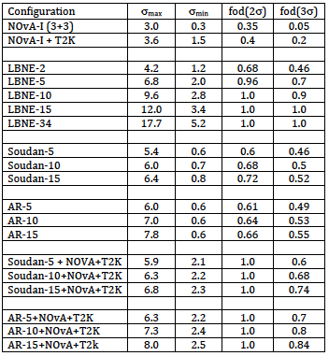
Summary of Mass Hierarchy Significance

Slide 41
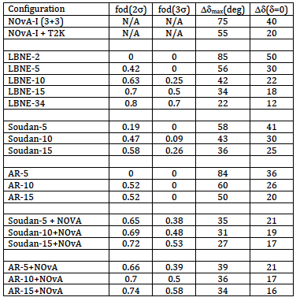
Summary of Significance

Slide 42
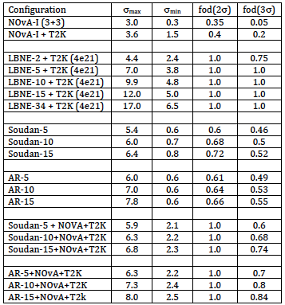
Summary of Mass Hierarchy Significance

Slide 43
Back-up

Slide 44
How does T2K help in CP reach?
LBNE

Slide 45
What if fluctuates down 2

Slide 47
Large Detectors

Slide 48
Evolution of a NuMI Program

Slide 50
Input from T2K
For NuMI program with Soudan-15
Mass Hierarchy

Slide 51
Definition of CP Significance
At a given value of Significance is defined as the number of standard deviations, d, from = 0 or (whichever is smaller)
Standard deviation (d) is defined as finding d with :

Slide 52
MH Ambiguity at 735km
Animation – will not work in .pdf
IH
NH pi/4

