Slide 1
Main Injector/Recycler Machine Report
Marty Murphy
AD 0900 Scheduling Meeting
Friday, 13 May 2022

Slide 2
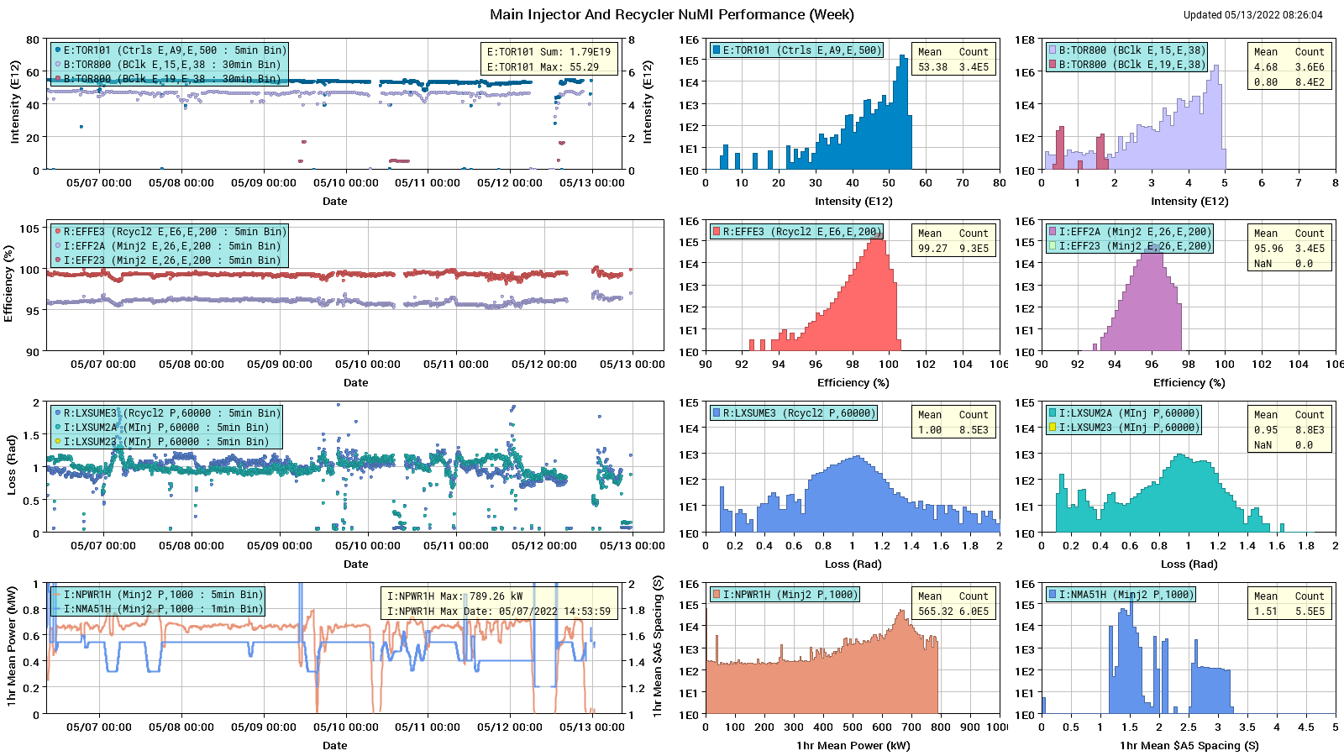
HEP Beam to NuMI

Slide 3
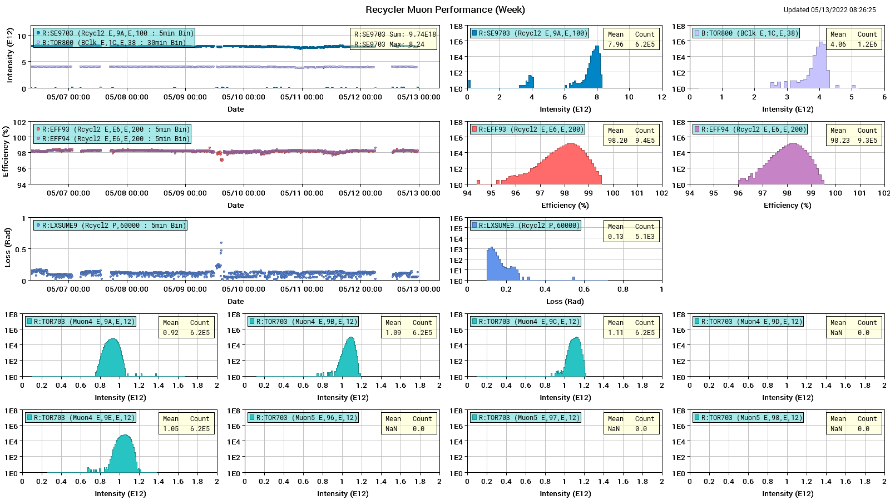
Protons to g-2

Slide 4
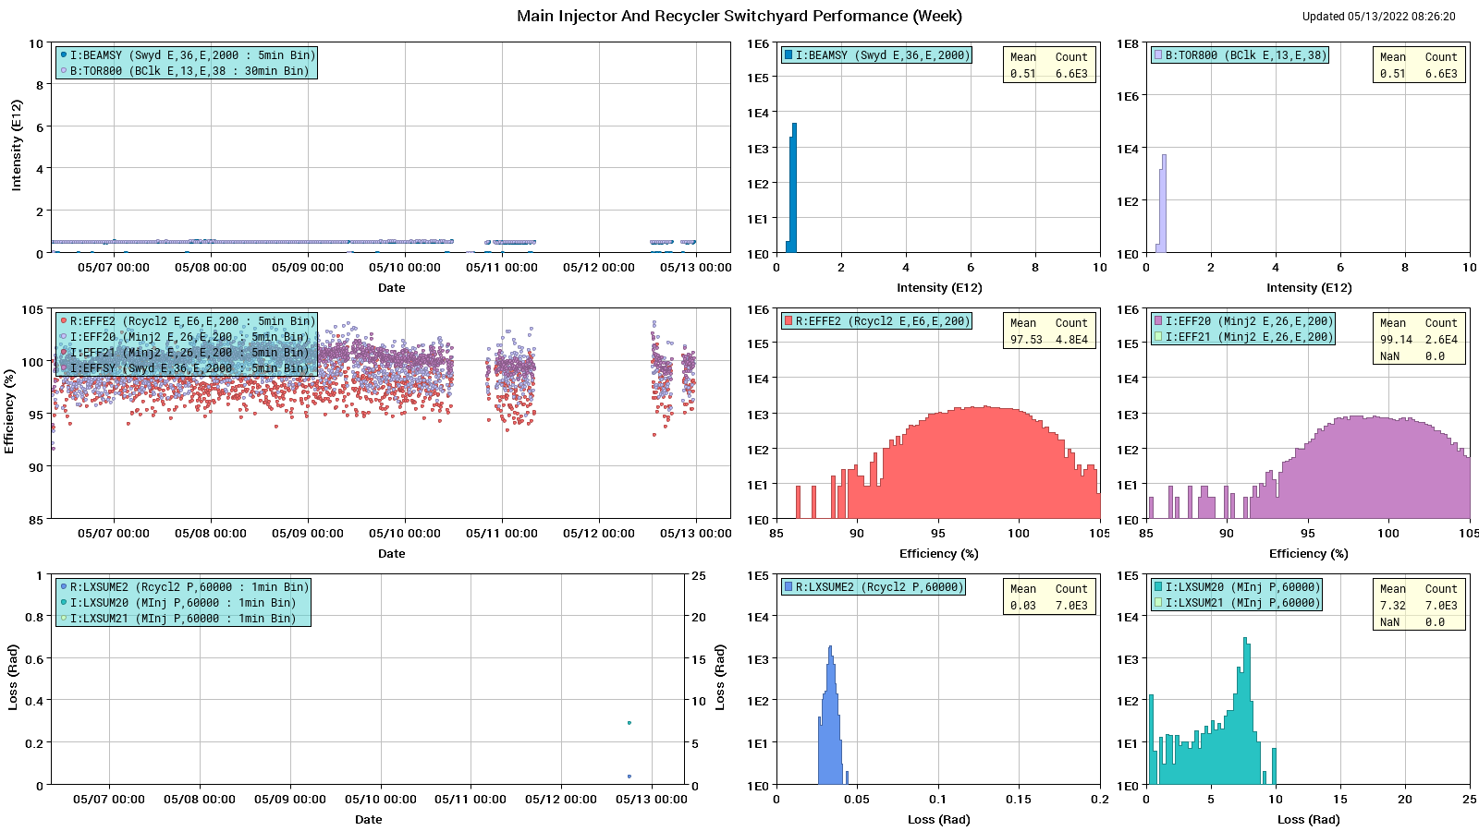
Protons: MI to SY

Slide 5
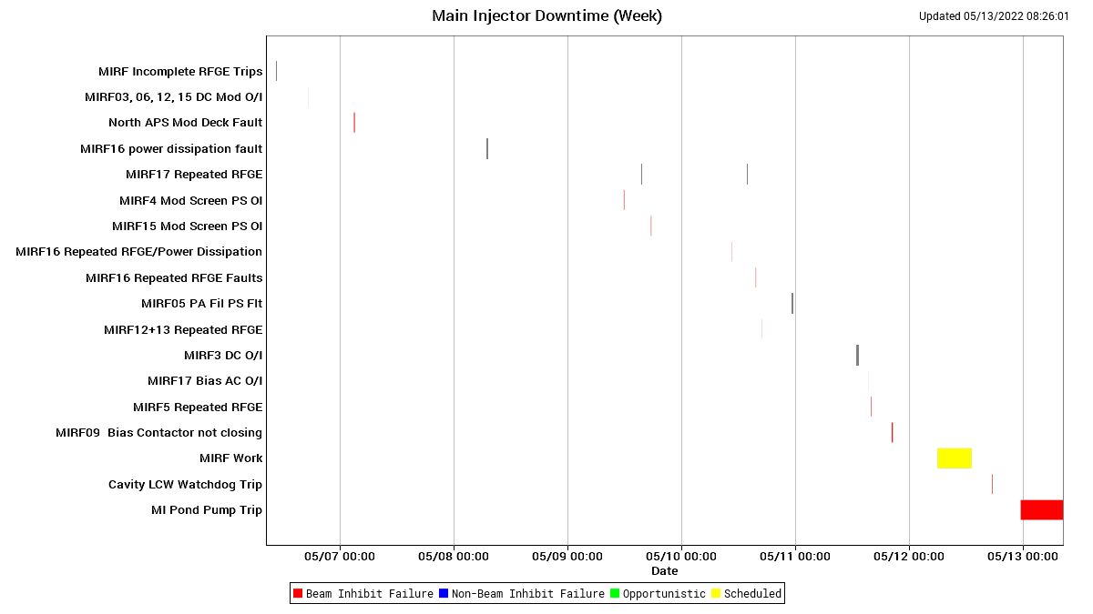
MI Down Time

Slide 6
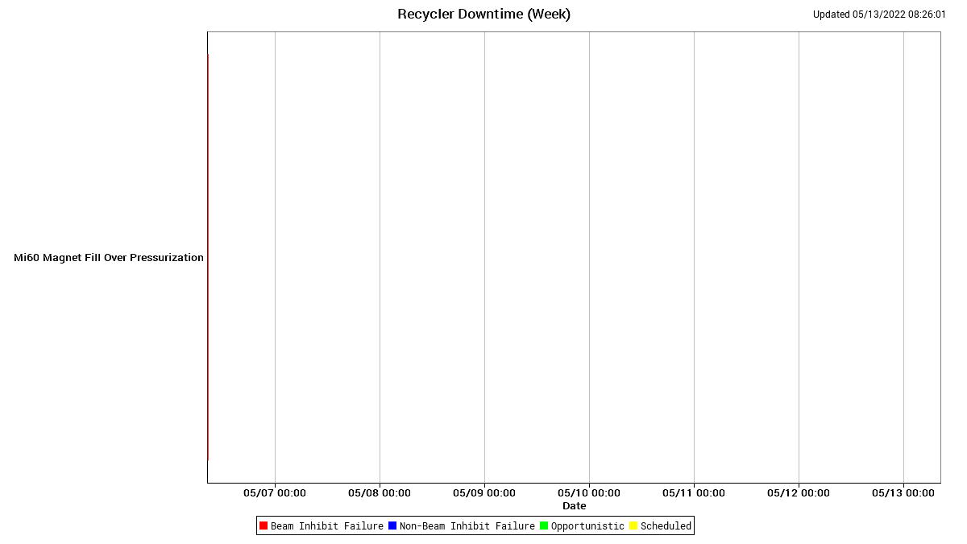
RR Down Time

Slide 7
This Week
A good week of running.
Beam to NuMI, g-2 & SY as requested.
Thanks to Proton Source for continued high intensity & Ops for vigilant tuning efforts.
MI instability at high intensity (> ~55 E12) caused by Mode-1 oscillation. Hunt for cause in progress. Suspect RF or longitudinal damper (less likely cause).
MI down time Thursday to fix MIRF08 and complete a few maintenance items; no access.
Overnight Thursday-Friday:
  MI60 60HP pond pump trip. PLC problem resolved this morning.
  Ops accessed and looked for a newly identified LCW leak. Busted hose found on quad bus jumper above MI 117-2 dipole. MSD accessed this morning and repaired the hose. Thanks to Ops, MSD & ESH for their help in this repair.
Current Conditions:
  Ops starting MI now.
Ongoing studies:
  RR: $E0 studies under SY event
  RR: Tune scans measuring affect of MI bend/quad ramps on beam in RR.
Next week:
  Continue various beam studies and longitudinal instability investigation.
  RR: Tune scans $E0 a pair of dry $2A events (not benign).

