Slide 1
Overview of the Collider, Cosmic, and Precision Science programs
Kevin Burkett
Fermilab PAC summer meeting
June 22, 2022

Slide 2
Outline
Overview: Strategy, Workforce, Facilities
Cosmic Science
Precision Science
Collider Science
Conclusion

Slide 3
Overview
Since the P5 report came out in 2014, FNAL has pursued a consistent strategy across the Collider, Cosmic, and Precision science programs:
Pursue the relevant science drivers
Use the Higgs boson as a new tool for discovery
Pursue the physics associated with neutrino mass
Identify the new physics of dark matter
Understand cosmic acceleration: dark energy and inflation
Explore the unknown: new particles, interactions, and physical principles
Follow the specific recommendations of P5
Choose activities and projects that build on the expertise of our staff and use FNAL’s unique facilities and core capabilities
Support the US HEP community and our international partners

Slide 4
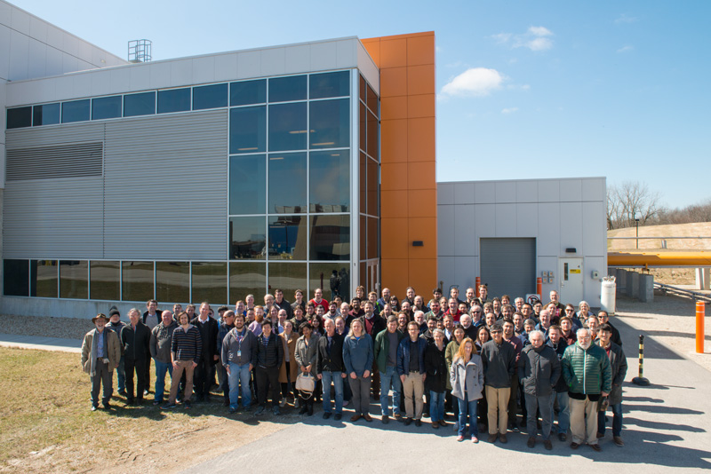
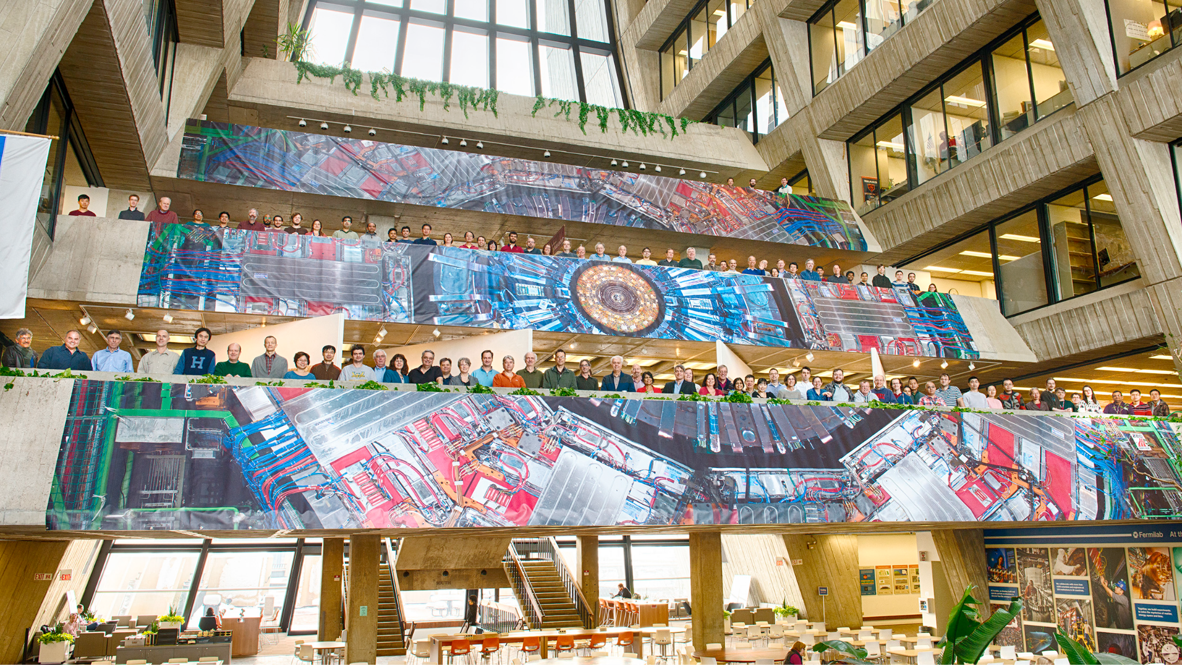
Overview
Experimental effort in these three programs includes approximately 120 scientists, 30 postdocs, and 10 joint appointees from divisions across the lab
They are supported by a large team engineers, technicians, computing professionals, and administrative staff to deliver on projects, operations, and analysis

Slide 5
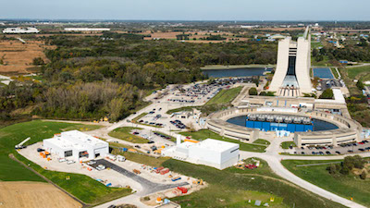
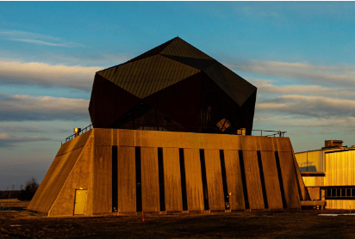
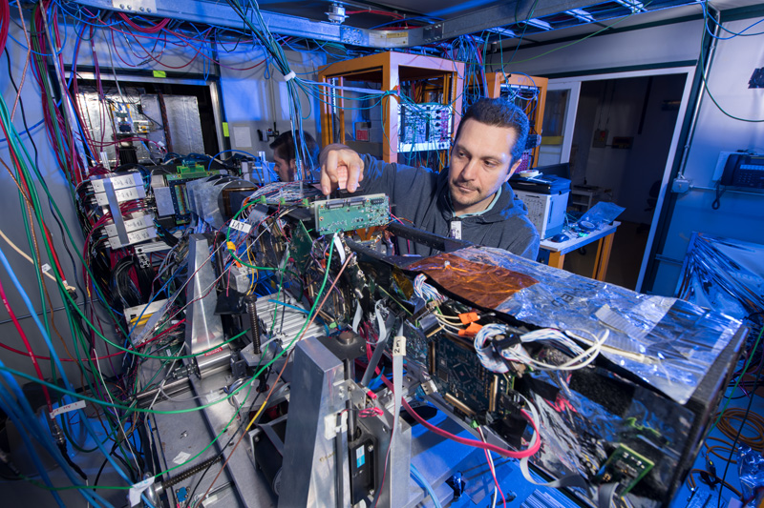
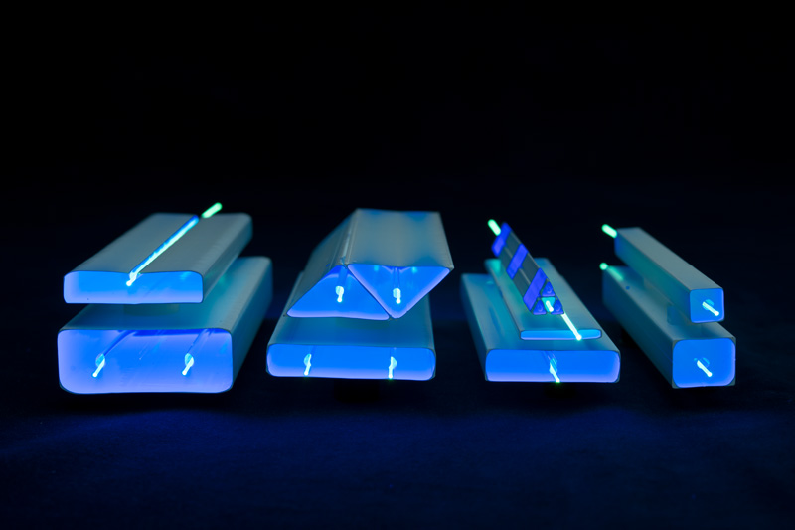
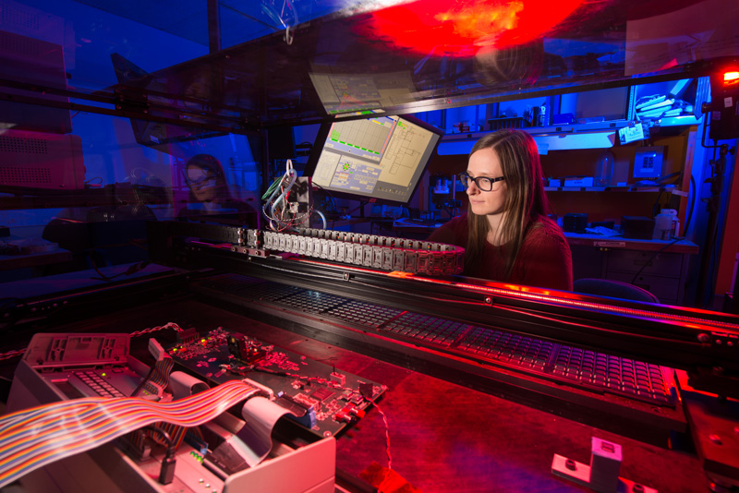
Overview
Accelerator Complex
and Muon Campus
SiDet
Test Beam and ITA
Custom Detector Technology
ASIC Development
These unique facilities are key to Fermilab’s leadership in support of the P5 Plan

Slide 6
Cosmic Science
Notes:
Should we add Eric Dahl and Hugh’s LDRD?

Slide 7
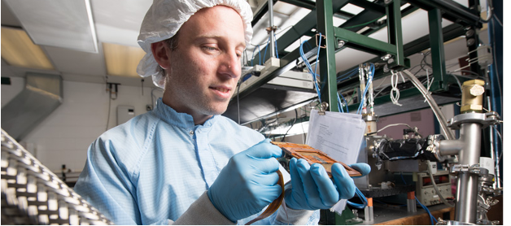
Fermilab Cosmic Program - Overview
Grew out of
the connection of particle physics and cosmology (inner-space – outer-space)
the close ties between the theoretical astrophysics groups at Fermilab and Chicago
Brilliant creative award-winning scientists in recognized leadership roles
Capitalizes on core capabilities, scientific expertise, technical skills, and unique facilities
Silicon Detector Facility (SiDet)
Sub-Kelvin Cryogenic expertise
Underground low background on-site facilities (e.g. NEXUS in the MINOS Tunnel)
Data handling, analysis and quality control expertise
New Integrated Engineering Research Center (IERC)
Highly leveraged by Fermilab expertise and support systems developed for the energy and intensity frontiers, as well as quantum, theory, LDRD, KA25, and private funding

Slide 8
Fermilab Cosmic Strategic Plan
Strategic Plan Developed in 2018-2019, Updated for FY21 Comparative Review
Cosmic Microwave Background (inflation, neutrinos)
SPT 3G lead operations 🡪 CMB Stage 4 major roles
Dark Matter Detection
Axions: lead lab ADMX*, develop Quantum sensors for next-gen expt
Sub-GeV DM:
SuperCDMS construction, operations; R&D at NEXUS
Skipper-CCD R&D and deployment: SENSEI/Oscura*
*Dark Matter New Initiatives (2 led by Fermilab)
Cosmic Surveys (dark energy, dark matter, neutrinos)
DES 🡪 LSST Rubin/DESC operations (small but critical role in DESI ops)
R&D toward next-gen spectroscopic survey (LDRD)
Astro Theory program with growing focus on cosmic neutrinos
Cosmic Physics Center to provide connectivity and serve user community
Cosmic activities flow from P5 drivers and from our core capabilities and synergize with other lab activities (Quantum, Neutrino, Energy...)
Grow
Consolidate
Transition

Slide 9
Response to P5 Recommendations
Strategic plan focuses on projects supported by P5: LSST, DESI, G2 DM, CMB-S4
Recommendation #16: “Build DESI as a major step forward in dark energy science”
Strong FNAL participation supported successful project and is now supporting operations
Recommendation #17: “Complete LSST as planned”
Specific roles on LSST/DESC and RUBIN operations build on DES/SDSS expertise and engage computing professionals.
Recommendation #18: “Support CMB experiments as part of the core particle physics program”
Made key hires to anchor CMB effort
Major roles for FNAL in CMB-S4 project well defined, group size gradually increased as CMB-S4 moved through agency approvals
Recommendation #19: “Proceed immediately with a broad second-generation (G2) dark matter direct detection program”
After G2 down-select consolidated effort on dark matter
Effort transitioned to G2 experiments: SuperCDMS SNOLAB, ADMX(lead lab) and LZ
Ramped down on SuperCDMS-Soudan, PICO, DAMIC, Darkside 50

Slide 10
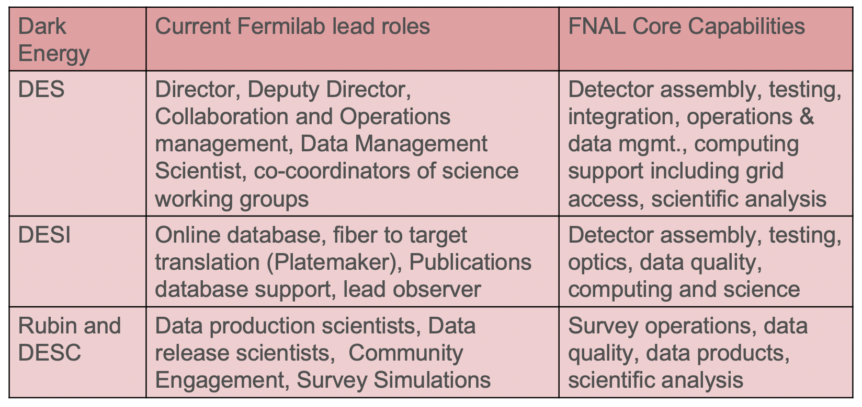
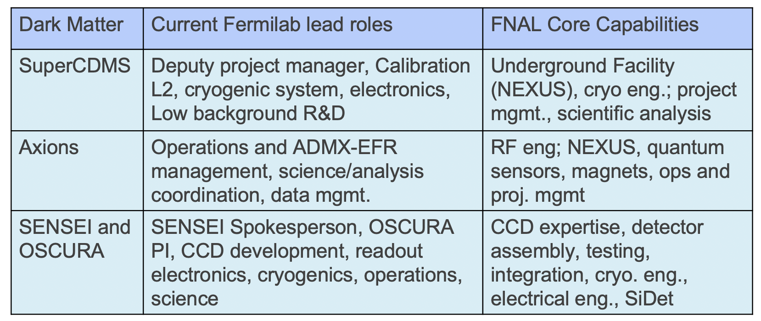
Fermilab’s Cosmic roles capitalize on our Core Capabilities
Synergies and collaboration between groups make efficient use of valuable resources
Expertise developed on SDSS, DES, SPT-3G
transitioned to DESI and Rubin/DESC
as well as Axions, SENSEI/Oscura ,CMB-S4

Slide 11
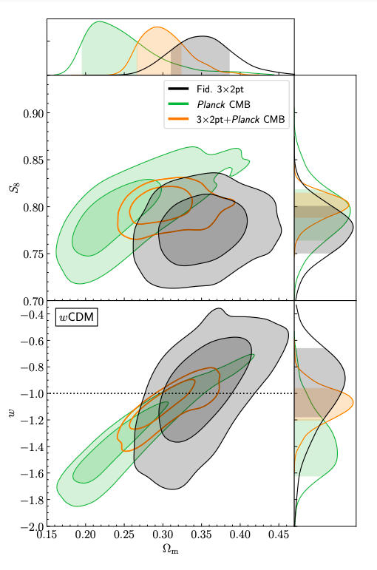
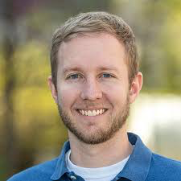
Recent Accomplishments by Fermilab Scientists in Dark Energy
DES
Year 3 world leading Cosmology results May 2021, 30 papers describe analysis, ~1/3 with FNAL top tier authors.
Director, Deputy Director, Data Scientist leading operations and critical functions for production of science results
DESI
Project contributions completed: 65 CCDs, Corrector barrel and telescope top end, Instrument Control system database, Platemaker
Buckley-Geer selected for Lead Observer
LSST DESC and Rubin Operations
DESC leadership: Co-Convenors of Survey Simulation, Galaxy Cluster, and Dark Matter working groups
Fermilab scientists performed LSST/Rubin’s first full data production run on simulated data
Roles and support for Rubin Ops is under discussion. SLAC requested ~ 1 FTE/yr more scientists than we can support on the CF research budget (in addition to 9 FTE technical/comput. prof. for Network and Data Curation)
Scientific Hire:
A. Drlica-Wagner 2018 Wilson Fellow
DES Year 3 constraints on the matter density, S8 and Dark energy equation of state
(DES Collaboration 2021)

Slide 12
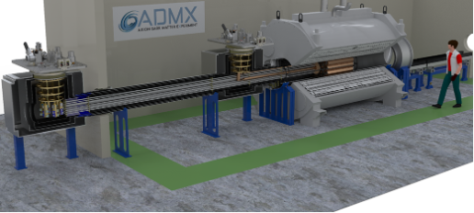
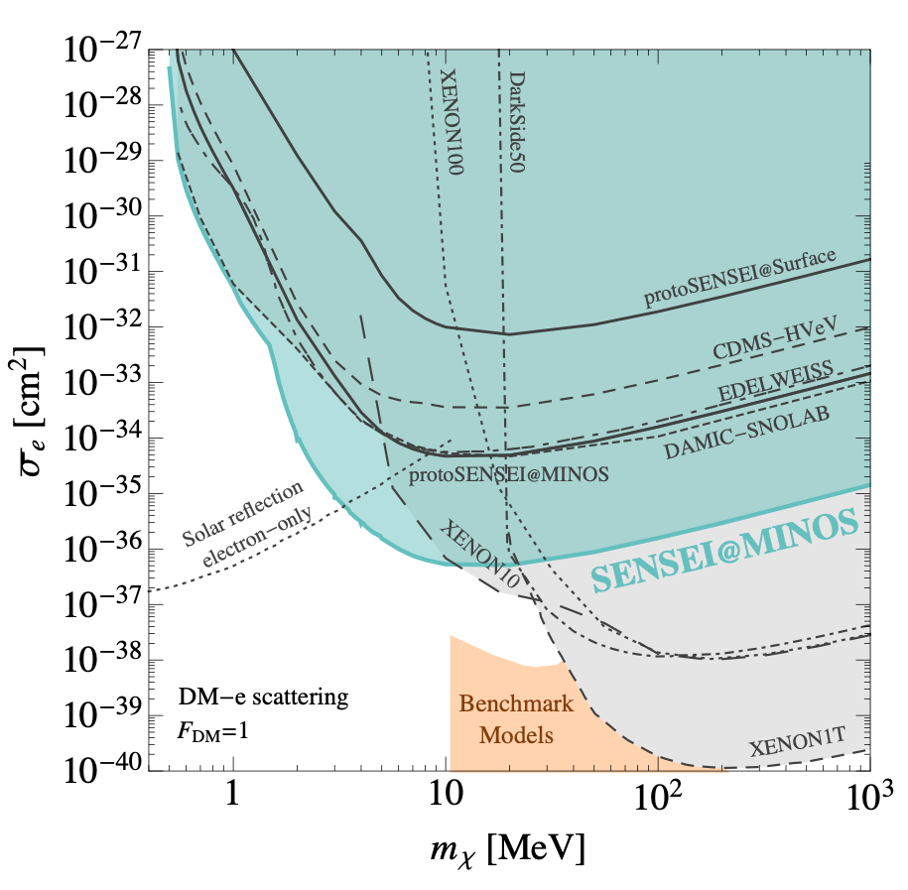
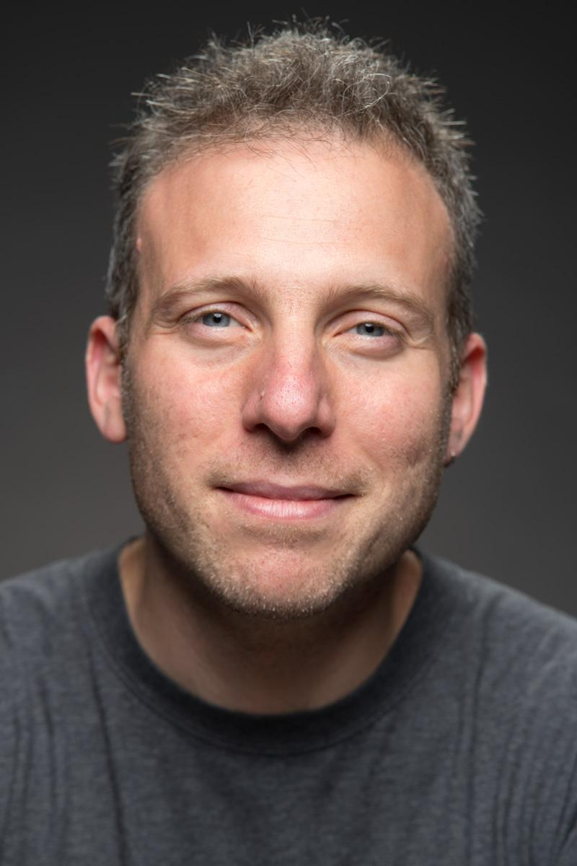
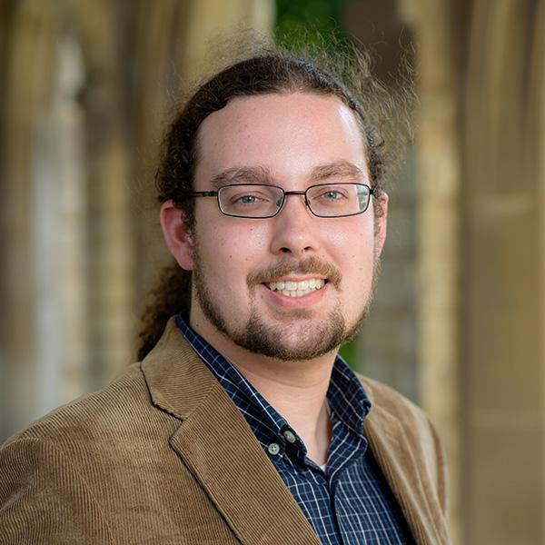
Recent Accomplishments by Fermilab Scientists in Dark Matter
Axions
Lead Lab for ADMX-G2, Operations Manager/PI
DMNI grant: design ADMX-EFR (extended frequency range)
Low Mass Dark Matter:
SuperCDMS SNOLAB: Deputy Project manager, spokesperson
NEXUS Underground Low Background Cryogenic Facility completed 2019
SENSEI (skipper-CCD) @ MINOS world leading results (2018, 2019, 2020)
SENSEI/Oscura pathfinder completed 100 gr detector (with H-S)
DMNI grant: Oscura for design 10 kg Skipper-CCD dark matter detector
Awards and Prizes:
Tiffenberg: URA and DOE Early Career awards, APS-DPF Instrumentation (EC), New Horizons Breakthrough Prize in Physics
Estrada: APS DPF Instrumentation (Sr. Scientist)
Scientific Hires
J. Tiffenberg 2017
D. Baxter 2021 (25-75% split
with Quantum Science Center)
ADMX-EFR experiment being designed for construction at Fermilab as part of the Dark Matter New Initiatives
World Leading constraints on electron recoils SENSEI@MINOS (SENSEI Collaboration 2020), SuperCDMS-HVeV Surface (SuperCDMS Collaboration 2018)

Slide 13
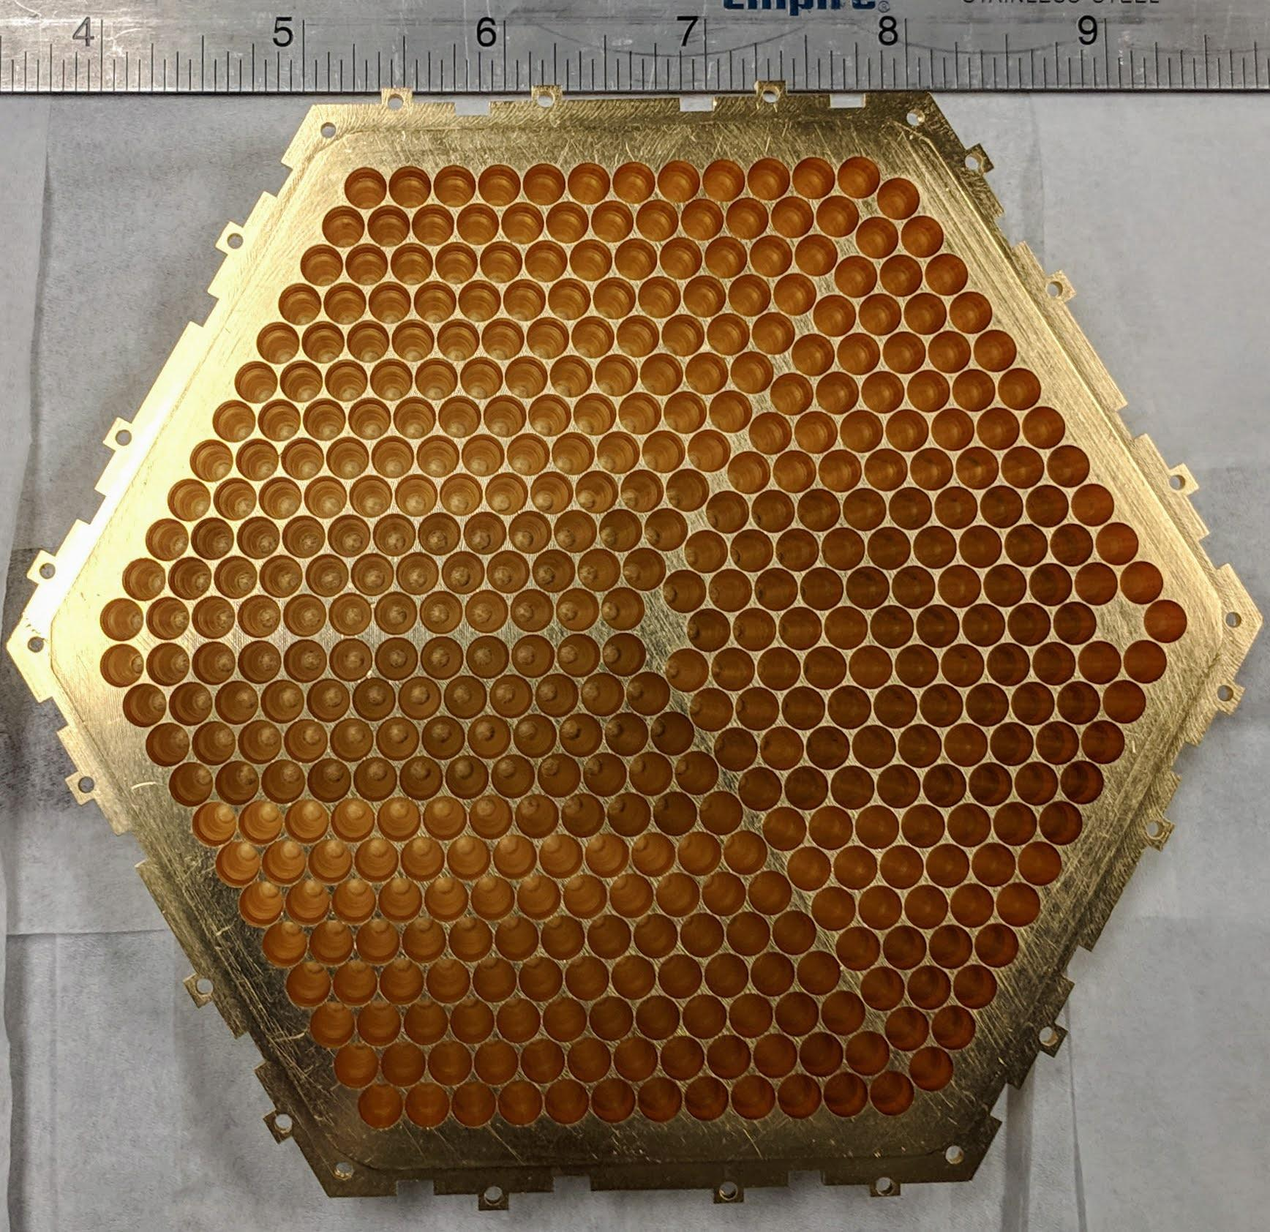
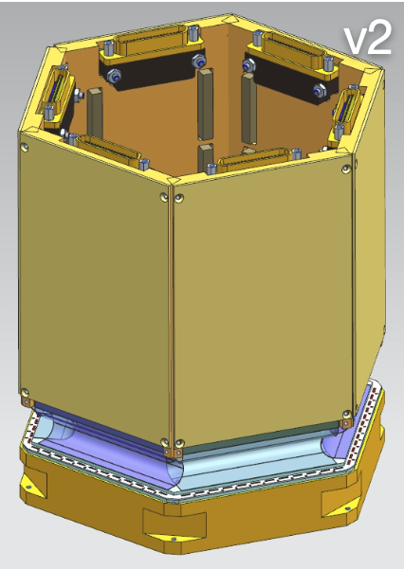
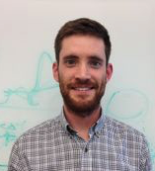
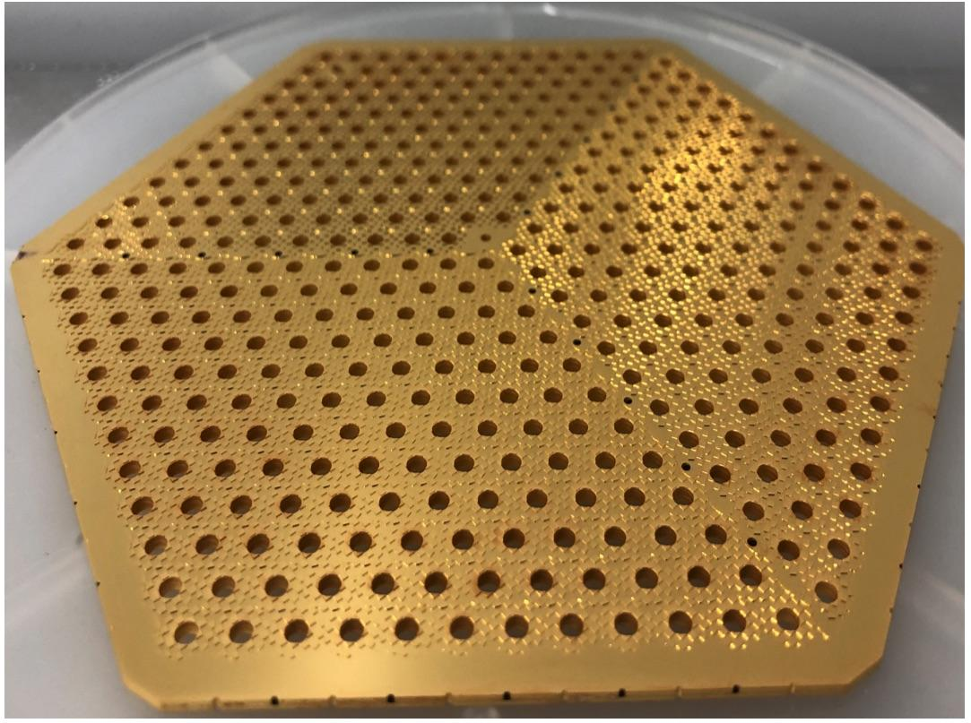
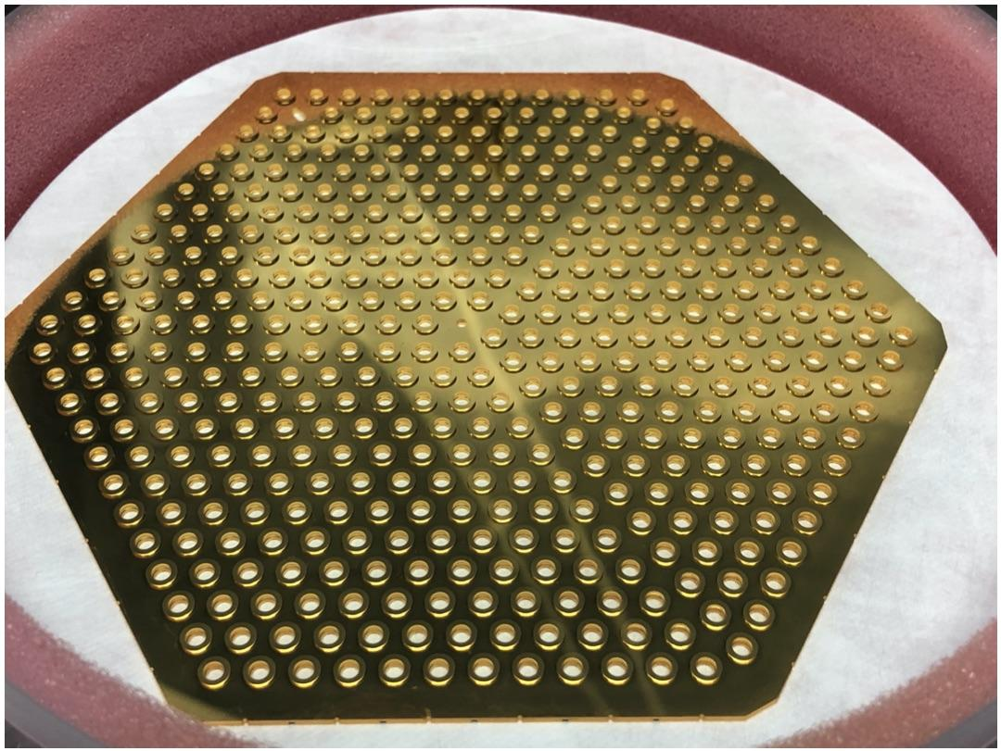
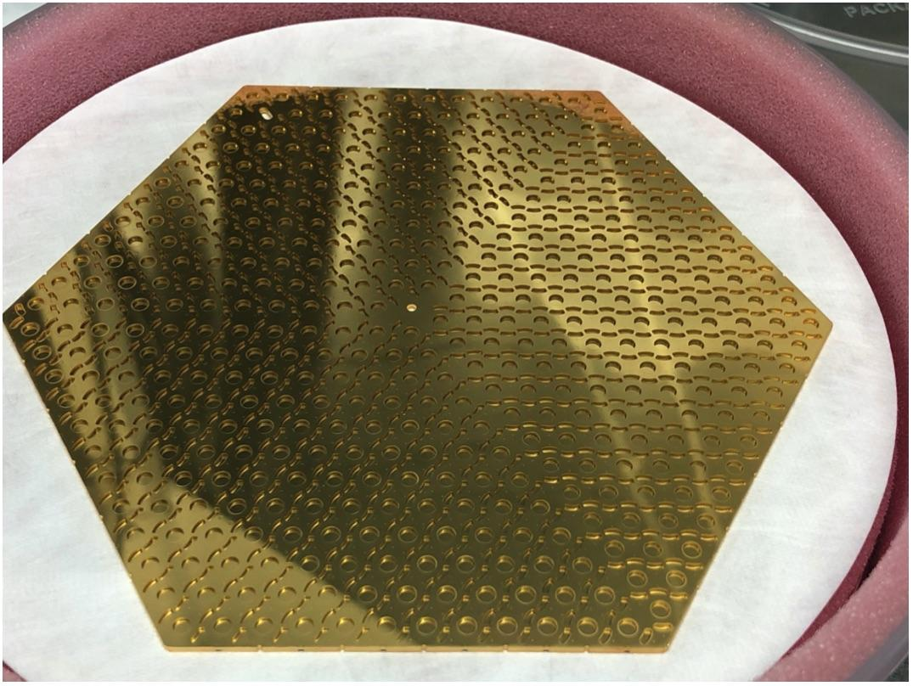
Recent Accomplishments by Fermilab Scientists in CMB
SPT-3G
packaged and tested >100 modules, camera cryostat
Scientist Benson is Associate Director of Operations
Critical roles in first cosmology results (2021)
CMB-S4
Agency Conceptual Design Team, Pre-project dev. team
Major Roles in project office and L2, L3 management
Awards and Prizes
Rahlin and Benson: 2020 Breakthrough Prize in Fundamental Physics for Event Horizon Telescope Imaging of a Black Hole
Scientific Hires
Anderson 2019 Wilson Fellow
Simon 2020 Wilson Fellow
SPT-3G data included in CMB-based constraints from temperature (TT), temperature-polarization (TE), and polarization-polarization (EE) Balkenhol et al., 2021. Light grey band: 95% confidence region of H₀, from Riess et al. (2020). CMB data finds H₀ = 67.49 km s⁻¹ Mpc⁻¹, in 4.1-sigma tension with the Riess et al. (2020) potentially an indication of the need for new physics in the standard cosmological model.

Slide 14
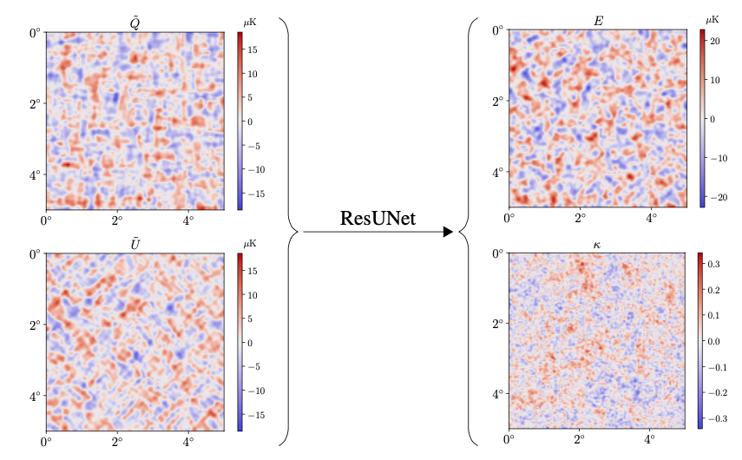
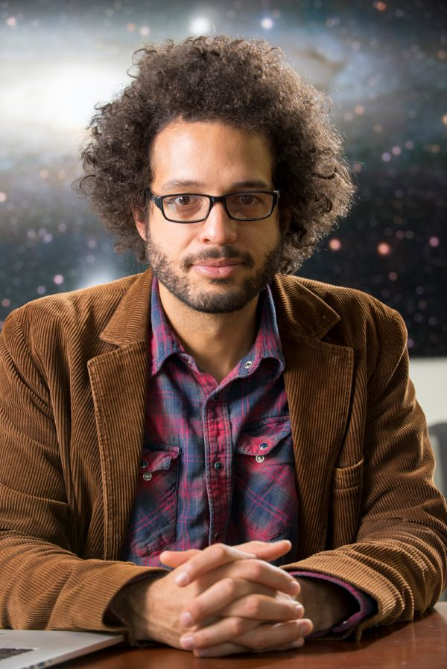
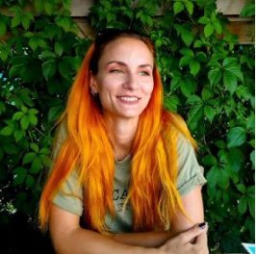
Recent Accomplishments by Fermilab Scientists in AI/ML
AI/ML Project office started in FY19
CF group: scientist Nord plus 2 postdocs (Ciprijanovic, Caldeira) who are not funded by cosmic research
AI/ML in Cosmic Surveys
Detection, modeling, and classification of faint galaxies [1911.06259, 2004.11981, 2006.04294]
Neural networks for strong lensing identification and modeling [1911.06341]
Machine learning to deblend galaxies in future surveys
Uncertainty assessment in cosmology (joint neutrino-cosmic effort)
AI/ML in CMB
Using neural networks to de-lense CMB [1810.01483]
Awards and Prizes
Nord 2021 DOE ECA “for simulation-based inference for cosmological parameter estimation and discovery”
Scientific Hires
B. Nord 2017
A. Ciprijanovic 2022
DeepCMB: Lensing Reconstruction of the Cosmic Microwave Background with Deep Neural Networks Caldeira et al. (2019)

Slide 15
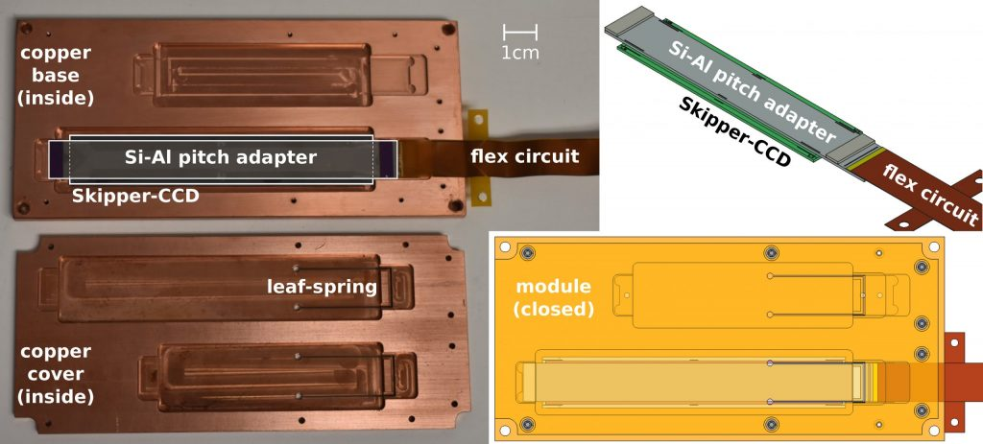
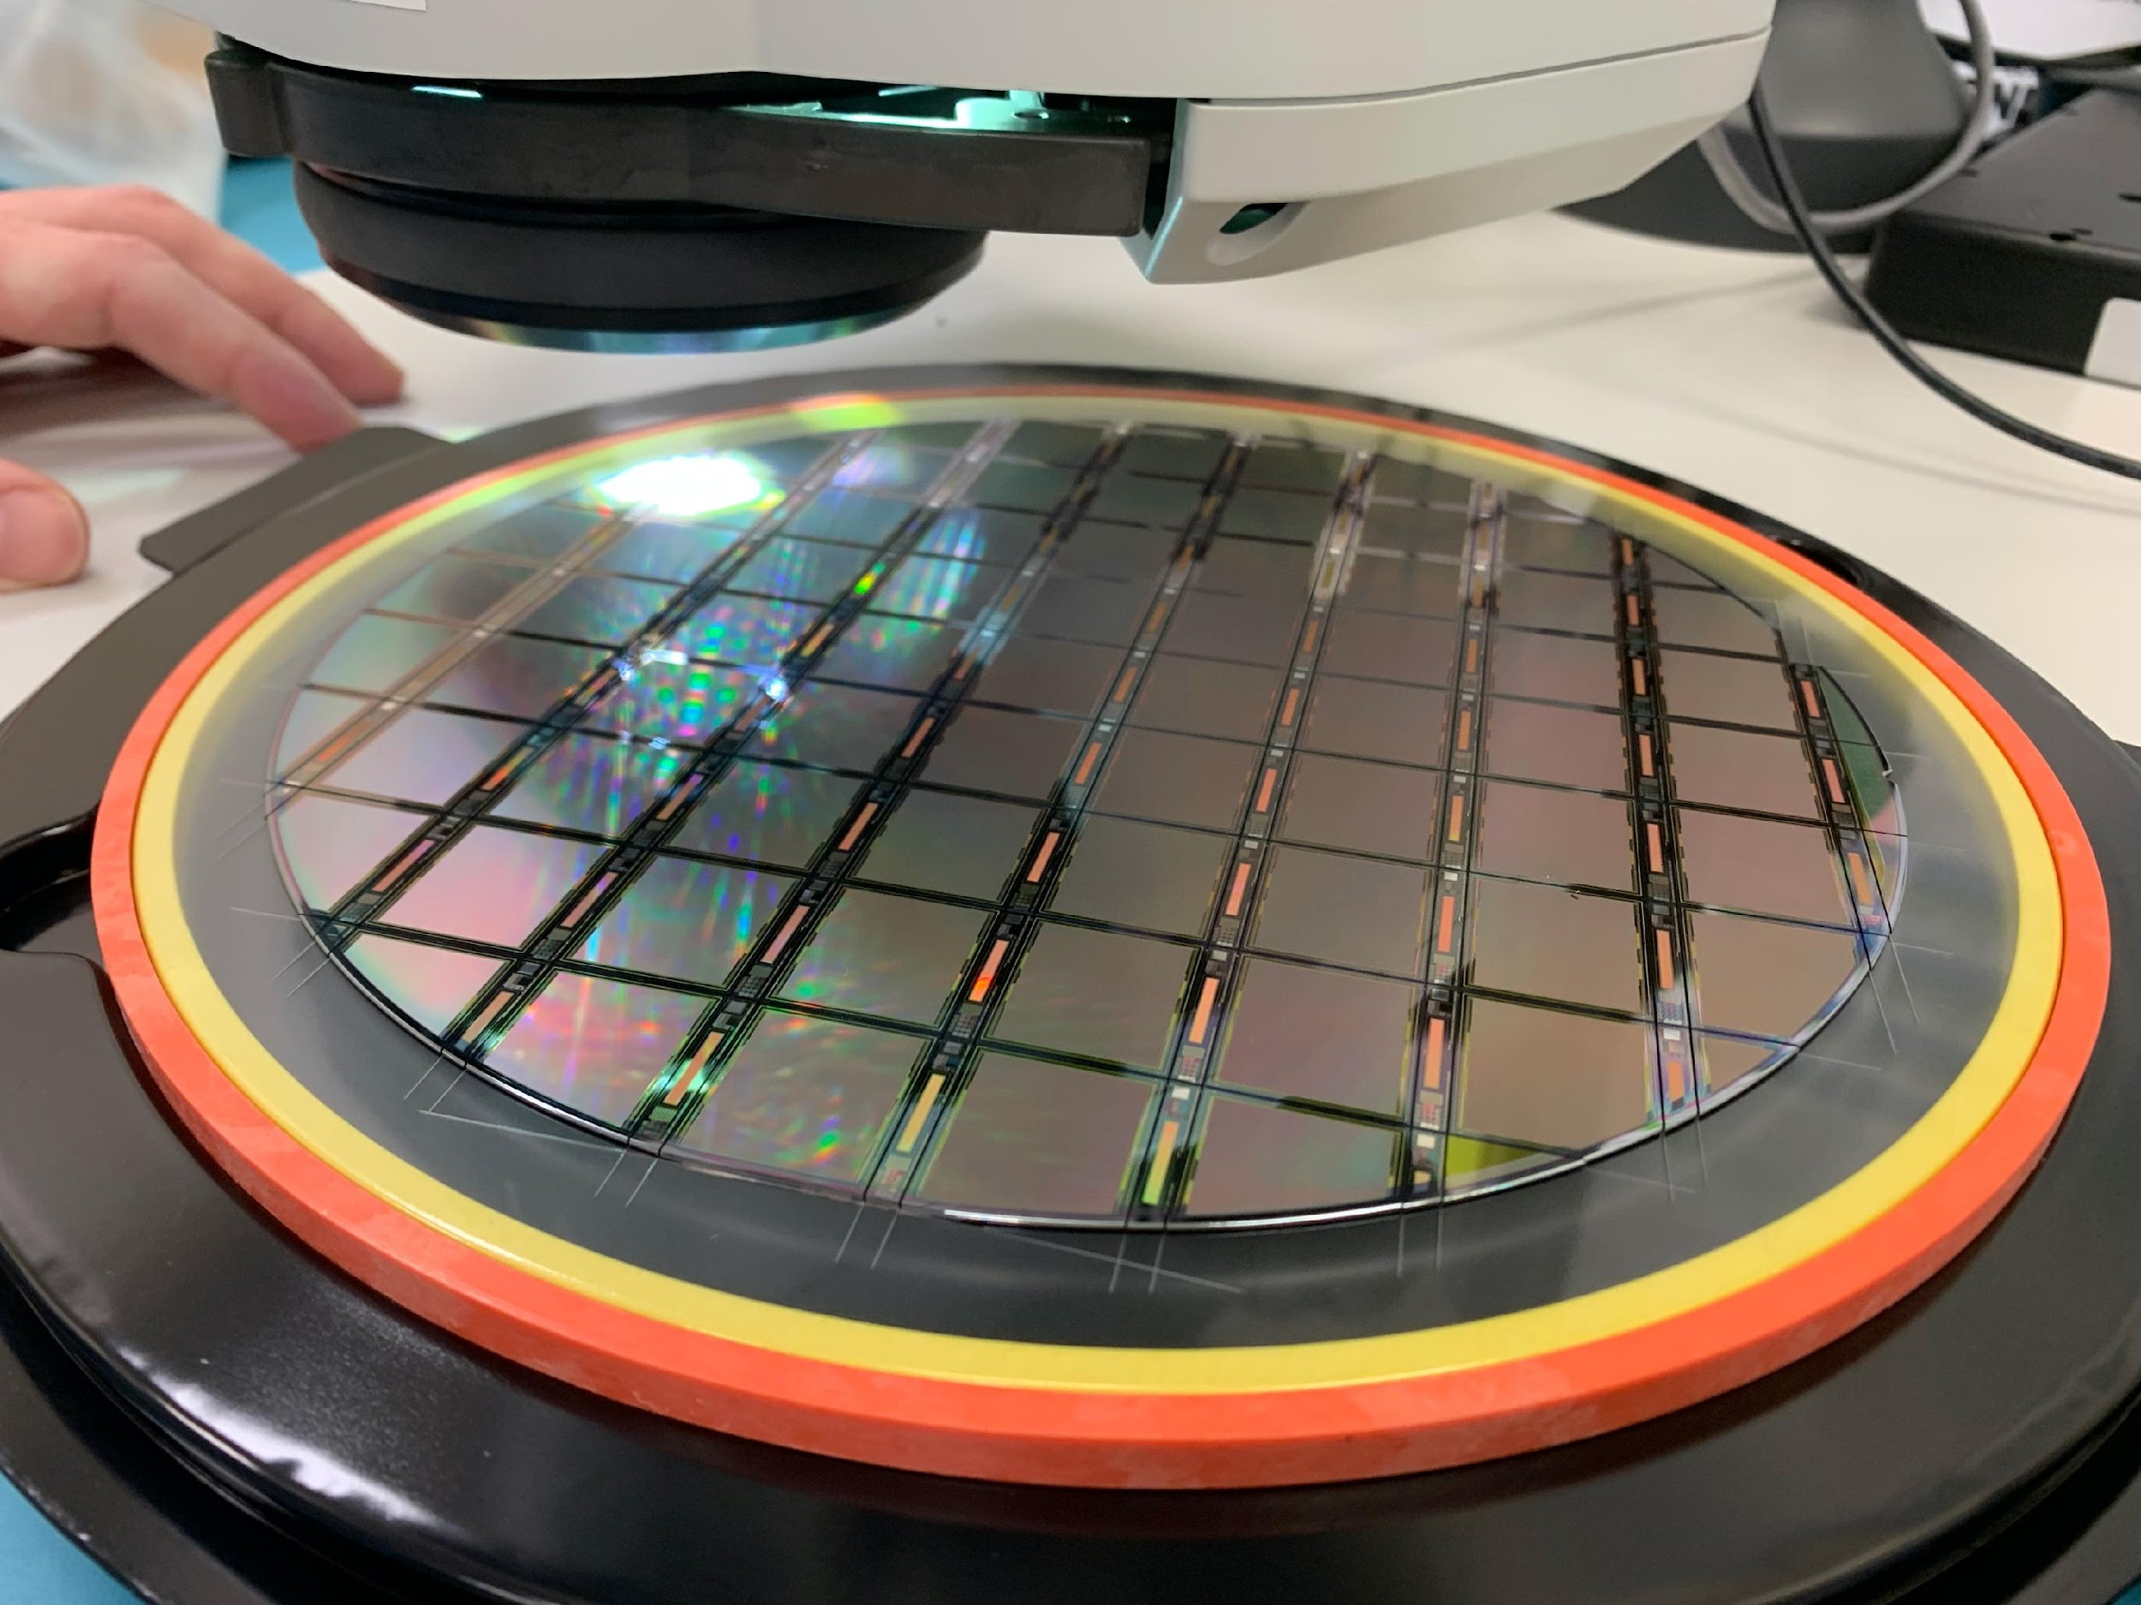
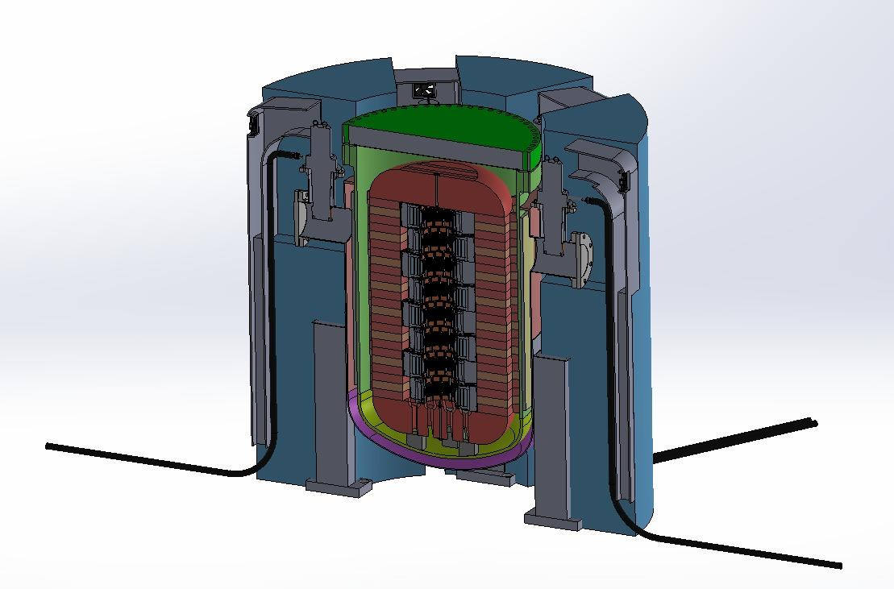
Detector R&D for Cosmic Experiments
2020 SENSEI
Current world leader in low mass
Dark matter
Focus on collaborative sensor design, packaging and integration with readout into functioning detectors for low-mass DM, DE, CMB
CCDs, Skipper CCDs, MKID, TES, SNSPD, Axion antenna, fiber positioner
Multiplexing, high-channel count, low threshold readout electronics
Pushing sub-GeV DM world-best limits already with small-mass demonstrator detectors
2024 Oscura
New sensors

Slide 16
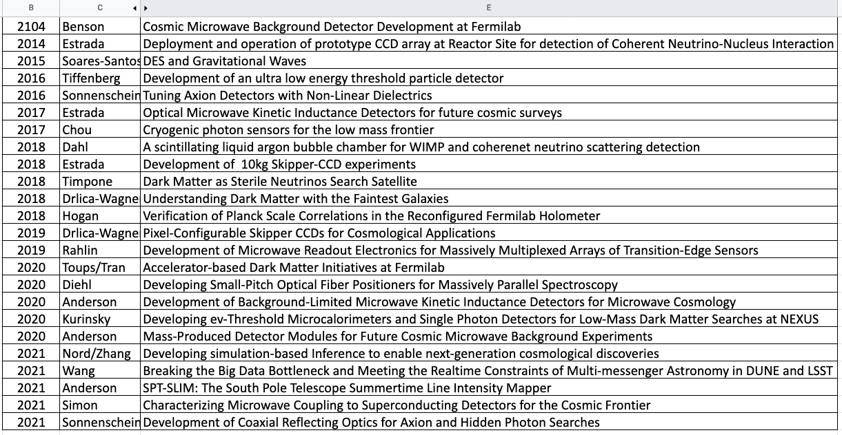
LDRD & Other Grants Leverage Cosmic Research Funds
QuantiSED/QSC:
Qubit single photon detection for axion searches (QuantiSED)
Skipper CCD’s for quantum imaging (QuantiSED)
DOE Early Career Awards:
Microwave Single-Photon Sensors for DM Searches and Precision Neutrino Measurements (Bowring 2018)
Towards table-top neutrino detectors: A 10 kg Skipper-CCD experiment (Tiffenberg 2018)
For simulation-based inference for cosmological parameter estimation and discovery (Nord 2021)
DOE Late Career Award:
Office of Science Distinguished Scientist Fellow Award (Frieman 2019)
Private Funds
Heising-Simons grant ($1M) for SENSEI detectors (Tiffenberg-FNAL and Essig-Stonybrook)
Since 2016 ~ 31% of the total FNAL LDRD program has supplemented Cosmic research
Notes:
Should we add Eric Dahl and Hugh’s LDRD?

Slide 17
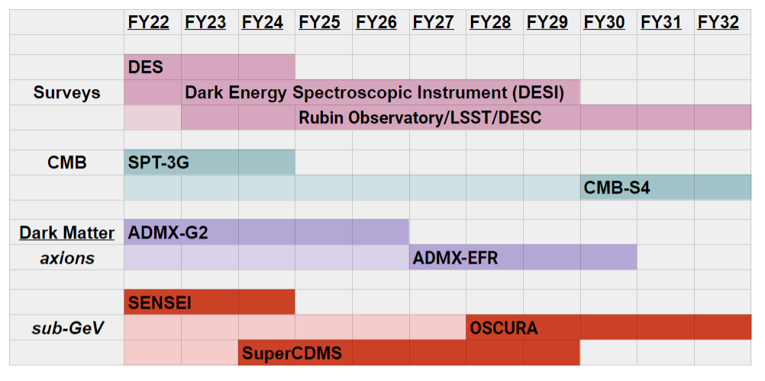
Major Activities and Milestones for next 3-5 years
Dark Energy
World-leading cosmology from full 6-year DES dataset
Support ops for LSST (Rubin Ops and DESC)
Develop leading role in next gen massive spectroscopy project
CMB
Complete SPT-3G operations
Fulfill major roles in CMB-S4, contribute to successful CD-1 and CD-2 reviews
Dark Matter
Complete/commission SuperCDMS, Successful operation of NEXUS facility
World-leading ADMX results, start construction of ADMX-EFR
World-leading results from SENSEI, bring together Skipper-CCD community (DAMIC-M, DAMIC, SENSEI) and start construction of OSCURA
Cosmic Physics Center
Strengthen connection to theory, quantum, AI/ML, neutrino, and cosmic user communities through workshops, hands-on detector training and access to the lab’s unique facilities
Fellowship program (example of success: Skipper ASIC design)

Slide 18
Plans for Snowmass and Next P5
Fermilab provides leadership within Snowmass Cosmic Frontier
A. Chou, Cosmic Frontier co-convener
A. Drlica-Wagner, B. Flaugher Topical group conveners
Plans and Priorities:
Support development of CMB-S4 : Leading/major roles: Module assembly and testing (IERC), Large Aperture Cryostat
Support development of Dark Matter New Initiatives: move from Design to Construction and operation - ADMX-EFR and OSCURA
Support next generation dark energy project: Massive spectroscopy - LDRDs in progress on tilting spines, Skipper CCDs
Build on technical expertise and connections with Chicago to support R&D for next next generation experiments: e.g Line Intensity Mapping

Slide 19
Precision Science
Notes:
Should we add Eric Dahl and Hugh’s LDRD?

Slide 20
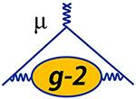
Precision Science
Muon Campus hosts Muon g-2 and Mu2e

Slide 21
Precision Science Frontier Strategy
Addresses the P5 Science Driver: “Explore the unknown: new particles, interactions, and physical principles”
This involves establishing experiments that aim to detect the quantum influence of new particles
Strategy:
Maximize the physics output of the Muon g-2 Experiment to investigate the difference between the experimental measurements and the theoretical predictions
Complete the Mu2e Project and make the world’s best measurement of charged lepton flavor violation
Develop the next generation of experiments that make use of the power available with the PIP-II upgrades

Slide 22
Precision Science - Main focus since last P5
Our main focus has been to execute P5 Recommendation 22: “Complete the Mu2e and muon g-2 projects”
“The Mu2e and muon g-2 projects… are immediate targets of opportunity in the drive to search for new physics, and they will help inform future choices of direction.”
“The global program includes projects that are complementary to one another using different kinds of particles as probes that are sensitive to different types of new particles and interactions. Some notable examples involve a revolutionary increase in sensitivity for the transition of a muon to an electron in the presence of a nucleus Mu2e (Fermilab)...”
Primary Physics Goals:
Muon g-2 aims to measure the anomalous magnetic moment of the muon to 140 part-per-billion and compare with theoretical calculations to search for evidence of the influence of new particles or forces
Mu2e is searching for muons spontaneously converting to electrons in the field of a nucleus with ~3x10-17 sensitivity, which would be a clear signal of New Physics

Slide 23
Fermilab Unique Capabilities
Strategic development of Muon Campus
Common elements of LINAC, recycler, and delivery ring utilized for both experiments
Reuse a large number of magnets from the decommissioned tevatron, and transported ring from BNL
Utilizes fast kickers and extraction septa, and AD pulsed-power expertise
Muon g-2 experiment relies heavily on the understanding of beam dynamics and subtle properties of the muons injected in the experiment
Mu2e relies on the development of a large number of superconducting magnets and high power targetry
Both experiments rely on the development of thin straw trackers for precision electron tracking

Slide 24
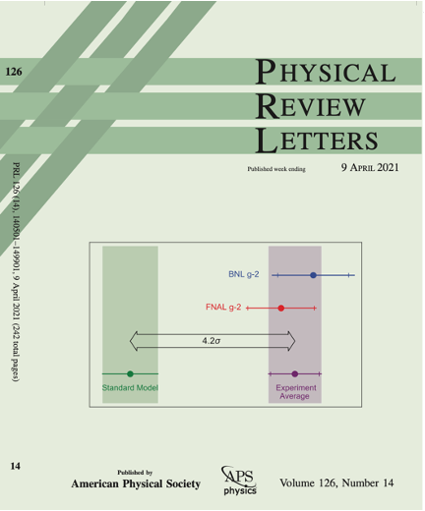
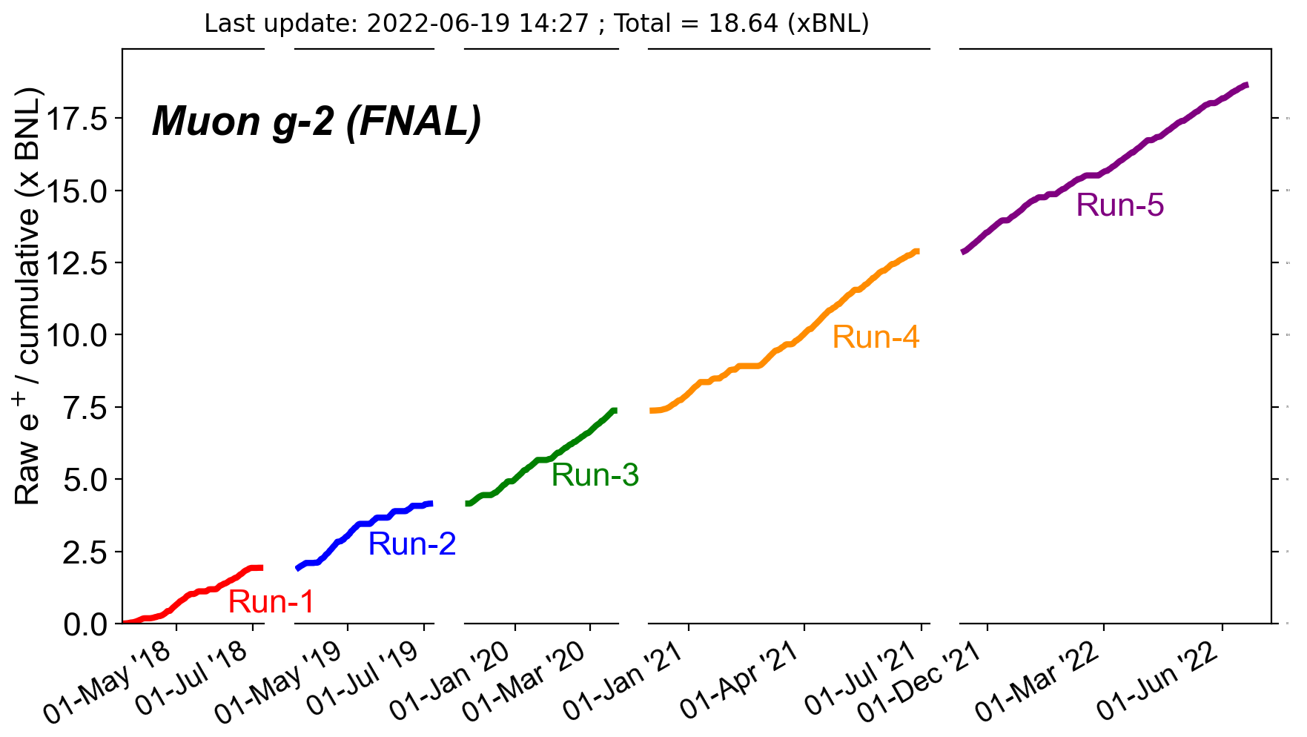
Precision Science - Current Experiment Status - g-2
Run-1 Physics result in April 2021 from <10 % of total data
Excellent progress on Run-2/3 Analysis
Operations continue to push towards statistics goal
Preparing for negative polarity running in Run-6

Slide 25
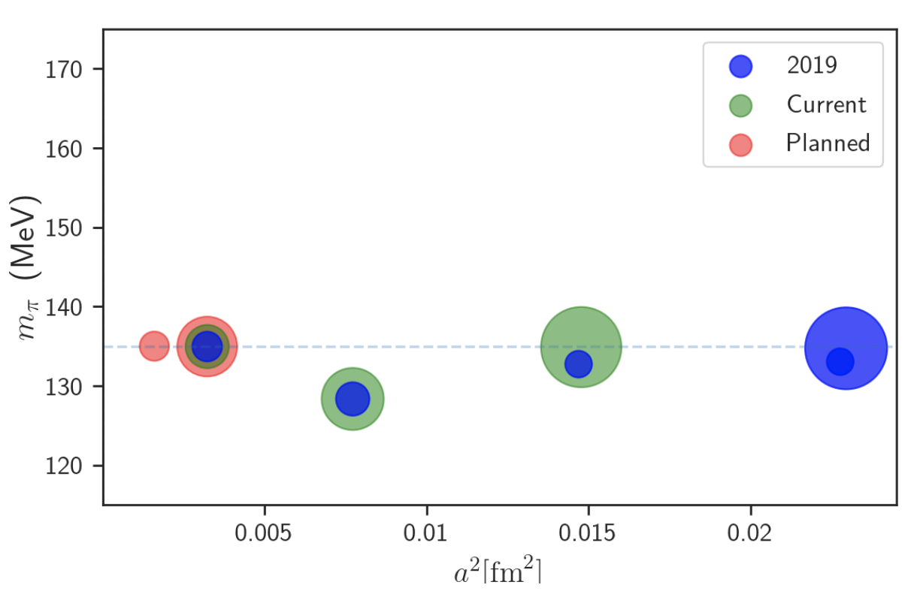
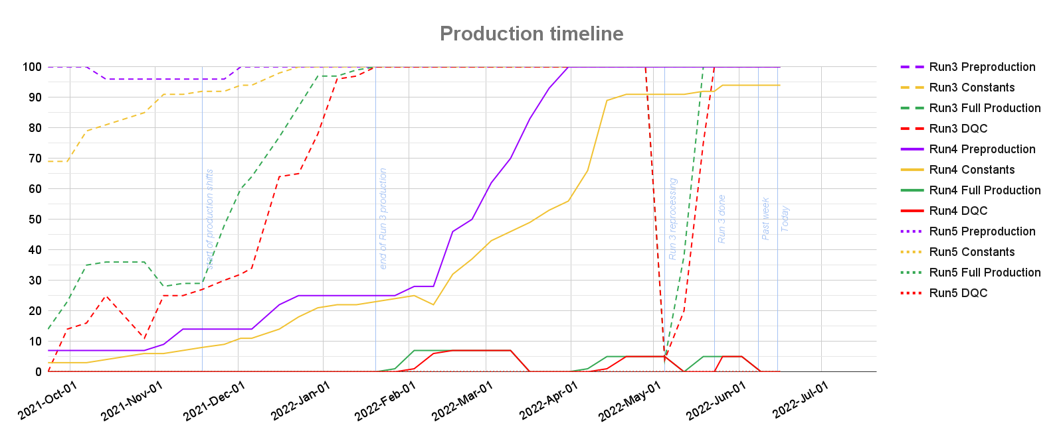
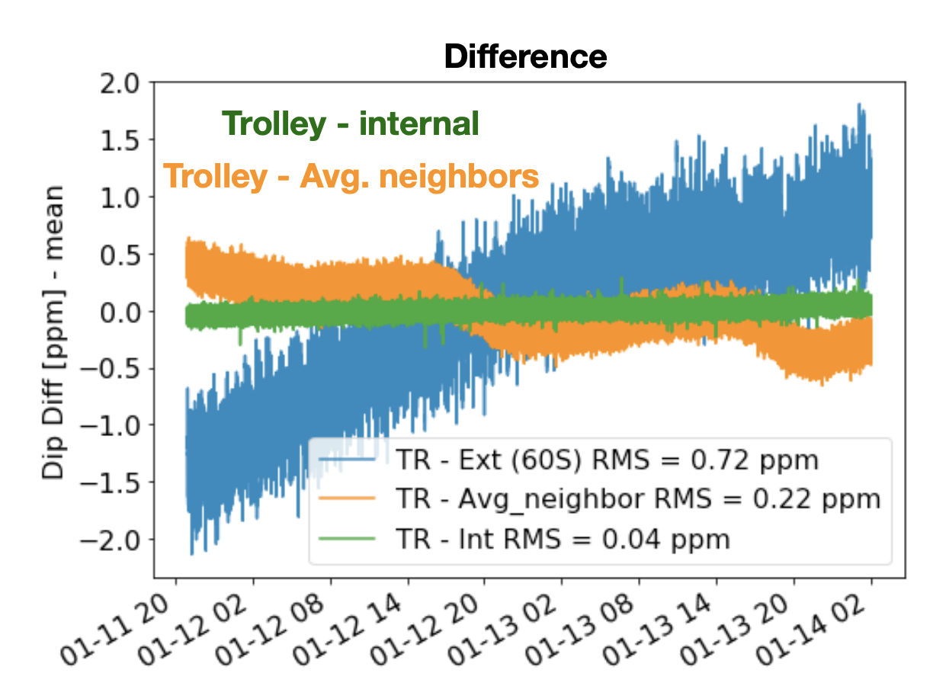
g-2 Recent Accomplishments
https://arxiv.org/pdf/2112.11647.pdf
Analysis production of runs 3 and 4 during the data collection of run 5
Theory critical for interpreting Muon g-2 result; Lattice QCD calculation expanding to new regimes with advanced computing resources
Run 5: Worked with KAIST to install novel RF system, dampens CBO oscillation amplitude
Development and installation of internal NMR probes improve field tracking

Slide 26
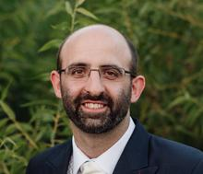
Precision Science - current FNAL activities g-2
Fermilab scientists leading throughout the experiment
Co-Spokesperson (Chris Polly 2017-2021, Brendan Casey 2021-present)
Physics Analysis Coordinator (James Mott 2021-present): leads effort of Run 2/3 Analysis
Field Analysis Coordinator (Brendan Kiburg 2018-2021, Saskia Charity 2021-present): developed new analysis techniques for tracking magnetic field in muon region during beam operations
Offline Analysis and Simulations (Tammy Walton 2020-present): significant improvements to offline analysis reliability and workflow
Operations Management in recent years
Overall: Chris Polly - Leading transition to negative muons
Ring: Hogan Nguyen - Kicker and Quad systems, including integration of novel RF system
Detector: Brendan Casey - Straw Tracker in-vacuum gaseous detectors
Field: Brendan Kiburg, Saskia Charity - Development of Surface coils, in-vacuum fixed probes
LDRD Awards, New Hires:
Brendan Kiburg, LDRD: Precision Compass: Measure vector field, needed for Muon EDM
Saskia Charity 2021 Tollestrup Award : Tracking detectors and magnetic field analysis
James Mott, 2020
Wilson Fellow
Tammy Walton, 2020 Associate Scientist
Jessica Esquivel, 2021 Associate Scientist

Slide 27
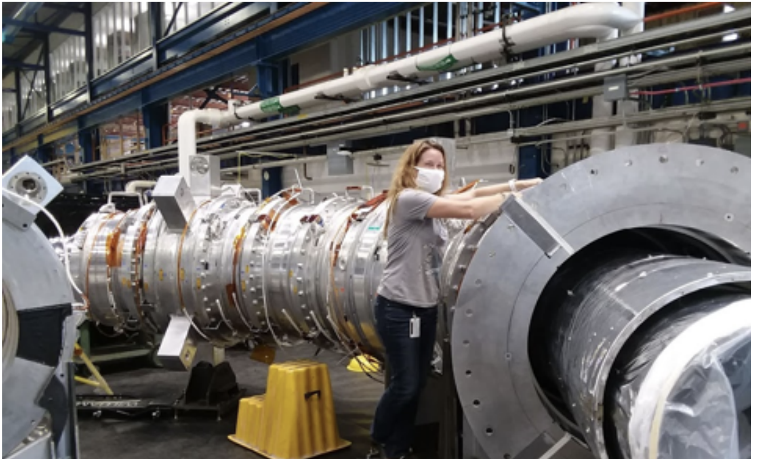
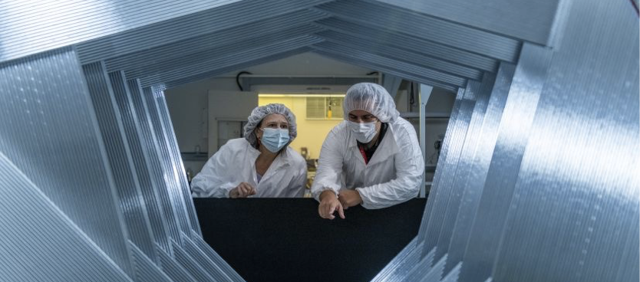
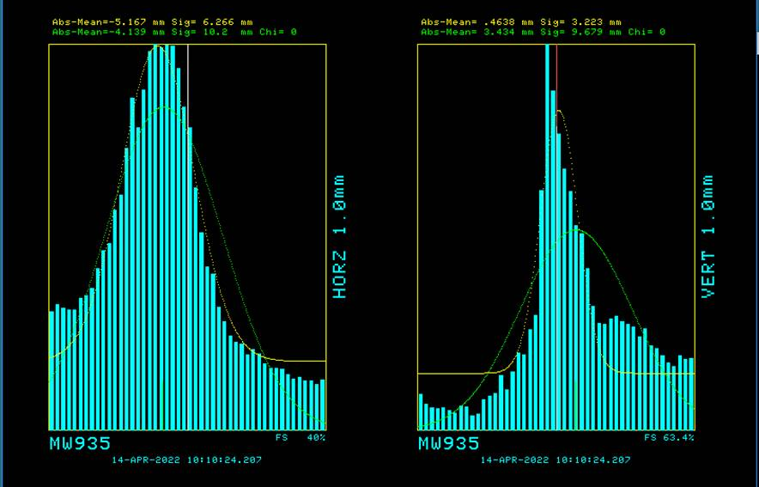
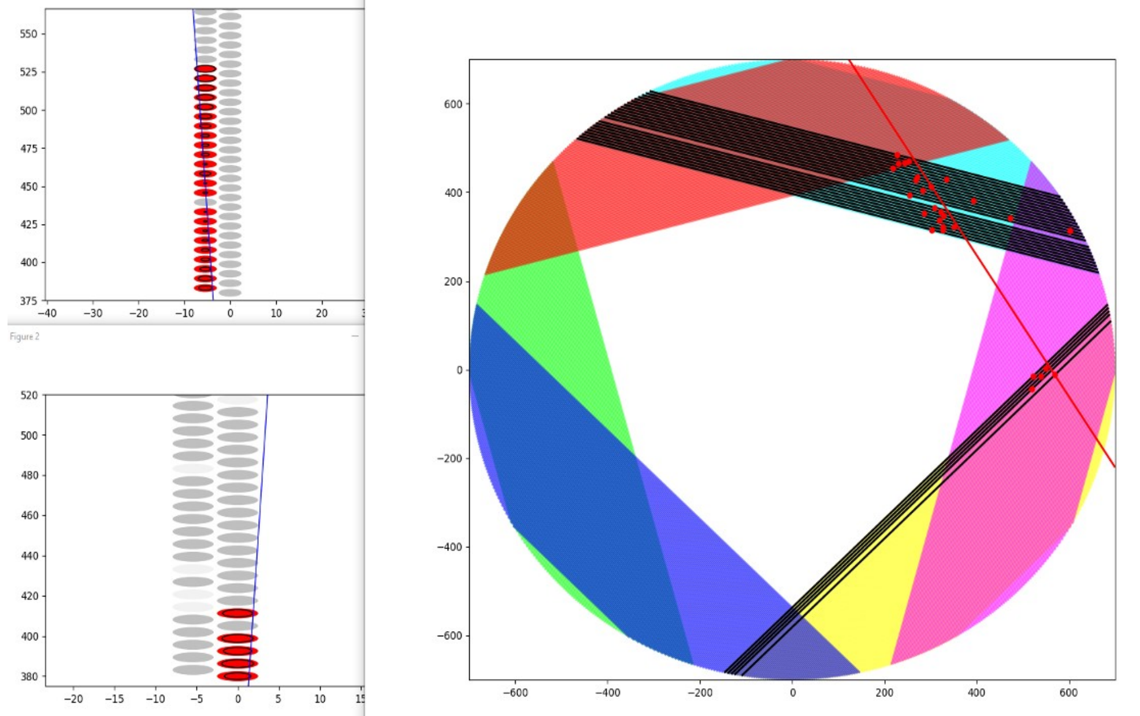
Mu2e Current Experiment Status
Transport solenoid development
Straw tracker assembly
Beam to diagnostic absorber (KPP)
Tracker VST: reconstructed cosmic ray

Slide 28
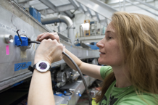
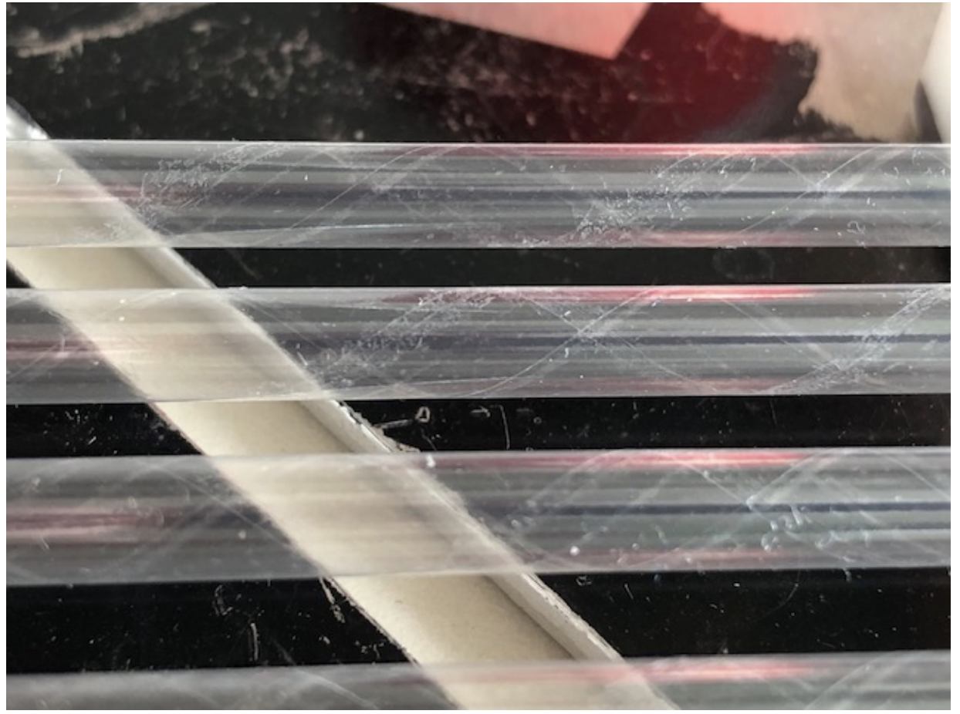
Precision Science - current FNAL activities Mu2e
Strong leadership contributions to many aspects of the experiment
Co-spokesperson (Bob Bernstein)
Project (Julie Whitmore) and operations (Greg Rakness) managers
Simulation WG co-leader (Pasha Murat to June 2021)
Current FNAL activities
Assembly of tracker planes, procurement of electronics, work on tracker services
Installation of cryo infrastructure
Assembly of the Transport solenoid, work with the vendor on Production and Detector solenoids
8 GeV proton beam studies in the Delivery ring and to M4. Construction of electrostatic septa.
Scintillator aging studies.
Development of Offline and TDAQ software, user support
LDRDs to support Mu2e-II R&D
Vitaly Pronskikh - pion production target concept for Mu2e-II
Brendan Casey - development of straws for an ultra-low mass tracker (Mu2e-II)
Recent hires
Karie Badgley (2018) Associate Scientist
Dan Ambrose (2021) Application Physicist
Vincent Fischer (2022) Application Physicist
Kevin Lynch (2022) Senior Scientist
Karie Badgley, 2018 Associate Scientist
LDRD for 8-μm-thick straw tracker R&D for Mu2e-II

Slide 29
Muon g-2 Near-term outlook
Muon g-2: Maximize Physics Output
Run 6 in FY23 with negative polarity muons
Complete analysis of collected data and publish
Additional analyses: EDM, light dark matter searches, CPT-LV
Lattice QCD input on HPV theory discrepancy

Slide 30
Mu2e near-term Outlook
Mu2e: World’s most sensitive CLFV search
Baseline Change review FY23
Complete the Project FY25
Prior to PIP-II long shutdown in FY27, collect highest statistics CLFV dataset

Slide 31
Precision Science - Plans for Next P5
Snowmass Participation and leadership
Frontier Convener Leadership (Bob Bernstein)
Strategic Planning Leadership at Lab (Brendan Kiburg)
Precision Science SAC Working Group Leaders (Chris Polly, James Mott)
Strong in-person participation in May RPF Workshop, July Snowmass CSS
Development of LOI and subsequent White Papers on a variety of topics:
Comprehensive CLFV program at new Advanced Muon Facility
Tests of Lepton Flavor Universality (PIONEER)
Eta Factory (REDTOP)
Fixed target Dark Matter Searches
Plans for next P5
Mu2e-II: Capitalize on major investment on Mu2e to extend reach by another order of magnitude
Development of Advanced Muon Facility that probes the major CLFV channels with muons and a broader muon program with support of the international muon community
Utilize close ties with Theory, Cosmic, Accelerator Frontiers to advance physics motivations for efforts like REDTOP, fixed target DM efforts and optimize machine design and flexibility of the Booster Replacement

Slide 32
Collider Science
Notes:
Should we add Eric Dahl and Hugh’s LDRD?

Slide 33
Fermilab Collider Program: Overview
The main focus of the Collider program is the CMS experiment
With CMS we can address three of the P5 science drivers:
Use the Higgs boson as a new tool for discovery
Identify the new physics of dark matter
Explore the unknown: new particles, interactions, and physical principles.
With Fermilab’s leading role in the HL-LHC upgrade, we are delivering on P5 recommendation #10:
“Complete the LHC phase-1 upgrades…”
“…and continue the strong collaboration in the LHC with the phase-2 (HL-LHC) upgrades of the accelerator and both general-purpose experiments (ATLAS and CMS). The LHC upgrades constitute our highest-priority near-term large project.”
As we prepare for Snowmass and look beyond the HL-LHC era, a modest but growing effort is devoted to future colliders

Slide 34
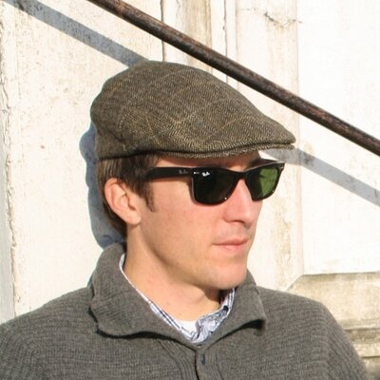
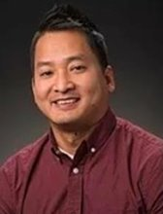
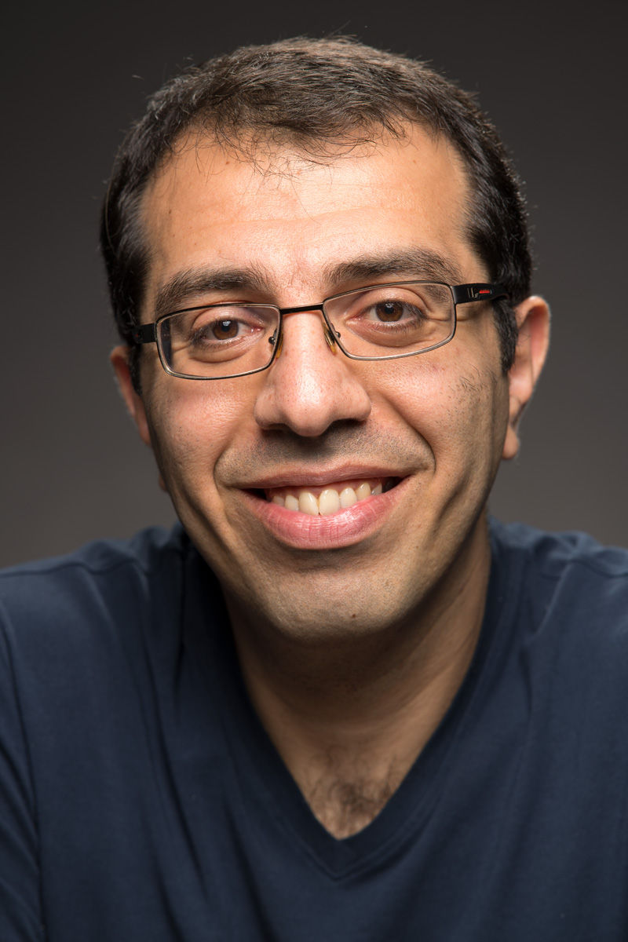
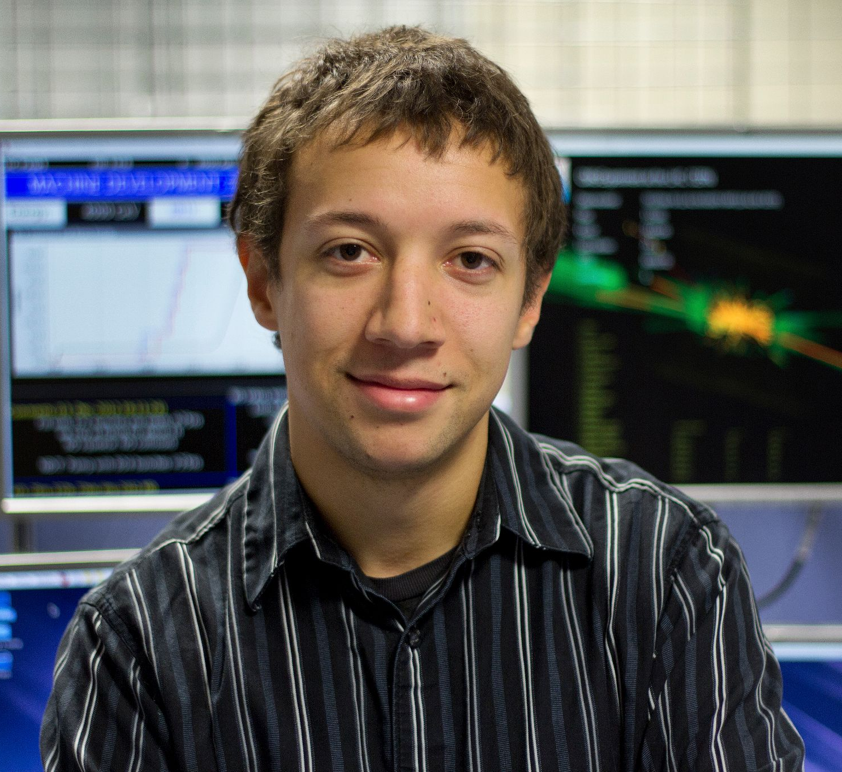
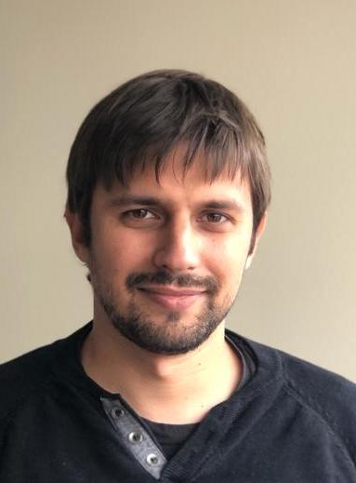
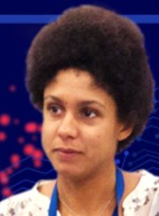
Overview of CMS at Fermilab
The Fermilab group remains one of the strongest in CMS and is critical to the success of both CMS and USCMS
Major roles in physics analysis, computing operations, and detector upgrades, built around Fermilab’s core capabilities and unique facilities
Leading the collaboration (Joel Butler, spokesperson 2016-18, and Patty McBride spokesperson-elect 2022-24) with many other scientists in convener/manager roles
Host lab for the US CMS collaboration (>1000 members, 54 institutions)
Management of the USCMS ops program and the HL-LHC CMS Detector and Accelerator Upgrade Projects
Home of the LHC Physics Center and Remote Operations Center
Recent ECAs and scientific hires:

Slide 35
Current Status of CMS: Starting Run 3
YOU ARE
HERE
Run 3 extended by 1 year (2022-25) and Run 4 will start in 2029
Run 3 will last as long as Run 2, but at a higher center of mass energy, providing unique physics opportunities
Enhanced capabilities of the CMS detector
Close to 10% of the HL-LHC dataset at lower pile-up
Significant increase of cross-sections for heavy new particles

Slide 36
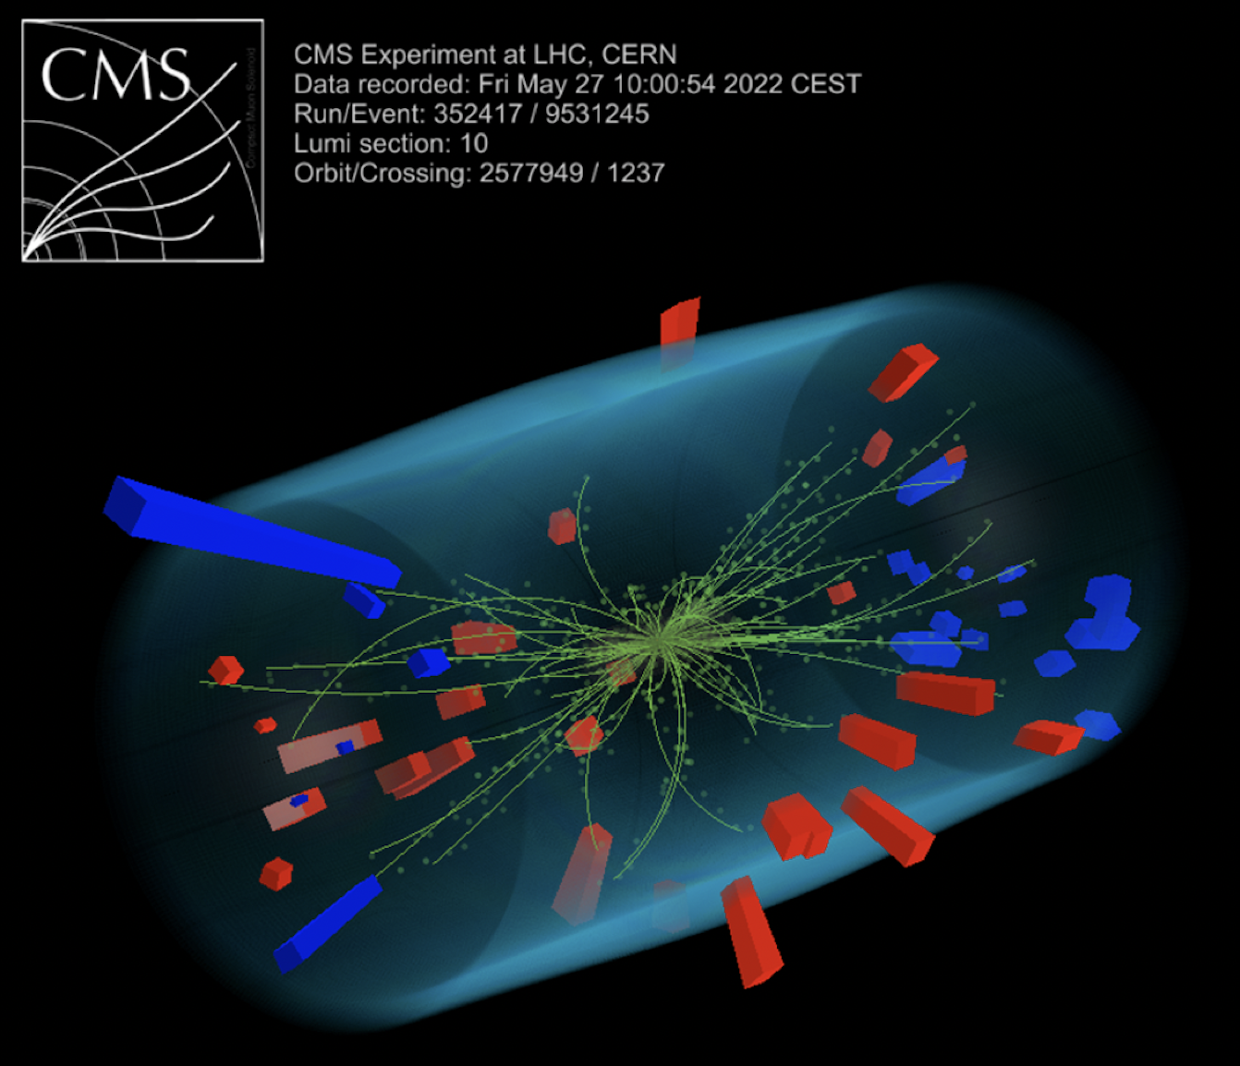
Current Status of CMS: Starting Run 3
After extensive work during the LHC Long Shutdown 2, CMS is ready to take data
The experiment has successfully recorded 900 GeV collisions and “splashes” at the new beam energy (6.8TeV)

Slide 37
Physics Analysis from FNAL
Pursue all three accessible P5 science drivers, using both “classic and novel” searches and measurements
Leading the development of advanced reconstruction techniques and innovative methods
Jet substructure, pileup subtraction
Deep Learning going much beyond classification
Capitalize on broad institutional knowledge and unique position as host of the LPC
Deep-neural-network for ID of boosted decay to b-quark pair
Search for Gluon Fusion production of Higgs into bb
Deep neural autoencoder network for identification of semi-visible jets

Slide 38
Selected Physics Highlights (since last PAC meeting)
Using the Higgs boson as a tool for discovery
First search for boosted Higgs decaying to charm
Observation of Z→cc, exp. sensitivity to SM Hcc: 38 x SM
Search for HH →(bb)(bb) with 4 b jets, and the first search for HH →(bb)(bb) in ”boosted” regime
Second best channel thanks to Graph Neural Network based jet selection
Identifying the Physics of Dark Matter
First collider search for dark matter from a strongly coupled hidden sector
Holistic search requiring new phenomenology models, modified simulation, innovative object reconstruction algorithms, novel background estimate techniques
Exploring the unknown
Search for resonant and non-resonant production of pairs of identical dijet resonances
Search for long-lived particles produced in association with a Z boson
Targeting decays in the tracker and complements “forward” experiments like FASER and SHiP in searches for Higgs portals

Slide 39
“Complete the LHC phase-1 upgrades and continue the strong collaboration in the LHC with the phase-2 (HL-LHC) upgrades…”
Phase 1 upgrades completed on schedule and on budget in 2019
New Forward Pixels, HCAL Electronics, L1 Trigger
HL-LHC upgrades prepare CMS for another decade running at 5-7x higher luminosity
Replace portions of the current detector that are radiation damaged
Prepare for higher luminosity, higher data rates, mitigate impact of increased pile-up

Slide 40
HL-LHC CMS Detector Upgrade: Reminder
Barrel Calorimeters
Trackers

Slide 41
HL-LHC CMS Detector Upgrade: FNAL deliverables
Barrel Calorimeters
Firmware for the Correlator Trigger
2000 SiPM modules
Concentrator ASIC (ECON)
525 Cassettes
Front End ETL ASIC
(ETROC)
2500 ETL modules (25%)
Mechanics
Trackers
2400 OT modules (18%)
All 6400 Macro Pixel Assemblies or MaPSAs
Flat Barrel
In collaboration with USCMS, using many FNAL facilities: SiDet, CDT, ASIC, FTBF, ITA

Slide 42
Status of FNAL Upgrade Deliverables
Significant technical progress
Finalizing designs, assembly procedures, and infrastructure
Prototypes performing well
Test beam results show good performance for FNAL-designed HGCal sensors and ETL sensors, before and after irradiation
ECON-T ASIC performing according to specification, ETROC v2 ASIC integration is progressing well
Implemented particle flow, pileup removal in L1T
Single board tests passed for correlator trigger
Project: Successful CD-3b IPR in early CY22, CD-2/3c planned in Fall 2022
Fabio Ravera testing OT module at SiDet
Zoltan Gecse, Maral Alyari testing prototype cassette at SiDet
ECON-T ASIC
Ryan Heller in FTBF CR

Slide 43
Software and Computing Operations and R&D
Fermilab Tier-1 availability (green is good)
FNAL provides the largest CMS computing facility outside CERN
Delivering critical new resources to computing systems for Run 3 & planned to expand into the exascale for HL-LHC
Infrastructure to exploit HPC (HEPCloud)
HPC contribution on average the size of the FNAL Tier-1
FNAL scientists are operating CMS computing infrastructure worldwide
Data recording at Tier-0@CERN operated from Fermilab outside CERN working hours
Fermilab continues pioneering the deployment of AI/ML at each stage of the experiment, from real time to offline data processing with focus on
Real-time AI in embedded/custom electronics (AI/ML in FPGAs, ASICs)
Inference as a service (Graph NNs for reconstruction; ML for simulation)
Three papers since last PAC: pileup removal, detector simulation, and semi-visible jet detection
Implemented ML-based trigger for displaced muons in the forward region
Providing competencies and resources to address all the “grand challenges” identified in the “US CMS Software and Computing: HL-LHC R&D” strategic planning document
Unified job submission infrastructure to HPCs (HEPCloud)
Adoption of modern columnar analysis tool
Workflows for High Performance Computing
HEPCloud:
HPC resources
in Sept. 2022
Notes:
To clarify the statement about the Tier1, I have removed the word HEPCloud
(the old bullet seemed to imply that we use the commercial cloud, while
HEPCloud is the name of our portal to HPC).
Oliver Gutsche confirmed that we use tape because it is cheaper than disks and
cloud (in the way the experiments would use the cloud).
He explained that besides Oakridge, we use all other US centers.

Slide 44
LHC Physics Center
Established center of excellence in physics, upgrades, and operations
> 90% USCMS institutions have personnel active at LPC
~30% of CMS Run 2 publications have a majority of contributors from the LPC
>500 users and ~800 people participating in LPC-organized events
CMS Data Analysis School, fully remote again in 2022
Graduate courses offering credit at home institutions
Statistics in Particle Physics, taught by Prof. Harrison Prosper (FSU)
Machine Learning, taught by Prof. Sergei Gleyzer (Alabama)
Current status
Some in-person activities have resumed
Physics Forum, Topic of the Week, LPC DR Office Hours conducted as hybrid
FNAL scientists and RAs provide support and intellectual leadership that is critical for the success of the LPC

Slide 45
Detector R&D for Collider Experiments
Pushing sensor and readout electronics to reach simultaneous ~5um/~10ps resolution for 4D tracking detectors for future lepton and hadron colliders
3D integrated sensors and ASICs: MAPS, HV-MAPS, AC-LGAD, TI-LGAD, double-sided LGAD, smart pixels
Extruded, molded and 3D-printed plastic scintillators: high granularity, fast, rad-hard, high light yield
Rad-hard optical links, Silicon Photonics
Also supported through LDRD:
Injection-molded plastic scintillator (Freeman);
Silicon precision timing detectors for minimum ionizing particles (Apresyan, Gray)
First-ever sensors with ~5 μm and 30 ps resolutions in a single sensor
First generation of FCFD 65nm chip

Slide 46
Future Colliders Initiative at Fermilab
New Future Colliders Group has been active, facilitating studies and discussions on future collider options
Develop Fermilab’s engagement plans in future collider projects, across aspects of accelerators, technology, particle physics and detectors
Provide a forum to synergize efforts on future colliders/accelerators across frontiers
Develop a roadmap for further (design) studies and R&D for future colliders
Recent Activities:
Hosted Snowmass Agora series on future colliders (5 events, Dec.’21- Apr. ’22)
Organized in conjunction with Snowmass Energy + Accelerator Frontiers; 100 - 220 attendees per event, ~2.5 hrs each
Linear e+e-, circular e+e-, muon collider, circular pp and ep, Advanced colliders
https://indico.fnal.gov/e/snowmass-agora-n, (n=1,..5)
Studying collider options with colleagues from the US and international community
Engage in global projects: FCC-ee, ILC, IMCC
Studies of domestic options: Cool Copper Collider (C³), High Gradient SRF (TW-SRF), FNAL-Site Filler (circular), Muon Collider; Future Collider Options for the U.S. https://arxiv.org/abs/2203.08088 (Contacts: Bhat, Jindariani)
Hosted a workshop on C³ R&D
U.S. National Accelerator R&D Program for Future Colliders (proposal whitepaper) (contacts Bhat, Lankford, Nagaitsev)
FCG members/leaders active as presenters, moderators, authors, editors in Snowmass Study

Slide 47
Major Activities and Milestones for next 3-5 years
Complete the publication of the analyses based on the Run 2 and Run 3 datasets
Lead detector and computing operations in Run 3
Perform software and advanced computing R&D (in preparation for the Computing TDR to be released in CY24).
Deliver on the upgrade project KPPs and transition into integration & commissioning of the Phase 2 CMS
Make major contributions to studies of future colliders, including science case, detector R&D, software and computing R&D following efforts already undertaken from the Snowmass process and the anticipated recommendations of P5.
Bolster the LHC Physics Center programs
Further strengthen the collaboration with the theory division
Co-organization of the Hadron Collider School
Theorists-experimentalists task forces established in 2019

Slide 48
Contributions to Snowmass
Fermilab provides leadership and stewardship of the HEP community within Snowmass
J. Butler, chair of DPF
O. Gutsche (replaced by D. Elvira), P. Merkel, A. Apresyan, J. Hirschauer, K. Pedro, D. Lincoln as Frontier/Topical Conveners
Fermilab physicists submitted a total of 30 White Papers
Future Collider Options (circular pp collider, circular and linear e⁺e⁻, muon collider): 7
Selected searches and measurements at Future Colliders: 5
Instrumentation (including facilities): 3
Software and Computing R&D (including AI/ML): 9
Climate impacts on Particle Physics: 1
Outreach: 1
In addition, Fermilab authored three broad reviews “Future Accelerator Projects: New Physics at the Energy Frontier”, “Detector simulation challenges for future accelerator experiment”, “Jets and Jet Substructure at Future Colliders” (to be published in Frontiers in Physics)

Slide 49
Conclusion
In Collider, Cosmic, and Precision science, FNAL has followed a strategy to pursue the relevant P5 science drivers and to adhere closely to the P5 recommendations.
We have taken on roles that leverage the expertise of our staff, our core capabilities and our unique facilities. We are delivering exciting, world-leading science results and project activities are making good progress.
Junior scientists at the lab are playing important roles in all three science programs. The lab must continue to bring in talented scientists to ensure knowledge transfer and maintain the expertise that will be needed to carry out the next P5 plan.
The Detector R&D program, supplemented by LDRDs, has launched new efforts that are now integrated in the program. This R&D must continue to position us to follow the recommendations of the next P5.

Slide 50
BACKUP
Notes:
Should we add Eric Dahl and Hugh’s LDRD?

Slide 51
Detector R&D: Snowmass and P5
Leading roles in Snowmass:
Instrumentation Frontier (IF) convener: P. Merkel
IF sub-group conveners: J. Estrada and C. Escobar (IF02 Photodetection), A. Apresyan (IF03 Silicon Tracking), J. Raaf and E. Dahl (IF07 Noble Element Detectors)
Detector R&D program at the lab is aligned with P5 and DOE BRN
Development of sensors for future collider and cosmic experiments is key component
Very active field with world leading contributions and breakthroughs
Key area that stimulates national and international collaborations and attracts alternative funding sources (LDRD, ECA, SBIR, QIS, Heising-Simons, IARPA, NASA, etc.)
Will update Fermilab’s Strategic Plan for Detector R&D to new P5 priorities, but expect to be very much in-synch already

