Slide 1
Performance and Plans for Fermilab Accelerator Complex Operations
Michael Lindgren
Fermilab PAC summer meeting
21 June 2022

Slide 2
Outline
Accelerator operations
P5/Scope
2016 to present
Plan until long shutdown
Modernization
COVID impacts
Workforce
Summary

Slide 3
Alignment
P5 plan has been in place for some time, and still the guide
Recommendations related to Fermilab accelerator operations:
Recommendation 1: Pursue the most important opportunities wherever they are, and host unique, world-class facilities that engage the global scientific community.
Recommendation 12: In collaboration with international partners, develop a coherent short- and long-baseline neutrino program hosted at Fermilab.
Recommendation 14: Upgrade the Fermilab proton accelerator complex to produce higher intensity beams. R&D for the Proton Improvement Plan II (PIP-II) should proceed immediately, followed by construction, to provide proton beams of >1 MW by the time of first operation of the new long-baseline neutrino facility.
Recommendation 22: Complete the Mu2e and muon g-2 projects.
Strong focus on these recommendations continues

Slide 4
Accelerator Operations Scope
Funding provided by DOE HEP for the operation of the Fermilab accelerator complex to supply particle beams to Intensity Frontier Experiments and the Test Beams
NOvA, g-2, ANNIE, ICARUS, SwitchYard 120 GeV (SY120) test beam program, MeV Test Area (MTA/ITA) – Spinquest (NE) and SBND (FY23)
Includes electrical power and computing activities for accelerator operations needs
Short and mid-term accelerator R&D
eg. Booster Studies joint task force with PIP-II, Accelerator complex studies task force
Special Process Spares(SPS), Accelerator Improvement Projects(AIP) are funded in separate operations Field Work Proposals, but considered operations.
Roughly speaking, an $80M budget has $60M labor, $10M power, and $10M other M&S.

Slide 5
Accelerator Operations funding
2016 Review Accelerator Operations Closeout Assumptions
The funding plan for Accelerator Operations including Accelerator Improvement Projects (AIP) from FY15 to FY20 is about flat: FY15: $81M, FY16: $91M, FY17: $87M, FY18: $89M, FY19: $89M, FY20: $91M.
B&R | All Divisions
 | FY16 Budget | FY17 Budget | FY18 Budget | FY19 Budget | FY20 Budget | FY21 Budget
KA 22 02 021 - Intensity Facilities - Accelerator Operations | $ 74,005,000 | $ 75,545,000 | $ 70,972,000 | $ 72,300,000 | $ 81,300,000 | $ 77,583,000
KA 22 02 021 - Intensity Facilities - Accelerator EQU | $ 8,325,000 | $ 11,000,000 | $ 4,592,000 | $ - | $ 1,000,000 | $ 1,500,000
KA 22 02 021 - Intensity Facilities - AIP | $ 7,450,000 | $ (1,800,000) | $ - | $ 5,600,000 | $ - | $ -
KA 22 02 811 - Inventory - Special process Spares | $ (2,400,000) | $ (2,565,000) | $ - | $ - | $ 900,000 | $ 1,500,000
Totals | $ 87,380,000 | $ 82,180,000 | $ 75,564,000 | $ 77,900,000 | $ 83,200,000 | $ 80,583,000
B&R | All Divisions
 | FY16 FTE | FY17 FTE | FY18 FTE | FY19 FTE | FY20 FTE | FY21 FTE
KA 22 02 021 Intensity Facilities - Accelerator EQU | 19.3 | 21.1 | 8.6 | 0.6 | 0.4 | 1.3
KA 22 02 021 Intensity Facilities - Accelerator Operations | 218.5 | 218.5 | 240.7 | 226.2 | 232.9 | 247.0
KA 22 02 021 Intensity Facilities - AIP | 20.4 | 11.0 | 1.1 | 4.4 | 4.7 | 2.0
KA 22 02 811 Inventory - Special Process Spares | 8.5 | 5.3 | 2.9 | 4.0 | 4.5 | 7.7
Totals | 266.8 | 255.9 | 253.3 | 235.1 | 242.5 | 258.0
Have not quite met the anticipated levels, overall budget alignment with P5 the priority

Slide 6
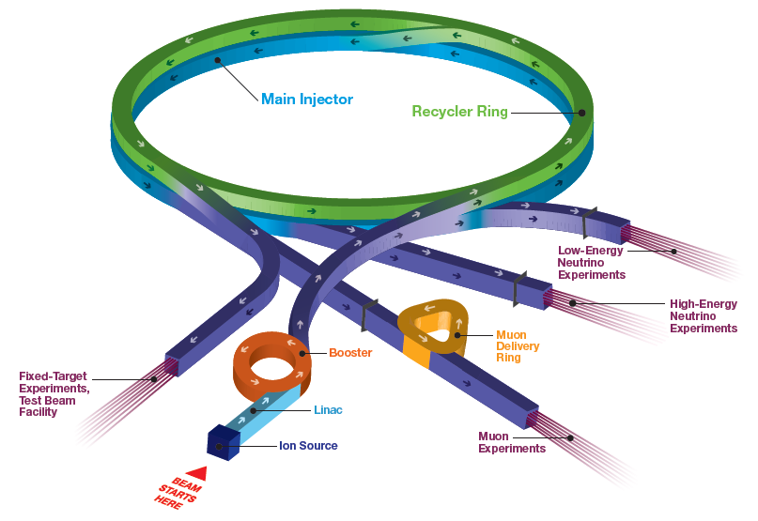
Current Accelerator Operations Beam Delivery
Short Baseline Neutrino:
MicroBooNE (completed), ICARUS,ANNIE, SBND
SwitchYard 120:
SpinQuest, Emphatic, test beam (FTBF)
NOvA
Long Baseline Neutrino:
NOvA, (LBNF/DUNE)
MTA/ITA
Muon Campus:
(g-2, Mu2e)

Slide 7
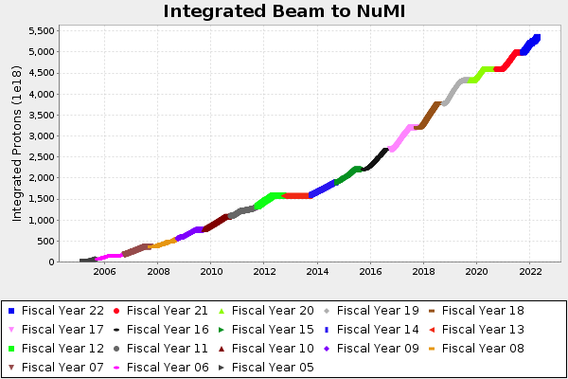
NuMI operations
Completion of PIP allowed consistent ~650kW to NuMI when SY/BNB/g-2 running
Power limited by booster throughput/losses
Plan to run until ~2026

Slide 8
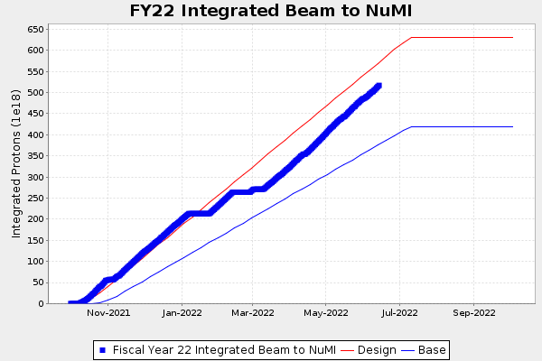
NuMI operations
Substantial downtime this running period
Quadrupole (IQC) failure in MI-30 High Radiation Area
Limited Spares, and failures of those
HRA work planning
Munters – supply chain
Did achieve 893 kW power
Keeping losses under control key to sustainable higher power running

Slide 9
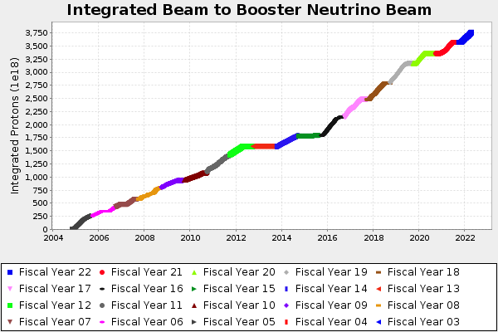
BNB operations
BNB operations generally stable and delivering beam when experiments are ready
MicroBooNE competed
ANNIE, ICARUS in operations
SBND online next year
Will run program until ~2026 (long shutdown for PIP-II/LBNF)

Slide 10
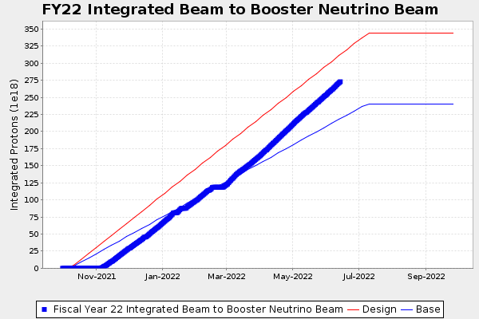
BNB operations
BNB startup slow this run period
Power panel failure in RAW system
Otherwise as needed by experiments

Slide 11
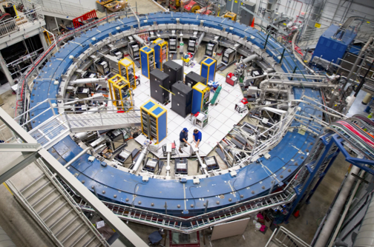
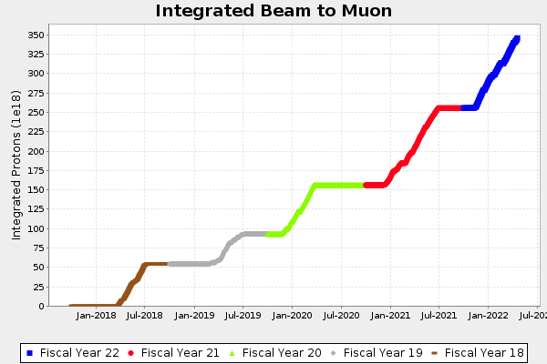
Muon Campus operations
g-2 beam operations since 2018
Accumulate ~19 BNL datasets by end of FY22 run
Accelerator downtime in 2019 from unexpected lens failures
Collider components – gradient reduced, at 340M pulses on current lens
Reduced data delivery rate
g-2 has delivered high impact science results from early running
Proposed FY23 run in opposite polarity mode – accumulate 4x BNL mu- data

Slide 12
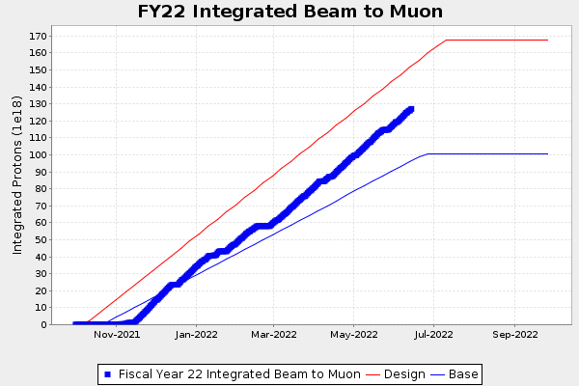
Muon Campus operations
Normal running for most of this run period
Some experiment startup issues
Downtimes coordinated with mu2e beamline work
g-2 proposed FY23 run in opposite polarity mode
Goal - 4x BNL mu- data
Reduces NOvA POT’s
Requires polarity reversals at beginning and end of run period
Was done in TeV era, believe we can execute safely

Slide 13
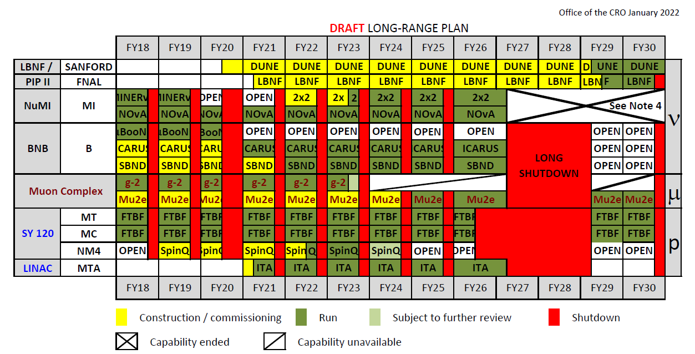
Operations plan through the long shutdown

Slide 14
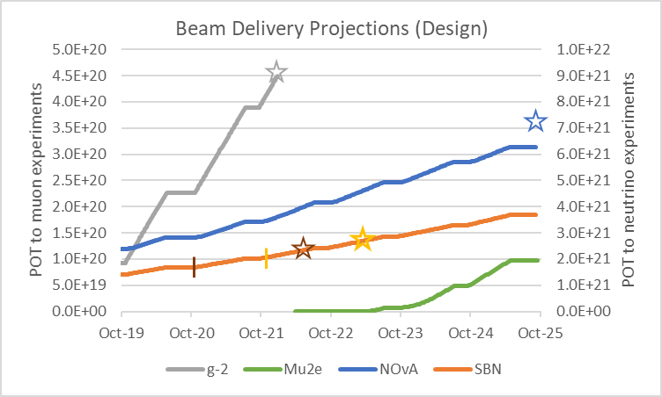
Beam delivery plan
Long shutdown for LBNF/PIP-II now begins January 2027
Will continue running NOvA, ICARUS, SBND
Mu2e helped – possible to get close to a year of physics data given current schedule
FY20 shutdown for LBNF site prep → 6 mo + COVID
FY21-FY25 planned 10-week shutdowns → 14 weeks FY21
skip the summer 2026 shutdown(?)
Electrical costs a recent concern
Plan for complex to be down for ~two years for PIP-II and LBNF starting January 2027
ICARUS
SBND

Slide 15
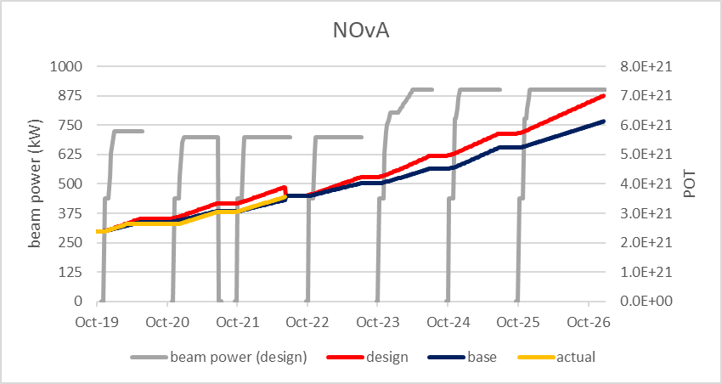
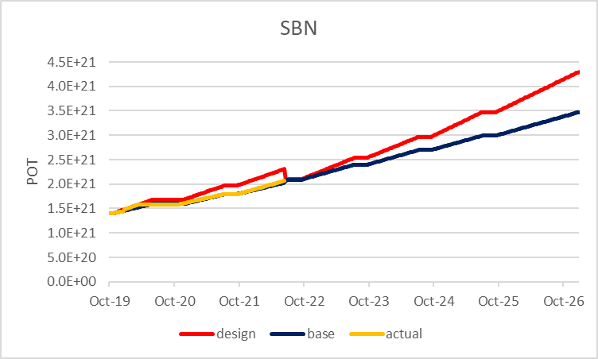
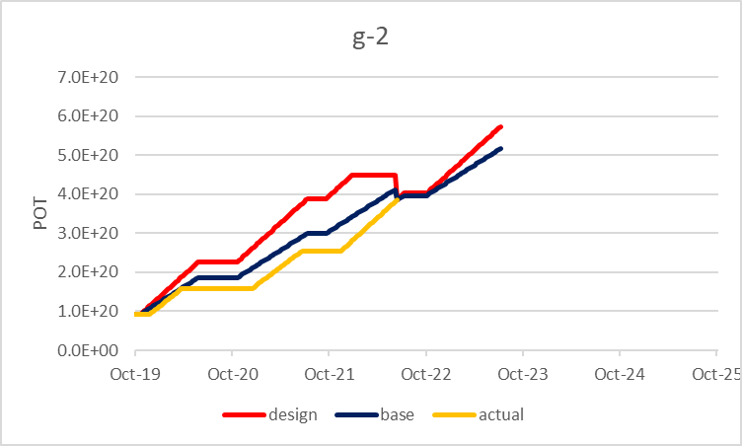
Beam Delivery estimates going forward
Actuals vs original predictions, then future predictions starting from current point
“Design” is the upper (red) curve on the previous annual delivery plots

Slide 16
Mu2e Operations planning
Commissioning behind original schedule
conflicts of funding, personnel availability, project delays, and g-2 running
Delivery of first proton beam to the M4 diagnostic absorber – KPP met
Accelerator scope remaining before operating Mu2e
Project scope
Assemble Extraction septa
ESS power supplies
Assemble AC Dipoles and install
Complete tune monitor system
M4 final focus vacuum installation
ESS fluorinert skid
AC Dipole power supplies
Install extinction monitor system
Insert HRS into PS
Install target into HRS
Install power supply for skew quads
Complete low level RF system
Operations scope
Installation coordination
Software
Beam Commissioning
Delivery Ring BPMs
Remote handling system
Spill control electronics
Shielding Assessments
Additional in tunnel shielding
Instrumentation for extraction
Design and install target air barrier
Radiation protection improvements
Obtain spares (ESS, AC dipole, targets etc.)
Install ESS
Completion of berm
Install end of M4 beam line
Install hatch blocks
SAD chapter update
ARR
Collimator upgrade
Abort kicker controls
Ongoing activities
Not yet begun

Slide 17
Accelerator improvements since ~2016
Proton Improvement Plan (PIP) largely completed by 2017
NuMI 1MW target AIP installed – 900 kW operations enabled
MTA/ITA facility designed, built, commissioned, and in operation
PreAcc - Laser notcher installed
Linac - Marx Modulators installed (increased tube lifetime)
Booster - RF solid state driver upgrade, final 3 RF cavities, BPM electronics upgrade
-> 15 Hz operations, up from 7.5 Hz historically
MI/RR - 2016 RR collimators, 2019 Addition of Sextupoles in RR, 2020 1.2 second ramp implemented in MI, 2022 Off axis injection in RR reduced losses
Increased beam power by 30% (700-900KW) and decreased losses by a factor of 2.

Slide 18
Accelerator Modernization Plans
PIP-II, LBNF/DUNE are major investments and upgrades to complex
ACNET is current accelerator controls system
1980’s system design, capable, but obsolete, increasingly
ACORN (Accelerator Controls and Operations Research Network) project proposed
Additional target/horn fabrication and target materials R&D capability planned
2019 Detector and Accelerator Modernization Plan
Identified equipment and facility needs to increase capability, reliability, and or system resilience. 54 total within the accelerator complex. 39 proposals support the main injector, 3 proposals support the booster, 1 supports the LINAC, and 11 support the general complex.
Look ahead to needs largely outside of major project scope – will attack according to priority and funding in concert with HEP

Slide 19
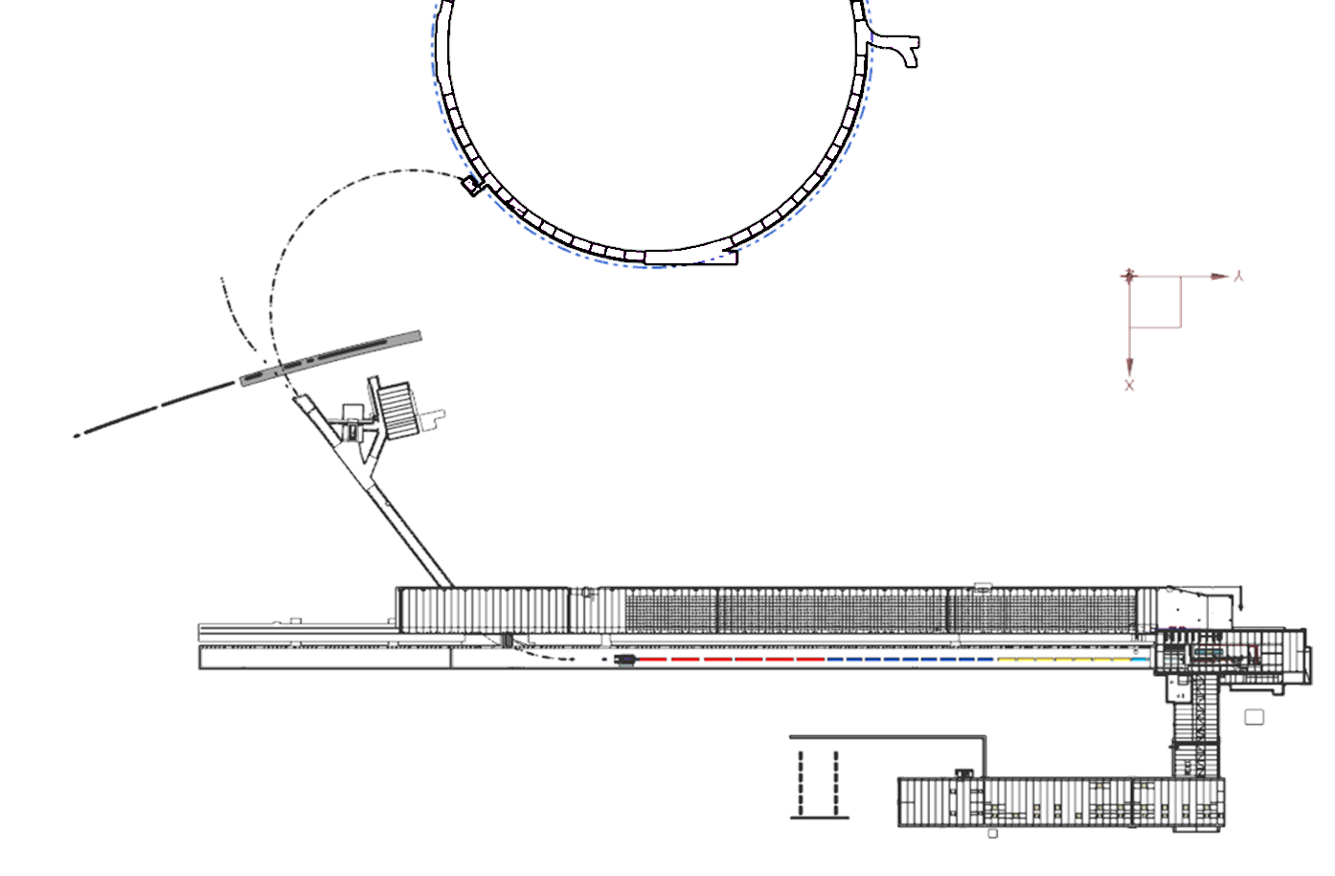
PIP-II - Scope and Layout
Plenary-Pozdeyev
800 MeV H−, 2mA, CW-compatible linac
Linac-to-Booster transfer line
Accelerator Complex Upgrades
Booster
Recycler Ring
Main injector
Conventional Facilities
Booster
Future muon line
Existing Main
Ring
F37 Service Building
BTL
Linac Gallery
HighBay Building (HBB)
Linac Tunnel
Tunnel Extension Option
Cryoplant

Slide 20
PIP-II and Operations before 2027 Shutdown
Interfaces coordinated with Accelerator Division - CF (Booster connection), Controls, Upgrades to Booster, Recycler, and Main Injector
Several PIP-II Accelerator Upgrade systems are delivered and tested with beam before the long shutdown
Booster DCCT (installed), Booster collimators (2023), Booster longitudinal dampers (2023), Booster Transverse dampers (2025), $γ$_t jump for MI (2024), MI RF stations (12 out of 20 installed before long shutdown)
Early installation and test of these systems will benefit operations of the Accelerator Complex, speed up the power ramp-up in PIP-II era, and reduce risk
Matrixed with operations experts
Joint Booster Intensity Team (PIP-II, Accelerator Division, Scientific Computing Division) conducts synergetic, comprehensive numerical and experiential studies to understand sources of beam losses and intensity limits in Booster in PIP-II era

Slide 21
LBNF/DUNE
Provides a beamline to support a 1.2 MW proton beam used to produce high-intensity muon neutrino beam for the DUNE experiment.
Upgradeable to 2.4MW
LBNF Near Site prep largely completed during extended 2020 shutdown
Extensive work done close to MI/RR – completed with minimal impact to MI/RR
Valuable exercise in project and operations coordination - lessons learned document
Matrixed workforce for beamline with Accelerator Division
AD facilities needed
Increased target/horn production capability and R&D for multi-MW - Proposal for TSIB GPP with HEP
Other staging/storage locations

Slide 22
Covid impacts
Accelerator operations paused mid-March 2020, and a decision to not attempt to restart before the scheduled summer shutdown was made in early April 2020.
Advanced shutdown work planning efforts and LBNF site prep
Protocols for on-site work developed and increased WPC implemented
Beam operations restarted Nov 2020
Lower efficiency in on-site work and response time
Supply chain issues and external workforce concerns common to SC complex
Issues related to remote work and new employee’s mirror impacts noted at all the operations focused SC labs https://www.osti.gov/biblio/1785683/
No known cases of COVID transmission related to accelerator operations

Slide 23
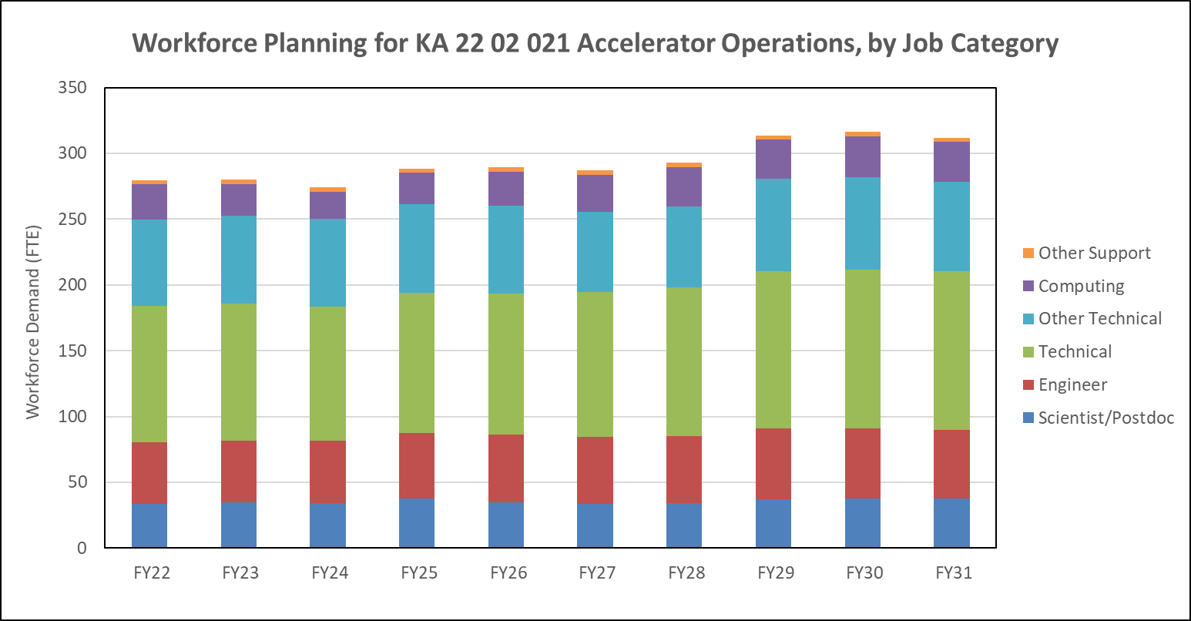
Workforce Planning - Accelerator Ops
Major effort in 2019 Detector and Accelerator Modernization (DAM) plan was to initiate a better workforce planning process
Effort has continued – annual process projecting out 10 years
~Flat to beginning of PIP-II operations

Slide 24
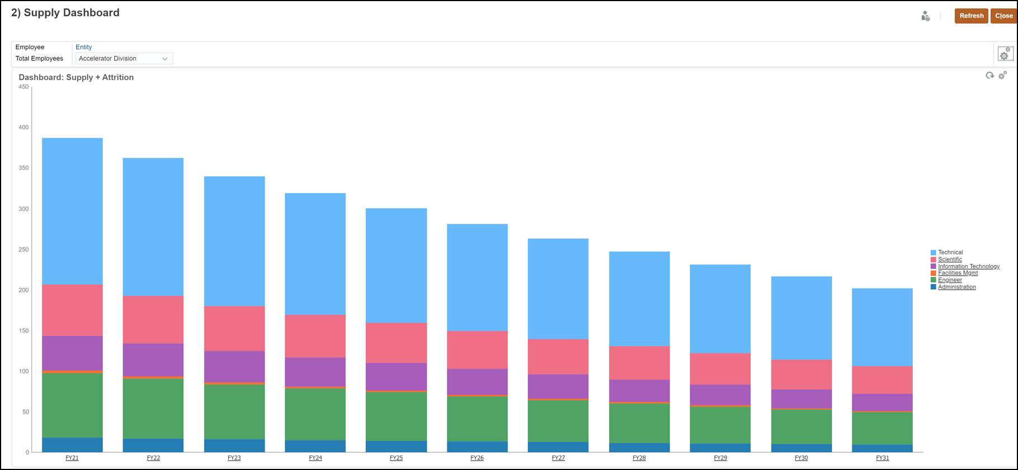
Workforce Planning – Accelerator ops attrition

Slide 25
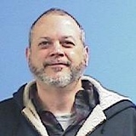
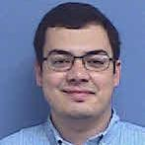
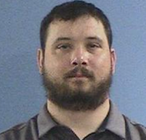
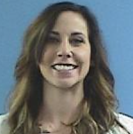
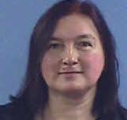
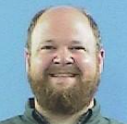
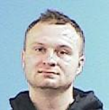
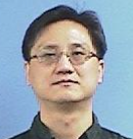
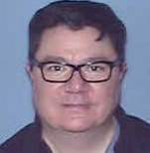
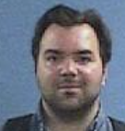
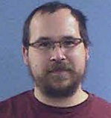
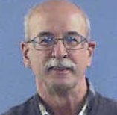
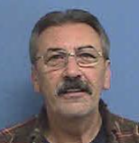
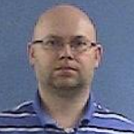
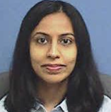
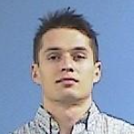
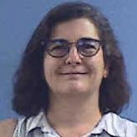
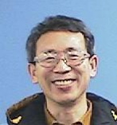
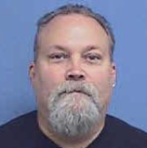
Workforce - New AD colleagues since March 15, 2020

Slide 26
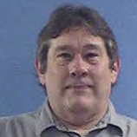
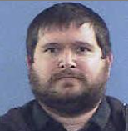
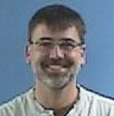
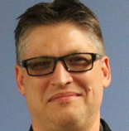
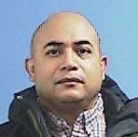
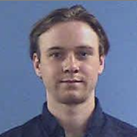
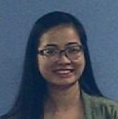
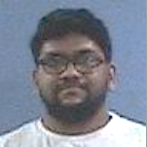
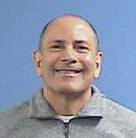
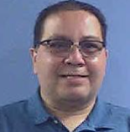
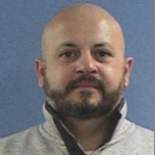
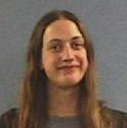
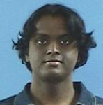
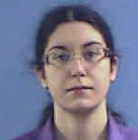
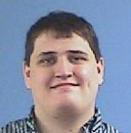
New AD colleagues (continued)
New to Division: 86

Slide 27
Workforce – departing AD colleagues since March 15, 2020

Slide 28
Former AD colleagues (since March 15, 2020)
Departed: 58

Slide 29
Operational Safety
Strong safety performance
Existing work planning and controls tools have been augmented with IMPACT software and extensive Rad Safety changes
Parts of enclosures have higher activation levels with higher beam power
Have continued to keep personnel exposure low
Contamination increasingly an issue
Tritium, Beryllium-7
We work with equipment that has other dangers as well – much equipment in use that was a different era in safety

Slide 30
Summary
Delivering on DOE science mission – operations work scope aligned with P5 and available funding
COVID navigated successfully – no known transmission on-site, operations made extensive adjustments to continue safe work, beam and shutdown
Critical Modernizations needed are understood and underway or planned
Projects and operations coordinate to share resources/support
These projects are building the future of Fermilab accelerator complex operations
Ten-year workforce plan developed and updated annually
We feel we have had a strong safety record, and as beam power increases the rad safety requirements must increase in step. ES&H is vital to successful operations
Continued focus on successful mission delivery through operations, while also working with projects to build the future laboratory

Slide 31
Backup slides

