Slide 1
NGLS CDR Preparations
John Corlett
April 13, 2012

Slide 2
Approach
High average power electron beam distributed to an array of FELs from high rep-rate injector and CW SCRF linac
Beam spreader
High-brightness, high rep-rate gun and injector
CW superconducting linac,
laser heater, bunch compressor
Array of independent FELs
X-ray beamlines and endstations
NGLS offers significant advances over current capabilities:
More photons per unit bandwidth
More photons per second
Shorter pulses
Controlled trade-off between time and energy resolution

Slide 3
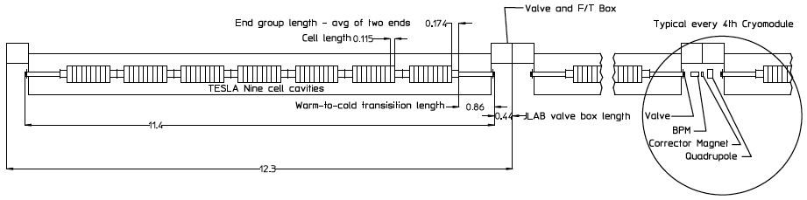
Cryomodule optimization (main linac)
Current cryomodule concept uses “TESLA” cavities in JLAB-style housing
  Cold/warm transitions on each cryomodule
  Distribute 5 K liquid, cool to 1.8 K at cryomodule
  Warm magnets & diagnostics

Slide 4
Cryomodule optimization (main linac)
Design questions
  Optimal operating gradient
  Q₀ ≥ 2x10¹⁰
HOM power dissipation and absorption
Power coupler design
  Waveguide / coax
  1 mA / 0.3 mA
Tuner type and access
Field emission
Cryomodule design
  Cavity support, He transport, warm/cold transitions, minimization of acoustic noise, shield temperature and arrangement, selection and sizing of cryogenic circuits, number of cavities within a single module
Instrumentation in cryomodule

Slide 5
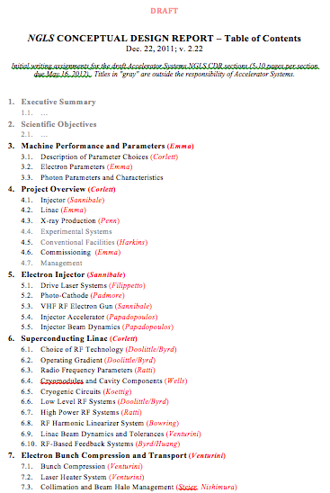
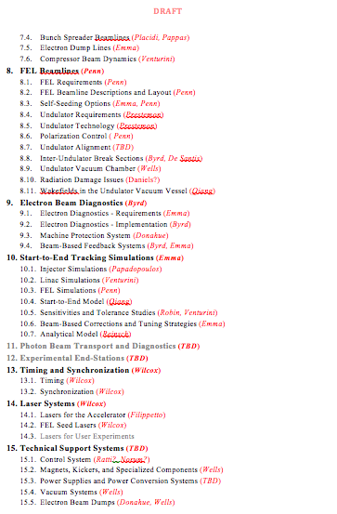
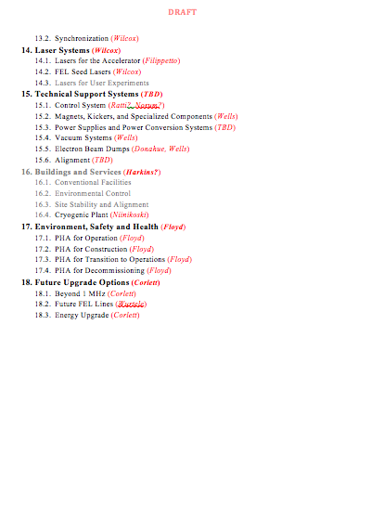
Preparations for a CDR
First draft due May 16

Slide 6
CDR Chapter 6. Superconducting Linac
Superconducting Linac (Corlett)
  Choice of RF Technology (Doolittle/Byrd)
  Operating Gradient (Doolittle/Byrd)
  Radio Frequency Parameters (Ratti)
  Cryomodules and Cavity Components (Wells)
  Cryogenic Circuits (Koettig)
  Low Level RF Systems (Doolittle/Byrd)
  High Power RF Systems (Ratti)
  RF Harmonic Linearizer System (Bowring)
  Linac Beam Dynamics and Tolerances (Venturini)
  RF-Based Feedback Systems (Byrd/Huang)
Outline the goals and challenges
Review options
Identify preferred approaches
Describe R&D and design challenges

Slide 7
CDR Chapter 6. Superconducting Linac
  Choice of RF Technology (Doolittle/Byrd)
    CW SCRF for beam power/rep rate. Cavity design. HOMs and wakefields (long-range, short-range). Frequency choice/TESLA technology/JLAB 12 GeV upgrade. Options, pros/cons (wakefields, physical size, lower BCS losses at low frequency, existing infrastructure for [TESLA, ILC, XFEL, ProjectX]…) Tuner type and access. HOMs and damper/absorber requirements. Differences from TESLA/existing pulsed systems.
  Operating Gradient (Doolittle/Byrd)
    Optimization / sensitivity to (#cryomodules, size of cryoplant, linac tunnel length, Q (+Q slope, temperature), field emission, …)
  Radio Frequency Parameters (Ratti)
    Cavity conditions (Q_{l}, ∆f, ß, …). Beam loading, dynamic response. Stability, flexibility to beam conditions. Power requirements. Heat load to He. Wall-plug power. For main linac and harmonic cavities.
  Cryomodules and Cavity Components (Wells)
    Supports, tuners, power coupler, vacuum, inputs and outputs. Operating temperature (Q), heat shields, thermal loads at each temperature, warm/cold transitions. # cavities per CM. Individual CM vs string. Differences from TESLA/existing pulsed systems. HOM dampers. Including harmonic linearizer.

Slide 8
CDR Chapter 6. Superconducting Linac
  Cryogenic Circuits (Koettig)
    Cryo circuits at each temperature, heat loads, He flow, pressure. Cryo components, distribution systems. Controls & instrumentation needs. Cryoplant power requirements (note that crypolant itself is described in Chapter 16). Including harmonic linearizer.
  Low Level RF Systems (Doolittle/Byrd)
    Architecture for control of phase & amplitude. Integrated with beam-based feedbacks, timing (reference Chapter 9).
  High Power RF Systems (Ratti)
    Options for tubes or solid state. Radiation “hardness” of options. Size of equipment. Installation & maintenance in tunnel.
  RF Harmonic Linearizer System (Bowring)
    Cavity design concept. HOMs. Cryo requirements. Extrapolations from existing pulsed systems
  Linac Beam Dynamics and Tolerances (Venturini)
    Requirements on linac systems (RF stability, feedbacks) for nominal 300 pC, exploration of charge / current.
  RF-Based Feedback Systems (Byrd/Huang)
    Beam-derived signals feed-back to RF set points to minimize jitter in energy and timing

Slide 9
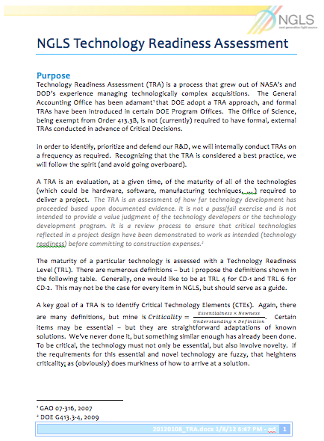
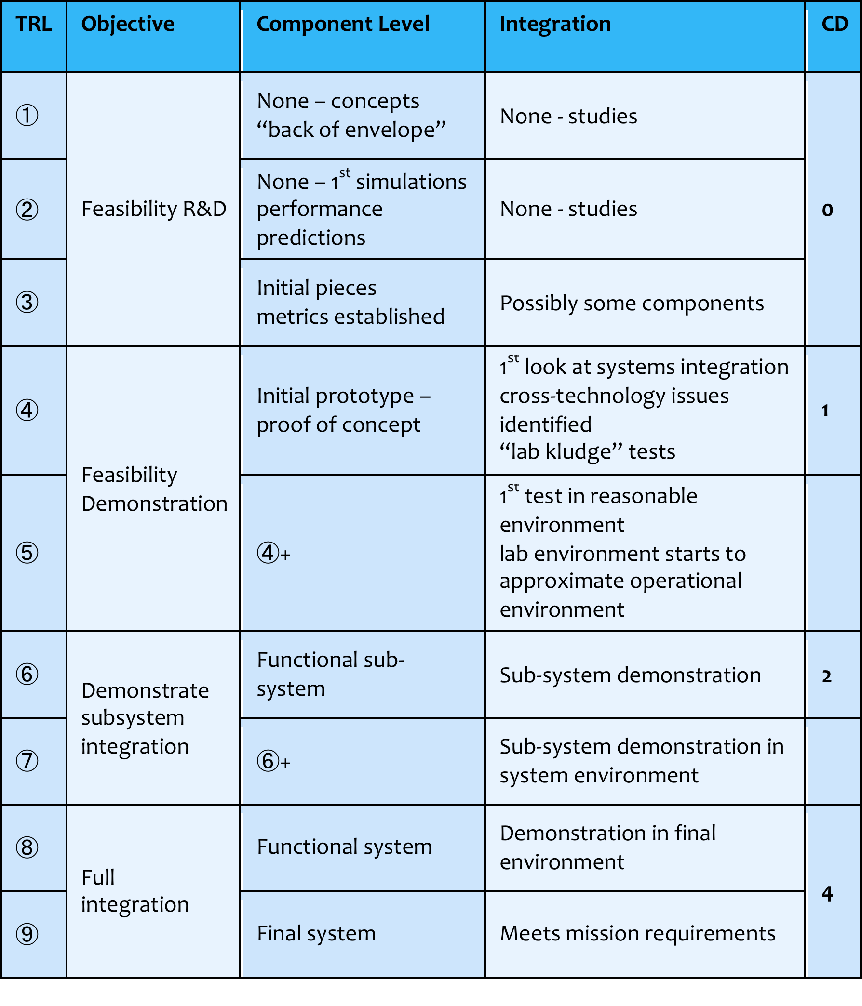
Technology Readiness Assessment and R&D planning
  Assess technical maturity for each system or component at level ~3 in the NGLS WBS
  ~50 items
  Determine Critical Technology Elements (CTEs)
    Essential, unique capabilities, incomplete requirements definition
Prioritized list of CTEs will guide R&D plan
FNAL input on SCRF TRA and R&D needs
WBS | WBS Name | TRL | Dictionary | References and comments from proponents
1.1.4 | VHF RF Electron Gun | 3 | The gun cavity is a resonant RF structure that supports the cathode, and the electric field that accelerates the photoelectrons, in a UHV environment. The gun RF system provides ~100 kW CW power at 187 MHz. A prototype gun is operational in APEX, has demonstrated design RF power capability, and is undergoing further tests for vacuum, long-term reliability, etc. | [1] "Schemes and challenges for electron injectors operating in high repetition rate X-ray FELs", Fernando Sannibale, Daniele Filippetto & Christos F. Papadopoulos, Journal of Modern Optics, Volume 58, Issue 16, 2011, Special Issue: Development and Technical Challenges of Next Generation Free Electron Lasers, pages 1419-1437
1.1.4.3 | Photocathode | 3 – 5 | Mounted inside the VHF RF gun cavity, and illuminated by the drive laser, the photocathode provides the electrons for the accelerator. CsTe photocathodes operate in accelerator environments and are used at FLASH, Fermilab, etc. at average repetition rates lower than NGLS. Alkali antimonides have been successfully demonstrated in tightly controlled laboratory environments; emittance under field, field emission, laser and beam damage are not yet tested. APEX will test cathodes, and demonstrate efficiency, lifetime, and reliability, under NGLS conditions. | TRL 4 seems to be to be just about right. We have done the lab kluge, tested a concept (TRL4), but we have not done 1st test in reasonable lab environment simulating gun conditions. Also in TRL 4, initial proof of concept.....we have proved the concept for QE and emittance, but not any other parameter (emittance under field, field emission, laser and beam damage). All in all, your rating of 3-5 is probably right; some bits are done and proven, others aren't. Is it OK to leave it like this, ie. 3-5. Some significant part we are still vulnerable if reviewed and need to ramp up efforts in the next year to get through at TRL 4 issues. [1] Vecchione et al, APL 99, 034103 (2011)
1.1.5 | Drive Laser System | 5 | The drive laser system provides photon pulses at a wavelength matched to the work-function of the photocathode material, with sufficient energy per pulse to emit the required number of electrons, and with the appropriate temporal and spatial shape to control beam dynamics of the emitted electrons. For CsTe photocathodes, operating laser systems exist at high repetition rate in burst mode, e.g. at FLASH. For alkali antimonides, lasers of required power are commercially available. What is needed are controls and filtering, and diagnostics, to provide spatial and temporal characteristics specific to NGLS needs, in a CW 1 MHz system. Transverse (position) and longitudinal (timing) feedback systems are also needed to achieve the pulse to pulse stability required. APEX will test these systems, which may be different depending on photocathode materials. | All the subsystems have been proven to work separately, and most of them have also been proven in the system an accelerator environment. Fiber laser (oscillator + amplifier) systems (ref.[1]) with the similar wavelength, energy per pulse and repetition rate are commercially available. The TRL also depends on energy per pulse needed, which in turn depends on the choice of cathode material. The challenge resides on interfacing the drive laser with the accelerator satisfying all the tight tolerances requested by user facility. Longitudinal pulse shaping of high rep. rate lasers has already been proven (ref. [2]), but further improvements will be required to get better results. Time and space stability tolerances require feedbacks on the system. The high repetition rate opens the door to high bandwidth feedbacks and can in principle make it very stable. Such systems are state of the art and could be implemented and proven already in the APEX laser. In conclusion, it can be said that all the subsystems are state of the art, but the new challenge of building a very stable laser of a future user facility, decreases the level of readiness down to 5. References [3] and [4] below describe similar high repetition rate laser systems, giving a sense of the level of complexity. [1] see for example: http://www.calmarlaser.com/products/fiber_laser/cazadero.php [2] I. Bazarov et. al., Phys. Rev. ST Accel. Beams 11, 040702 (2008) [3] Ingo Will, Horst I. Templin, Siegfried Schreiber, and Wolfgang Sandner, "Photoinjector drive laser of the FLASH FEL," Opt. Express 19, 23770-23781 (2011) [4] D.G. Ouzonov, I. Bazarov, B. Dunham and C. Sinclair, "The Laser System for the ERL Electron Source at Cornell University", Proceedings of PAC07, Albuquerque, New Mexico, USA.
1.1.6 | Buncher Cavity | 5 | The buncher cavity supports a resonant RF field, that provides an energy chirp to the weakly relativistic electron bunches output from the gun, thereby producing bunching in the downstream beam. A similar system has operated for the ALS harmonic cavities, and at the Cornell ERL prototype. RF power coupler modifications are required for NGLS needs. The buncher RF system provides ~10 kW CW power at 1.3 GHz. | The design of the buncher we are using is based on the existing ALS 3rd harmonic cavity with two significant modifications: the buncher is active (coupler added) and it is scaled from 1.5 to 1.3 GHz. So probably that makes it more a 4 than a 5, but I don't have a strong preference

Slide 10
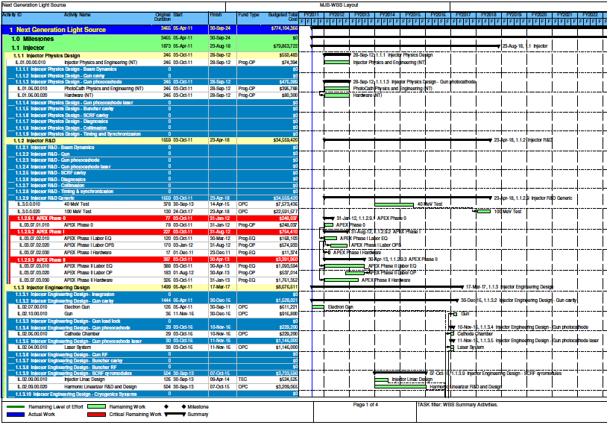
Developing cost and schedule estimate
  Revisit cost estimate developed for CD-0 independent cost review
  FNAL input from recent experience

