Slide 1
Power couplers Timergali Khabiboulline (FNAL) FNAL-LBNL meeting on NGLS April 13, 2012

Slide 2
TTF-III coupler thermal analysis
ILC coupler thermal analysis at 15 kW of average power. Weak point is overheating of the warm bellow of the central conductor due to RF losses.
Copper coating

Slide 3
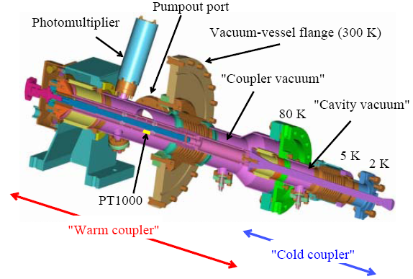
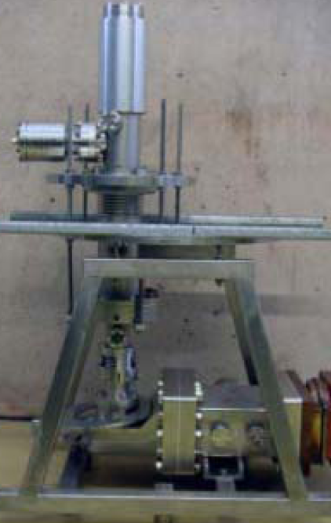
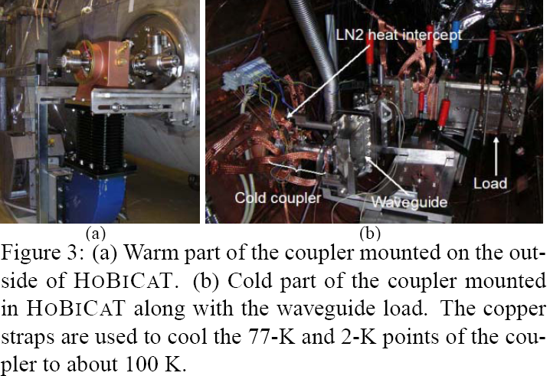
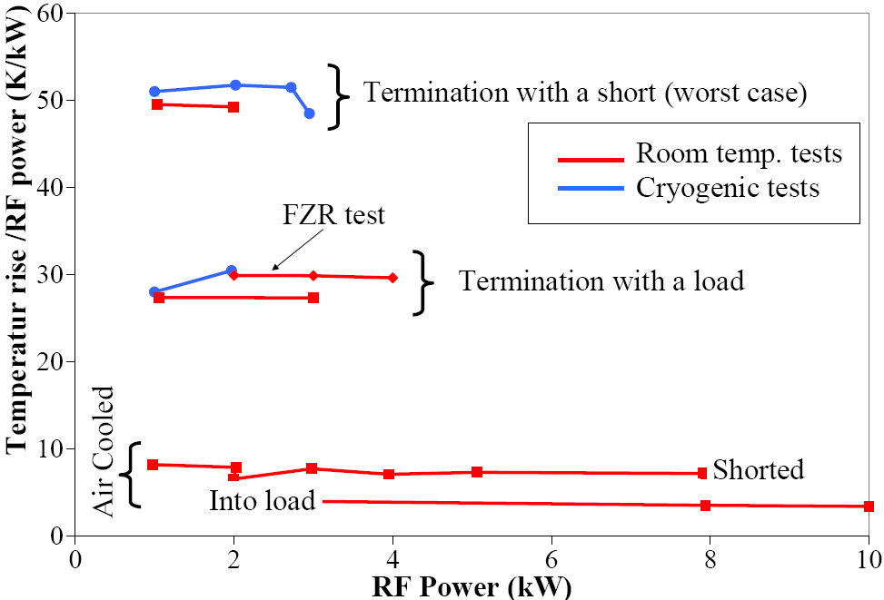
TTF-III coupler CW tests
CW operation tests of TTF-III coupler. J. Knobloch et. al., PAC’05
The feedthrough at the warm ceramic was removed and a tube was inserted into inner conductor. Room-temperature air was flowed through the tube and allowed to escape through the open feedthrough flange. Since there are small holes in the inner conductor, the entire warm coupler thus was at 1 atm, but most of the air flow was limited to the interior of the inner conductor. The total air-flow rate for these tests was about 20 liter/min.

Slide 4
EXPERIMENTAL SETUP Tests at Rossendorf. Room temperature only. The only cooling provided was cold-water (2.2 ◦C) cooling of the 70 K flange. IR sensors monitored via viewports the warm ceramic temperature and that of the warm inner conductor. The tuning rod was removed and a PT1000 temperature sensor was attached inside the inner conductor near the bellows. Several PT100 sensors were also mounted on the exterior of the coupler. A CPI klystron provided 10 kW CW RF power. Tests at BESSY At BESSY, the waveguide test stand was mounted in the HOBICAT facility. Initial warm tests with a matched load were performed to verify the Rossendorf results. For cryogenic tests, HOBICAT was operated with liquid nitrogen only. Copper bands were attached to the 77 K and 2 K points of the coupler so that the coupler could be cooled. Typically the 77 K point reached an equilibrium temperature of about 120 K. The waveguide ferrite load was also in the HoBiCaT insulation vacuum and kept at room temperature by the water flow that removes the dissipated RF power. Additional ports were added in the waveguide to improve the pumping of the load by the insulation vacuum. Nevertheless, at power levels above 2 kW the outgassing from the ferrite was so severe that arcing would occur in the load. Thus cold tests were limited to 2 kW TW power. For SW operation the load was replaced by a short. SUMMARY AND OUTLOOK The extrapolation of the test results suggest that the existing TTF-III coupler can very likely be operated safely up to 10 kW TW and 5 kW SW, although the direct verification is still outstanding. Whether long term operation with a cavity at this power level is possible must also still be demonstrated. For example, outgassing may be an issue due to the elevated coupler temperatures.

Slide 5
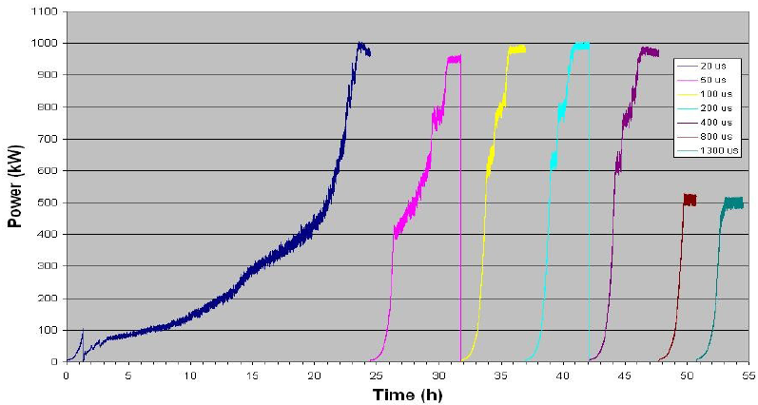
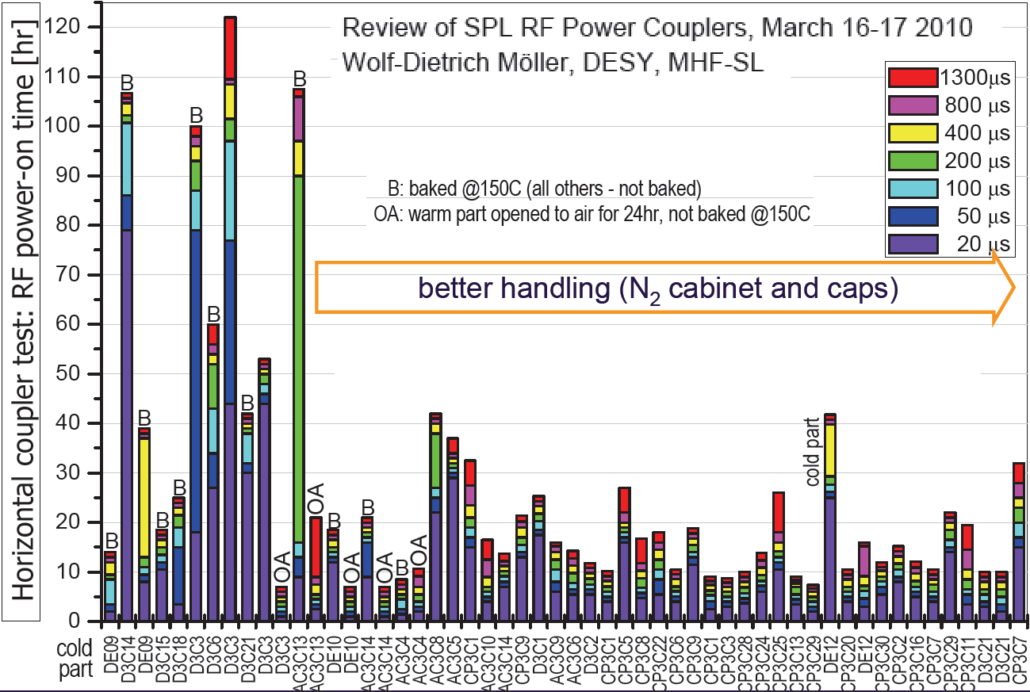
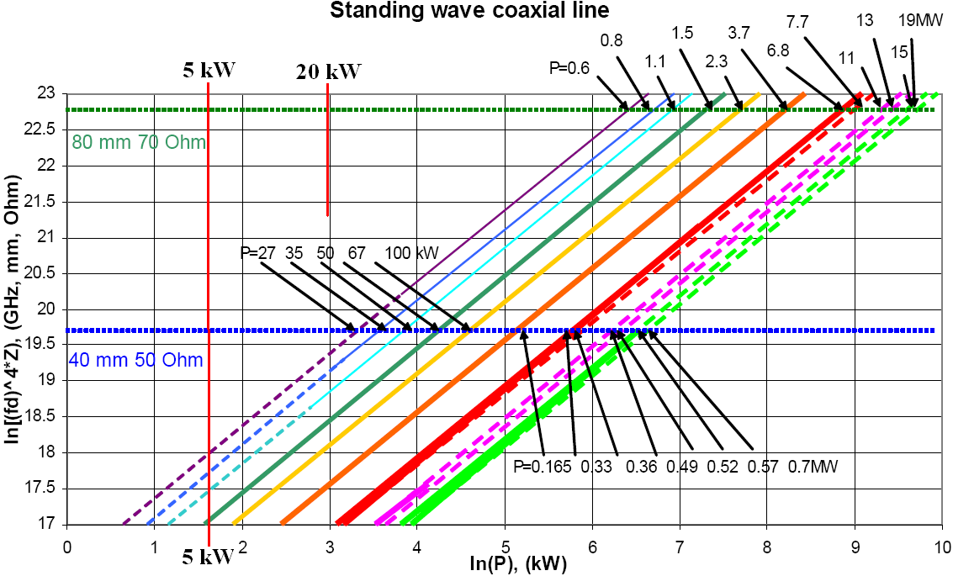
TTF-III coupler power processing
Coupler power processing
Before installation
With cavity warm
With cavity cold
Processing in pulsed regime
Speed limited by vacuum
Most of the time at RF power P>30 kW
No multipactoring at RF power P<20 kW
Dry air or nitrogen storage is important
May not need power processing at P<20kW

Slide 6
TTF III coupler for NGLS
Complicated for fabrication
Complicated for installation
High fabrication cost
Power limit 4 kW as is due to overheating
N2 gas cooling of central conductor can increase operating power range but eliminate double window reliability
Multipactoring at 3-30kW power may be not an issue

Slide 7
New power coupler design for NGLS
Coaxial coupler compatible with cavity
Waveguide input
20 kW CW 1.3 GHz TW RF power operation
Reliability, one or two windows
Clean and simple assembly
Safe and simple operation
Simple fabrication and low cost
Low cryogenic load
Reduced power processing time
Minimum or now multipactoring at 3-30kW power

Slide 8
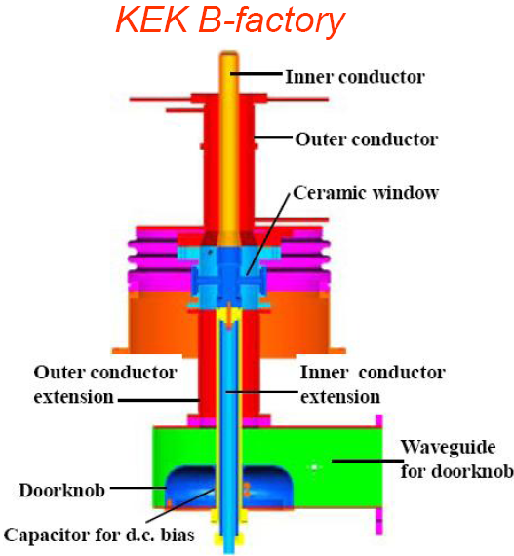
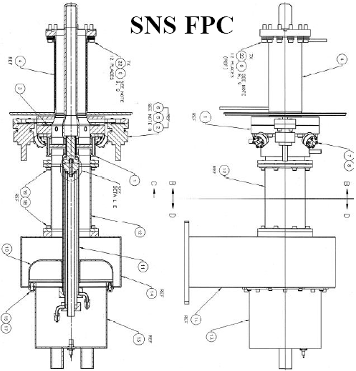
Number of ceramic windows
Two windows
Safe operation. Vacuum leak of one window is not so critical.
More fabrication cost
More parts
One window
Simpler fabrication, less windows, less parts, no remote operation
Lower cost
Lower reliability. But several machines in operation with one window

Slide 9
Fixed coupling options without external matcher
Optimum coupling for a high current
Pros: minimum power requirement at high current, less sensitive to micro-phonics at low current
Cons: power more power for low current
Optimum coupling for low current
Pros: minimum power requirement at low current
Cons: power more power for high current
Intermediate coupling
Pros: less sensitive to micro-phonics at low current
Cons: higher Extra power for both currents, more sensitive to micro-phonics at high current

