Slide 1
NGLS Tunnel Update
Russell Wells
April 13, 2012

Slide 2
Progress
Increased spreader bend angle
30 deg => 36 deg makes for a better fit to the site
Increase in CSR does not appear to significantly degrade the beam emittance
Whole machine rotated ~2 deg CCW
Allowed by results from GeoTech/hydrology results from test bore near Chicken Creek contaminant plume
Moves the 10th Photon Beam line off of the present roadway

Slide 3
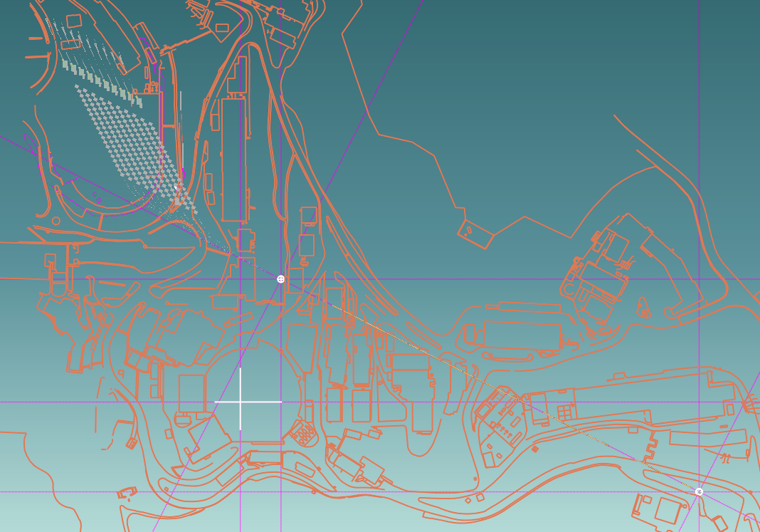
NGLS Layout as of February 3, 2012 with 36 Degree Spreader
Final Quadrupole of Linac, QL3ED14
(UC2633.48E, UC402.79N)
26.936º
Reference point
(UC2500E, Axis)
Electron Gun, Cathode face
(UC4005.86E, UC294.60S)

Slide 4
Progress
New Spreader
Less demanding kicker requirements
3mrad => 0.62mrad
Shorter path length lattice
FEL and Beam Dump maturation in process
Seeded FEL at 110m represents the longest path
Experimental requirements could add to this length.
Electron diagnostic sections are in the process of being added

Slide 5
Take-Off
L_{DOFO}=9.2m, Δμ=45º, f=6.01m
ESS
2.0m – 7.7mrad
Kicker
1.8m – 0.62mrad
EMS
0.8m – 33mrad
3.7
x
55
39mrad
160
z
Linac line
D
F
3.1
15.0
D
ARC
18.0
20.4
F
1.9
2.3
0.5
1.9
0.6
0.3
0.5
4.6
4.6
11.7
Quads – DT, FT : J. Tanabe’s septum-type – r_{b}=30mm, W_{Q}=245mm, L_{steel}= L_{eff}=200mm
θ_{OUT} Clearance: (X_{bsi})_{K}=55mm, (X_{bs})_{QD}=160mm
BPM
Beam Profile

Slide 6
EM SEPTUM / Staggered Coils θ_{EM} =35.0mrad / B₀=0.38T / g₀=12.0mm
10 turns/coil x 185A
30.5
13.0
13.0
20.0
From Linac
45.0
From Kicker
48.0
Field-free
channel
Outgoing
28.0
108.0
g₀
18.0
10.0
12.0
Vac. Pipe
ID/OD: 10/12
20.0
30.0
Shielding: 2mm
38.0
H_{p}
4.5
4.0
7.5
5.5
Vac. Pipe
ID: 28 x 10
18.0
18.8
(X_{bsi})_{EM}
114.5mm

Slide 7
EM SEPTUM / Staggered Coils θ_{EM} =35.0mrad / L_{m}=0.8m / g₀=12.0mm
Zero-field channel
B_{RES}~ 5mG
Septum
5.5mm
(X_{os})_{EM}
20.4mm
Main Field 0.38T
Septum deflection
θ_{EM}= 35.0mrad
(X_{bsi})_{EM}
18mm
(X_{bso})_{EM}
36.8mm
x
From Linac
z
From Kicker
Θ_{IN}=6mrad
18.8
H_{b}
140
H_{p}
38.0
ARCS
Total deflection
Θ_{OUT} =41mrad
L_{EM} = 800

Slide 8
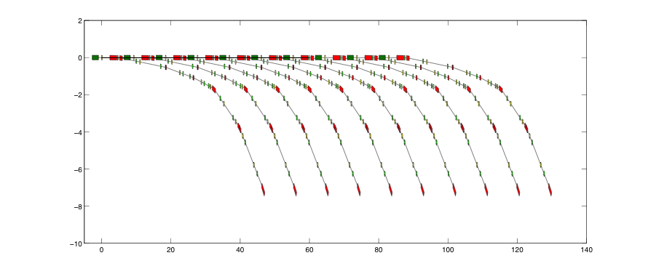
Baseline: Footprint
C. Sun
Baseline - Take-Off DOFO cell, 9.2m length, 45º phase advance
ARCs: Two separate double-bend achromats, 36º total deflection
Total footprint: ~135 x 7.8m²

Slide 9
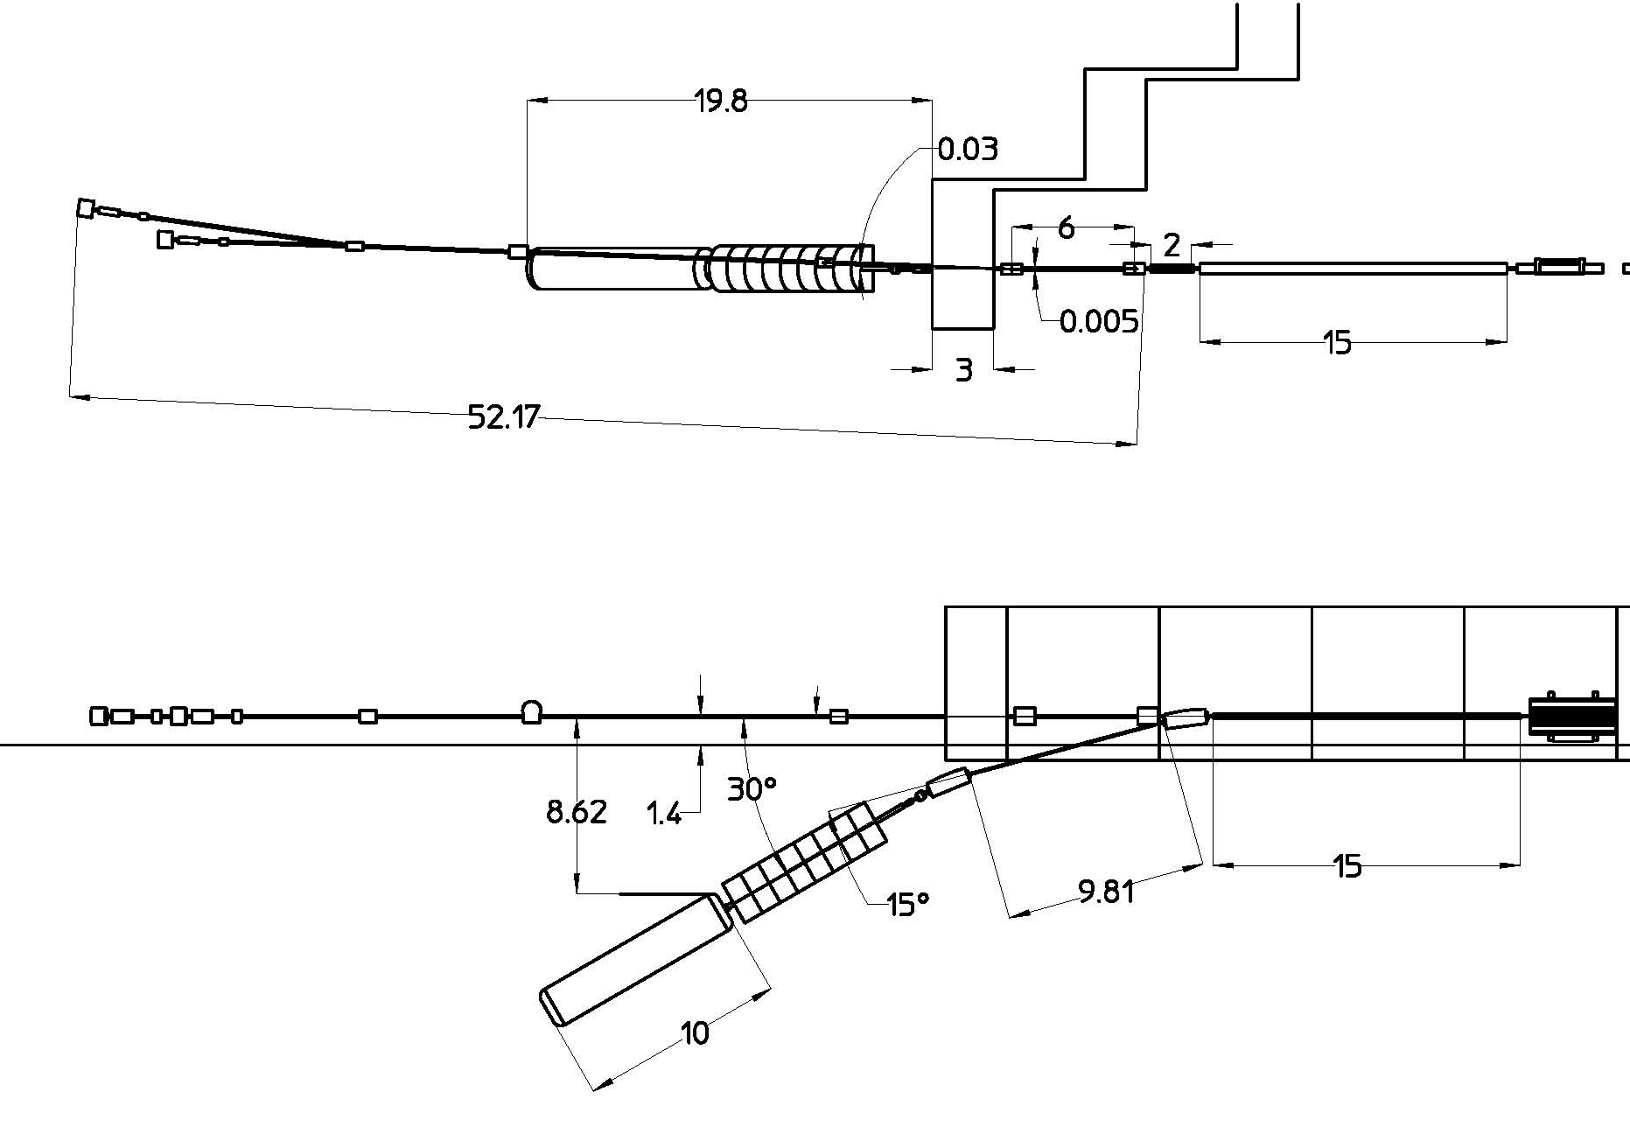
Conceptual Layout of Beam Dump Region
PLAN VIEW
End Shield Wall
Dump magnet 1
e- diagnostics
2nd mirror
(30mrad)
1st mirror
(5mrad)
Dump magnet 1
ELEVATION VIEW
raster magnets
End stations
Solid beam dump
e- diagnostics
Dump magnet 2
Shielding (plugs)

Slide 10
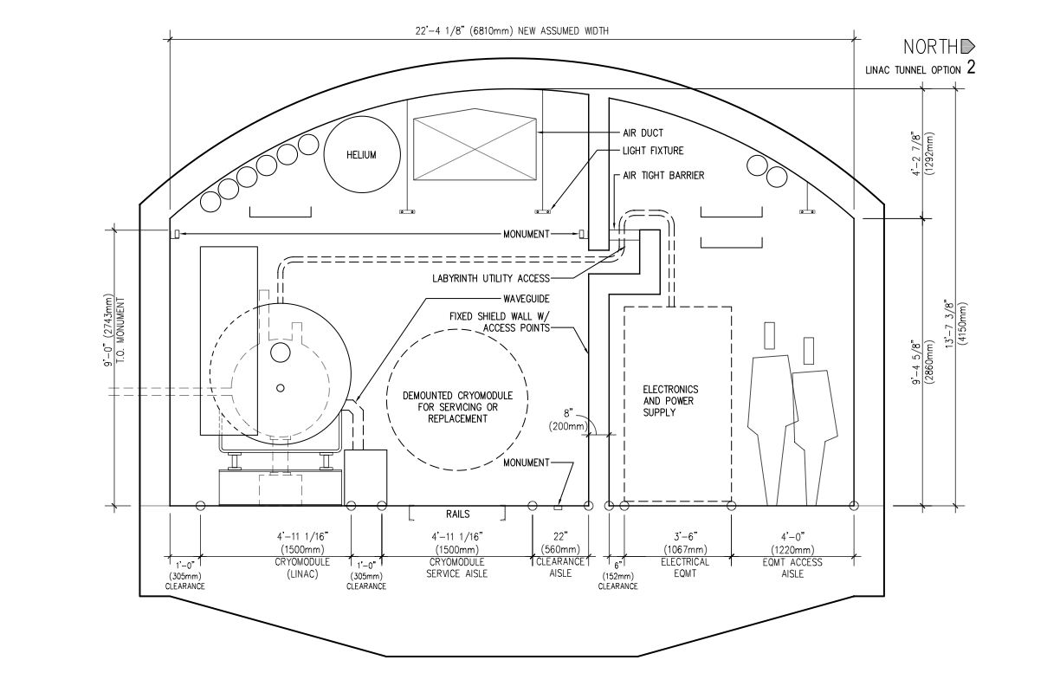
Cross Section from A&E Firm

