Slide 1
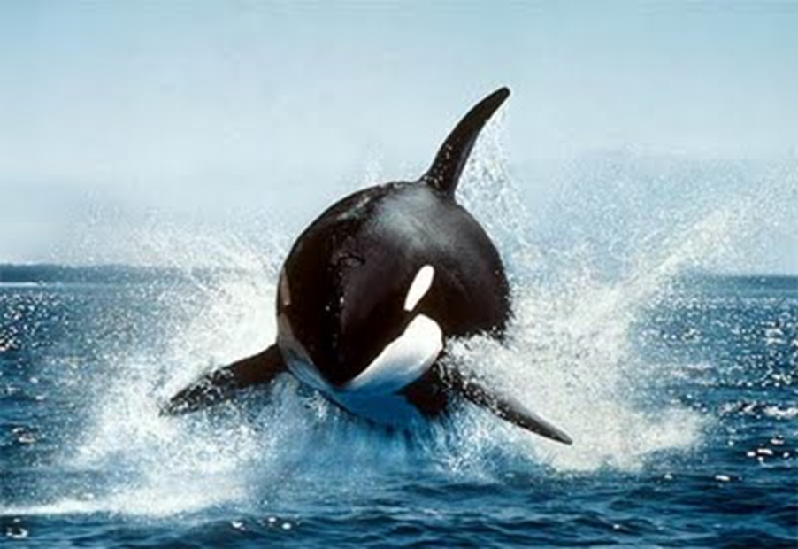
ORKA: The Golden Kaon Experiment
Elizabeth Worcester (BNL)
for the ORKA collaboration
June 13, 2012
Photo: Life of Sea blogspot

Slide 2
ORKA: The Golden Kaon Experiment
Precision measurement of K⁺→π⁺νν BR with ~1000 expected events at FNAL MI
Expected BR uncertainty matches Standard Model uncertainty
Sensitivity to new physics at and beyond LHC mass scale
Builds on successful previous experiments (BNL E787/E949 – 7 events already seen)
High impact measurement
Total estimated cost: $53M (FY2010)

Slide 3
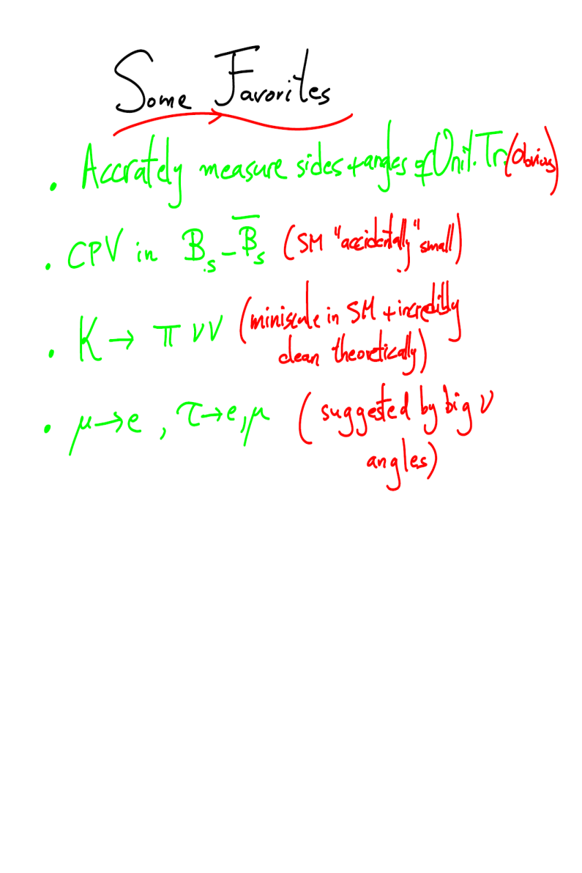
Motivation
Flavor problem:
  We expect new physics at the TeV scale . . .
  Why don’t we see this new physics affecting the flavor physics we study today?
If new physics found at LHC:
  Precision flavor-physics experiments needed to explore flavor- and CP-violating couplings
If no new physics found at LHC:
  Precision flavor-physics experiments needed to search for new physics beyond the reach of the LHC through virtual effects
Flavor Physics: Pushing Beyond the LHC.
Intensity Frontier Workshop
Nima Arkani-Hamed (Princeton, IAS)

Slide 4
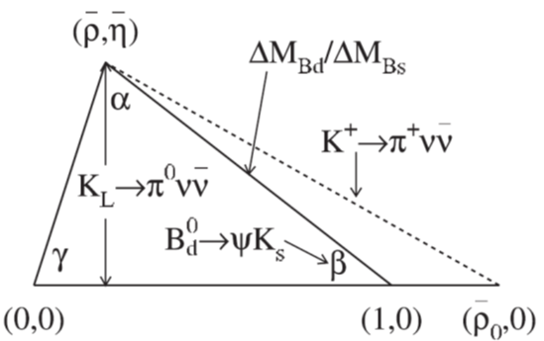
CKM Matrix and Unitarity Triangle
Wolfenstein Parameterization
CP Violation

Slide 5
K⁺→π⁺νν in the Standard Model
K⁺→π⁺νν is the most precisely predicted FCNC decay involving quarks
A single effective operator:
Dominated by top quark
Hadronic matrix element shared with Ke3⁺
Dominant uncertainty from CKM matrix elements (expect prediction to improve to ~5%)
Notes:
1 loop electroweak s->dvv transitions, 1 box, 2 z-penguin
Dominated by top quark, charm contribution significant but controlled
cc E787/949 BR = (17 pm 11)e-11
~10% current precision expected to be ~5% with improvements to CKM measurements

Slide 6
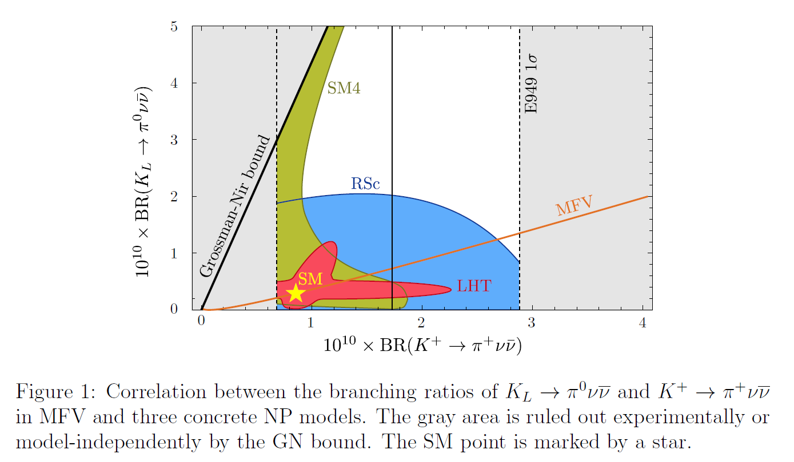
Sensitivity to New Physics
D.M. Straub, CKM 2010 Workshop, arXiv:1012.3893[hep-ph]
Notes:
LHT: Littlest Higgs model with t-parity
MFV: tight constraint of minimal flavor violation
RSc: Ranall-Sundrum model with custodial protection
SM4: standard model w/ 4th generation
MSSM: most of the rest of the experimentally allowed region
Grossman-Nir bound holds only for non lepton violating models

Slide 7
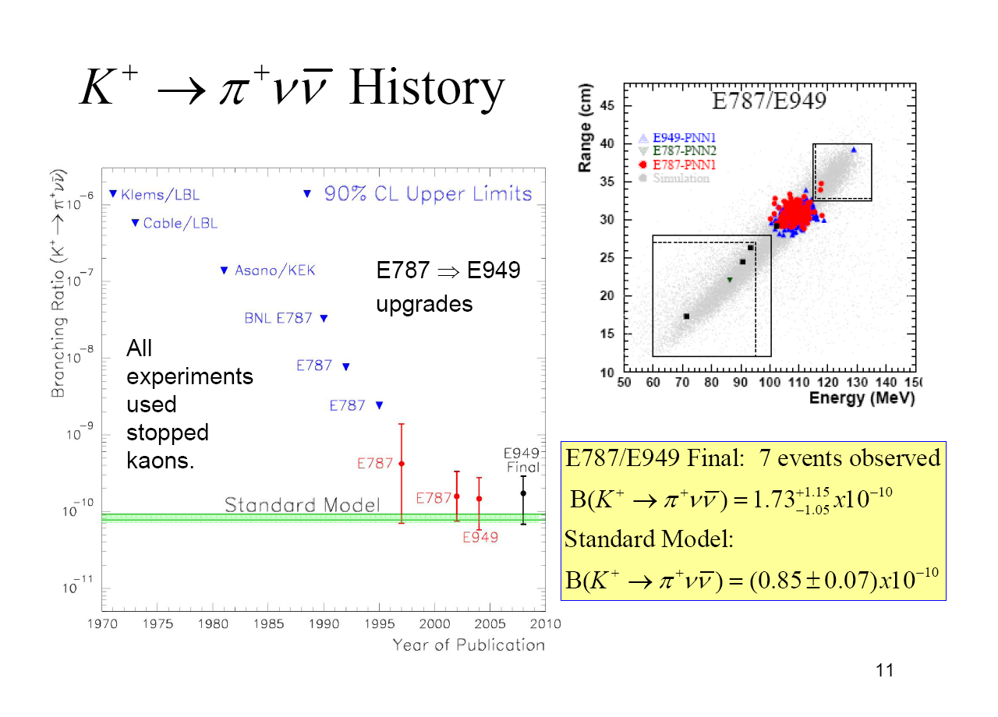
Experimental History
E787/E949 Final: 7 events observed
Standard Model:
Notes:
All measurements slightly above but consistent with SM.

Slide 8
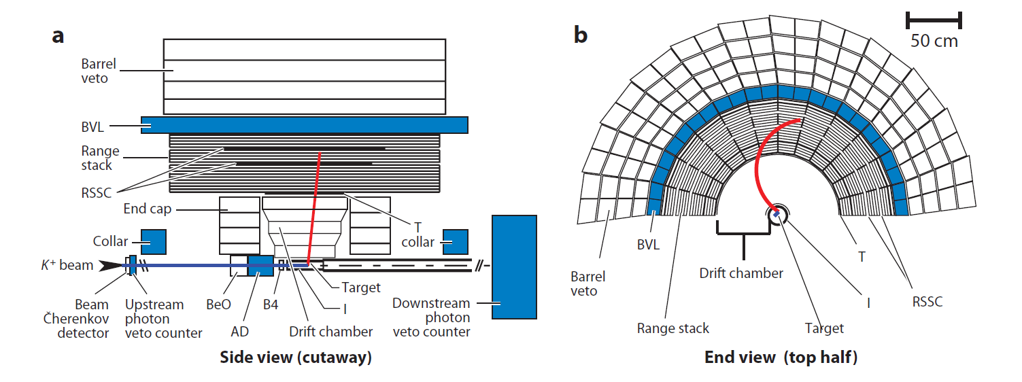
BNL E787/E949
Stopped Kaon Technique
Measure everything!
K⁺ detected and decays at rest in the stopping target
Decay π⁺ track momentum analyzed in drift chamber
Decay π⁺ stops in range stack, range and energy are measured
Range stack STRAW chamber provides additional π⁺ position measurement in range stack
Barrel veto + End caps + Collar provide 4π photon veto coverage
Notes:
energy loss in target and dc also important

Slide 9
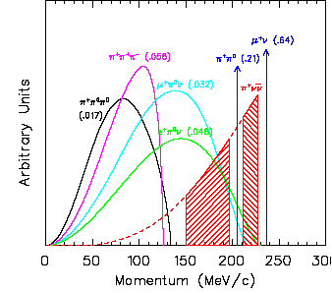
Difficult Measurement
π⁺π⁰ BR 21%
μ⁺ν BR 64%
Observed signal is K⁺→ π⁺→μ⁺→e⁺
Background exceeds signal by > 10¹⁰
Requires suppression of background well below expected signal (S/N ~10)
Requires π/μ/e particle ID > 10⁶
Requires π⁰ inefficiency < 10⁻⁶
II
I
Momentum spectra of charged particles from K⁺ decays in the rest frame
Notes:
cc k->pnn br of e-10

Slide 10
Background (E747/E949)
Charged particle for events passing
PNN1 trigger
Stopped kaon background:
K⁺→ π⁺π⁰
K⁺→μ⁺ν
μ⁺ band
  K⁺→μ⁺νγ
  K⁺→μ⁺π⁰ν
Beam background:
Single beam
Double beam
Charge exchange

Slide 11
Analysis Strategy (E747/E949)
Measure everything!
Separate analyses for PNN1 and PNN2 regions
Blind analysis
  Blinded signal box
  Final background estimates obtained from different samples than used to determine selection criteria (1/3 and 2/3 samples)
Bifurcation method to determine background from data
  Use data outside signal region
  Two complementary, uncorrelated cuts
  Expected background << 1 event
Measure acceptance from data where possible

Slide 12
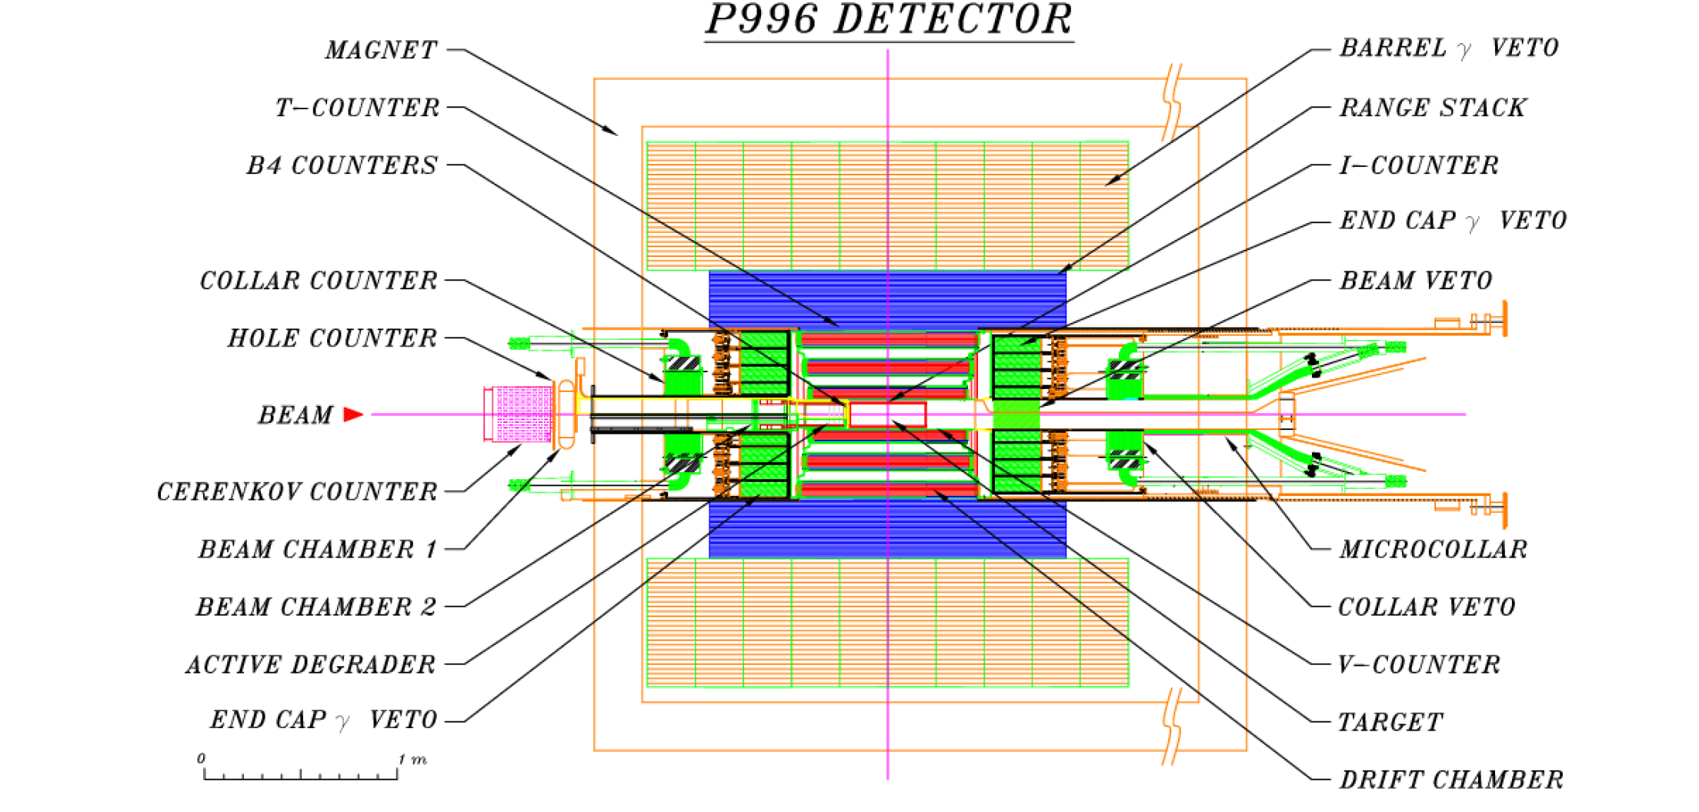
ORKA: a 4th generation detector
Expect ×100 sensitivity relative to BNL experiment:
×10 from beam and ×10 from detector

Slide 13
Sensitivity Improvements: Beam
Main Injector
  95 GeV/c protons
  50-75 kW of slow-extracted beam
  48 × 10¹² protons per spill
  Duty factor of ~45%
  # of protons/spill (×0.74)
Secondary Beam Line
  600 MeV/c K⁺ particles
  Increased number of kaons/proton from longer target, increased angular acceptance, increased momentum acceptance (×4.3)
  Larger kaon survival fraction (×1.4)
  Increased fraction of stopped kaons (×2.6)
Increased veto losses due to higher instantaneous rate (×0.87)
×10
relative to E949
Notes:
K:pi ratio ~3:1

Slide 14
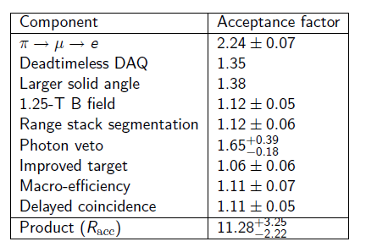
Sensitivity Improvements: Acceptance
×11
relative to E949

Slide 15
π⁺→μ⁺→e⁺ Acceptance
E949 PNN1 π⁺→μ⁺→e⁺ acceptance: 35%
Improvements to increase acceptance relative to E949:
  Increase segmentation in range stack to reduce loss from accidental activity and improve π/μ particle ID
  Increase scintillator light yield by using higher QE photo-detectors and/or better optical coupling to improve μ identification
  Deadtime-less DAQ and trigger so online π/μ particle ID unnecessary
Irreducible losses:
 | Range | Acceptance
Measured π⁺ lifetime | 3-105 ns | ~87%
Measured μ⁺ lifetime | 0.1-10 ns | ~95%
μ⁺ escape | n/a | ~98%
Undetectable e⁺ | n/a | ~97%
Total |  | ~78%

Slide 16
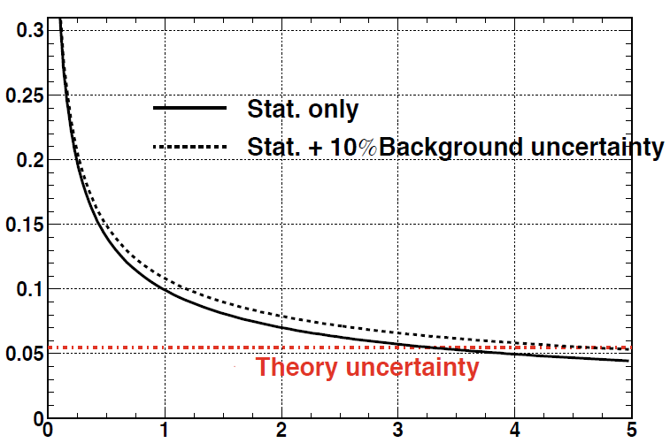
ORKA K⁺→π⁺νν Sensitivity
210 events/year (SM)
Fractional Error on Branching Ratio
5% measurement in 5 years
(projected)
Running Time (years)

Slide 17
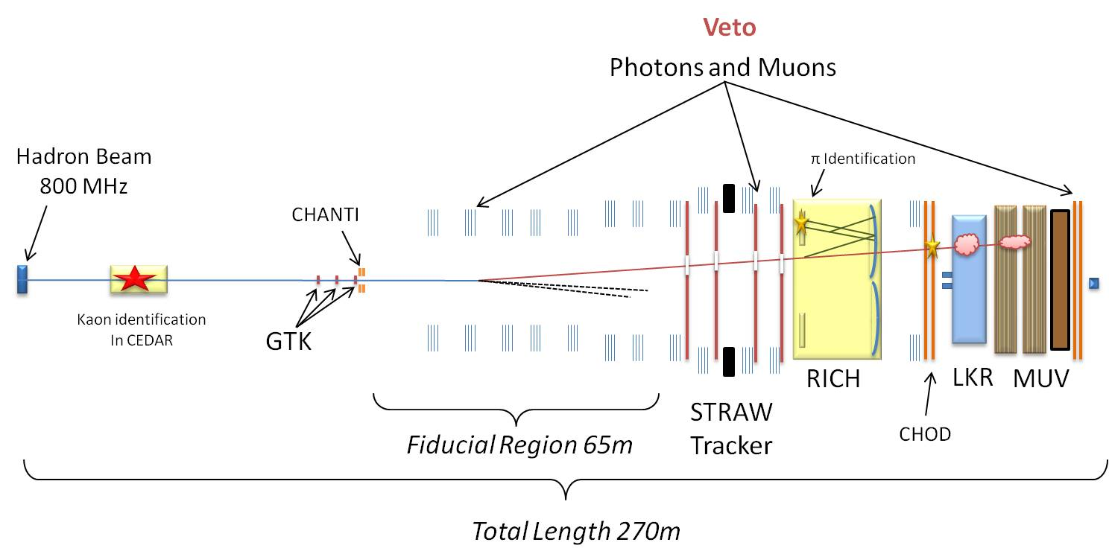
Worldwide Effort
CERN NA-62 (K⁺→π⁺νν)
Decay-in-flight experiment
Builds on NA-31/NA-48
Expect ~55 K⁺→π⁺νν events per year (SM) with ~7 bg events per year for ~100 total events
Expect 10% measurement of K⁺→π⁺νν BR
Under construction
Complementary measurement to ORKA
J-PARC E14 “KOTO” (K⁰→π⁰νν)
Pencil beam decay-in-flight experiment
Improved J-PARC beam line
2nd generation detector building on E391 at KEK
Re-using KTeV CsI crystals to improve calorimeter (better resolution and veto power)
Expect ~3 K⁰→π⁰νν events (SM)
Under construction
Notes:
KOTO expects 3.5 events (SM) w/ 2.5 events background (w/o upgrade to Main Barrel
Gives SES at SM

Slide 18
Other Physics Topics
More info in my talk at Project X Physics Study: June 19
Notes:
highly optimized for K->pnn, good at missing energy

Slide 19
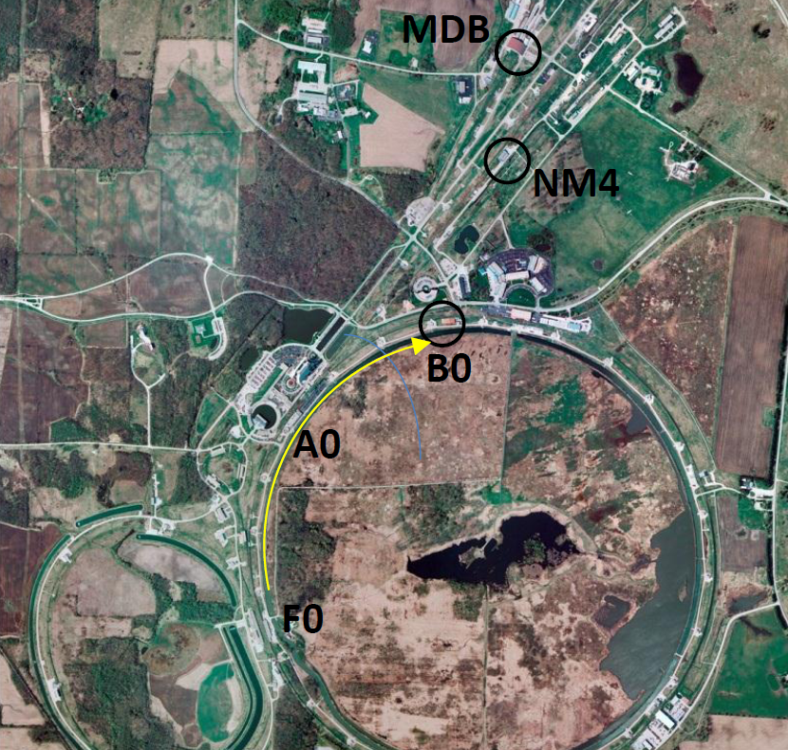

Potential Sites
B0 (CDF)
  Preferred
  Re-use CDF solenoid, cryogenics, infrastructure
  Requires new beam line from A0-B0
Also considering Meson Detector Building and NM4 (SeaQuest)

Slide 20
Schedule
Milestone | Time
Stage One Approval | Winter 2012 ✓
DOE Approval of Mission Need (CD-0) | Fall 2012
Beam/Detector Design | 2012-2013
DOE Approval of Cost Range (CD-1) | Early 2013
DOE Baseline Review (CD-2) | End of 2013
Start Construction (CD-3) | Spring 2014
Begin Installation | Mid 2015
First Beam/Beam Tests | End of 2015
Complete Installation | Mid 2016
First Data (Start Operations/CD-4) | End of 2016

Slide 21















Collaboration
2 US National Labs, 5 US Universities
16 Institutions spanning 6 countries: Canada, China, Italy, Mexico, Russia, USA
Leadership from successful rare kaon decay experiments
Many sub-systems: excellent opportunity for universities
New collaborators welcome!

Slide 22
ORKA Summary
High precision measurement of K⁺→π⁺νν at FNAL MI
Expect ~1000 events and 5% precision on BR measurement with 5 years of data
Discovery potential for new physics at and above LHC mass scale
High impact measurement with 4th generation detector
Requires modest accelerator improvements and no civil construction
Total cost $53M (FY2010)
Construction by 2014, data by 2017 is plausible
ORKA proposal:
  http://www.fnal.gov/directorate/program_planning/Dec2011PACPublic/ORKA_Proposal.pdf
More ORKA: See David Jaffe’s talk June 18 at PXPS
Notes:
“modest accelerator improvements” – each piece has been accomplished somewhere

Slide 23
Extra Slides

Slide 24
Cost (FY2010)
 | Cost (million) | w/ 60% contingency
Accelerator and Beams | 7.5 | 12
A0 to B0 transport | 2.2 | 3.5
Target and Dump | 0.9 | 1.5
Kaon Beam | 4.4 | 7.0
Detector | 22.4 | 35.8
Magnet | 0.5 | 0.8
Beam and Target | 0.6 | 1.0
Drift Chamber | 1.9 | 3.0
Range Stack | 2.5 | 4.0
Photon Veto | 3.0 | 4.8
Electronics | 4.0 | 6.4
Trigger and DAQ | 2.0 | 3.2
Software and Computing | 2.0 | 3.2
Installation and Integration | 5.9 | 9.4
Project Management | 2.7 | 4.4
Total | 33 | 53

Slide 25
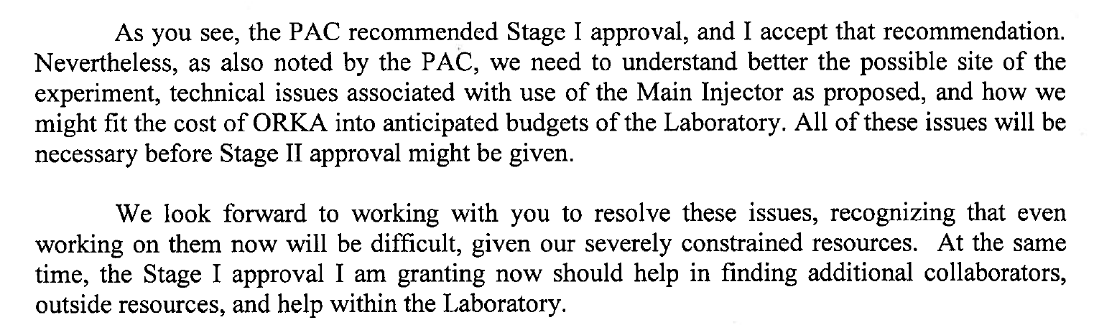
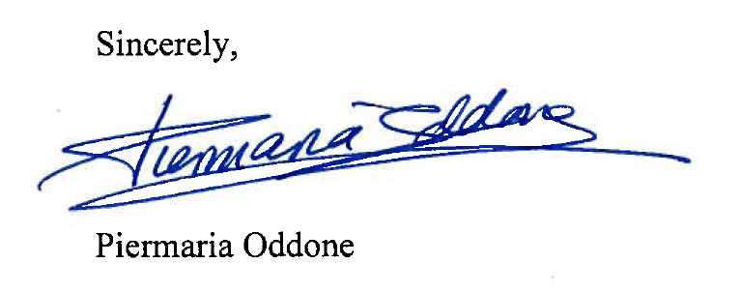
Stage One Approval (Excerpt)

Slide 26
NA62

Slide 27
KOTO
Jiasen Ma, APS Meeting, March 2012

Slide 28
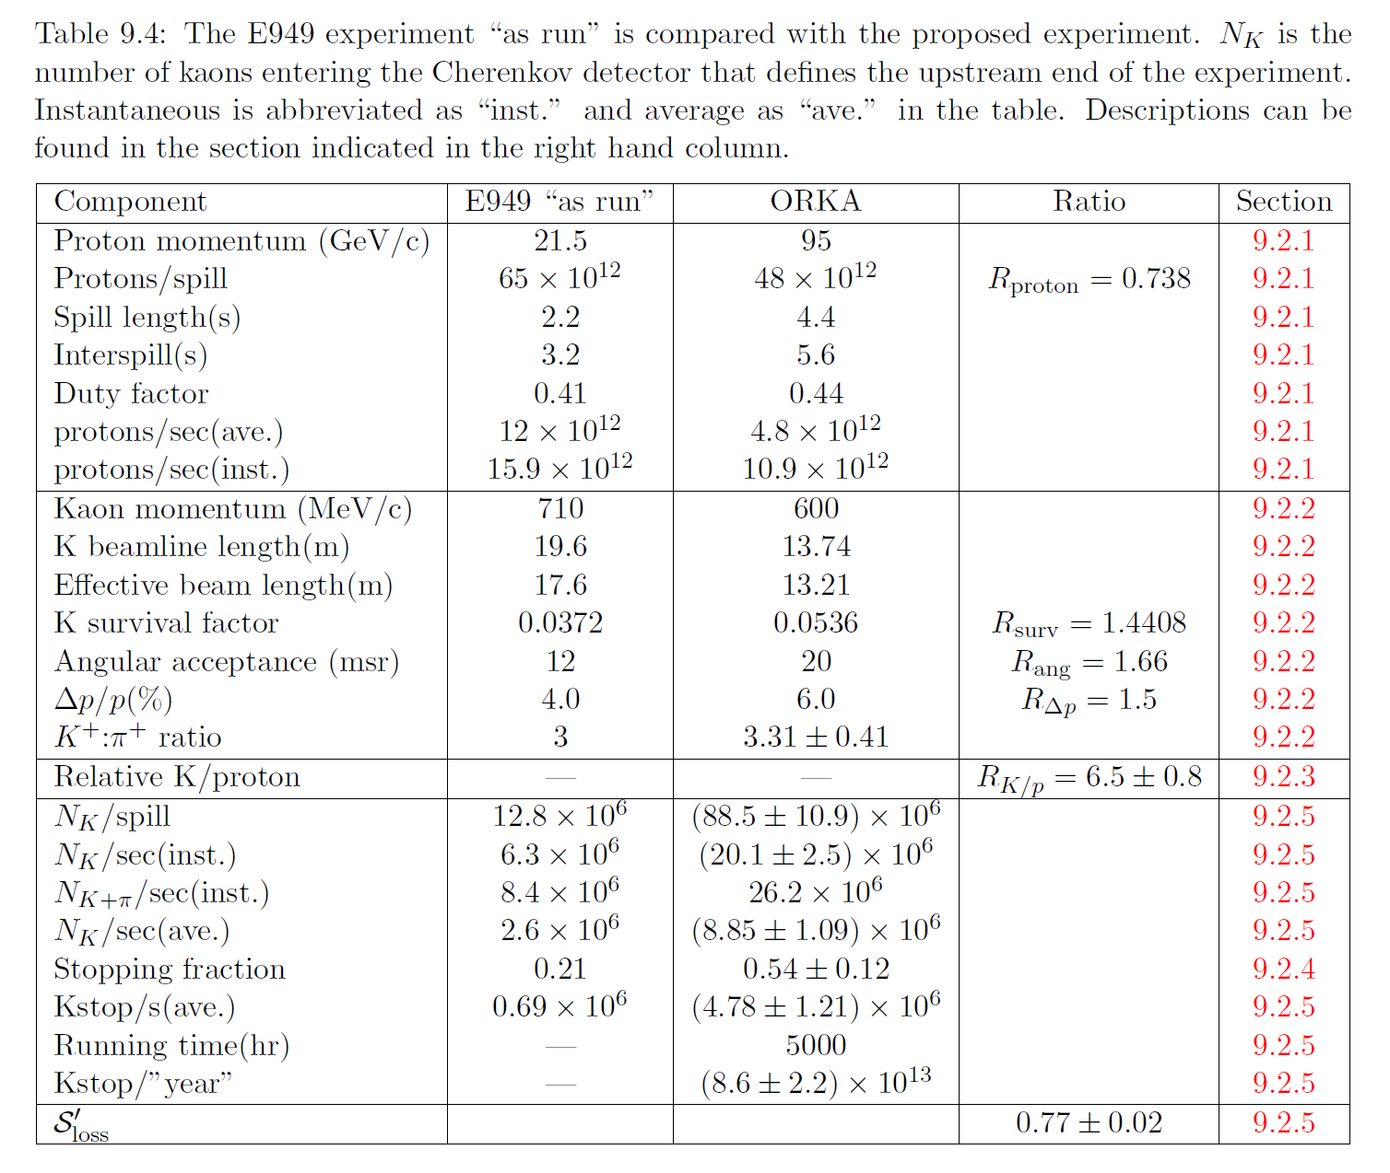

Slide 29
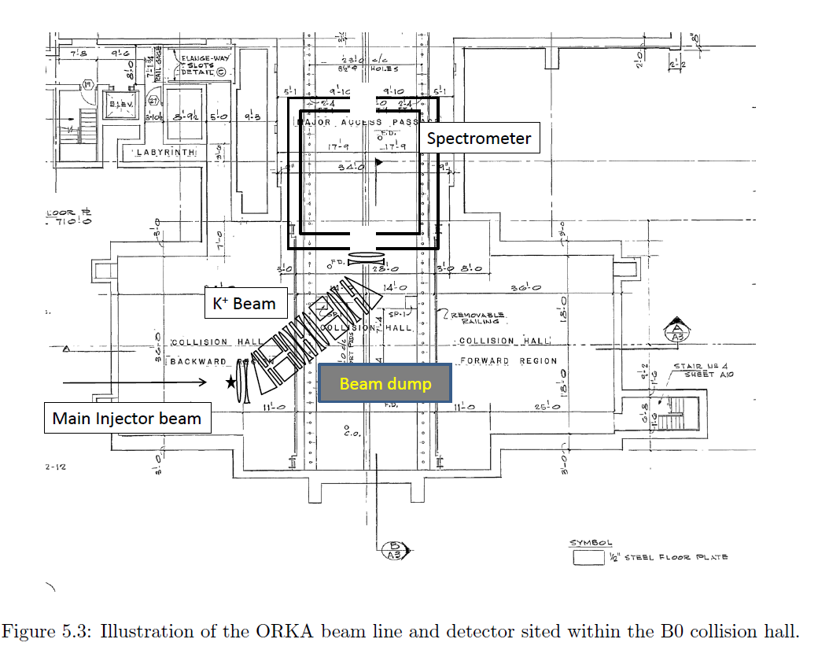
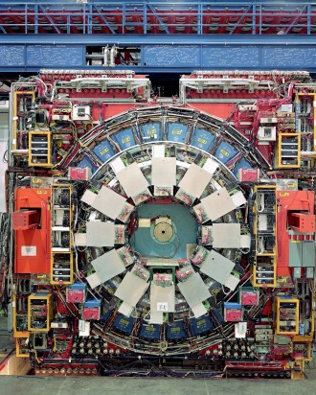

Slide 30
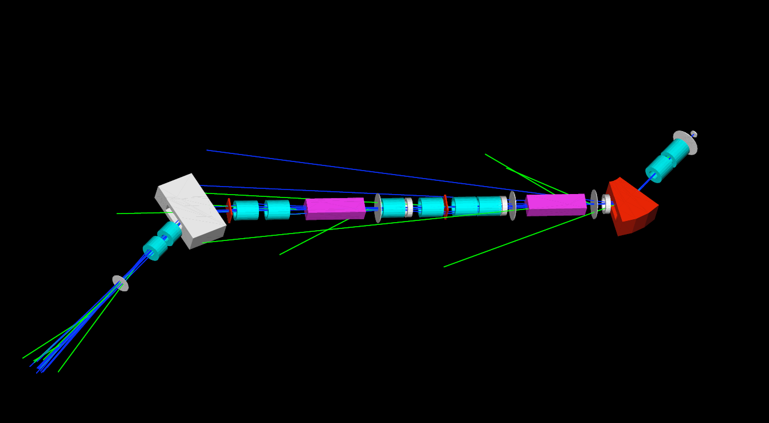
G4Beamline dog-leg design underway to preserve CDF detector orientation.

